Slide 1
Specially Designed Instruction:
The Heart of Special Education

Slide 2

Specially Designed Instruction – The heart of Special Education

Slide 3

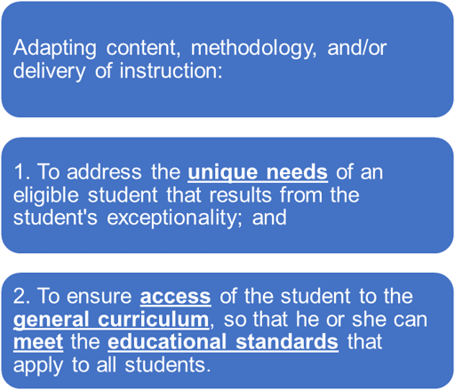


Specially Designed Instruction (SDI)
“special education” means specially designed instruction
Individuals with Disabilities Act (IDEA)
and
WVBE Policy 2419

Slide 4

How does instruction become intentionally designed?
Evidence Based Practices
Modeling
Explicit Instruction
Scaffolding
Corrective Feedback
Graphic Organizers
Student Data
Progress monitoring
Work samples
Observations
Disability Related Need
Organization
Self-regulation
Memory
Fine-motor
Decoding
Intentional
Design
SDI
The special is in the intentional design of instruction.

Slide 5
Incidental Benefits of SDI
When we design instruction for students who receive special education services…
We clarify academic language
We use multiple ways to represent ideas
We provide structured, explicit instruction
We increase opportunities to respond and get feedback
These practices may benefit all learners, not just students who receive special education services but they are required by law for students with disabilities.

Slide 6
Advancing SDI Through Cross-Office Collaboration
Partnering across WVDE offices to ensure students with disabilities are intentionally included in statewide initiatives.
Co-developing aligned resources and professional learning that connect special education expertise with content-area priorities.
Creating a more consistent system of support for educators, schools, and LEAs across West Virginia.

Slide 7

WVDE SDI Resources
SDI Postcard
SDI Guidance Document
Matching Disability Categories, Learning Challenges and SDI Strategies
Specially Designed Instruction Planning Template
SDI Resource Bank
High Quality Literacy Instructional Practices for Students with IEPs
SDI Sticker
High Quality Mathematical Instructional Practices
SDI Scavenger Hunt
EBP Spotlight: Explicit Instruction
EBP Spotlight: Corrective Feedback
EBP Spotlight: Scaffolding SDI
Comparison of SDI, DI, UDL
SDI Behavior
SDI IEP Goals
SDI CANVAS Training
SDI CANVAS Training Co-teaching and SDI
All SDI Resources are located on WVDE website:
https://wvde.us
Academics
Special Education
Learn More About SDI
Additional SDI Resources (right side)

Slide 8
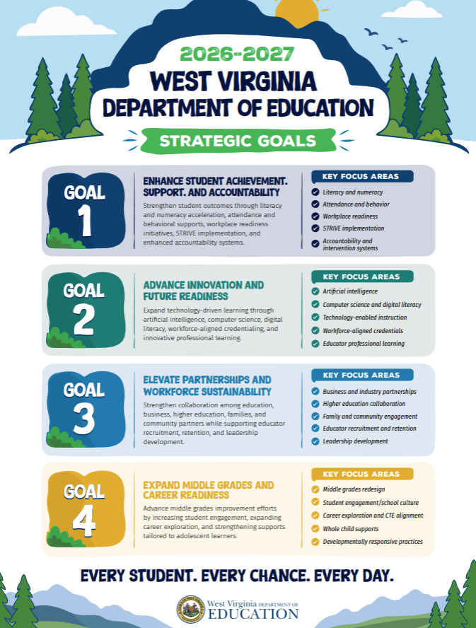
SDI: Advancing WVDE's Strategic Goals
Improves student achievement by connecting individualized, high-quality instruction to grade-level learning.
Builds educator capacity through professional learning and collaborative planning.
Promotes shared responsibility for ensuring students with disabilities are included in WVDE's vision for student success.

Slide 9

Positive Expectations. Intentional Instruction.
Whitney White- whitney.white@k12.wv.us

