Slide 1

Public Integrity & Fraud Unit
(PIFU)
West Virginia State Auditor’s Office

Slide 2


PIFU – Outline
WV Code
Current Structure
Investigative Process
Current Cases
Common Crimes
What Influences Fraud
Common Fraud Schemes
Selected Case Updates
Questions

Slide 3
PIFU – WV Code
  Applicable WV State Code sections
    § 6-9-2
    § 6-9-7
      (j)
      (k)
      (l)
      (o)
    § 6-9-8(c)
    § 6-9-9
    § 6-9-11
    § 7-1-16
Notes:
6-9-2 - establish WVSAO purview regarding audits and the PIFU performing Fraud Investigations
6-9-7 - Authorizes the chief inspector to examine into the financial affairs of any local government or political subdivision and to issue subpoenas to facilitate that process.
(j)
(k)
(l)
(o)
6-9-8 (c) - Notwithstanding §61-11A-4 of this code, a court may, in its discretion, when sentencing a defendant convicted of a felony or misdemeanor based upon any audit, examination, or investigation by the State Auditor, which discloses misfeasance, malfeasance, or nonfeasance in the office on the part of any public officer or employee, order reimbursement to the State Auditor for the actual costs of auditing, investigating, or prosecuting a violation.
6-9-9 - Working papers of chief inspector are confidential and not subject to the Freedom of Information Act. Reports are public in nature. In situations which malfeasance, nonfeasance, misfeasance occurs, the chief inspector may direct the report to remain confidential until the proper legal authority has completed its investigation and/or adjudication of the matter.
6-9-11 - State Auditor shall be the chief inspector and supervisor of local government offices which includes perform special financial and compliance examinations or audits, provide training, reviewing and approving budgets and any changes during the fiscal year (and approve proposed levy rates)
7-1-16 – if county commission (or other entities) obtains info that an employee, officer or member of any county commission may have misappropriated funds, engaged in fraud or otherwise violated a law relating to the public trust shall timely report that info or allegation in writing to (1) county pros. Office (2) Legislature’s Committee on Special Investigations AND (3) State Auditor

Slide 4
PIFU - Current Structure
Evolved from Fraud Section to the PIFU in Aug 2018.
  Director / General Counsel to the WV State Auditor
  Assistant Director
  Financial Forensic Examiners FFE (6)
  Criminal Investigators (3)
  Case Manager
  Certified Cyber Crime Examiner
  State Fleet Compliance Auditor
  Purchasing Card Monitors (2)
  PIFU footprint located in Charleston, Morgantown, Elkins, Beckley, Fairmont & Clarksburg, WV
  PIFU members maintain the CFE Credential
We work closely with federal and county prosecutors, the Commission on Special Investigations (CSI), and law enforcement agencies.

Slide 5
Investigative Process
Fraud intake
  Multiple ways
Establish approach
  Assign FFE/Investigator by location
  Site assessment performed
  Collect documents from Entity
  Seize any computers or electronic data
  Request documents from other Entities
  Develop predication / Fraud Theory
Conduct Interviews
FFEs complete fraud examination field work
Complete Criminal Report of Investigation (FFE report is addendum to CI)
Submit for Prosecution
Indictment/Information

Slide 6
PIFU – Current Cases
Forty-three (43) active fraud cases
  3 state agency level matters
  9 county or county subdivision investigations
  11 municipalities or municipal subdivision cases
  14 volunteer fire departments
  6 other entities
In various stages of review, investigation and prosecution
  PIFU Director appointed as special prosecuting attorney in some instances

Slide 7
PIFU – Common Crimes
WV Code §61-3-20 (WV Code 62-2-5) | Embezzlement
WV Code §61-3-14&15 | Larceny
WV Code §61-3-22 | Falsifying Accounts
WV Code §61-3-24d | Fraudulent Scheme
WV Code §61-3-37 | False Statement as to Financial Condition
WV Code §61-3C-13 | Fraud and Related Activity with Access Device
WV Code §61-4-5 | Forgery / Uttering
WV Code §61-4-9 | Improper Public Benefit
WV Code §61-5-4 | Bribery
WV Code §6-9-2c / §12-3-10b | Fraudulent or Unauthorized use of Purchasing Card
WV Code §6-3-1 to 5 | Arson

Slide 8
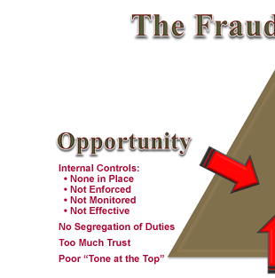
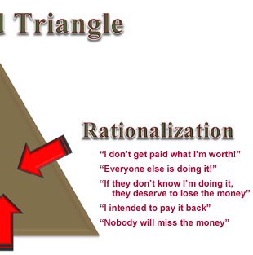

Source: Association of Government Accountants
Notes:
WHAT Influences Fraud?
Pressures such as medical bills, expensive taxes, living beyond means, educational expenses, gambling, drug addiction problems can contribute to fraud.
The “everyone does it” or “being owed / entitled” rationalization.
The opportunity presented itself through weak controls and override policies. Individuals charged with implementing & enforcing internal controls can be potential targets.

Slide 9
PIFU – Common Fraud Schemes
Asset Misappropriation more common than Corruption and Financial Statement Fraud
Cash Skimming / Off-Book
Cash Larceny / On-Book
Check / Cash Substitution
Ghost Employees
Falsified Timecards / Timesheets
Additional Paychecks
Expense Reimbursements (Overstated, Mischaracterized, Multiple)
Check Forgeries / Uttering
Purchasing Card Fraud (Personal)
Falsified / Altered Invoices

Slide 10
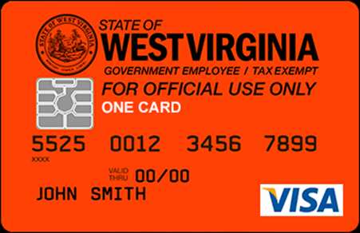
P-Card Fraud
Purchasing Card
  P-Card Program Coordinator (first line defense for P-Card fraud)
  Provide oversight to ensure ALL expenditures are properly reviewed and approved prior to invoice payment
  ALL expenditures MUST be for official business purposes
  Most common types of P-Card fraud:
    Personal expenditures
    Compromised cardholder identity

Slide 11
PIFU – Selected Case Updates
State vs. Thomas and Cody Perry
(Lincoln County)
Thomas Perry
  Plead guilty to Conspiracy to Commit Embezzlement and Fraudulent Schemes
    CVFD Fire Chief derived a personal benefit of $38,987.83
    Mailbox and Water Heater installed in his home
    Expansive Home office
    Mother’s Day Gift
  Sentencing
    1-5 yrs and $10,000 fine
    5 yrs probation
    Ordered restitution of $16,210.63.
Cody Perry
  Plead guilty to Embezzlement
    CVFD Assistant Fire Chief used the Auxiliary account funds for a personal benefit of $38,739.15
  Sentencing
    1-10 yrs suspended for 5 yrs probation
    Restitution ordered

Slide 12
PIFU – Selected Case Updates
State vs. Gary Feaster
(Mineral County)
  Plead guilty to Embezzlement and Fraudulent Schemes
    Deputy Circuit Clerk embezzled in excess of $65,000 to support his alcohol and gambling addiction
  Sentencing
    2-20 years in prison
    Ordered restitution of $75,000
    $41,666.59 restitution as cost of WVSAO investigation

Slide 13
PIFU – Selected Case Updates
State v. Suzette Wagner (Harrison County)
Plead guilty to Embezzlement
  City of Clarksburg Chief Tax and Fee Collector used a check substitution scheme to embezzle funds in the amount of $85,348.30 from December 2017 to the end of 2019
Sentencing
  1-10 year sentence on Home Confinement
  Ordered full restitution within five days
  Ordered PIFU investigation costs of $39,607.86

Slide 14
PIFU – Selected Case Updates
State v. Reneda Welch (Kanawha County)
  Plead guilty to two (2) felony counts of embezzlement.
    City Accountant (CPA / MBA) embezzled cash collections from Municipal Court and established ghost employee from July 2012 to June 2016.
    Stole $202,804.05 for personal use
  Sentencing
    1 year in jail, full restitution to begin at conclusion of jail-time
    5 years supervised probation

Slide 15
PIFU – Selected Case Updates
State v. Michael Cheney
(Tucker County)
Plead guilty to five (5) counts of Embezzlement
    Canaan Resort Parks Director of Operations purchased personal items by altering and falsifying invoices including an ATV, ten firearms and approximately $20,000.00 for Christmas lights for a total of $178,426.36
  Sentencing
    1-10 year sentence on each count ran concurrently
    Ordered restitution of $197,808.21
      audit fee and travel expenses for the audit performed by Arnett Carbis Toothman LLP, CPAs totaling $23,000.00
      PIFU investigation costs of $11,305.00
      returned amount of $14,923.15

Slide 16
PIFU – Selected Case Updates
State v. Christian Elliot
(Clay County)
Plead guilty to Forgery and Falsifying Accounts
    Bookkeeper for Lizemore VFD embezzled funds from the Apple Festival and paid personal bills
  Sentencing
    Forgery - 1-10 years and $500 fine on Forgery
    Falsifying Accounts -1-10 years, ran consecutively to Forgery, second sentence suspended for 6 years of probation
    She agreed to pay the state $8,896.34 and $2,782.37 to the fire department in restitution.

Slide 17
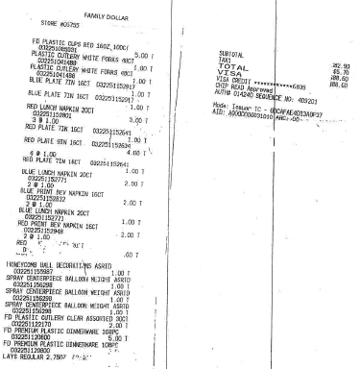

Slide 18
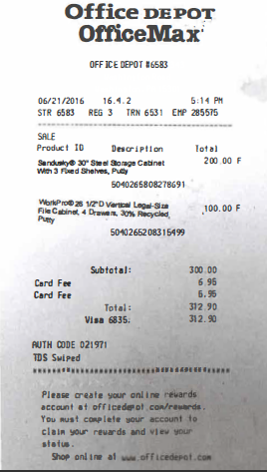


Slide 19
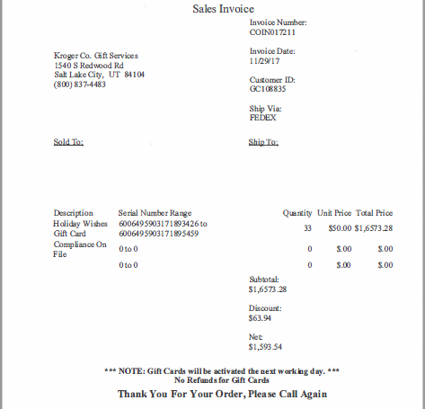


Slide 20
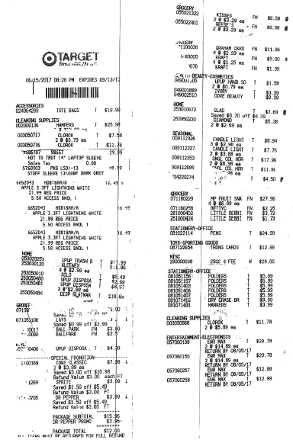
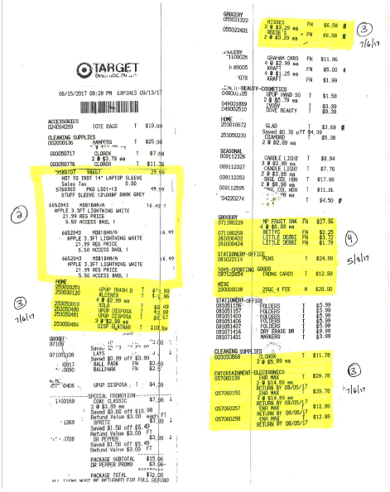

Slide 21
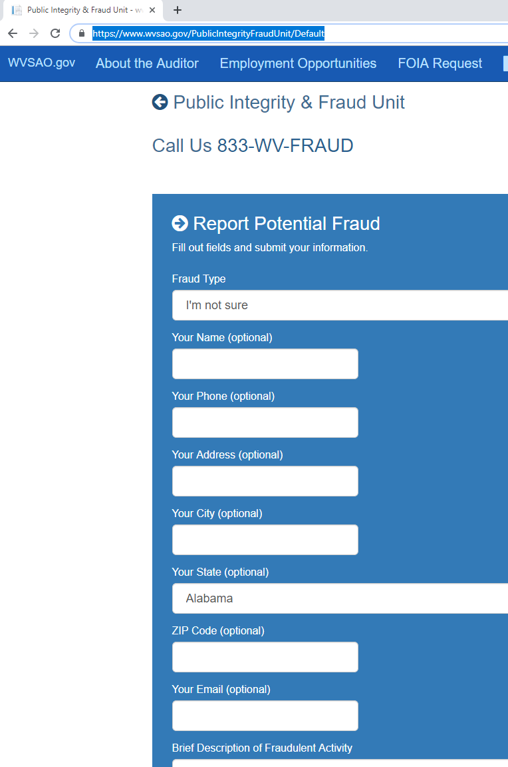
CONTACT US
https://www.wvsao.gov/PublicIntegrityFraudUnit/Default
833-WV-FRAUD
wvfraud@wvsao.gov

Slide 22



Slide 23
Contact Information
Lauren Plymale, Esquire
General Counsel/ Director- PIFU
WV State Auditor's Office
State Capitol
Building 1, Suite W-100
1900 Kanawha Blvd.
Charleston, WV 25305
Phone 304-558-2251
Lauren.Plymale@wvsao.gov
John Jones, CFE
Assistant Director - PIFU
WV State Auditor's Office
State Capitol
Building 1, Suite W-100
1900 Kanawha Blvd.
Charleston, WV 25305
Phone 304-558-2251
John.Jones@wvsao.gov

