Slide 1
ESSER Updates
October 5, 2023

Slide 2
Topics
ESSER Timeline
Reporting
Findings
Construction Cautions
Set-Asides
ARP HCY
Monitoring

Slide 3
ESSER Timeline
ESSER I – Expired
ESSER II – Obligation Closed and liquidation date of 11/15/23
ARP ESSER – Obligation date of 9/30/24 and liquidation date of 11/15/24
ARP HCY – Obligation date of 9/30/24 and liquidation date of 11/15/24
Summer SOLE – Obligation Closed and liquidation date of 11/15/23

Slide 4
Ongoing Reporting Timeline
ESSER Year 4 Reporting Timeline
Reporting will open January 2024 and will be due in April 2024
This report will include the final report for ESSER I formula and competitive, ESSER II, Summer SOLE and ARP ESSER activity through June 30, 2023.
ESSER Year 5 Reporting Timeline
Reporting will open in January 2025 and will be due in April 2025.
This report will include the final report for ESSER II and Summer SOLE, ARP ESSER activity through June 30, 2024.
ESSER Year 6 Reporting Timeline
Reporting will open in January 2026 and will be due in April 2026
This report will be the final report for ARP ESSER.

Slide 5
Reporting Updates
There will be NO optional sections starting this year.
Section 4b.1 and 4b.2 will be required.
Office of Federal Programs is working on a guidance document to help LEAs with 4b.1 and 4b.2

Slide 6
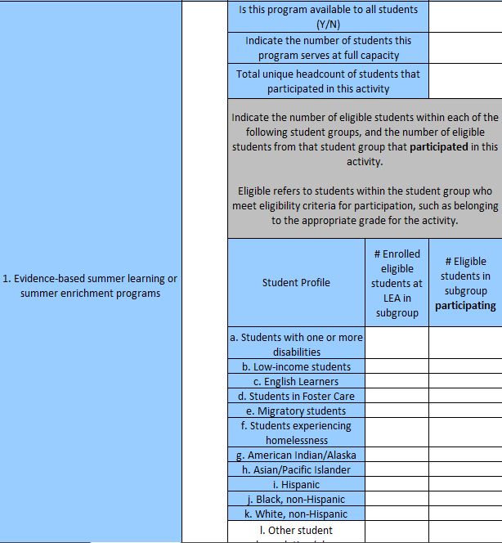
4.b1

Slide 7
3.b2
Grantees will complete question 3.b2 in addition to question 3.b1 beginning in Year 4 of CARES annual performance reporting, Year 3 of CRRSA and ARP annual performance reporting.
3.b2 Provide the amount of the LEA expenditures by ESSER Subgrant fund and activity for the current reporting period.
Report any expenditure ONLY ONCE in the table below; All cells in each column should sum to the total expended by the LEA (or unitary SEA) in this reporting period. Please use the most appropriate and most specific applicable activity for each expenditure
*NEW* Starting in Year 4 Reporting

Slide 8
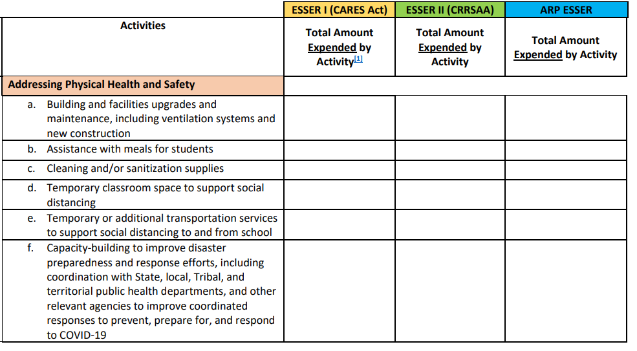

Slide 9
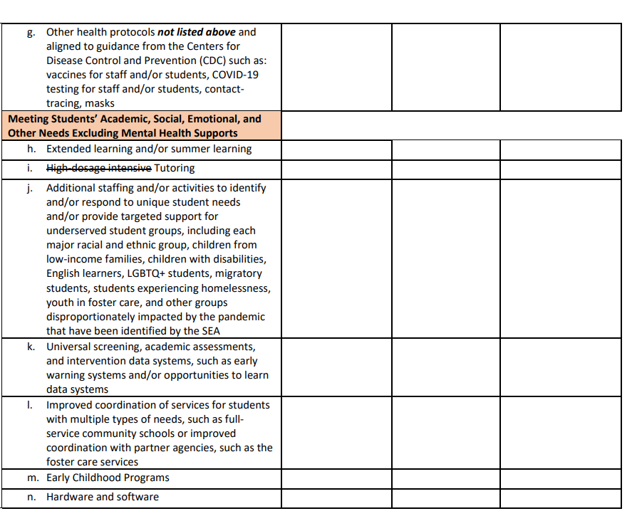

Slide 10
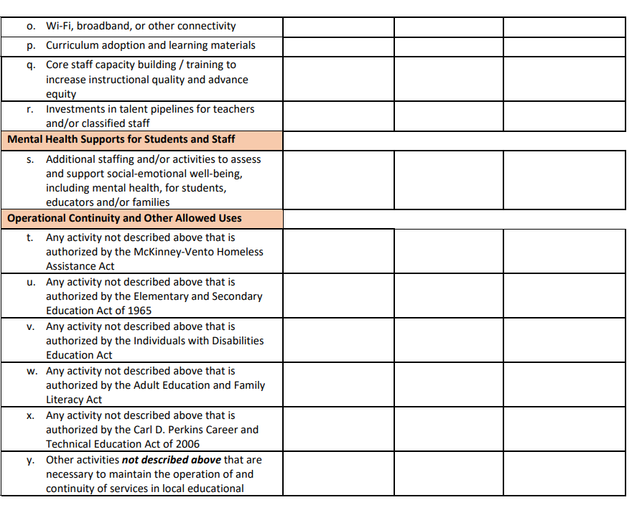

Slide 11
Ongoing Reporting
All reporting information becomes public and posted on US Ed’s Recovery Funding Website
  It is important that these reports are accurate, and districts keep their source documentation on file for future auditing/monitoring.
  OIG, News media, US ED, Legislative Leaders all are watching what is being reported.

Slide 12
Document Retention
  3 years past when funds are subject to audit / monitoring
    ESSER I – 3/31/27
    ESSER II – 3/31/28
    ARP ESSER / ARP HCY – 3/31/29

Slide 13
Construction Cautions
Davis-Bacon Prevailing Wage
  an LEA that uses ESSER funds for minor remodeling (including painting and decoration), renovation, repair, or construction contracts over $2,000 must meet all Davis-Bacon prevailing wage requirements and include language in the contracts that all contractors or subcontractors must pay wages that are not less than those established for the locality of the project (prevailing wage rates).

Slide 14
Construction Cautions
Construction Projects require prior written approval.
The Uniform Guidance at 2 CFR § 200.407 requires prior written approval from either the Department or the State (Governor or SEA, as applicable) for certain costs, such as the purchase of real property; equipment and other capital expenditures; entertainment costs; and travel costs.

Slide 15
Construction Cautions
How do I know what Construction projects are approved?
Review the 2022 ESSER Application in GPS.
Under Related Documents review the Construction Applications that have been uploaded with the approved application.
What if I have started a Construction project that wasn’t approved?
This project would be unallowable with ESSER funding and would have to paid from another funding source.

Slide 16
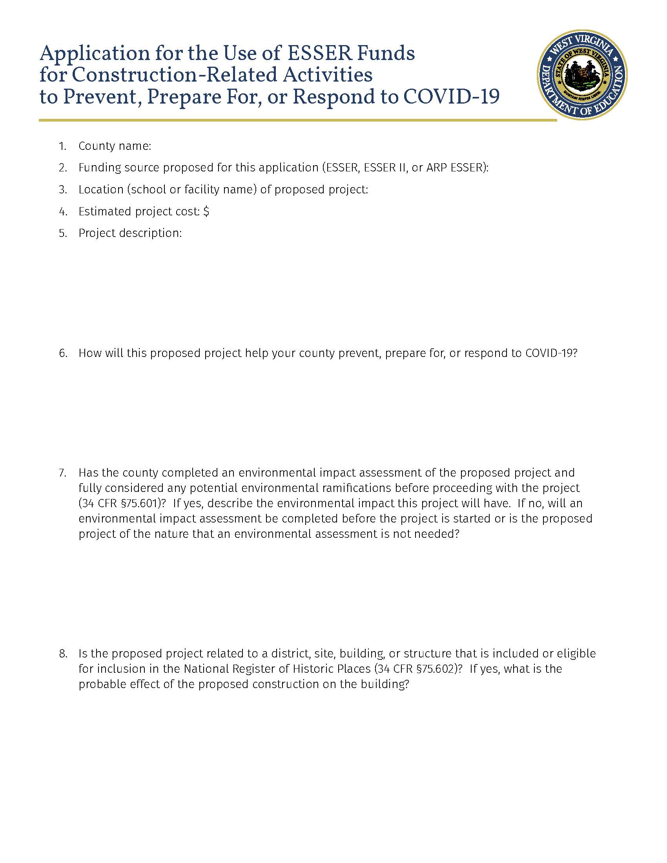

Slide 17
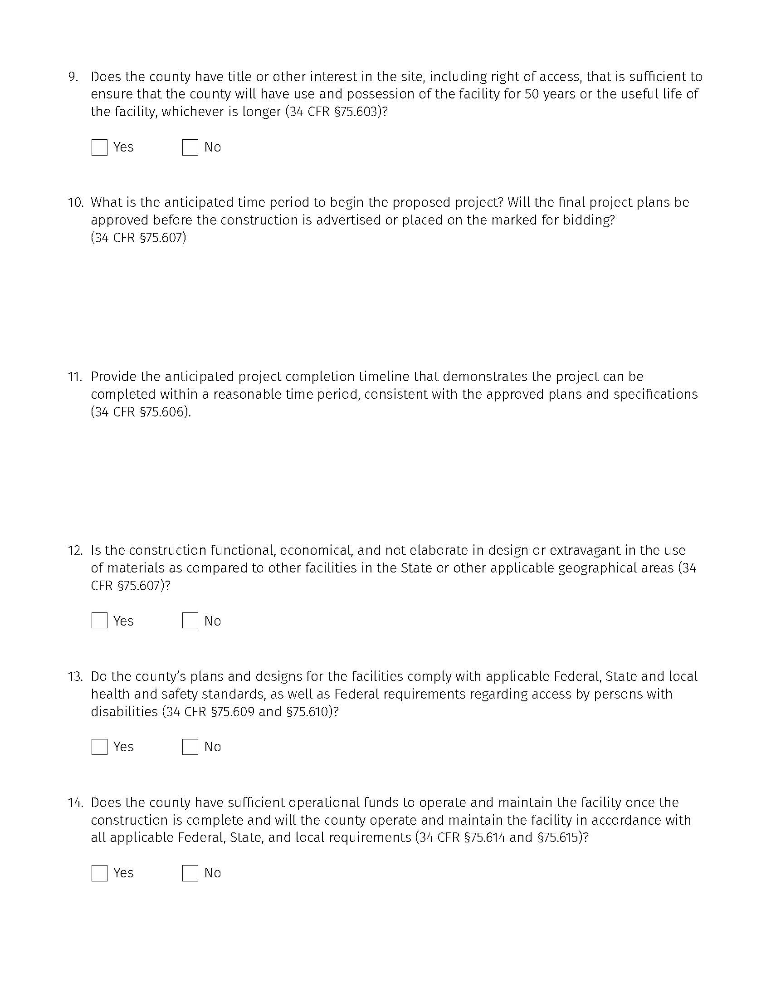

Slide 18
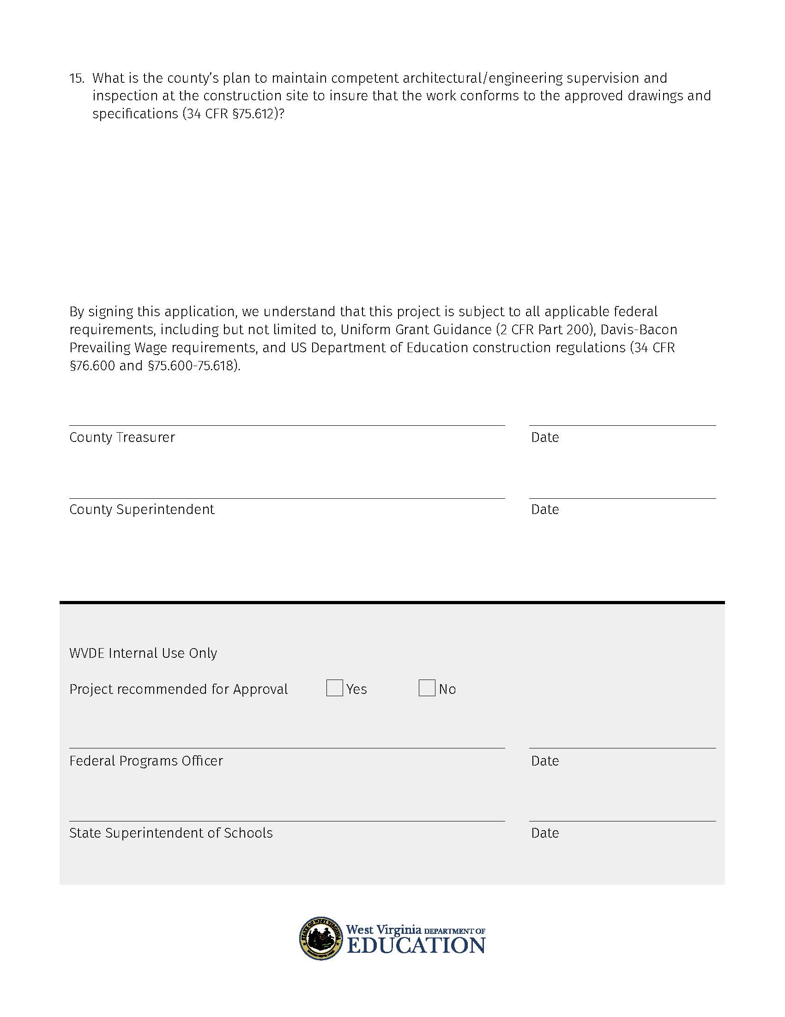

Slide 19
ARP ESSER Required Set-Asides
Addressing Learning Loss
Evidence-based interventions that respond to student’s social, emotional and academic needs because of COVID
Summer Enrichment
Evidence-based summer programs
After-School Programs
Evidence-based comprehensive afterschool programs
Remainder – LEA Discretionary
To address the district’s needs arising from the coronavirus pandemic

Slide 20
Evidence-Based
Tier 1
Strong evidence from at least one well-designed and well-implemented experimental study
Tier 2
Moderate evidence from at least one well-designed and well-implemented quasi-experimental study
Tier 3
Promising evidence from at least one well-designed and well-implemented correlational study with statistical control for selection bias
Tier 4
Demonstrates a rationale based on high-quality research findings or positive evaluation that such activity, strategy, or intervention is likely to improve student outcomes or other relevant outcomes and includes ongoing efforts to examine the effects of such activity, strategy, or intervention
What does it mean for a program to be evidence-based?
Demonstrates a statistically significant effect on improving student outcomes or other relevant outcomes based on -

Slide 21
ARP ESSER Required Set-Asides
  Set-Asides must be documented through the mandatory use of WVEIS cost centers:
    4350 – Addressing Learning Loss
    4610 – Summer Enrichment
    4870 – After-School Programs

Slide 22
ARP ESSER Required Set-Asides
Any set-aside that is not met will result in forfeiture of the remining funds.
WVDE does not have the ability to waive the set-aside amounts
Set-aside amounts can be found in the 2022 ESSER Application in GPS

Slide 23
ARP HCY
Many LEAs still have over 75% of their ARP HCY funding remaining.
This funding will run out next September.
Be sure to spend this funding!

Slide 24
ESSER Monitoring
Grant | FY22 | FY23 | FY24 | FY25
ESSER I | 1st Monitoring |  | Final Monitoring
ESSER II |  | 1st Monitoring | Final Monitoring Expires 9/30/23
ARP-ESSER |  | 1st Monitoring | 2nd Monitoring | Final Monitoring Expires 9/30/24

Slide 25
Most Common Fiscal Findings
Overcharging of indirect cost resulting in fund payback.
Improper procurement which could result in fund payback.
Unallowable expenses resulting in fund payback
Examples: Items of personal benefit, entertainment costs, general costs of government, items without proper approval.
Construction not done in compliance with Davis Bacon, resulting in fund payback
Activities charged to Addressing Learning Loss that aren’t allowable for the set-aside

Slide 26
Most Common Findings
Not having an updated Return to In-Person Plan
ARP ESSER Uses of Funds Presentation not on webpage.
Addressing Learning Loss purchases not Evidence-based.
Not uploading documentation for inventory procedures, internal controls, or conflict of interest.
Not meeting Maintenance of Equity.

Slide 27


