Slide 1
Certified List on WOW
Kim Harvey
WVEIS Consultant
knharvey@k12.wv.us
419-202-9898

Slide 2
Certified List is on WOW
You will need to get with your County Contact to give you access to the Certified List on WOW and show you how to access.
You will be able to view edits and certified list record information, print and enter comments.
Additional reports are available to view/print.

Slide 3
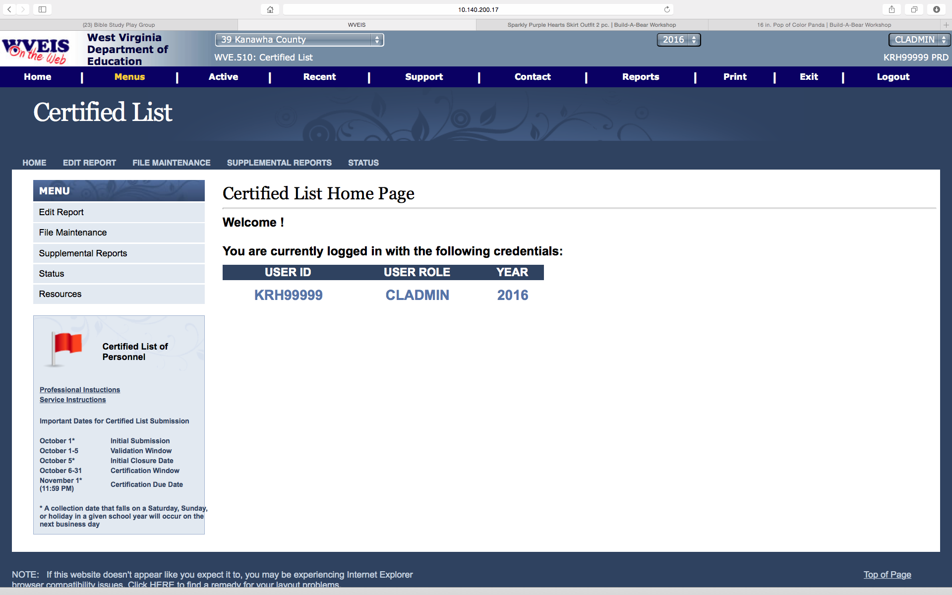
Certified List on WOW
Notes:
Your user ID and the FY you are defaulting to will display. You can use the tabs on the side or at the top to run the Edit and other reports. Also note the important dates related to the Certified List on the left.

Slide 4
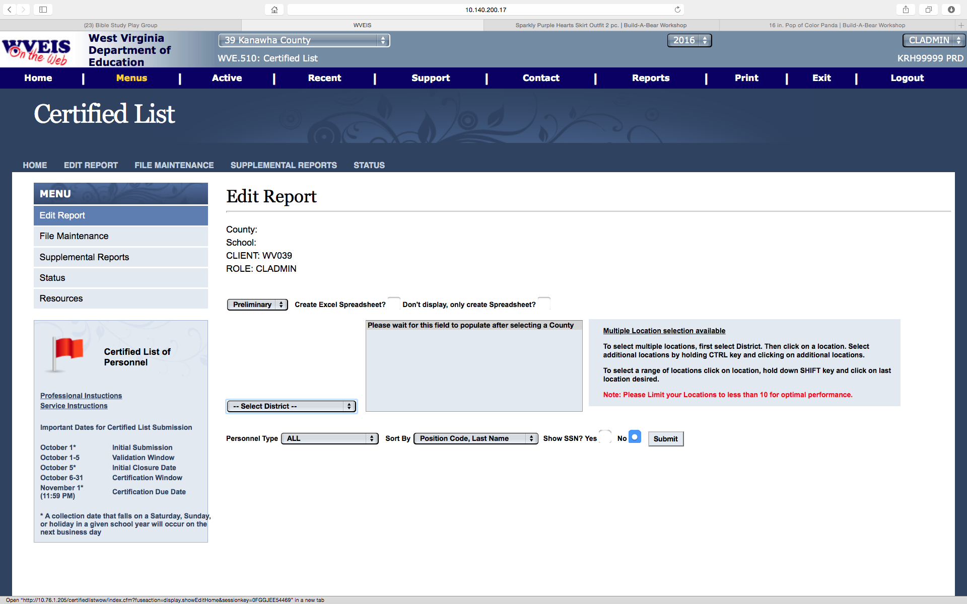
Certified List Edits
Notes:
You must have built and submitted your certified list on the WVEIS side before you can view the edits here. This report will look for a number of scenarios and display warnings and errors related to the data in your Certified List file. Those errors with a red bullet indicate a critical error that must be fixed in order to submit the final. You must enter a comment for all edits listed before submitting the final. To change information on your Certified List, you must go back into WVEIS to Edit/Maintain the Certified List, then submit the file again from WVEIS. Then you can run the edit list again here.
On this screen, you will select which file to run the edits against, preliminary or final. The Output options allow you to create a PDF or download to Excel to print or save. You can choose locations or all locations. Personnel types to choose from are All, Professional or Service. You have a few choices on how you want the edit list to sort. You can choose to display the SSN or not. When you have made your selections, hit submit. The program will build your edit list. Please be patient as this could take several moments.

Slide 5
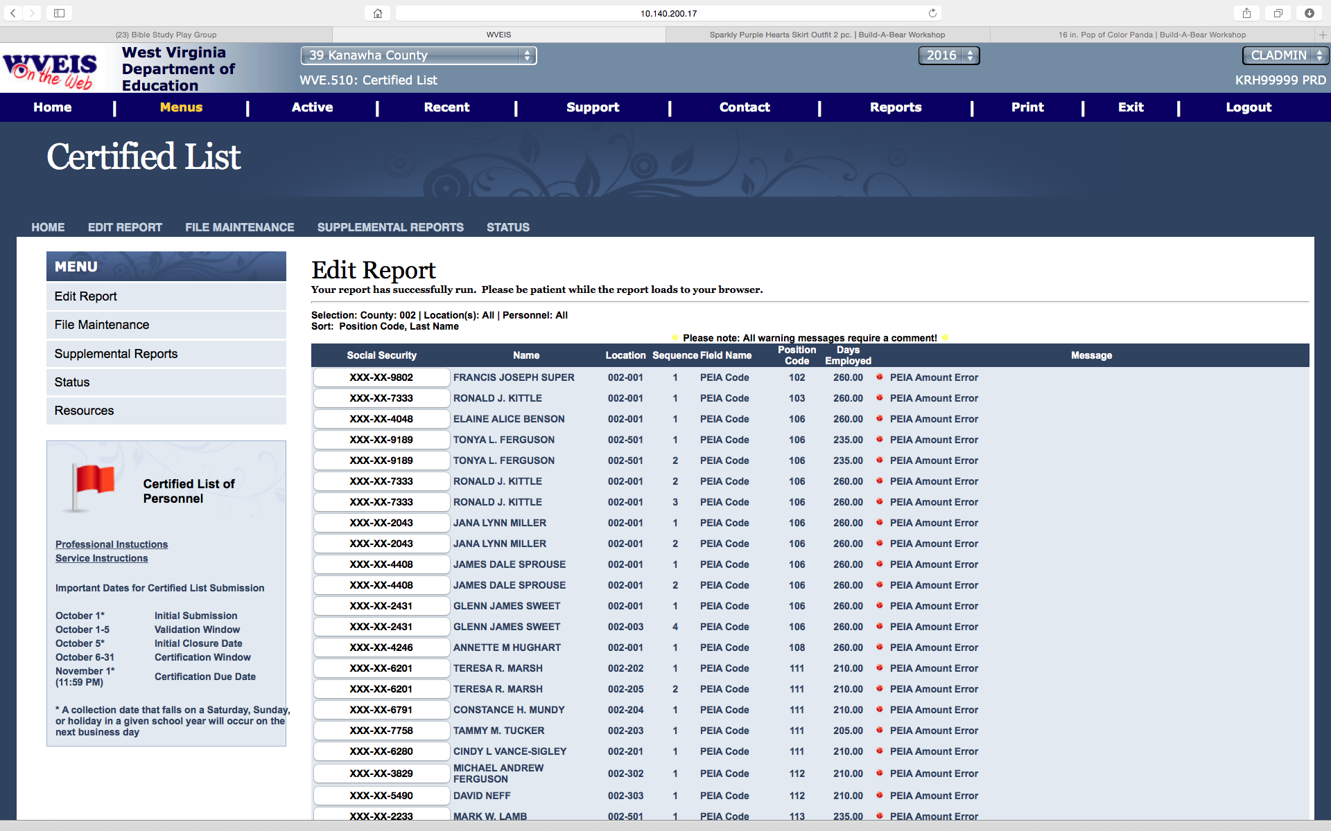
Certified List Edit Report
Notes:
The edits will display. Each message is color coded to let you know if the message is a Warning (yellow) or a Critical Error (red). Click on any part of the record to display the certified list record and to view options.
.

Slide 6
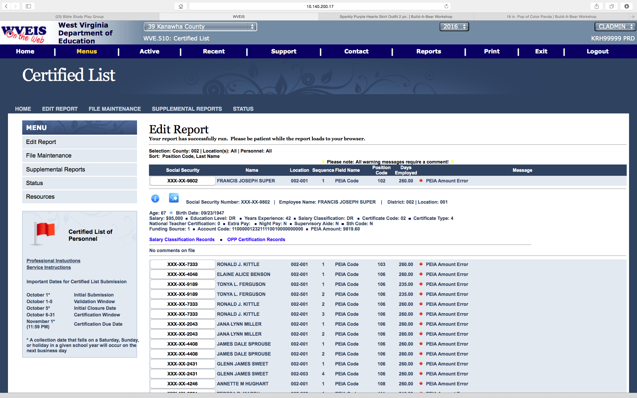
Certified List Edit Report
Notes:
By clicking on the record, a sample of fields of the record display. By clicking the left icon with ‘I’, all information will display. (See next slide)
Click on the same line of the report to go back to just the line listing. No detail.

Slide 7
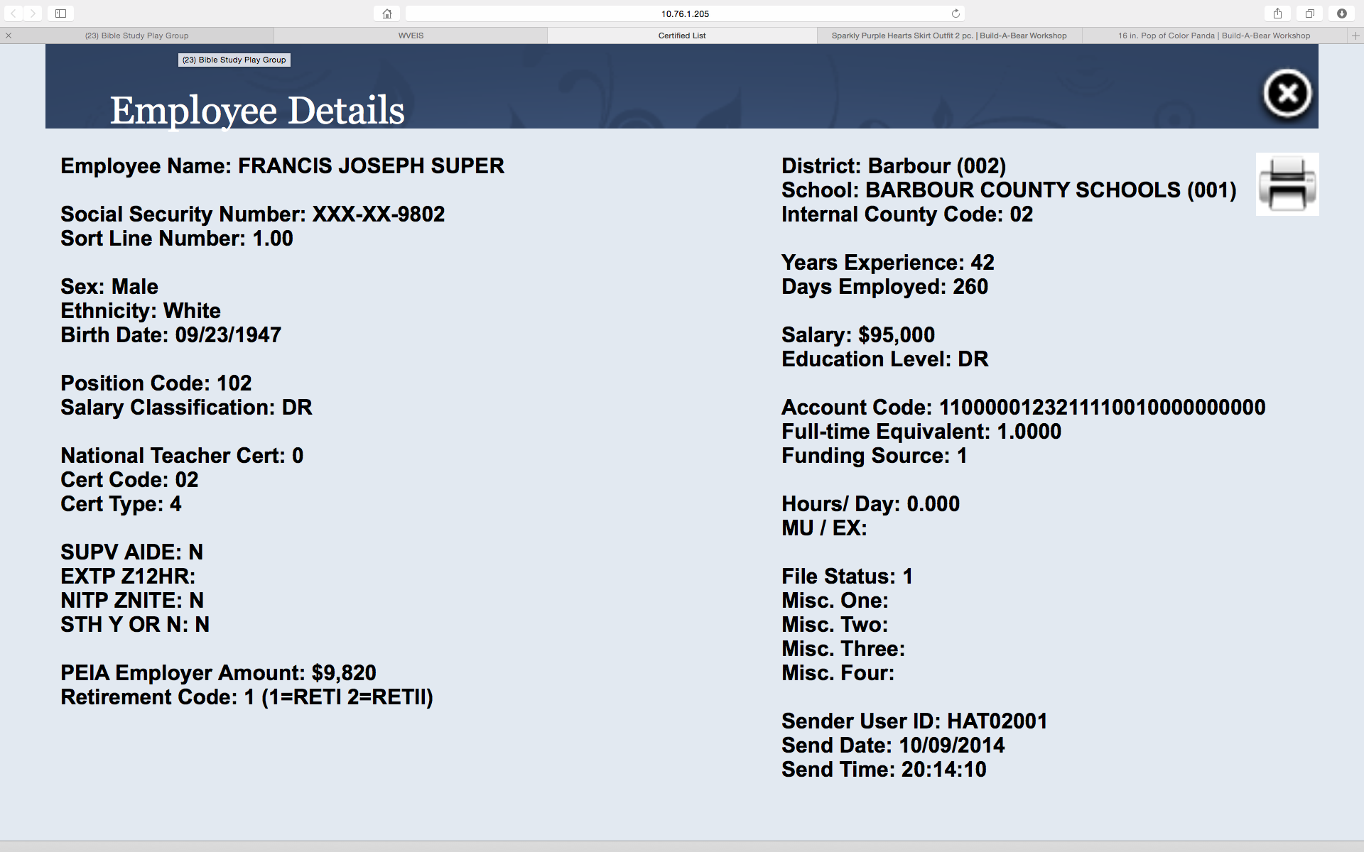
Certified List Edit Report
Notes:
All information related to this record will display. Click X in the upper right corner to get out of the Employee Details.

Slide 8
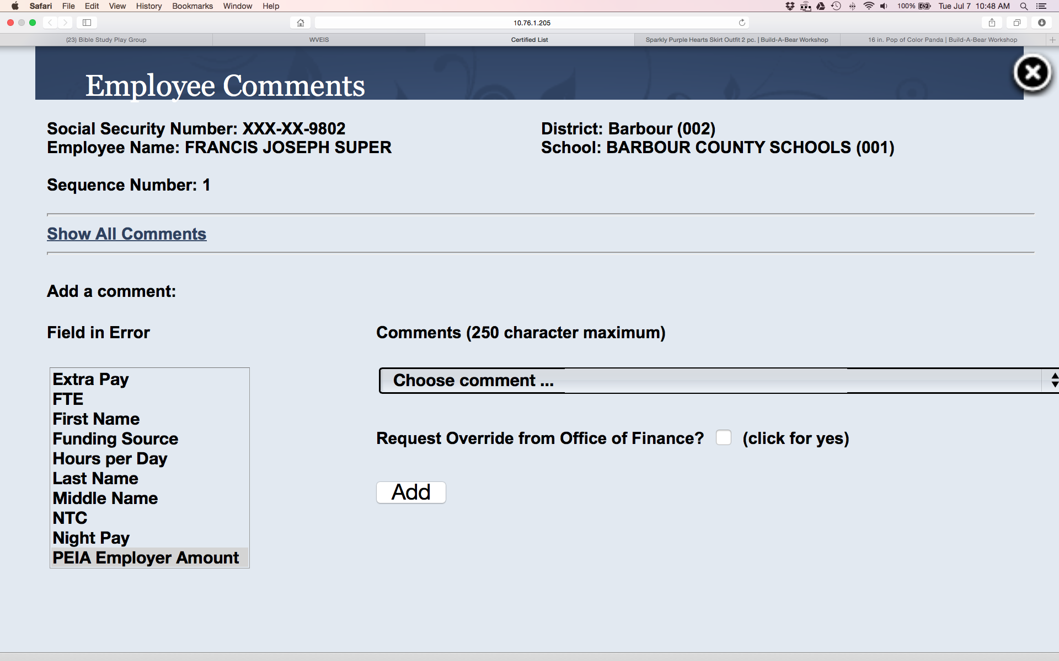
Certified List Edit Report
Notes:
The comments window will pop up by clicking on the other icon just to the left of the SSN. Select the field in error. You can choose a standard comment or select other and you can enter your comment in the comment box. Click Add. If a person has multiple edits, you will need to enter a comment for each one separately. To close out any of the pop-up boxes, click on the X in the upper right hand corner.

Slide 9
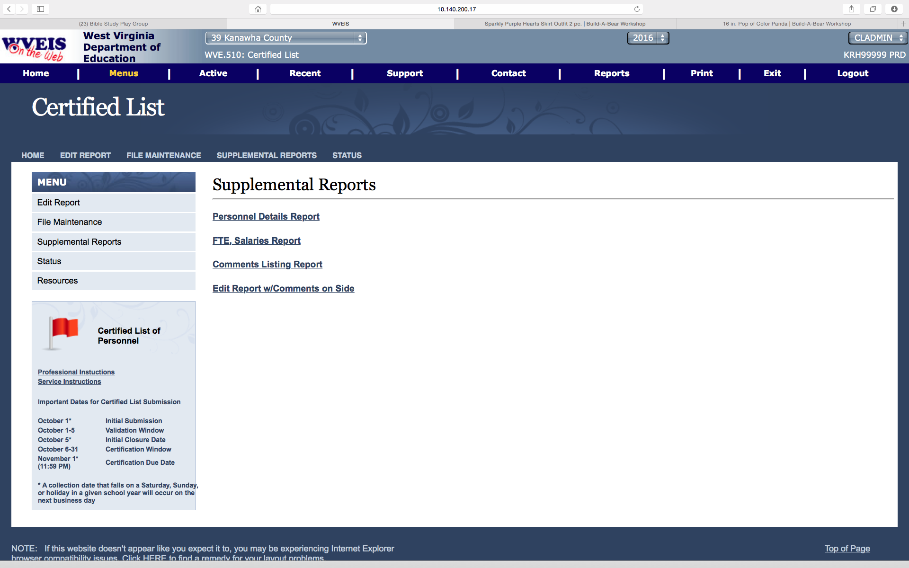
Supplemental Reports
Notes:
Click on the report to print.

Slide 10
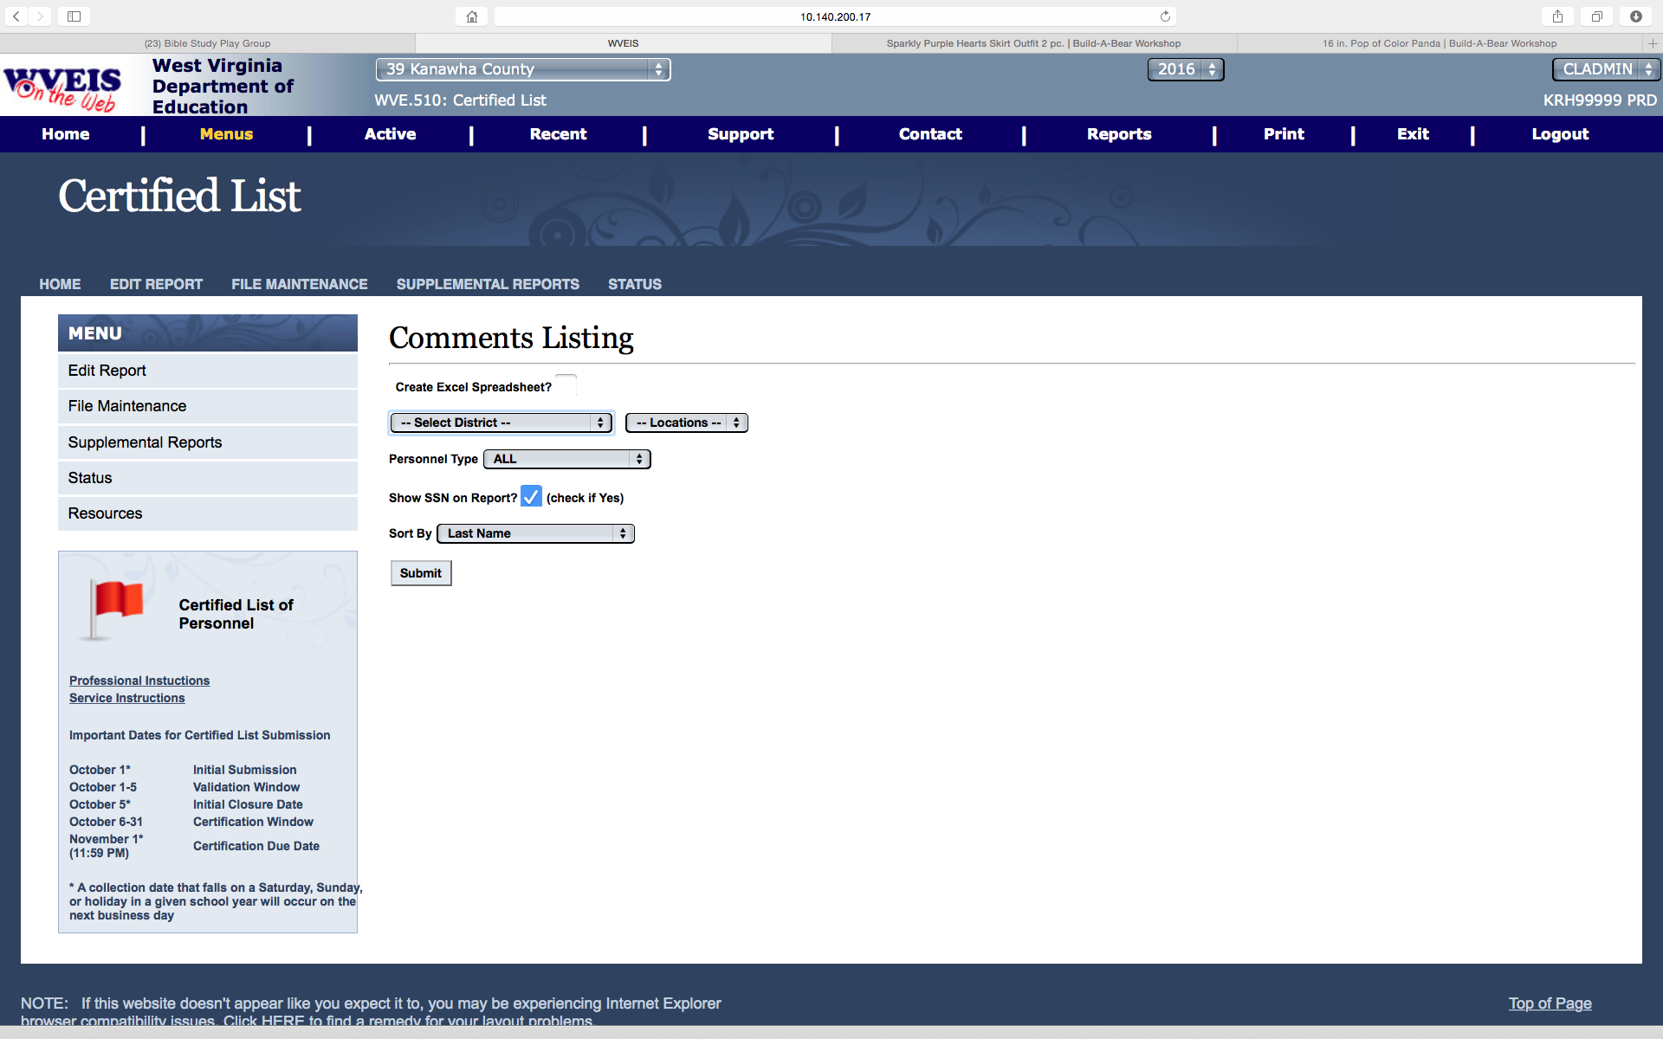
Comments Listing
Notes:
Select Locations, Personnel type and Sorting options. You can also choose whether or not to display the SSN. You can create an Excel spreadsheet by clicking the option at the top.

Slide 11
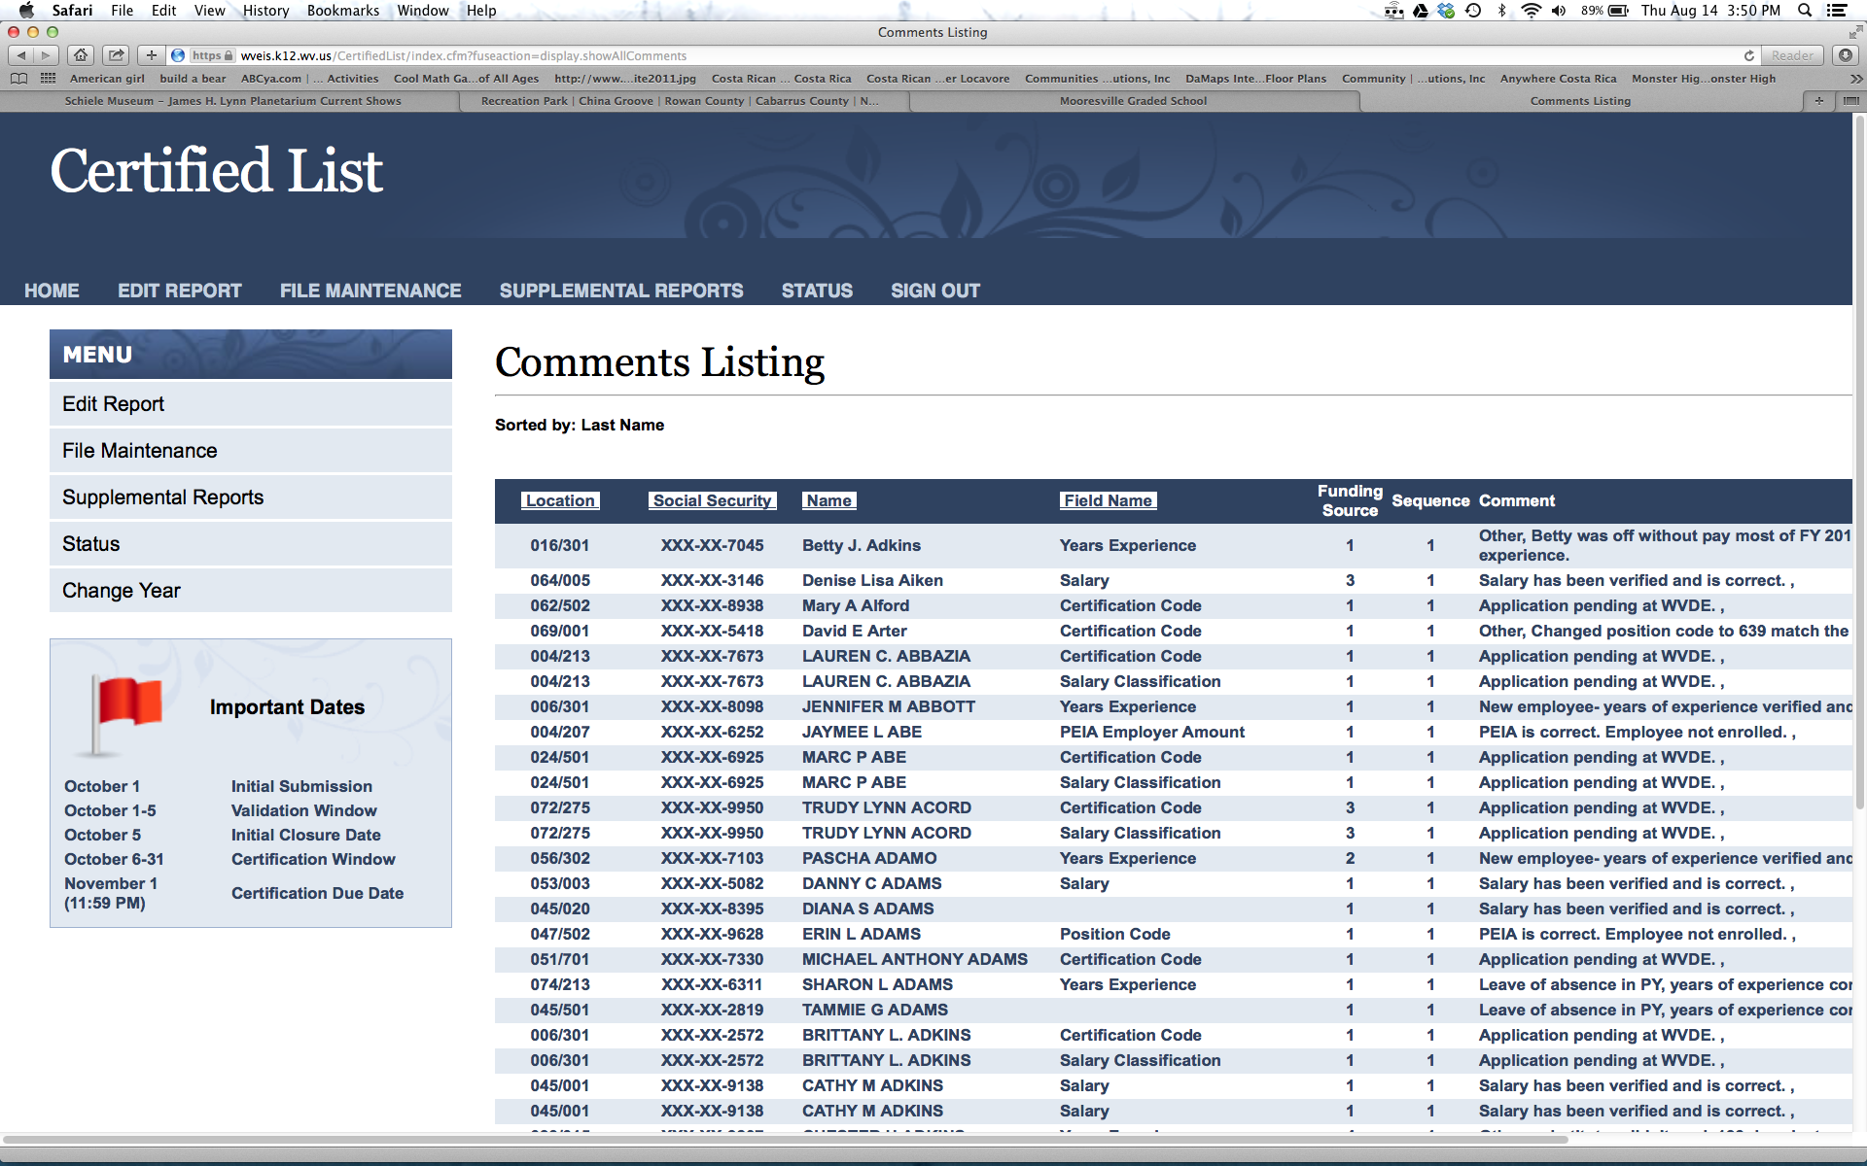
Comment Listing Report
Notes:
You can click on the Location, Social Security, Name or Field Name tabs to change the sort of the listing.

Slide 12
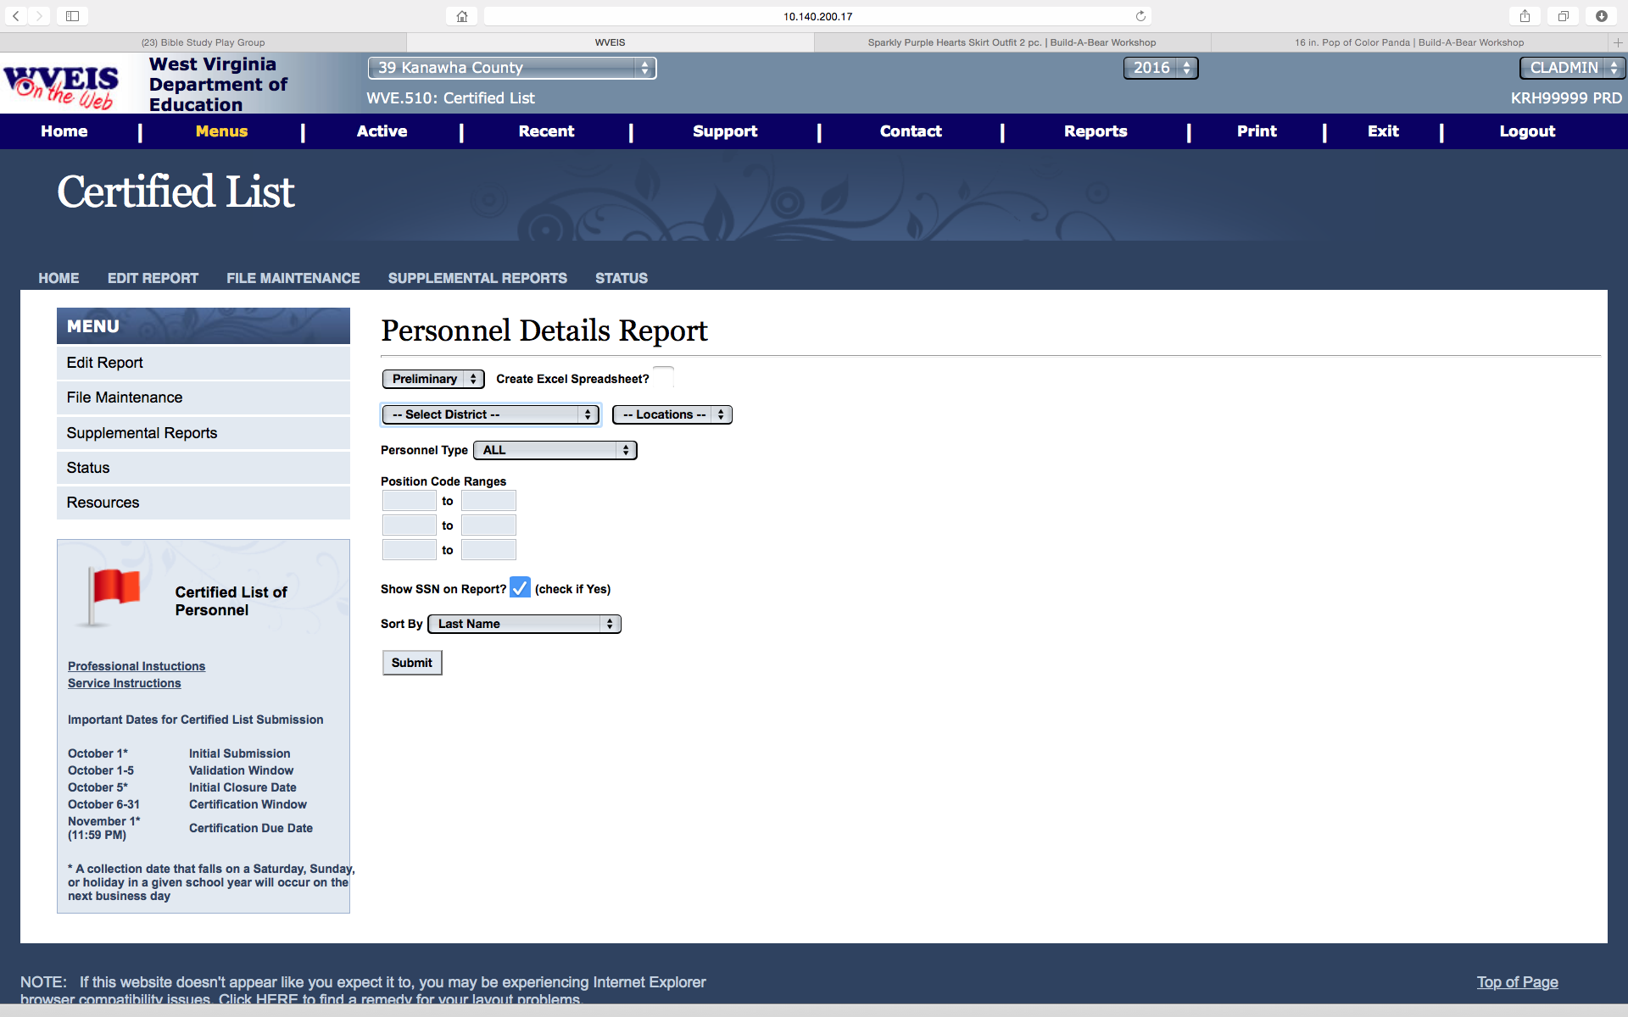
Personnel Details Report
Notes:
Choose Preliminary or Final, Locations, Personnel Type, Sort options and whether or not to display the SSN. You can also restrict to Position Code Ranges, if wanting a listing of only certain positions within professional or service types.

Slide 13
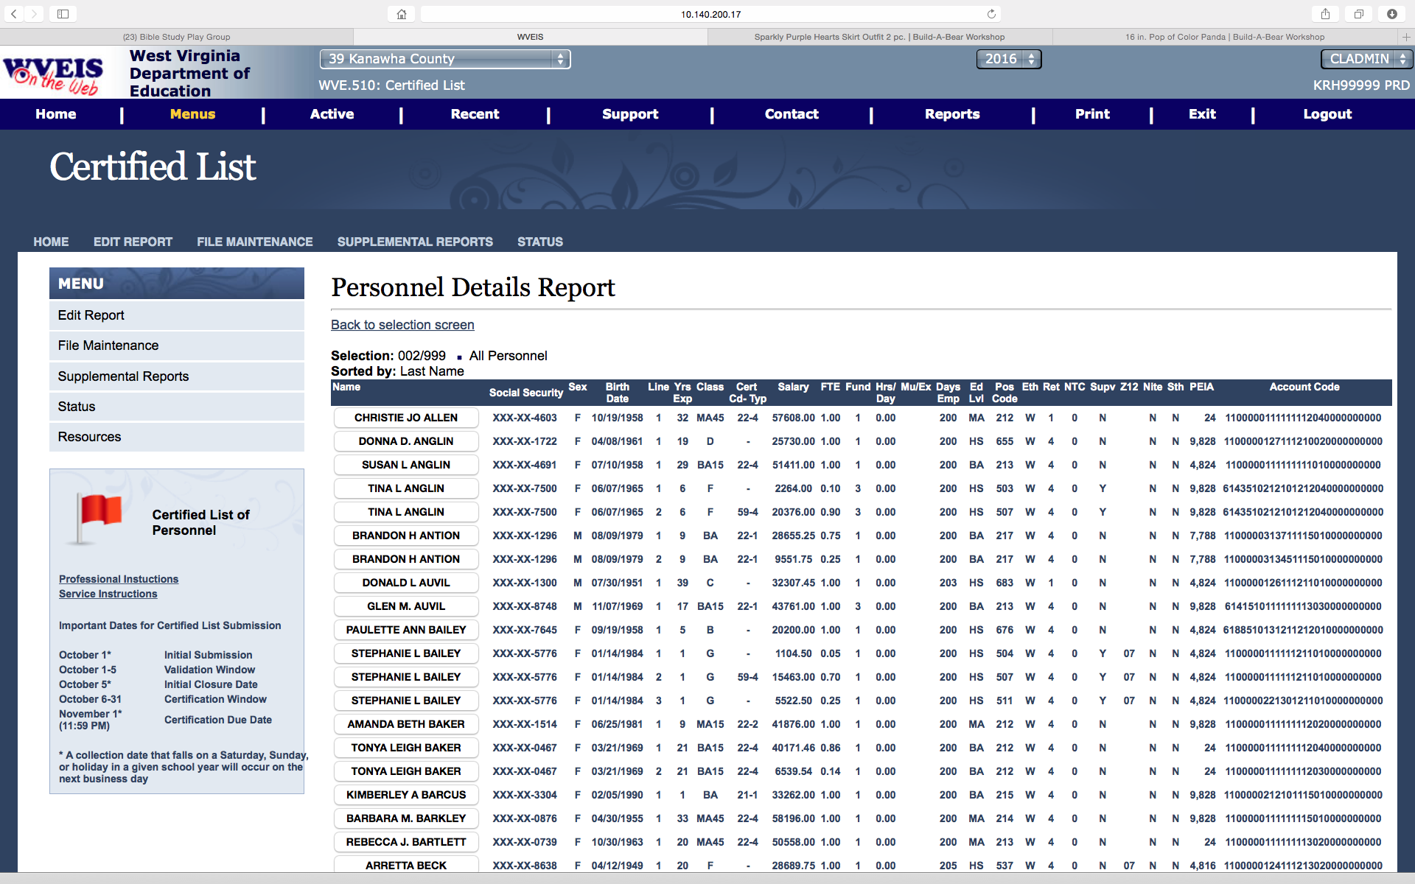
Personnel Details Report
Notes:
This report will display sex, birth date, years experience, salary class, certificate, salary, FTE, funding source, days employed, education level, position code, ethnic, retirement plan, PEIA and account code.

Slide 14
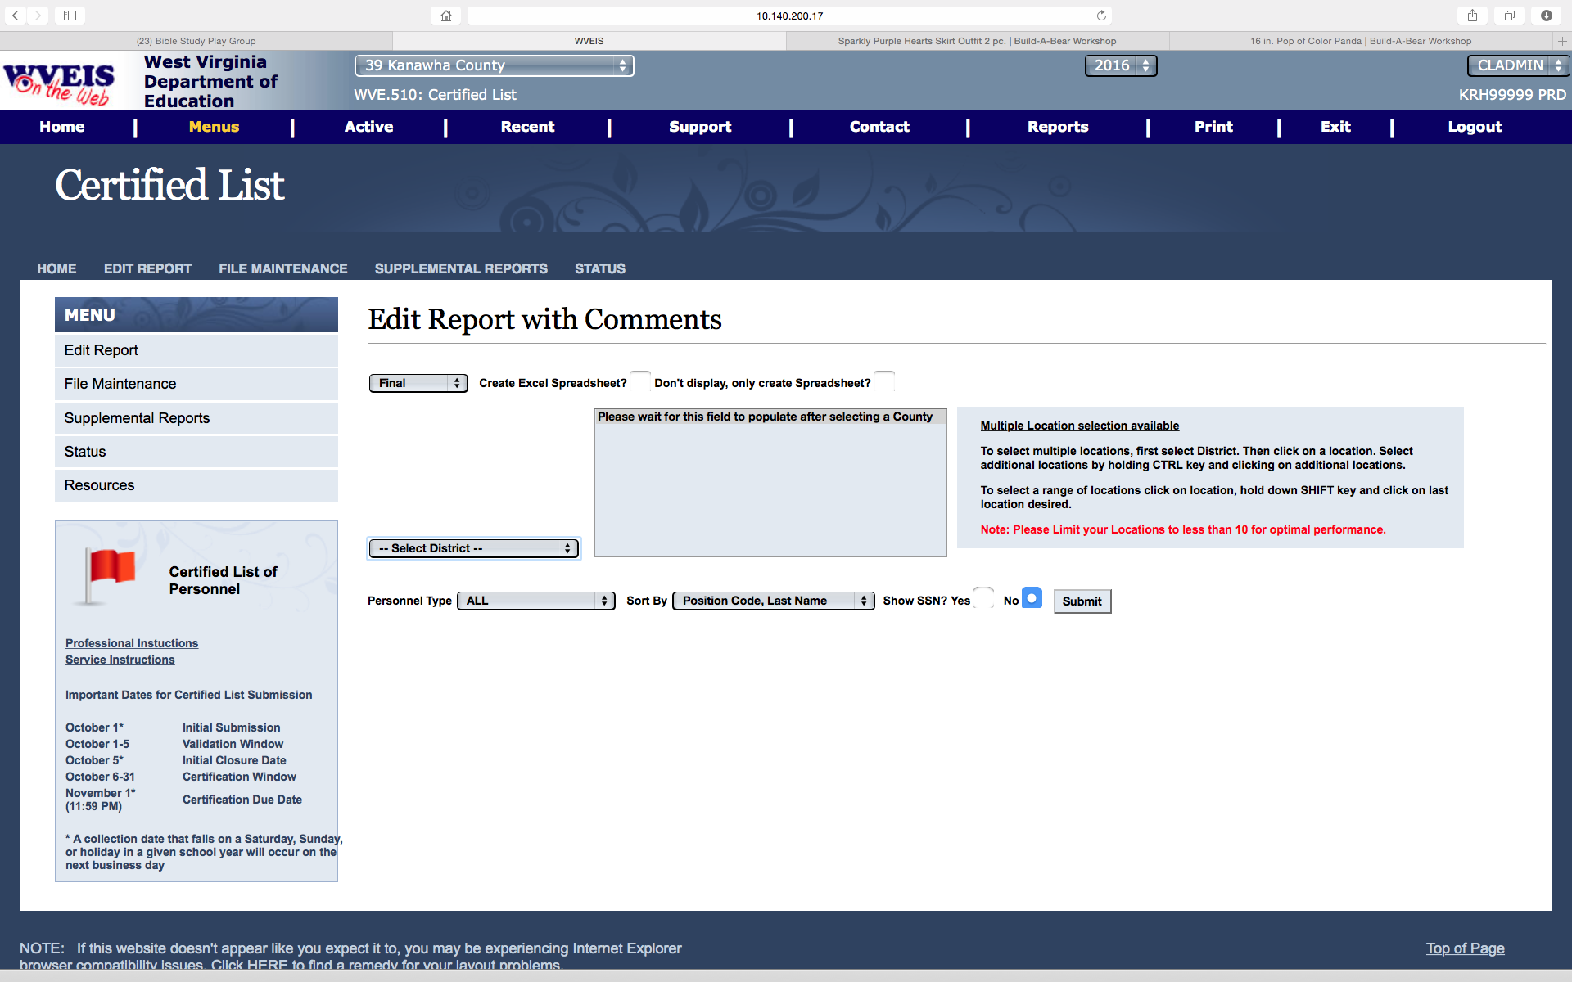
Edit Report with Comments
Notes:
Similar options as on other reports. This will print the Edits with any comments entered.

Slide 15
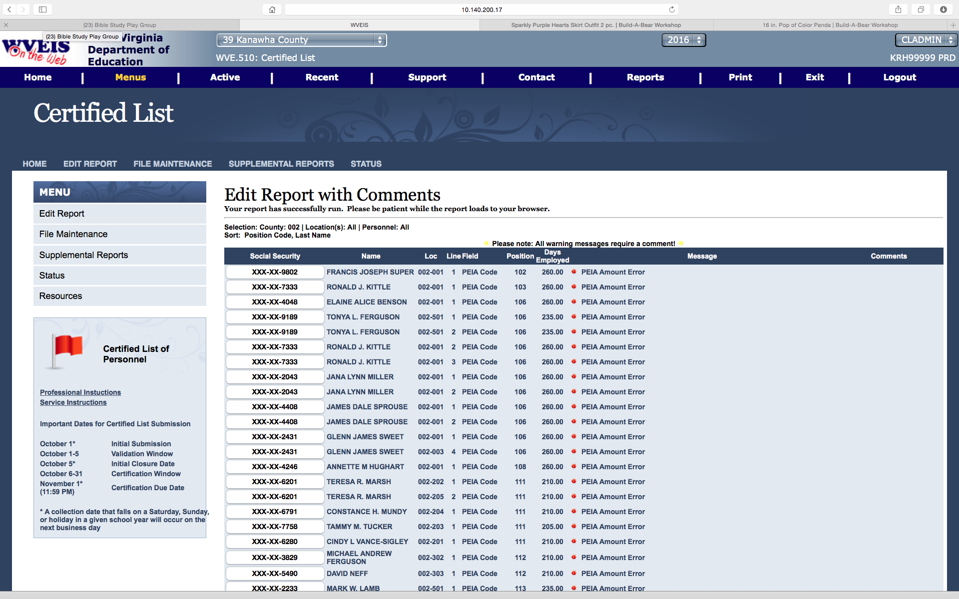
Edit Report with Comments

