Slide 1

West Virginia
Ethics Commission
2023 Ethics Acts Training
P Card
Presented By:
Kimberly B. Weber
Executive Director

Slide 2
West Virginia
Ethics Commission
*School board eligibility
*W. Va. Code § 61-10-15 (County officials and employees)
*ALJ Code of Conduct
*Lobbyists Registration
*Financial Disclosure Statements

Slide 3

School Board Eligibility
BOE member may not hold any other “public office,” unless other office is uncompensated and unrelated to public schools. W. Va. Code § 18-5-1a(a)(3).

Slide 4
BOE Prohibited Public Offices
2003-01: Soil Conservation District
2003-02: County Emergency Ambulance Authority​
2004-03: Public Service District
2010-01: County Board of Health
2014-04: Police officer for city police department in same county
2014-03: Substitute Bus Operator

Slide 5
Topics of Ethics Act
Office for Private Gain
Solicitation and Gifts
Name/Likeness (“Trinkets”)
Prohibited Public Contracts
Voting
Conflicts of Interest
Employment Restrictions

Slide 6

Use of Public Office for
Private Gain
May not use public resources, including time and subordinate staff, for someone’s unlawful personal benefit.
Ethics Act prohibits more than a de minimis use for personal purposes.
W. Va. Code § 6B-2-5(b)
Notes:
Motorcycle on pcard
Law enforcement vehicle

Slide 7

Unauthorized Spending
Use of Public Office for
Private Gain
The Ethics Commission only has authority to determine whether a proposed expenditure violates the private gain provision of the Act.
The Commission considers, among other factors, whether the proposed expenditure is authorized elsewhere.
    W. Va. Code
    Legislative Rules
    Attorney General Opinions
    Auditor Opinion Letters
    Agency’s attorney

Slide 8

Use of Public Office for
Private Gain
Agency employees and officials may not use their agency’s Sam’s Club card or similar shopping club memberships for personal purchases- even if the agency does not incur any additional costs.
AO 2010-18
CA

Slide 9

Use of Public Office for
Private Gain
P card misuse
CIC 2017-05
An administrator at a High School was a P card holder. In the past, she bought chair covers and decoration for school events. In 2016, she charged $550 for table covers and chair covers for her wedding. She received a public reprimand and $2,000 fine.

Slide 10

Use of Public Office for
Private Gain
P card misuse
CIC 2017-05
An administrator at a College or University was a P card holder in the football program. He used bonus points from purchases of sportswear he made for the team to buy $540 for personal apparel for himself and his family. He received a public reprimand, and $1,000 fine, and restitution.

Slide 11


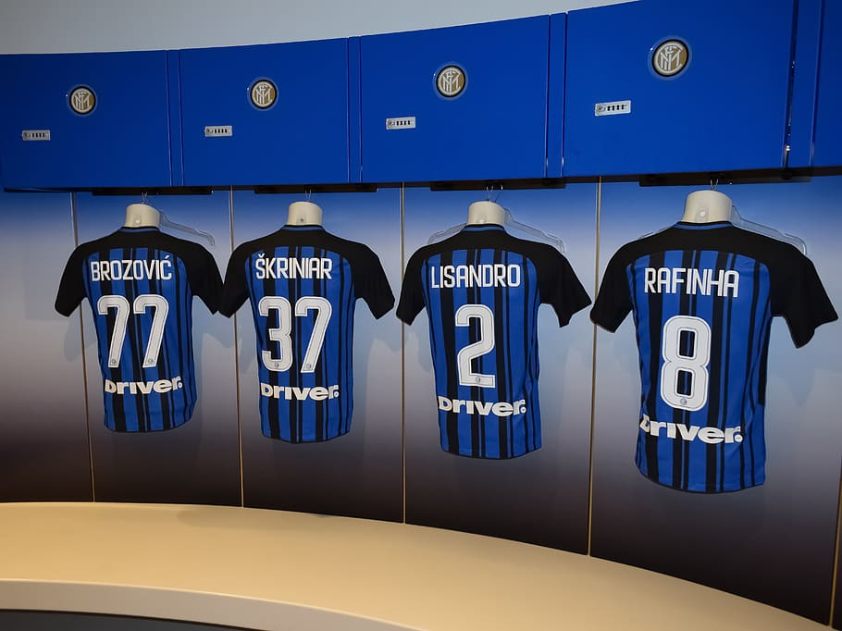

Bonus Points
Private Gain
Business travel-related bonus or reward points
Airplane, hotel, gas
Non-travel related reward points
Merchandise from online catalog

Slide 12

Use of Public Office for
Private Gain
P card misuse
P Card and
County Assessor, in 2015, used his P Card and county credit card for over $50k in personal items. Biggest charge was for a Harley Davidson motorcycle. Pled guilty to embezzlement, and the EC found he violated the Ethics Act and was fined $10k.

Slide 13

Use of Public Office for
Private Gain
County Ambulance Authority: Loaned public funds of $103k for 24 yrs., interest free, to executive director to allow director to transfer from PERS into a more lucrative retirement plan.

Slide 14

Use of Public Office for
Private Gain
Circuit Clerk tried to convince arresting police officer not to take him to jail.
Statements like “You know I am the Circuit Clerk.”
Threats to retaliate against the arresting officer.
Agreed to settlement
W. Va. Code § 6B-2-5(b) Prestige of Office

Slide 15
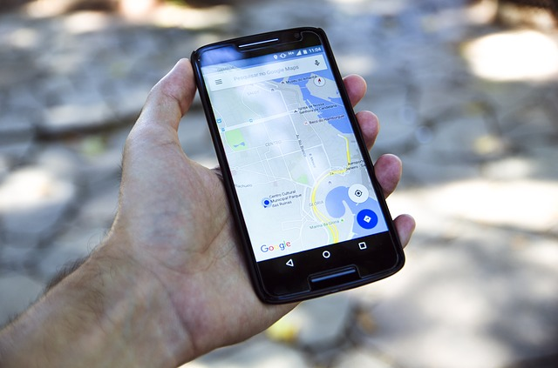
Use of Public Office for
Private Gain
2021-15 County Health Department
Agency may not allow its employees to use (more than de minimis amount of) their agency-provided cell phone as their personal cell phone unless the employees pay a reasonable fee to the agency. Even if unlimited plan.
No commercial or political campaign use.

Slide 16

2020 Employee Recognition/Retirement Events
Use of Public Office for
Private Gain
Food and beverages, entertainment, and gift or memento.
Total public funds = $25 per employee per year. May be allocated between events and employees. (Maximum $100 per employee.)

Slide 17

Retirement Gifts/Events
Use of Public Office for
Private Gain
May spend up to $100 of public funds to purchase plaque or another commemorative item.
This Photo by Unknown Author is licensed under CC BY-NC

Slide 18
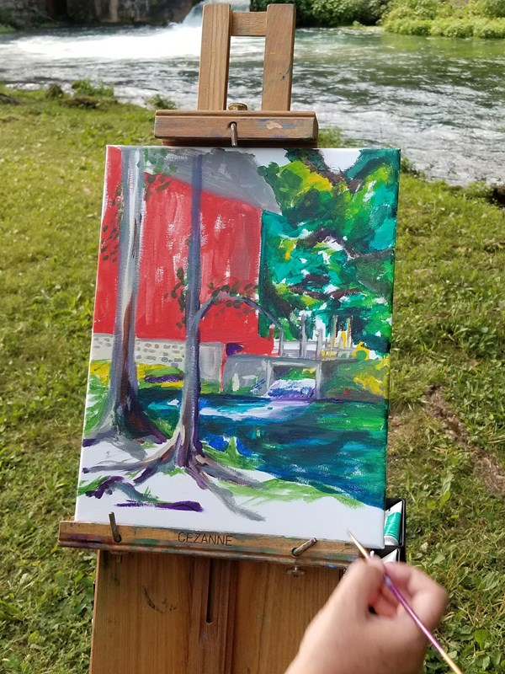

Use of Public Office for
Private Gain
State agency director of nine employees held employee morale events at a painting studio ($350) and a sports bar ($190)
Employee Recognition Guideline max is $25 per employee not $60.
Also spent $37 on an edible arrangement for a sick employee

Slide 19

Use of Public Office for
Private Gain
    Nepotism
    “Nepotism" means favoritism shown or patronage granted in employment or working conditions by a public official or public employee to relatives or persons with whom the public official or public employee resides.
"Relative" means spouse, mother, father, sister, brother, son, daughter,
grandmother, grandfather, grandchild, mother-in-law, father-in-law,
sister-in-law, brother-in-law, son-in-law or daughter-in-law.

Slide 20

Paying for Meals
Use of Public Office for
Private Gain
Review applicable laws to determine whether there is express or implied authority for the expenditure.
Unauthorized expenditures for meals violate the private gain provision of the Act if the overriding benefit is to the employee, or another person, and not the government agency.
Notes:
2018-04 -When a meal is authorized, reimbursement at a rate established by the West Virginia Travel Rules does not violate the Ethics Act.

Slide 21

Unauthorized Expenditures:
Paying for Meals
2018-02 A County Commission
The Ethics Commission was unable to determine whether there is implied or express authority for a county commission to use public funds to buy lunches for county elected officials and their staffs for an annual working lunch meeting. If the Office of the Attorney General or Auditor’s Office opines there is express or implied authority for the expenditure, then the expenditure of public funds for this purpose would not violate the Ethics Act.
2015-07 College
A College may not use public funds to buy meals for its employees at events held by a local chamber of commerce.
2021-06 College Professor Public higher education institutions may use public funds for meals for college-approved student events, regardless of whether the event is held on or off campus, if the expenditure is for a legitimate government purpose.

Slide 22

Use of Public Office
Private Gain
    Nepotism
    A public official or employee may not directly supervise or participate in decisions affecting the employment and working conditions of his or her relative or a person with whom he or she resides.
    Exception: Required by law and independent third party involved.
    Legislative Rule at 158 C.S.R. § 6.

Slide 23

Use of Public Office for
Private Gain
A Prosecutor wanted to know if her boyfriend could serve as an Assistant Prosecutor.
They did not live together or have a financial relationship.
Prosecutor did not formally advertise the job opening, so the Commission held that the Requester’s boyfriend received an unfair advantage in being hired.
W. Va. Code § 6B-2-5(b)

Slide 24


Unauthorized Spending
Use of Public Office for
Private Gain
May you use BOE funds to reward the superintendent with a trip to Myrtle Beach?
May you use BOE funds to support a candidate for governor?
This Photo by Unknown Author is licensed under CC BY-SA

Slide 25


Spending Public Funds
Use of Public Office for
Private Gain
QUESTION: May a public agency use public funds to purchase coffee makers or refrigerators for office employees?
A.O. 2016-09

Slide 26

Spending Public Funds
Use of Public Office for
Private Gain
2012-20 Public University
May use public funds to purchase prizes or incentives, including gift cards,
for wellness related competitions or promotions when prize recipients include University employees.

Slide 27
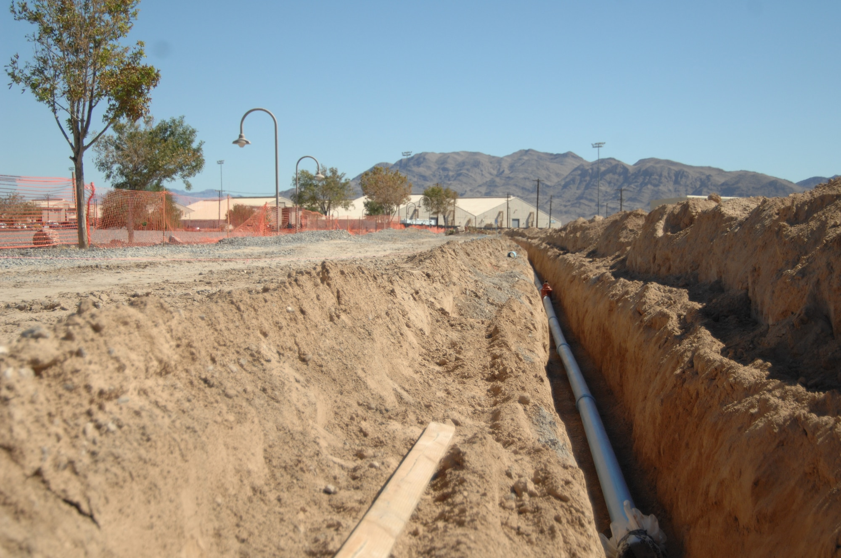
Use of Public Office for
Private Gain
2021-23 County Commission​
The Ethics Commission held that if the County Commission determines that building the proposed waterline extension project benefits the County by promoting tourism or economic development, then using American Rescue Plan funds for the project would not violate the Ethics Act even if the developer may uniquely benefit from the project.

Slide 28

Endorsements
Use of Public Office for
Private Gain
Do not endorse commercial products. Do not give testimonials such as town was a “satisfied customer.”
Exception: Overriding public benefit

Slide 29
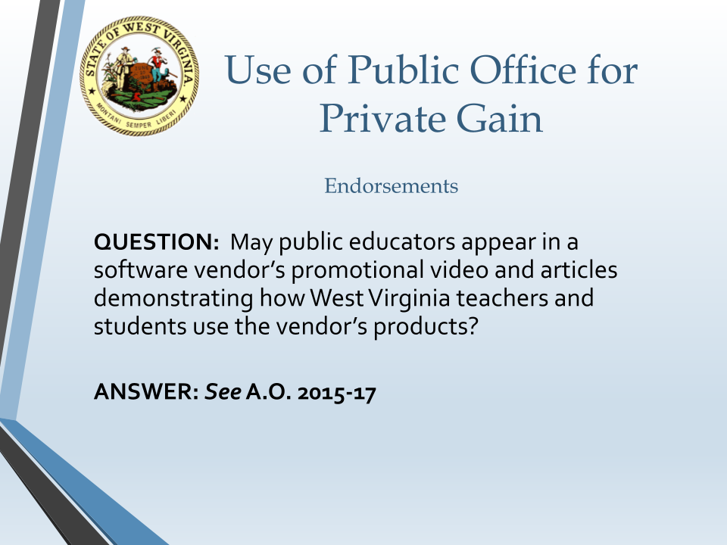

Endorsements
Use of Public Office for
Private Gain
Do not endorse commercial products. Do not give testimonials such as town was a “satisfied customer.”

Slide 30

Endorsement candidate
Use of Public Office for
Private Gain
College professor may not exclusively invite and allow one candidate to speak to a class at a public college about his or her platform without giving other candidates in the same political race the same opportunity.
A.O. 2021-06

Slide 31

Use of Public Office for
Private Gain
Nepotism
A.O. 2020-13 A principal’s wife, sister, and brother-in-law may be employed in the same school where he or she serves as principal, but the principal may not be involved in hiring or supervising them.

Slide 32

Use of Public Office for
Private Gain
2022-02 County Commission Employee
A county commission employee may be a candidate for and hold office on city council. She must not campaign while she is on the clock at work.

Slide 33

Use of Public Office for
Private Gain
Nepotism
Teachers arranging for relatives to substitute and/or placing relatives on a preferred list of substitutes violates the Ethics Act’s nepotism provisions.
AO 2019-03.

Slide 34

Confidential Info
No present or former public official or employee may disclose confidential information or use that information to further his/her personal interests or the interests of another person. [Address, SS#, credit card, driver’s license and marital status]
Executive Session not necessarily confidential
2022-01
W. Va. Code § 6B-2-5(e)
Improper disclosure of confidential information is a criminal misdemeanor!
Notes:
Sheriff used deputy’s sick leave in campaign. Executive Session not necessarily confidential 2021 AO

Slide 35

Gift Rules
No Gifts over $25 from Interested Persons
An interested person is:
A Lobbyist
Or one who:
Seeks or does business with the public servant’s agency (vendor);
Is regulated or controlled by the agency; or,
Has a specific financial interest which may be substantially affected by the performance or nonperformance of official duties.
Notes:
2020 – Even police officer saved by a bullet proof vest could not accept gift from vest man.

Slide 36
Gift Rules
Some Exceptions!
Meals and beverages of any value if the person purchasing them is present
Ceremonial gifts with insignificant value – for example, a plaque
Reasonable travel, meals and lodging expenses for being a speaker at conference or benefit performance of public job. (May have to report on FDS.)
Gifts that are purely private in nature
Ethics Commission Gift Guideline – outlines other exceptions
Notes:
Return
Donate to charity
Donate to the agency

Slide 37

Gift Rules
Solicitation of gifts is generally prohibited.
W. Va. Code § 6B-2-5(c)

Slide 38

Gift Rules
Charitable Solicitations
W. Va. Code § 6B-2-5(c)
Gifts may only be solicited for a charitable
purpose, such as the United Way.
Public agency may impose stricter standards.
Supervisors may not solicit contributions from a subordinate.
May solicit other public agencies 2019-11

Slide 39

Gift Rules
Charitable Solicitations
W. Va. Code § 6B-2-5(c)
Mayor may appear in a video using his name and public title to promote and solicit donations for a local nonprofit drug and alcohol recovery center because it served a charitable purpose and was not a commercial business.
Advisory Opinion 2021-02
This Photo by Unknown Author is licensed under CC BY-SA
Notes:
Selling products as part of a fundraiser is not soliciting. Foster family donations.

Slide 40

Gift Rules
Charitable Solicitations
W. Va. Code § 6B-2-5(c)
Health Department employees may solicit from local businesses and people to supplement public health programs.
AO 2005-02

Slide 41

Public Official’s Name or Likeness
    May not use public funds or public resources to display the public official’s name or likeness for the purpose of promoting public official or political party. W. Va. Code § 6B-2B-2(b).
Elect Jones
for Sherriff!
Notes:
Sheriff coins case

Slide 42


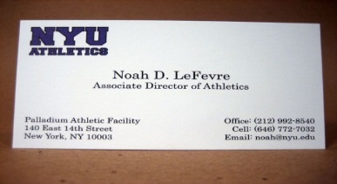

Public Official’s Name or Likeness
  May use name on letterhead, envelopes, educational materials, reports, certificates, office signs, press releases, bios, social media, and websites

Slide 43

Limitations on Public Official’s Name or Likeness
A town employee may not display a cup that contains a campaign slogan to work at Town Hall.
(The use of public resources to promote a political party.)
    AO 2021-19
Notes:
May
Purchase and distribute with private funds and on own time

Slide 44
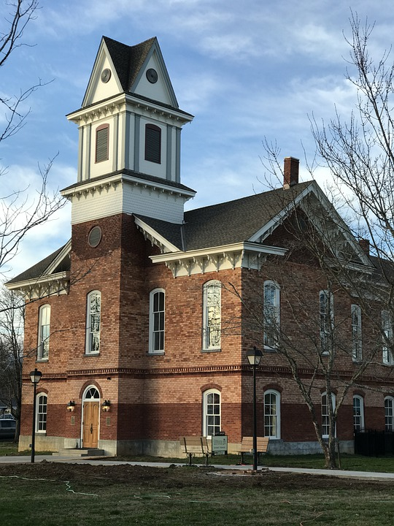
Public Official’s Name or Likeness
Effective on June 6, and will be codified in new Code sections, W. Va. Code §§ 5-6-4, 7-3-19, and 8-12-22. The law prohibits state, county and municipal entities from dedicating or naming any public building or public structure for a public official who is currently holding office.

Slide 45

Prohibited Interest in Agency Contracts
W. Va. Code § 6B-2-5(d)
Public servants may not have a financial interest in a public contract under their authority or control.
Notes:
city council member’s business should not k with city.

Slide 46

Prohibited Contracts
Exceptions
W. Va. Code § 6B-2-5(d)
$1,000 threshold
Part-time appointed officials and legislators are not subject to prohibition
Public employment.
but must recuse themselves if a conflict arises.

Slide 47

Prohibited County
Contracts
W. Va. Code § 61-10-15
W. Va. Code § 61-10-15 prohibits county officials from having financial interests, directly or indirectly, in a contract, including employment, over which their public position gives them voice, influence or control.
Notes:
Criminal offense: $500 fine, 1 yr jail time and removal from public office and employment
List of officials: county commissioners, BOE members, district school officers, supervisors, superintendents, secretaries, any other county or district board or district officer. Examples: PSD members, airport authority, 2012-12 county health department officers Can’t accept referrals.
Employment and part-time officials. CC spouse may not work in the assessor’s office.

Slide 48

Prohibited County
Contracts
W. Va. Code § 61-10-15
W. Va. Code § 61-10-15 applies to a county board member, district school officer, secretary of a Board of Education, supervisor or superintendent, principal or teacher at public schools.
Notes:
Criminal offense: $500 fine, 1 yr jail time and removal from public office and employment
List of officials: county commissioners, BOE members, district school officers, supervisors, superintendents, secretaries, any other county or district board or district officer. Examples: PSD members, airport authority, 2012-12 county health department officers Can’t accept referrals.
Employment and part-time officials. CC spouse may not work in the assessor’s office.

Slide 49
Prohibited County
Contracts
Exceptions
Spouse may be employed in the public schools in county, Commissioner’s spouse may be licensed health care provider at government-owned hospitals.
Does not apply to any person who is a salaried employee of a vendor or supplier if the employee meets the five criteria found in W. Va. Code § 61-10-15(e). (No commission, not owner, etc.)
Notes:
2015-15-prohibits a County Board of Education from employing the Superintendent’s spouse as a literacy coach, only can as a principal or teacher or auxiliary or service employee

Slide 50
Prohibited County
Contracts
W. Va. Code § 61-10-15
The 2022 new exception permits county officials to have pecuniary interests in contracts for goods and supplies if the county official is the lowest bidder, gets opinion from Commission, and other conditions.
Notes:
Criminal offense: $500 fine, 1 yr jail time and removal from public office and employment
List of officials: county commissioners, BOE members, district school officers, supervisors, superintendents, secretaries, any other county or district board or district officer. Examples: PSD members, airport authority, 2012-12 county health department officers Can’t accept referrals.
Employment and part-time officials. CC spouse may not work in the assessor’s office.

Slide 51
Prohibited County
Contracts and employment
Voice, Influence, or Control
County Commissioner Example
County Commissioners (and often spouses) can’t have contracts with or be employed by any County Office, e.g., Assessor’s Office, Sheriff’s.
Appointment power
If a County Commission appoints another entity’s board members, e.g., PSC, county parks board, Commissioner can’t have contract.
Appropriations
Or makes appropriations to an entity, a commissioner (or spouse) may not work for the entity or have a contract with it.
The County Commissioner may not work for CVB because Commission appropriated approximately 43 percent of the CVB’s budget. 2021
Notes:
Examples: PSD members, airport authority
Employment and part-time officials. CC spouse may not work in the assessor’s office.

Slide 52
Prohibited County
Contracts
W. Va. Code § 61-10-15
BOE examples:
Member could work for WVU Extension Services due to small appropriation and lack of power to make appointments to her local extension service committee. 2018-05
Member could work for staffing agency to perform work for a textbook company that markets textbooks and educational materials. AO 2018-10
BOE may not contract with a business that leases commercial property from a company owned by the board of education member’s spouse. AO 2017-15.
Notes:
Criminal offense: $500 fine, 1 yr jail time and removal from public office and employment
List of officials: county commissioners, BOE members, district school officers, supervisors, superintendents, secretaries, any other county or district board or district officer. Examples: PSD members, airport authority, 2012-12 county health department officers Can’t accept referrals.
Employment and part-time officials. CC spouse may not work in the assessor’s office.

Slide 53

Public
Contract
Ethics Commission has discretion to grant an exemption to public entity based upon undue hardship or excessive cost.
Exemptions

Slide 54

Voting
W. Va. Code § 6B-2-5(j)
May not vote if public official, or an immediate family member, or a business with which they or a family member is associated, has a financial interest.
Public officials may not vote on a personnel matter involving a relative.
(Class exception - five similarly situated)
2019-08 hotel development in mayor’s neighborhood
Notes:
Class example: a physician or health care provider to vote on health care legislation or for a teacher to vote on matters affecting education, or for a coal miner to vote on laws regulating the coal industry.

Slide 55

Voting
W. Va. Code § 6B-2-5(j)
If member also serves on a non-profit, the agency may still make appropriations to the non-profit.
Member or spouse may not vote if either is employed by non-profit.
If Board member is unpaid, he/she may vote only if disclosed on agenda and at the meeting.
Notes:
(D) The appropriations of public moneys or the awarding of a contract to a nonprofit corporation if the public official or an immediate family member is employed by, or a compensated officer or board member of, the nonprofit: Provided, That if the public official or immediate family member is an uncompensated officer or board member of the nonprofit, then the public official shall publicly disclose such relationship prior to a vote on the appropriations of public moneys or award of contract to the nonprofit;

Slide 56

Voting
Proper Recusal
A public servant who is required to recuse himself or herself must:
Fully disclose his or her interest
Leave the room during both the discussion of, and the vote on, the issue
Minutes must reflect recusal
Notes:
5.2. Making a full disclosure of one's interest means making a prior public disclosure including the amount of interest held directly or indirectly by a public employee or public official or immediate family thereof in a public contract.

Slide 57

Employment Restrictions
Full-time public employees may not seek employment with, or buy, sell or lease property to or from, any person who:
Had a matter on which they or their subordinate took regulatory action within the past 12 months, or
Currently has a matter before their agency on which they or a subordinate is working, or
Is a vendor over which they exercise control
Employment Exemptions available
2019-17 and 2020-05
W. Va. Code § 6B-2-5(h)
Notes:
Fire code deputy owned bar ok

Slide 58

Post-employment Restrictions
          Revolving Door
No elected or appointed public official or full-time staff attorney or accountant, shall:
for ONE YEAR after the termination of that service, appear in a representative capacity before the entity he or she served in:
  A contested administrative matter,
  To support or oppose a proposed rule,
  To support or oppose issuance of a license or permit,
  Rate-making proceedings, or
  To influence the expenditure of public funds
W. Va. Code § 6B-2-5(g)

Slide 59

Financial Disclosures
W. Va. Code § 6B-2-6
Must file by February 1 annually.
(1) Elected state and county officials
(2) All members of state boards, commissions and agencies appointed by the Governor; and
(3) Secretaries of departments, commissioners, deputy commissioners, assistant commissioners, directors, deputy directors, assistant directors, department heads, deputy department heads and assistant department heads.

Slide 60
Lobbying Contracts
W. Va. Code § 6B-3-10:
The new provision prescribes disclosure requirements for government agencies that contract for lobbying services, including filing lobbyist contracts with the Ethics Commission.

Slide 61
Disclosure of $1 million dollar Contracts
Disclosure of Interested Parties, such as
contractor and subcontractors. State agency must file with the Commission before beginning work.
W. Va. Code § 6D-1-1, et seq.

Slide 62
Sanctions
W. Va. Code § 6B-2-4(s)(1)
  Public reprimand
  Restitution
  Fines of $5,000 per violation
  Reimbursement to the Commission
  Recommendation that a Respondent be terminated from employment or removed from office.

Slide 63

Open Meetings Act
State, county, and municipal administrative and legislative bodies, and any bodies that meet the definition of ‘public agency,’ are subject to the Act.

Slide 64

Meeting defined
A meeting subject to OMA is defined by the Act as:
  The convening of a governing body of a public agency
  For which a quorum is required in order to make, or deliberate toward, a decision
  On a matter which results or will result in official action.
Notes:
A gathering where a quorum of the governing body meets with staff is a “meeting” within the scope of the Act.
W.Va. Code § 6-9A-2(5)
OMAO 2011-02
One member of the body meeting with staff is not governed by the Act.

Slide 65

Topics of Open Meetings Act
Meetings subject to OMA
Meetings not subject to OMA
Notice/Agenda for meetings
Executive sessions
Meeting minutes
Violations

Slide 66
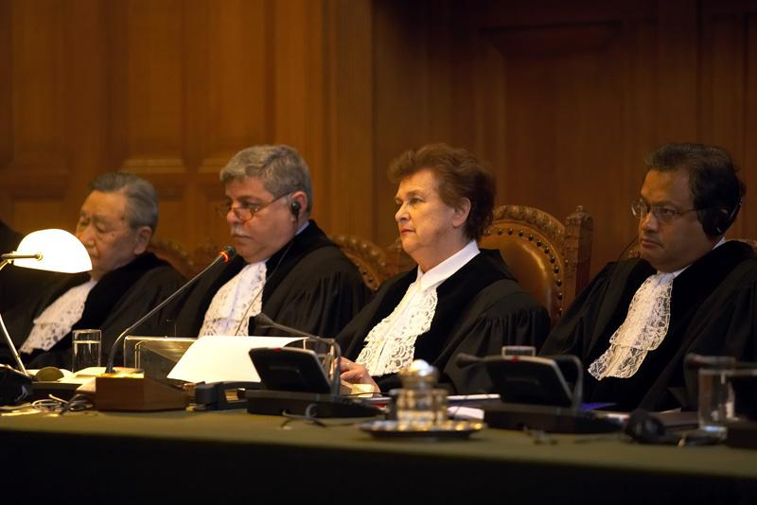
Exceptions
Adjudicatory
On-site inspection
  Construction site
Political party caucus

Slide 67

Exceptions
General Discussions
Planned or unplanned
Social, educational, training, informal, ceremonial or similar setting
Without intent to conduct public business
No intention for the discussion to lead to an official action

Slide 68

Coronavirus
Don’t need to meet in person if deemed a health risk by the CDC or other government agency authorized to make these types of decisions.
The public agency may instead provide citizens with a call-in number for a telephonic meeting or provide access via web link to a livestream of the meeting.
This Photo by Unknown Author is licensed under CC BY-SA

Slide 69


Notice
  The Open Meetings Act requires advance notice of the date, time, and place of the meeting, including any committee meeting.

Slide 70

Meeting Notice
Promulgate Rules
Regular meeting’ notice must be posted THREE business days in advance (unless you meet every week, then two days).
‘Special meeting’ notice must be posted TWO business days in advance.
But – state agency = FIVE business days notice w SOS.
Notes:
Each governing body shall promulgate rules by which the date, time, place and agenda of all regularly scheduled meetings and the date, time, place and purpose of all special meetings are made available, in advance, to the public and news media.
In regard to emergency meetings, W. Va. Code § 6-9A-2(2) states as follows:
(2) "Emergency meeting" means any meeting called by a governing body for the purpose of addressing an unexpected event which requires immediate attention because it poses:
(A) An imminent threat to public health or safety;
(B) An imminent threat of damage to public or private property; or
(C) An imminent material financial loss or other imminent substantial harm to a public agency, its employees or the members of the public which it serves.
W. Va. Code § 6-9A-2 also reads:
(h) In the event of an emergency a governing body may call an emergency meeting.
(1) The governing body of a state executive branch agency shall electronically file a notice for an emergency meeting with the Secretary of State, as soon as practicable prior to the meeting. Any other governing body shall notice an emergency meeting in a manner which is consistent with this article and the Ethics Commission Committee on Open Governmental Meeting's opinions issued pursuant to the authority of section ten of this article, as soon as practicable prior to the meeting.
(2) The emergency meeting notice shall state the date, time, place and purpose of the meeting and the facts and circumstances of the emergency.

Slide 71
Meeting Notice Days
When counting business days , the day of the meeting, Saturdays, Sundays and legal holidays are excluded. BOEs are required to designate both “outside the school environment” days and “out-of-calendar” days in a school term. The OMA Committee held that “outside the school environment” days and “out-of-calendar” days are not considered legal holidays and are therefore counted for purposes of computing time periods under the Open Meetings Act.
OMAO 2019-01
Notes:
Each governing body shall promulgate rules by which the date, time, place and agenda of all regularly scheduled meetings and the date, time, place and purpose of all special meetings are made available, in advance, to the public and news media.
In regard to emergency meetings, W. Va. Code § 6-9A-2(2) states as follows:
(2) "Emergency meeting" means any meeting called by a governing body for the purpose of addressing an unexpected event which requires immediate attention because it poses:
(A) An imminent threat to public health or safety;
(B) An imminent threat of damage to public or private property; or
(C) An imminent material financial loss or other imminent substantial harm to a public agency, its employees or the members of the public which it serves.
W. Va. Code § 6-9A-2 also reads:
(h) In the event of an emergency a governing body may call an emergency meeting.
(1) The governing body of a state executive branch agency shall electronically file a notice for an emergency meeting with the Secretary of State, as soon as practicable prior to the meeting. Any other governing body shall notice an emergency meeting in a manner which is consistent with this article and the Ethics Commission Committee on Open Governmental Meeting's opinions issued pursuant to the authority of section ten of this article, as soon as practicable prior to the meeting.
(2) The emergency meeting notice shall state the date, time, place and purpose of the meeting and the facts and circumstances of the emergency.

Slide 72
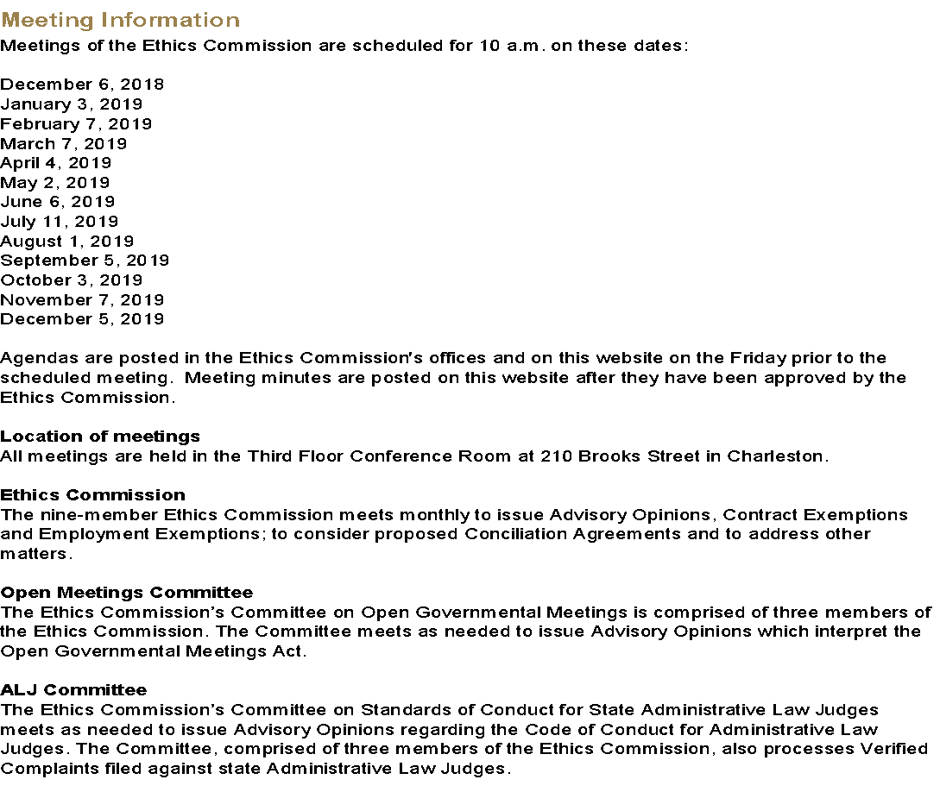
Notice: Ethics Commission website
Notes:
Minimum requirements for posting a notice is in a public place.

Slide 73

Agenda
Regular meeting agenda must be made available THREE business days in advance (unless you meet every week, then two days).
Special meeting – TWO business days
Notes:
Each governing body shall promulgate rules by which the date, time, place and agenda of all regularly scheduled meetings and the date, time, place and purpose of all special meetings are made available, in advance, to the public and news media.

Slide 74
Emergency Meeting
W. Va. Code § 6-9A-2-(2)
(2) "Emergency meeting" means any meeting called by a governing body for the purpose of addressing an unexpected event which requires immediate attention because it poses:
An imminent threat to public health or safety;
(B) An imminent threat of damage to public or private property; or
(C) An imminent material financial loss or other imminent substantial harm to a public agency, its employees or the members of the public which it serves.
Notes:
Each governing body shall promulgate rules by which the date, time, place and agenda of all regularly scheduled meetings and the date, time, place and purpose of all special meetings are made available, in advance, to the public and news media.

Slide 75
Meeting Agenda
Agendas must give reasonable notice to the public of every issue to be discussed. Don’t take up issues not on the agenda. Hold them over for next agenda.
Items must be specific enough to put the public on notice of intended action.
Vague headings are insufficient, e.g.,
  Old Business
  New Business
OMAO 2008-17

Slide 76

Meeting Agenda
“Personnel” and “Opening sealed bids” are too vague a description
Instead, use ”filling position of office manager,” or
“‘open sealed bids for city hall roof repair project.”
  OMAO 99-10: Marshall Co BOE Employee grievance: ”Level III grievance” is sufficient.

Slide 77
Executive Session
W.Va. Code § 6-9A-4
May only go into executive session for reasons permitted by the Open Meetings Act.
There must be a corresponding agenda item.
The motion to go into executive session must identify the reason for entering the session.
Majority vote of those present is required.
Vote must be made in public (except for student matters).
Notes:
OM 2001-24 – may interview engineering firm in an executive session

Slide 78
Executive Session reasons include -
To consider personnel matters of a particular public official or employee. But must vote in public and announce employee’s name. OMAO 99-10
To decide upon disciplining, suspension, or expulsion of any student in any public school, unless the student requests an open meeting.
To discuss matters which, by express provision of federal law or state statute or rule of court is rendered confidential. OMAO 2017-02.
W. Va. Code § 6-9A-4 (contains complete list)

Slide 79
Executive Session
Open Meetings Advisory Opinion 2022-01
The Open Meetings Act does not make information discussed during executive sessions confidential; nor does it create an excessive session privilege. Other rules and laws may create a duty of confidentiality.

Slide 80

Meeting Minutes
W.Va. Code § 6-9A-5
Minutes required for all meetings, including committee and sub-committee meetings, but not what is said in executive sessions.
OMAO 99-09

Slide 81
Minutes
The date, time and place of the meeting;
The name of each member of the governing body present and absent;
All motions, proposals, resolutions, orders, ordinances and measures proposed, the name of the person proposing the same and their disposition, and
The results of all votes and, upon the request of a member, pursuant to the rules, policies or procedures of the governing board for recording roll call votes, the vote of each member by name.

Slide 82
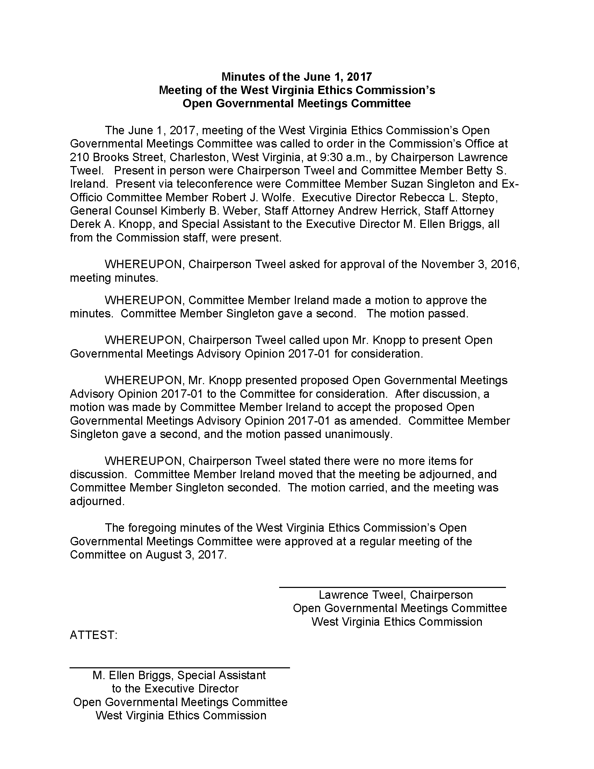
Sample Minutes

Slide 83
Minutes
W.Va. Code § 6-9A-5
Meeting minutes must be made available within a ‘reasonable time.’
‘Reasonable time’ defined by OMAO 2010-04 as ‘close of business on the next business day following [the next meeting].’
If material changes to the minutes are necessary, then the minutes should be available no later than three business days following the next meeting.
Draft minutes are encouraged, but not required, to be made available for public inspection.

Slide 84

Violations
W.Va. Code § § 6-9A-6 and 7
An intentional violation is a criminal misdemeanor subject to prosecution by the county prosecutor and up to a $500 fine. ($1,000 for additional violations)
May also be liable to wronged parties in civil court. (within 120 days of action)
Court may annul vote taken in violation of Act.

Slide 85
West Virginia
Ethics Commission
210 Brooks Street, Suite 300
Charleston WV 25301
(304) 558-0664
www.ethics.wv.gov
Email: ethics@wv.gov

