Slide 1


Unclaimed Property for WV School Business Officials
Presented by Maegan Trout
West Virginia State Treasurer’s Office

Slide 2


Identifying the Basics
What type of property to report
Where and When to report
How to report
How to claim back property

Slide 3

What is Unclaimed Property?
Financial assets owed to an individual or business entity where the owner cannot be located
Any business entity could have unclaimed property

Slide 4
Basic Terminology
Holder – The business Entity “Holding” the unclaimed funds. Your School or County would be the “Holder”
Owner – The individual or business entity that the funds belong to.
Property – The entire report record of Owner and amount information.
Claim – Process the rightful owner takes to receive payment for Unclaimed Property funds.

Slide 5

Examples of property
Accounts Payable Checks
Expense Checks
Vendor Payments
Overpayment or Refund Checks
Any Miscellaneous Outstanding Checks
Any unknown money – cleanup items

Slide 6
Where do I report?
Rules of Jurisdiction as defined by Texas v. New Jersey
Property is reportable to the state of owner’s last known address
If no address is on record – report to West Virginia
West Virginia will accept property for owners in other states – as long as it is less than 10% of your total report.

Slide 7

When to report?
Reports and payment are due before November 1st
Reporting period runs July 1st – June 30th
Only file ONE report per year
Property at least one year old on June 30th gets reported on November 1st.
Negative ($0) Reports are NOT required
All public entities have a 1-year dormancy period

Slide 8

Stages of the UP Lifecycle
Data Collection – Start July 1
Consolidation & Analysis
Due Diligence
Reporting – Before November 1
Reconciliations & Adjustments

Slide 9

Due Diligence
What is it?
Due Diligence is the process of a holder attempting to contact the owner of dormant property to give them a last opportunity to claim the property from the holder before it is turned over to a State Unclaimed Property Administration.
Due Diligence is mandated by state law
W. Va. Code 36-8-7
W. Va. Legislative Rule 112-5-6

Slide 10
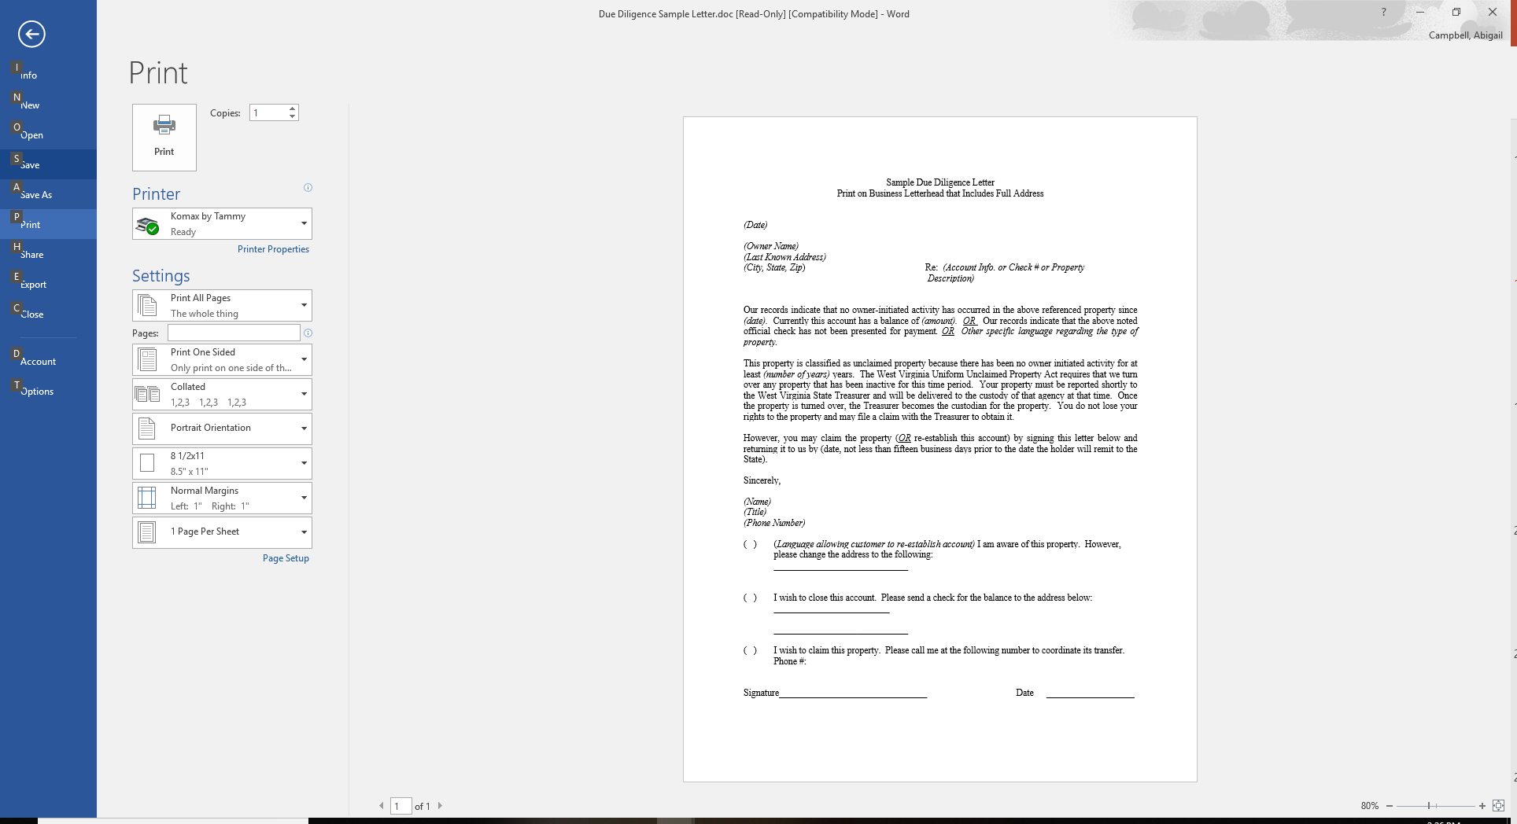
Due Diligence
Send a first class mailing to the owner of the property if:
Amount is over $50
Not required if known bad address.
60 to 120 days prior to reporting.

Slide 11

Electronic Reporting
Paper reports are NO longer accepted – per WV House Bill 4290, passed 2008
If you must file a paper report, you must obtain a hardship waiver.
Electronic Reporting protects everyone

Slide 12

What info is required?
Property type code
Relationship code
Property description
Owner name and address
Date of last activity
Dollar amount
Any additional detail you may have: ss#, date of birth, email address, etc

Slide 13
Electronic Reporting Options
Upload a Report: Use a third party software to create a Naupa File. Upload the file on our website.
Manual Online Reporting: Report online for free on the Treasurer’s new website. Each property will be hand entered individually and report submitted electronically.

Slide 14

Property Type Codes
CK13 – Vendor checks
MS11 – Refunds due
MS99 – Aggregate Misc Property
Entire list can be found on our website

Slide 15
Relationship Codes
This is the Relationship of the “Owner” to the “Property”
Generally, one owner properties are the “Payee” or “Primary Owner” of the funds
Multi Owner – use “And” or “Or”
Deceased – “Estate of”

Slide 16
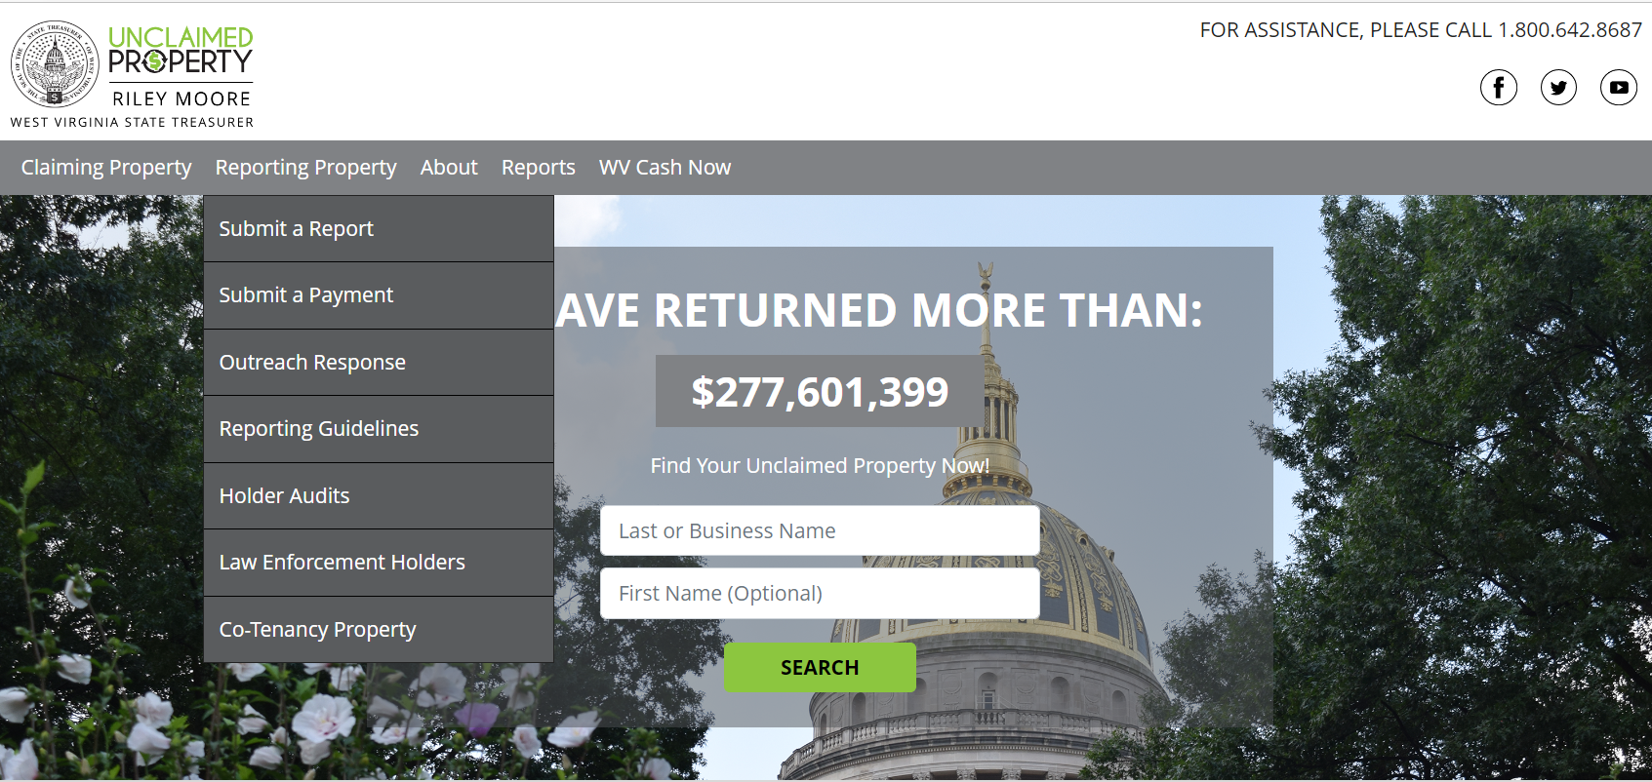
Website Walkthrough
wvunclaimedproperty.com
Reporting Property drop down options

Slide 17
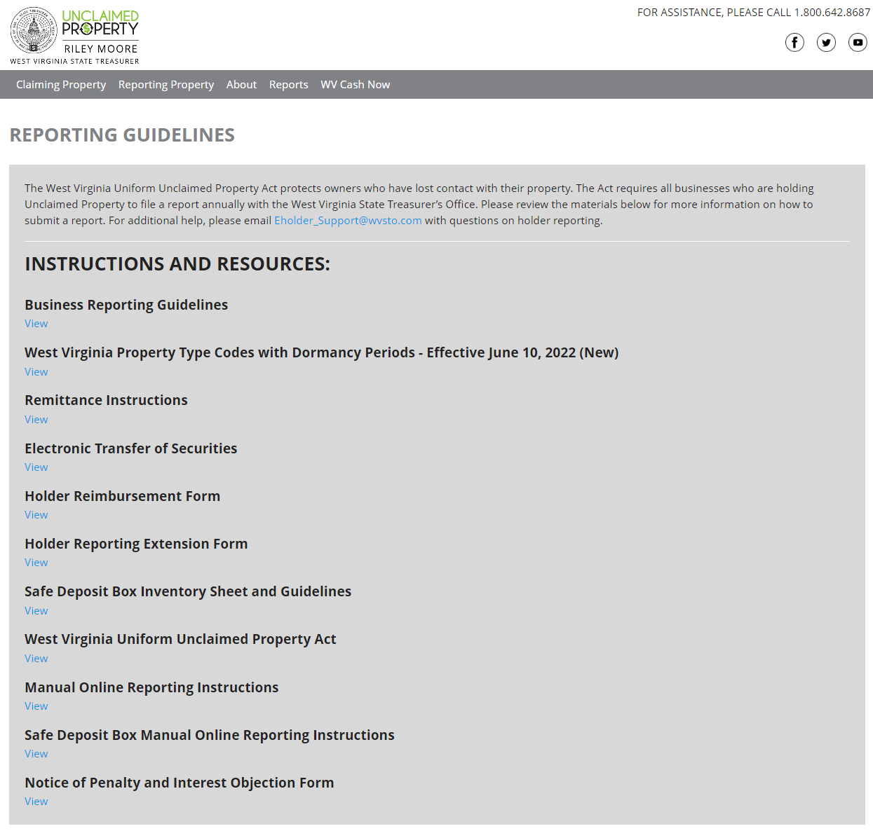
Reporting Guidelines Page
All reporting instructions will be found under the Reporting Guidelines page

Slide 18
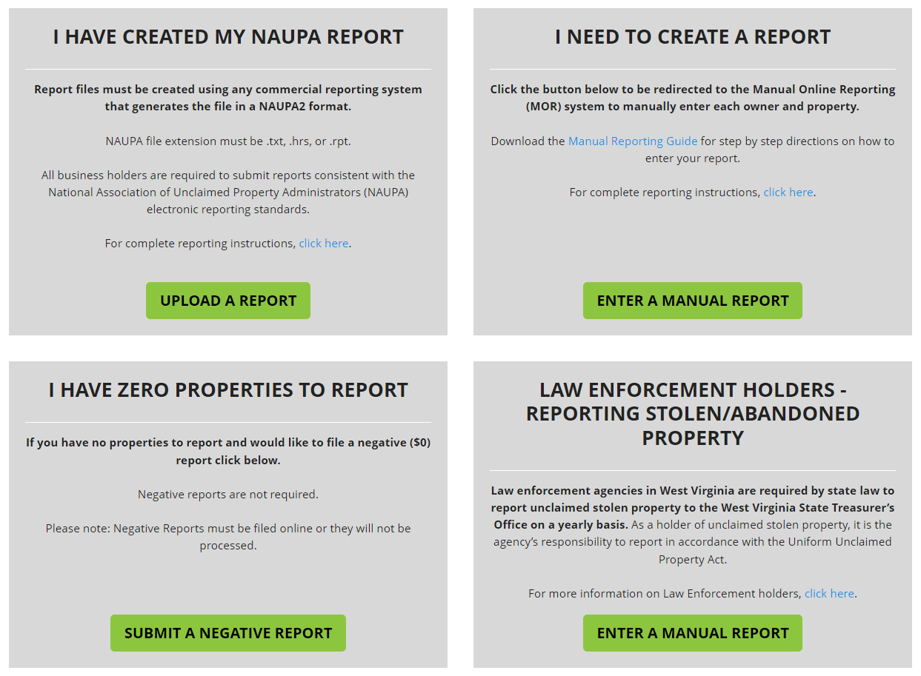
Begin to File a Report
Select “Enter a Manual Report” to hand enter each property on the website

Slide 19
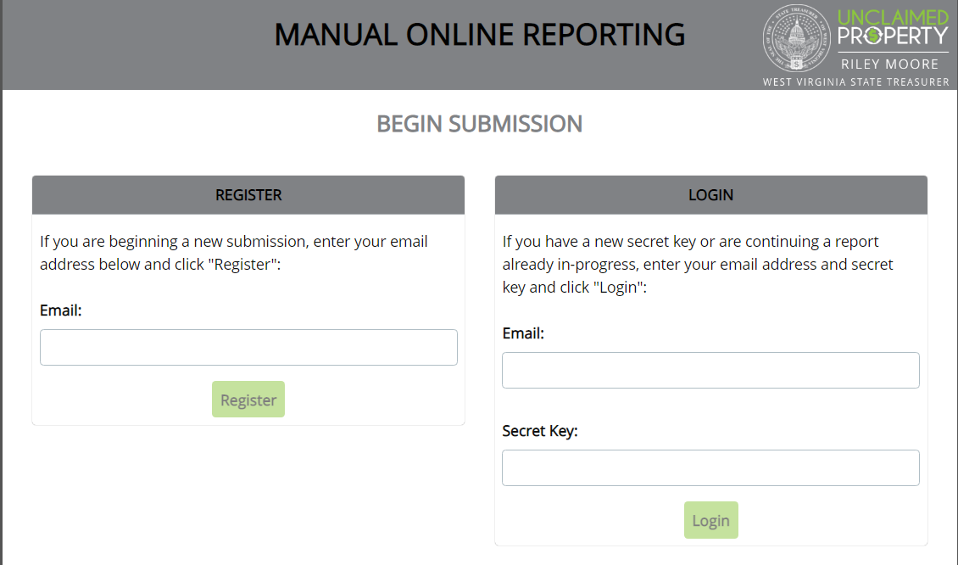
Register for an Account
Enter your Email address and select “Register” to begin your report

Slide 20
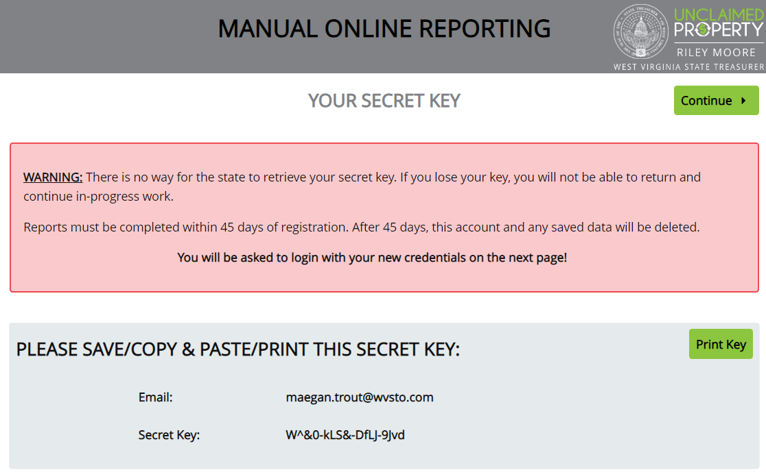

Obtain your Secret Key
You MUST remember your secret key to leave and come back to your report.

Slide 21
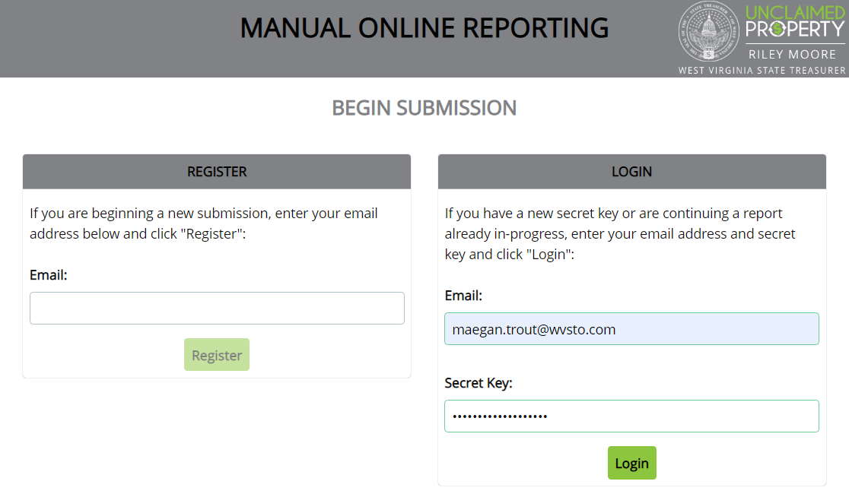
Login with your Email and Key
Enter your Email address and Secret Key to Login

Slide 22
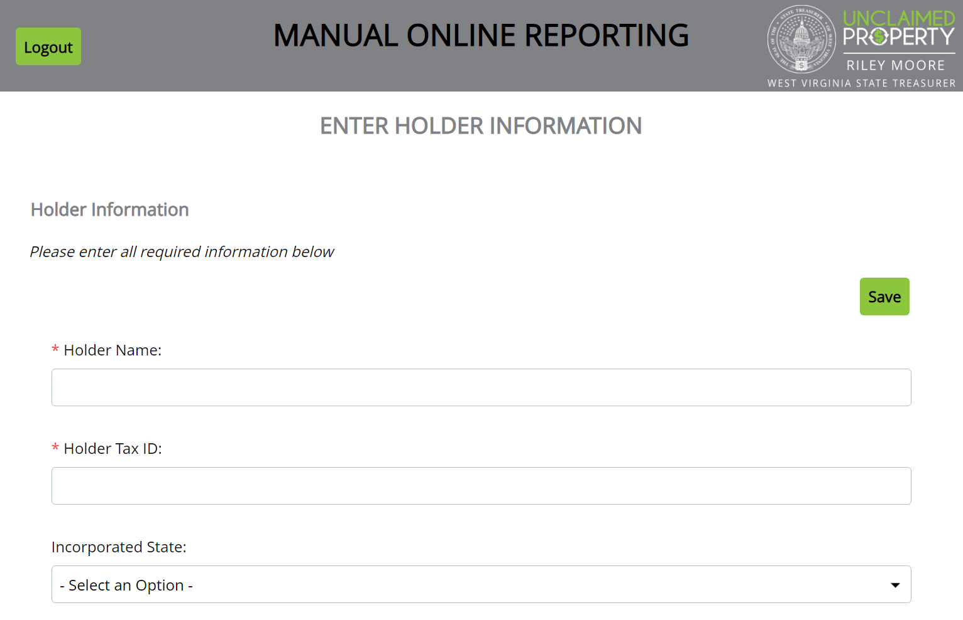
Enter Holder Information
All fields with a Red Asterisk are required fields.

Slide 23
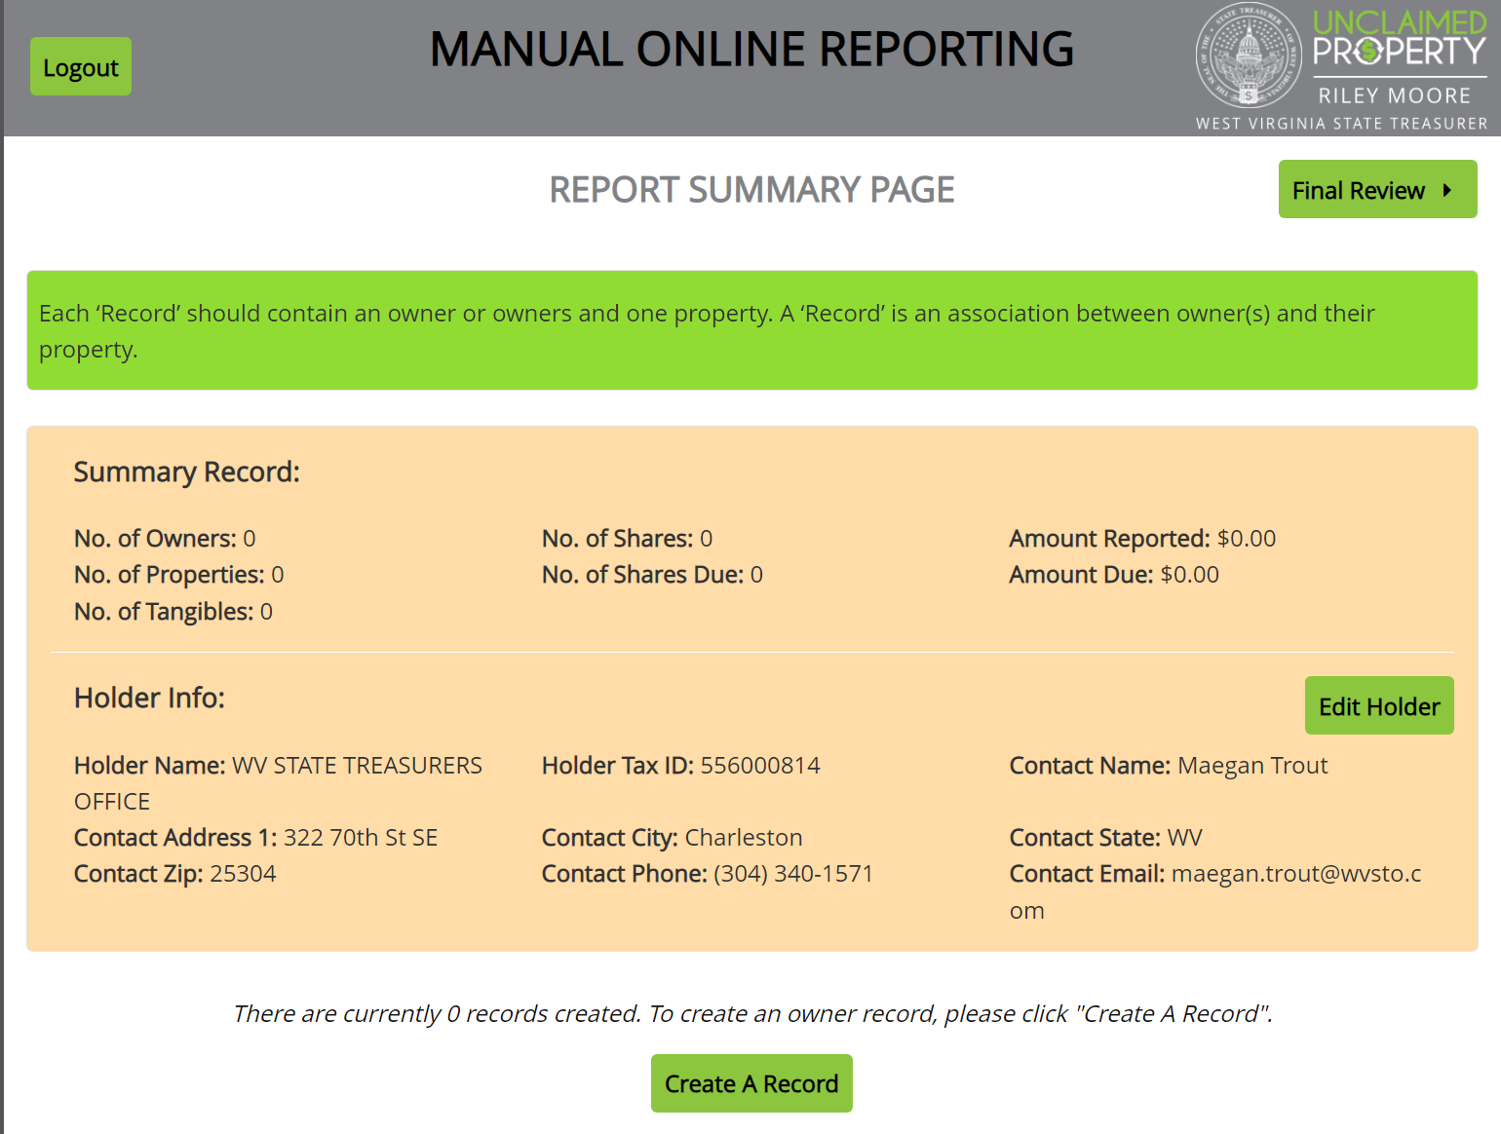
Review Holder Info / Create a Record

Slide 24
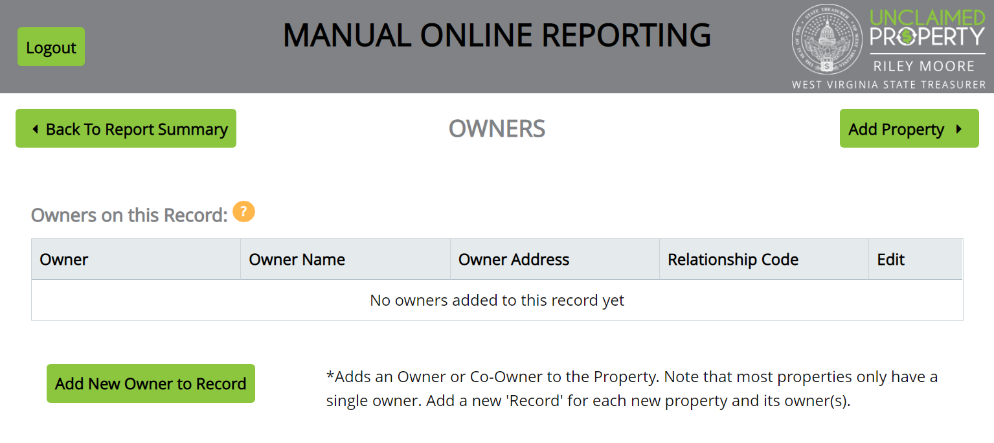
Add First Owner
Properties are added in a Two-Step Process. Each entry will have an Owner screen and a Property screen

Slide 25
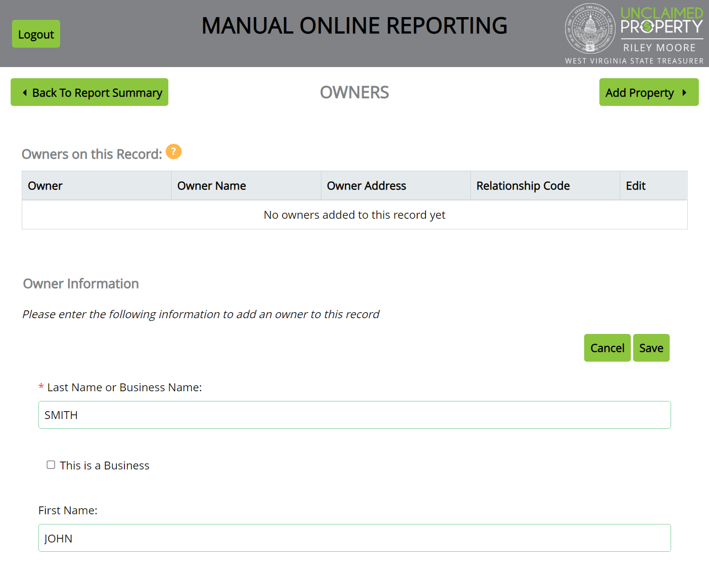
Add Owner and Save
The more information provided, the easier it is to return funds to the rightful owner.

Slide 26
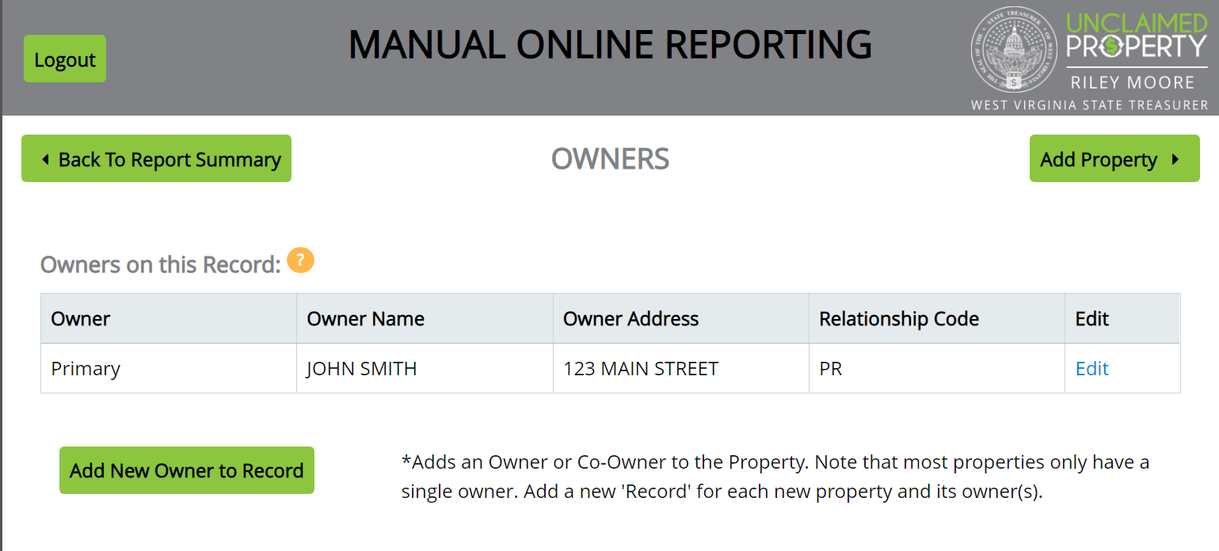
Add First Property
Verify the name and address appear correct before adding the Property information

Slide 27
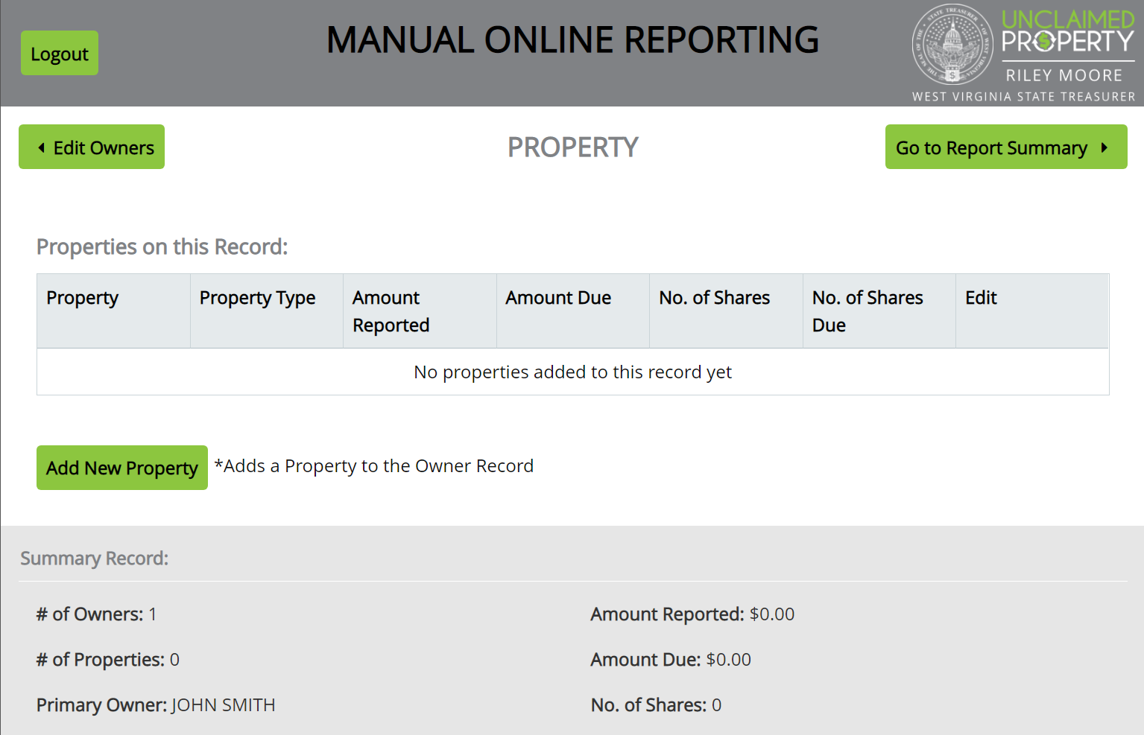
Add a new Property

Slide 28
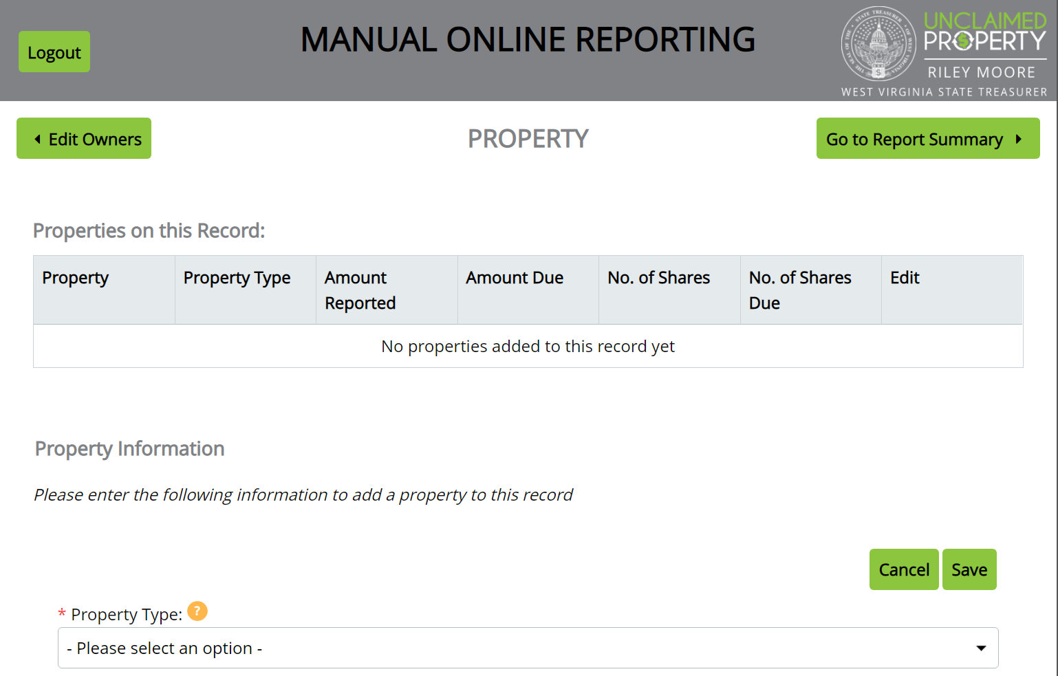
Add property information / Save
Start Date: Date of last activity (last contact) or check date

Slide 29
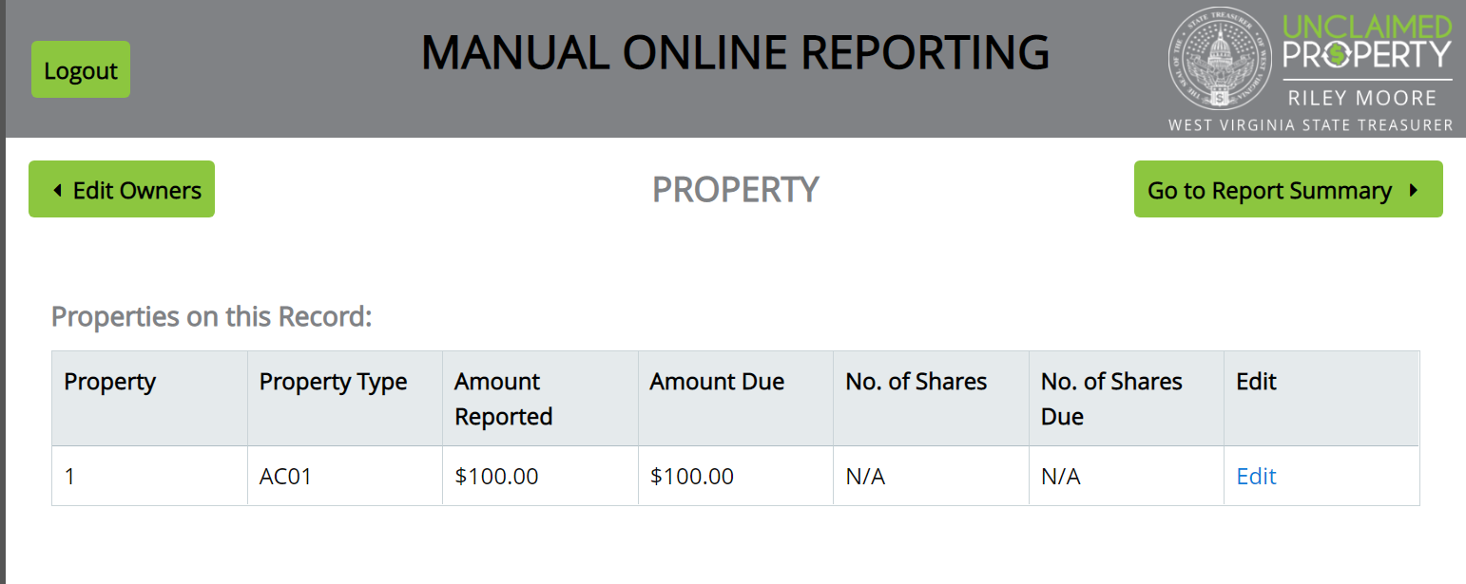
Properties will save
If property information looks correct, go to Report Summary

Slide 30
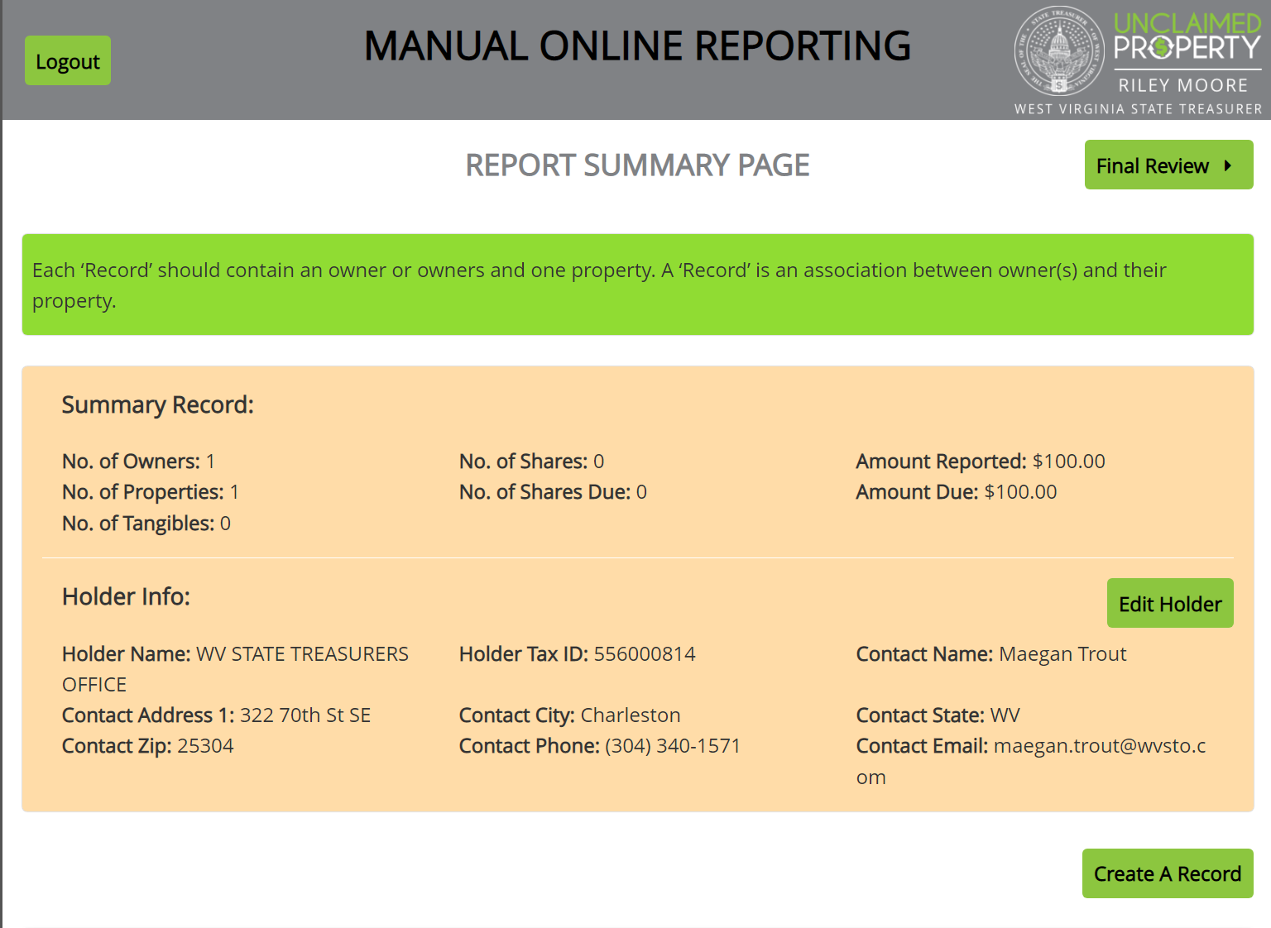
Report Summary

Slide 31
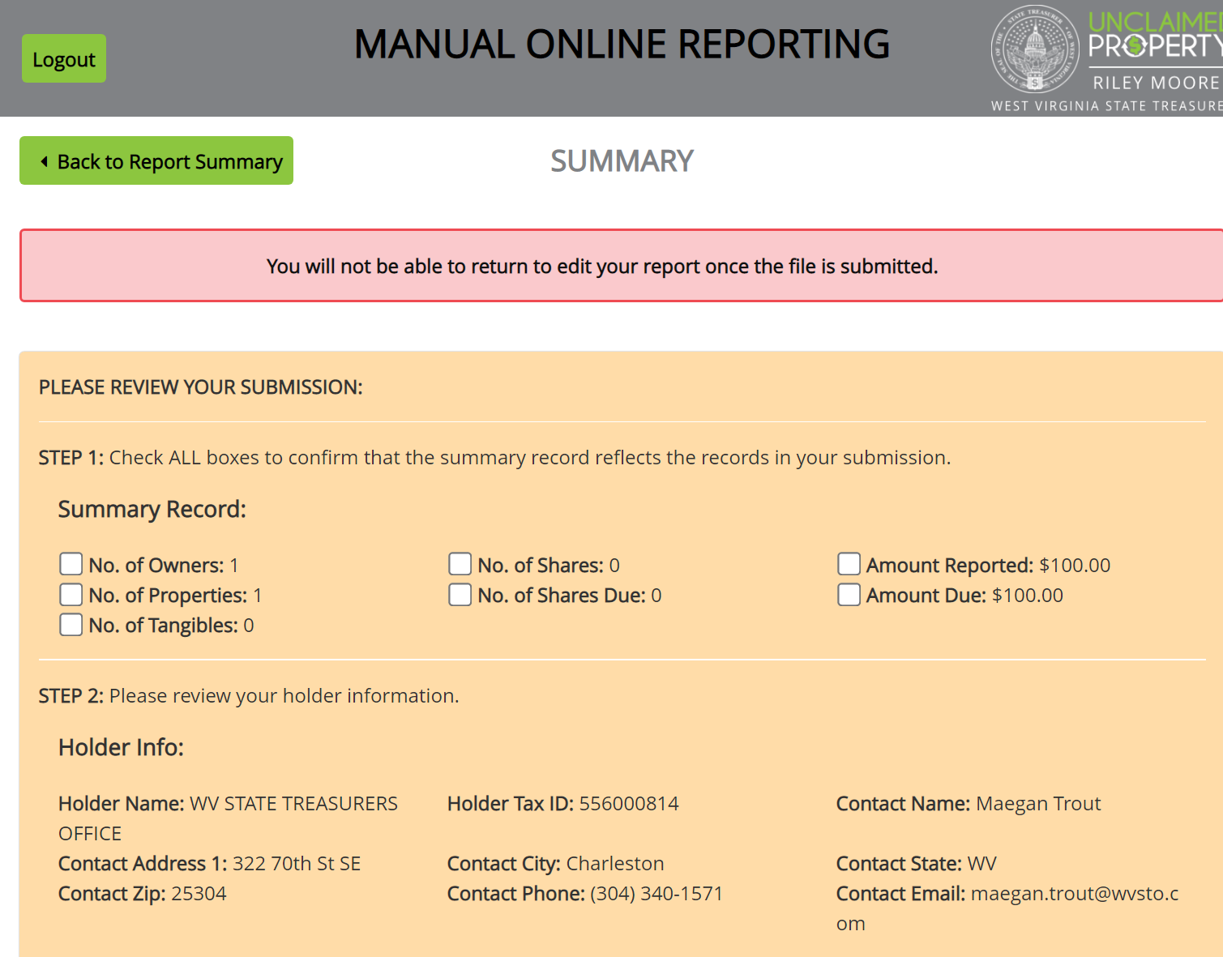
Final Review
Make sure ALL seven boxes are checked – or Submit button will not be clickable

Slide 32
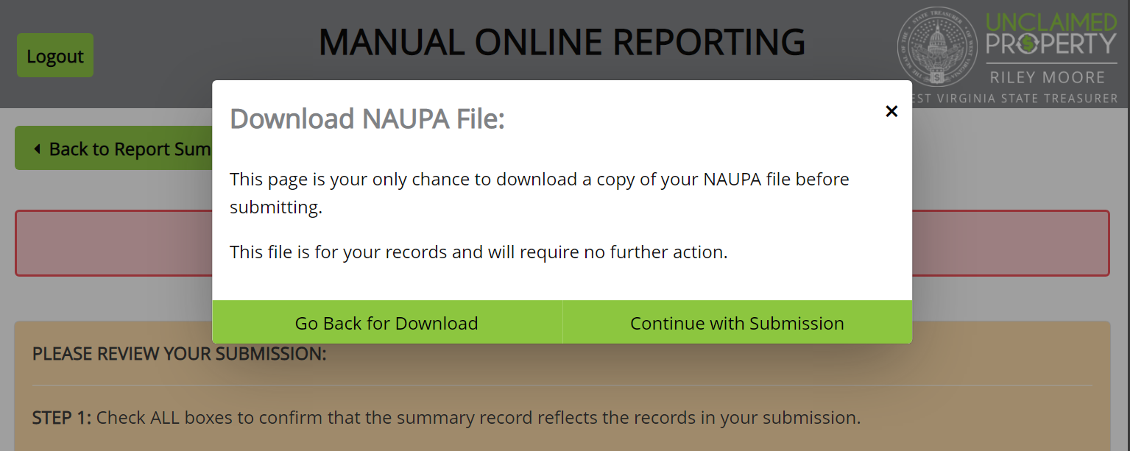
NAUPA File Pop Up
NAUPA file is a flat .txt file that is not easily readable. You do not have to download this file.

Slide 33
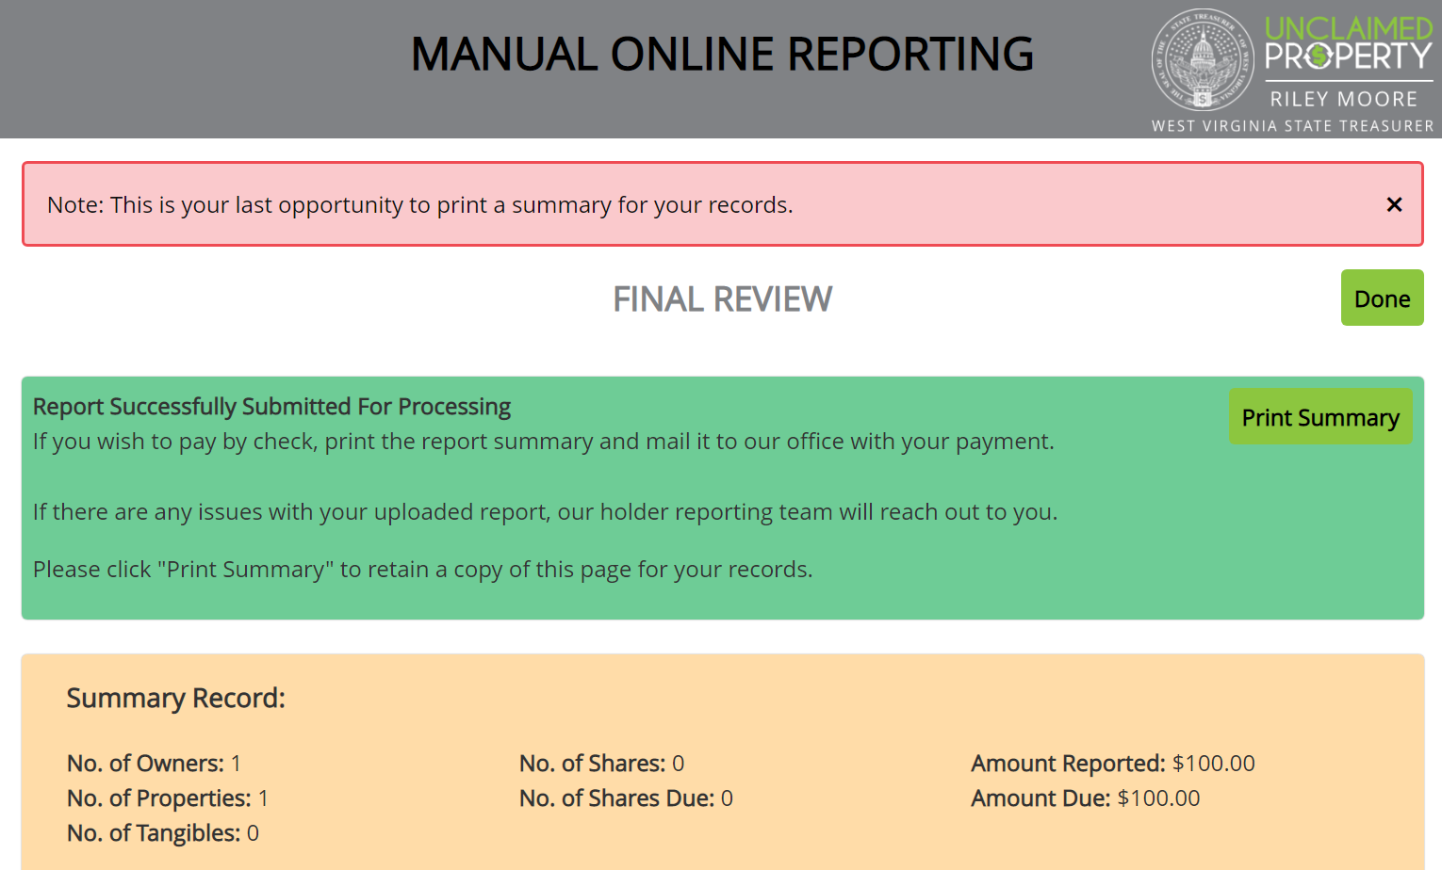
Final Review / Print
Print this summary for your records instead of the NAUPA file

Slide 34
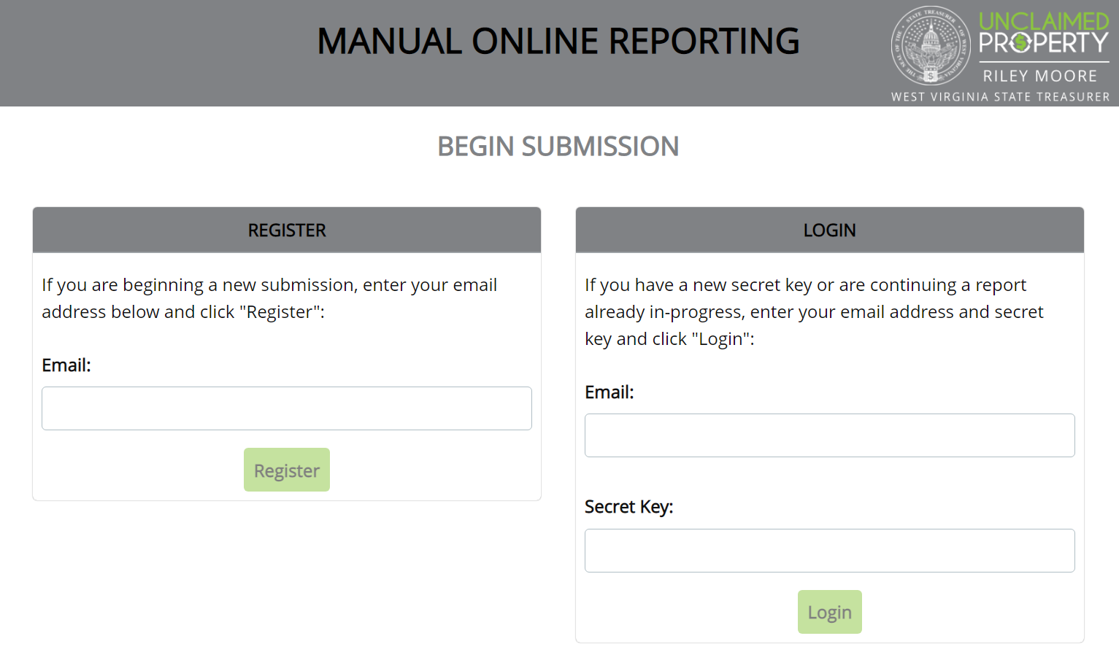
Return to Begin Submission page
Filing a new report requires starting over from the beginning and requesting a new Secret Key

Slide 35
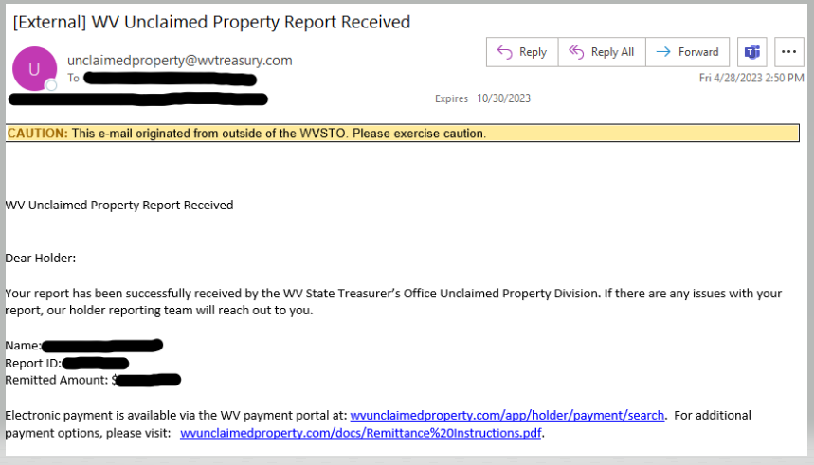
Email Confirmation
Email confirmation should be received by the following business day

Slide 36
Remit Payment
Payment is accepted via:
Online Payment portal
Electronic Check
Credit / Debit Card
ACH Credit
Paper Check
Debit Payments are accepted for $100,000 maximum dollar amount

Slide 37
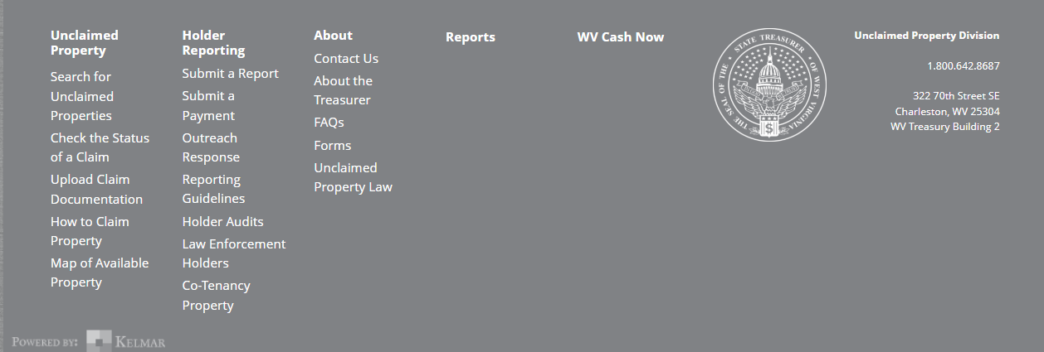
Payment Portal

Slide 38
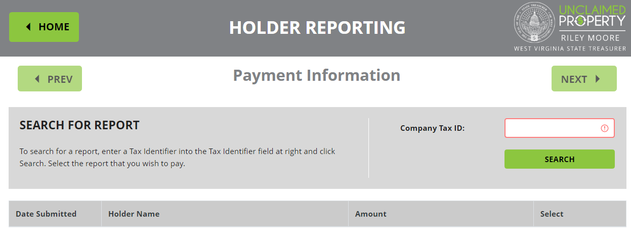
Enter FEIN to find Report

Slide 39
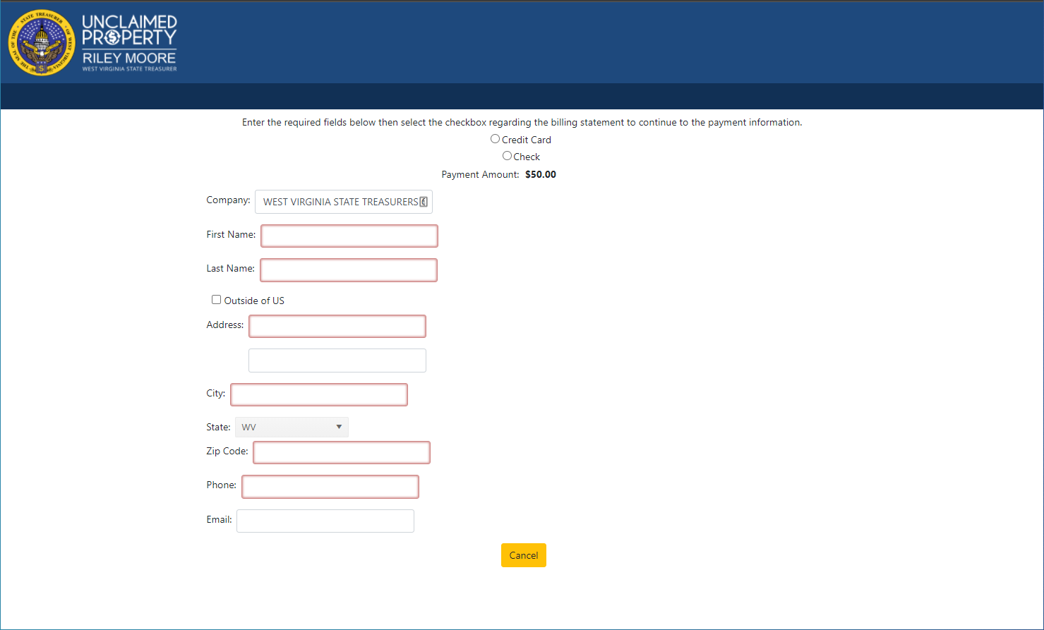
Follow steps to complete payment
You must select Credit Card or Check and enter Card number or Routing / Account number here

Slide 40

Benefits of Electronic Reports
NO Paper Report
NO Paper Check
Accepted Business Practice
Speed and Efficiency
Reduces Errors
Accuracy
Historical Information readily available
Mandated by law

Slide 41

Extensions – Why & When
Ensures Compliance
Establishes “good faith”
Reduces audit risk
Must be filed 30 days before the reporting deadline

Slide 42

Reasons to Request an Extension
Technology changes or updates
Change in Personnel
Disaster: Flood, Earthquake, Pandemic
*Forgetting to complete due diligence can NOT be used to request an extension*

Slide 43
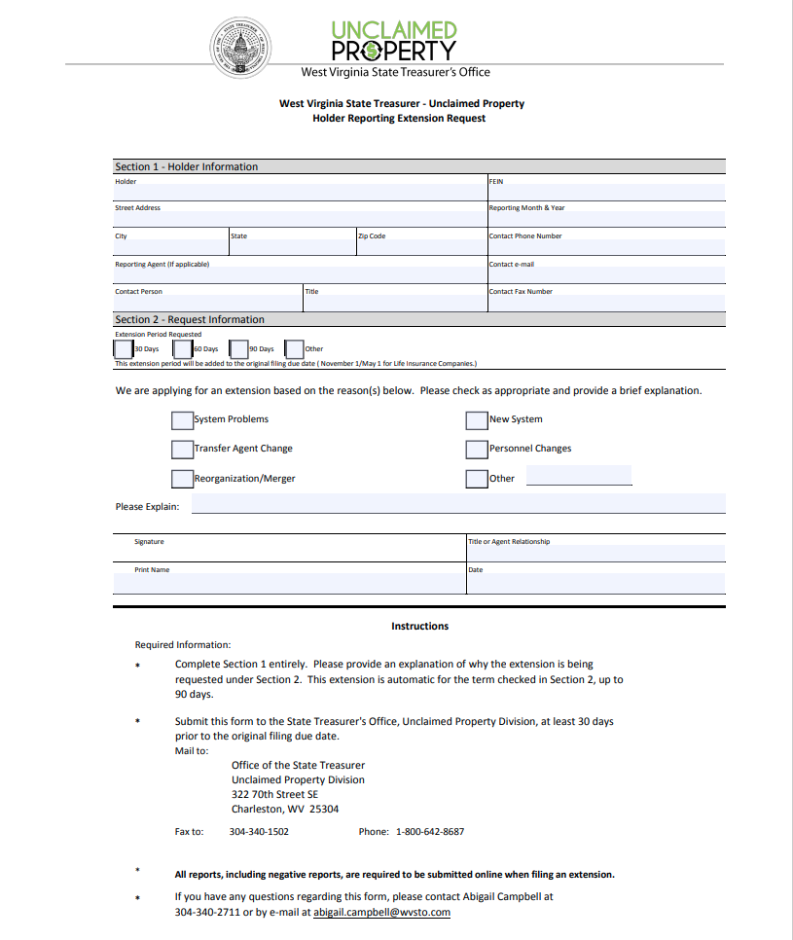
Filing the Extension
Form is on “Reporting Guidelines” website page
Fill out and email or fax to Maegan Trout
Extensions can be requested for 30, 60, or 90 days

Slide 44
Types of Claims
Customer / Owner Claims
Business Claims
Holder Reimbursements

Slide 45
Customer / Owner claims
Payee or their heirs contact you. You have already reported the property. What do you do??
Direct them to call our office at 1-800-642-8687
Direct them to our Website: wvunclaimedproperty.com

Slide 46
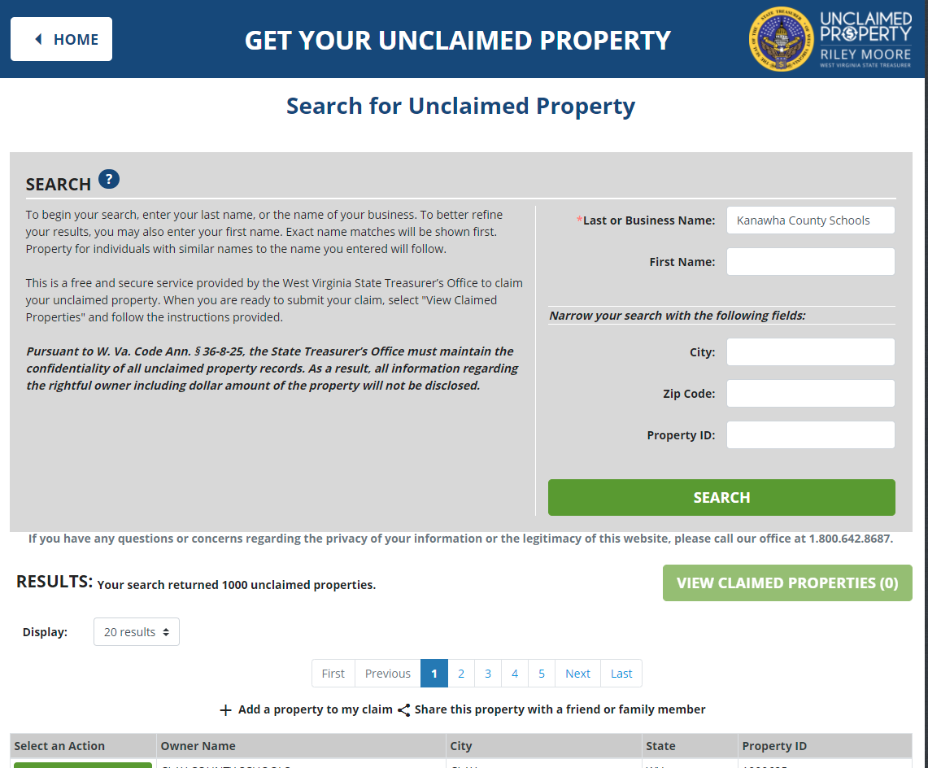
Claims for your School or County / Business Claims
Search the Website for your entity name:

Slide 47
Business Claim
Follow remaining steps
Email will be sent detailing next steps. Mail in:
Notarized Claim Form
Photo ID for business representative
Proof of representative’s relationship to business
Proof of Tax ID (cannot be a W-9 form)
Other information may be required, based on type of property

Slide 48

Holder Reimbursement
Item was reported in error
Check was mailed for the incorrect amount
You would like to pay the customer instead of having them claim from us

Slide 49
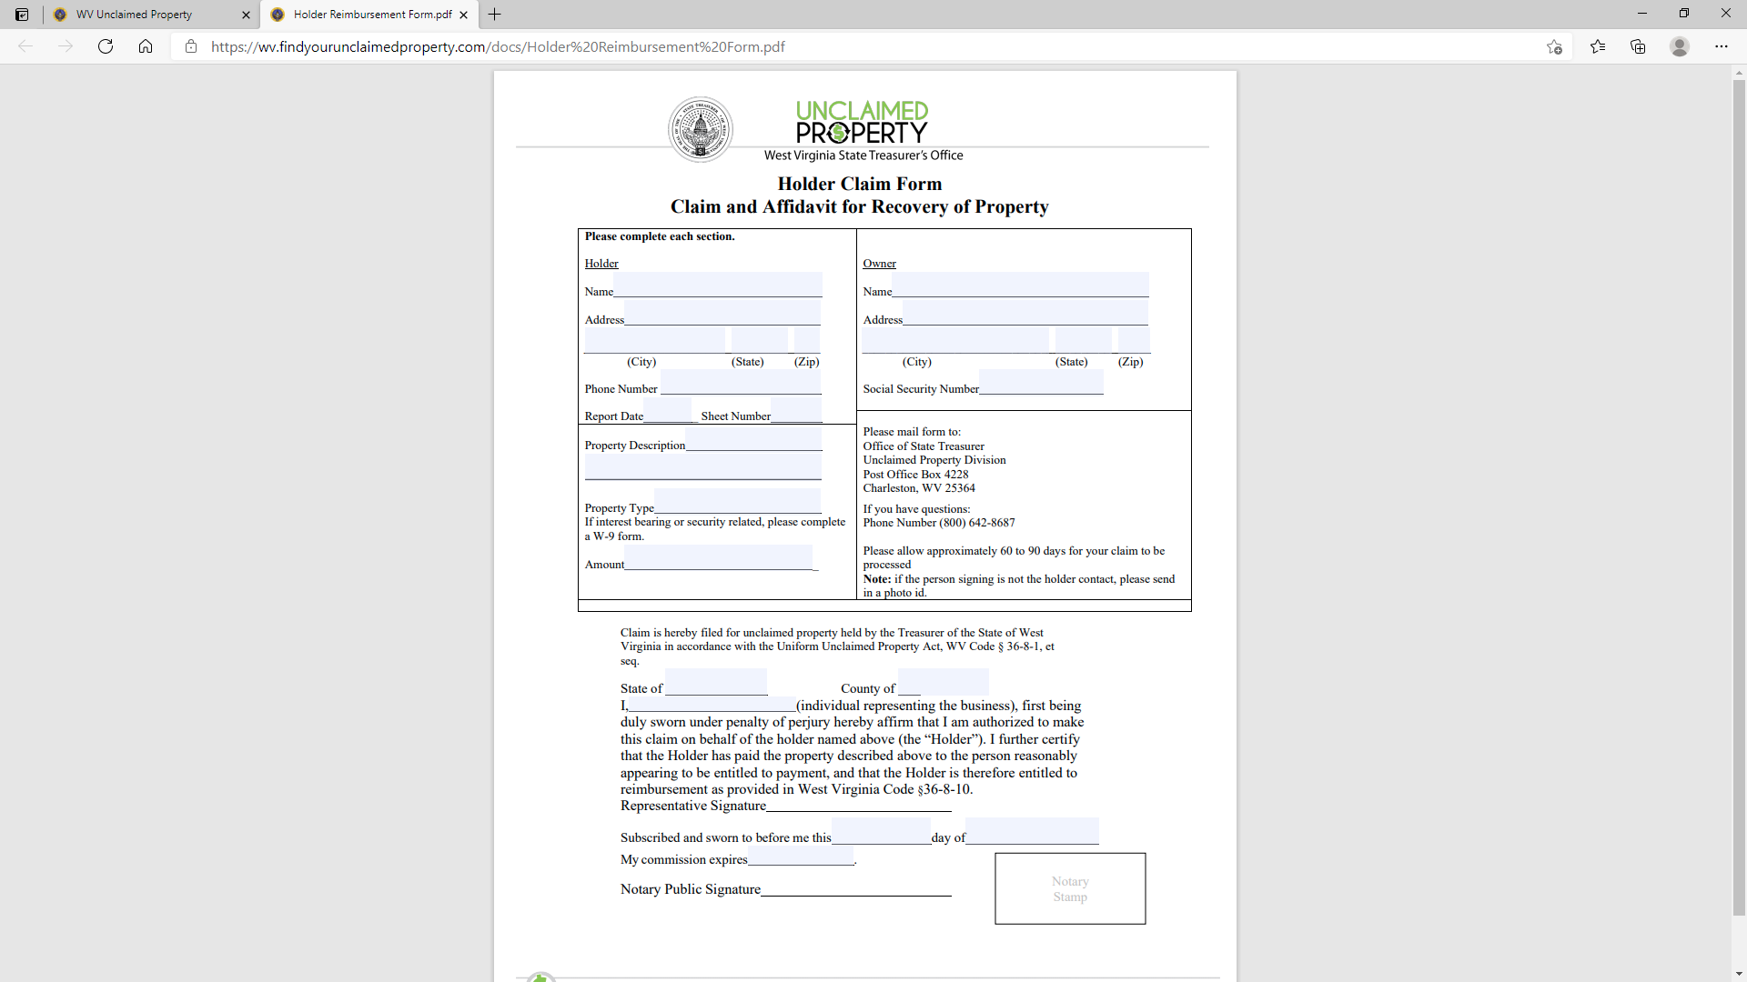
Holder Reimbursement Form
Enter Holder and Owner information – As it was entered on your report
Form must be notarized

Slide 50

Contact Information - Reports
Maegan Trout
Receipts Manager
Eholder_Support@wvsto.com
(304) 340-1571

Slide 51

Questions

