Slide 1
STATEWIDE CONTRACTS
Local Governments Informational Seminar

Slide 2
Objectives
Recognize the benefits of statewide contracts to local government entities
Understand purchasing procedures related to statewide contracts
How to locate statewide contracts

Slide 3
Statewide Contracts
Contract between the state and vendor which is used by state agencies and some political subdivisions to purchase frequently used commodities and services
Bid and managed by the Purchasing Division
Notes:
State purchasing card shall not be used to circumvent purchases from established contracts

Slide 4
Statewide Contracts
Benefits of using statewide contracts
  Quick (Available to use right now)
  Cost savings (The volume savings over the life of the contract)
  Easily accessible
  Efficiency in the procurement process
  Reduces Soft Costs?
    Mitigate risks!
      All vendors on SWC’s are properly vetted with SOS, Tax, Workers Comp, Fed % State Debarments.
    Time is money!

Slide 5
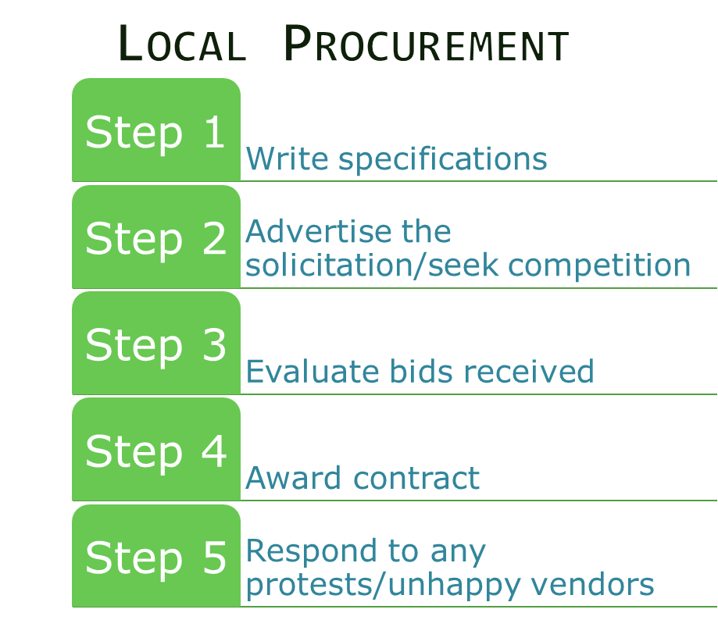
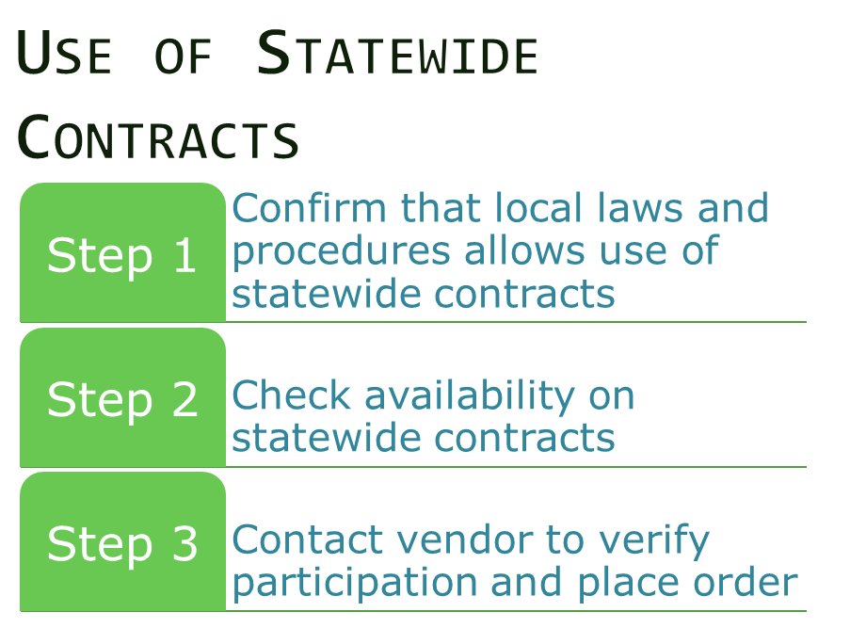
Local Government entity defines a need… What Happens Next?
Notes:
Waiver from WVARF and Correctional Industries must be sent to the Purchasing Division, or maintained in the agency file.

Slide 6







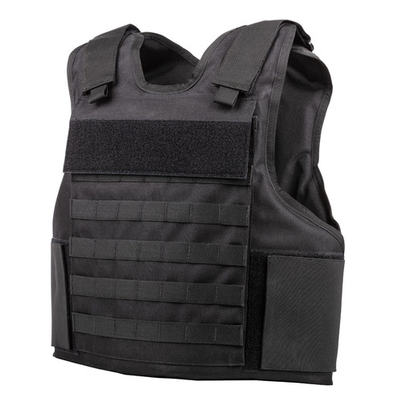


Commodities and services covered by statewide contracts
Notes:
Anyone who wants set up with an Amazon Business Prime account can email purchasing.training@wv.gov

Slide 7
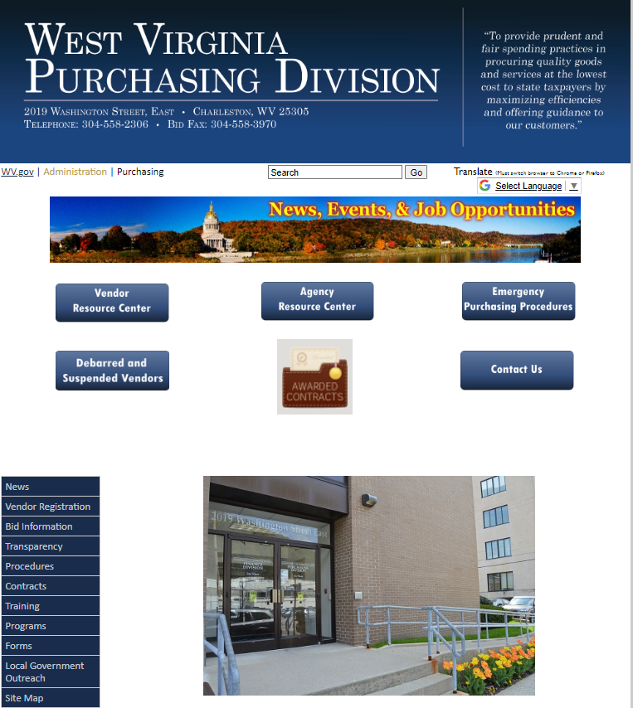
How Can I view the statewide contracts bid and maintained on behalf of local governments?
At WVPurchasing.gov, click on the “Local Government Outreach” tab

Slide 8
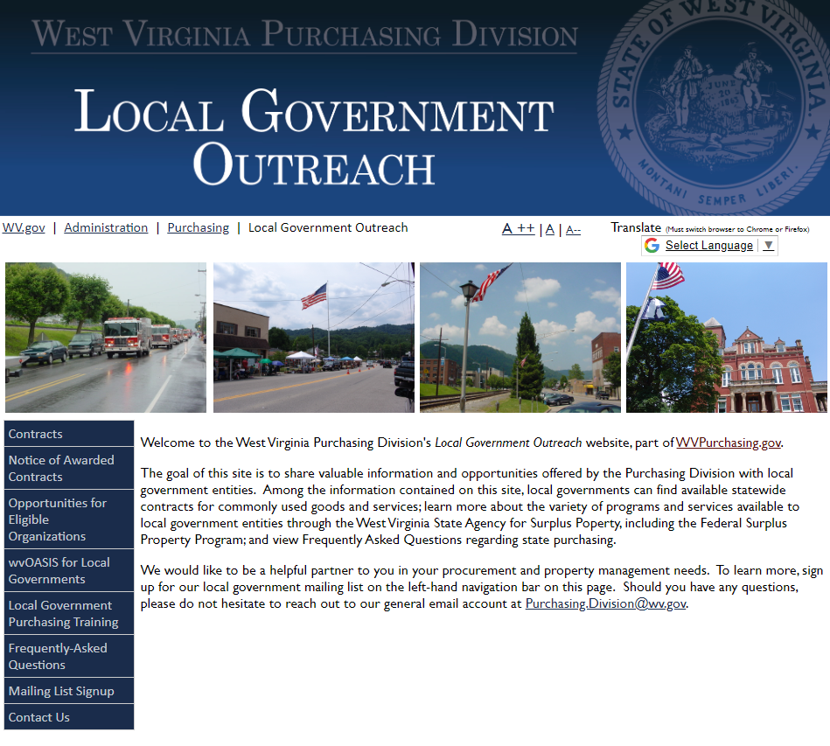
From there, click on the “Contracts” tab

Slide 9
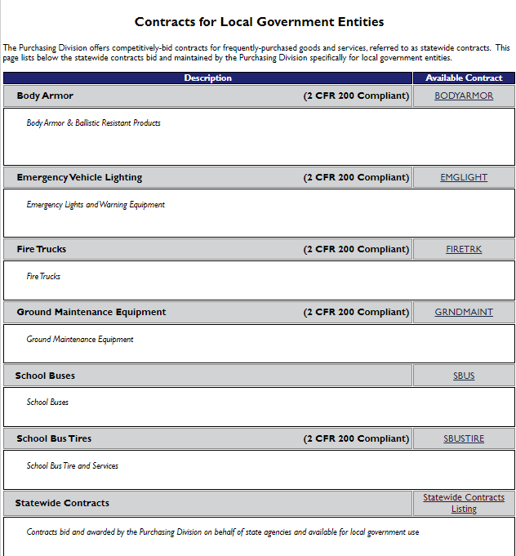
The hyperlinked contract name takes you to the contract page

Slide 10
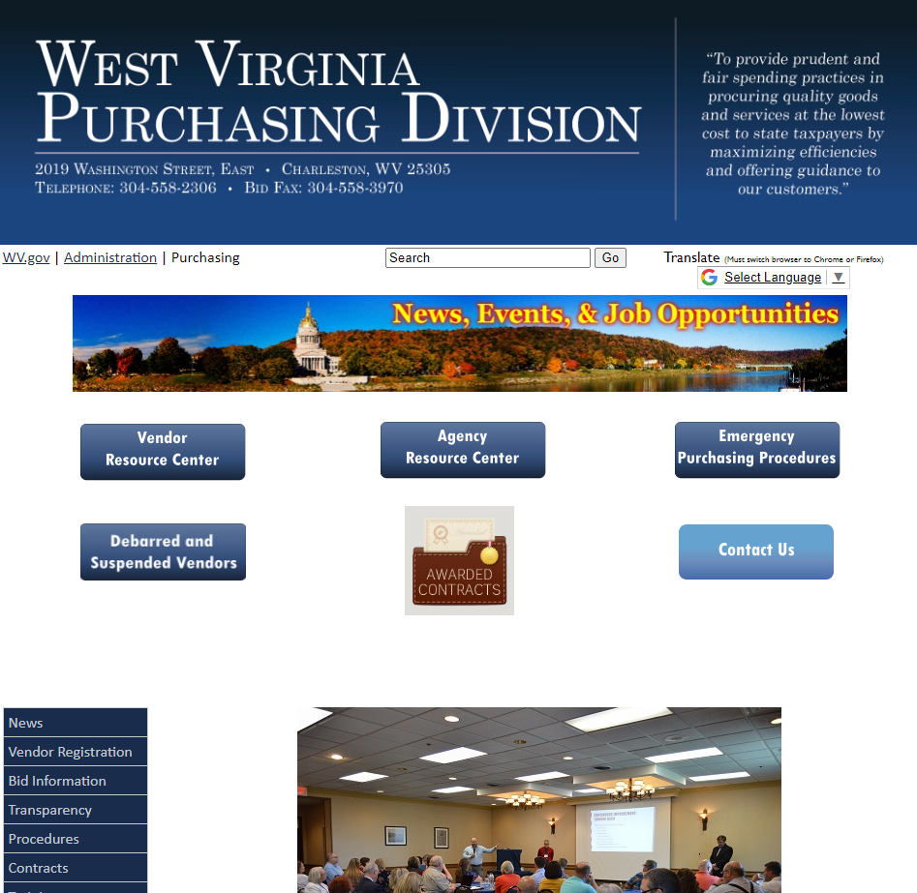
How Can I view the statewide contracts?
At WVPurchasing.gov, click on the “Contracts” tab

Slide 11
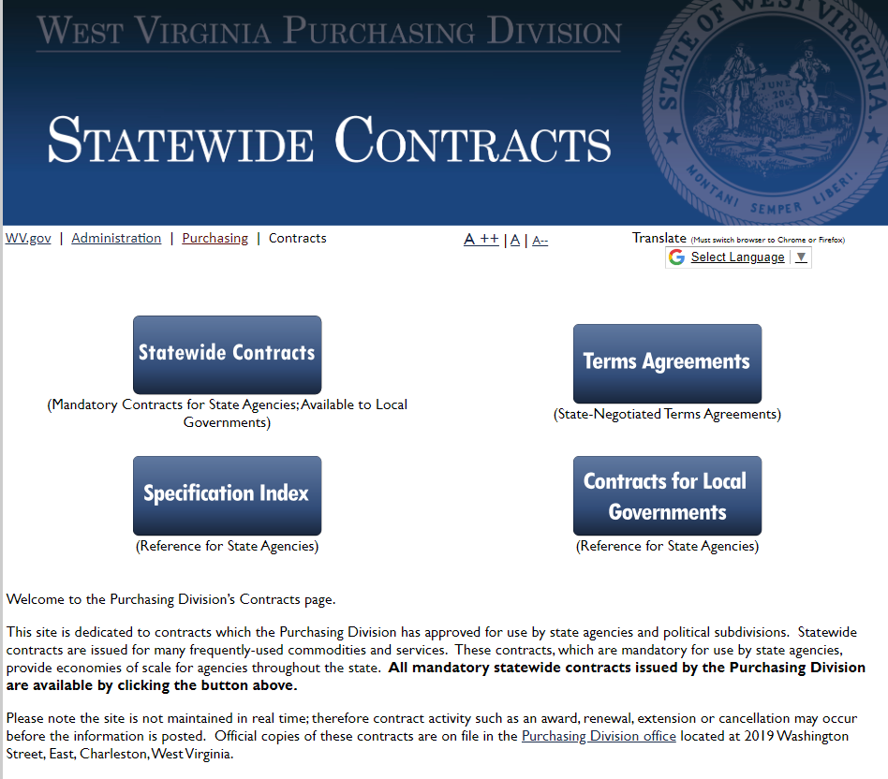
From there, click on the “Statewide Contracts” button

Slide 12
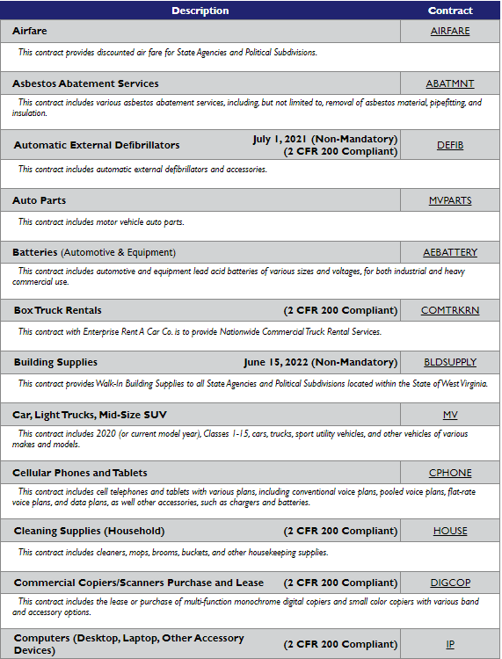
The hyperlinked contract name takes you to the contract page

Slide 13
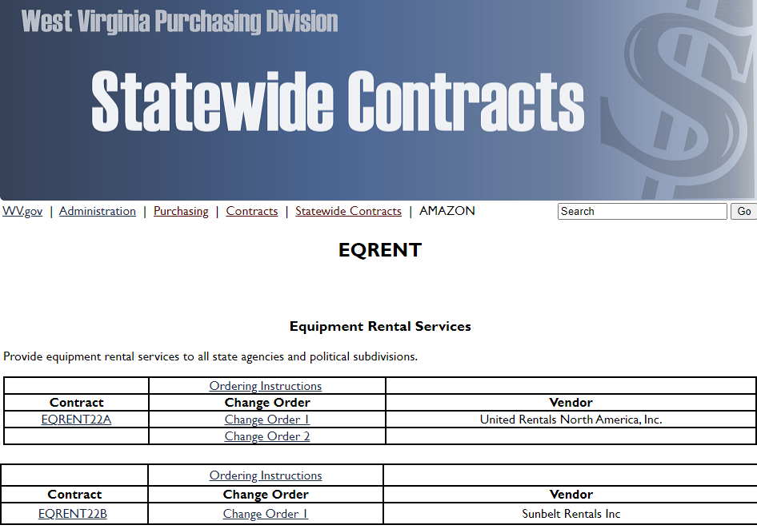



This is what the contract page looks like
1. Contract Name – refer to this name when contacting the vendors if interested in using the contract.
2. Look for any change orders issued on the contract. Change orders may renew/extend the contract, change pricing, make corrections or change the vendor contact information.
3. Ordering Instructions - Detailed information about placing an order on the contract. This may only be applicable to the State agencies, however, the vendor contact information will be provided.

Slide 14
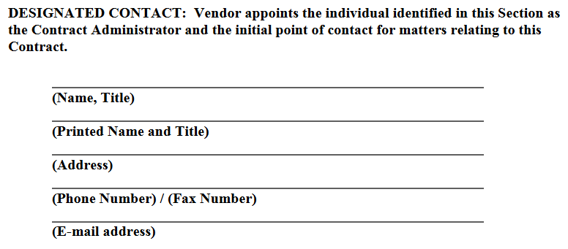
Within each contract is a designated contact for the vendor

Slide 15
Questions about statewide contracts?

Slide 16
Contact US
West Virginia Purchasing Division
Mark Atkins
Buyer Supervisor
304-558-2307
Mark.A.Atkins@wv.gov
Toby Welch
Senior Buyer
304-558-8802
Toby.L.Welch@wv.gov

