Slide 1
WVBE Policy 2419
Overview of Revisions and Changes
Effective March 2023

Slide 2
Policy 2419 Revisions
Last revised in August 2017
Revised Effective November 14, 2022
New revisions in effect - March 2023
Current revision necessitated by:
Contemporary legislation and case law
Guidance from technical assistance centers
Guidance from Office of Special Education Programs (OSEP)
Stakeholder input
Updated internal practices
Updated 2/6/23

Slide 3
Policy 2419: Comment Period
318 comments received during initial public comment period
32 comments received following a stakeholder meeting regarding the changes to the developmental delay category
Many comments received pertained to overlapping issues or concerns
More than 100 comments received resulted in further changes and revisions to the originally proposed policy to reflect stakeholder input
https://apps.sos.wv.gov/adlaw/csr/readfile.aspx?DocId=55901&Format=PDF

Slide 4
Policy 2419: Comment Period
Comments were received from the following groups:
Attorneys
Educational Diagnosticians
Education Recovery Specialists
Advocacy Specialists
LEA Coordinators
  (psychological services, special education, preschool special needs)
Speech-Language Pathologists
School Psychologists
Directors of advocacy centers
Directors of Special Education
Directors of Early Childhood Programs / Preschool
LEA Board of Education staff
Special Education Specialists
Library Media Specialists
Teachers and Co-Teachers
Special Education Teachers
Visual Impairment Teachers
Gifted Teachers
Occupational Therapists
Retired Teachers
Parents
Citizens
Others

Slide 5
Changes at a Glance
Updates related to:
  Policy language and terminology, including provisions related to charter public schools
  Procedural changes
  Alignment of language with federal, state, and board policy, as well as case law
  Glossary and acronym lists
  Glossary has been moved to the front of the document
  Clarifications of existing policy content

Slide 6
Changes at a Glance
Updates related to:
  Eligibility criteria and language for certain disability categories
    Visual impairment, developmental delay, emotional disturbance, specific learning disabilities, speech or language impairment
  IEPs, caseloads, special education services, and related procedures
  LRE and classrooms
  Waivers
  Typographical, formatting, and technical revisions

Slide 7
Legislative Rule 126 CSR 16
Inclusion of charter public schools, and private schools where students are placed at expense of the State
Added definitions of:
  Local Educational Agency (LEA)
  Parent
  Adult Student
Minor Changes related to filing and effective dates, format, style, and terminology

Slide 8
Acronyms and Abbreviations
Added
APRN - Advanced Practice Registered Nurse
DARF - Disciplinary Action Review Form
ECCAT - Early Childhood Classroom Assistant Teacher
GEFT - General Education: Full-Time
GEPT - General Education: Part-Time
PEP - Personalized Education Plan
PA - Physician’s Assistant
WVBE – West Virginia Board of Education
Removed
Various terms that are no longer relevant, or that do not necessarily belong in Policy 2419

Slide 9
Definitions (formerly Glossary)
  Moved to the front of the document after “Acronyms and Abbreviations”
  Removed
  Individualized Family Service Plan (IFSP)
  Consultation
  Day; School Day
  Destruction

Slide 10
Definitions (formerly Glossary)
Added
  Adult Student
  Disability
  Exceptionality
  General Education: Full-Time (GEFT)
  General Education: Part-Time (GEPT)
  Individuals with Disabilities Education Improvement Act of 2004
  Personalized Education Plan (PEP)
  Resource Room
  Self-Contained Special Education Classroom
  Student Assistance Team (SAT)
  Supported Decision-Making (SDM)
  Targeted IEP Review

Slide 11
Definitions (formerly Glossary)
Revised
  Behavior Intervention Plan
  Case Management
  Communication
  Consent
  Co-teaching
  Day
  Early Learning Programs
  Eligible Students with Disabilities
  General Education
  Indirect Services
  Instructional Day
  Local Educational Agency (LEA)
  Meeting
  Placement
  Transition Services
  Most definitions were revised to:
  more accurately reflect the meaning of the term,
  condense the definition for clarity, or
  add clarifications

Slide 12
Introduction
Minor Changes
  Format and style
  Terminology
    Moving toward using “Local Educational Agency (LEA)” rather than “county” or “school district”

Slide 13
Chapter 1:
Free Appropriate Public Education
Inclusion of charter public schools, and private schools where students are placed at expense of the State
FAPE obligations apply to students who have not turned 21 prior to July 1 (previously September 1)
Replaced “standard diploma” with “regular diploma” to be consistent with federal language
Clarified that FAPE ends when a student with a disability has been exited from special education or graduates with a regular high school diploma.
Minor Changes include format, style, terminology, and updates regarding policy language and titles

Slide 14
Chapter 2:
Child Find
Clarifications
“There are no exemptions from Child Find responsibilities during national emergencies or health crises.”
“Charter public schools, acting as their own LEA, are responsible for Child Find within their own schools.”
LEAs should ensure a smooth transition “to the LEA prior to the student’s third birthday” for children receiving services through WVDHHR
A teacher may refer a student suspected of needed special education and related services (previously read, "a parent or other interested party")
“Charter public schools are responsible for this location, identification, and evaluation process for students enrolled in their schools.”

Slide 15
Chapter 2:
Child Find
Clarifications
Students entering K or PK may not require screening if they have passed a relevant screening previously
SAT should receive annual training in all relevant procedures
Student needs should be reviewed at least once per grading period for any student in the SAT process
The options to consider when concluding the SAT process for students referred for multidisciplinary evaluation (i.e., to close the case, or refer student for further evaluation)
Added “social/emotional” to potential student needs in the section on the SAT process
Minor Changes include format, style, and terminology

Slide 16
Chapter 3:
Evaluation / Reevaluation
80-Day Initial Evaluation Timeline Clarification for #1 and #4
The 80-day timeline does not apply to a LEA if:
1. the parent repeatedly fails or refuses to produce the student for evaluation [34 CFR §300.301(d)].
4. LEAs are closed due to weather conditions determined by the county superintendent, and no remote options are required. The timeline will be extended directly proportional to the duration of the weather conditions. Days missed must be clearly documented in the student’s file to accurately record the interruption. If a LEA is closed due to weather conditions with remote learning options, this timeline is not extended.

Slide 17
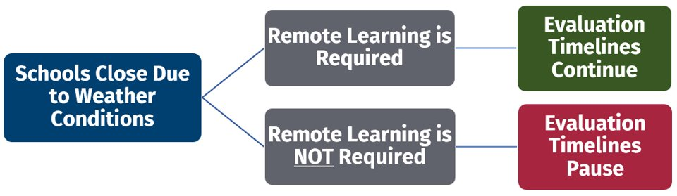
Chapter 3:
Evaluation / Reevaluation
80-Day Initial Evaluation Timeline Clarification

Slide 18
Chapter 3:
Evaluation / Reevaluation
Added under the sources of evaluation data teams may review as part of an initial evaluation:
"1. evaluations and information provided by the parent/adult student;
2. data regarding the student’s response to scientific evidence-based and/or research-based interventions using:
a. current classroom-based assessments and classroom-based observations;
b. observations by teachers and related service providers;
c. results from statewide and LEA-wide testing; and/or
“3. current evaluations received or on file in the LEA that are less than three years old for a student who was formerly entitled to special education services, exited public school due to home schooling, and is re-enrolling in the LEA. In this case, a review of existing evaluation data should expedite the eligibility determination.”

Slide 19
Chapter 3:
Evaluation / Reevaluation
Clarification - Timeline when Additional Testing is requested:
“The 60-day timeline will be extended for an LEA over summer break. The timeline will stop on the last day of instruction for the school year and resume on the first instructional day the following school year.”
Made the following statement its own numbered bullet point under Evaluation Procedures and Instruments
  “e. For a child who is deaf or hard of hearing, a comprehensive language assessment in the child’s language and communication mode must be included in his/her comprehensive evaluation”
Minor Changes include format, style, and terminology

Slide 20
Chapter 4:
Eligibility
Removed redundant bullet from the three prongs of eligibility under Section 1. Eligibility Determination
“4. No longer meets the eligibility criteria or no longer needs specially designed instruction.”
Added “advanced practice registered nurse (APRN), physician assistant (PA)” as additional clinical professionals who can render medical diagnoses for the categories of Autism, Orthopedic Impairment, Other Health Impairment, and Traumatic Brain Injury
A. Autism
Added “also referred to as Autism Spectrum Disorder (ASD)” to the definition to be consistent with contemporary terminology

Slide 21
Chapter 4:
Eligibility
B. Blindness and Low Vision
Modified Definition of Visual Impairment to ''Visual impairment including blindness means an impairment in vision that, even with correction, adversely affects a child’s educational performance. The term includes both partial sight and blindness."
Removed qualifiers under examples.
Changed acuity requirement to "decreased visual acuity even with corrections, and changed visual field qualifier to "a visual field restriction."
C. Deafblindness
Added “or neurologist” as an additional clinical professional who can render vision loss diagnoses

Slide 22
Chapter 4:
Eligibility (Developmental Delay)
The definition has been revised as follows to allow more flexibility in assessment:
“Developmental delays occur in students, ages three through five, who are functioning at, or lower than, 75 percent of the normal rate of development, or who perform 1.5 standard deviations or more below the mean in consideration of 1.0 standard error of measurement on a standardized evaluation instrument, in two or more of the following areas:”

Slide 23
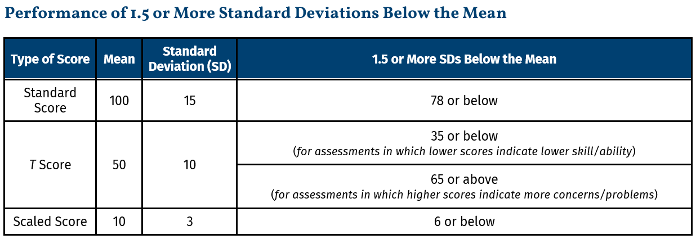
Chapter 4:
Eligibility (Developmental Delay)

Slide 24
Chapter 4:
Eligibility (Developmental Delay)
In response to stakeholder input from various groups, the age range for Developmental Delay has been expanded as follows:
Effective July 1, 2023, the age range defined for developmental delay will be extended to include ages three through six.
  (i.e., up to age seven)
Effective July 1, 2024, the age range defined for developmental delay will be extended to include ages three through seven.
  (i.e., up to age eight)
Updated 2/6/23

Slide 25
Chapter 4:
Eligibility (Developmental Delay)
Further, Special Consideration # 7 now states students who are eligible for developmental delay during the 2022-2023 school year after the Policy 2419 effective date shall remain eligible through the end of the school year during which the student turns 6.
For example, a student eligible for developmental delay who turns six in January 2023 can remain eligible for services until the end of the school year, rather than exiting or reevaluating the student by the student’s sixth birthday.

Slide 26
Chapter 4:
Eligibility (Developmental Delay)
Special Considerations # 3 and # 4
Removed the option to develop or use an Individual Family Service Plan (IFSP) - an IEP is now the only option
Special Consideration # 7
Revised to reflect the age range expansion rollout
Three more special considerations (8, 9, and 10) have been added to add clarifications and specify limitations of the age range expansion

Slide 27
Chapter 4:
Eligibility (Developmental Delay)
Special Consideration #7
“At the end of the school year during which the student reaches age six (which will change to age seven beginning July 1, 2023, and will change to age eight beginning July 1, 2024), or in cases where the student reaches age six (which will change to age seven beginning July 1, 2023, and will change to age eight beginning July 1, 2024) during the following summer, the student no longer meets the eligibility criteria for developmental delay; therefore, the IEP Team must follow procedures for reevaluation and reconvene the EC prior to the start of the following school year during which the student would begin at age six (which will change to age seven beginning July 1, 2023, and will change to age eight beginning July 1, 2024) to determine if the student meets eligibility under another exceptionality or will no longer be eligible for special education services”.
Updated 2/6/23

Slide 28
Chapter 4:
Eligibility (Developmental Delay)
Special Consideration #8
Initial eligibility under the category of developmental delay must be determined before the student’s sixth birthday.
    That is, a student may not undergo initial evaluation at age six or older and be identified as a student with a developmental delay.
Special Consideration #9
Other disability categories should be considered if the EC can make a clear and conclusive determination under another category besides developmental delay.
    That is, if a student’s difficulties are better explained by another disability category, and the student meets the specific criteria for that category, then that category should be used instead of developmental delay.

Slide 29
Chapter 4:
Eligibility (Developmental Delay)
Special Consideration #10
As is the case for all students with disabilities, students served under developmental delay are entitled to benefit from intervention and supports provided through an MTSS framework in addition to special education and related services, particularly if eligibility under SLD may be considered in the future; tiered intervention, intervention documentation, and frequent progress monitoring are critical for the determination of SLD.
  That is, a student served under the category of developmental delay who is approaching the age limit must still meet the criteria for any other category as stated in WVBE Policy 2419 for the student to become eligible under a different category.

Slide 30
Chapter 4:
Eligibility (Developmental Delay)
Certification and the Age Range Expansion
For students in pre-k, special education services can be provided by:
Special educators with a Preschool Special Needs endorsement (4120, 4121, 4122)
Special educators with a Developmental Delay endorsement (4123)
For students in kindergarten, special education services can be provided by:
Special educators with a Preschool Special Needs endorsement (4120, 4121, 4122)
Special educators with a Developmental Delay endorsement (4123)
Special educators with a Multi-Categorical (4115) endorsement
For students in first or second grade, special education services can be provided by:
Special educators with a Developmental Delay endorsement (4123)
Special educators with a Multi-Categorical (4115) endorsement
Updated 2/6/23

Slide 31
Chapter 4:
Eligibility
“Emotional/Behavioral Disorder” has been renamed "Emotional Disturbance" for consistency with federal language
The definition and criteria are unchanged
Reference to “WVEIS on the Web Interventions Tab” has been removed
L. Specific Learning Disability
Added “mental health” to the needs potentially addressed by MTSS
Added “The determination of eligibility for SLD services should be made using an MTSS framework.”
Removed the language related to the MTSS process as this content is more appropriate for inclusion in guidance documents rather than board policy

Slide 32
Chapter 4:
Eligibility (Speech or Language Impairment)
M. Speech or Language Impairment
Changes
Changed the eligibility category title to “Speech or Language Impairment” from “Speech/Language Impairment”
Moved all speech-language charts, resources, and developmental norm information from the Appendices to the Speech-Language Pathology Services in West Virginia Schools: Guidance for West Virginia Schools and Districts, 2022
Reorganized all Speech or Language Impairment Eligibility Criteria to correlate with the three prongs of eligibility

Slide 33
Chapter 4:
Eligibility (Speech or Language Impairment)
M. Speech or Language Impairment
Changes
Added Summary Assessment Forms for Speech Sound Disorders, Language Disorders, Child Onset Fluency Disorder, and Voice Disorders
“Comprehensive Assessments” are expected for all five areas of eligibility

Slide 34
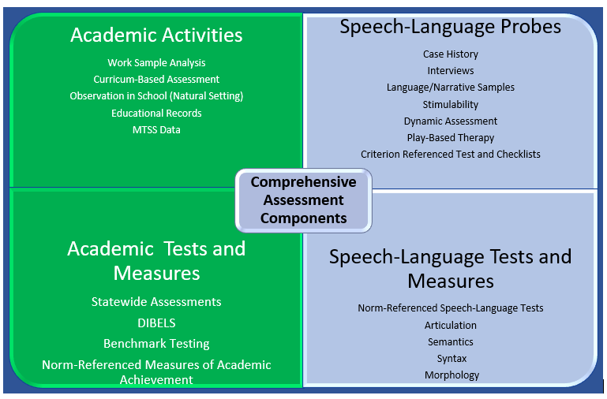
Chapter 4:
Eligibility (Speech or Language Impairment)

Slide 35
Chapter 4:
Eligibility (Speech or Language Impairment)
Eligibility Criteria
1. Diagnostic information demonstrates the disorder or impairment. (S-L Probes and Standardized S-L Tests and Measures);
2. Adverse impact on educational, vocational, or social-communicative performance (Academic Activities and Academic Tests and Measures); and
3. Need for specially-designed instruction.
Three-Pronged Eligibility
meets the state eligibility criteria in one of the designated exceptionalities:
experiences an adverse impact on educational performance; and
needs special education (specially designed instruction).

Slide 36
Chapter 4:
Eligibility (Speech or Language Impairment)
Language Disorder
Changes
Added the updated categorization terminology of “form, use, and content” to the Language Disorder: Diagnostic Criteria definition
Updated the onset of Language Disorder to include not on the early developmental period, but when “academic language demands in the classroom increase”
Added the use of a “Functional Communication Summary” for students who cannot participate in the assessment process

Slide 37
Chapter 4:
Eligibility (Speech or Language Impairment)
Language Disorder – Eligibility Criteria
Simplified the description of acceptable diagnostic accuracy for standardized language assessments
Updated the statement at the beginning of the Eligibility Criteria section to include current terminology
  “Following consideration of the child’s age, culture, language background, or dialect, an EC will determine that a student is eligible for special education and/or related services as a student who has a language disorder when the following criteria are met.”

Slide 38
Chapter 4:
Eligibility (Speech or Language Impairment)
Language Disorder – Eligibility Criteria – Continued
(Provided speech-language pathologist the ability to use professional judgement to select the Comprehensive Assessment Components to address the individual needs of each student.)
“1. Three or more speech-language probes or standardized speech-language assessments as listed below are performed as part of the comprehensive language evaluation process. For students who cannot participate in the assessment process, consider the use of the Functional Communication Assessment Summary – see Speech-Language Pathology Services in WV: Guidance for West Virginia Schools and Districts. A student with a language disorder exhibits at least three of the following characteristics of a through e:”

Slide 39
Chapter 4:
Eligibility (Speech or Language Impairment)
Language Disorder – Eligibility Criteria – Continued
assessment on a composite norm-referenced test of both receptive and expressive language with a diagnostic accuracy (sensitivity/specificity) of 80 percent or higher yields one or more composite scores that align with those who have a language disorder based on the test publisher’s recommended cut score. Note: Only composite test scores may be used. Individual subtest scores may not be considered;
language sample analysis results in a score of at least 1.5 standard deviations or more below similar-aged peers (e.g., +/- 6 months) at least two measures of productivity and/or complexity;

Slide 40
Chapter 4:
Eligibility (Speech or Language Impairment)
Language Disorder – Eligibility Criteria – Continued
dynamic assessment (test-teach-retest) that demonstrates limited or very limited improvement (see Speech-Language Pathology Services in West Virginia Schools: Guidance for West Virginia Schools and Districts, 2022);
in conjunction with item a (above), norm-referenced test(s) for specific components or processes of language which do not meet the 80 percent diagnostic accuracy, or development scale(s), or criterion-based assessment(s) indicate that the student’s language skills are lower than expected for their age; and/or
case history, observation, parent and teacher interviews, and informal assessment(s) indicate the student has difficulty understanding or expressing ideas or concepts to such a degree that it significantly interferes with social interaction or educational progress, except for preschool, which is a socio-communicative impact.

Slide 41
Chapter 4:
Eligibility (Speech or Language Impairment)
Language Disorder – Eligibility Criteria – Continued
The student’s disability adversely affects educational or vocational performance, or social-communicative performance in the case of preschoolers, as shown by a review of the educational activities and LEA-wide assessments. (See Speech-Language Pathology Services in West Virginia Schools: Guidance for West Virginia Schools and Districts, 2022).
The student needs special education. (Language disorder can be a primary special education or related service.)
    language disorder is not considered the primary disability when the symptoms are attributable to hearing or other impairments that are more appropriately defined under another eligibility category.
    A language disorder is considered a related service when services are required to assist an eligible student with a disability to benefit from special education.

Slide 42
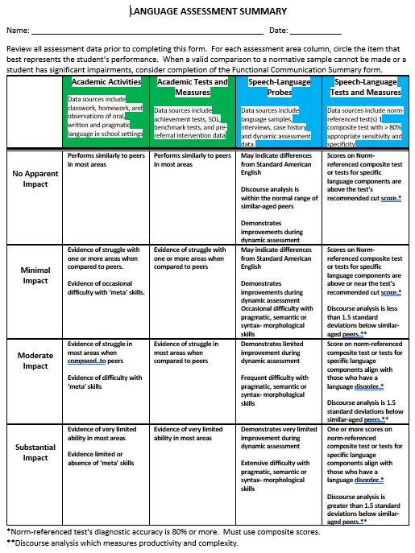
Chapter 4:
Eligibility (Speech or Language Impairment)

Slide 43
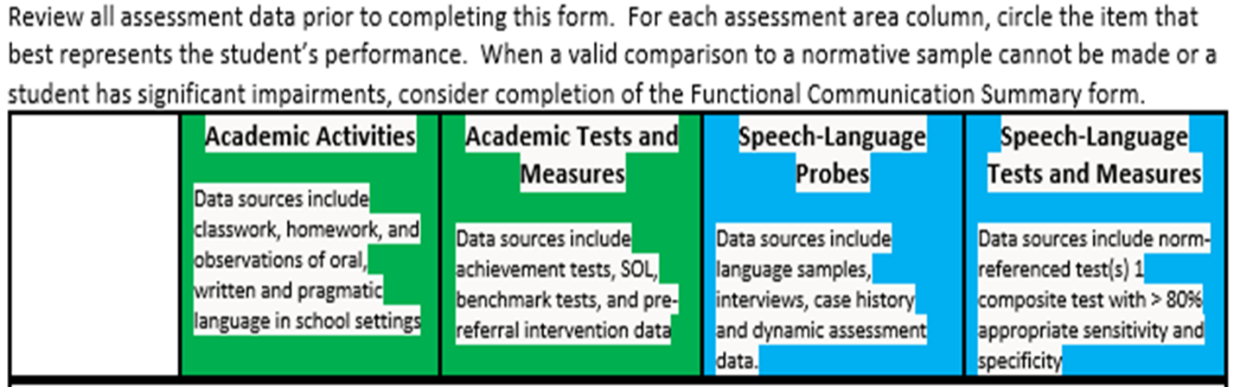
Chapter 4:
Eligibility (Speech or Language Impairment)
Language Disorder – Language Summary Assessment Form Headings

Slide 44
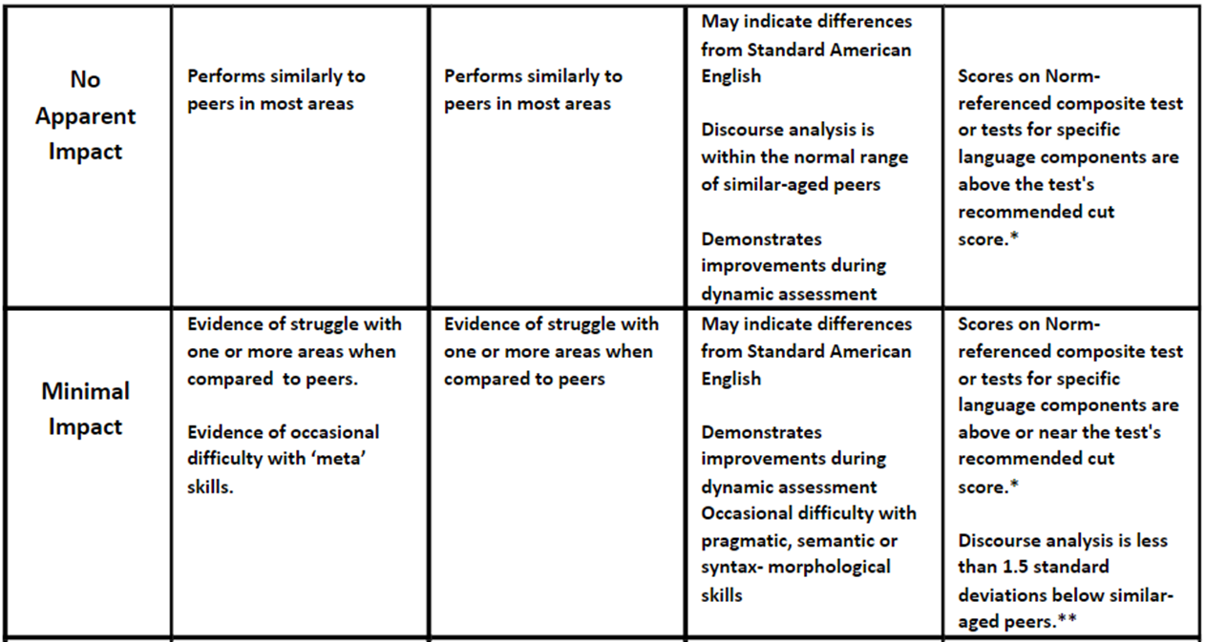
Chapter 4:
Eligibility (Speech or Language Impairment)
Language Disorder - No Apparent or Minimal Impact

Slide 45
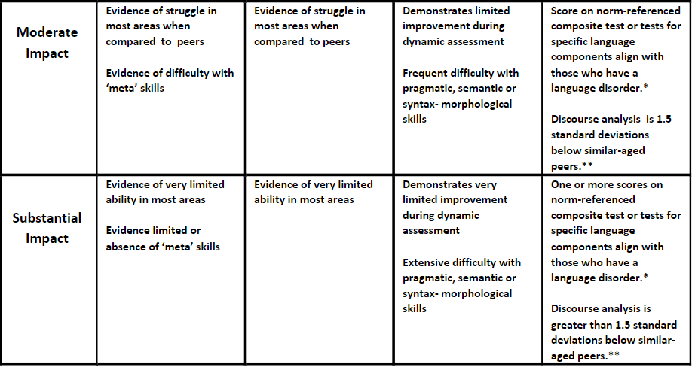
Chapter 4:
Eligibility (Speech or Language Impairment)
Language Disorder - Moderate or Substantial Impact

Slide 46
Chapter 4:
Eligibility (Speech or Language Impairment)
Speech Sound Disorder (Articulation/Phonology Disorder)
Changes
Added the Diagnostic Criteria to include onset of symptoms “after an acquired brain injury”
Updated the characteristics for a Speech Sound or Phonological Disorder
Added the use of a Speech Sound Production Summary
Added the use of a Functional Communication Summary

Slide 47
Chapter 4:
Eligibility (Speech or Language Impairment)
Speech Sound Disorder – Eligibility Criteria
An EC will determine that a student is eligible for special education and/or related services as a student who has a speech sound disorder when the following criteria are met.
1. Three or more speech probes or standardized speech assessments listed below and application of developmental norms (see Speech-Language Pathology Services in West Virginia Schools: Guidance for West Virginia Schools and Districts, 2022) are performed as part of the comprehensive speech sound evaluation process. For students who cannot participate in the assessment process, consider using the Functional Communication Assessment Summary (see Speech-Language Pathology Services in West Virginia Schools: Guidance for West Virginia Schools and Districts, 2022). The student with a speech sound disorder exhibits three of the following characteristics in a through e:

Slide 48
Chapter 4:
Eligibility (Speech or Language Impairment)
  Speech Sound Disorders – Eligibility Criteria
  a. a standardized speech assessment demonstrates three or more phonemic errors not expected at the student’s current age or developmental level are observed during direct testing and/or conversational speech;
  b. one or more phonological processes designated on the Speech Production Assessment Summary (see Speech-Language Pathology Services in West Virginia Schools: Guidance for West Virginia Schools and Districts, 2022) as a moderate to substantial are observed during direct testing and/or in conversational speech;
  c. the student is less than 59 percent stimulable for age-appropriate phonemic errors as listed on the Speech Production Assessment Summary (see Speech-Language Pathology Services in West Virginia Schools: Guidance for West Virginia Schools and Districts, 2022);
  d. the student’s speech intelligibility is below the expected range and not due to influences of a second language or dialect. Intelligibility ratings as documented by school staff or caregivers indicate an impact across environments (see Speech-Language Pathology Services in West Virginia Schools: Guidance for West Virginia Schools and Districts, 2022); or
  e. Percentage of Consonants Correct is 84 percent or below.

Slide 49
Chapter 4:
Eligibility (Speech or Language Impairment)
The student’s disability adversely affects educational or vocational performance, or social-communicative performance in the case of preschoolers, as shown by a review of educational activities and LEA-wide assessments.
The student needs special education. (Speech sound disorder therapy can be a primary special education or related service.)
  A speech sound disorder is not considered the primary disability when the symptoms are attributable to hearing or other impairments that are more appropriately defined under another eligibility category.
  A speech sound disorder is considered a related service when services are required to assist an eligible student with a disability to benefit from special education.

Slide 50
Chapter 4:
Eligibility (Speech or Language Impairment)
Other Areas of Speech or Language Impairment
Changes
Childhood Fluency Disorder
  Added the definition, diagnostic criteria, and eligibility criteria for “Cluttering”
  Removed the use of the Suggested Guidelines for Fluency as Eligibility Criteria
Voice
  Changed Voice Rating Scale to “an age-appropriate voice rating scale”
Social (Pragmatic) Communication Disorder
  Removed “Pragmatic” from the label and used “Social Communication Disorder (SCD)” to align with the American-Speech-Language and Hearing Association(ASHA) terminology
  Added a statement that SCD is a primary disability and not a related service.

Slide 51
Chapter 5:
Individualized Education Programs (IEP)
Clarifications
The age at which transition planning must begin is now 14 years old
IEP Team members participating through an alternate method, such as by telephone or virtually, may be documented without signature in the appropriate section
Clarified who can file a written explanation of disagreement with an IEP decision, and to whom that explanation shall be submitted
"WV Code makes a provision that any teacher or other service provider who disagrees with the IEP shall file a written explanation with the district special education director outlining the disagreement."
IEP goals should be “appropriately ambitious”

Slide 52
Chapter 5:
Individualized Education Programs (IEP)
Added
The IDEA, in conjunction with the Endrew F. v. Douglas County School District decision in 2017 by the Supreme Court of the United States, requires that students be provided an educational program that is reasonably calculated to enable a child to make progress appropriate in light of the child’s circumstances. The IDEA and the Endrew F. decision require schools to create IEPs that are appropriately ambitious; thus, allowing every student the opportunity to achieve challenging goals such as those set for non-disabled peers, readying them for post-secondary life based on a student’s unique needs.

Slide 53
Chapter 5:
Individualized Education Programs (IEP)
F. Secondary Transition Services and Summary of Performance
Aligned the definition of Secondary Transition Services with federal language (34 CFR § 300.43)
Rearranged the order of requirements to prioritize that transition planning
  begins with the first IEP in effect when a student is 14 years old;
  is based on data obtained from age-appropriate transition assessments; and
  contains activities and supports based on the individual student’s needs.
Clarified language related to notification to both the parent and student regarding automatic transfer of special education rights to a student upon their 18th birthday
Added language to encourage IEP Teams to review alternatives to guardianship, such as supported decision-making when appropriate

Slide 54
Chapter 5:
Individualized Education Programs (IEP)
F. Secondary Transition Services and Summary of Performance
Moved the Summary of Performance information from Chapter 3 (Re-evaluation) to Chapter 5.
Added clarifying language on timelines for completing a Summary of Performance
  For a student who graduates with a high school diploma, or reaches the 21st birthday, the LEA must provide the student with a summary of performance that includes: the student’s academic achievement and functional performance, with recommendations on how to assist the student in meeting postsecondary goals. An exit meeting to review summary of performance must be conducted no earlier than 45 days, and no later than seven days, prior to graduation or reaching the end of the school year following the student’s 21st birthday.

Slide 55
Chapter 5:
Individualized Education Programs (IEP)
Section 2. IEP Development
G. Statement of Special Education and Related Services
  Clarified that IEPs should also enable the student to make progress in career and technical education coursework offered outside the school of record
  Added to the “Special Education Services” bullet
    In the case of assistive technology services, the indirect service may include collaboration with the individuals responsible for the provision of services described in the IEP to directly benefit the student. Indirect services include, but are not limited to selecting or designing materials and/or activities, monitoring behavior management plans, programming assistive technology devices, or evaluating student progress on short-term objectives.
  Added examples of “blood glucose or seizure monitoring devices” to the list of exceptions to what qualifies as a related service

Slide 56
Chapter 5:
Individualized Education Programs (IEP)
I. Statewide and LEA-wide Achievement Testing
Added
“Accommodation needs for statewide testing must align with documented and justified accommodations in the supplementary aids, services, and program accommodations, modifications and supports section and/or in the PLEPs section of the IEP and must be part of the daily instructional and assessment routines in the classroom.”

Slide 57
Chapter 5:
Individualized Education Programs (IEP)
J. Least Restrictive Environment (LRE) Considerations and Placement Decisions
Added
“For the purposes of compliance with W. Va. Code §18-20-11, video cameras are required in certain special education classrooms. A self-contained Special Education Classroom is defined as a classroom where students with the most significant disabilities with similar needs receive instruction in all academic subjects for a least 60 percent of the student’s time.”

Slide 58
Chapter 5:
Individualized Education Programs (IEP)
Section 3. IEP Reviews
B. IEP Amendments
  Added
  “The amendment process should be used only when minor changes to the IEP are warranted. The need for more substantial changes should result in scheduling an IEP Team meeting.”
C. Other IEP Reviews
  Added
  “Targeted IEP Meetings – a Targeted IEP review may be conducted when only a portion of an IEP requires review or modification (example: reviewing only the behavior PLEPs/goals/behavior plans of an IEP that also addresses academic areas). Conducting a Targeted IEP meeting does not change the Annual Review meeting date.”

Slide 59
Chapter 5:
Individualized Education Programs (IEP)
Section 4. IEPs for Transfer Students
B. Transfer from an Out-of-State School
  Added
  When a LEA receives an out-of-state IEP with platform-embedded assessment accommodations (e.g. text-to-speech), the receiving LEA must enter those accommodations in WVEIS using the Temporary Assessment Accommodations Entry System (TAAES) application. Once West Virginia eligibility for special education services has been determined, the LEA must remove the information previously entered in the TAAES program.

Slide 60
Chapter 5:
Individualized Education Programs (IEP)
Individual Family Service Plans (IFSPs) are no longer allowed for students with disabilities ages 3-5
  An IEP must be initiated by the child's third birthday for eligible students who are transitioning from WV Birth to Three
  Minor Changes include format, style, and other minor clarifications that do not substantially change content

Slide 61
Chapter 6:
Administration of Services
Clarified the regulatory body requiring LEAs to maintain records to show compliance with the IEP
Section 2. Provision of IEP Information
  Added
  Each teacher and provider must be informed of specific responsibilities related to implementing the student's IEP and acknowledgement of receipt must be documented.
  Added
  “The official IEP is the completed version of the IEP that is provided to the parent/adult student at the conclusion of the IEP team meeting. An electronic version of that IEP must be recorded in the online state-approved IEP system. The IEP should be finalized, and each implementer should be given access to the document in the online IEP system at the conclusion of the IEP Team meeting. The online IEP must be finalized and each implementer must be given access to the IEP in the online IEP system within five days following the IEP Team meeting. This finalization and access will allow all IEP implementers the opportunity to review the information necessary for planning and delivery of educational services.”

Slide 62
Chapter 6:
Administration of Services
Section 3. Provision of Services
Clarified where policy applies to students with federally-recognized disabilities, as opposed to using the blanket term “exceptionalities,” which includes students identified as gifted or exceptional gifted
Added to #7
  appropriate grouping of students with disabilities for specially designed instruction based upon meeting the students’ similar social, functional and/or academic needs, as specified in the students’ IEPs and without regard to identified disability; students receiving direct special education services for different content areas should not be grouped together within the same class period.

Slide 63
Chapter 6:
Administration of Services
Section 4. Provision of Staff
Staffing for Case Management/Procedural Accountability
  Clarified that students assigned to service providers includes both duplicated and unduplicated students
“Maximum Limits for Case Management Assignments” table update:
Maximum Limits for Case Management Assignments
Teachers of students with developmental delays grades Pre-K through K | 20 students with IEPs/ See Class Size Requirement Below
Teachers of the gifted/exceptional gifted | 45 50
Speech Therapists | 50 (primary and related service)
Teachers of all other exceptionalities (including developmental delay grades K-2) | 30/ See Class Size Requirement for Instructional Period

Slide 64
Chapter 6:
Administration of Services
Section 4. Provision of Staff
All West Virginia Pre-K classrooms
  Revised, and Added
    “Pre-K special education classrooms require at least one aide two adults, one of whom is a teacher, regardless of the number of students being served. WVBE Policy 2510, Assuring the Quality of Education: Regulations for Education Programs (9.f.3.) details maximum teacher-pupil ratios for Pre-K as requiring one Early Childhood Classroom Assistant Teacher (ECCAT) per classroom.”

Slide 65
Chapter 6:
Administration of Services
Section 4. Provision of Staff
Clarified definition of “integrated classrooms” to include
  “instructed exclusively by the general education teacher.”
Clarified definition of “co-taught classrooms” to include
  “Both teachers should be assigned to the classroom for the full duration of the instructional period. If co-taught classrooms are established in any of the academic subjects of ELA, science, social studies, or mathematics no more than 50 percent of the total class enrollment can be students with disabilities requiring direct IEP services in that academic subject. ”

Slide 66
Chapter 6:
Administration of Services
“Maximum Number of Students Per Classroom for Pre-K Children with Developmental Delays” Table
  ***The stated number of students provides a maximum caseload amount, as specified in Chapter 5, Section 2J: LRE Considerations and Placement Options.
Program | Maximum Students Per Classroom | Staff
Universal Pre-k with Students with IEPs * includes at least 50% of students without disabilities | 20 students per classroom with limit of 10 students with IEPs*** per classroom | 2 staff persons per classroom (1 teacher and 1 additional staff person) with no more than 8 students with IEPs 3 staff persons per classroom (1 teacher and 2 additional staff persons) required for 10 students with IEPs
Special Education Pre-k * includes less than 50% of students without disabilities | 8 students | 1 teacher and 1 additional staff as specified earlier in this section person
 | 9-10 students | 1 teacher and 2 additional staff as specified earlier in this section persons

Slide 67
Chapter 6:
Administration of Services
Clarified language regarding waivers for staffing ratios
“When student numbers exceed staffing ratios or appropriate percentage of special education students in co-taught or integrated classrooms, additional staff must be added or a waiver request must be submitted in writing to the WVDE. Waivers will be considered on a case-by-case basis, which may require an on-site visit, and will remain valid for the current school year only.”
  The following classroom instructional period requirement for gifted was moved to the end of Chapter 6: Special education classroom for students with giftedness. – When gifted services are delivered in a special education setting, no more than 15 students may be scheduled in an instructional period.
  Minor Changes include format, style, and other minor clarifications that do not substantially change content

Slide 68
Chapter 7:
Discipline
Clarified and revised the policies referenced in the introduction to this chapter
Added
  For students with disabilities, the preventive discipline program must include a tiered system of support with Positive Behavior Interventions and Supports (PBIS).
Added
  “Policy 3300, §126-79-9.4.b. states that, “Student expulsions from a charter school shall be approved by the governing board of the charter school. In accordance with federal law, students with disabilities must be provided procedural safeguards and due process rights and procedures in accordance with IDEA 2004 and WVBE Policy 2419.” Additionally, §126-79-9.4.c. continues with, “Students receiving out-of- school suspensions from charter schools must still receive educational instruction and other legally required services during the term of their suspension.”

Slide 69
Chapter 7:
Discipline
Section 2. District Actions When Considering a Disciplinary Change of Placement
Revised
  1. Provide same-day written notice of the removal, PWN, and the procedural safeguards notice to the parent/adult student of the disciplinary action to be taken (parent/adult student must give prior approval for electronic notification); and
Revised to comply with relevant state statute, applicable to Interim Alternative Educational Setting (IAES) for 45 school days.
  Weapon – a weapon, device, instrument, material or substance, animate or inanimate, that is used for, or is readily capable of causing death or serious bodily injury, except that such a term does NOT include a pocket knife with a blade of less than 2 3½ inches in length (W. Va. Code §61-7-2).

Slide 70
Chapter 7:
Discipline
Section 3. Additional Disciplinary Considerations
A. Requesting an Expedited Hearing
Added
In making a determination in an expedited hearing, the due process hearing officer may:
return the student to the placement from which the student was removed; or
order a change in placement of a student with a disability to an appropriate interim alternative educational setting (IAES) for not more than 45 days if the LEA believes maintaining the current placement of the student is substantially likely to result in injury to the student or others.
after an initial placement in an IAES has concluded, and if the LEA believes that returning the student to the original placement is substantially likely to result in injury to the student or others, another hearing request may be filed and the hearing officer may redetermine either option 1 or 2 above.
Minor Changes include format, style, and other minor clarifications that do not substantially change content

Slide 71
Chapter 8:
Private School Students
Section 2. Students Voluntarily Enrolled by a Parent
C. Consultation
  Revised
    Consultation Process: The consultation process among the district, private school officials, and representatives of parents of parentally-placed private school students with disabilities, including how such process will operate throughout the school year to ensure that parentally-placed private school students with disabilities identified through the Child Find process can meaningfully participate in special education and/or related services. LEAs should keep accurate records of all attempts to complete the consultation process, including telephone calls, emails, site visits, etc.
  Minor Changes include format, style, and other minor clarifications that do not substantially change content

Slide 72
Chapter 9:
General Supervision and Accountability for Performance and Compliance
Section 1. General Supervision, C. Responsibilities of the LEAs
Revised language to include charter public schools
Clarifies professional learning requirements for teachers and speech-language pathologists
Removed language pertaining to professional learning as it relates to school psychologists
Minor Changes include format, style, and other minor clarifications that do not substantially change content
Updated 2/6/23

Slide 73
Chapter 10:
Procedural Safeguards
Section 9. Adult Students and the Transfer of Rights
A. Discussion of Transfer of Rights
  Added
    In the case that a legal guardian is appointed, a copy of the court order must be provided to school personnel.
    Minor Changes include format, style, and other minor clarifications that do not substantially change content

Slide 74
Chapter 11:
Dispute Resolution
Section 1. Facilitated IEP Team Meeting
    B. Responsibilities of the WVDE
    Added
      To #1) The Facilitated IEP is voluntary and agreed to by both parties, unless ordered as a result of a state complaint, mediation, or due process decision;
    Revised
      #4) Facilitators are assigned based on availability, from the list of qualified facilitators, on a rotational basis and are available during the timeframe for the IEP Team meeting”
    Removed
      “When a Facilitated IEP Team Meeting occurs as a result of a state complaint, mediation or a due process hearing, the procedures as stated in Section 1.B may be altered by an agreement, decision or order.”

Slide 75
Chapter 11:
Dispute Resolution
Added to sections regarding
  Facilitated IEP Team Meetings,
  State Complaint Procedures,
  Mediation, and
  Due Process
    “The WVDE has a form available on its website and upon request…”

Slide 76
Chapter 11:
Dispute Resolution
Section 1. Facilitated IEP Team Meeting
Added
  The facilitation process may also be used for eligibility committee meetings on an individualized or as needed basis.
    A. Responsibilities of an Individual/LEA Requesting a Facilitated IEP
      Removed
        “The request must contain an original signature (i.e., facsimiles and e- mails will not be accepted).”

Slide 77
Chapter 11:
Dispute Resolution
Section 2. State Complaint Procedures
    D. Early Resolution to State Complaints
      Added
      The early resolution meeting “may not include an attorney of [the district] unless the parent is accompanied by the attorney.” (34 CFR § 300.510 (a) (1) (ii))
Section 3. Mediation
    A. Responsibilities of an Individual/LEA Requesting Mediation
      Revised
      The request must be signed by the complainant. contain an original signature (e.g., facsimiles and e-mails will not be accepted).

Slide 78
Chapter 11:
Dispute Resolution
Section 4. Due Process Complaints
    D. Responding to a Due Process Complaint
      Revised
      “The party, the district, or the parent/adult student, receiving a due process complaint must, within ten 10 days of receiving receipt the due process complaint notice send to the other party a response that specifically addresses the issues raised in the due process complaint notice. The district's response must and include the following:"
    Minor Changes include format, style, and other minor clarifications that do not substantially change content

Slide 79
Appendices
Removed all appendices except:
A Step-by-Step Guide to the Discipline Process for Students with Disabilities under the IDEA
Severity Levels for Adaptive Functioning

