Slide 1
Legal Developments and Current Legal Issues for the School Business Office
WVASBO
Charleston
May 20, 2022
Howard Seufer, Bowles Rice LLP

Slide 2
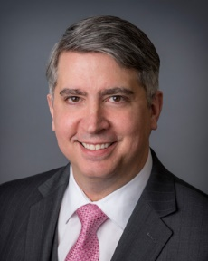


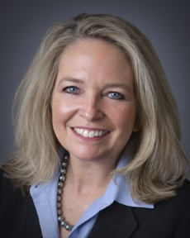
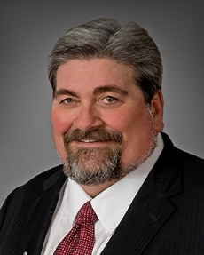
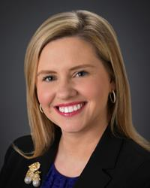
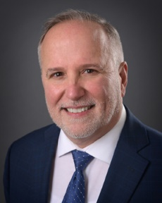

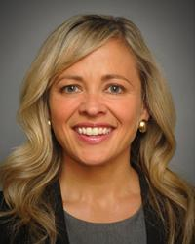

Bowles Rice Education Law Group
Rick
Boothby
Kayla
Cook
Josh
Cottle
Kim
Croyle
Roger
Hunter
Julie
Moore
Trey
Morrone
Howard
Seufer
Leigh Anne
Wilson
Top Ranked in Education Law

Slide 3
“Ignorance of the law is no excuse in any country. If it were, the laws would lose their effect, because it can always be pretended.” -- Thomas Jefferson

Slide 4



Education Law Updates
https://www.bowlesrice.com/education-law-blog

Slide 5
Join the Mailing Lists
Send an email to Sarah Plantz:
splantz@bowlesrice.com
Tell Sarah:
Who you are
Your position in public education
Your school board’s name
That you want to be added to the mailing lists

Slide 6
Today
This is an overview of school-related legal developments since we met last fall
We speak in general terms only. Our observations must not be treated as legal advice about any specific situation
Court decisions and other legal processes may modify our understanding of the new laws
When in doubt, don’t act or rely on information from this presentation without seeking legal advice

Slide 7
Our Agenda
Selected highlights of recent legislation
Recent decisions of the Supreme Court
Recent decisions of the Grievance Board
Recent Ethics Commission opinions
Distinctions: Extracurricular/Extra Duty
The proposed constitutional amendments
Josh’s top 10 contract review issues

Slide 8
Selected highlights of recent legislation Handout pages 1-5

Slide 9
Senate Bill 438 Relating generally to WV Security for Public Deposits Act In effect June 10, 2022 Handout, page 1

Slide 10
Under the new West Virginia Security for Public Deposits Act and West Virginia Security for Public Deposits Program, county boards will be required to make public deposits under their control in designated state depositories that participate in the Program

Slide 11
These depositories will be allowed to pledge collateral for the deposits through a pooled method
The Legislature hopes this will lower the overall costs of deposits and make public banking contracts more desirable to banks

Slide 12
The State Treasurer is to implement & administer the Program, which will be operational by March 1, 2024

Slide 13
Senate Bill 531 Increasing annual salaries of certain state employees In effect July 1, 2022 Handout, page 1

Slide 14
Beginning with school year 2022-2023, the minimum state salaries of school employees are increased
for teachers, by the annual amount of $2,240
for service employees, by the monthly amount of $122

Slide 15
House Bill 3220 Restrictions on taxpayer funded lobbying In effect July 1, 2022 Handout, page 2

Slide 16
A school district contracting for lobbying services must annually make a report to the West Virginia Ethics Commission on July 1 beginning in 2023

Slide 17
Details of the contract: parties, effective date, terms of payment and reimbursement, any renewal dates
A copy of the contract
All costs & reimbursements paid & to be paid, including expense for meals & events
The identities of people or firms whose work may require them to register as lobbyists

Slide 18
“Lobbying” means communicating with a government officer or employee to promote, advocate or oppose or otherwise attempt to influence:
the passage, defeat, executive approval or veto of any legislation which may be considered by the Legislature, or
the adoption or rejection of any rule, regulation, legislative rule, standard, rate, fee or other delegated legislative or quasi-legislative action to be taken or withheld by any executive department

Slide 19
House Bill 4110 Relating to staffing levels at multi-county vocational centers In effect June 9, 2022 Handout, page 2

Slide 20
Under the Public School Support Program, a county’s allowance under Step 1 is reduced for not maintaining the specified ratio of professional instructional personnel per state aid-funded professional educators

Slide 21
There has been (and still is) an exemption from the penalty for a county with increased enrollment during the school year
This bill creates another exemption: for a county that serves as fiscal agent for a multi-county vocational center, where the county’s failure to meet the minimum ratio is due to staffing levels at the center

Slide 22
House Bill 4353 Relating to On Cycle Elections – Voter Turnout Act In effect June 10, 2022 Handout, page 2

Slide 23
County boards may schedule excess and bond levy elections for only the same date as
the statewide primary elections and
the statewide general elections
Statewide primary and general elections occur in May and November of even-numbered years

Slide 24
If a levy is defeated at a primary election, it may be re-submitted to the voters at the next general election
School boards no longer appoint election officials

Slide 25
House Bill 4466 Relating to School Building Authority’s review of school bond applications In effect June 9, 2022 Handout, page 3

Slide 26
A county board planning to run a bond issue for a project that will use School Building Authority funding must meet new requirements

Slide 27
The proposed project must be in accordance with the county’s approved CEFP
Prior to the proposed election, the county must submit a funding request to the SBA

Slide 28
Following initial consultation with the SBA executive director, the county must prepare a written outline of
the bond finance plan
the capital improvements to be made with levy funds
the amount & timing of funding requested from the SBA

Slide 29
The county must then present its request at an SBA meeting
Even if the SBA then approves the grant, the grant is, by law contingent on
passage of the bond levy, and
final approval by the SBA of the county’s finance plan
Any materials the county produces must state these contingencies and terms

Slide 30
Any such SBA funds may be used only to pay costs of capital improvements
The funds may not be pledged as security for or repayment of any bonds
If the bond levy passes, the county must finalize its project in 4 years (although the SBA can grant extensions in “extenuating circumstances”)

Slide 31
House Bill 4562 Relating generally to the suspension and dismissal of school personnel by board and the appeals process In effect June 7, 2022 Handout, page 14

Slide 32
When a county board, alone or in cooperation with the police or DHHR, begins investigating an allegation that an employee jeopardized students’ health, safety, welfare, or learning environment, the county board has a duty to exercise one of three options

Slide 33
Suspend the employee
Place them on administrative leave
Reassign them to duties that do not involve direct pupil interaction

Slide 34
Principals have a duty to report any such allegation to the superintendent within 24 hours
The report is in addition to any report required of the principal as a mandatory reporter of suspected child abuse or neglect

Slide 35
House Bill 4571 Modifying foundation allowance to account for transportation by electric powered buses In effect July 1, 2022 Handout, page 15

Slide 36
Under the Public School Support Program, the part of a county’s bus system that uses electric school buses will now be entitled to the same increase of the Step 4 allowance as the part of the system that uses compressed natural gas or propane

Slide 37
To qualify, a bus must be fully powered by electricity that is stored in an onboard device
Counties will also receive an additional increase in the allowance for the portion of its bus system that is manufactured in West Virginia

Slide 38
Recent decisions of the West Virginia Supreme Court of Appeals Handout pages 6-7

Slide 39
2. Justice v. West Virginia AFL-CIO
4. McCartney v. Randolph County Board of Education
8. Williams-Grant v. Jefferson County Board of Education

Slide 40
Recent decisions of the West Virginia Education Employees Grievance Board Handout pages 8-13

Slide 41
3. Underwood v. Brooke County Board of Educ.
7. Compton v. West Virginia Board of Educ.
8. Dutko v. Berkeley County Board of Educ.
11. Francis v. Lewis County Board of Educ.
15. DeWitt v. Preston County Board of Educ.
18. Thornton v. Mercer County Board of Educ.

Slide 42
Recent West Virginia Ethics Commission advisory opinions Handout pages 14-32

Slide 43
No. 2022-17; board and member advocacy about the proposed constitutional amendments (handout page 14)
No. 2022-15: whether board member may volunteer coach in the county of that board (handout 23)
2022-01: Related “School Board Advisory Opinion” re board member as in-county volunteer coach

Slide 44
Distinctions: extracurricular/extra duty Handout pages 35-37

Slide 45
There are only 3 categories of service employee assignments
Regular
Extra-duty
Extracurricular
If an assignment is neither regular nor extra-duty, it must be extracurricular
Code 18-4-16(1) (handout page 37)

Slide 46
Extra-duty assignments
Definition and staffing: Code 18A-4-8b(f) (handout page 36)
(1) Definition: “an irregular job that occurs periodically or occasionally such as, but not limited to, field trips, athletic events, proms, banquets and band festival trips”
(2) Staffing: Make offers on a rotating seniority basis within the particular category of employment, unless an alternative procedure is properly approved

Slide 47
(Extra-duty assignments)
Compensation: Code 18A-4-8a(k) (handout page 35)
Minimum hourly rate: one seventh of the person’s total daily salary for each hour involved in the assignment, unless an alternative minimum hourly rate of pay within a particular classification category has been properly approved
Paid entirely from local funds

Slide 48
Extracurricular assignments
Definition and staffing: Code 18A-4-16 (handout page 37)
(1) Definition: “shall include but not be limited to , any activities that occur at times other than regularly scheduled working hours, which include the instruction, coaching, chaperoning, escorting, providing support services or caring for the needs of students, which occur on a regularly scheduled basis
(5) Staffing: Fill under the same school laws that apply to filling, posting and selecting persons for regular service (or professional) positions

Slide 49
(Extracurricular assignments)
Compensation: Code 18A-4-16 (handout page 37)
(1) By “mutual agreement”
(4) Important requirement: A contract separate from the employee’s regular contract, which cannot be conditioned on the employee’s acceptance or continuance of any extracurricular agreement

Slide 50
The proposed constitutional amendments Handout pages 42-44

Slide 51
Proposed Amendment 2: Property Tax Modernization Amendment (page 42)
Proposed Amendment 4: Education Accountability Amendment (page 44)

Slide 52
Josh’s top 10 issues for contract review Handout pages 45-46

Slide 53
Issue 1: Who is the contracting party?
Issue 2: Who signs the contract?
Issue 3: Is the expenditure authorized?
Issue 4: Is the WVBOE addendum attached?
Issue 5: Is the WVBOE addendum incorporated?

Slide 54
Issue 6: Is the contract of lawful length?
Issue 7: Otherwise, is there an annual out clause?
Issue 8: Any indemnity/hold harmless provisions?
Issue 9: Is the form from an out of state vendor?
Issue 10: Is the contract proper under the laws?
Bonus Issue: Is this a “stringing” contract? Was it properly bid?

Slide 55
Time for questions?

Slide 56
Thanks for taking time to stay on top of developments in our school laws And thank you for all you do to improve student safety and achievement in West Virginia’s schools

