Slide 1

State of West Virginia Local
Government Purchasing Card Solution & Update
October 19th, 2022

Slide 2



Introductions
U.S. Bank as a strategic payments partner
Ryan Calloway
Vice President, Large Market Strategic Sales – Public Sector & Higher Education
Traci Miner
Vice President, Senior Solutions Engineer
Jim Smith
Director of Operations- State Auditor's Office Purchasing Card Divisions, State of West Virginia

Slide 3

U.S. Bank as a strategic payments partner
Agenda
Introductions
State Auditor’s Office Update on Transition
Experience
Solution Overview
Technology Demonstration
Question & Answer

Slide 4

U.S. Bank Transition Update
LG P-Card – U.S. Bank Award Announcement – August 5, 2022
U.S. Bank Transition-Onboarding Tool Instructions – August 11, 2022
The invitation emails will be coming from: apply.paymentsolutions@usbank.com
The purpose of the onboarding tool is to streamline the process for you to provide required information to U.S. Bank for them to begin setting up your card program. This will include documentation to satisfy “Know Your Client” banking requirements, information to credit qualify your entity, and a separate U.S. Bank WV Program Member Agreement form.
U.S. Bank Transition Revised Participant Rebate Schedule – September 2, 2022

Slide 5
U.S. Bank Transition Update
Training
Beginning week of November 14, 2022 – January 15, 2023
Teams, Access Online, Quick Reference Guides, etc.
Contract Term
January 1, 2023 – June 30, 2028
Optional 2 years of renewals
Card Issuance
Hand delivered by your Field Representative beginning the first week of December.
Hard cutover January 1, 2023
After January 1, 2023, they will be bulk shipped to the primary coordinator we have on file.
Onboarding process must be completed by 10/28/22 to guarantee card delivery

Slide 6
U.S. Bank Transition Update
Changes:
Card Brand will be VISA
Fuel Tax Reclamation by NECS
Access Online
One Portal single login for statements, reconciliation, payments, reporting, etc.
Mobile App
Card Activations, Disputes, PIN changes online

Slide 7
How to Participate
Receive the governing body of the Local Governmental Entity’s approval
Submit meeting minutes that include approval to participate
Appoint Program Coordinators
Create and Adopt P-Card Policies and Procedures
Execute Program Participation Agreement
Submit most recent financial statements
Complete the LG P-Card Account Administration Worksheets to set up Coordinators, Corporate Accounts, and Card Accounts
Obtain signed Cardholder Agreements
Complete applicable training
Complete ACH setup for rebate payments

Slide 8
Questions?
Office of the West Virginia State Auditor
Local Government Purchasing Card Division
General:
email: wvlgpcard@wvsao.gov phone: 304.558.2251
Bank Transition:
Julie Gray: julie.gray@wvsao.gov phone: 304-558-2261 x2423

Slide 9
Public Sector Experience in Payables
HIGHER education experience
U.S. Bank brings expertise gained from thousands of Public Sector purchasing & travel programs
Federal Government
State Government
Local Government
Air Force
Army
Navy
Defense Agencies
NASA
Postal Service
Department of Transportation
Department of Agriculture
Veterans Affairs
Alabama | Montana
Alaska | Nebraska
Arizona | Ohio
California | Oregon
Colorado | Pennsylvania
Idaho | South Dakota
Iowa | Tennessee
Kentucky | Washington
Maryland | West Virginia
Michigan | Wisconsin
Minnesota | Utah
Anoka-Hennepin County Public Schools, MN
Anne Arundel County Public Schools, MD
Tacoma School District, WA
Anchorage School District, AK
School District of Washington, MO
Worcester County Public Schools, MD
Lakeville Schools, MN
Eau Claire County Schools, WI
Madison School District, WI
Oshkosh Area Schools, WI
More than 60% of the Federal Government’s spend is managed by U.S. Bank
Thousands of Local Government purchasing and travel programs
We manage 22 State Government purchasing and travel programs

Slide 10
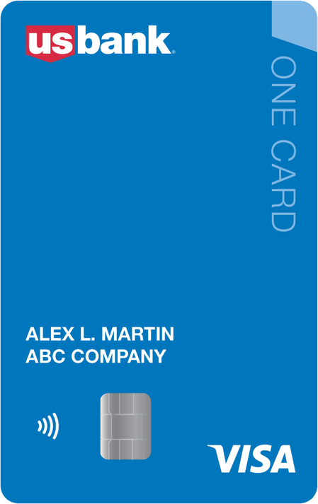
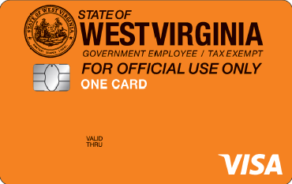
One card, one process, one solution for all expenses
One card overview
Flexible card controls reduce maverick spending and improves compliance with travel and procurement policies
Acceptance
Card Controls
Protection
Visa network provides unsurpassed global acceptance in more than 200 countries
Cash access restrictions
Merchant Category Code (MCC) blocking
Managed Spend/Declining balance feature
Virtual Card Programs
Fleet- Tax Reclamation (NECS)
Overall spending limits
Transaction amount or number of transactions
Daily, cycle, monthly, quarterly, yearly or custom velocity spending limits
Effective dating
Templates/Profiles
EMV® and Contactless cards
Text and email alerts
Payment Analytics
Liability Waiver Program Protects against eligible losses up to $100,000 of cardholder misuse
Liability Policy & Fraud Protection Safeguards employees from unauthorized charges if card is lost, stolen, or compromised
Travel & Emergency Services Accident insurance, auto coverage, lost luggage

Slide 11
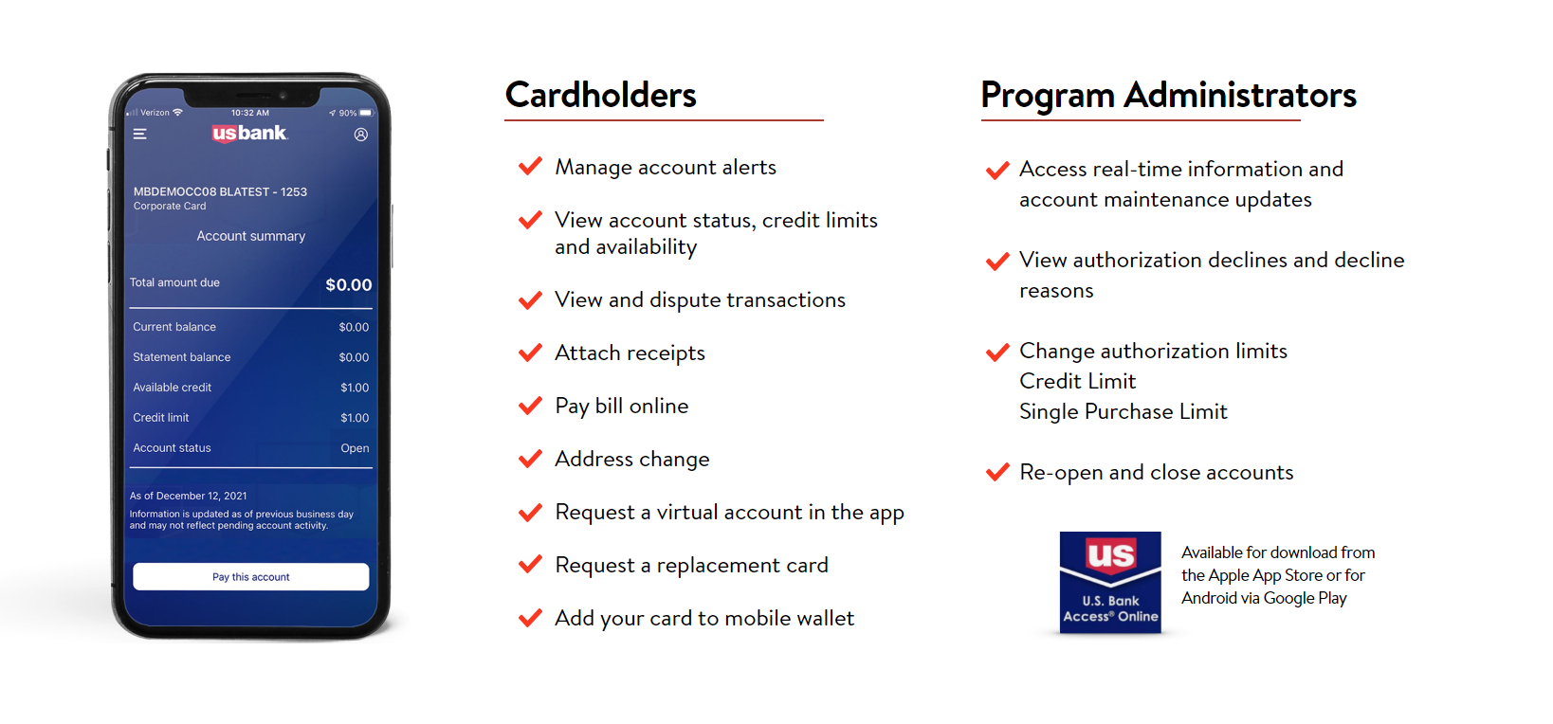
U.S. Bank as a strategic payments partner
Access Online Mobile
U.S. Bank provides mobile technology to further enhance the user experience

Slide 12
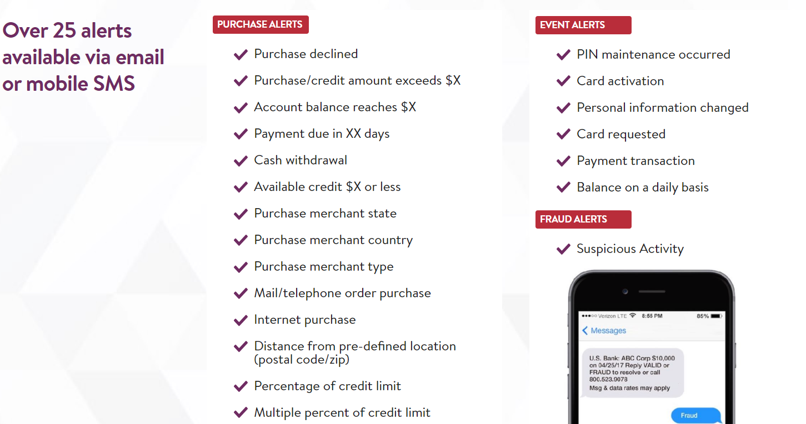
U.S. Bank as a strategic payments partner
Access Online Account Alerts
U.S. Bank provides real-time email and mobile SMS alerts to enhance the cardholder experience and visibility

Slide 13
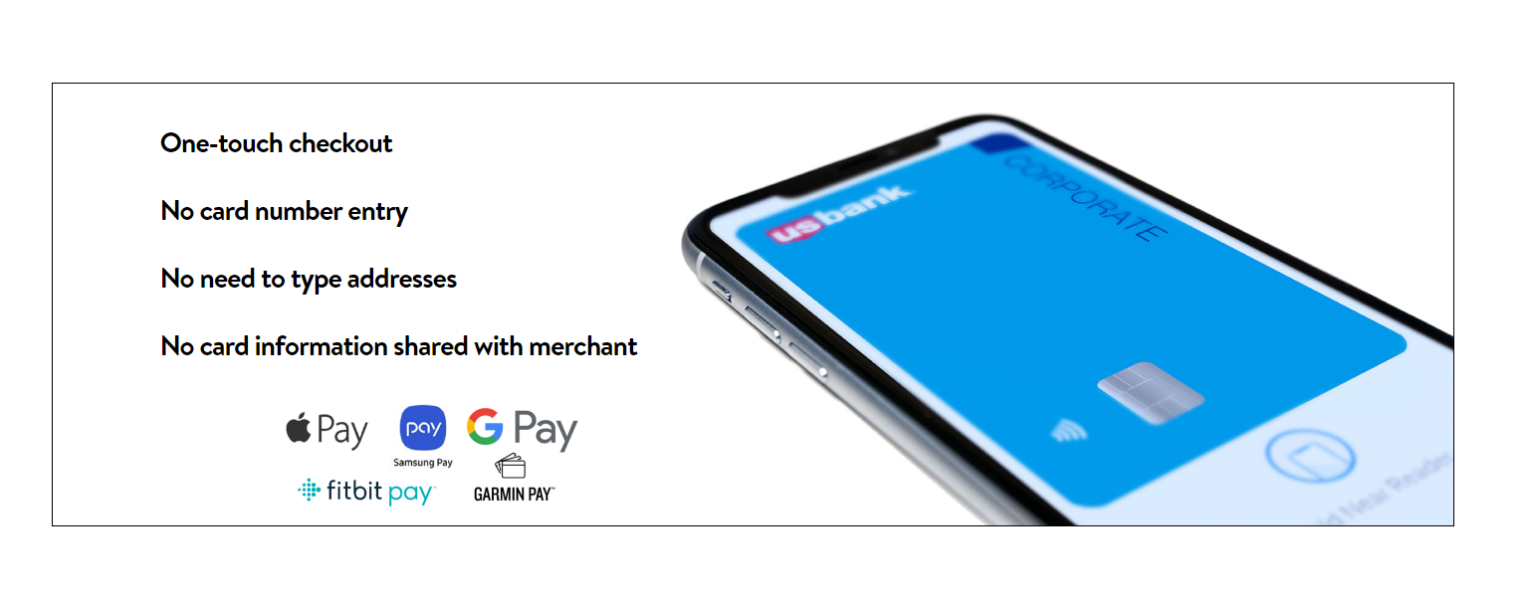
U.S. Bank as a strategic payments partner
Mobile Payments
U.S. Bank’s commitment to mobile applications provides added security and convenience to your purchases

Slide 14
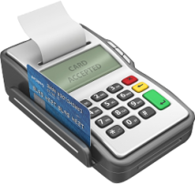
U.S. Bank as a strategic payments partner
Payment Analytics Compliance Tool
Payment Analytics adds another layer to mitigate misuse and non-preferred spend
Alerts
Transaction
Payment Analytics
Rules

Slide 15
U.S. Bank as a strategic payments partner
Sample Rule Templates
Payment Analytics supports over 30 customizable templates to help clients manage and enforce policy compliance
Merchant Watch List
Transaction Outside Spending Guidelines
Split Transaction
Transaction Close to Single Purchase Limit
Large Spend Increase over Average Spend
Airline Travel Purchase Exception
Hotel Room Purchase Exception
Travel Card Purchase in Cardholder’s Postal Code
Account Opened/Maintained with Limits Exceeding Standards

Slide 16





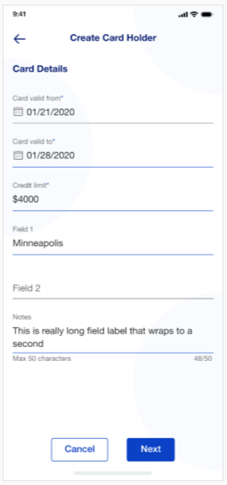
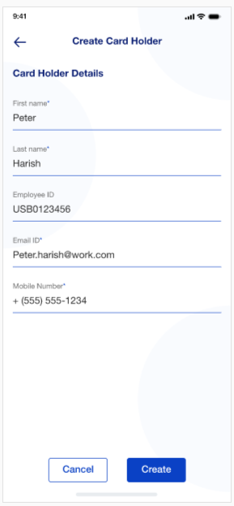
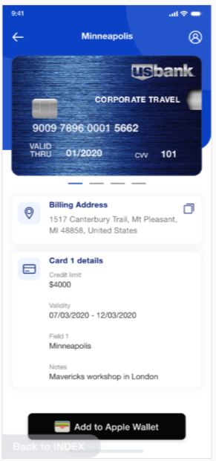
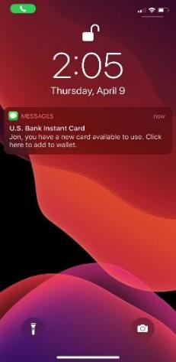
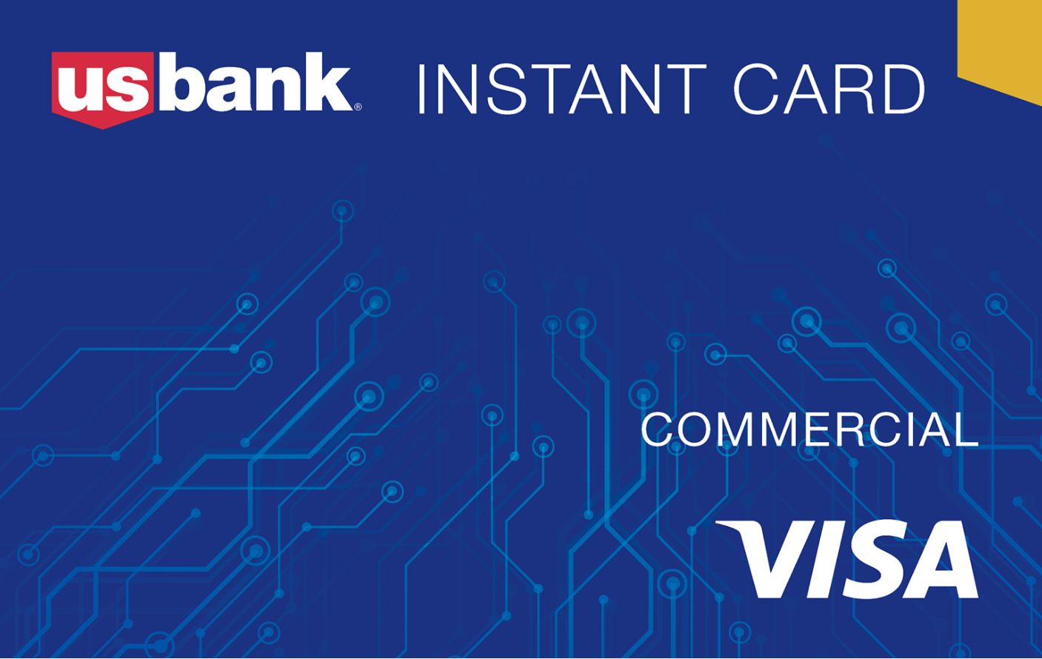
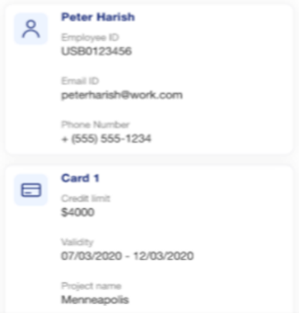



Capabilities overview
Latest Innovations – Instant Card
U.S. Bank exclusive offering launched in two months to help meet customer needs due to COVID-19
Provision a virtual card real-time and push to a user through a mobile app
Dollar and date controls
Included up to three data fields
$
!
3 Easy Steps
Spend!
How much?
Who?
Send!
Receive email
Add to
Mobile Wallet

Slide 17


Capabilities overview
Latest Innovations – Instant Card
Instant Card addresses the needs of a variety of use cases to provide benefits to the State and Local government
Classroom Funds
Eliminates reimbursement for personal spend
Fast, safe & easy provisioning of a virtual card
Infrequent
Traveler
Office Supplies
New Hire
Improved control
Incidentals
Interim Card
Benefits
Instant access to funds – no wait for a card
PTA/
Volunteers
Contractor
Field Expenses
Facilitates both online & mobile payments
Travelers
Lost/Stolen
Card
Reduce fraud through secure mobile wallet
Access® Online used for reporting & established integration with Concur, Chrome River and TravelBank

Slide 18

U.S. Bank as a strategic payments partner
Program Optimization Team
In-house team dedicated to proactive, consultative client engagement
Available for life of U.S. Bank relationship
Expertise across full spectrum of Procure-to-Pay processes
Provided at no cost
Leverages McKinsey & Company external data sources
Industry certified expertise
Services provided
Payment strategy development
Industry benchmarking analysis
Best practices consultation
Program optimization
Payment process mapping
Program utilization review
Whitepaper program evaluation
Supplier retention strategy recommendations

Slide 19
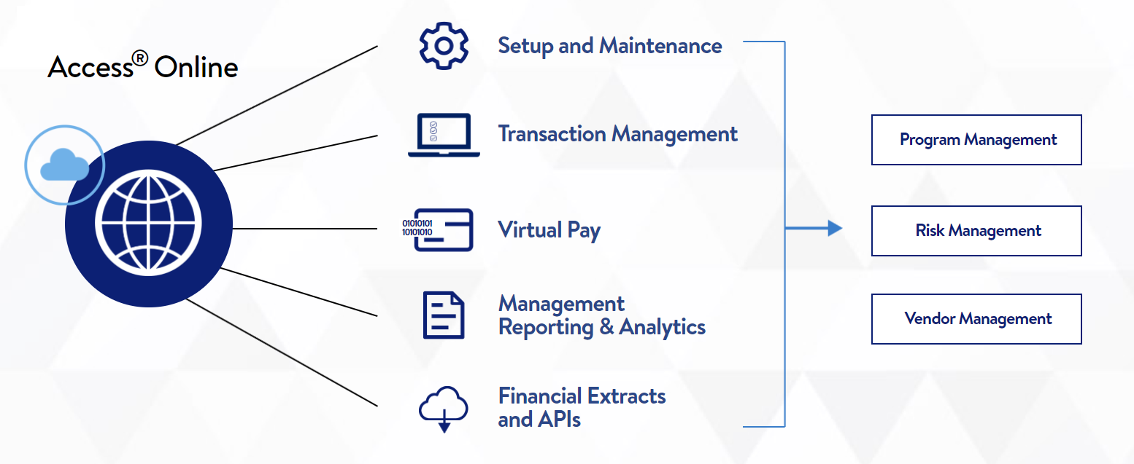
Access® Online Functionality
Technology overview
Continuous investment in propriety technology allows management all aspects of the program

Slide 20


Demonstration

Slide 21

Question & Answer

