Slide 1
OHOA Modules:
Helping Students Become Available to Learn
Scoggin, K., Christianson, K., Cooper, H., Lauger, K., Knapp, M., Peterson, D., Mogan, M. (2014)

Slide 2
Overview
Internal and external factors influence a student’ availability for learning.
In this presentation, you will use that knowledge to better understand what you can do to support a child’s availability to learn.

Slide 3

Kimberly Lauger discusses ways to support students to help them become available to learn.

Slide 4
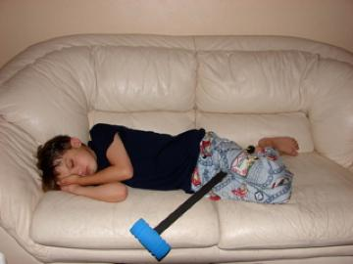
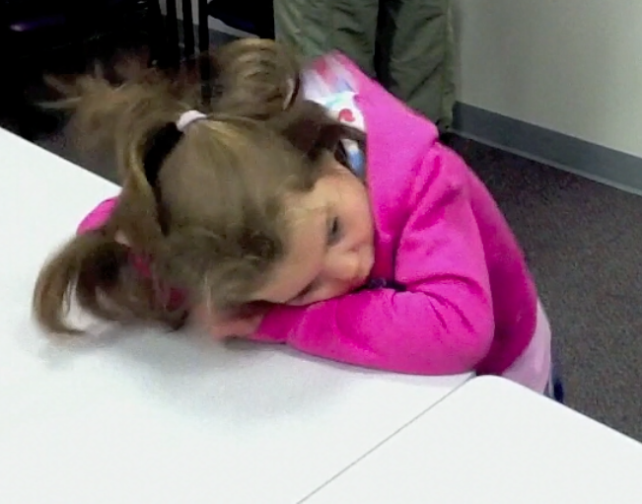
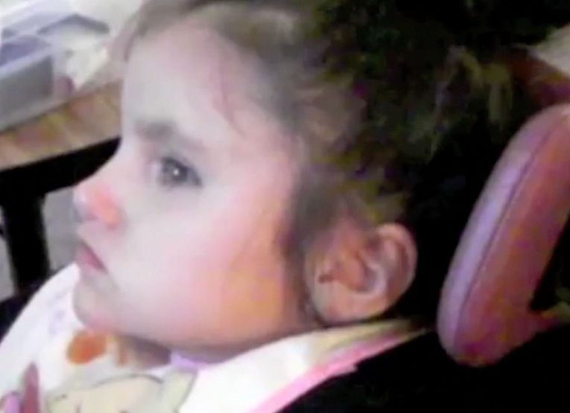
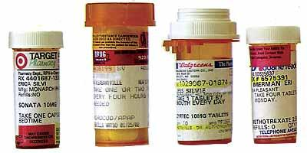
Let’s review some of the internal factors that influence a student’s availability for learning.
Need for movement - head on table and
bouncing up and down on balls of her feet
Headache
Medications
Type and degree of vision and hearing loss

Slide 5
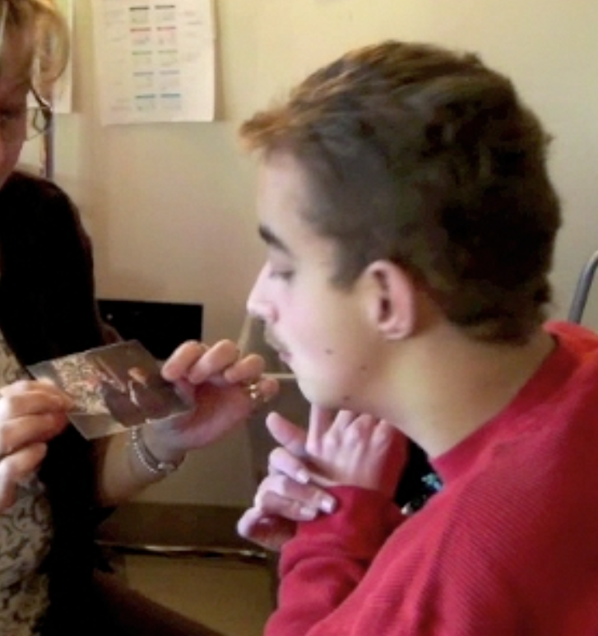
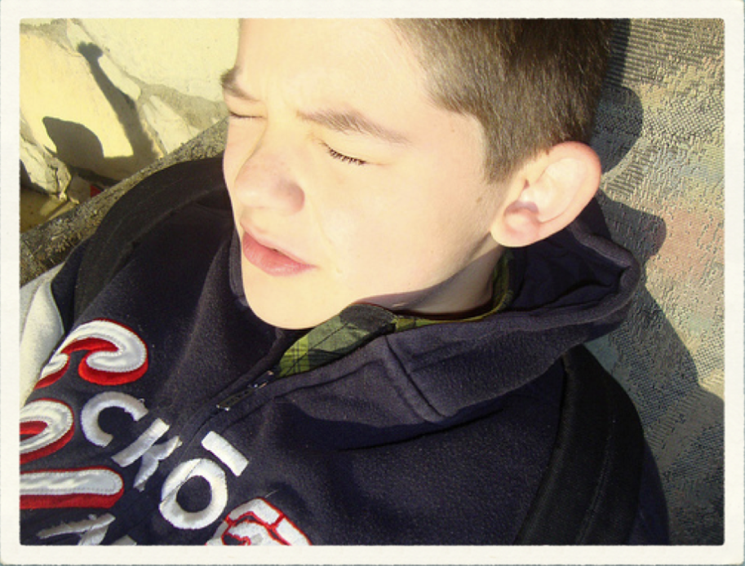

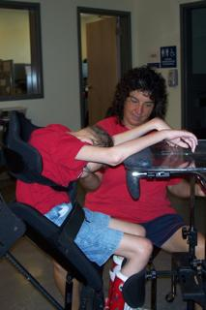
Now let’s review some of the external factors that influence availability to learn.
Is the light interfering?
Is visual contrast a problem?
Is background noise bothersome?
What is the effect of positioning?

Slide 6
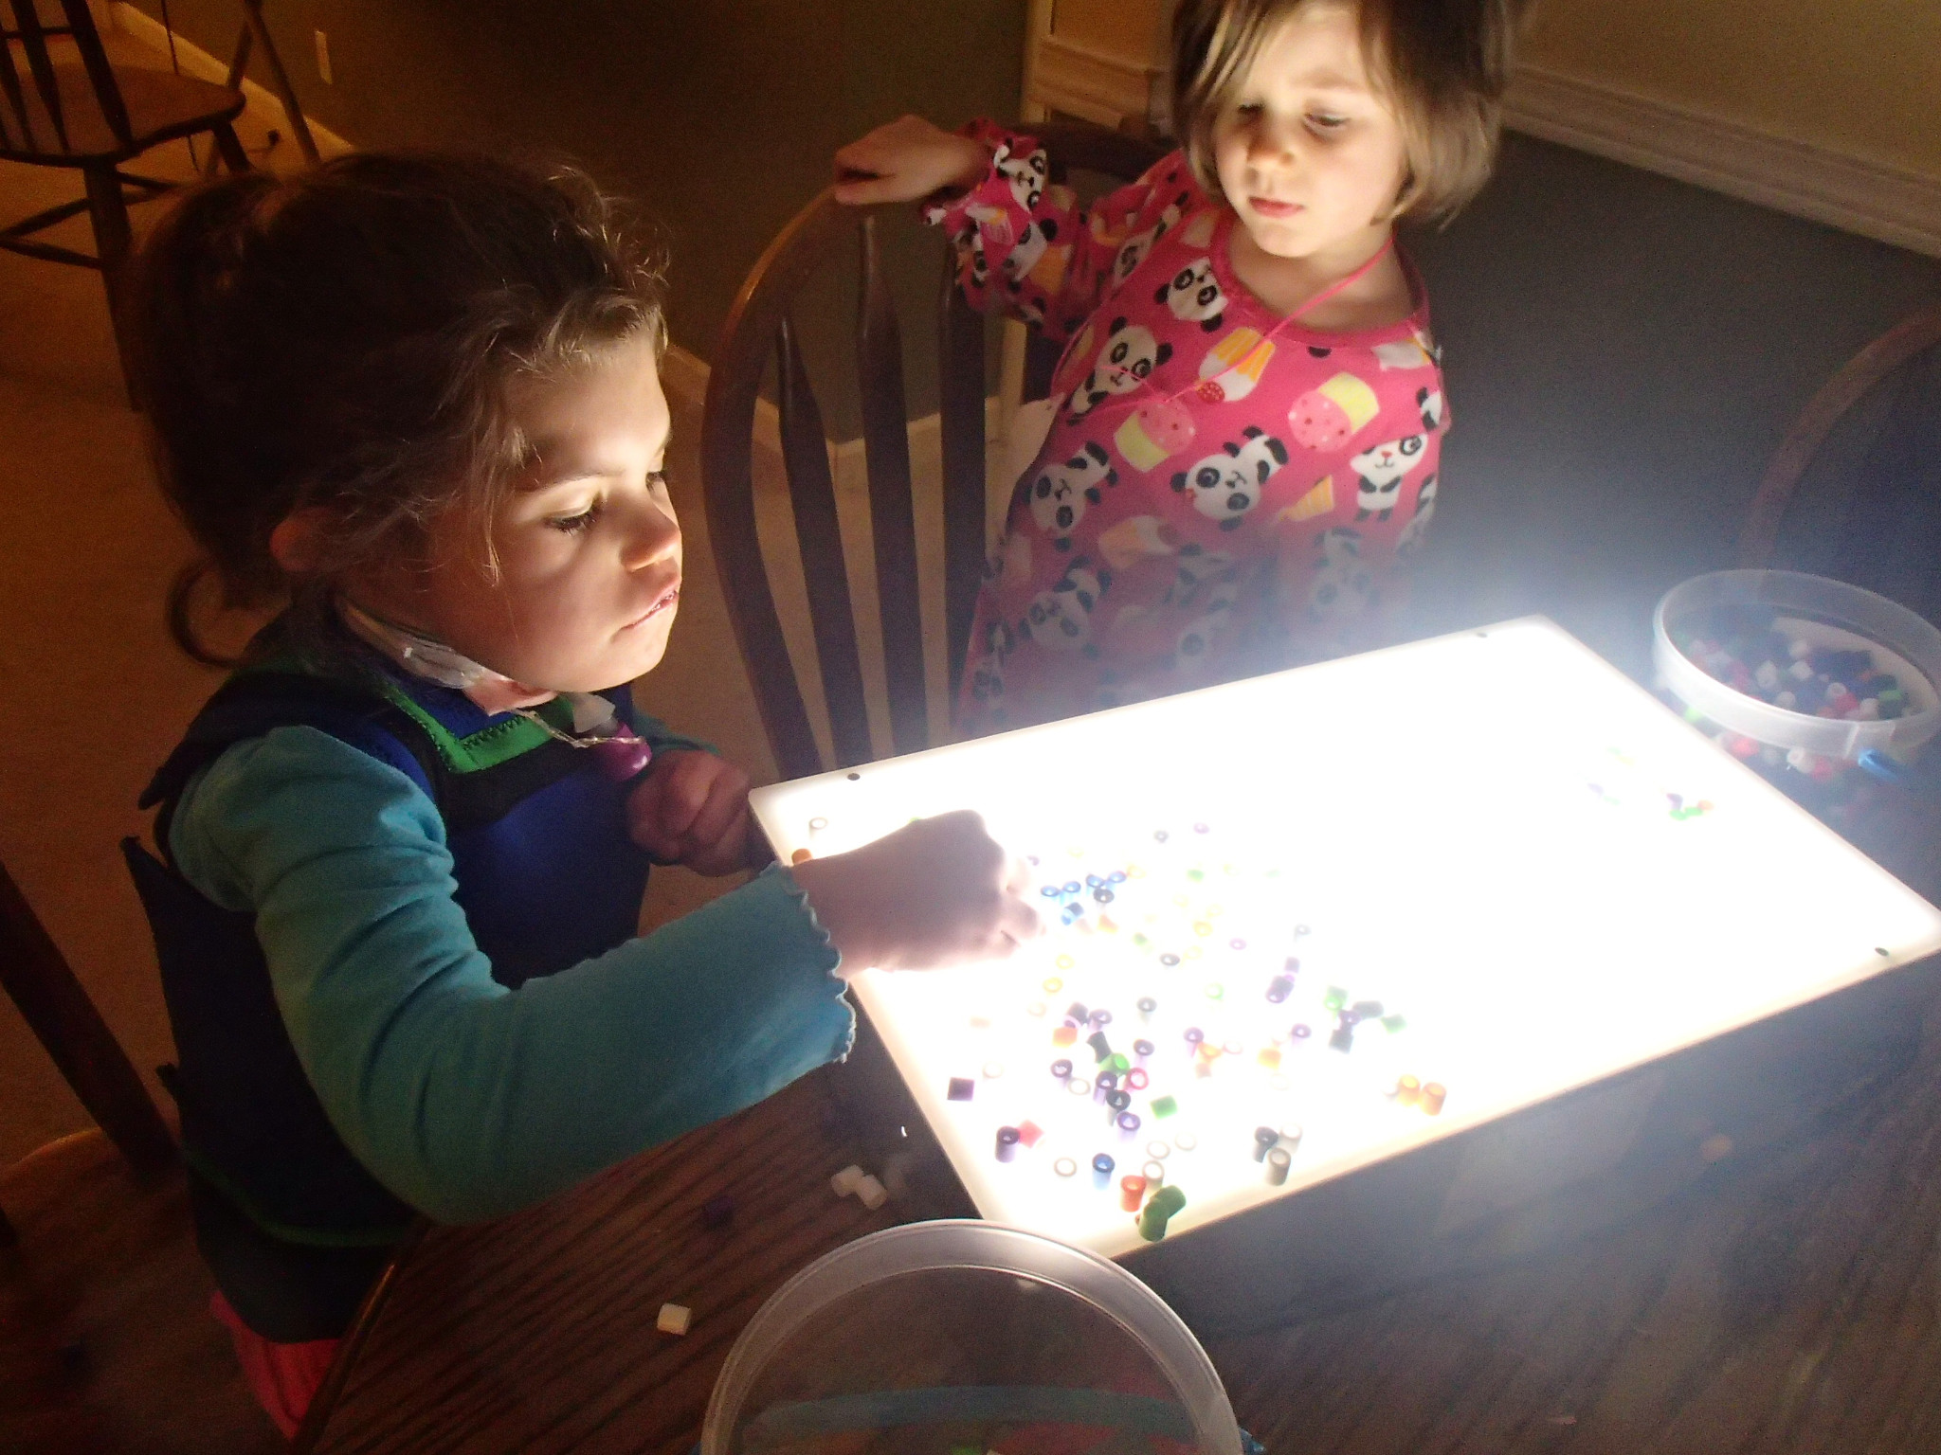
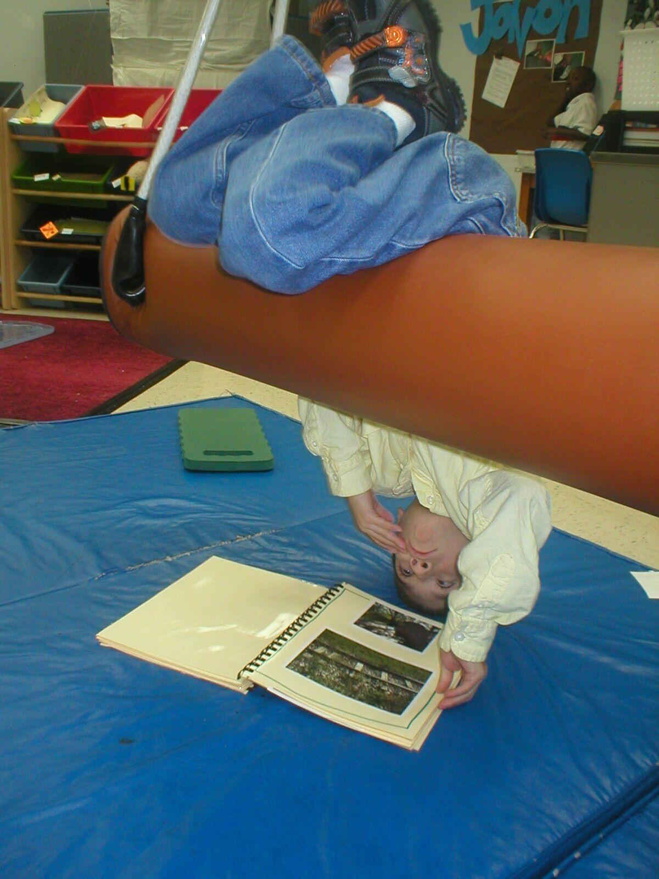
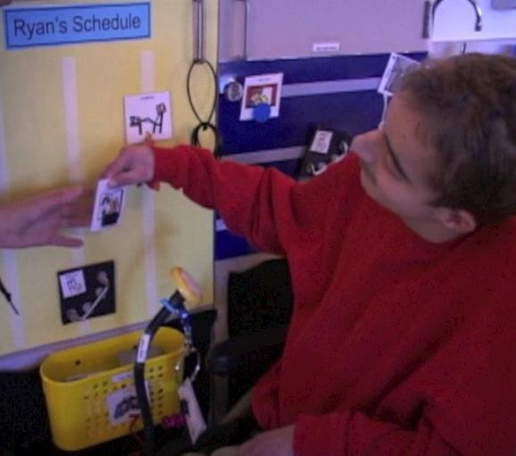
Helpful External Supports
Appropriate lighting.
A consistent daily calendar to help the student anticipate activities and changes.
Positioning that matches the student’s preferences.

Slide 7
Examples
The next three videos show examples of students who were having a difficult time engaging with people and their surroundings because of specific internal and external factors.
You will see in the videos how simple modifications of external factors resolved their difficulties.
Take notes as you listen. You can use the notes later when you take a short quiz.

Slide 8
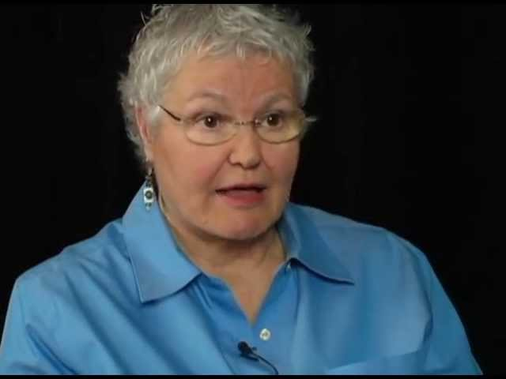
External Factors in the Cafeteria
Kathee Scoggin describes the influence of the environment on memory and behavior.

Slide 9
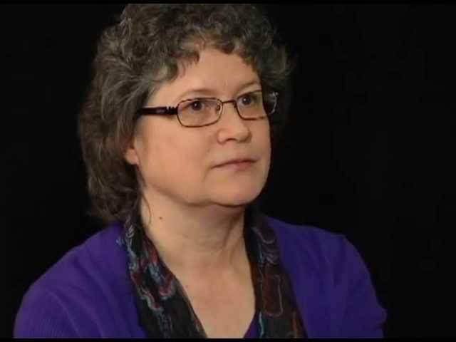
Influencing External Factors at Home
Kimberly Lauger describes Dylan's "laugh attacks" and the support he needed to calm down.

Slide 10
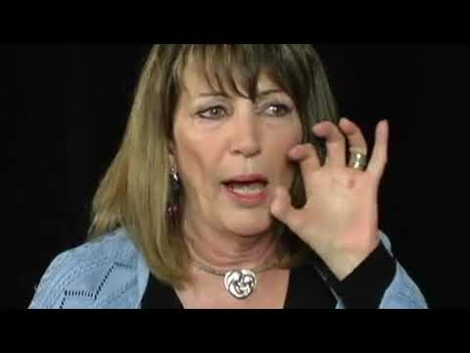
External Factors through Intervention
Melanie Knapp describes her son Christian's response to intervention.

Slide 11
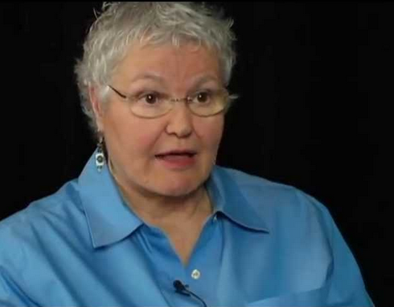
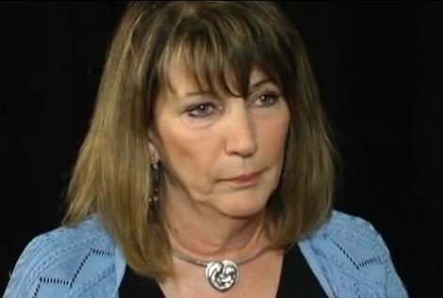
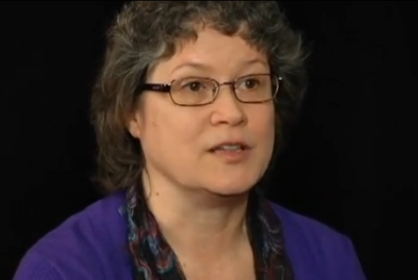
Review
Think about the ways that, in each of the situations described, someone was able to influence the student’s external environment in a beneficial way.
How did this allow each student to become available for learning or communicating?

Slide 12
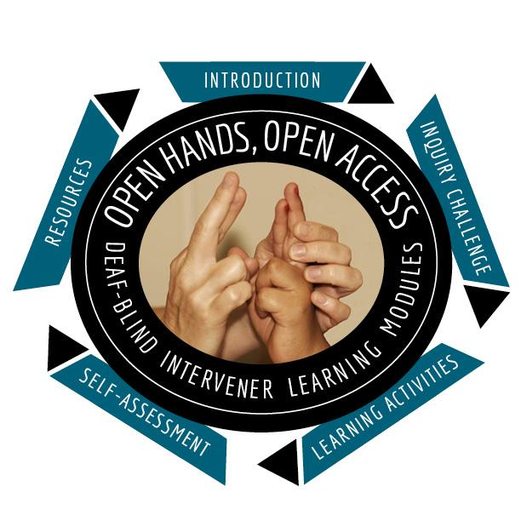


OHOA Deaf-Blind Intervener Learning Modules
A national resource designed to increase awareness, knowledge, and skills related to the process of intervention for students who are deaf-blind. Developed by National Consortium on Deaf-Blindness.
For more information, contact NCDB at
info@nationaldb.org.
The contents of this presentation were developed under a grant from the U.S. Department of Education #H326T130013. However, those contents do not necessarily represent the policy of the The Research Institute, nor the US Department of Education, and you should not assume endorsement by the Federal Government. Project Officer, Jo Ann McCann.

