Slide 1
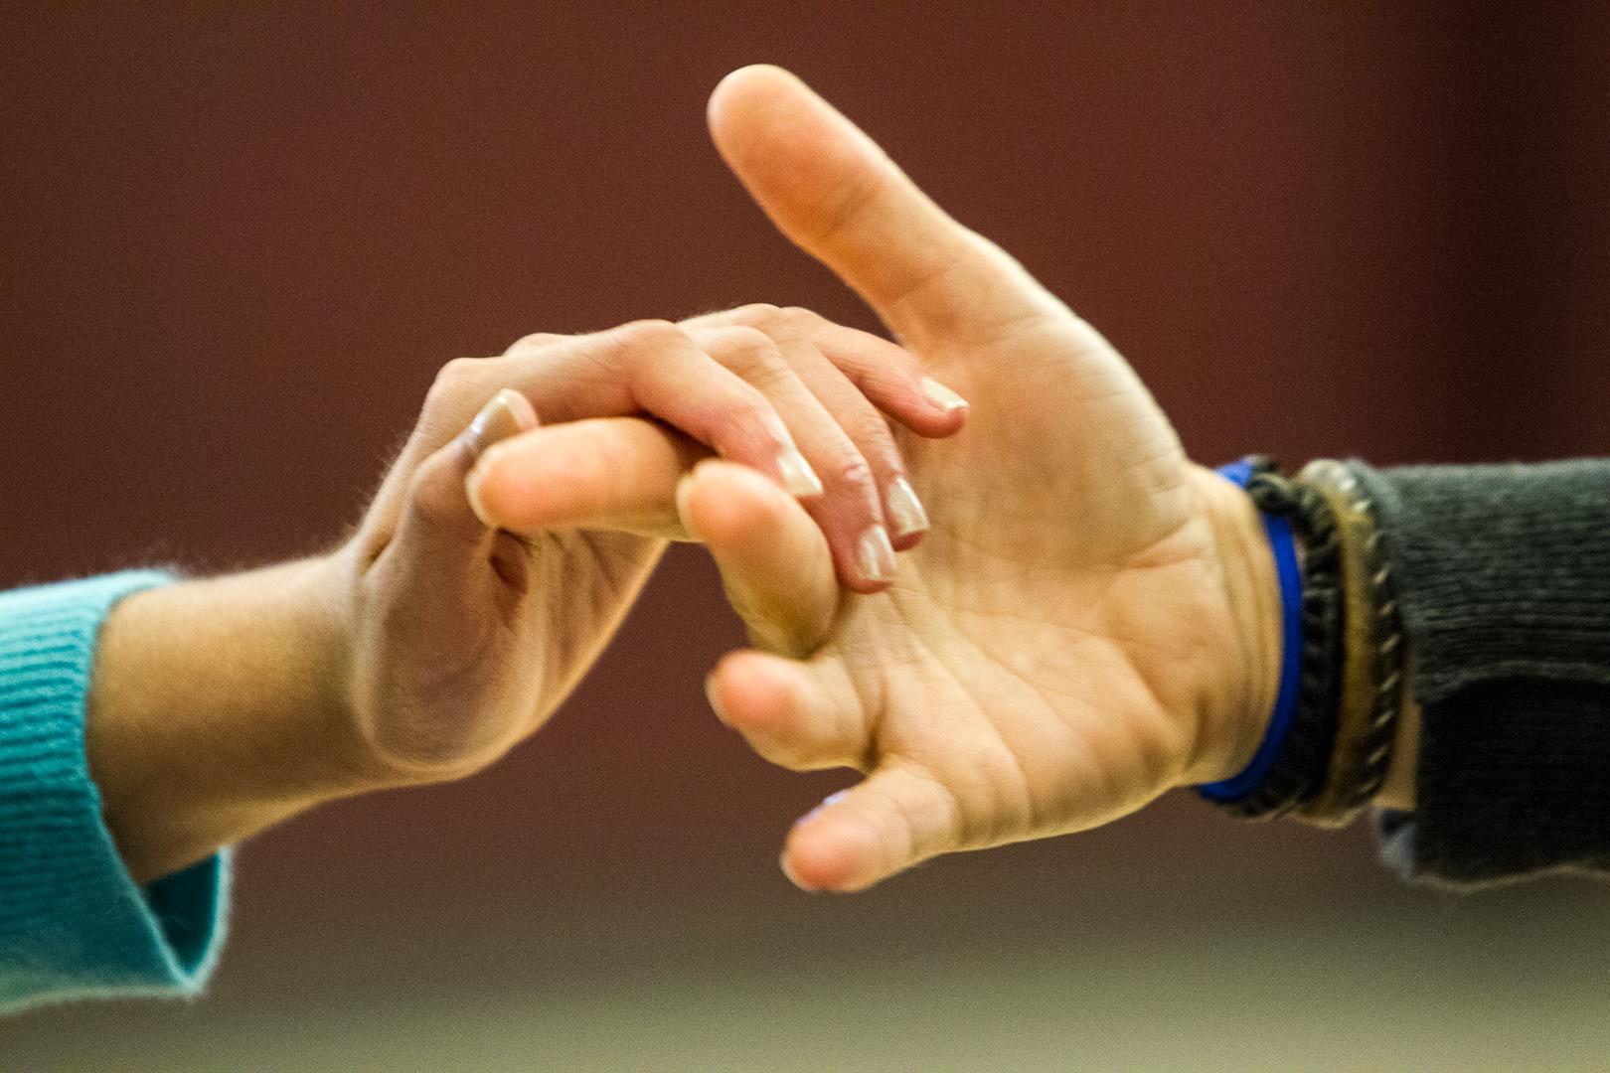
Enhancing Concept Development Through Respectful Touch
Hand-Under-Hand
Buchanan, L., Hayes, J., Montgomery, C., Peterson, L., Stagg, S. (2015)

Slide 2
Tactile Learning Strategies
In the early 2000s, Deborah Chen and June Downing, professors at California State University, Northridge, worked on a project to identify tactile learning strategies for students who are deaf-blind.
The project, called Project SALUTE (Successful Adaptations for Learning to Use Touch Effectively), was funded by the U.S. Department of Education.

Slide 3
Hand-Under-Hand Guidance
You will learn about hand-under-hand guidance in your reading, “Talking the Language of the Hands, to the Hands.” It is a less intrusive strategy than the often used, hand-over-hand guidance.
Then watch Barbara Miles’ webcast on Perkins Elearning.
Perkins Webcast: Barbara Miles -Reflections on Deaf-Blindness: Hands and Touch the whole thing is fabulous, but if you don’t have 20 minutes, especially chapter 5 and 6: https://perkinselearning.org/videos/webcast/reflections-deafblindness-hands-touch (Chapter 5 starts at 12:45)
Talking the Language of the Hands to the Hands, Barbara Miles https://www.nationaldb.org/media/doc/hands-to-hands-english.pdf

Slide 4
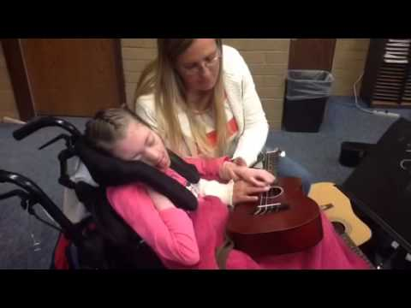
Hand-Under-Hand Guidance
Let’s watch the video of Cora and Suzanne. Notice how Suzanne encourages Cora’s involvement with light, hand-under-hand guidance. She gently guides Cora’s hand to the guitar.
Audio Description

Slide 5
Things Communication Partners Can Do to Promote Hand-Under-Hand Guidance
Invite the student to touch by simply putting your hand gently under his hand and moving it toward the activity.
Allow the student to “overhear” other people’s signed conversations. They can do this by touching the hands of the persons involved in the conversation as they are signing.
Do activities together.
Source: Miles, 2003

Slide 6
Hand-Over-Hand Guidance
There are times when a partner may need to use hand-over-hand guidance.
This may be necessary:
  with a student who has very limited hand use and needs gentle assistance to handle objects or
  for a student who needs specific direction on how to place fingers or hands for signing or another task.
In these situations, a trusting relationship is essential.
The degree of assistance should decrease as the child’s active involvement increases.
Source: Chen & Downing, 2006

Slide 7
Hand-Over-Hand Guidance (cont.)
If possible, avoid all control of a child’s hand (except for safety reasons). Every time you take control, you are teaching the child that his hands do not really belong to him, but to others. Children easily learn to be passive and this often gets labeled “tactile defensiveness,” but really it is a learned behavior. Be aware of the student’s reaction to touch.
Barbara Miles

Slide 8
Things Communication Partners Can Do to Insure Hand-Over-Hand is Used Appropriately
Build on your relationship with her. Make sure all touch is respectful.
Fade hand-over-hand assistance as soon as possible.
Consider whether there are alternate ways for the student to be involved.
Could she hold onto something that touches the object or activity? For example, if it is difficult for her to reach out to trail a wall or touch a landmark, could she hold a drumstick which trails the wall instead?
Source: Chen & Downing, 2006

Slide 9
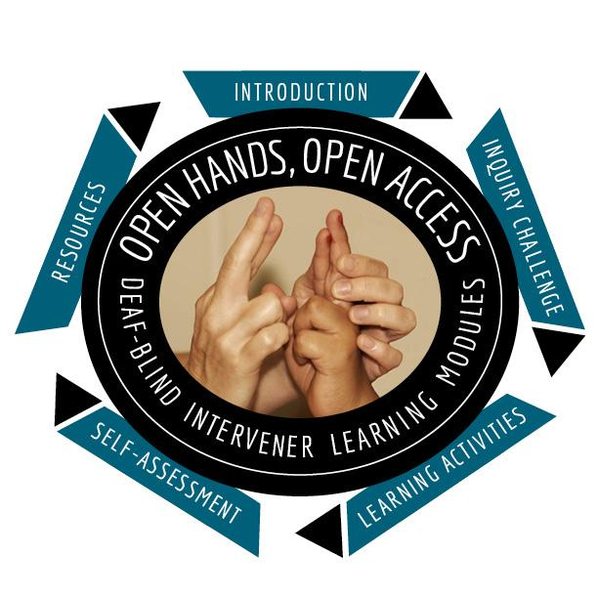


OHOA Deaf-Blind Intervener Learning Modules
A national resource designed to increase awareness, knowledge, and skills related to the process of intervention for students who are deaf-blind. Developed by National Consortium on Deaf-Blindness.
For more information, contact NCDB at
info@nationaldb.org.
The contents of this presentation were developed under a grant from the U.S. Department of Education #H326T130013. However, those contents do not necessarily represent the policy of the The Research Institute, nor the US Department of Education, and you should not assume endorsement by the Federal Government. Project Officer, Jo Ann McCann.

