Slide 1
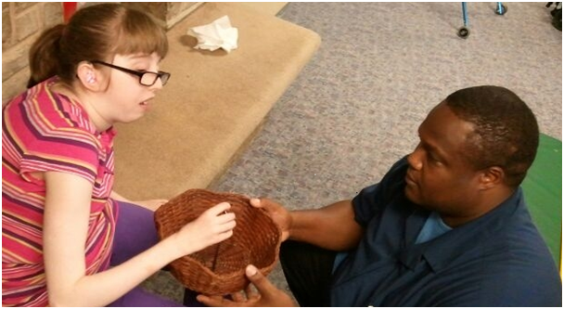
Anticipation Calendars
Blaha, R., Borg, J., Clyne, M., Hartman, V., Martin, B. (2015)

Slide 2
What is an Anticipation Calendar?
An anticipation calendar is the entry level calendar system.
It is a student’s first timepiece.
It consists of two containers that represent two “chunks of time.”
  The past - what you just did.
  The future - what you are about to do.

Slide 3
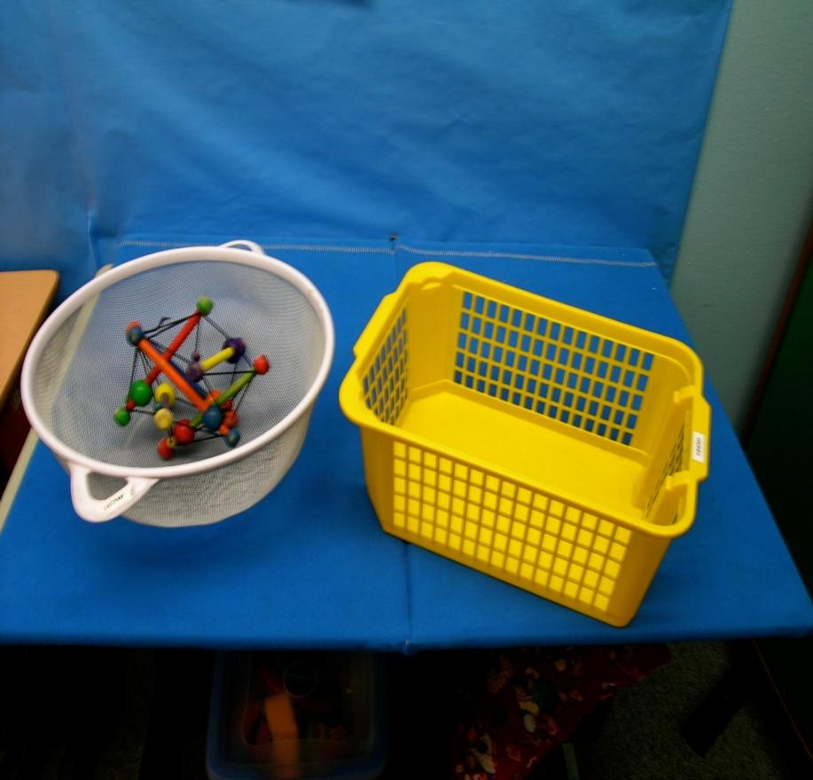
What is an Anticipation Calendar? (cont.)
It is important to use containers that are distinctly different from each other.
They should also be attractive to the student (e.g., yellow is the favorite color of the student who uses the calendar in the photo).
In this photo, the white container represents the future and the yellow container represents the past.
Notes:
*

Slide 4

What is an Anticipation Calendar? (cont.)
Because each container represents a different concept (one is the past, one is the future). They should look and feel very different to the student.

Slide 5
Indicators that a Student is Ready for an Anticipation Calendar
Students who are ready for an anticipation calendar still require maximum support in attending to people, places, and things, but with support they should be able to:
Recognize some of the people, locations, sounds, scents, and actions in two or three of their routines.
Act appropriately with one or two objects that are a part of familiar routines.
Engage in brief interactions with others.
Distinguish between a few caregivers.
Notes:
*
INSERT PICTURE

Slide 6
Indicators that a Student is Ready for an Anticipation Calendar (cont.)
With support, they should also be able to:
Anticipate a few steps ahead during a familiar routine (indicates memory of routine).
Understand when a routine is finished.
If the student does not meet the criteria on this slide and the previous slide, he is not yet ready for a calendar system. Instead, focus on developing his participation in routines and engagement in interactions.
Notes:
*
INSERT PICTURE

Slide 7

Calendars and Routines
Routines are the foundation for all types of calendar activities.
Without a routine, calendar activities do not have meaning or purpose.

Slide 8
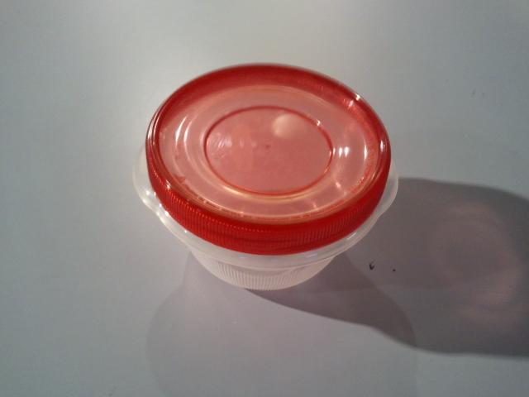
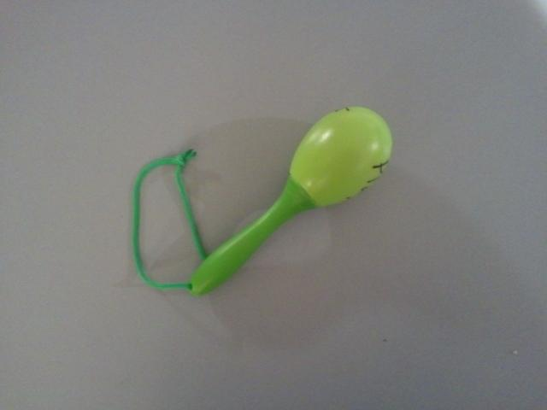
Calendars and Routines (cont.)
A student who is ready for an anticipation calendar will already have several established routines with labels that are meaningful to her.
Routine: Snack Time
Object Symbol Label: Red Tupperware
Routine: Relax
Object Symbol Label: Plastic Shaker
Once a student has a little experience with a routine, you can give the routine an object symbol label that is meaningful to the student (e.g., a spoon to represent a snack time routine).
Once the student has several established everyday routines, you can start using the labels (symbols) for the those routines within calendar systems.

Slide 9
Benefits of Anticipation Calendars
Anticipation calendars help students learn that there is an association between an object symbol and an activity (i.e., they learn that the symbol represents the activity).
They introduce “past” and “future” (these are the most basic time concepts).
They provide a sense of security because the student comes to know what will happen next.
They enhance cognitive abilities (when the student understands what is happening, it is easier for her to incorporate new information).

Slide 10
Using the Timepiece to Teach Basic Time Concepts
The anticipation calendar teaches representation of the immediate past and the immediate future.
At this level of understanding, the student’s past consists of the activity just completed and his future is the activity about to take place.
Notes:
*
discussion

Slide 11
Using the Timepiece to Teach “Future”
Right before beginning an activity, use the anticipation basket to present the object symbol representing the activity.
This cues the student that something is about to happen.
In this picture, you see an adult offering a future basket to a student. This basket is distinctive because it is wicker and has a wavy edge. It contains a spoon, which represents her lunch activity.
Notes:
*
discussion

Slide 12

Using the Timepiece to Teach “Future” (cont.)
Make sure the student recognizes the object.
How can you tell if she recognizes it?
  She might begin to move to the routine location right after the symbol is presented.
  She smiles or has some other positive response.

Slide 13
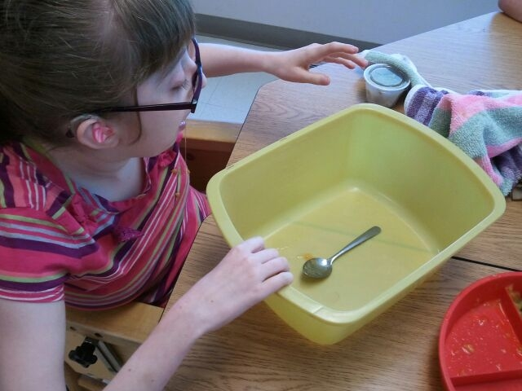
Using the Timepiece to Teach “Past”
Have the finished container in the location where you complete the routine.
As soon as the routine is finished, have the student place the object that represents the routine (e.g., the spoon) in the container.
Make sure you have the student’s attention, then sign and/or say “finished.”
In this picture, the student has just dropped her spoon into the finished basket. The adult signed "finished" (not shown in photo) immediately after the student shifted her attention from the basket to him.
Notes:
*

Slide 14
The Basic Calendar Routine
Now let’s look at a sequence of photos that show the use of an anticipation calendar.

Slide 15
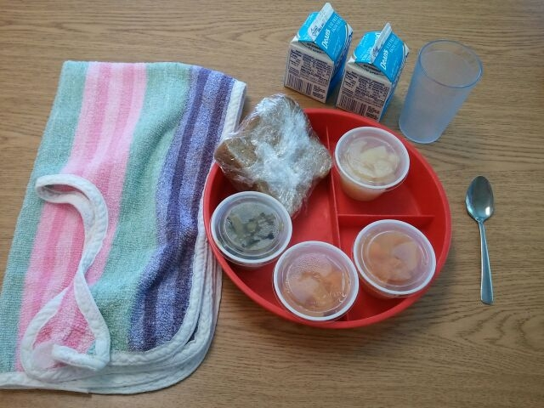
Set up the activity before beginning the calendar routine. Here you see a table set up for a lunch activity.
Notes:
*

Slide 16
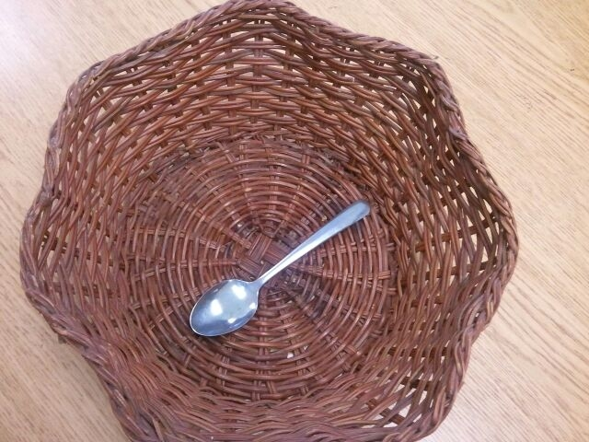
Here is the future container with the object symbol representing the student’s lunch activity.
Notes:
*

Slide 17
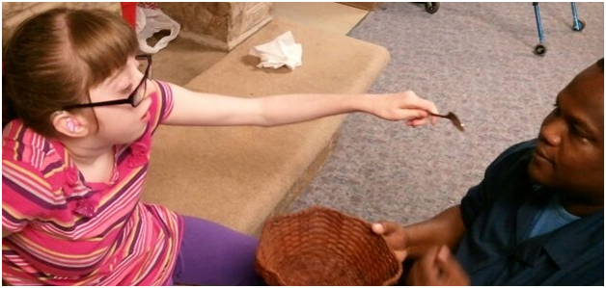
The adult presents the future basket to the student. She then removes the spoon and holds it towards him.
Notes:
*

Slide 18
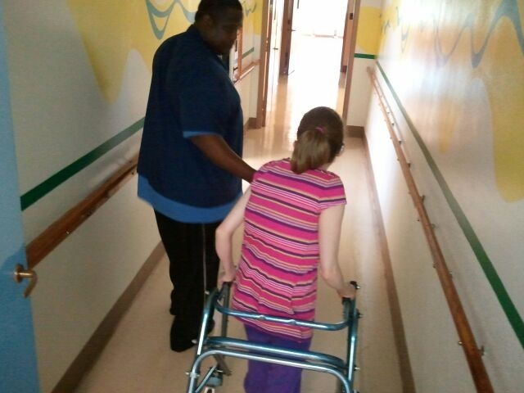
They travel to the activity location.

Slide 19
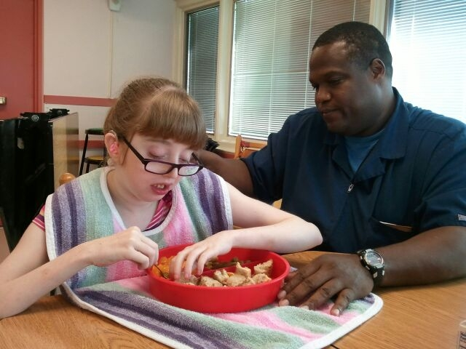
The student eats her lunch using the same spoon.
Notes:
*

Slide 20
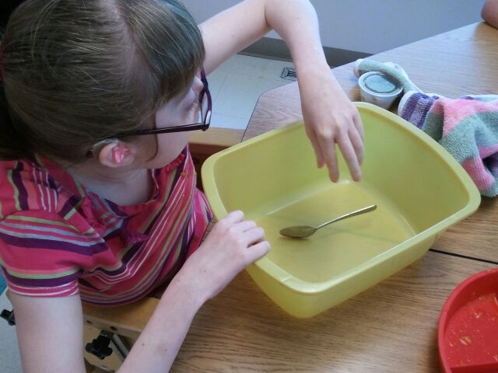
After the lunch routine is completed, the student places her spoon into the finished container.
Notes:
*

Slide 21
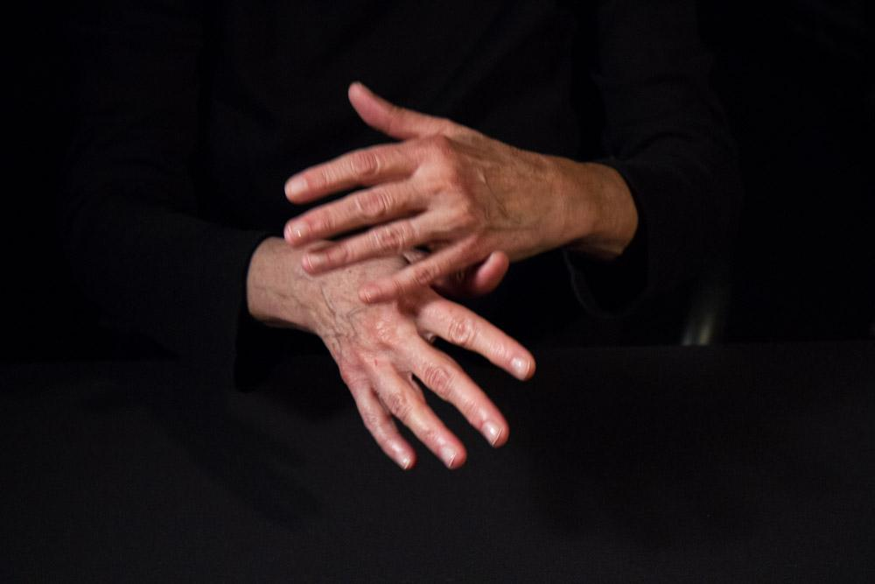
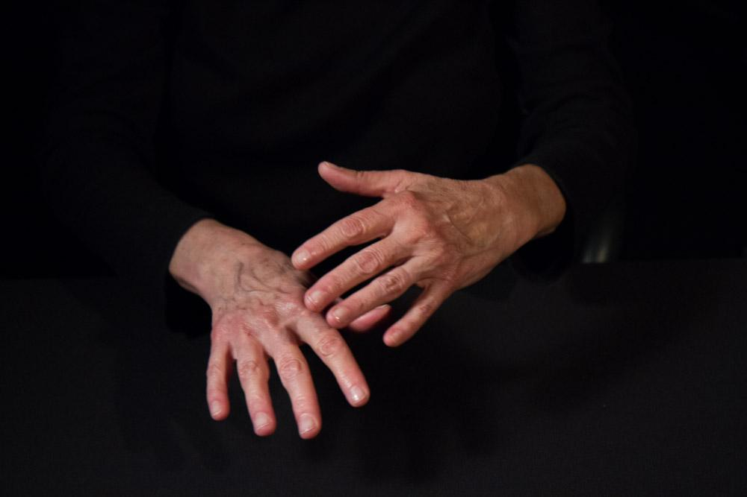

Time Vocabulary: Finished
As you have learned, “finished” is an important vocabulary term to represent the past.
Here is the sign for “finished.”

Slide 22
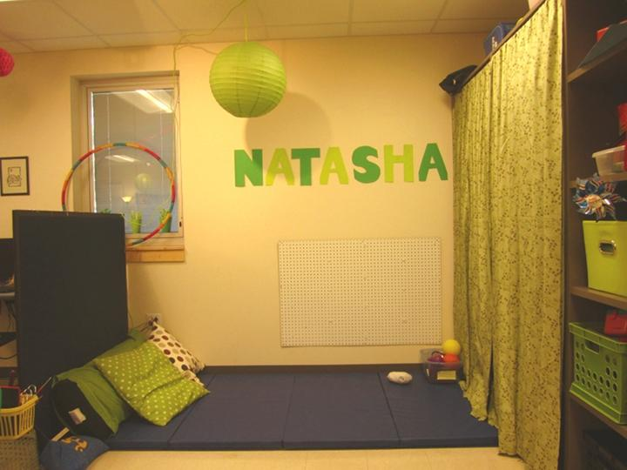
Time Concept: Taking a Break
Students who are just beginning to use calendars may become easily overwhelmed by too much information.
It is not a good idea to have them move directly from one intensive activity to another.
One thing you can do to help the student is create a break area--a predictable place where she can feel safe and do small, fun things independently until the next activity is set.
This also gives you time to prepare for the next activity.
Remember to make a symbol for “break.” Include it in the student's’ schedule.

Slide 23
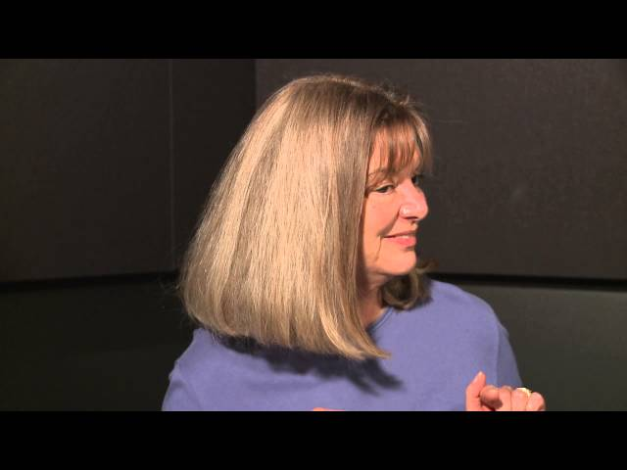
Inviting Participation

Slide 24
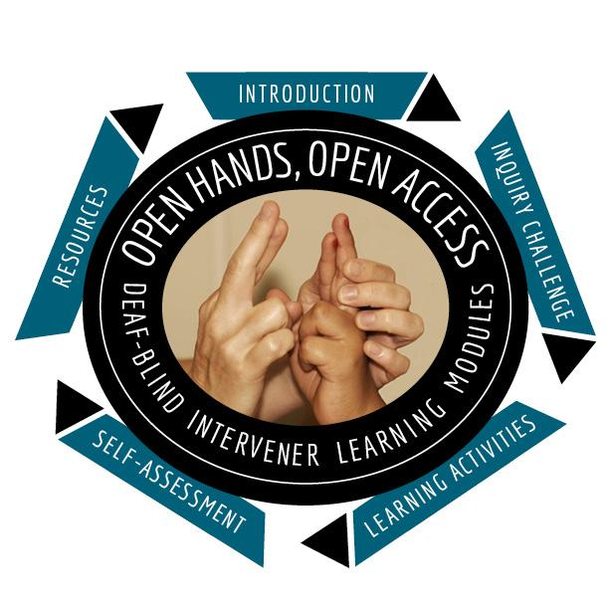


OHOA Deaf-Blind Intervener Learning Modules
A national resource designed to increase awareness, knowledge, and skills related to the process of intervention for students who are deaf-blind. Developed by National Center on Deaf-Blindness.
For more information, contact NCDB at
info@nationaldb.org.
The contents of this presentation were developed under a grant from the U.S. Department of Education #H326T130013. However, those contents do not necessarily represent the policy of the The Research Institute, nor the US Department of Education, and you should not assume endorsement by the Federal Government. Project Officer, Jo Ann McCann.

