Slide 1
Federal Programs Update
July 12, 2022
Laura Pauley, CPA
lepauley@k12.wv.us

Slide 2
Title I Methodology
To demonstrate compliance with the supplement not supplant requirement, a local educational agency shall demonstrate that the methodology used to allocate State and local funds to each school receiving Title I, Part A funds ensures that such school receives all of the State and local funds it would otherwise receive if it were not receiving Title I, Part A funds.
Methodology and Comparability go hand in hand. If your schools are not showing comparable then there is something missing in your methodology.

Slide 3
Supplement, Not Supplant
Federal funds must be used to enhance or increase the level of funding which is normally available from state or local sources.
Federal funds must not replace state and local funds.

Slide 4

Example: Supplement Not Supplant
Consider an ice cream party. What is absolutely necessary?
  Dish (or cone) and ice cream represent basic required elements of program. (It isn’t an ice cream party without them!)

Slide 5

Example: Supplement Not Supplant
Consider an ice cream party. What’s absolutely necessary?
  Additional elements (syrup, cherries, sprinkles, whipped cream, toppings, etc.) represent
  supplementary services available
  from federal programs
  They add to the basic
  “ice cream party” – and
  hopefully make it even more
  successful!

Slide 6
Example: Supplement Not Supplant
When planning your program, ask yourself whether
the desired activities are for BASICS…
….or the EXTRAS!

Slide 7
Comparability
Title I Schools
Non-Title I Schools
State and Local Funds

Slide 8
Comparability Legal Requirements
ESEA (as amended by ESSA) Section 1119C states that a LEA may receive Title I, Part A funds only if State and local funds will be used in schools served under Title I to provide services that, taken as a whole, are at least comparable to the services in schools that are not receiving funds under Title I. If the LEA serves all of the schools in its district with Title I funds, the LEA must use state and local funds to provide services that are substantially comparable in each school. State and local funds spent for bilingual education for children of limited English proficiency, special education, and supplemental State and local funds spent for programs that meet the intent of Title I, Part A may be excluded when computing comparability (amended P.L. 114-95 to exclude local Title I type programs and as cited in Sec.1119C Fiscal Requirements).

Slide 9
Where to Find Comparability
To access the comparability report complete the following steps:
  Access WVEIS WOW
    Note: be sure you have the Title I Director role
  WVRP – Office of Federal Programs
  Menu – COMP.RPT

Slide 10
Comparability Timeline
December 1
Comparability Opens
January 31
Submission Date
February 28
Documentation of the corrective action and confirmation of comparability submission date for those not found comparable

Slide 11
Maintenance of Effort
ESEA and ESSERF

Slide 12
MOEffort
Maintenance of Effort – is generally a component of some federal programs that require the State and/or LEA to maintain State and/or local funding at approximate levels (at least 90%) compared to the previous year.
This requirement is established to ensure that the federal funding remains "supplemental" and is not used to replace regular state and local spending.

Slide 13
MOEffort
MOEffort applies to LEAs on the following programs:
  ESEA
    Titles I, II, III, IV & V

Slide 14
Considerations for Using ESSERF for Staffing

Slide 15
If you plan to move current staff salaries to ESSERF,...
Don't move state/local funded special education or child nutrition staff to ESSERF funds without checking on the impact this would have on your special education and/or child nutrition funding.
Don't move state/local funded staff in Title I schools to ESSERF funds without checking on the impact this would have on your Title I Comparability.
Consider the state aid funding formula and state aid eligible positions

Slide 16
ESSERF Personnel Time & Effort Considerations:
All staff funded by ESSERF must complete semi-annual time and effort certification.
  Due to the generalized allowable use of ESSERF for payroll, any cost objective under which a staff person may work could be allowable under ESSERF. Even if someone is split funded, every job task they do could be allowable under ESSERF.

Slide 17
Maintenance of Equity for ARP ESSERF
USDE Guidance – June 2021

Slide 18





ARP ESSERF MOEquity
State-level Test
District-level Test
50%
20%
Highest-Poverty LEAs "Hold-Harmless" Test
High-Need LEAs Proportionality Test
Funding Test
FTE Staffing Test

Slide 19
ARP ESSERF MOEquity
State Level – Highest-Poverty LEAs
Highest-Poverty LEAs -
  Rank order LEAs by Census poverty data
  Identify highest poverty LEAs representing at least 20% of the State's total enrollment
States can't reduce state per pupil funding to "highest-poverty LEAs" below the level of funding provided to that LEA in school year 2018-2019
State-level Test
State Level – High-Need LEAs
High-Needs LEAs -
  Rank order LEAs by Census poverty data
  Identify highest poverty LEAs representing at least 50% of the State's total enrollment
States can't reduce state per pupil funding to "high-need LEAs" in a way that is disproportionate to statewide average per pupil allocations for each fiscal year.
20%
50%
Highest-Poverty LEAs "hold-harmless" test
High-Need LEAs proportionality test

Slide 20
USDE MOEquity Guidance
Guidance published June 2021
States must submit baseline data by July 30, 2021 and final data in July 2022
What expenditures count?
  Funds appropriated and allocated by the State to all LEAs for current expenditures for free public education
  Does not include dedicated funds for capital outlay and debt service
  Does not include federal funds, local revenues, or support from private donors

Slide 21
ARP ESSERF MOEquity
"High-Poverty School"
A school that is in the highest quartile (rounded up to the nearest whole number) of schools served by the LEA based on the percentage of economically disadvantaged students served (as determined by the Percent Needy Report provided by the WVDE).
LEA Level – Funding Test
LEAs can't reduce per pupil funding to "high-poverty schools" more than the total reduction divided by the number of students enrolled in the LEA (state and local funding combined)
District-level Test
LEA Level – FTE Staffing Test
LEAs can't reduce the number of FTE staff per pupil in "high-poverty schools" by an amount that exceeds the total reduction, if any, in FTE staff per pupil in all schools served by the LEA in each fiscal year (include all paid and contracted staff from all funding sources)
Funding Test
FTE Staffing Test

Slide 22
LEA MOEquity Exceptions:
LEAs with fewer than 1,000 students
Single-school LEAs
LEAs with one school per grade span
LEAs that "demonstrate an exceptional or uncontrollable circumstance, such as unpredictable changes in student enrollment or a precipitous decline in the financial resources of such agency, as determined by the Secretary of Education."

Slide 23
LEA MOEquity Grade Span Option
LEA may identify "high-poverty schools" on a strict ranking basis or by grade span (matching the Title I ranking option)

Slide 24
Additional MOEquity Guidance
Identification of LEAs and Schools must be done annually
MOEquity must be maintained for school years 2021-2022 and 2022-2023 (state FY22 and FY23)

Slide 25
Time & Effort Documentation

Slide 26
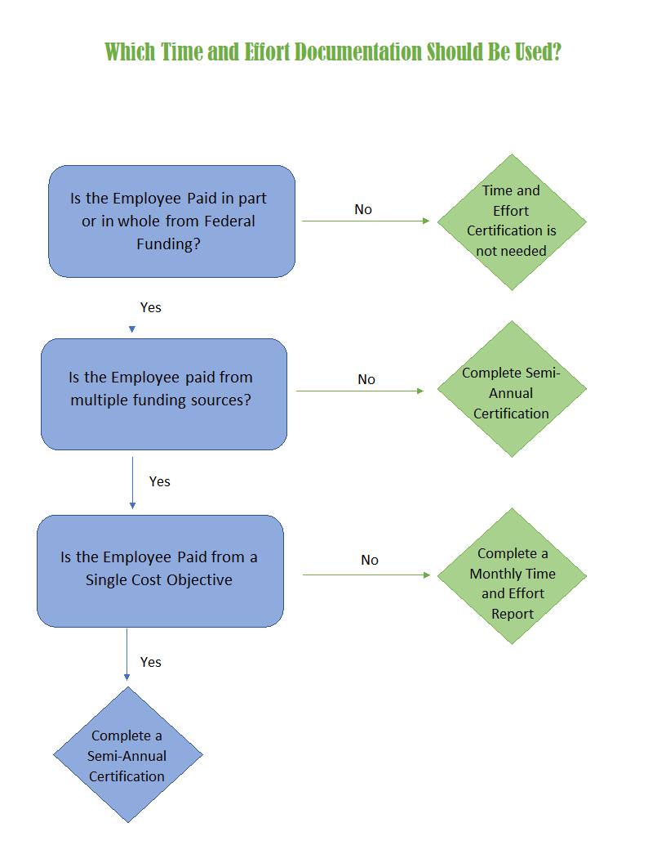
What Time & Effort Documentation Should be Used?

Slide 27
Who must complete Time & Effort Documentation?
Time & Effort documentation must be maintained for all employees whose salaries are:
  Paid in whole or in part with Federal Funds
Part-time and Full-time employees must complete Time & Effort documentation

Slide 28
Semi-Annual Certification
Must be prepared at least semiannually
Must be signed and dated by the employee or supervisor that has first-hand knowledge of the work performed.
Must be signed and dated after the end of the certification period
Must include a statement that the employee worked solely on that program for a period covered by the certification

Slide 29
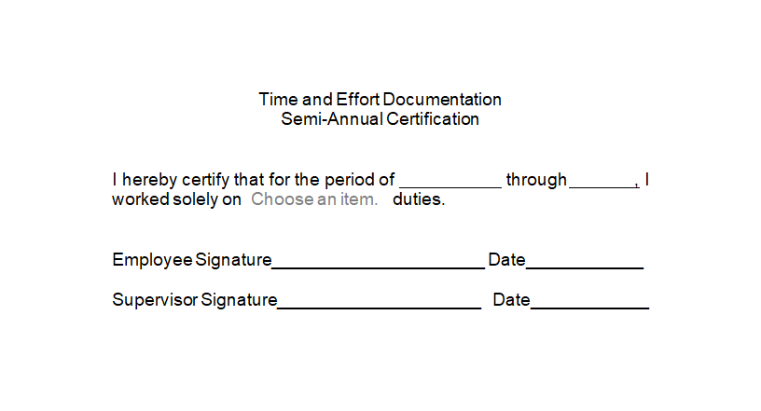
Sample Semi-Annual

Slide 30
Monthly Time & Effort Report
If an employee works on multiple activities or cost objectives, salary and wages must be supported by a Monthly Time & Effort Report.
Must reflect an after the fact distribution of the actual activity of the employee
Must account for the total activity for which the employee is compensated.
Must be prepared at least monthly
Must be signed and dated by the employee after the reported period

Slide 31
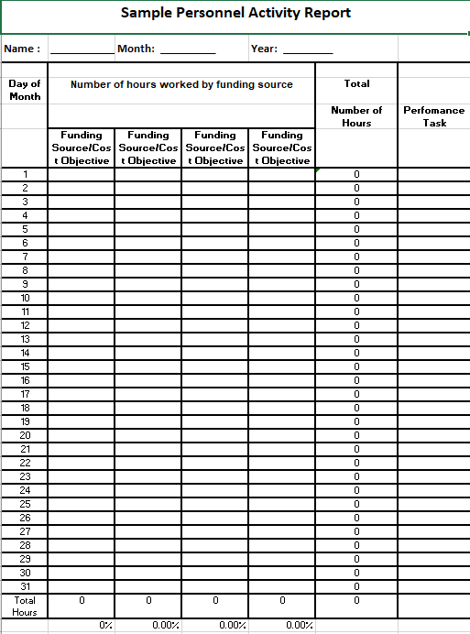
Monthly Time & Effort Sample Report

Slide 32
Cost Objectives
Cost Objectives are dependent on the objectives of the Federal funding source.
An individual who has a “single cost objective” has a position that is dedicated to a singular purpose and can complete a semi-annual certification.

Slide 33
Cost Objectives
  It is possible to work on a single cost objective even if an employee works on more than one Federal award or on a Federal award and a non-Federal award.
    The key to determining whether it is a single cost objective is whether the employee’s salary and wages can be supported, in full, from each of the Federal awards on which the employee is working or from the Federal award alone if the employee’s salary is also paid with non-Federal funds.

Slide 34
Common Monitoring Findings

Slide 35
Most Common Fiscal Findings
Wrong Dates
Missing Paperwork
Unallowable Expenses

Slide 36
Allowable Activities
Indicator: The LEA only spends funds for allowable activities based on an approved application. The LEA shows funding compliance for each program
Sample Evidence: A sampling of financial records will be requested by WVDE to check allowable costs.
WVDE Verification: WVEIS, Consolidated Application
Common Findings: PO dated after the invoice or missing PO, PO didn’t include all items on invoice, payment made prior to the goods or services being received, goods or service not within the performance period, unallowable costs, SNS violations, violation of purchasing policies – stringing, brand specific, failure to bid appropriately (item vs total cost), geographic preference

Slide 37
Equitable Services to Private Schools
Indicator: The LEA provides services to private school students and teachers in an equitable manner based on the needs of the private schools choosing to participate
Sample Evidence: Private school agreements, contractual agreements, documented expenditures
WVDE Verification: WVEIS, Consolidated Application
Common Findings: payments made directly to the private school, not maintaining control over inventory

Slide 38
Indirect Cost Recovery
Indicator: The LEA does not exceed their approved indirect cost rate
WVDE Verification: WVEIS, Application
Common Findings: Not backing out excluded costs when charging indirect cost rate
Costs excluded from the direct cost base:
Program/Functions: Facilities & Acquisitions X4XXX, Interfund Transfers X61XXX, Other Transfers X62XX, Reserved X63XX
Objects not included above: Capital Assets 73X. Bus Replacement 74X, Food & Food Supplies 63X, OPEB 217

Slide 39
Equipment
Indicator: The LEA supports an updated equipment list for all federal funded purchased items (public and private schools) and conducts a physical inventory of all equipment at least once every two years
WVDE Verification: equipment inventory listing, written procedures for managing equipment
Common Findings: not maintaining proper equipment inventory records, no proof of physical inventory count, not following disposal requirements
200.313 Property records must be maintained that include a description of the property, a serial number or other identification number, the source of funding for the property (including the FAIN), who holds title, the acquisition date, and cost of the property, percentage of Federal participation in the project costs for the Federal award under which the property was acquired, the location, use and condition of the property, and any ultimate disposition data including the date of disposal and sale price of the property.
A physical inventory of the property must be taken and the results reconciled with the property records at least once every two years.

Slide 40
Equipment Disposition
Disposition. When original or replacement equipment acquired under a Federal award is no longer needed for the original project or program or for other activities currently or previously supported by a Federal awarding agency, except as otherwise provided in Federal statutes, regulations, or Federal awarding agency disposition instructions, the non-Federal entity must request disposition instructions from the Federal awarding agency if required by the terms and conditions of the Federal award. Disposition of the equipment will be made as follows, in accordance with Federal awarding agency disposition instructions:
(1) Items of equipment with a current per unit fair market value of $5,000 or less may be retained, sold or otherwise disposed of with no further responsibility to the Federal awarding agency.
(2) Except as provided in § 200.312(b), or if the Federal awarding agency fails to provide requested disposition instructions within 120 days, items of equipment with a current per-unit fair market value in excess of $5,000 may be retained by the non-Federal entity or sold. The Federal awarding agency is entitled to an amount calculated by multiplying the current market value or proceeds from sale by the Federal awarding agency's percentage of participation in the cost of the original purchase. If the equipment is sold, the Federal awarding agency may permit the non-Federal entity to deduct and retain from the Federal share $500 or ten percent of the proceeds, whichever is less, for its selling and handling expenses.

Slide 41
Personnel Costs
Indicator: All federally funded staff complete Time and Effort reports (monthly or semi-annual).
Sample Evidence: Time and Effort reports for all individuals paid out of federal funding (full and part-time)
WVDE Verification: Certified List, Payroll Detail Reports
Common Findings: Not completing the proper time and effort form, forms not signed, forms dated prior to the ending date on the certification, certification period more than six months

Slide 42
Internal Controls
Indicator: LEA has a system of internal controls
Sample Evidence: Internal controls policy/procedures
Common Findings: Not providing documentation
200.303 Internal Controls
(a) Establish and maintain effective internal control over the Federal award that provides reasonable assurance that the non-Federal entity is managing the Federal award in compliance with Federal statutes, regulations, and the terms and conditions of the Federal award. These internal controls should be in compliance with guidance in “Standards for Internal Control in the Federal Government” issued by the Comptroller General of the United States or the “Internal Control Integrated Framework”, issued by the Committee of Sponsoring Organizations of the Treadway Commission (COSO).
(b) Comply with the U.S. Constitution, Federal statutes, regulations, and the terms and conditions of the Federal awards.
(c) Evaluate and monitor the non-Federal entity's compliance with statutes, regulations and the terms and conditions of Federal awards.
(d) Take prompt action when instances of noncompliance are identified including noncompliance identified in audit findings.
(e) Take reasonable measures to safeguard protected personally identifiable information and other information the Federal awarding agency or pass-through entity designates as sensitive or the non-Federal entity considers sensitive consistent with applicable Federal, State, local, and tribal laws regarding privacy and responsibility over confidentiality.

Slide 43
Conflict of Interest
Indicator: LEA has a written conflict of interest policy
Sample Evidence: Conflict of interest policy/certifications
Common Findings: Not providing documentation
200.318
(c)(1) The non-Federal entity must maintain written standards of conduct covering conflicts of interest and governing the actions of its employees engaged in the selection, award and administration of contracts. No employee, officer, or agent may participate in the selection, award, or administration of a contract supported by a Federal award if he or she has a real or apparent conflict of interest. Such a conflict of interest would arise when the employee, officer, or agent, any member of his or her immediate family, his or her partner, or an organization which employs or is about to employ any of the parties indicated herein, has a financial or other interest in or a tangible personal benefit from a firm considered for a contract. The officers, employees, and agents of the non-Federal entity may neither solicit nor accept gratuities, favors, or anything of monetary value from contractors or parties to subcontracts. However, non-Federal entities may set standards for situations in which the financial interest is not substantial or the gift is an unsolicited item of nominal value. The standards of conduct must provide for disciplinary actions to be applied for violations of such standards by officers, employees, or agents of the non-Federal entity.

Slide 44
Unallowable Costs

Slide 45
200.438 Entertainment Costs
Costs of entertainment, including amusement, diversion, and social activities and any associated costs are unallowable, except where specific costs that might otherwise be considered entertainment have a programmatic purpose and are authorized either in the approved budget for the Federal award or with prior written approval of the Federal awarding agency.

Slide 46
200.444 General Costs of Government
  Required executive level positions cannot be charged to federal grants (i.e. Superintendent, Treasurer, Attendance Director)
  Travel costs for these individuals can be charged when participation of the individual is necessary to the federal award (watch for SNS when required)

Slide 47
20.445 Goods or services for personal use
Costs of goods or services for personal use of the non-Federal entity's employees are unallowable regardless of whether the cost is reported as taxable income to the employees.
(b) Costs of housing (e.g., depreciation, maintenance, utilities, furnishings, rent), housing allowances and personal living expenses are only allowable as direct costs regardless of whether reported as taxable income to the employees. In addition, to be allowable direct costs must be approved in advance by a Federal awarding agency.

Slide 48
20.454 Memberships, subscriptions, and professional activity cost
Costs of the non-Federal entity's membership in business, technical, and professional organizations are allowable.
Costs of the non-Federal entity's subscriptions to business, professional, and technical periodicals are allowable.
Costs of membership in any civic or community organization are allowable with prior approval by the Federal awarding agency or pass-through entity.
Costs of membership in any country club or social or dining club or organization are unallowable.
Costs of membership in organizations whose primary purpose is lobbying are unallowable.

Slide 49
Late Liquidation - ESSER

Slide 50
US Ed is developing guidelines for late liquidation requests on ESSER funding
  Process is not automatic
  Cannot be applied for in advance
    Obligation date must have passed before application
  Case-by-case basis
  Substantial documentation required
  Liquidation extension only, must still be properly obligated

Slide 51
Expiring Funds

Slide 52
Grant funds expiring soon!
  ESSER I, formula and competitive
  FY20 and FY21 ESEA awards
  9/30/22 obligation 11/15/22 liquidation

Slide 53
The following table shows when a State or a subgrantee makes obligations for various kinds of property and services.
If the obligation is for - | The obligation is made -
(a) Acquisition of real or personal property | On the date on which the State or subgrantee makes a binding written commitment to acquire the property.
(b) Personal services by an employee of the State or subgrantee | When the services are performed.
(c) Personal services by a contractor who is not an employee of the State or subgrantee | On the date on which the State or subgrantee makes a binding written commitment to obtain the services.
(d) Performance of work other than personal services | On the date on which the State or subgrantee makes a binding written commitment to obtain the work.
(e) Public utility services | When the State or subgrantee receives the services.
(f) Travel | When the travel is taken.
(g) Rental of real or personal property | When the State or subgrantee uses the property.
(h) A pre-agreement cost that was properly approved by the Secretary under the cost principles in 2 CFR part 200, Subpart E - Cost Principles | On the first day of the grant or subgrant performance period.

Slide 54
Final FY23 Allocations

Slide 55
FY23 ESEA allocations are still preliminary
  Be conservative with your budgets as amounts will change for certified charter school enrollment

