Slide 1
November 2022
On the November 2022 General Election ballot, there’s a very
concerning vote to amend Section 1, Article X (10) in the state’s
constitution.
Amendment 2, if passes, will allow legislative authority to:
*Exempt machinery and equipment-business tangible personal
property-used in business activity, gas-stored inventory; coal
stockpiles; retail sales; manufacturing used in production (raw
materials, work-in-progress & finished goods.
*Exempt tangible inventory personal property directly used in business
activity.
*Exempt personal property tax on motor vehicles.

Slide 2
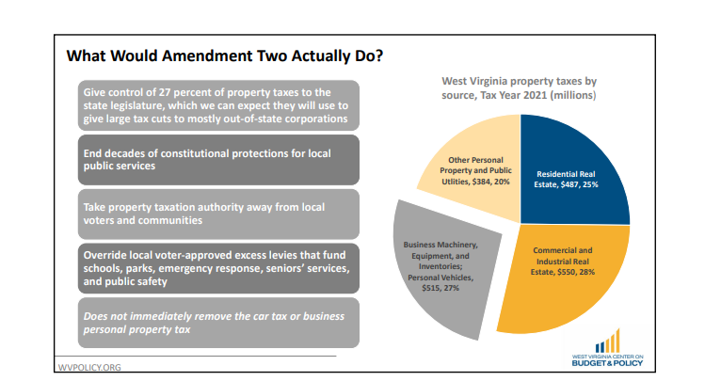

Slide 3
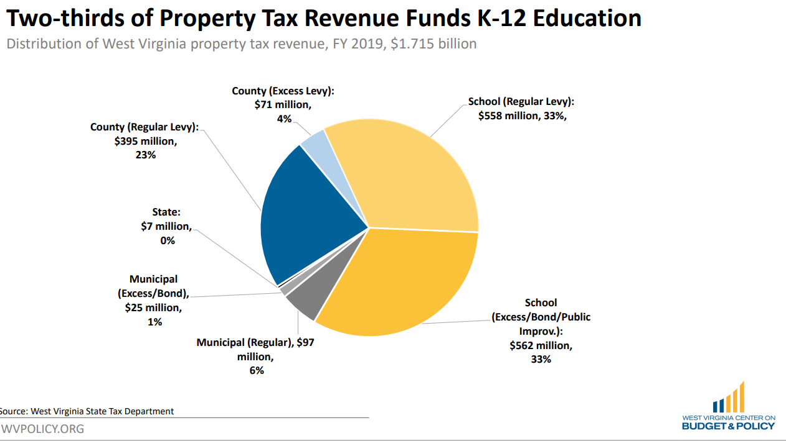
Why is this important?

Slide 4
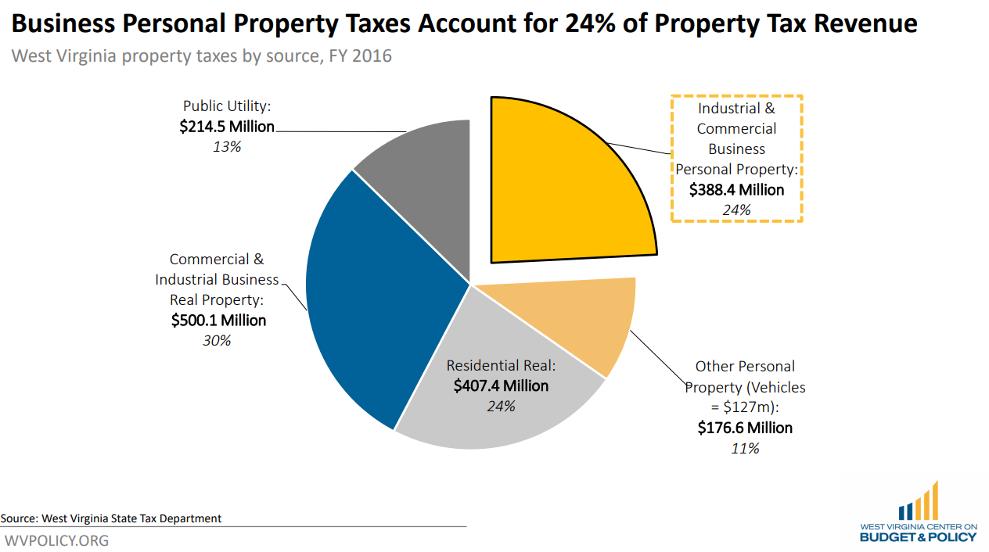

Slide 5
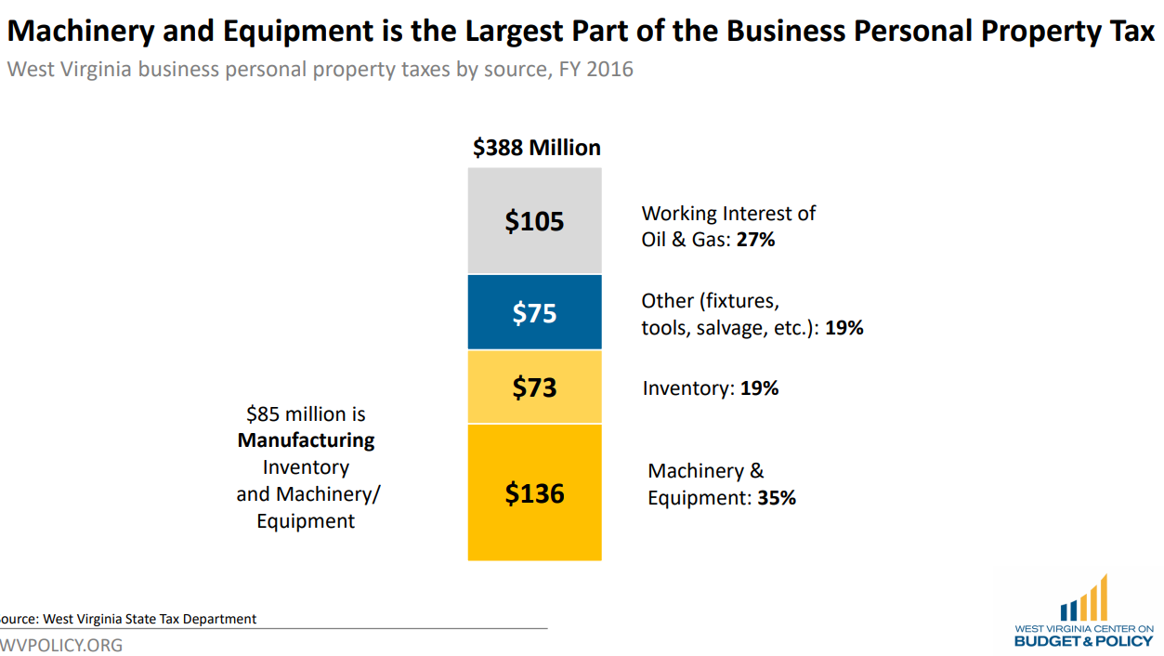
The legislature wants to control the taxing of business machinery and equipment BUT:
And don’t forget: Business PP Tax accounts for 24% of the Property Tax Revenue and
2/3 of Property Tax Revenue Funds K-12 Education.

Slide 6
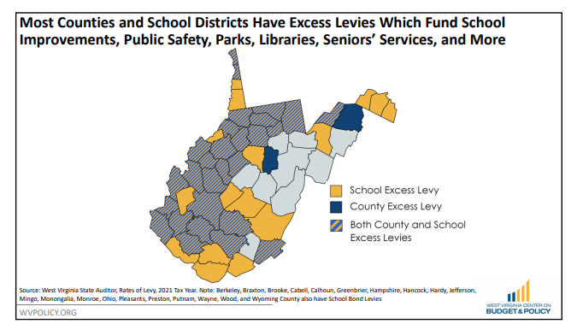

Slide 7
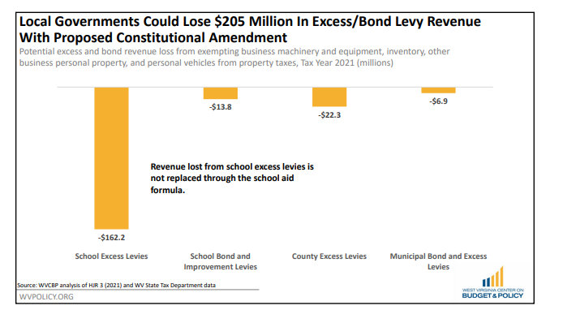

Slide 8
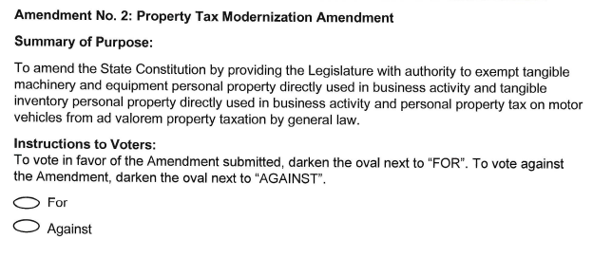
If Amendment 2 passes, it doesn’t exempt anything, rather, it permits the Legislature to, through general law, exempt certain properties from property taxation. This Amendment gives current and future Legislatures the ability/power to make changes/exempt business personal property machinery, equipment, and inventory along with personal property vehicle taxes without coming back to you, the taxpayers for your approval.

Slide 9
The numbers on the next slides were requested by Senator Tarr and were generated by an Assessors Task Force.
LEGEND
Machinery &
Equipment
Furniture &
Fixtures
Leasehold
Improvements
Computer
Equipment
Inventory
Vehicles

Slide 10
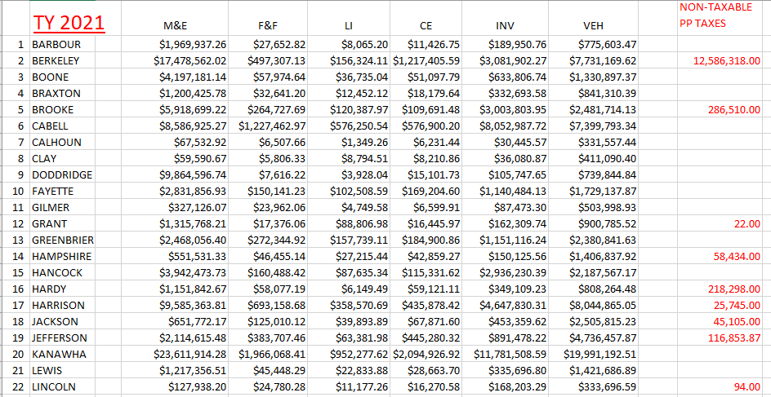

Slide 11
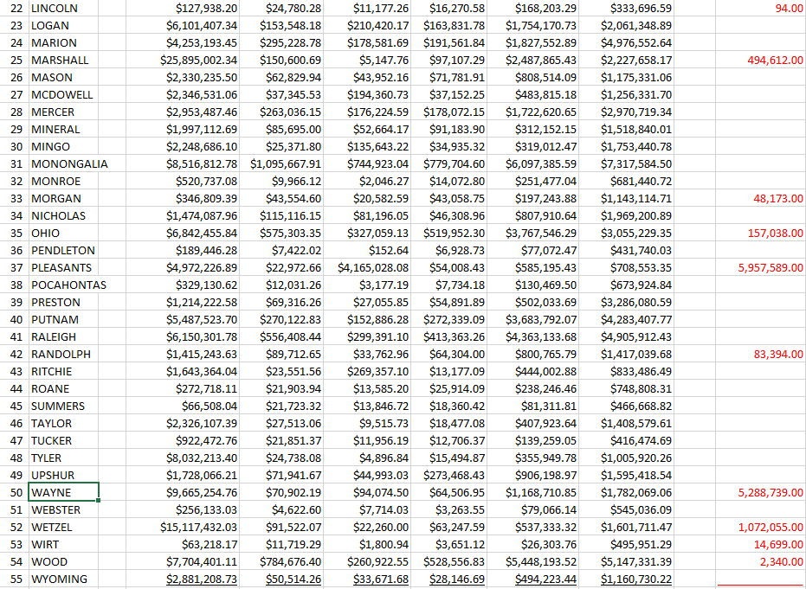

Slide 12
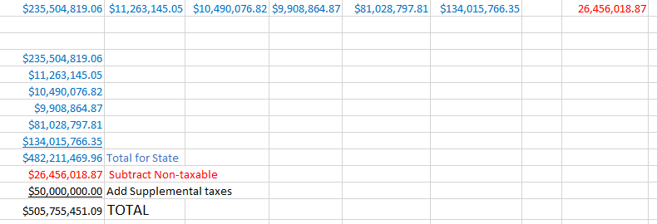
2021
Grand Totals
Machinery &
Equipment
Furniture &
Fixtures
Leasehold
Improvements
Computer
Equipment
Inventory
Vehicles
Non Taxable

