Slide 1
Civil Rights Training

Slide 2
Purpose of Civil Rights Policy
The purpose of civil rights policy as it pertain to the United States Department of Agriculture (USDA) Food and Nutrition Service (FNS) programs is to ensure compliance with and enforcement of the prohibition against discrimination in ALL federally funded child nutrition programs and to protect the recipients and customers of said programs.
Notes:
(Read slide) Programs and activities receiving ANY federal financial assistance must abide by Civil Rights requirements

Slide 3
Civil Rights Concepts
Stereotyping
  Preconceived beliefs or over-simplified generalizations about a particular group
Prejudice
  A set of rigid and unfavorable attitudes toward a particular group that is formed without considering facts
Discrimination
  The practice of treating people differently because of how we have grouped them in our minds according to our prejudices
Notes:
Some Civil Rights concepts: (read each)

Slide 4
What is discrimination in CNP?
Different treatment which makes a distinction of one person or a group of persons from others, either intentionally, by neglect, or by the actions or lack of actions based on a protected class
Protected classes for CNP
  Race
  Color
  National origin
  Age
  Sex
  Disability
Notes:
(Read Slide) The protected classes for Child Nutrition Programs (CNP) vary from other federal programs.

Slide 5
Areas of Compliance
  Assurances
  Public notification
  Complaints of discrimination
  Civil Rights training
  Racial and ethnic data collection
  Limited English Proficiency (LEP)
  Disability compliance
  Compliance reviews and resolution of noncompliance
Notes:
There are eight areas of Civil Rights Compliance which is what we will quickly review today.

Slide 6
Assurances
To qualify for Federal financial assistance, an application must be accompanied by a written assurance that the entity to receive financial assistance will be operated in compliance with all nondiscrimination laws, regulations, instructions, policies, and guidelines.
    Example: SFAs Permanent Agreement with WVDE
Notes:
Areas of compliance:
Assurances: (Read slide)
In order to receive federal funding for any CNP, an organization would apply using a Permanent Agreement with the State Agency: WV has a Permanent Agreement with USDA/our sponsors have a Permanent Agreement with the Department of Education. Within the Permanent Agreement, there’s an Assurance Statement saying the Sponsor will following CR compliance.
(NOTE: Food Service management agreement can be found in Appendix B – FNS instruction 113-1)

Slide 7
Public Notification
All FNS assistance programs (i.e. CNP) must include a public notification system.
  The purpose of this system is to inform applicants, participants, and potentially eligible persons of the programs availability, programs rights and responsibilities, the policy of nondiscrimination, and the procedure for filing a complaint.
Notes:
Largest area probably: divided up in to three areas

Slide 8
Elements of Public Notification
Program Availability
Inform applicants, participants, and potentially eligible persons of their program rights and responsibilities and the steps necessary for participation
Complaint Information
  Must advise applicants and participants at the service delivery point of their right to file a complaint, how to file a complaint, and the complaint procedures
Nondiscrimination Statement
  All information materials and sources, including websites, must contain a nondiscrimination statement. (The statement is not required to be included on every page of the program Web site. At a minimum the nondiscrimination statement or a link to it must be included on the home page of the program information.)
Notes:
The public notification system must include the following three basis elements

Slide 9
Methods of Public Notification
  Must prominently display the “And Justice for All” poster at service delivery points
  Inform applicants or participants of programs or changes in programs
  Provide information in alternative formats and languages as necessary
  Convey message of equal opportunity in all photographic or pictorial program information

Slide 10
Nondiscrimination Statement
In accordance with Federal civil rights law and U.S. Department of Agriculture (USDA) civil rights regulations and policies, the USDA, its Agencies, offices, and employees, and institutions participating in or administering USDA programs are prohibited from discriminating based on race, color, national origin, religion, sex, disability, age, marital status, family/parental status, income derived from a public assistance program, political beliefs, or reprisal or retaliation for prior civil rights activity, in any program or activity conducted or funded by USDA (not all bases apply to all programs). Remedies and complaint filing deadlines vary by program or incident.
Persons with disabilities who require alternative means of communication for program information (e.g., Braille, large print, audiotape, American Sign Language, etc.) should contact the responsible Agency or USDA's TARGET Center at (202) 720-2600 (voice and TTY) or contact USDA through the Federal Relay Service at (800) 877-8339. Additionally, program information may be made available in languages other than English.
To file a program discrimination complaint, complete the USDA Program Discrimination Complaint Form, AD-3027, found online at How to File a Program Discrimination Complaint and at any USDA office or write a letter addressed to USDA and provide in the letter all of the information requested in the form. To request a copy of the complaint form, call (866) 632-9992. Submit your completed form or letter to USDA by:
mail:
U.S. Department of Agriculture
Office of the Assistant Secretary for Civil Rights
1400 Independence Avenue, SW
Washington, D.C. 20250-9410; or
fax:
(833) 256-1665 or (202) 690-7442; or
email:
program.intake@usda.gov
USDA is an equal opportunity provider, employer, and lender.

Slide 11
Nondiscrimination Statement (Spanish)
De acuerdo con la ley federal de derechos civiles y las normas y políticas de derechos civiles del Departamento de Agricultura de los Estados Unidos (USDA), el USDA, sus agencias, oficinas y empleados, y las instituciones que participan o administran programas del USDA tienen prohibido discriminar por motivos de raza, color, origen nacional, religión, sexo, discapacidad, edad, estado civil, estado familiar/parental, ingresos derivados de un programa de asistencia pública, creencias políticas o represalias o retaliación por actividades previas de derechos civiles, en cualquier programa o actividad realizada o financiada por el USDA (no todas las bases se aplican a todos los programas). Los recursos y los plazos para presentar quejas varían según el programa o incidente.
Las personas con discapacidades que requieran medios alternativos de comunicación para obtener información sobre el programa (por ejemplo, Braille, letra grande, cinta de audio, lenguaje de señas estadounidense, etc.) deben comunicarse con la agencia responsable o el Centro TARGET del USDA al (202) 720-2600 (voz y TTY) o comunicarse con el USDA a través del Servicio Federal de Retransmisión al (800) 877-8339. Además, la información sobre el programa puede estar disponible en otros idiomas además del inglés.
Para presentar una queja por discriminación en el programa, complete el Formulario de queja por discriminación en el programa del USDA, AD-3027, que se encuentra en línea en Cómo presentar una queja por discriminación en el programa y en cualquier oficina del USDA o escriba una carta dirigida al USDA y proporcione en la carta toda la información solicitada en el formulario. Para solicitar una copia del formulario de queja, llame al (866) 632-9992. Envíe su formulario o carta completos al USDA por:
correo:
Departamento de Agricultura de EE. UU.
Oficina del Subsecretario de Derechos Civiles
1400 Avenida Independencia, SW
Washington, DC 20250-9410;
fax:
(833) 256-1665 o (202) 690-7442;
correo electrónico:
program.intake@usda.gov
El USDA es un proveedor, empleador y prestamista que ofrece igualdad de oportunidades.
Notes:
USDA can provide the Nondiscrimination Statement in other languages it just has to be requested from them.

Slide 12
Complaints of Discrimination
Applicants or participants allege different treatment based on protected class(es)
  Race
  Color
  National origin
  Age
  Sex
  Disability

Slide 13
Complaints of Discrimination
  Applicants and participants must file within 180 days of the alleged action
  Sponsor must notify the OCN immediately when a complaint of discrimination is received
    OCN will forward the complaint to USDA within five days of receipt
  REMEMBER: Confidentiality extremely important
  ALL complaints (verbal or written) must be documented by the Sponsor
    The WVDE recommends using the WVDE Sample Civil Rights Complaint Log for this purpose
  Other methods of documents may be the USDA complaint forms:
    English version: http://www.ocio.usda.gov/sites/default/files/docs/2012/Complain_combined_6_8_12.pdf
    Spanish version: http://www.ocio.usda.gov/sites/default/files/docs/2012/Spanish_Form_508_Compliant_6_8_12_0.pdf
Notes:
If a sponsor receives any Civil Rights complaint regarding Federally Funded Child Nutrition Programs, the sponsor must first document the complaint (the WVDE highly recommends using the Civil Rights complaint form for this purpose), then the complaint must be forwarded to USDA within five days of receipt of complaint. A sponsor

Slide 14
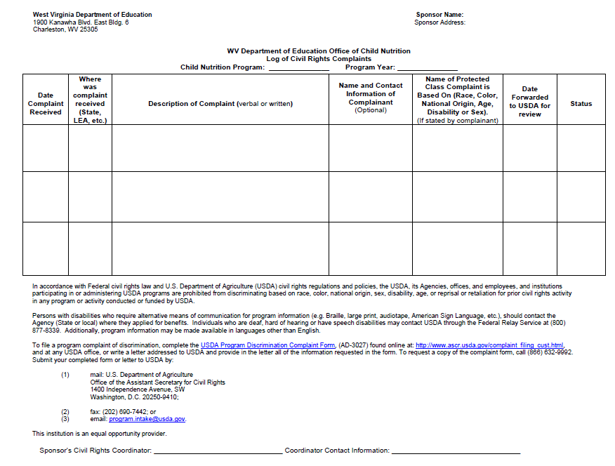
WVDE Civil Rights Complaint Log
Notes:
A Civil Rights Complaint Log must be maintained by all sponsoring organizations of any federally-funded Child Nutrition Program (CNP). The log must contain the date the complaint was received, a description of the complaint, The log must be completed whenever a sponsoring agency receives a complaint of discrimination regarding the CNPs. Any time a complaint of discrimination is received, the Sponsoring Organization must immediately notify the OCN. The OCN will then forward the complaint to USDA within five days of receipt.

Slide 15
Civil Rights Training
Training is required so that individuals involved in all levels of administration of programs that receive Federal financial assistance understand Federal laws, regulations, instructions, policies and other guidance.
Notes:
Every level of administration should be trained on an annual basis
Those that interact with participation on a daily basis and those who supervise.
Cooks & Principals should be trained.
Slide presentation could be forwarded to principals, etc., just make sure it’s annually and log kept!

Slide 16
Civil Rights Training
State agencies are responsible for training local agencies/sub-recipients.
Local agencies are responsible for training their staff and sub-recipients on an annual basis.
  Includes “frontline staff” and those who supervise frontline staff
New employees must receive Civil Rights training before participating in Program activities.
Volunteers (if any) must also receive training appropriate for their roles and responsibilities.
Notes:
Agenda, can include package of what was trained on and a log of who was trained

Slide 17
Civil Rights Training
All staff should receive training on all aspects of Civil Rights compliance, including:
  Assurances
  Public notification
  Complaints of discrimination
  Civil Rights training
  Racial and ethnic data collection
  Limited English Proficiency (LEP)
  Disability compliance
  Compliance reviews and resolution of noncompliance
  Conflict Resolution
  Customer Service

Slide 18
Customer Service
Service is
Effectively communicating with customers,
Responding to their needs,
Valuing their worth, and
Instilling excellence through
Courtesy, confidence, and
Enthusiasm.

Slide 19
Conflict Resolution
IDENTIFY THE PROBLEM. Identify the problem based on the information the customer gives you.
DETERMINE A SOLUTION. Depending on the specifics of the conversation and your knowledge of your organization, the solution may involve calling the customer again.
GAIN APPROVAL FROM THE CUSTOMER. If the customer does not agree to the proposed solution, it will resolve nothing!
MAKE AN AGREEMENT. You and the customer should determine what is to be done, when it is to be done, and by whom. If it is not possible, suggest an alternative.
FOLLOW UP. Personally make sure that the customer has been satisfied; and provide feedback.

Slide 20
Racial and Ethnic Data
Collection and Reporting
Data collection is mandatory
Recipients of federal financial assistance must maintain a system to collect racial and ethnic data in accordance with FNS policy
Data must be maintained for 3 years
  Must be submitted to FNS as requested
Notes:
Only one program in FNS is NOT required to collect data but that isn’t any child nutrition programs

Slide 21
Limited English Proficiency (LEP) and Program Access
Who are persons with LEP?
  Individuals who do not speak English as their primary language and who have a limited ability to read, speak, write, or understand English because of their national origin
Recipients of Federal financial assistance have a responsibility to take reasonable steps to ensure meaningful access to their programs and activities by persons with LEP.
Failure to provide “meaningful” access to persons with LEP could be discrimination on the basis of national origin.

Slide 22
Disability Discrimination
What is the definition of disability?
  A person who has a physical or mental impairment which substantially limits one or more major life activities, has a record of such an impairment, or is regarded as having such an impairment.
  Major life activity means functions such as caring for one’s self, performing manual tasks, walking, seeing, hearing, speaking, breathing, learning and working.
    functions of the immune system, normal cell growth, digestive, bowel, bladder, neurological, brain, respiratory, circulatory, cardiovascular, endocrine, and reproductive functions. (ADA Amendments Act of 2008)

Slide 23
Disability Discrimination
State and local offices must provide reasonable accommodations in policies and practices to applicants and participants with disabilities when necessary.
Reasonable accommodations
  Must be funded through State/local offices, not by applicants and participants
  Require good communication between all parties involved
  Provide the same level of service to applicants and participants in an alternative way

Slide 24
Disability Discrimination
Accessibility of State and local agency websites, and online application systems to persons with visual impairments and other disabilities.
Physical Program access to persons in wheelchairs and with mobility disabilities.
Accessibility through Braille, large print and audio tape and other alternative formats.
Accessibility to American Sign Language (ASL) and interpreters.

Slide 25
Compliance Reviews
Examine the activities of State agencies, local agencies, and sub-recipients to determine Civil Rights compliance
FNS Civil Rights and Program staff review State agencies.
  FNS staff and State agencies review local agencies and sub-recipients.
Significant findings must be provided in writing to the reviewed entity.

Slide 26
Resolution of Noncompliance
A factual finding that any Civil Rights requirement, as provided by law, regulation, policy, instruction, or guidelines, is not being adhered to by a State agency, local agency or sub-recipient agency
Steps must be taken immediately to obtain voluntary compliance
A finding’s effective date is the date of notice to the reviewed entity

Slide 27
Questions?

Slide 28
Contact Information
West Virginia Department of Education
Office of Child Nutrition
1900 Kanawha Blvd, East
Charleston, WV 25305
Telephone: (304) 558-3396

