Slide 1
SEQUEL REPORTS
What County Offices are Using
Putnam County Sequels we use the most!
Dawn Gessel
dgessel@k12.wv.us

Slide 2
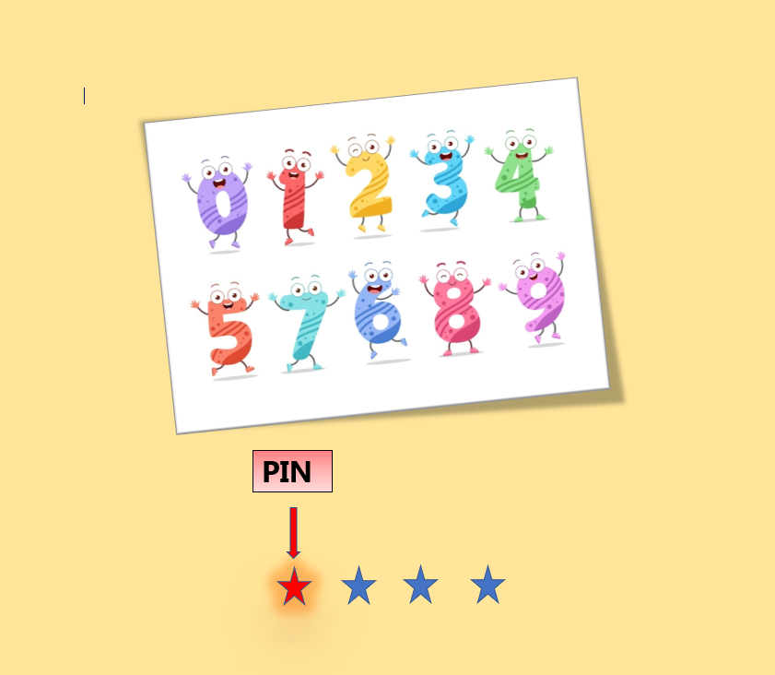
1st Pin#

Slide 3
Chris’ Favorites
F.QTREMP - Total Employees By Location
F.QTRWAGES - Quarterly Wages by Location
E.VACBALRP - Vacation Balance (EOY Vacation Rollover)

Slide 4
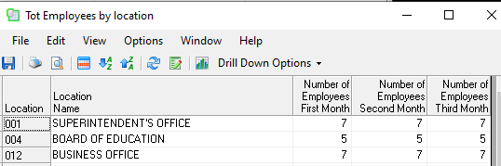
F.QTREMP Total Employees By Location
Sequel Sample:
The program that creates the sequel is: F.QTREMP
Enter the payroll run number for each quarter.

Slide 5

F.QTRWAGES Quarterly Wages by Location
Sequel Example:
The program that creates the sequel is: F.QTRWAGES
You may need to tweak: We eliminate our board members by job type “BD”.
Enter the quarter as “1” or “2”, etc.

Slide 6
E.VACBALRP Vacation Balance (EOY Vacation Rollover) and the Deferred Compensation report
Report Sample:
The program that creates the sequel is: E.VACBAL
The report sequel is E.VACBALRP
You may need to tweak: We pull for absence codes V240, V250 and V260.
You have the option to put a limit to the number of days it will pull.

Slide 7
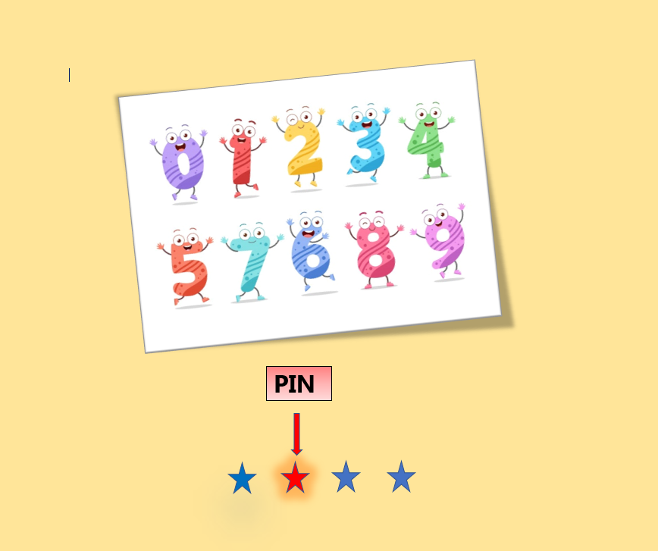
2nd Pin #

Slide 8
Tracy’s Favorites
F.TRACYCHK - Balancing sequel to pull what has been paid between two check numbers; Shows account.
F.TRACYREC - Run at EOM to see if any AP check not coded to expense acct.
E.PRCHCKSR - Run at EOM for total of payroll checks
F.ALOCBEG; F.ALOCJRNL; F.ALOCENC; F.ALOCTRN - Creates excel feed for End of Month reports going to school.

Slide 9

F.TRACYCHK – Balancing sequel to pull what has been paid between two check numbers; Shows account.
Sequel Results:
Enter Report Month
Enter Beginning Check Number
Enter Ending Check Number

Slide 10
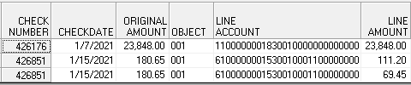
F.TRACYREC – Run at EOM to see if any AP check not coded to expense acct.
Sequel Results:
Enter Report Month
Will show accounts that include objects < 100 and not equal to 004.

Slide 11
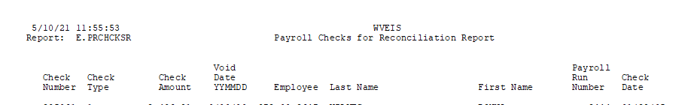
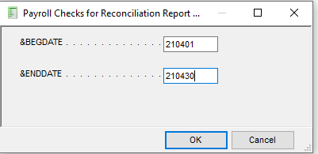
E.PRCHCKSR – Run at EOM for total of payroll checks
Report Sample:
Prints by check type and check number.
Enter beginning and ending dates as shown:

Slide 12
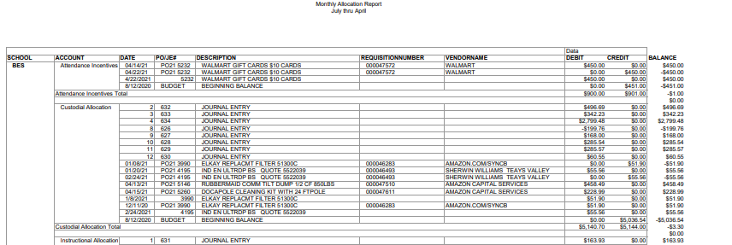
F.ALOCBEG; F.ALOCJRNL; F.ALOCENC; F.ALOCTRN – Creates excel feed for End of Month reports going to school
Report Sample(Excel)
F.ALOCBEG creates ALOCBEG
F.ALOCJRNL creates ALOCJRNL
F.ALOCENC creates ALOCENC
F.ALOCTRN create ALOCTRN
Once files are created, open in excel and combine files into one.
Use excel pivot table function to format.

Slide 13
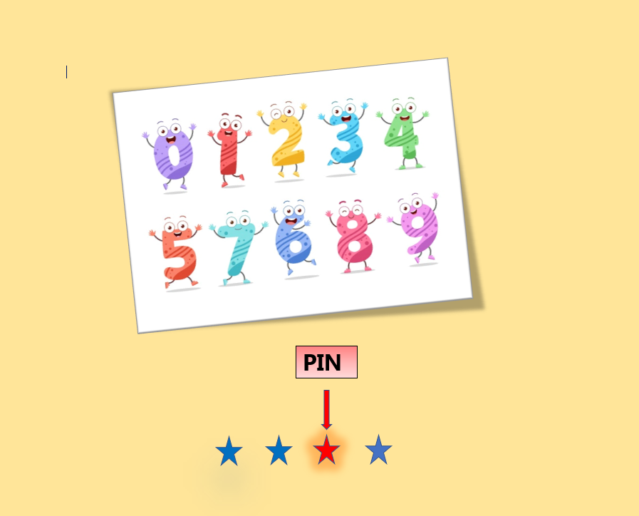
3rd Pin #

Slide 14
David’s Favorites
E.FACSENFT; E.FACSENFR – Faculty Senate Distribution Report
E.FACSNR – Faculty Senate Nurse Report
E.FACSSE – Faculty Senate Speech Pathologists Report

Slide 15
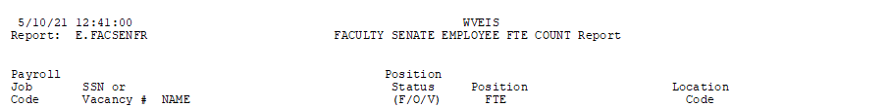
E.FACSENFT; E.FACSENFR – Faculty Senate Distribution Report
Report Results:
E.FACSENFT generates data for report feed.
E.FACSENFR generates the report.
Report based on position inventory

Slide 16
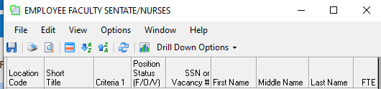
E.FACSNR – Faculty Senate Nurse Report
Sequel Results:
Report based on position inventory
E.FACSNR generates the list of nurses and their FTE.

Slide 17
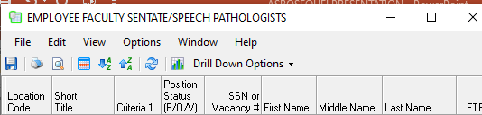
E.FACSSE – Faculty Senate Speech Pathologists Report
Sequel Results:
Report based on position inventory
E.FACSSE generates the list of Speech Language Pathologists and their FTE

Slide 18
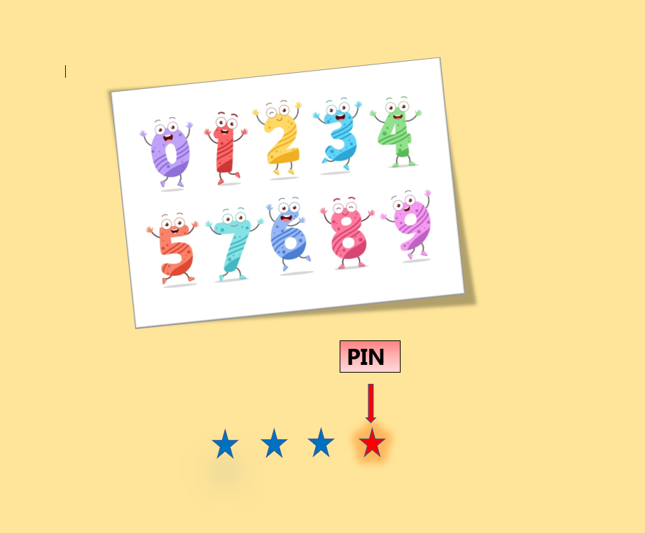
4th Pin #

Slide 19
My favorites
E.LEAVEBAL; E.LEAVEBL2; E.LEAVEBLR – Quick Snapshot of Leave Balances
PI.VACANCT; PI.VACRPT – Position Inventory Vacancy Report
E.AVGDEGP2 – Professional employee count by Pay Step or Pay Grade
E.AVGYRSSV – Service employee county by Pay Step
E.PROADDEN; E.PROADDNB; E.PROSALAR – Professional Daily Rates
E.SVCADDEN; E.SVCADDNB; E.SVCSALAR – Service Daily Rates
EMPLEELIST – Employee Count by location
POLOGNY – Purchase Order Log by year

Slide 20
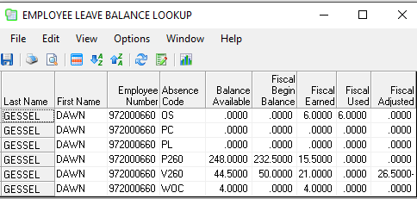
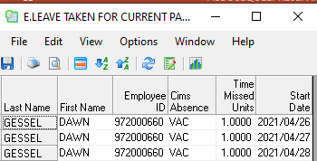
E.LEAVEBAL; E.LEAVEBL2; E.LEAVEBLR – Quick Snapshot of Leave Balances
Sequel Results:
Enter employee name
E.LEAVEBAL will generate the Leave balance from balances file
E.LEAVEBL2 will generate the leave taken from the TSSI system
E.LEAVEBLR is a script that will prompt for employee name one time and run both.

Slide 21
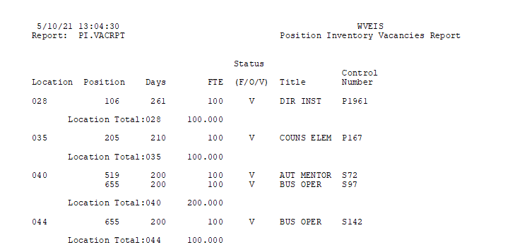
PI.VACANCT; PI.VACRPT – Position Inventory Vacancy Report
Report Results:
PI.VACANCT generates file to feed report.
PI.VACRPT generates report.

Slide 22
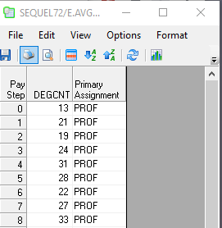
E.AVGDEGP2 for Professional staff with a degree and also years of experience.
Sequel Sample:
The program that creates the sequel is: E.AVGDEGP2
You can tweak to hide the pay step and sort by pay grade.

Slide 23
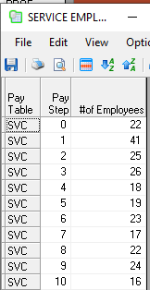
E.AVGYRSSV for Service staff - years of experience.
Sequel Sample:
The program that creates the sequel is: E.AVGYRSSV

Slide 24
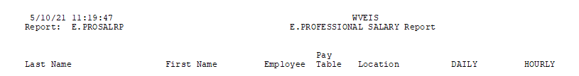
E.PROADDEN; E.PROADDNB; E.PROSALAR; E.PROSALRP – Professional Daily Rates
Report Sample:
This will require all 4 sequels
E.PROADDEN will create PROADDENDA
E.PROADDNB will create PROADDENDB
E.PROSALRP will generate the report

Slide 25

E.SVCADDEN; E.SVCADDNB; E.SVCSALAR; E.SVCSALRP – Service Daily Rates
Report Sample:
E.SVCADDEN will create SVCADDENDA
E.SVCADDNB will create SVCADDENDB
E.SVCSALRP will generate the report

Slide 26
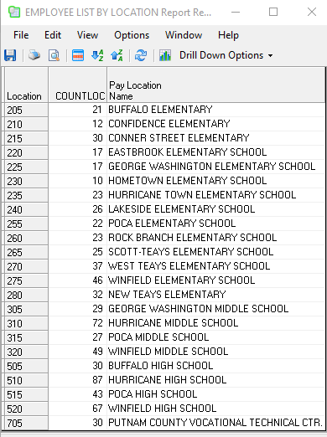
EMPLEELIST – Professional Employee Count by location
Sequel Sample:
Professional Employee Count

Slide 27
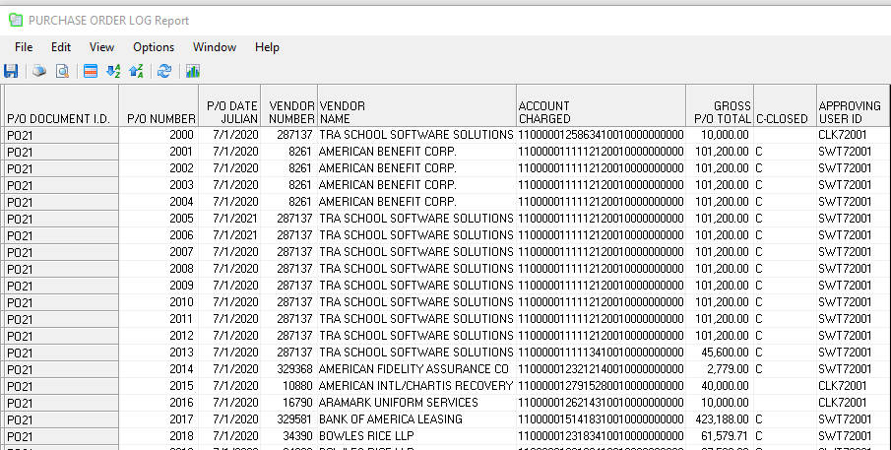
POLOGNY – Purchase Order Log for year
Sequel Results:
Purchase order log by fiscal year.

Slide 28
When pulling sequels, what you need to know:
Sequel72 is Putnams’ directory name
Sequels named with E. for Employee(EMS) data
Sequels named with F. for Financial(FMS)
Sequels named with FA. for fixed assets
Sequels named with PI. for position inventory

Slide 29
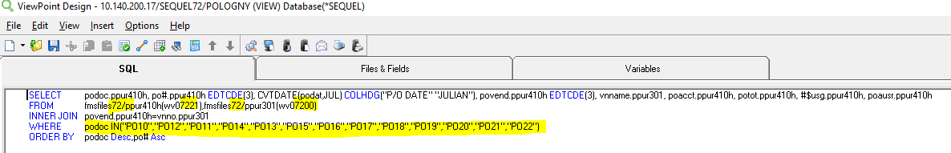
Example Sequel to alter for your county
ViewPoint Design Screen
When opening the sequel, you will receive an error since you do not have access to the SEQUEL72 directory.
You will see the SQL tab
Altering the 72 with your county number and saving the sequel in your sequel directory should correct the access issue.
You will then want to review the Where statement to make sure it matches the data you use.

Slide 30
Questions?
Dawn Gessel
Director of Information Systems
Putnam County Schools
dgessel@k12.wv.us

