Slide 1
Overview of The West Virginia Open Governmental Proceedings Act
Roger Hanshaw
Trey Morrone
October 29, 2020

Slide 2
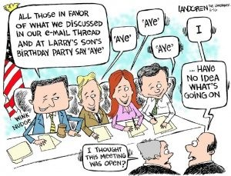

Slide 3
Legislative Intent
W. Va. Code 6-9A-1
The people in delegating authority do not give their public servants the right to decide what is good for them to know and what is not good for them to know
Informed people retain control over the instruments of government
Openness fosters preparation and public input which allow government agencies to more closely tailor actions and policies to public needs
Openness, public access, and a desire to improve government operations do not require nor permit every meeting to be a public meeting

Slide 4

The Meaning of Meeting
W. Va. Code 6-9A-2(4)
The convening of a governing body
Of a public agency
For which a quorum is required
To make a decision or deliberate toward a decision on any matter which results in official action
Telephone meetings?
  Special requirements must be met

Slide 5
The Act Covers:
Meeting notice: When, where, how
Meeting conduct: Speakers, order, voting, media
Meeting minutes: Contents and access
Executive sessions: Grounds and procedure
Violations: Civil and criminal penalties and consequences
Education and interpretation

Slide 6
Not Covered: Gatherings That Are Not Meetings
W. Va. Code §§ 6-9A-2(4)(A) through (E)
Making adjudicatory decisions
On site inspections
Political party caucuses
General discussions with no intent to lead to action
Discussions of meeting logistics and procedures

Slide 7
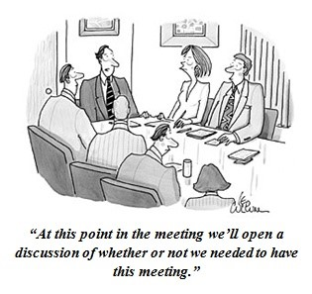
Also Not Covered
W. Va. Code § 6-9A-3
Open/closed meetings expressly and specifically provided by other provisions of law

Slide 8
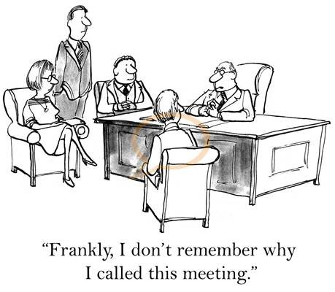
The Key Question: Is it a Meeting?
Is it a “meeting” under the Sunshine Law when more than a quorum participates in:
  information sessions?
  work sessions?
  committee work?
  parking lot conversation?
  telephone tag?
  e-mail discussions?
  polling?

Slide 9
Meetings in a school system contest
With that in mind, what is a meeting?
W. Va. Code § 6-9A-2(5) defines a “meeting” as:
  the convening of a governing body of a public agency for which a quorum is required in order to make a decision or to deliberate toward a decision on any matter which results in an official action. Meetings may be held by telephone conference or other electronic means.
Be careful not to have an “accidental meeting.”

Slide 10
McComas v. Fayette County Bd. of Education
McComas v. Bd. of Educ. Fayette Co., 197 W. Va. 188 (1996).
In 1996, the Fayette County Board of Education was facing the question of whether to move forward with a consolidation plan.
After a series of informal discussions and gatherings, none of which involved a quorum of the board, the board eventually voted to consolidate.
Citizens filed a lawsuit alleging violations of the WVOGPA.
The circuit court, and later the West Virginia Supreme Court, found that the board HAD violated the act by having what amounted to a meeting to decide the question of consolidation.

Slide 11

Meeting Notice: When, Where, How

Slide 12
Meeting Notice: When, Where, How
W. Va. Code § 6-9A-3
Every public body must have a policy providing for making available to public and news media, in advance, the
  Date, time, place, and agenda of all regularly scheduled meetings
  Date, time, place and purpose of all special meetings
Exception: In the event of an emergency requiring immediate official action
  File a meeting notice at any time prior to meeting stating:
    The date, time, place, and purpose of the meeting
    The facts and circumstances of the emergency

Slide 13
Meeting Notice: When, Where, How
How much notice? According to the W. Va. Open Governmental Meetings Advisory Committee, the minimum requirements are:
  For bodies which meet twice or less per month:
    3 business days notice of regular meetings
    2 business days notice of amendments to regular meeting agendas
    2 business days notice of special meetings
  For bodies that meet more often:
    2 business days notice of regular meetings
    Otherwise, the same as above

Slide 14
A Word About Agendas
At a regular meeting, the body may not deliberate or take action upon an item that was not on the agenda
At a special meeting, the body may not deliberate or take action upon an item that was not a stated purpose in the notice of meeting
Items on the agenda must be described with sufficient flexibility, but may be worded to give clear notice of flexibility
  Unacceptable: “New business,” “Old business,” “Other business,” “Personnel matters”
Topics not on the agenda that come up during “delegations” may be listened to but not acted upon

Slide 15
POSTING MEETING NOTICES & AGENDAS
  At least three business days before a regularly scheduled meeting
  At least two business days before a special meeting
  Consider the following when computing the number of business days required for giving appropriate notice:
    Saturdays
    Sundays
    Legal Holidays
    Day of the Meeting
    Outside School Environment (OSE) Days
    Out-of-Calendar (OC) Days
  Open Meetings Advisory Opinion No. 2019-01 (January 3, 2019)

Slide 16
CHANGES TO AGENDA DURING MEETING
Changing the order of business at beginning or during a meeting
  Inherent discretion
  As circumstances require
  Subject to duly adopted procedural rules
  Open Meetings Advisory Opinion No. 2008-011 (September 04, 2008)
  New matters arise during course of a meeting
    Discussion
    Official action or decision must be deferred
    Open Meetings Advisory Opinion No. 2008-017 (December 04, 2008)

Slide 17
ITEMS NOT LISTED ON THE AGENDA
A matter must be listed on the agenda in order to:
vote
discuss the merits
deliberate towards a decision
  Open Meetings Advisory Opinion No. 2011-03 (May 5, 2011)

Slide 18
WORK SESSIONS
Work Sessions with Quorum of Members
  Agenda must be published which identifies items to be discussed (even if no voting)
  Agenda must be published in a manner consistent with the county boards usual and regular procedures for noticing an official meeting
  Work Sessions with Less Than Quorum of Members
  Discussions by less than quorum of county board members when acting as a subgroup of the county board and meeting to exercise some portion of county board’s authority
  Open Meetings Advisory Opinion No. 2013-06 (February 06, 2014)

Slide 19
INVOICES & COUNTY BOARD APPROVAL
Agenda Item
“Approve Invoices”
“Payment of Bills”
No requirement that the agenda list each invoice and the amount being considered
Open Meetings Advisory Opinion No. 2012-04 (December 6, 2012)

Slide 20
ENSURING PUBLIC ACCESS TO INFORMATION
General agenda items and do not list on agenda all payments being considered must either make available for public review at least two business days before the meeting:
  a list of all invoices being considered and including
  name of each vendor
  amount owed to each
  or
  all invoices being considered
In either case, the agenda must state under the agenda item that a list of the invoices or the invoices themselves are available for review
Open Meetings Advisory Opinion No. 2012-04 (December 6, 2012)

Slide 21

Meeting Minutes: Contents and Access
Attendees can verify that what they think happened did happen, and non-attendees can learn what happened.

Slide 22
Meeting Minutes: Contents & Access
W. Va. Code § 6-9A-5
Minimum contents:
  Meeting date, time, and place
  Name of each member present and absent
  Each motion and other measure proposed, by whom, and the disposition
  The results of all votes and, upon request of a member, the vote of each member, by name
Optional matters
Executive sessions exception

Slide 23
MINUTES BECOME OFFICIAL RECORD
Minutes become the official record of a county board meeting when approved by the county board at its next meeting
When must minutes be made available to the public?
  “draft” minutes
  “official” minutes
  “reasonable period of time”
  “material changes”
  Open Meetings Advisory Opinion No. 2010-04 (October 7, 2010)

Slide 24
INVOICES & COUNTY BOARD MINUTES
In its minutes, the governing body may simply indicate that there was a motion to approve invoices and that it passed
If the minutes do not record the name and amount of every invoice approved, governing bodies should attach to the minutes a list of the invoices approved and the amount of each
Open Meetings Advisory Opinion No. 2012-04 (December 6, 2012)

Slide 25
GRANT AWARDS OR REQUESTS FOR MONEY
Agenda
sufficient wording - “Consider grant application of Sue Smith”
Motion
must include the amount being awarded
Minutes
must include name of recipient and the amount awarded
Open Meetings Advisory Opinion No. 2012-04 (December 6, 2012)

Slide 26

Meeting Conduct:
Speakers, Order, Voting, Media
Open meetings are required even when logistical and other challenges occur, but the challenges can be surmounted.

Slide 27
Meeting Conduct: Speakers, Order, Voting, Media
W. Va. Code § 6-9A-3, 8, 9
Presumption: Open meetings
Radio and television: Placement and use, pooling
Crowded meetings: Attendance and presentation rules
Disruption: The right to attend is not the right to disrupt
The “15 minute” rule
Action by reference; written ballots

Slide 28
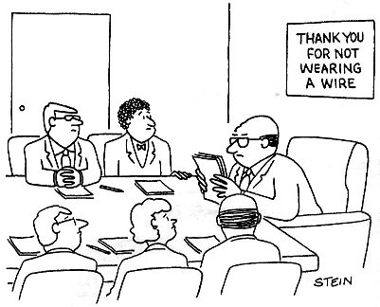
Executive Sessions: Grounds and Procedure

Slide 29
Executive Sessions: Grounds and Procedure
W. Va. Code § 6-9A-4
No wholly secret meetings. You must at least convene and adjourn in public.
No decisions in executive session
What is a decision?
Discretion to go into executive session

Slide 30
The Justifications for Executive Session
War and riot
Personnel matters and hearings (specific personnel matters, not policy matters)
Disciplining a student
License and certification actions
A person’s physical or mental health
Unwarranted invasion of a person’s privacy
Crime prevention; law enforcement
Security personnel/devices
Property transactions, construction plans, investments & commercial competition, IF publicity would harm public interest
Secrecy of prizes and awards
Settlements
Matters rendered confidential by law

Slide 31
The Procedure for Going Into Executive Session
Not determined by the agenda
The ONLY valid way:
  Motion adopted in public session, stating the reason:
    Identify “the authorization” under the statute for going into executive session
    Pointer: be as specific as you can without negating the very reason that confidentiality is warranted
  Presiding officer’s announcement of the authorization to the public and the body

Slide 32
Executive Sessions: Issues Under the Act
Individuals may force a public session in the case of:
  Personnel matters and hearings
  Disciplining a student
  Specific license and certification actions
  A person’s physical or mental health
Exceptions to the Act’s “no decision” rule?
  Disciplining a student
  Settlement

Slide 33
Executive Sessions: Consultation with an Attorney?
W. Va. Code 6-9A-4(b)(11): Nothing in this article permits a public agency to close a meeting that otherwise would be open, merely because an agency attorney is present
Peters v. County Commission of Wood County (1999): Privileged communications between a public body and its attorney may be closed to the public, but only by
  A majority affirmative vote of the members
  In accordance with the notice requirements of 6-9A-3
  If the written minutes requirements of 6-9A-5 are observed

Slide 34
Violations: Civil and Criminal Consequences
W. Va. Code § 6-9A-3, 6, 7
Civil Remedies:
  Compel compliance, enjoin non-compliance
  Nullify decisions
  Order future compliance
  Attorney fees and expenses
  Bond issue exception
  Recorded in minutes
Criminal Penalties:
  Misdemeanor
    First offense: fine not to exceed $500
    Subsequent offenses: fine of between $100 and $1,000

Slide 35
Education and Interpretation
W. Va. Code § 6-9A-10, 11
Committee on Open Governmental Meetings
  A committee of the W. Va. Governmental Ethics Commission
    http://www.ethics.wv.gov/openmeetings/Pages/default.aspx
  Advisory opinions
    Binding on the requesting party
    Immunity if act in good faith on the opinion, or on an opinion regarding another body
    Confidentiality
    Phone: 558-0664; 1-866-558-0664

Slide 36
Education and Interpretation
W. Va. Code § 6-9A-12
  The Attorney General compiles open meetings statutes, case law, summaries and interpretations
The Clerk of the County Commission must
  provide the compilation to each elected official within the jurisdiction
  make the material available to appointed public officials
  provide a copy or summary to newly appointed or elected persons within 30 days of when they take the oath of office or, as to appointees, when they begin their term

Slide 37


