Slide 1





School Based Health©
Web Demonstration Transportation Services

Slide 2
NON-EMERGENCY TRANSPORTATION DEFINITION
Non-emergency Medical Transportation is a service in which a one-way transport of a member by a vehicle other than an ambulance is provided. If more than one member is being transported, each member’s transport to the Medicaid service is billable. Non-Emergency Transportation may only be billed when a Medicaid covered service is billed for the same date of service

Slide 3
DOCUMENTATION:
Documentation must contain an activity note for each separate transport describing the purpose for the transport, type of vehicle used for the transport, place of departure and arrival, date of service, signature of the providing staff (along with their credentials), and actual time spent providing the service by listing the start-and-stop times. Please see Appendix 538I Transportation Billing Form.

Slide 4
TRANSPORTATION SERVICES
NON-EMERGENCY MEDICAL TRANSPORTATION
WITH BUS AIDE DEFINITION
Non-emergency Medical Transportation with attendant is a service in which a one-way transport of a member by a vehicle other than an ambulance is provided. If more than one member is being transported, each member’s transport to the Medicaid service is billable. Non-Emergency Transportation with an attendant may only be billed when a Medicaid covered service is billed for the same date of service and the attendant is present during the transport.

Slide 5
DOCUMENTATION
Documentation must contain an activity note for each separate transport describing the purpose for the transport, type of vehicle used for the transport, place of departure and arrival, date of service, signature of the providing staff (along with their credentials), and actual time spent providing the service by listing the start-and-stop times. Please see Appendix 538I Transportation Billing Form.

Slide 6
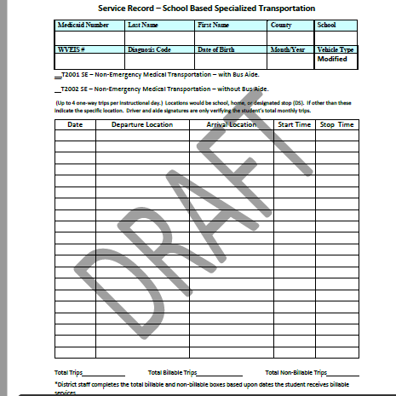

Slide 7

CONTACT INFORMATION FOR KEPRO TRAINER/CONSULTANT
Terri Barnhart BSN, RN
Clinical Auditor/Assessor School Based Health Services
1007 Bullitt Street
Suite 200
Charleston, WV 25301
Telephone: 304-380-0600 Extension 4437
Email; tbarnhart@kepro.com

Slide 8

QUESTIONS OR CONCERNS

