Slide 1





School Based Health © Web Demonstration
Targeted Case Management Services

Slide 2
TARGETED CASE MANAGEMENT (TCM) SERVICES
STAFF CREDENTIALS:
A psychologist with a master’ or doctoral degree from an accredited program
A licensed social worker
A licensed RN
A master or bachelors’ degree granted by an accredited college or university in one of the following human services fields:
  Psychology
  Criminal Justice
  Board of Regents with health specialization
  Recreational Therapy
  Political Science
  Nursing
  Sociology
  Social Work
  Counseling
  Teacher Education
  Behavioral Health Liberal Arts or other degrees approved by the DOE

Slide 3
TCM SERVICES
TCM is a component of the TCM Service Plan. TCM identifies and addresses special health problems and needs that affect the member’s ability to learn, assist the child to gain and coordinate access to a broad range of medical, social, educational, and other services, and ensures that the member receives effective and timely services appropriate to their needs.

Slide 4
TCM SERVICES
The relationship of the targeted case manager with a member and his or her family should be one of a partnership. As such, members, parents, and families are not merely spectators of case management recommendations, but active participants in care planning throughout the case management process. This is a necessary perspective for the member’s needs and/or preferences to be considered and addressed individually and within the environment in which the person resides.

Slide 5
TCM SERVICES
Accordingly, organized strategies that empower members, parents, and families to assume and carry out their responsibilities must be included in this mutual planning process. It is very important that a targeted case manager is aware of and sensitive to the values, attitudes, and beliefs that are unique to each family. Values concerning approaches and styles of parenting and/or family life vary according to culture. The effectiveness of TCM is positively impacted by a demonstrated respect for cultural variations among families. Thus, it is critical that case managers be able to identify and understand cultural beliefs, values, attitudes, and morals by which beneficiaries and their families operate.

Slide 6
TCM SERVICES
TCM effectiveness is further enhanced when integrated with other services and resources identified through a systems perspective, considering all active participants in the individual’s life (including the individual’s parents, family, and significant others and any involved service providers). Interschool collaboration is crucial to ensuring that a member’s needs are adequately met without duplication of services. Thus, it is important for a system to exist within each school to ensure that targeted case managers are communicating with other professionals and involved parties, coordinating care and services and meeting the specific needs of each individual and, as appropriate, the needs of families.

Slide 7
TCM SERVICES
TCM is the coordination of services to ensure that eligible Medicaid members have access to a full array of needed services including the appropriate medical, educational, or other services. TCM is responsible for identifying individual problems, needs, strengths, and resources; coordinating services necessary to meet those needs; and monitoring the provision of necessary and appropriate services. This process is intended to assist beneficiaries and as appropriate, their families, in accessing services which are supportive, effective and cost efficient. TCM activities ensure that the changing needs of the Medicaid beneficiary are addressed on an ongoing basis and that appropriate choices are provided from the widest array of options for meeting those needs.

Slide 8
TCM SERVICES
The LEA is required to have the member’s Targeted Case Management Consent Form (please see Appendix 538H Targeted Case Management Consent Form) signed by the member’s legal representative and kept in the member’s file. LEA’s may not bill for TCM services until the form is completed and signed by the member’s representative.

Slide 9
TCM SERVICES
TCM services must include any of the following activities:
Needs assessment and reassessment
Development and revision of Service Plan
Referral and related activities
Monitoring and follow-up activities
All services shall be fully documented in the member’s record.

Slide 10
TCM SERVICES-NEEDS ASSESSMENT AND REASSESSMENT
Reviewing of the individual’s current and potential strengths, resources, deficits and need for medical, social, educational and other services.
Gathering information from other sources such as family members, medical providers, social workers, and educators (if necessary), to form a complete assessment of the eligible individual. Results of assessments and evaluations are reviewed, and a meeting is held with the individual, his or her parent(s) and /or guardian, and the case manager to determine whether services are needed and, if so, to develop a service plan. At a minimum, an annual face-to-face reassessment shall be conducted to determine if the client’s needs or preferences have changed.

Slide 11
TCM SERVICES-DEVELOPMENT AND REVISION OF THE TCM SERVICE PLAN
Developing a written plan based on the assessment of strengths and needs, which identifies the activities and assistance needed to accomplish the goals collaboratively developed by the individual, his or her parents(s) or legal guardian, and the case manager. Development (and periodic revision) of the TCM Service Plan will specify the goals and actions to address the medical, social, educational, and other services needed by the eligible individual. The service plan describes the nature, frequency, and duration of the activities and assistance that meet the individual’s needs. Periodic revisions to the TCM Service Plan will be made at a minimum annually. The IEP is not the TCM Service Plan.

Slide 12
TCM SERVICES-REFERRAL AND RELATED ACTIVITIES
Facilitating the individual’s access to the care, services and resources through linkage, coordination, referral, consultation, and monitoring. This is accomplished through in-person and telephone contacts with the individual, his or her parent(s) or legal guardian, and with service providers and other collaterals on behalf of the individual. This will occur as necessary, but at least annually. This may include facilitating the recipient’s physical accessibility to services such as arranging transportation to medical, social, educational and other services; facilitating communication between the individual, his or her parent(s) or legal guardian and the case manager and between the individual, his or her parent(s) or legal guardian and other service providers; or, arranging for translation or another mode of communication. It also includes advocating for the individual in matters regarding access, appropriateness and proper utilization of services; and evaluating, coordinating and arranging immediate services or treatment needed in situations that appear to be emergent in nature or which require immediate attention or resolution in order to avoid, eliminate or reduce a crisis situation for a specific individual. This may also include acquainting the individual, his or her parent(s) or legal guardian with resources in the community and providing information for obtaining services through community programs.

Slide 13
TCM SERVICES-MONITORING AND FOLLOW-UP ACTIVITIES
The case manager shall conduct regular monitoring and follow-up activities with the client, the client’s legal representative, or with other related service providers. Monitoring will be done to ensure that services are being furnished in accordance with the individual's TCM Service Plan. Periodic review of the progress the individual has made on the service plan goals and objectives and the appropriateness and effectiveness of the services being provided on a periodic basis. This review may result in revision or continuation of the plan, or termination of TCM services if they are no longer appropriate. Periodic reviews may be done through personal and telephone contacts with the individual and other involved parties. The periodic reviews will be conducted as necessary but at least annually.

Slide 14
TCM SERVICES-NON-DUPLICATION OF SERVICES
If a member chooses to have TCM services from another provider agency as a result of being members of other covered targeted groups such as foster children etc.; the School-Based Health Services providers will ensure that TCM activities are coordinated to avoid duplication of services.
TCM includes contacts with non-eligible individuals that are directly related to identifying the eligible individual's needs and care, for the purposes of helping the eligible individual access services; identifying needs and supports to assist the eligible individual in obtaining services; providing case managers with useful feedback, and alerting case managers to changes in the eligible individual's needs. TCM activities shall not restrict or be used as a condition to restrict a client’s access to other services under the state plan.

Slide 15
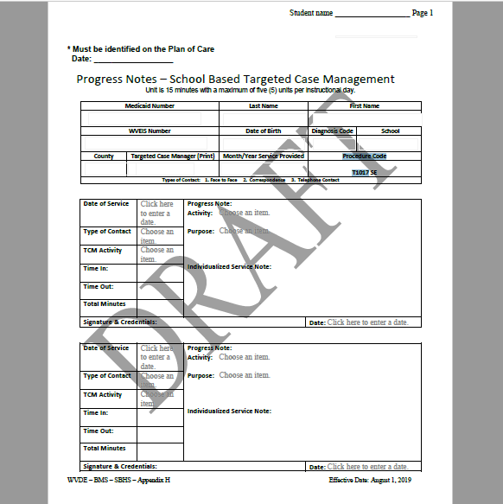
Page 1 of 2

Slide 16
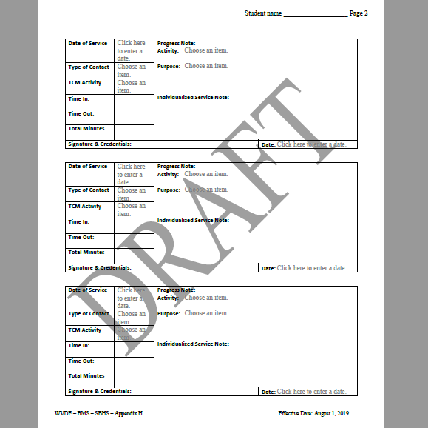
Page 2 of 2

Slide 17

CONTACT INFORMATION FOR KEPRO TRAINER/CONSULTANT
Terri Barnhart BSN, RN
Clinical Auditor/Assessor School Based Health Services
1007 Bullitt Street
Suite 200
Charleston, WV 25301
Telephone: 304-380-0600 Extension 4437
Email; tbarnhart@kepro.com

Slide 18

QUESTIONS OR CONCERNS

