Slide 1





School Based Health © Web Demonstration
Speech Therapy Services

Slide 2
Speech therapy is deemed not medically necessary when the member has:
Reached the highest level of functioning and is no longer progressing
The established plan of care goals and objectives are met
The established plan of care does not require the skills of a speech-language Therapist/pathologist
The member or his/her legal representative has demonstrated the knowledge and skill of providing the speech therapy regime themselves

Slide 3
Speech Therapy Required documentation
A written referral from the treating/prescribing practitioner with pertinent clinical documentation for service(s) requested. The referral must include, but is not limited to:
The member’s name
Date of referral
Type of service requested
Frequency and duration of treatment
Diagnosis
Physician’s, PA’s, or APRN’s signature. Supporting documentation must not be more than six months old

Slide 4
Speech Therapy Required documentation (Cont’d)
The plan of care which must include, but is not limited to:
The date the plan was developed
  Diagnosis
  Short-and long-term functional goals
  Measurable treatment objectives
  Frequency and duration of treatment
  Education/training in speech therapy or hearing devices for the member or their legal representative to attain maximum rehabilitation
  Prognosis
  Date discussed with member or legal representative
  Signature and date of the member or legal representative agreeing to the treatment
  Date, and signature and title of the individual providing treatment
  Plan of care may be developed from information found in the IEP
  An audiology evaluation with audiometric results which cannot be more than six months old prior to dispensing the hearing aid

Slide 5
Speech Therapy Billing Information
Please see Appendix 538B Audio logical Therapy Billing Form or Appendix 538C Speech Therapy Billing Form.

Slide 6
Individual - Speech, Language, Voice, Communication, Auditory Processing
Documentation must contain the following and be completed within 30 calendar days from the date of service.
Documentation must indicate how often this service is to be provided. There must be a progress note describing each service provided, the relationship of the service to the identified speech therapy needs, and the member’s response to the service. The progress note must include the reason for the service, symptoms and functioning of the member, a therapeutic intervention grounded in a specific and identifiable theoretical base that provides framework for assessing change, and the member’s response to the intervention and/or treatment.
Documentation must also include the following:
Member Service Plan
Signature with credentials
Place of service
Date of service
Start and stop time
Utilized Interventions

Slide 7
Group - Speech, Language, Voice, Communication, Auditory Processing
Documentation must contain the following and be completed within 30 calendar days from the date of service.
Documentation must indicate how often this service is to be provided. There must be a progress note describing each service provided, the relationship of the service to the identified speech therapy needs, and the member’s response to the service. The progress note must include the reason for the service, symptoms and functioning of the member, a therapeutic intervention grounded in a specific and identifiable theoretical base that provides framework for assessing change, and the member’s response to the intervention and/or treatment.
Documentation must also include the following:
Member Service Plan
Signature with credentials
Place of service
Date of service
Start and stop time
Utilized Interventions

Slide 8
Evaluation of Speech Fluency
Documentation must contain the following and be completed within 35 calendar days from the date of service:
Date of service
Start and stop time
Location of Service
Physician, PA or APRN order for the evaluation
Purpose of evaluation
Evaluator’s signature with credentials
Presenting problem
Duration and frequency of symptoms
Members diagnosis per current International Classification of Diseases (ICD) methodology
Medicaid Member’s prognosis and rationale
Rationale for diagnosis
Appropriate recommendations consistent with the findings of the evaluation

Slide 9
Evaluation of Speech Sound Production
Documentation must contain the following and be completed within 35 calendar days from the date of service:
Date of service
Start and stop time
Location of service
Physician, PA, or APRN order for the evaluation
Purpose of evaluation
Evaluator’s signature with credentials
Presenting problem
Duration and frequency of symptoms
Members diagnosis per current ICD methodology
Medicaid Member’s prognosis and rationale
Rationale for diagnosis
Appropriate recommendations consistent with the findings of the evaluation

Slide 10
Evaluation of Speech Sound Production with Evaluation of Language Comprehension
Documentation must contain the following and be completed within 35 calendar days from the date of service:
Date of service
Start and stop time
Location of service
Physician, PA, or APRN order for the evaluation
Purpose of evaluation
Evaluator’s signature with credentials
Presenting problem
Duration and frequency of symptoms
Members diagnosis per current ICD methodology
Member’s prognosis and rationale
Rationale for diagnosis
Appropriate recommendations consistent with the findings of the evaluation.

Slide 11
Behavioral and Qualitative Analysis
Documentation must contain the following and be completed within 35 calendar days from the date of service:
Date of service
Start and stop time
Location of service
Physician, PA or APRN order for the evaluation
Purpose of evaluation
Evaluator’s signature with credentials
Presenting problem
Duration and frequency of symptoms
Members diagnosis per current ICD methodology
Rationale for diagnosis
Member’s prognosis and rationale
Appropriate recommendations consistent with the findings of the evaluation.

Slide 12
Speech Auditory Threshold
Documentation must contain the following and be completed within 35 calendar days from the date of service:
Date of service
Start and stop time
Location of service
Physician, PA, or APRN order for the evaluation
Purpose of evaluation
Evaluator’s signature with credentials
Presenting problem
Duration and frequency of symptoms
Members diagnosis per current ICD methodology
Member’s prognosis and rationale
Rationale for diagnosis
Appropriate recommendations consistent with the findings of the evaluation

Slide 13
Speech Audiometry with Speech Recognition
Documentation must contain the following and be completed within 35 calendar days from the date of service:
Date of service
Start and stop time
Location of Service
Physician, PA, or APRN order for the evaluation
Purpose of evaluation
Evaluator’s signature with credentials
Presenting problem
Duration and frequency of symptoms
Members diagnosis per current ICD methodology
Member’s prognosis and rationale
Rationale for diagnosis
Appropriate recommendations consistent with the findings of the evaluation

Slide 14
Comprehensive Audiometry Threshold Evaluation with Speech Recognition
Documentation must contain the following and be completed within 35 calendar days from the date of service:
Date of service
Start and stop time
Location of service
Physician, PA, or APRN order for the evaluation
Purpose of evaluation
Evaluator’s signature with credentials
Presenting problem
Duration and frequency of symptoms
Member’s diagnosis per current ICD methodology
Member’s prognosis and rationale
Rationale for diagnosis
Appropriate recommendations consistent with the findings of the evaluation

Slide 15
Loudness Balance Test
Documentation must contain the following and be completed within 35 calendar days from the date of service:
Date of service
Start and stop time
Location of service
Physician, PA, or APRN order for the evaluation
Purpose of evaluation
Evaluator’s signature with credentials
Presenting problem
Duration and frequency of symptoms
Members diagnosis per current ICD methodology
Member’s prognosis and rationale
Rationale for diagnosis
Appropriate recommendations consistent with the findings of the evaluation

Slide 16
Tympanometry
Documentation must contain the following and be completed within 35 calendar days from the date of service:
Date of service
Start and stop time
Location of service
Physician, PA, or APRN order for the evaluation
Purpose of evaluation
Evaluator’s signature with credentials
Presenting problem
Duration and frequency of symptoms
Members diagnosis per current ICD methodology
Member’s prognosis and rationale
Rationale for diagnosis
Appropriate recommendations consistent with the findings of the evaluation

Slide 17
Acoustic Reflex Testing
Documentation must contain the following and be completed within 35 calendar days from the date of service:
Date of service
Start and stop time
Location of service
Physician, PA or APRN order for the evaluation
Purpose of evaluation
Evaluator’s signature with credentials
Presenting problem
Duration and frequency of symptoms
Members diagnosis per current ICD methodology
Member’s prognosis and rationale
Rationale for diagnosis
Appropriate recommendations consistent with the findings of the evaluation

Slide 18
Acoustic Emittance Testing
Documentation must contain the following and be completed within 35 calendar days from the date of service:
Date of service
Start and stop time
Location of Service
Physician, PA, or APRN order for the evaluation
Purpose of evaluation
Evaluator’s signature with credentials
Presenting problem
Duration and frequency of symptoms
Members diagnosis per current ICD methodology
Medicaid Member’s prognosis and rationale
Rationale for diagnosis
Appropriate recommendations consistent with the findings of the evaluation

Slide 19
Filtered Speech Test
Documentation must contain the following and be completed within 35 calendar days from the date of service:
Date of service
Start and stop time
Location of service
Physician, PA or APRN order for the evaluation
Purpose of evaluation
Evaluator’s signature with credentials
Presenting problem
Duration and frequency of symptoms
Members diagnosis per current ICD methodology
Member’s prognosis and rationale

Slide 20
Conditioning Play Audiometry
Documentation must contain the following and be completed within 35 calendar days from the date of service:
Date of service
Start and stop time
Location of service
Physician, PA, or APRN order for the evaluation
Purpose of evaluation
Evaluator’s signature with credentials
Presenting problem
Duration and frequency of symptoms
Members diagnosis per current ICD methodology
Medicaid Member’s prognosis and rationale
Rationale for diagnosis
Appropriate recommendations consistent with the findings of the evaluation

Slide 21
Select Picture Audiometry
Documentation must contain the following and be completed within 35 calendar days from the date of service:
Date of service
Start and stop time
Location of service
Physician, PA, or APRN order for the evaluation
Purpose of evaluation
Evaluator’s signature with credentials
Presenting problem
Duration and frequency of symptoms
Members diagnosis per current ICD methodology
Member’s prognosis and rationale
Rationale for diagnosis
Appropriate recommendations consistent with the findings of the evaluation

Slide 22
Distortion Product Evoked Otoacoustic Emission
Documentation must contain the following and be completed within 35 calendar days from the date of service:
Date of service
Start and stop time
Location of service
Physician, PA, or APRN order for the evaluation
Purpose of evaluation
Evaluator’s signature with credentials
Presenting problem
Duration and frequency of symptoms
Members diagnosis per current ICD methodology
Member’s prognosis and rationale
Rationale for diagnosis
Appropriate recommendations consistent with the findings of the evaluation

Slide 23
Hearing Aid Examination - Monaural
Documentation must contain the following and be completed within 35 calendar days from the date of service:
Date of service
Start and stop time
Location of service
Physician, PA, or APRN order for the evaluation
Purpose of evaluation
Evaluator’s signature with credentials
Members diagnosis per current ICD methodology
Member’s prognosis and rationale
Rationale for diagnosis
Appropriate recommendations consistent with the findings of the evaluation

Slide 24
Hearing Aid Examination - Binaural
Documentation must contain the following and be completed within 35 calendar days from the date of service:
Date of service
Start and stop time
Location of service
Physician, PA, or APRN order for the evaluation
Purpose of evaluation
Evaluator’s signature with credentials
Members diagnosis per current ICD methodology
Member’s prognosis and rationale
Rationale for diagnosis
Appropriate recommendations consistent with the findings of the evaluation

Slide 25
Hearing Aid Check- Monaural
Documentation must contain the following and be completed within 35 calendar days from the date of service:
Date of service
Start and stop time
Location of service
Provider’s signature with credentials
Documentation with results of check
Appropriate recommendations consistent with the findings of the check

Slide 26
Hearing Aid Check - Binaural
Documentation must contain the following and be completed within 35 calendar days from the date of service:
Date of service
Start and stop time
Location of service
Provider’s signature with credentials
Documentation with results of check
Appropriate recommendations consistent with the findings of the check

Slide 27
Electroacoustic Evaluation for Hearing Aid - Monaural
Documentation must contain the following and be completed within 35 calendar days from the date of service:
Date of service
Start and stop time
Location of service
Physician, PA, or APRN order for the evaluation
Purpose of evaluation
Evaluator’s signature with credentials
Presenting problem
Duration and frequency of symptoms
Members diagnosis per current ICD methodology
Member’s prognosis and rationale
Rationale for diagnosis
Appropriate recommendations consistent with the findings of the evaluation

Slide 28
Ear Protector Attenuation Measurements
Documentation must contain the following and be completed within 35 calendar days from the date of service:
Date of service
Start and stop time
Location of service
Physician, PA, or APRN order for the evaluation
Purpose of measurements
Evaluator’s signature with credentials
Presenting problem
Members diagnosis per current ICD methodology
Documentation of measurements

Slide 29
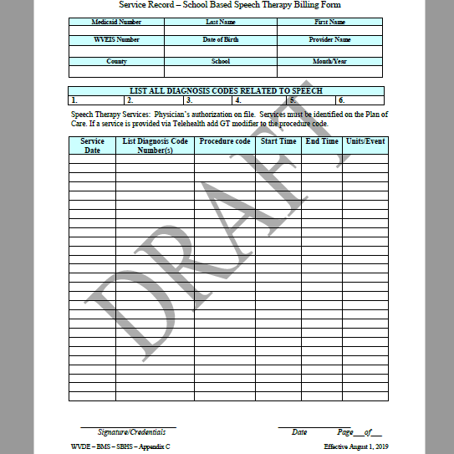

Slide 30
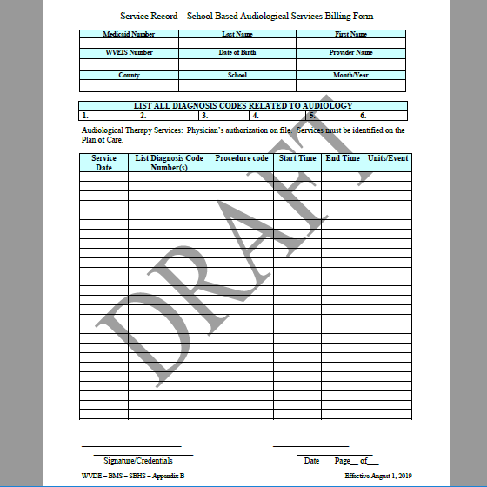

Slide 31

Contact information for KEPRO Trainer/Consultant
Terri Barnhart BSN, RN
Clinical Auditor/Assessor School Based Health Services
1007 Bullitt Street
Suite 200
Charleston, WV 25301
Telephone: 304-380-0600 Extension 4437
Email: tbarnhart@kepro.com

Slide 32

Questions or Concerns

