Slide 1






School Based Health © Web Demonstration
Psychological Services

Slide 2
Psychiatric Diagnostic Evaluation (No Medical Services)
Documentation must contain the following and be completed within 20 calendar days from the date of service:
Date of service
Location of service
Purpose of evaluation
Psychiatrist’s/psychologist’s signature with credentials
Presenting problem
History of member’s presenting illness
Duration and frequency of symptoms
Current and past medication efficacy and compliance
Psychiatric history up to present day
Medical history related to behavioral health condition
Mental Status Exam must include the following elements:
Appearance
Behavior
Attitude (continued on next slide)

Slide 3
Psychiatric Diagnostic Evaluation (No Medical Services) continued
Level of consciousness
Orientation
Speech
Mood and Affect
Thought process/form and thought content
Suicidality and homicidally
Insight and judgment
Members diagnosis per current Diagnostic and Statistical Manual of Mental Disorders (DSM) or ICD methodology
Member’s prognosis and rationale

Slide 4
Psychological Testing, Administration and Scoring
Documentation must be completed within 20 calendar days from the date of service and must include the following:
Date of service; Location of services; Start and stop time; Signature with credentials
Purpose of the evaluation
Documentation that member was present for the evaluation
Report must contain results (score and category) of the administered tests/evaluation
Report must contain interpretation of the administered tests/evaluations
Behavior
Mental Status Exam must include the following elements: o Appearance
Attitude
Level of consciousness
Orientation
Speech
Mood and affect
Thought process/form and thought content
Suicidality and homicidally
Insight and judgment
Rendering of the member’s diagnosis within the current DSM or ICD methodology
Recommendations consistent with the findings of administered tests/evaluations

Slide 5

Psychological Testing, Administration and Scoring Service Exclusions
Psychometrician/technician work
Computer - scoring
Self-administered assessments
Computer - interpretation
Interns may not bill for this service
Must utilize 96130 to be able to bill for 96131

Slide 6
Psychotherapy Services
Psychotherapy is the treatment of mental illness and behavioral disturbances in which the psychologist through definitive therapeutic communication, attempts to alleviate the emotional disturbances, reverse or change maladaptive patterns of behavior, and encourage personality growth and development. The psychotherapy codes 90832, 90834, and 90837 include ongoing assessment and adjustment of psychotherapeutic interventions and may include the involvement of family member(s) or others in the treatment process.
Psychotherapy times are face-to-face services with member and/or family member. The patient must be present for all or some of the service. In reporting, choose the code closest to the actual time (i.e., 16-37 minutes for 90832, 38-52 minutes for 90834, and 53 or more minutes for 90837).

Slide 7
Psychotherapy Services Required Documentation
Documentation must contain the following and be completed within 20 calendar days from the date of service.
Documentation must indicate how often this service is to be provided. There must be a progress note describing each service provided, the relationship of the service to the identified mental health treatment needs, and the member’s response to the service. The progress note must include the reason for the service, symptoms and functioning of the member, a therapeutic intervention grounded in a specific and identifiable theoretical base that provides framework for assessing change, and the member’s response to the intervention and/or treatment.
Documentation must also include the following:
Member Service Plan
Signature with credentials
Place of service
Date of service
Start and stop time
Utilized interventions

Slide 8
Family Psychotherapy (without the patient present)
Documentation must contain the following and be completed within 20 calendar days from the date of service.
Documentation must indicate how often this service is to be provided. There must be a progress note describing each service provided, the relationship of the service to the identified mental health treatment needs, and the member’s response to the service. The progress note must include the reason for the service, symptoms and functioning of the member, a therapeutic intervention grounded in a specific and identifiable theoretical base that provides framework for assessing change, and the member’s response to the intervention and/or treatment.
The documentation must also include the following:
Member Service Plan
Signature with credentials
Place of service
Date of service
Start and stop time
Utilized interventions

Slide 9
Family Psychotherapy (with the patient present)
Documentation must contain the following and be completed within 20 calendar days from the date of service.
Documentation must indicate how often this service is to be provided. There must be a progress note describing each service provided, the relationship of the service to the identified mental health treatment needs, and the member’s response to the service. The progress note must include the reason for the service, symptoms and functioning of the member, a therapeutic intervention grounded in a specific and identifiable theoretical base that provides framework for assessing change, and the member’s response to the intervention and/or treatment.
The documentation must also include the following:
Member’s Service Plan
Signature with credentials
Place of service
Date of service
Start and stop times
Utilized interventions

Slide 10
Group Psychotherapy (Other than of a multiple-family group)
Documentation must indicate how often this service is to be provided. There must be a progress note describing each service provided, the relationship of the service to the identified mental health treatment needs, and the member’s response to the service. The progress note must include the reason for the service, symptoms and functioning of the member, a therapeutic intervention grounded in a specific and identifiable theoretical base that provides framework for assessing change, and the member’s response to the intervention and/or treatment.
The documentation must also include the following:
Signature with credentials
Group topic
Place of service
Date of service
Start and stop time
Utilized interventions

Slide 11
Psychotherapy for Crisis
Documentation must contain the following and be completed within 20 calendar days from the date of service.
There must be a progress note for this service. The progress note must include the reason for the service, symptoms and functioning of the member, a therapeutic intervention grounded in a specific and identifiable theoretical base that provides framework for assessing change, and the member’s response to the intervention and/or treatment for the crisis
The documentation must also include the following:
Signature with credentials
Safety plan
Place of service
Date of service
Start and stop time
Mental Status Exam must include the following elements:
Appearance; Behavior; Attitude; Level of consciousness
Orientation
Mood and affect
Thought process/form and thought content
Suicidality and homicidality

Slide 12
Psychotherapy for Crisis Service Exclusions
Response to a domestic violence situation
Admission to a hospital
Admission to a CSU
Transportation or time waiting for transportation
Removal of a minor or an incapacitated adult from an abusive or neglectful household
Completion of certification for involuntary commitment

Slide 13
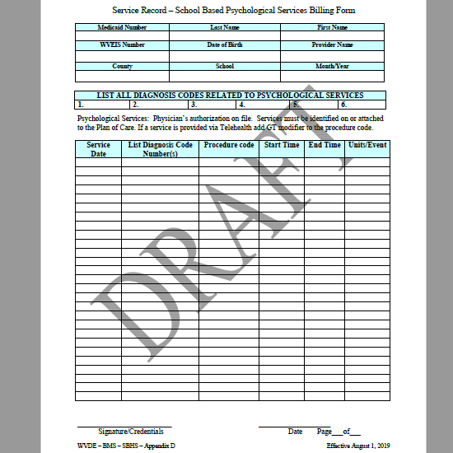

Slide 14

Contact information for KEPRO Trainer/Consultant
Terri Barnhart BSN, RN
Clinical Auditor/Assessor School Based Health Services
1007 Bullitt Street
Suite 200
Charleston, WV 25301
Telephone: 304-380-0600 Extension 4437
Email; tbarnhart@kepro.com

Slide 15

Questions or Concerns

