Slide 1





School Based Health © Web Demonstration
Personal Care Services

Slide 2
PERSONAL CARE SERVICES (ONE-ON-ONE AIDE)
Services are furnished by providers who have satisfactorily completed a program for home health aides/nursing assistants, or other equivalent training, or who have appropriate background and experience in the provision of personal care or related services for individuals with a need for assistance due to physical or behavioral conditions. Providers must have completed a GED or high school diploma. Providers must complete AND continue to have up to date training for the following:
CPR/First Aid;
Abuse, neglect, exploitation and mandatory reporting requirements training; and
HIPAA/confidentiality training

Slide 3
DEFINITION
Services related to a child’s physical and behavioral health requirements, including assistance with eating, dressing, personal hygiene, activities of daily living, bladder and bowel requirements, use of adaptive equipment, ambulation and exercise, behavior modification, and/or other remedial services necessary to promote a child’s ability to participate in, and benefit from, the educational setting. Aide services can be shared across two staff. However, each staff must document their service time with the member. Interpreters and autism mentors can serve as personal care aides. Parents cannot be counted as personal care aides.

Slide 4
THE FOLLOWING ARE THE POSITIONS THAT HAVE BEEN IDENTIFIED AS PROVIDERS OF PERSONAL CARE SERVICES BY THE DOE
Aide I
Aide II
Aide III
Aide IV
Paraprofessional
Autism mentor
Early Childhood Classroom Assistant Teacher (ECCAT) I
Early Childhood Classroom Assistant Teacher (ECCAT) II
Early Childhood Classroom Assistant Teacher (ECCAT) III
Braille specialist
Sign support specialist
Educational Sign Language Interpreter I
Educational Sign Language Interpreter II
Licensed Practical Nurse (LPN)

Slide 5

DOCUMENTATION
Documentation must be completed within 20 calendar days from the date of service. (please see Appendix 538E – Personal Care Medicaid Log).

Slide 6
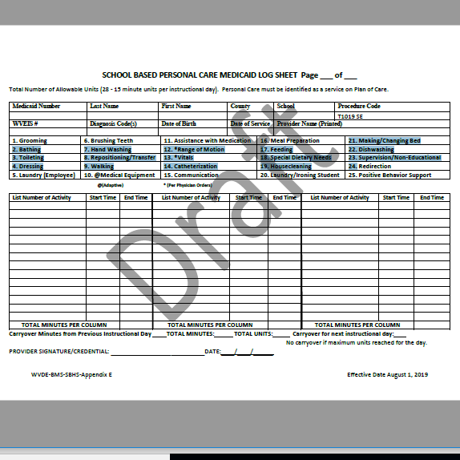

Slide 7

CONTACT INFORMATION FOR KEPRO TRAINER/CONSULTANT
Terri Barnhart BSN, RN
Clinical Auditor/Assessor School Based Health Services
1007 Bullitt Street
Suite 200
Charleston, WV 25301
Telephone: 304-380-0600 Extension 4437
Email; tbarnhart@kepro.com

Slide 8

QUESTIONS OR CONCERNS

