Slide 1





School Based Health © Web
Occupational and Physical Therapy Services

Slide 2

Occupational and Physical Therapy Credentials and Documentation:
Staff Credentials: Must be performed by a West Virginia licensed physical therapist, PTA, licensed occupational therapist, or COTA.
Documentation: Must be completed within 20 calendar days from the date of service. Please see Appendix 538F Occupational Therapy Billing Form or Appendix 538G Physical Therapy Billing Form.

Slide 3
Occupational and Physical Therapy Services
The documentation must also include the following:
Physical therapy diagnosis
Recent physical therapy
Prior functional status
Plan of Care
Physical therapy profile and context
Tolerance to Instrumental Activities of Daily Living (IADLS)
Tolerance to activities
Current splint and orthoses
Recommendations
Prognosis for treatment
Signature with credentials
Place of service
Date of service
Start and stop time

Slide 4
Occupational and physical therapy:
Continuous progress/improvement must be documented for coverage of therapy. The member must show compliance with therapy.
Continuation of services may be considered, when an exacerbated episode of a chronic condition is clearly documented.
A member has the freedom to choose services from Medicaid providers outside the school system. However, West Virginia cannot cover this duplication of services, that is, pay claims for the same services provided in the school system and also outside the school system by private. The LEA is responsible to have the Medicaid member’s representative sign consent for treatment form for any occupational or physical therapy services provided at a school that is intended to be billed to Medicaid.
When school is not in session, continuation of therapy services, if necessary, should be coordinated with a qualified therapist in private practice. The plan of care established by the school system should be written in a way that the private practitioner can pick up where the school therapist ended.

Slide 5
Service Exclusions:
Occupational/physical therapy services that are rendered to an inpatient in a hospital, skilled nursing facility, or other facility.
Occupational / physical therapy services furnished to persons who are not eligible for such services on the date the services are rendered.
Occupational / physical therapy services for members who have reached maximum rehabilitation potential.
Separate payment for hot or cold packs (CPT 97010). Payment for this code has been bundled into the payment for other services.
Experimental services or drugs.

Slide 6
Physical Therapy Evaluation Documentation
Documentation of the evaluation must contain the following and be completed within 20 calendar days from the date of service.
The documentation must also include the following:
Physical therapy diagnosis
Recent physical therapy
Prior functional status
Plan of Care
Physical therapy profile and context
Tolerance to Instrumental Activities of Daily Living (IADLS)
Tolerance to activities
Current splint and orthoses
Recommendations
Prognosis for treatment
Signature with credentials
Place of service
Date of service
Start and stop time

Slide 7
Occupational Therapy Evaluation documentation
Documentation of the evaluation must contain the following and be completed within 20 calendar days from the date of service.
The documentation must also include the following:
Occupational therapy diagnosis;
Recent occupational therapy;
Prior functional status;
Weight bearing activities;
Occupational therapy profile and context
Tolerance to IADLs;
Tolerance to activities;
Current splint and orthoses;
Recommendation;
Prognosis for treatment;
Signature with credentials;
Place of service;
Date of service; and
Start and stop time.

Slide 8
Physical Therapy Re-Evaluation documentation
Documentation of the re-evaluation must contain the following and be completed within 20 calendar days from the date of service.
The documentation must also include the following:
Change or no change of physical therapy diagnosis;
Frequency of physical therapy duration of physical therapy;
Prognosis toward established goals;
Member compliance to treatment;
Signature with credentials;
Place of service;
Date of service; and
Start and stop time.

Slide 9
Occupational Therapy Re-Evaluation documentation
Documentation of the re-evaluation must contain the following and be completed within 20 calendar days from the date of service.
The documentation must also include the following:
Change or no change of occupational therapy diagnosis;
Frequency of occupational therapy;
Duration of occupational therapy;
Prognosis toward established goals;
Member compliance to treatment;
Update to tolerance to IADLS;
Signature with credentials;
Place of service;
Date of service; and
Start and stop time.

Slide 10
Occupational/Physical Therapy Services Definitions
Application of a modality to one or more areas; electrical stimulation (manual), each 15 Minutes.
Therapeutic procedure 1 or more areas each 15 minutes therapeutic exercise to develop strength and endurance range of motion and flexibility.
Neuromuscular reduction of movement, balance, coordination, kinesthetic sense, posture, and/or proprioception for sitting and/or standing activities
Therapeutic procedure, one or more areas, each 15 minutes; aquatic therapy with therapeutic exercises.
Gait training and stair climbing.
Therapeutic activities, direct (one-on-one) patient contact by the provider (use of dynamic activities to improve functional performance).
Sensory integrative techniques to enhance sensory processing and promote adaptive response to environmental demands, direct (one-on-one) patient contact by the provider, each 15 minutes.

Slide 11
Occupational and physical therapy services documentation for services provided
Documentation must include the following:
Member Service Plan;
Physical therapy/occupational therapy utilized interventions;
Signature with credentials;
Place of service;
Date of service; and
Start and stop times.

Slide 12
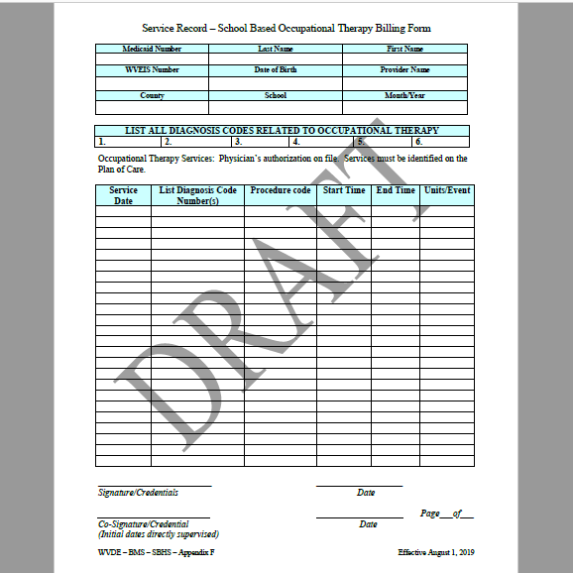
Occupational Therapy Billing Form

Slide 13
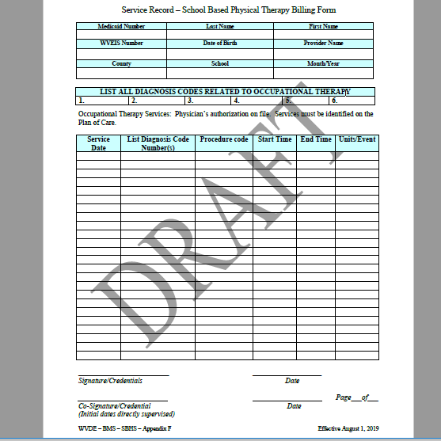
Physical Therapy Billing Form

Slide 14

Contact information for KEPRO Trainer/Consultant
Terri Barnhart BSN, RN
Clinical Auditor/Assessor School Based Health Services
1007 Bullitt Street
Suite 200
Charleston, WV 25301
Telephone: 304-380-0600 Extension 4437
Email: tbarnhart@kepro.com

Slide 15

Questions or Concerns

