Slide 1
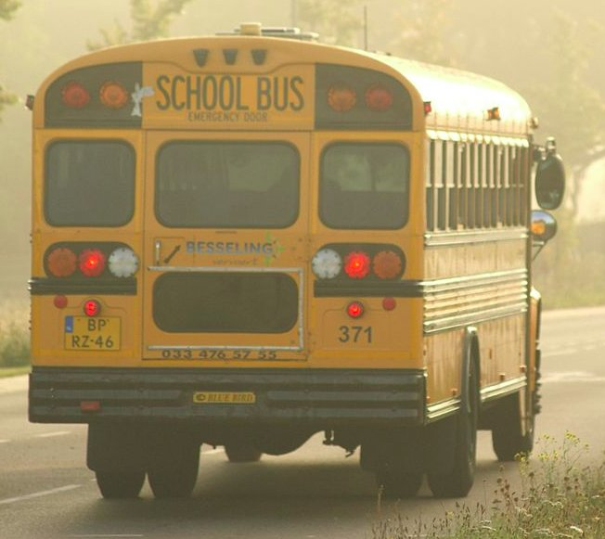
Transporting Our Youngest Learners:
Best Practices and Policy Considerations
WVBE Policy 2525:
WV Universal Access to a Quality Early Education System
§126-28-7: Transportation
Notes:
Goals for today:
Goal one is to take a brief look at pre-k and transportation requirements
Goal two will discuss a few techniques for supervising young children that might make your job a bit easier
And goal three---how to get those little ones on and off your bus…

Slide 2
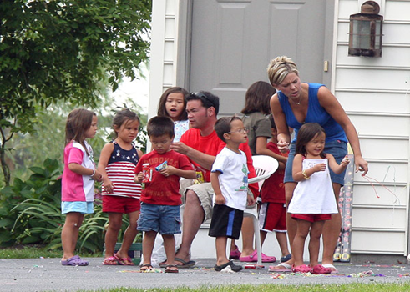
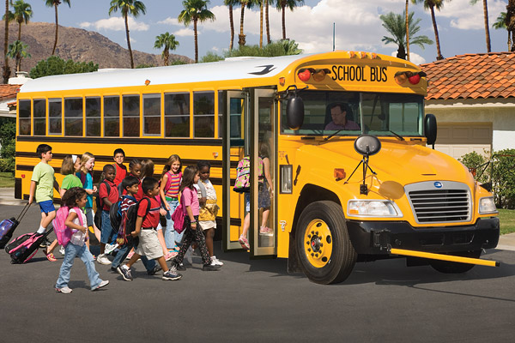
WV Pre-K and Transportation Requirements
Introduction to WV Pre-K and Transportation Requirements
Supervision of Young Children
Focusing on the Loading and Unloading
Introduction

Slide 3
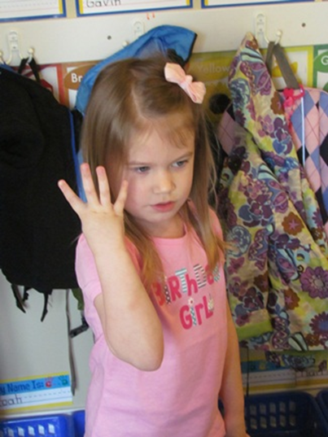
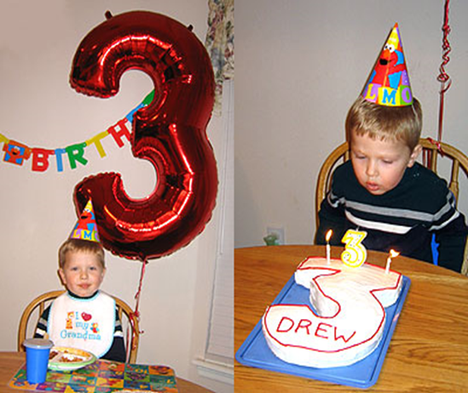
Who is the eligible for pre-k?
Four years of age prior to July 1st or a three year old child with an Individualized Education Plan (IEP).
The pre-k child may also be enrolled and receive services from Head Start, childcare, and/or preschool special needs.
Introduction
Notes:
1 & 2. WV Universal Pre-K (WVBE Policy 2525) defines an eligible pre-k child as one who is four years of age by July 1st or a three year old child with an Individualized Education Program (IEP).
**** This is optional. Not all counties enroll 2 year olds. BUT, Yes, it may be possible for you to have a two year old on your bus… Two year olds may be enrolled in Universal Pre-K if they have an IEP and are transitioning from Part B to C (birth to three to public school). It does happen, seldom, but it does happen that if the birth date is close to the start of the year or mid-year a two year old may transition early since the county will have to serve or hold the space.
Where?
The preschool child on your bus may be there because of any of the following:
The child attends a head start that is a collaborative partner
The child has an IEP
The child attends a BOE preschool classroom.

Slide 4
Is Transportation Required?
WVBE Policy 2525
§126-28-7 Transportation
7.1 In WV Universal Pre-K programs, transportation is considered a support, not a mandated service, unless it is a related service for children with disabilities in accordance with state and federal requirements; however…
Introduction
Notes:
The first question:
Do we have to transport pre-k students?
This is what policy says:

Slide 5

Though not mandated, once a county chooses to transport young learners, transportation requirements of WVBE Policy 2525 must be put in place.
Introduction

Slide 6
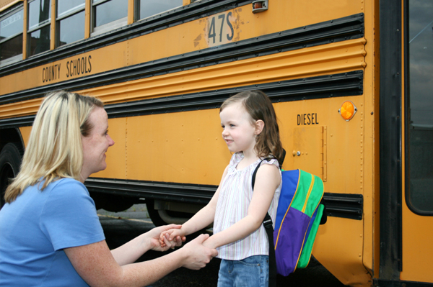
There are many reasons to transport pre-k children…
Provides an opportunity for children to participate in pre-k who might not be able to otherwise.
Supports positive attendance.
Transportation is required for some children (those with an IEP).
Introduction

Slide 7

Is Transportation Required?
Over half of WV Universal Pre-K classrooms are collaborative with Head Start, which warrants review of:
Head Start Transportation Regulation
45 CFR Part 1303.7
Head Start Performance Standards (2016)
Introduction
Notes:
Once a county decides to transport young learners, there are some requirements to follow:
In policy, page 7: bus drivers, must be trained in the supervision of young children annually.
This training must include all of the elements we are discussing today:
An introduction to policy
Supervision and requirements of transporting young children
Loading/unloading of young children

Slide 8

Head Start Requirements
45 CFR Part 1303
General:
Head Start agency must assist families with transportation.
If a Head Start agency decides not to provide transportation, it must provide reasonable assistance to arrange transportation for the families of the children enrolled.
Head Start agencies must follow state requirements (state inspections, maintenance).
Introduction

Slide 9
Head Start Requirements
45 CFR Part 1303
When head start programs provide transportation, they must:
Use school buses or allowable alternate vehicles.
Use child restraint systems for all children. (Unless a waiver for alternate transportation has been approved).
Have up-to-date lists of adults authorized to receive the students, including emergency contacts/alternates.
Have emergency equipment (Communication system, seatbelt cutter, charged fire extinguisher, first aid kit).
Have child rosters to ensure that no student is left behind.
Introduction

Slide 10
Head Start Requirements
45 CFR Part 1303
When head start programs provide transportation, they must:
Have a bus monitor on board each bus during routes.
Ensure driver qualifications are met.
Ensure proper maintenance of each bus.
Conduct annual observations of bus drivers.
Annual driver training, including safe driving and development of young children).
Introduction

Slide 11

Head Start Requirements
45 CFR Part 1303
A Head Start program may request to waive a specific requirement of transportation standards, such as:
  Adherence to a requirement in this part would create a safety hazard in the circumstances faced by the agency; and,
  Compliance with requirements related to child restraint systems and/or bus monitors will result in a significant disruption to the program and the agency demonstrates that waiving such requirements is in the best interest of the children involved.
  The responsible Heath and Human Services official (In this case Head Start) is not authorized to waive any requirements of the Federal Motor Vehicle Safety Standards (FMVSS).
Introduction

Slide 12

Head Start Requirements
45 CFR Part 1303
For more information regarding Head Start, including Head Start Performance Standards, visit https://eclkc.ohs.acf.hhs.gov/.
Introduction

Slide 13
Why are we here today?
While training on transporting young learners is a requirement of WVBE Policy 2525, it is also an opportunity to provide tools to help ensure the best and safest environments for our youngest learners.
What the policy says….
7.1.a. bus drivers are trained in the supervision of young children (in addition to any other staff development received);
Introduction
Notes:
Once your county decides to transport young learners, there are some requirements to follow:
In policy, page 7: you, as a bus driver, must be trained in the supervision of young children annually.
This training must include all of the elements we are discussing today:
An introduction to policy
Supervision and requirements of transporting young children
Loading/unloading of young children

Slide 14
WVBE Policy 2525
7.1.b. children transported by a school bus who attend a pre-k classroom and are not yet enrolled in kindergarten will sit in a segregated area of the vehicle with other pre-k children.
Introduction
Notes:
Notice the word Segregated!!! Children need to sit in a designated area. Children enrolled in pre-k must sit in the front only with pre-k students. One reason could be, if the need to evacuate would occur the pre-k children would need assistance. If they are scattered around the bus, you, as the bus driver would have difficulty managing the evacuation. Also in some counties all age children are on the bus together. It is much easier for a bus driver to maintain visual contact if the children are seated in the front of the bus.

Slide 15
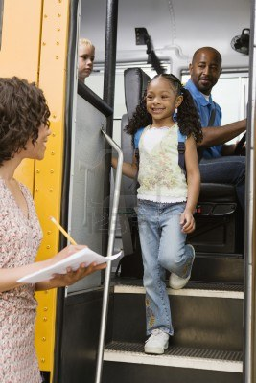
WVBE Policy 2525
7.1.c Staff shall be available to assist children on and off buses at the WV Pre-k site.
If a parent/guardian is unable to meet the bus, there shall be a person designated by the parent/guardian to assist the child.
Introduction
Notes:
Let’s break it down into four separate sections for easier understanding:
It all talks about on and off the bus- we are going to talk more in depth about this in a few minutes

Slide 16
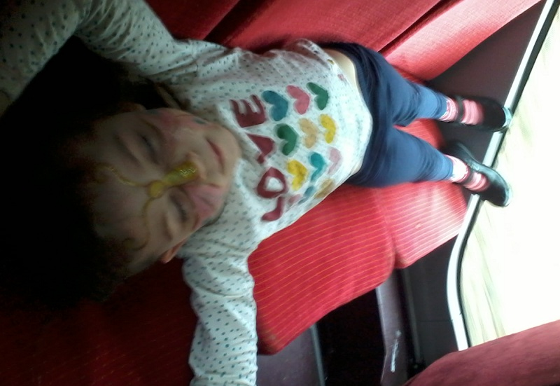
WVBE Policy 2525
7.1.d Bus drivers must inspect the bus at all final drop off points to assure that no children are left on the bus and these inspections must be charted. A log of daily inspections shall be maintained on file with the principal/supervisor.
Introduction

Slide 17
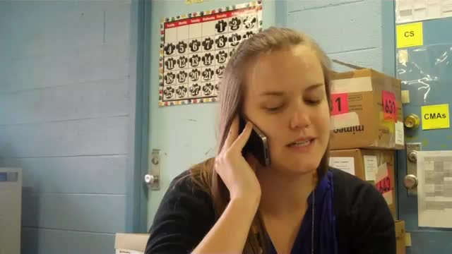
WVBE Policy 2525
7.1.e At each WV Pre-K site where bus transportation is provided, a designated person must follow-up within the first hour of arrival time with the family of any child who is not present or accounted for each day.
Introduction
Notes:
Robo calling does not meet this requirement. It is suggested that these calls be documented for accountability purposes.

Slide 18
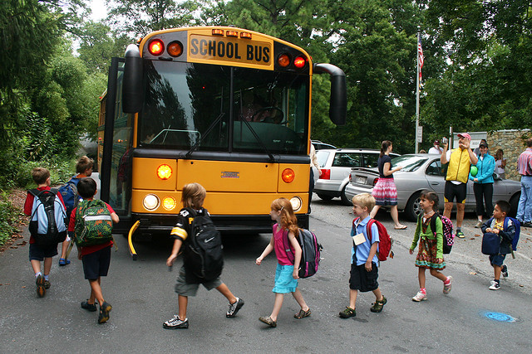
Supervising Young Children:
The Challenges!
Supervision

Slide 19
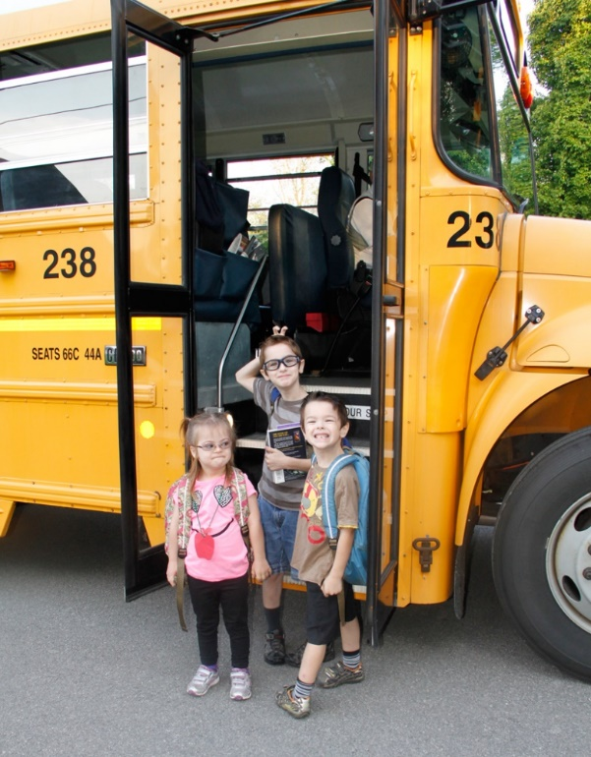
Facts
Drivers can lose sight of very young children as opposed to bigger, older students.
Small children have been known to climb into wheel wells.
Young children can be thrown more easily from their seats.
Young children are more often left on the school bus at the end of a route, posing danger to the child.
Supervision

Slide 20
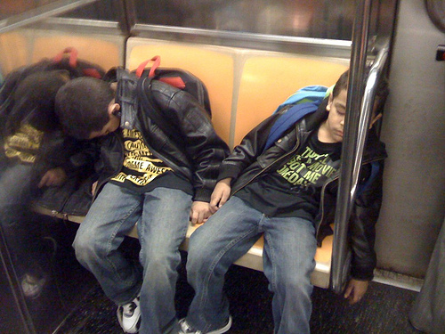
Facts
Younger children do not process sounds the same way as older children.
Younger children have 1/3 less peripheral vision than older children.
Younger children have shorter attention spans than older children.
Younger children do not judge moving objects well (do not perceive an approaching vehicle’s changing size as a threat).
Supervision

Slide 21
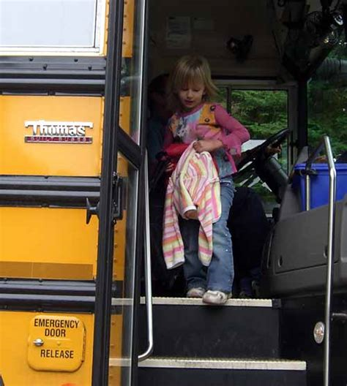
Facts
The size of a young child makes it difficult to step up on school bus steps.
High windows do not allow younger children to see out the school bus window.
Most importantly, young children should be included in emergency evacuation drills and taught how to evacuate with other children.
Supervision

Slide 22

Challenges to Supervising Young Children
The Three and Four Year Old Child
Developmental Concerns
Guidance Approaches
Resources
Supervision
Notes:
Knowing the developmentally appropriate expectations is critical. You can not assume that children know the rules on the bus.

Slide 23
The Three and Four Year Old Child:
How Preschoolers Think
Jean Piaget, the psychologist credited with forming the theory of cognitive development in the late 1920s, created a list of what kids at each stage are capable of, and what they are not quite ready to do yet. Here is what he found for preschoolers:
A preschooler can speak in complex sentences. But his thought process won't always seem logical to outsiders. For example he may say, “If an apple is red, then a green fruit is not an apple.”
Once a preschooler has come to a conclusion, it is difficult to reverse his thinking. Preschoolers are not yet capable of easily going backwards through each step to see if it makes sense. They do not yet completely understand cause and effect.
Supervision

Slide 24
The Three and Four Year Old Child:
How Preschoolers Think
Preschoolers are egocentric, they believe everyone sees the world as they see it.
Preschoolers often pay attention to one aspect of an event and ignore other details. For example, if a child goes to a birthday party he/she might give a detailed description of the cake, but not any of the party games.
Supervision

Slide 25
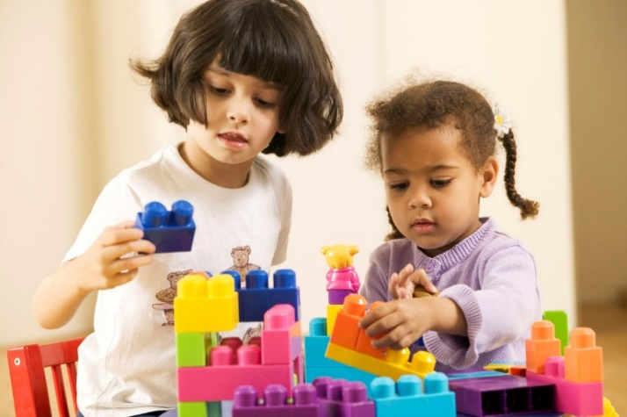
The Three and Four Year Old Child:
How Preschoolers Think
It is important to realize each child develops at his/her own pace. This is exceedingly noticeable during the preschool years. Not every four year old will act or respond similarly – keep in mind that one four year old may be, developmentally, a two year old in many domains.
The following slides contain a developmental overview for three and four year old children.
Supervision

Slide 26
Developmental Overviews for Three and Four Year Olds
The past is divided into the immediate past, yesterday, last week and last month, and a long time ago. An example of this is when their parents were young. The future is divided into tomorrow, soon, and "when I get big." Although they may not know the names of the seasons, children are beginning to make the relevant associations. They might remember summer as when it's hot and you go on vacation and fall as when the trees turn color, when you go trick-or-treating, and when you watch football on television.
Supervision

Slide 27
Developmental Overviews for Three and Four Year Olds
Space, like time, is also divided into categories. Some places are near and you can walk to them. Some places are too far to walk. Some places are really far away, like Africa and the moon. There are also categories of people, such as children, teenagers, people who are old and work at jobs, and people who are very old and don't do much at all. Things can be living or not living, people and animals can be alive or dead, and things can be real or pretend.
Supervision

Slide 28
Developmental Overviews for Three and Four Year Olds
By 3 years old, children have expanded their repertoire of emotional responses. They can be sad or pensive. They can be jealous, wary, or frightened. They can be contented, jolly, or exuberant. They are also more tuned in to the feelings of others. Pleasing adults is becoming increasingly more important, and receiving praise or affection is becoming a powerful reinforce. Although 3-year-olds are less apt to throw temper tantrums than 2-year-olds, their behavior can disintegrate when they are tired or hungry.
(Excerpt from All About Child Care and Early Education A Comprehensive Resource for Child Care Professionals , by M. Segal & B. Bardige & M.J. Woika & J. Leinfelder, 2006 edition, p. 110-112. Pearson Education Inc.)
Supervision

Slide 29
Developmental Overviews for Three and Four Year Olds
Although children are learning to take turns and share toys, arguments over possessions take place continually. Frequently, disputes that begin verbally end with a push, a punch, or a skirmish. For the most part, the children do not really hurt each other in these skirmishes, but providing adult supervision is an important safeguard.
Supervision

Slide 30
Developmental Overviews for Three and Four Year Olds
Four-year-old children are becoming increasingly aware of themselves as members of a peer group. Much of their day is spent establishing and maintaining their position with peers. Children who are 4 years old use their growing facility with words to praise or to criticize and correct other children, to call attention to their own accomplishments, and to convince a group to adopt their ideas. Four-year-olds are interested in playing with other children and will use threats and promises to win a friend or gain entry into a group. Remarks like "I'll be your best friend" and "I won't be your friend" are frequently heard in a preschool.
Supervision

Slide 31
Tips on Positive Approaches to Discipline
Early Childhood Learning and Knowledge Center
Exerts from Head Start Transportation Pathfinder
In a community where cultural values may be perceived as different from the majority of society, it is important to understand how adults communicate with their children. This parenting style will support a child's learning about personal space, expressing emotions, and self-control. Together with parents, transportation staff can make the bus route an enjoyable experience.
Supervision

Slide 32
Tips on Positive Approaches to Discipline
Early Childhood Learning and Knowledge Center
Exerts from Head Start Transportation Pathfinder
Transportation staff can reduce the amount of time spent on discipline problems by prioritizing time to review safety procedures with children. As children gain a sense of self-control, they increase their ability to regulate their own behavior. This situation may be likened to a seesaw. Discipline problems rise when procedures are not known and discipline lowers when procedures have been learned.
Supervision

Slide 33
Positive Approaches to Discipline
The goal of transportation staff should be for routines and transitions to occur in a timely, predictable, and un-rushed manner. These would include:
  How to board the vehicle.
  Where to be seat on the vehicle.
  When it is appropriate to leave a seat on the vehicle.
  How to exit from the vehicle.
  What to do during evacuation drill.
Supervision

Slide 34

Positive Approaches to Discipline
Help children name things in the bus and how they are used:
  Aisle
  Door
  Emergency Exit
  Handrail
  Restraint System
  Seat
  Seat Belt
  Step
  Window
Supervision

Slide 35
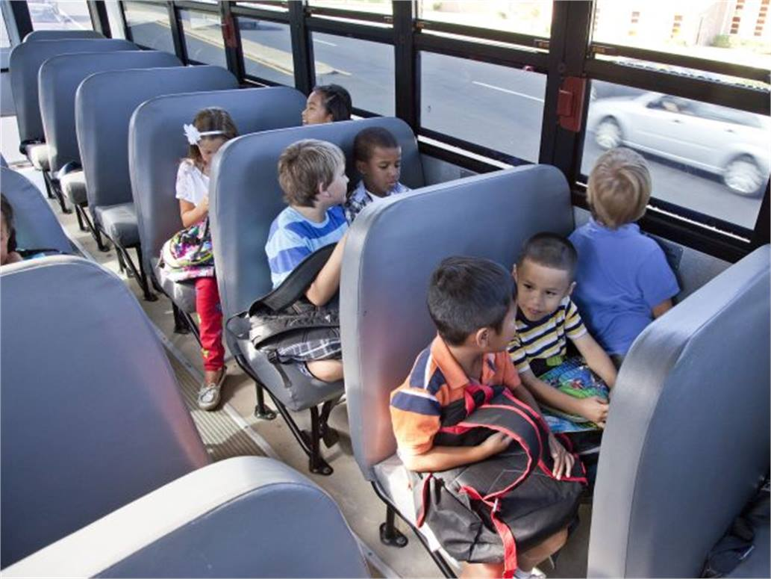
Positive Approaches to Discipline
Practice dialogue that conveys and encourages positive behaviors, such as:
“Remember to say ‘Excuse me’ when you bump into a person.”
“I like the way Johnny is sitting. He found his seat is ready to ride.”
"I like the way Desiree is using words to ask for help.”
Supervision

Slide 36
Positive Approaches to Discipline
Hearing positive remarks from adults help children develop a sense of accomplishment at doing things correctly:
“I see Ali is ready to go to work. I see that Tyree is also ready.”
“Everyone needs to use the handrail to get off the bus. Good job.”
Supervision

Slide 37
Positive Approaches to Discipline
It is important to recognize that body language, personality, and the attitude of an adult person on the bus can influence the expectations of students both positively and negatively.
  Be calm in all interactions with children as hearing a harsh tone or the loud adult voices may frighten children.
  Speak clearly and with consistency about what children are expected to do and use the child's name when speaking to that individual.
Supervision

Slide 38
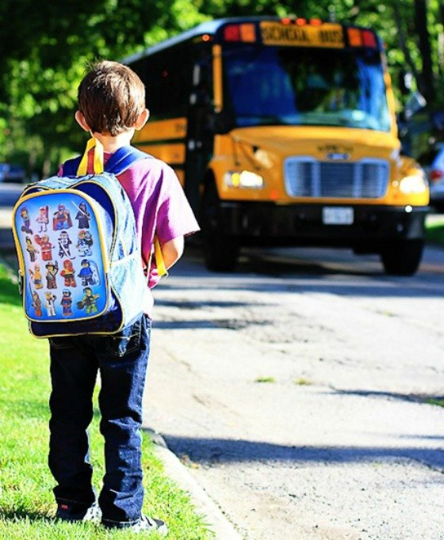
Positive Approaches to Discipline
Remember that the need for discipline arises when children fail to understand the procedures.
  When children fail to follow a procedure, it is important to deal with the behavior while maintaining their dignity.
  Repeat the procedure that is desired and encourage children to practice it.
Supervision

Slide 39
Tips for Dealing with Aggressive Behaviors
Exerts from Dealing with Aggressive Behaviors. DHHS/ACYF/ACF/HSB.
Aggressive behavior in children is disruptive in nature and indicates a lack of self-control. It creates feelings of fear, insecurity, and anxiety in a child. Examples of aggressive behaviors include: yelling, biting, scratching, kicking, hitting, fighting, bullying, and name-calling. During these times, children often find that they are unable to problem solve, communicate effectively, or respect others.
Supervision

Slide 40
Tips for Dealing with Aggressive Behaviors
Exerts from Dealing with Aggressive Behaviors. DHHS/ACYF/ACF/HSB.
Children who are exposed to unrealistic expectations or confusing situations are likely to react aggressively towards adults and other children. Therefore,
Adults need to be highly observant of children and anticipate their needs.
No child should be left alone unsupervised.
By redirecting children through clear and consistent language and realistic expectations, adults may help children avoid an outburst of aggression.
Supervision

Slide 41
Tips for Dealing with Aggressive Behaviors
Exerts from Dealing with Aggressive Behaviors. DHHS/ACYF/ACF/HSB.
  Do not discipline by addressing one behavior to all students:
  “Everyone should use their quiet voices on the bus.”
  Become more specific only if necessary:
  “Sasha, please keep your hands off of Minh's jacket.”
  Encourage respect for the feelings and rights of others:
  “Heidi feels sad today. Maybe we can cheer her up with a song.”
  “We need to share the bus seats with others.”
Supervision

Slide 42
Tips for Dealing with Aggressive Behaviors
Exerts from Dealing with Aggressive Behaviors. DHHS/ACYF/ACF/HSB.
Never discipline using methods like isolating a child, rewarding or punishing with food, or denying the basic needs of a child.
Give children immediate feedback on their behavior:
  "What a nice line! Everyone is standing without pushing.”
  "Joyce, you listened and sat down. Good job."
  Allow children time to relearn correct procedures:
  "Sarah, show us how you use the handrail. Thank you.”
  "Let's show the bus driver how we walk down the aisle to our seats."
Supervision

Slide 43
Tips for Dealing with Aggressive Behaviors
Exerts from Dealing with Aggressive Behaviors. DHHS/ACYF/ACF/HSB.
Use positive methods of child guidance without engaging in corporal punishment, emotional or physical abuse, or humiliation (45 CFR 1304.52(h)(1)(iv)).
Incorporate local guidelines for transportation discipline procedures.
Supervision

Slide 44

Loading and Unloading
§126-28-7
WV Pre-K Site
Child’s Pick-up/Drop-off Site
Seating Arrangements on the Bus
Documenting Daily Inspections
WV Pre-K Site Designee
Loading and Unloading
Notes:
Policy is very clear with the expectations for loading and unloading the bus. Let’s take a look at what has to happen at the pre-k site, pick-up and drop off site, where the students must sit on the bus, your daily responsibility and who is present at the pre-k site for unloading.

Slide 45
WV Pre-K Site
§126-28-7.1.c. staff shall be available to assist children on and off buses at the WV Pre-K site.
WV Pre-K Site
Who is designated to assist children on and off the bus?
Where do the children go after exiting the bus?
What if the designee is not there to assist?
Loading and Unloading
Notes:
Each school MUST have a designee to assist children on and off the bus. This should be the same person each day. This person will walk the children to your bus to load and come to the bus to unload.
Upon exiting the bus, the students are to be taken to a separate area. This is usually the classroom. The students should not be taken to a bus room with other students.
What happens if there is no designee there to assist with unloading? Easy- they stay on the bus. Radio the office and ask for the designee.

Slide 46
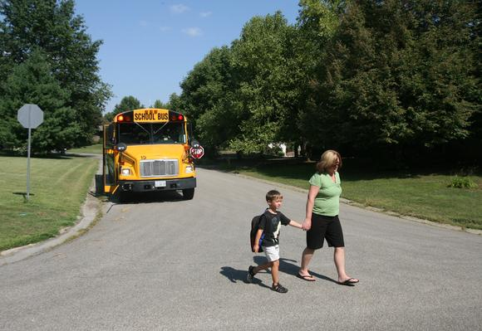
WV Pre-K Site
§126-28-7.1.c. If a parent/guardian is unable to meet the bus, there shall be a person designated by the parent/guardian to assist the child.
Child’s Pick-up/Drop-off Site
Are parents required to meet the bus daily?
What is the county’s procedure for a family to designate another?
Who can be designated?
What are the procedures if the parent or designee is not at the drop-off site?
Loading and Unloading
Notes:
Each school MUST have a designee to assist children on and off the bus. This should be the same person each day. This person will walk the children to your bus to load and come to the bus to unload.
Upon exiting the bus, the students are to be taken to a separate area. This is usually the classroom. The students should not be taken to a bus room with other students.
What happens if there is no designee there to assist with unloading? Easy- they stay on the bus. Radio the office and ask for the designee.

Slide 47
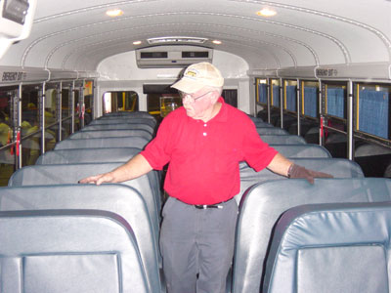
Documenting Daily Inspections
§126-28-7.1.d.
Bus drivers must inspect the bus at all final drop off points to assure that no children are left on the bus and these inspections must be documented.
A log of daily inspections shall be maintained on file with the principal/supervisor.
Loading and Unloading

Slide 48

Seating Arrangements
§126-28-7.1.b. children transported by a school bus who attend a WV Pre-K classroom and are not yet enrolled in kindergarten will sit in a segregated area of the vehicle with other WV Pre-K children.
Seating Arrangements
Where should pre-k students be seated on the bus?
How will this area assist with supervision?
Can a pre-k child be seated with older siblings?
Loading and Unloading

Slide 49
Documenting Daily Inspections
What must bus drivers complete at all final drop off points?
Why?
How must this be documented?
Loading and Unloading

Slide 50
WV Pre-K Site Designee
§126-28-7.1
Who is the pre-k designee at the WV Pre-K Site?
What is the communication process for the bus driver and pre-k designee for any pre-k child not present?
At each pre-k site where bus transportation is provided, a designated person must follow-up with the family of any child who is not present or accounted for each day.
Loading and Unloading

Slide 51

Questions

