Slide 1
Accessible Educational Materials (AEM) aka
Accessible Instructional Materials (AIM)

Slide 2
Note that the largest groups are communication disorders 29% and learning disability 29%. That is 58% of special education students. Also, notice that intellectual disability is found in 16% of our students. This tells us that 84% students with IEPs have average or above average intelligence.

Slide 3
Student demographics, SY 2013-2014
All students
Grades: PK - 12
Of all students, 15% qualify as SWD
Of all students, 48% qualify as
Low-SES
62% of SWD qualify as Low-SES
Data source: End of Year Certified Enrollment file, 2013 – 2014
Notes: Results incorporate all school districts (including WVSDB & Institutional Programs), Grades Pre-K – 12, analysis excludes exceptionally gifted (EG) and gifted (GF) from SWD classification
Notes:
Data source: End of Year Certified Enrollment file, 2013 – 2014
All school districts (including WVSDB & Institutional Programs)
Grades Pre-K – 12
Analysis excludes exceptionally gifted (EG) and gifted (GF) from SWD classification
Prepared by Amber Stohr (astohr@k12.wv.us) Office of Research, December 2014
10.2% of our Students both SWD/Low SES 27,186

Slide 4

Online at wvde.us/special-education/initiatives/accessible-educational-materials/

Slide 5
What is AEM?
AEM are materials that are designed or converted in a way that makes them usable across the widest range of student variability in any format (print, digital, graphical, audio, video).
IDEA specifically focuses on accessible formats of print instructional materials. In relation to IDEA, the term AEM refers to print educational materials that have been transformed into the specialized formats of braille, large print, audio, or digital text.
AEM provides exactly the same content in a format that makes the information usable by the widest range of students.

Slide 6
Accommodations vs. Modifications
(attention IEP Team)
Accommodations and Modifications:
How They’re Different

Slide 7

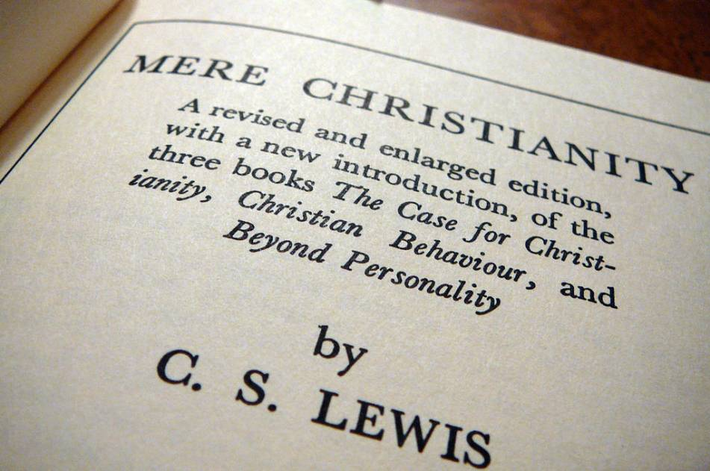
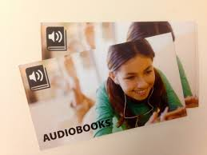
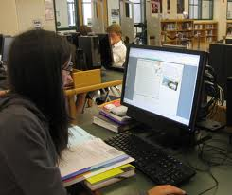
Braille
Formats for AEM
Enlarged Print
Audio Books
Digital Text
Notes:
If the IEP Team determines a student needs AIM, the next step is to select which specialized format(s) would be most appropriate. The four types of specialized formats are braille, large print, audio and digital text:
You would already be acquainted with braille and large print and may have used them with students with visual challenges. You may also be very familiar with audio and digital books.
Audio formats present content as speech to which a student listens. Audio formats include recorded human voice or synthesized electronic speech. It has no visual component.
Digital text provides electronic content that is delivered on a computer or another device. Electronic content can be changed in many ways (e.g., size, contrast, read aloud) to accommodate the needs and preferences of a student. How content is presented to a user depends upon the technology being used and student needs.
Caution: Some materials converted to digital text do not provide descriptors for charts, graphs and pictures. For a student who is blind or visually impaired, the materials may need to be enhanced by a transcriber to include this information.

Slide 8
I susgect th at thechil b wi tha learn ing disadility mu
lyex ger i
e
n
o
e
a
n alicein won berl an bex is ten ceof the wef in b tba
tthe ymu st co ge sthey rec
on Fuseb dyth ym dols we piv them gress ureb
dy t he leng tho ft imei nwic hto b oi tamb frus tra ted
dy fa ily resth eybo no tlear no hetra bit lon
alw ayamb sow ern u stte achth embif Fere ntly.
Notes:
This activity was modified from one of the presentations referenced on the resource page.
I will give you time to read this slide.
This may be what some of our students experience when they look at complicated text.

Slide 9
ACTUAL PASSAGE:
LEARNING DISABILITY SIMULATION
I suspect that children with learning disabilities may experience an "Alice in Wonderland" existence. They may become confused by symbols we give them, may feel pressured by the length of time in which to do it and may become frustrated by failure. Often, students with learning disabilities do not learn the traditional way, so we must teach them differently.

Slide 10
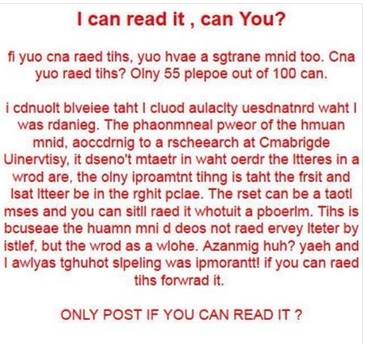
Notes:
Saw this on FB. Food for thought about how people may view printed text.

Slide 11
Do you have students:
who are not reading “typical” grade level instructional materials?
or
whose problem solving teams believe progress would increase if students could just decode the text in a timely manner?
Then you have students who need AEM!
Notes:
In other words, do you have students that don’t read text well but would understand the concepts if they could access the information?

Slide 12
FYI
If students have the read aloud accommodation for assessment on their IEP they need all of their educational materials in that format.
From a national study, the statistical probability that an individual would need AEM is about 2-4 percent of the general population. Applied to WV statistics, that would be approximately 5,643 to 11, 285 individuals.
An additional study demonstrated that for students with IEPs the Statistical Probability for needing AEM is 20 – 40%. Again applying this to our WV population, that would be approximately 8,852 - 17,703

Slide 13
What Is the Relationship of AEM to FAPE?
  “Timely access to appropriate and accessible instructional materials is an inherent component of [an LEA’s/SEA’s] our obligation under [IDEA] to ensure:
    that FAPE is available for children with disabilities and
    that children with disabilities participate in the general education curriculum as specified in their IEPs.”
  Office of Special Education Programs (OSEP), 71 Fed Reg. 46618

Slide 14
AEM-Related Responsibilities of Decision-Making Teams
Establish need for instructional materials in specialized format(s)
Select specialized format(s) needed by a student for educational participation and achievement
Commence the defined steps to acquire needed format(s) in a timely manner
Determine supports needed for effective use for educational participation and achievement.

Slide 15
Who Needs AEM?
Students whose disability presents difficulty accessing traditional instructional materials, such as print or locked digital materials effectively.
Students with sensory, orthopedic or learning-related impairments

Slide 16
Who Needs AEM?
Struggling readers?
Students lacking English proficiency?
Notes:
Does the student have the decoding, fluency and processing skills needed to gain information from grade-level printed materials?
Is the student a proficient English language speaker?
• Has the student received appropriate instruction in reading and math?
If the answer to either of these questions is “no”, the provision of AIM may not lower barriers to participation and achievement. Other supports, such as focused instruction, must be considered.

Slide 17
Who Needs AEM?
Students who simply prefer options for different tasks or for use in different environments.
Notes:
As an aspect of Support for Personalized Learning, a student may prefer an alternative access to the text, such as an audio book read by a human. The use of audio supported reading (ASR) shows promise as a tool in the tool box of struggling readers. To read more about ASR, go to the link provided in the notes of the ppt. http://aim.cast.org/learn/student_learning/ASR/forBVI#.U1_QGfldWSo
Schools need to build audio libraries for any student to access. A school account with Audible.com may be a cost effective way to get this started.

Slide 18
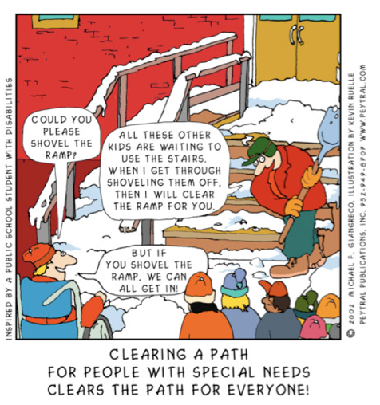

Slide 19
Who Needs AEM?
If any student is unable to read traditional grade level print instructional materials
at a sufficient rate and with adequate comprehension to complete academic tasks with success, relative to same-age peers,
or cannot do this independently, or cannot do this across environments and tasks,
then the student may need AEM.
Notes:
This is reflected in the proposed policy 2419, Consideration Factor #9 says “Consider the student’s ability to access print if the student has a physical disability (cannot manipulate the material without strenuous effort); or is unable to read and comprehend grade level print at a rate to complete the academic task independently and with success; or is blind/low vision.”
AEM is also an important component of the IEP for students of transition age, 16 and older, because specific transition services based on the student’s post-secondary goals must be documented. The decision an individual makes upon exit from school is whether or not there is a continued need for AIM in the post-school setting of education, training or employment. If this is a need, then transition activities and linkages may include support for seeking eligibility under the Americans with Disabilities Act of 1990 (ADA) and/or Section 504 of the Rehabilitation Act of 1973.

Slide 20
Video
Students Speak Out on Accessible Educational Materials

Slide 21
#2 Select specialized format(s) needed by a student for educational participation and achievement

Slide 22

The AEM Navigator
A process facilitator to help educators, families, and students make decisions about AEM for an individual student
(Not a screening or evaluative tool)
Notes:
The AIM Navigator is an interactive online tool to be used prior to IEP meeting as a part of your informative data regarding the student. The AIM Navigator facilitates the process of decision-making about accessible instructional materials for an individual student by IEP or other decision-making teams. The AIM Navigator provides extensive support for decision-making at each point by providing guiding questions, resources, and links to other tools. The AIM Navigator collects all decisions and all supporting information entered by a team and creates a summary that can be printed or saved to a local computer, along with a running To Do List.

Slide 23

The AIM Explorer
A free downloadable simulation tool that combines grade-leveled digital text with access features common to most text readers and supported reading software.

Slide 24
#3 Commence the defined steps to acquire needed format(s) in a timely manner
Notes:
Having identified the need and formats for the learner, step 3 is to acquire the AEM materials.

Slide 25
Bookshare and Learning Ally
Who qualifies to use these resources?
http://www.bookshare.org/ - free
http://www.learningally.org/ - paid
Online Comparison
Notes:
Bookshare free, federally funded, digital text, computer voice
Learning Ally paid, primo resources, digital text, human read
Bookshare and Learning Ally provide different things. Bookshare has many more titles in its library – nearly 348,000.
Learning Ally has more than 80,000 titles – 65% are textbooks and 35% are literature and supplemental materials.
One of the biggest differences is that Learning Ally puts out human narrated books. This is a big advantage when producing STEM books, since many of the pictures, graphs, and mathematical formulas, expressions, and calculations often drop out or are not readable by conventional text-to-speech synthesized voices.
Bookshare produces several different digital book formats, including DAISY-text, DAISY text with images, DAISY-audio, MP3, and BRF.
Learning Ally produces VOICEtext (H), VOICEtext (S), and Classic Audio. VOICEtext (H) is human narration with text that the user follows along with as it reads; VOICEtext (S) is synthetic voice with text that a user follows along with as it reads; and Classic Audio is a human narrated audiobook. VOICEtext audiobooks highlight text by sentence level as it is being read. VOICEtext has a bookshelf; ability to change font size, text color, color background, highlight color, speed, pitch, interval; table of contents; bookmarking feature; ability to move to next sentence, move back a sentence, and go to page.
Learning Ally members can download free playback software for PC and Mac computers and free playback apps for Apple and Android devices. Due to the high cost of producing a VOICEtext audiobook (up to $7000 for a textbook), Learning Ally has only 2000-3000 books in VOICEtext books.
Eligibility for Learning Ally is the same as for Bookshare and the National Library Service for the Blind and Physically Handicapped (NLS). If a student has Bookshare and/or NLS membership, a school can provide this information to Learning Ally as proof of student eligibility. Schools can certify students online.
Learning Ally offers individual memberships (both quarterly and annual) and institutional/organizational memberships. Individual memberships are usually fee-based, which depends on circumstances. Organizational memberships are fee-based, but several states provide funding for K-12 public or charter schools to give students with print disabilities unlimited access to Learning Ally’s library of audio textbooks and literature titles (e.g., Texas, Florida).
To see comparisons of Bookshare, Learning Ally, and APH, refer to the AIM Guide to Acccessible Media Producers (AMPs) Summary Table. http://aem.cast.org/about/publications/2016/aem-guide-amps-summary-table.html#.V1GNJJErKUk
In summary, Bookshare and Learning Ally complement each other. Each provides AEM in different

Slide 26
West Virginia Library Commission
Visit their website: http://www.librarycommission.wv.gov/
  Under Services, select “Special Services Library”
http://www.librarycommission.wv.gov/services/specialservices/Pages/default.aspx
Download an application

Slide 27
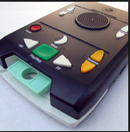
WV Library Commission cont.
Receive in the mail, free of charge a Daisy reader
Receive a catalog with new book available every 3 months
Email titles and numbers for books you want to talkbks@wvlc.lib.wv.us
Receive in the mail, listen, and return
Materials are free as long as you are using them

Slide 28
WV Library Commission cont.
Offer text to speech options for
PC
Mac (app available on iTunes)
Android (app available on Google Play)
iOS Apple devices (ipod, ipod Touch, iPad)

Slide 29
NIMAC
National Instructional Materials Accessibility Center
Notes:
To facilitate efficient and cost effective services, West Virginia has opted to coordinate with the National Instructional Materials Access Center (NIMAC) as a means for providing specialized formats in a timely manner to qualified students. These electronic files of print instructional materials can be more easily converted into accessible formats which make it easier for students with disabilities to access learning materials in the formats they need as quickly as possible.
When accepting IDEA entitlement funds, each school district in WV assures that it will coordinate with NIMAC when needed to provide AIM to qualified students. This assurance accompanies the district’s IDEA grant award.
The NIMAC is the national repository for electronic files of books created using (what’s called) the NIMAS format which are designed to be easily converted into specialized formats, including braille, large print, audio, and digital text.

Slide 30
Who Qualifies for NIMAC?
Notes:
The 1996 Chafee Amendment to Copyright Law, established an exception to copyright infringement for the reproduction of works for use by the blind or other persons with identified disabilities. Therefore, reproduction of materials is allowed for students who meet the following criteria.
Individuals with a print disability are those who have been certified by a competent authority to be unable to read or use standard print instructional materials because of:
• blindness,
• visual impairment,
• physical limitations, or
• reading disabilities resulting from an organic dysfunction
Further details and specific requirements for each category are described on p. 9-16 of the AIM guidance document.

Slide 31
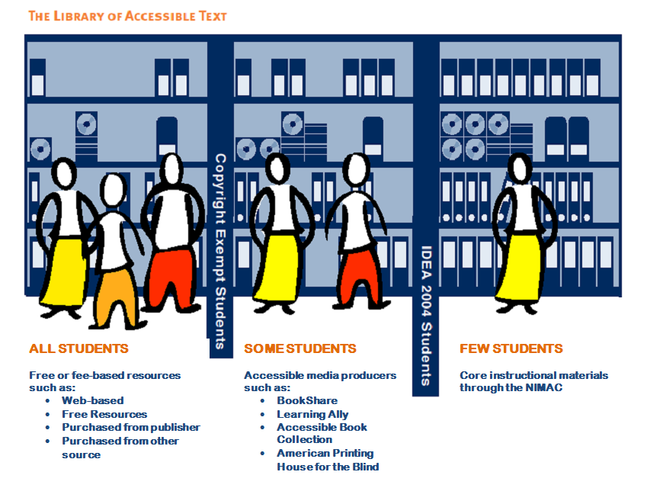
Notes:
This graphic illustrates who “qualifies” for which resources. The first column represents that all students should have access to AIM if it will be helpful to them. Sources for all students are listed. Students in the second column have access to the materials in the first room as well as a few more materials available because they meet the copy right law by having a print disability and may have an IEP or 504. The final room with the student with the yellow skirt has access to the previous materials as well as the NIMAC center materials at no cost because she is eligible under the copyright law and is eligible under IDEA.
Some students = students with print disabilities that may also have a 504 or an IEP
Few students = only students with IEPs and print disability may access NIMAC
Procedures for identifying students with a print disability are described in detail in the guidance document.

Slide 32
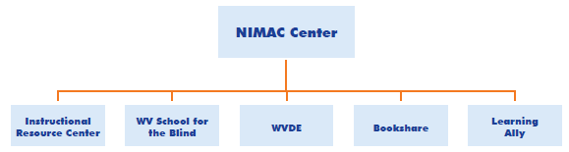
Notes:
This graphic illustrates what organizations are able to access the NIMAC center directly. Districts will contact one of these sources to acquire materials created from a NIMAC held file.
Documentation is essential to ensure compliance with copyright laws. Districts are encouraged to develop policies and/or procedures to track distribution and use of AIM. Copyrighted materials in specialized formats intended for students with disabilities may not be distributed to other students without publisher permission, even though they would be beneficial. Additional information regarding copyright may be obtained at the link in the ppt notes: http://www.loc.gov/nls/eligible.html.
A chart on p. 14 of the guidance document compares Bookshare and Learning Ally, the two main providers of AIM for districts.

Slide 33
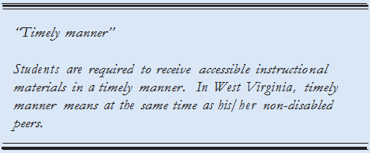
Timely Provision of AEM
Notes:
West Virginia defines “Timely manner” to mean all students receive their instructional materials, including AIM, at the same time as other students. All reasonable efforts must be made by the district to acquire accessible materials. The document associated with this presentation will guide the district in the identification of roles and responsibilities to accomplish this. Districts and IEP Teams should ensure decisions regarding whether a student needs AIM and identification of specific printed instructional materials the student will need are made to allow for timely acquisition of the materials. For example, even though a high school student’s schedule may not yet be finalized in the spring, classes and materials should be identified so materials can be obtained before school starts.
WVDE provides assurance for all state adopted materials to comply with the NIMAC center requirements. Publishers must create and deposit a validated file set in the NIMAC. Districts may request a waiver for instructional materials not on this list. However, the district is responsible for ensuring these materials are in an accessible format for students who require them. See WVDE contract language on page 5 of the guidance document.

Slide 34

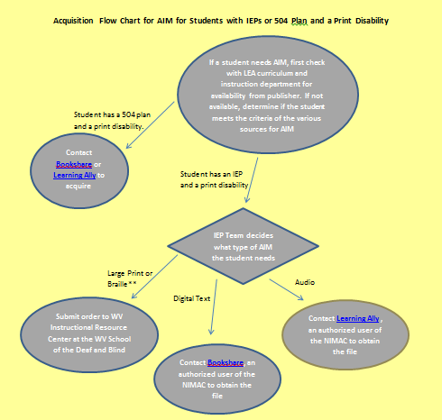
Page 17 of the AEM-WV guidance document shows the steps to acquire AEM for students with an IEP or 504 plan and a print disability. Online at https://wvde.us/special-education/initiatives/accessible-educational-materials/
Notes:
This flowchart shown on p. 17 of the AIM-WV guidance document shows the steps to acquire AIM for students with an IEP or 504 plan and a print disability. If a student needs AIM, first check with the district’s curriculum and instruction department for availability from publisher. If not available, determine if the student meets the criteria of the various sources for AIM. If the student has a 504 plan and meets the copyright criteria for a print disability the next step is to contact Bookshare or Learning Ally to acquire it. If the student has an IEP and meets copyright criteria, the IEP team determines what format is needed. For large print or braille, submit an order to the WV Instructional Resource Center (the IRC) at the WV School for the Deaf and Blind. For digital text, contact Bookshare. For audio format contact Learning Ally. Remember that the IRC, Bookshare and Learning Ally may access the national repository to obtain the file if needed.

Slide 35
Page18 of the AEM-WV guidance document shows the steps to acquire AEM for students who do not meet the criteria for copyright law but may benefit from AEM
Notes:
This flowchart shown on p. 18 of the AIM-WV guidance document shows the steps to acquire AIM for students who do not meet the criteria for copyright law but may benefit from AIM. As in the previous chart, always check with the district authority to see if the material is available from the publisher. In this case a Student Assistance Team (SAT) decides what format the student needs. To obtain AIM contact the Louis Database. A link is provided in the ppt notes. http://louis.aph.org/ . If it is available, the district follows the steps needed to obtain the material. If it is not available from the Louis Database, than the district must acquire it elsewhere or produce it themselves.

Slide 36
Tools for Students Who Don’t Qualify for AEM
Read&Write for Google (Chrome Required)
  Read Write Gold
  Kurzweil 3000
Access Tools From WVTIS
Notes:
The last link is 97 text to speech, speech to text, ebook sites that WV TIS have reviewed.

Slide 37
#4
Determine supports needed for effective use for educational participation and achievement
Notes:
After establishing the need for AEM, identifying the format and acquisition steps, step 4 is to determine supports needed for the effective use of AEM in the learning environment

Slide 38

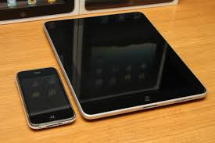
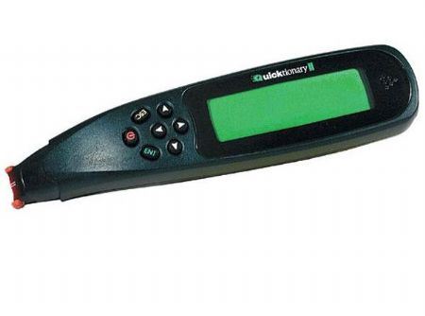
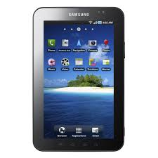
Notes:
After selecting the specialized formats and determining how to acquire them, the team should decide what types of technology or tools are needed for a student to use the accessible materials. The information already identified by the team about the specific formats, the features needed by the student, along with how and where the student will use the accessible materials, can be helpful when choosing among the various technology tools that might be used to deliver the specialized formats.

Slide 39
Assistive Technology
SETT Process
WVATS
Notes:
Assistive technology is defined in IDEA as “Any item, piece of equipment or product system, whether acquired commercially or off the shelf, modified or customized, that is used to maintain or improve functional capabilities of individuals with disabilities” Individuals with Disabilities Education Act (IDEA).
School districts are mandated to make assistive technology available to all students with disabilities if needed to receive a free, an appropriate public education (FAPE). It is:
• an IEP Team decision
• available for home use as determined by IEP Team
• funded by district.
Resources to help you make assistive technology decisions are listed on p. 21 of the guidance document. Also WVDE OSP recommends that teams use the SETT process developed by Joy Zabala to determine what assistive technology may be useful. See the link in the presentation for guidance documents for this process.

Slide 40



Training
Notes:
The amount of training required for the student and instructional team to use AIM will vary according to the complexity of the technology or tool selected to access the specialized formats. For example, use of a large print book would not require much training. However, if a student is using text-to-speech software or a screen reader to access digital text, he or she may need to learn more advanced skills. Teachers, other school staff and families may also need training in order to support the child at home and school.
Initial success with the tool is critical, and the next step is to build on that success by gradually introducing more features of the technology that enable the student to accomplish additional tasks.
Determination of training needs should address:
1. Operational skills - Training on the technology the student will need in order to benefit from the specialized format and may also include training in skills necessary to access format.
2. Functional skills - Training the student will need on the independent learning strategies that are necessary to benefit from the specialized format. This may include remembering, identifying key points, responding to questions. This training will address the use of specialized formats in environments where others are using traditional print materials.
3. Families - Training the family will need to know to support the student in both the specialized format(s) and technology.
Students may also need additional types of training, such as when to use a particular format or tool for a specific learning task or how to ask for needed supports when they are not readily available.

Slide 41
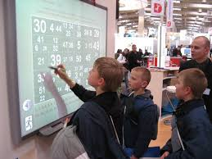
Instructional Strategies
Notes:
Educators may need to use various instructional strategies to support students using specialized formats and supporting technologies. When a student first begins using these tools, instruction should include multiple opportunities for the student to understand the purpose, benefits and outcomes of using the tools. It is helpful to start by providing opportunities for the student to use the tools to successfully complete familiar learning tasks (possibly in a single environment). Gradually building on early successes and slowly introducing the complexity of the tools will enable the student to master them and work as independently as possible on learning goals in a variety of environments. Educators and families will need to work together to support the student’s use of accessible materials and to monitor the change in the student’s participation and achievement.
Learning through listening requires skills such as the following:
• Listening with the attention and intensity necessary to gain meaning from instructional materials
• Listening for extended periods of time (listening target is approximately 55 minutes at a time—the length of a typical secondary class)

Slide 42
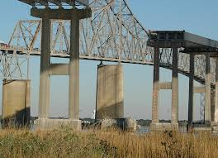
Support Services

Slide 43
REMINDER:
AEM is an Accommodation NOT a Modification
Notes:
The use of AEM may require accommodations or modifications to a student’s educational program. For example, a student may need classroom environment accommodations such as outlet access…cart from class to class…space (table) for equipment…or additional time to complete tasks due to the time required to use a specialized format. A student may need frequent breaks to avoid fatigue. Some students may need to provide responses orally rather than in writing. The team considers which accommodations will be necessary when writing the IEP.

Slide 44
AEM Navigator
http://aem.cast.org/navigating/aem-navigator.html#.VWouS1xVikp
AIM Explorer
http://aem.cast.org/navigating/aim-explorer.html#.VWouc1xViko
AEM-WV Guidance
http://wvde.state.wv.us/osp/accessiblematerials.html
Audio Supported Reading
http://aem.cast.org/search?query=ASR
Jeff Diedrich, CCC-SLP, Director, Michigan’s Integrated Technology Supports Ruth Ziolkowski, MBA, OTR, President, Don Johnston Incorporated Presentation at ATIA 2009, Orlando, Florida
National Center on Accessible Educational Material
http://aem.cast.org/
Accommodations and Modifications: How They’re Different
SETT Process
http://www.joyzabala.com/Documents.html

Slide 45
Free Android and iOS Text-to-Speech
PCs and MACs have text to speech tools.
Most new android and iOS devices have text to speech built in
http://www.dummies.com/how-to/content/how-to-prep-for-dictation-on-the-samsung-galaxy-ta.html
Text to speech translators can be used translating from English to English

Slide 46
idevice Apps
Claro Scan Pen
http://www.claro-apps.com/claro-scanpen/
TableTop Translator
http://www.tabletoptranslator.com/
Google Translate
https://translate.google.com
Keedogo Plus – Keyboard for education
https://itunes.apple.com/nz/app/keedogo-plus-keyboard-for/id918496636?mt=8

Slide 47
AT web extension
Dyslexie extension allows you to read websites in Dyslexie font
https://www.dyslexiefont.com/

Slide 48
Other great resources
Talk Typer
https://talktyper.com/
Free Technology Toolkit for Universal Design for Learning
http://udltechtoolkit.wikispaces.com/home
Tech Tools for Struggling Learners
http://tinyurl.com/pulolzm

