Slide 1
UPDATED ACES
CACFP

Slide 2
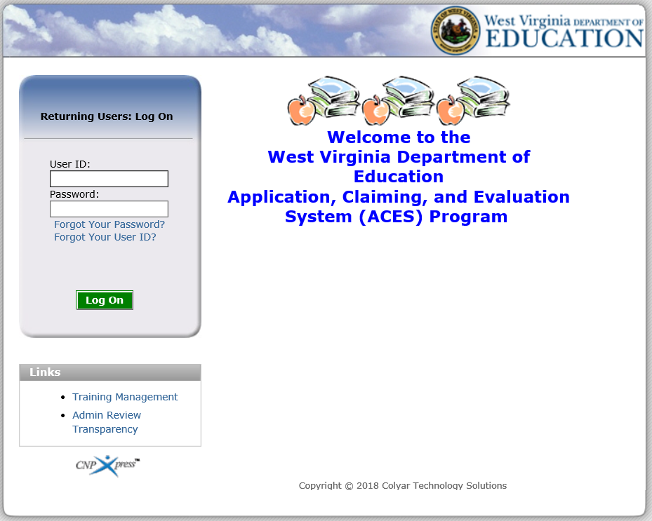
Has a Similar Feel
Notes:
The login screen for the updated ACES has a new look but a similar feel.

Slide 3
Has a Similar Feel
Notes:
Some good news is that the links for Forgot Your Password and Forgot Your User ID work. To reset your password, select the Forgot Your Password link and enter the User ID and email address associated with the account. To reset your User ID, select the Forgot Your User ID link, and enter the email address associated with the account.

Slide 4
Has a Similar Feel
Notes:
The login screen still provides a Training Management link which allows users to register for WVDE OCN trainings. Each time a new training is offered, WVDE OCN will email detailed instructions and screenshots on how to register for the training.

Slide 5
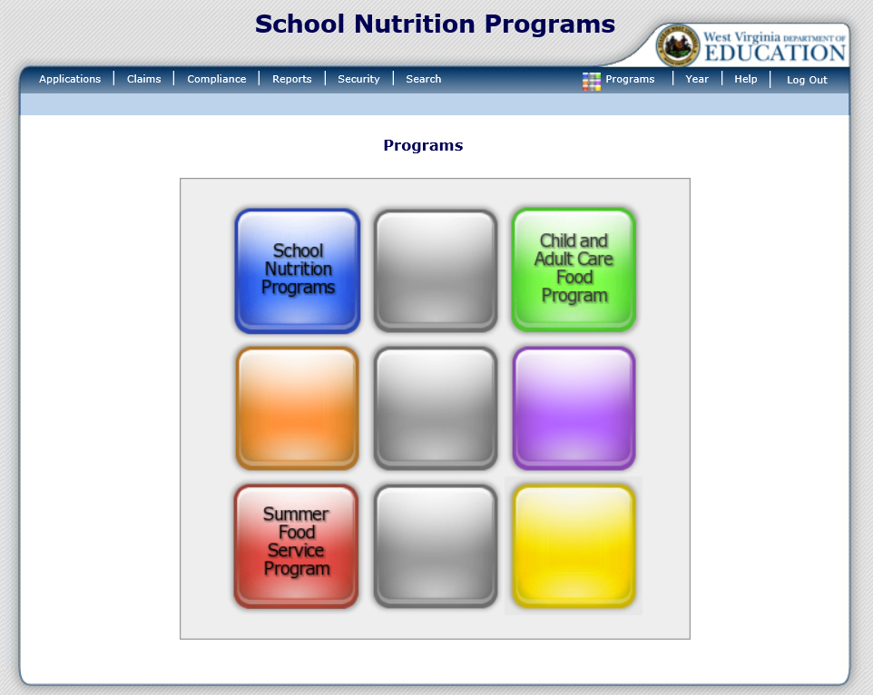
Introducing the Waffle
Notes:
Once you successfully log on, you will be directed to the Programs home page. The Programs home page provides access to all of the Child Nutrition Programs. The screen now displays a waffle instead of a pie. Actual access to specific programs and modules depends on a user’s security rights. All Child Nutrition Programs you are approved for, will be listed here. In this example, the sponsor is approved to modify School Nutrition Programs (NSLP/SBP/SMP/ASSP/SSO), the Child and Adult Care Food Program (CACFP), and the Summer Food Service Program (SFSP). If you are not approved to modify one of these programs, it will simply show up as a blank square.
If you only participate in the CACFP Program, you will log straight into it.

Slide 6
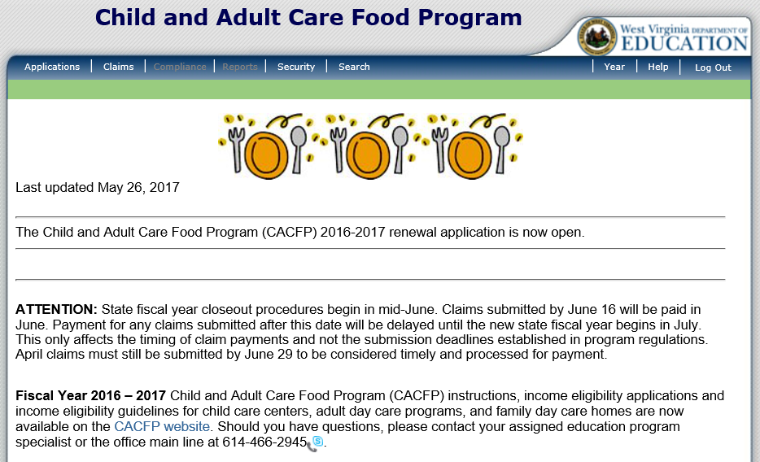
Navigation of ACES
Notes:
Once you select a program, you will see all of the navigation options for the program located at the top of the screen. In this example we selected Child and Adult Care Food Program.

Slide 7
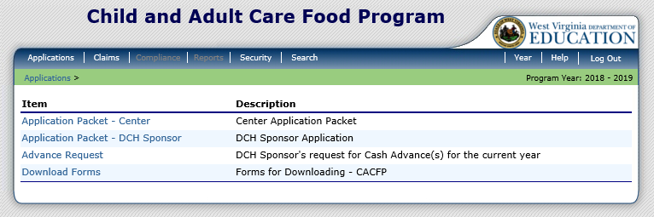
Applications
Notes:
Selecting Applications, on the left side of the dark blue menu bar, will bring you to this screen.
Application Packet – Center is where you complete all of the information for you application renewal, including all of your site applications for Child Care.
Application Packet – DCH Sponsor is where you complete all of the information for a Family Day Care Home application, including all provider applications for Family Day Care Home.
Advance Request is only for Family Day Care Homes and not Child Care Centers.
Download Forms is the area where WVDE OCN may put documents for you to download.

Slide 8
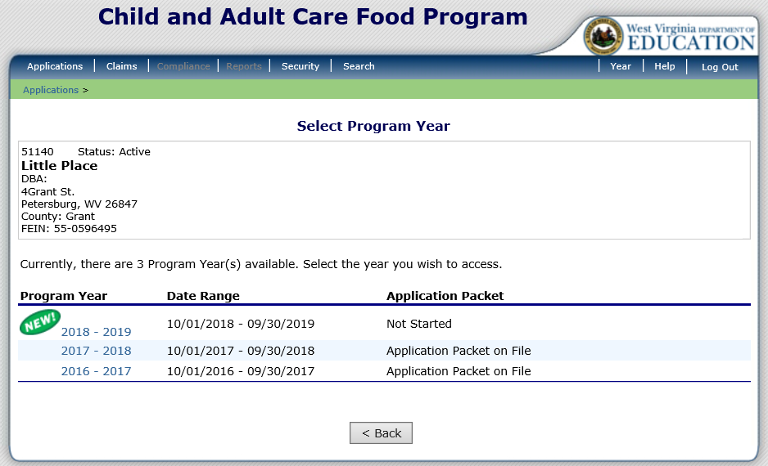
Application Packet
Notes:
Once you are on the Application screen, select the Program Year you wish to access. The updated ACES shows both the program year and the actual date range. To begin the new application packet for the 2018 – 2019 Program Year, simply click on “2018 – 2019”.

Slide 9
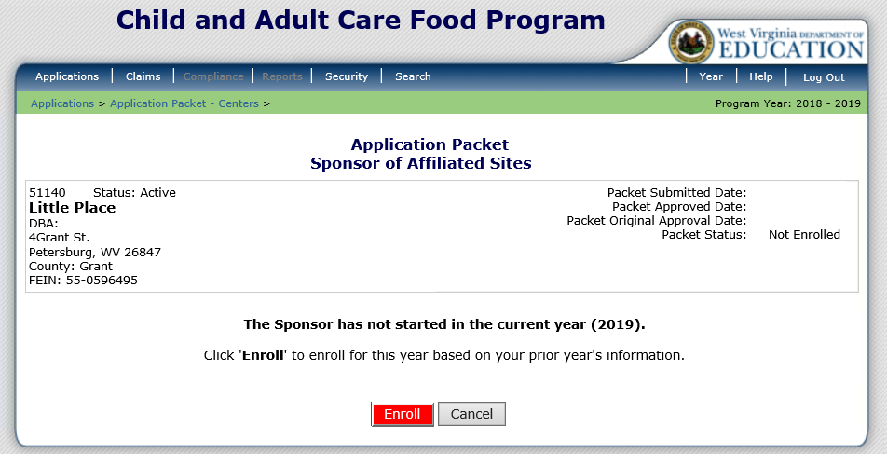
Application Packet
Notes:
If it is the first time working on the application, you must select the red Enroll button. Once selected, you will get a popup window asking you to confirm that you want to continue. Please click OK once this window appears.

Slide 10
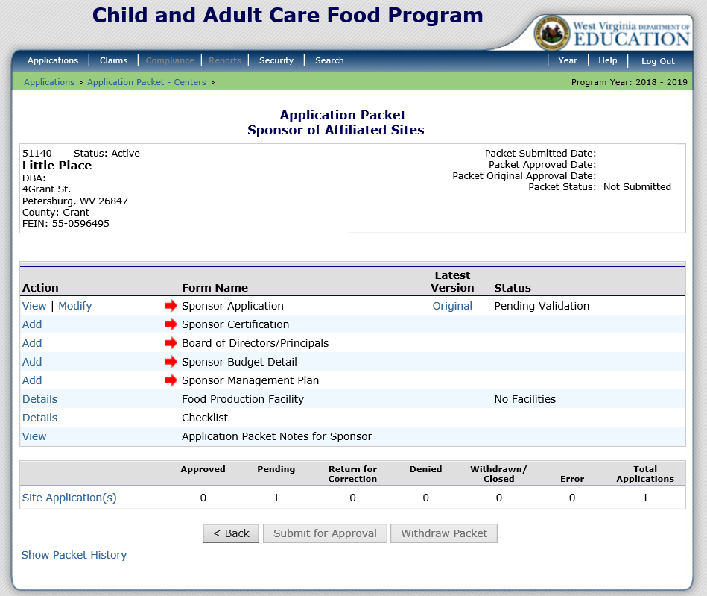
Application Packet
Notes:
The terminology on the Application Packet screen is exactly the same as it was in the old version of ACES. The first section of the Application Packet is the “Sponsor Application”.
Board of Directors/Principals is where you would enter at least three Board Members (this is only required for non-profits centers).
Sponsor Budget Detail is your budget for the program year.
Sponsor Management Plan is the Program Year Management Plan.
Food Production Facility is if you purchase meals from another place. In the old version of ACES, this was labeled as “Vendor” and was located at the bottom of the Site Application. The Food Production Facility link is where Vendor information is now entered. The information entered here will appear in a dropdown box in the site application.
Checklist is the Supporting Documents. This must be completed after all of the site applications are entered.
At the bottom of the screen is where you complete your site applications.

Slide 11
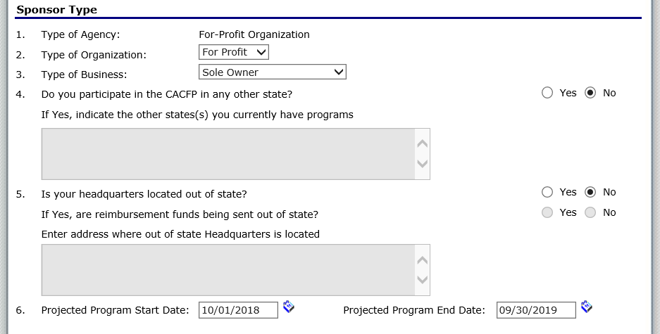
Application Packet – Sponsor Application
Notes:
To access the sponsor application select Sponsor Application from the Application Packet screen. The Sponsor Application begins by requesting general information about the sponsor.

Slide 12
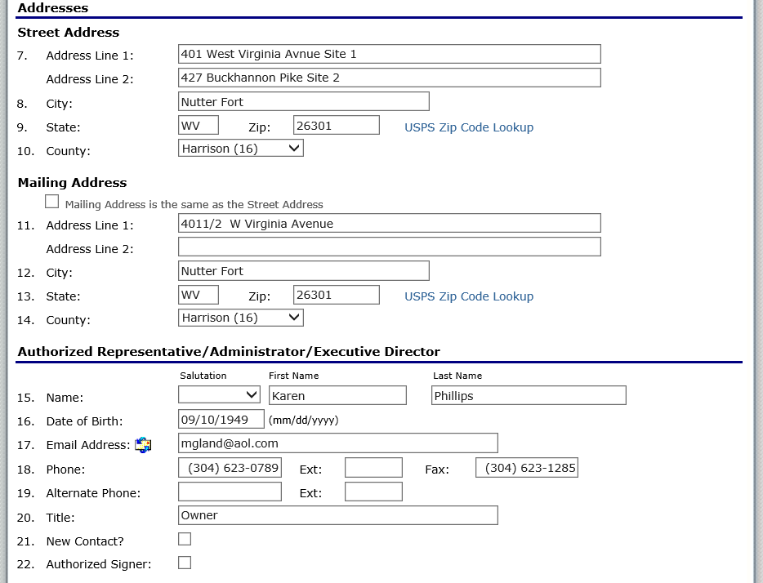
Application Packet – Sponsor Application
Notes:
Street Address and Mailing Address are required fields. Please notice the checkbox below Mailing Address. If your mailing address is the same as the street address, you may check this box and it will fill in the Mailing Address information for you.
Next complete the contact information in the Authorized Representative/Administrator/Executive Director section. Please notice we now require the Date of Birth for each contact.

Slide 13
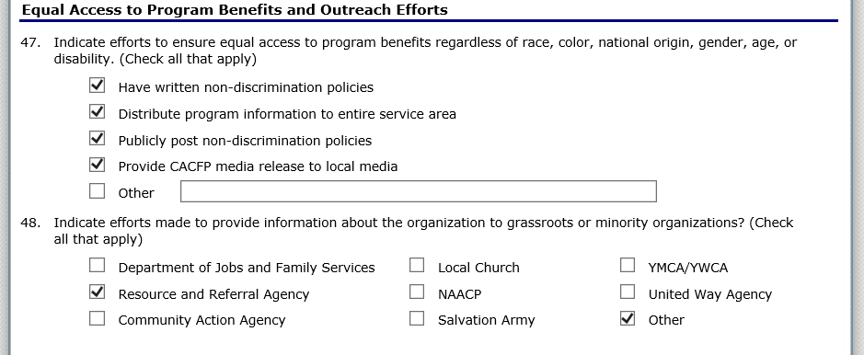
Application Packet – Sponsor Application
Notes:
The Equal Access to Program Benefits and Outreach Efforts section of the Sponsor Application should carry over from your previous application.

Slide 14
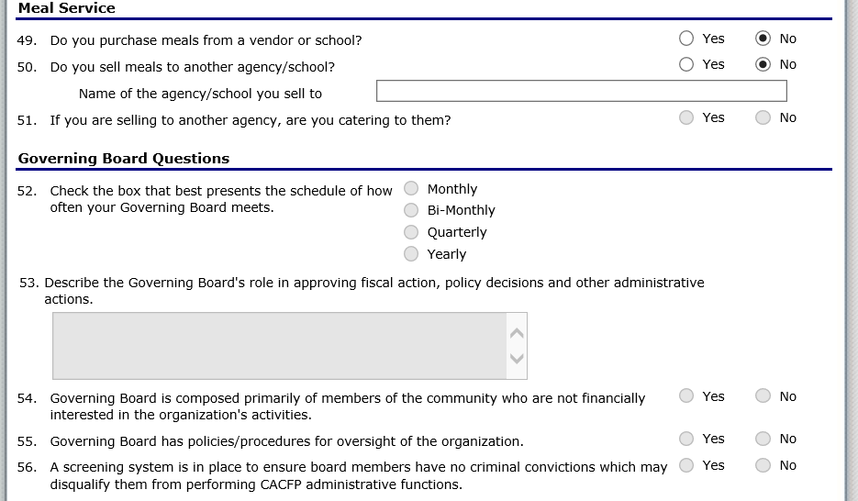
Application Packet – Sponsor Application
Notes:
Meal Service questions should also carry over from your previous application.
The Governing Board Questions will be grayed out unless you selected Non-Profit on Question 2 of the Sponsor Application.

Slide 15
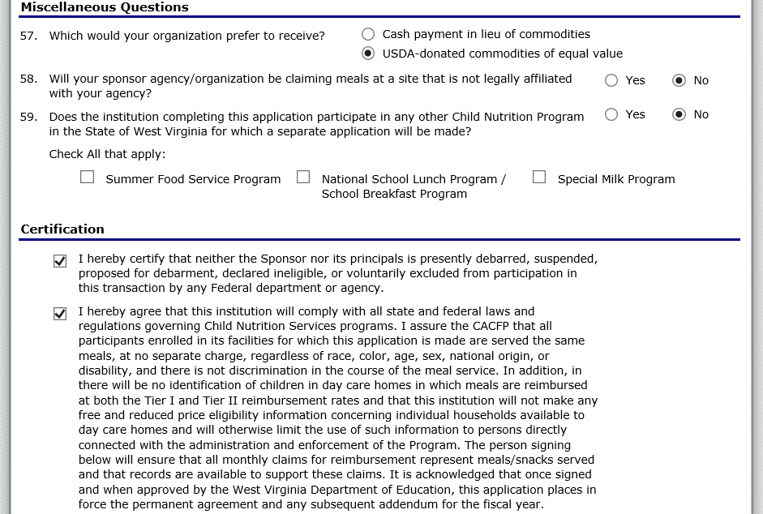
Application Packet – Sponsor Application
Notes:
The Sponsor Application ends with Miscellaneous Questions and Certification. Once completed, please remember to click Save at the bottom of the screen.

Slide 16
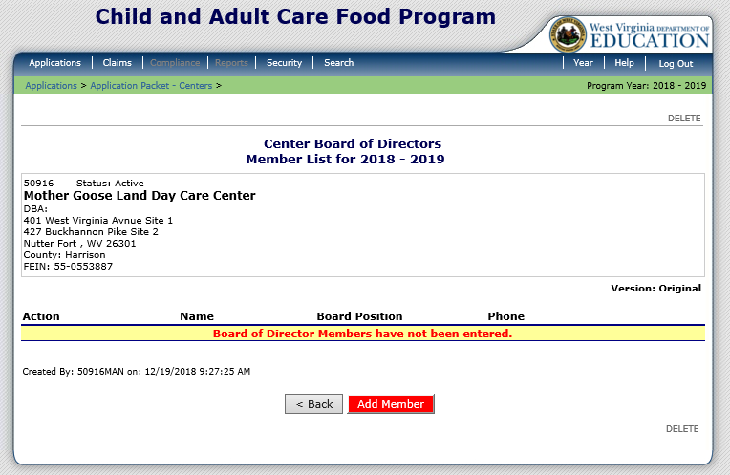
Application Packet – Board of Directors
Notes:
If you are a non-profit you would select Board of Directors/Principals in the application packet and then select the red Add Member button to add a board member. If you are a for profit, you will not complete this. Once Question 2 of the Sponsor Application is completed and marked For Profit, the Center Board of Directors/Principals will not appear in the Application Packet.

Slide 17
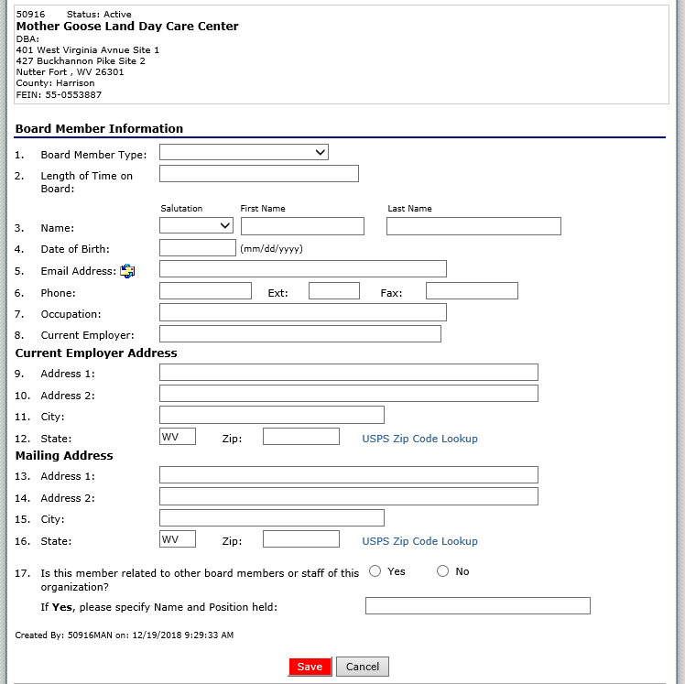
Application Packet – Board of Directors
Notes:
Once you complete the Board Member section, click the red Save button at the bottom of the screen. Please remember that you must have three board members.

Slide 18
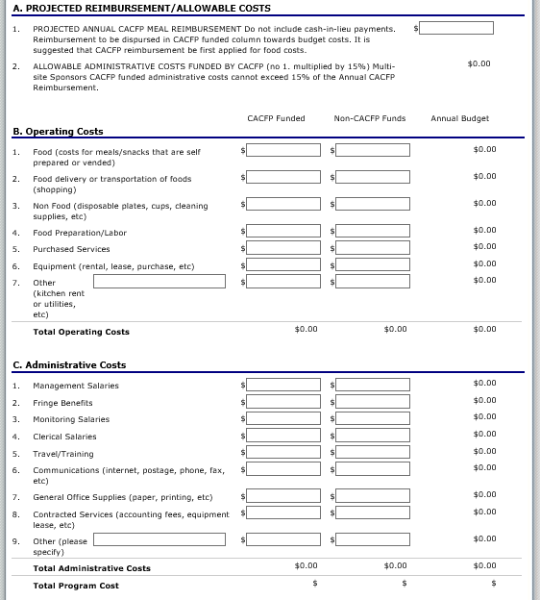
Application Packet – Budget Detail
Notes:
The Budget Detail screen in the new ACES is similar to the screen in the old version of ACES, with just a slightly different look.
The best part about the new ACES is that it automatically calculates totals on the Budget Detail screen.

Slide 19
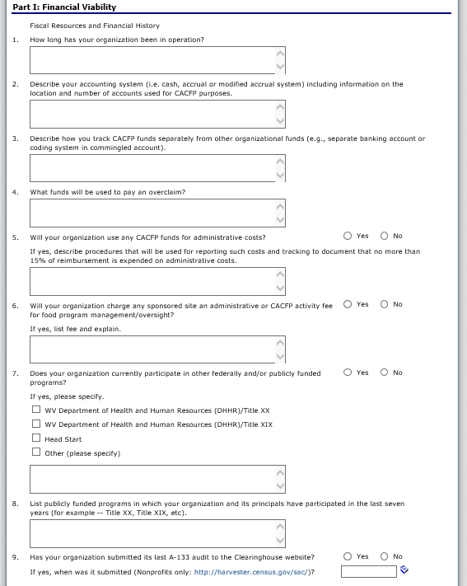
Application Packet – Management Plan
Notes:
In the old version of ACES, the Management Plan had four different sections. In the new version of ACES there are three Parts that are all on the same page. Part I is the Financial Viability section.

Slide 20
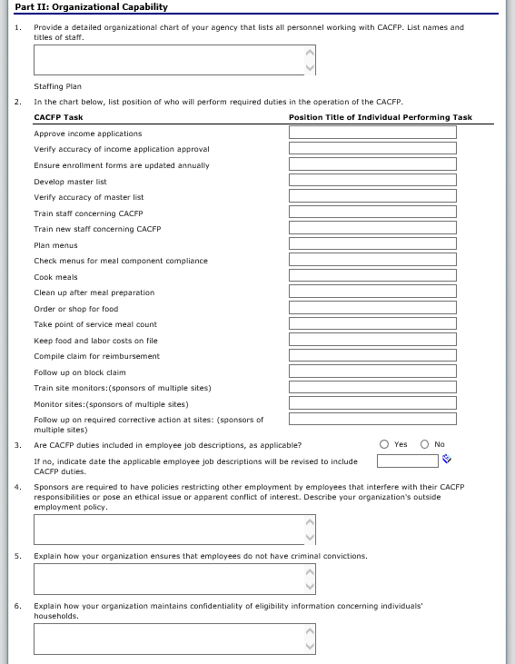
Application Packet – Management Plan
Notes:
Part II of the Management Plan is Organizational Capability. Questions 1 – 6 of this section are general questions about the sponsor.

Slide 21
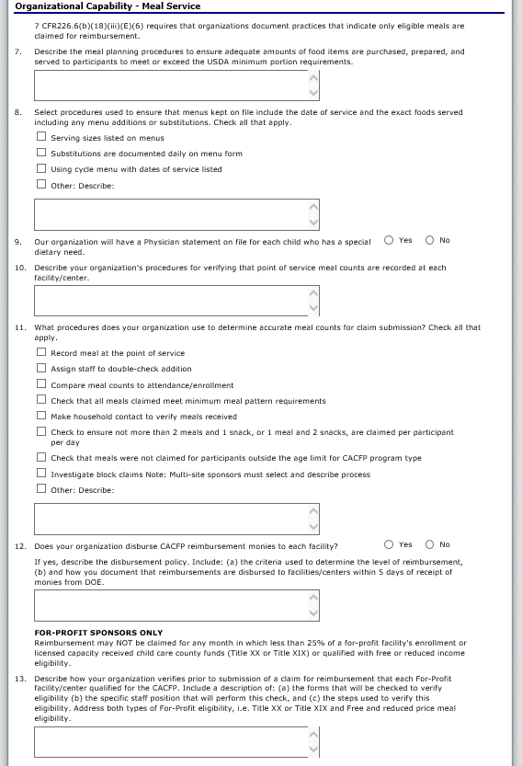
Application Packet – Management Plan
Notes:
Question 7 – 13 in Part II are about the Organizational Capability of the Meal Service.

Slide 22
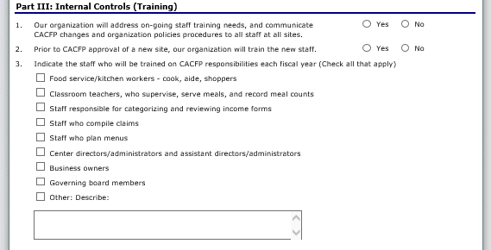
Application Packet – Management Plan
Notes:
Part III gathers information on Trainings.

Slide 23
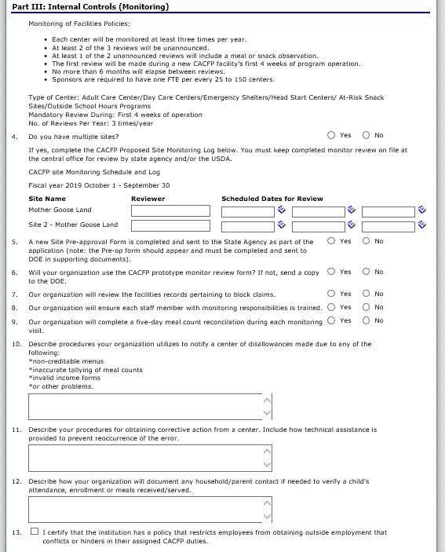
Application Packet – Management Plan
Notes:
Part III also requests information on monitoring. If you are a single site then you do not have to complete the monitoring section. If you answer Question 4 in this section as “No”, it will gray out all the fields you do not need to answer. If you are a multi-site then you need to list dates that each site will be monitored and answer the remaining monitoring questions.

Slide 24
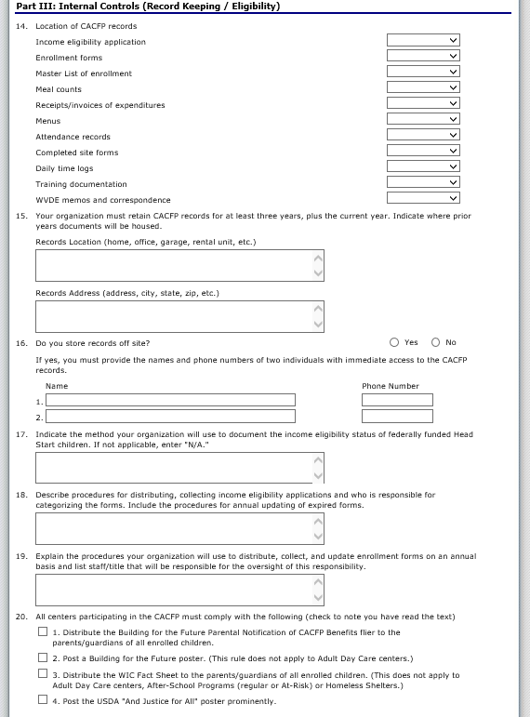
Application Packet – Management Plan
Notes:
The final questions of Part III are about Eligibility. All sponsors must answer these questions.

Slide 25
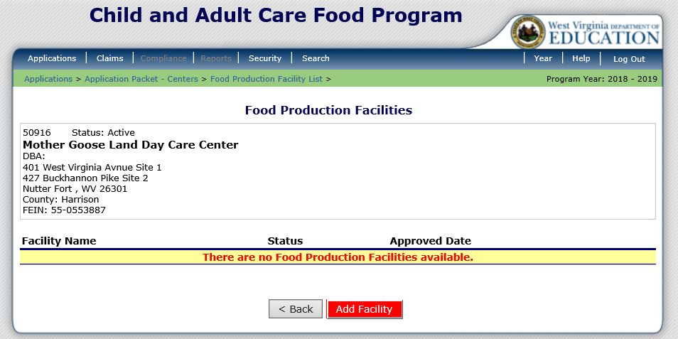
Application Packet – Food Production Facility
Notes:
If you are purchasing food from another place then you will need to add this information in the Food Production Facilities section in the Application Packet. To begin, click the red Add Facility button.

Slide 26
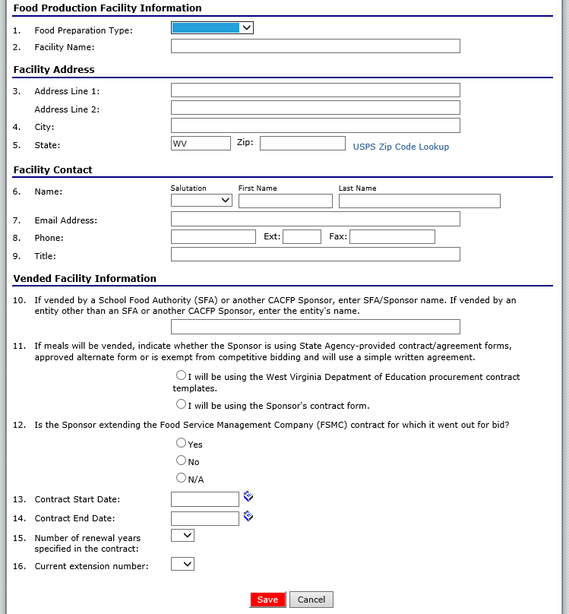
Application Packet – Food Production Facility
Notes:
All the information shown on the screen must be completed. Once completed, select Save at the bottom of the screen. If you purchase food from more than one vendor then repeat these steps.

Slide 27
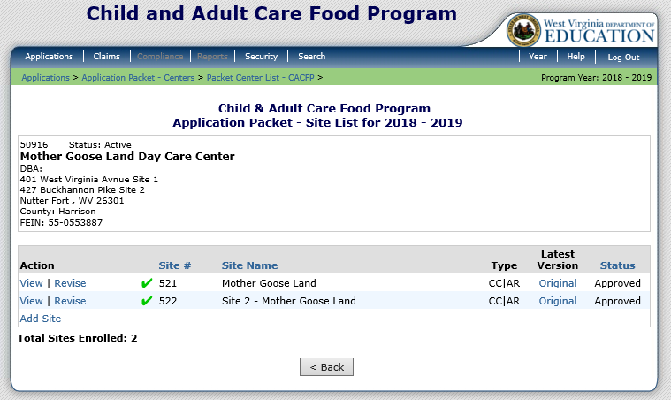
Application Packet – Site Application
Notes:
Once you select Site Applications on the Application Packet screen, it will display all of your active sites. You no longer need to select Add/Renew Site. You can just select Modify beside the site you are working on (or select Revise if the site has already been approved).

Slide 28
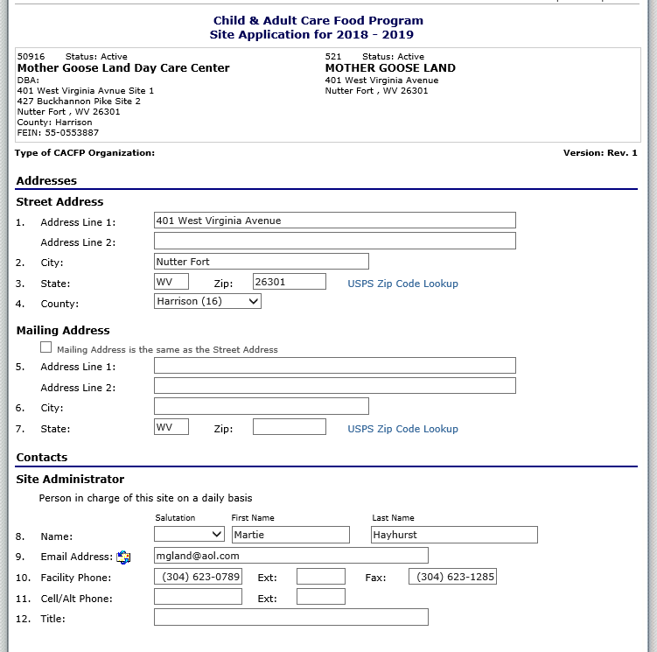
Application Packet – Site Application
Notes:
The site application begins by entering the site’s address and contact information. Some of this information will roll over from the old version of ACES; however, the new site application requests additional information.

Slide 29
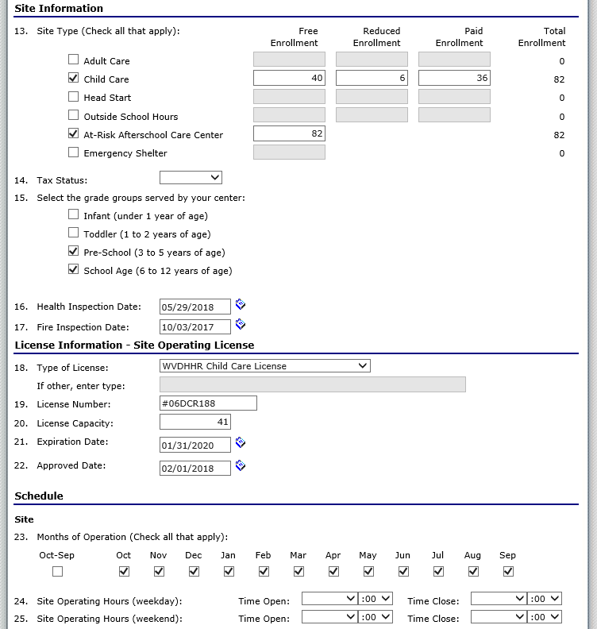
Application Packet – Site Application
Notes:
Next is the Site Information and License Information sections. Child Care and At-Risk are now included on the same site application. In this example both Child Care and At-Risk are selected (question 13). The site’s operation schedule is required in questions 23-25. It requests months of operation as well as the hours of operation. Question 25 is only applicable if you operate during the weekend.

Slide 30
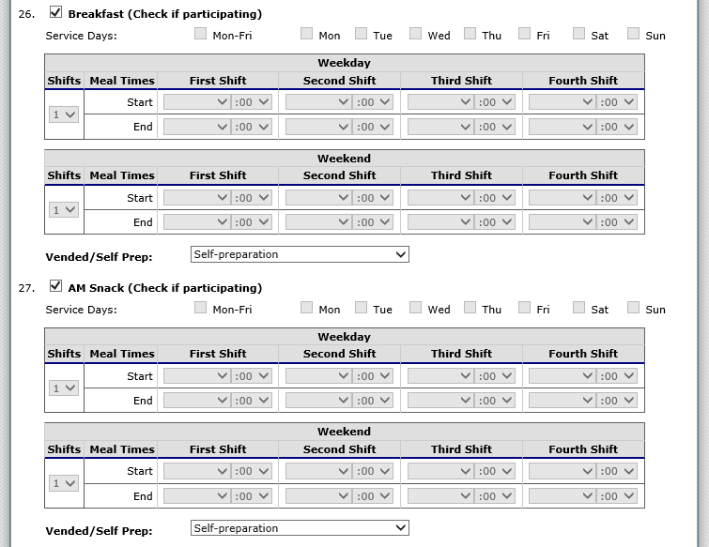
Application Packet – Site Application
Notes:
The way meal information is entered into ACES has changed. Notice that Question 26 is for Breakfast and Question 27 is for AM Snack. You must check if you are participating in these separately. For example, if you do not plan on offering an AM Snack then the box beside Question 27 would need to be unchecked.
The days of the week that meals are served, meal start times, and meal end times are required. If you only serve one breakfast then enter the serving times for the First Shift. If you serve more than one breakfast at different times then you will need to complete both First Shift and Second Shift. Please do not forget to select an option from the Vended/Self Prep dropdown for each meal/snack.

Slide 31
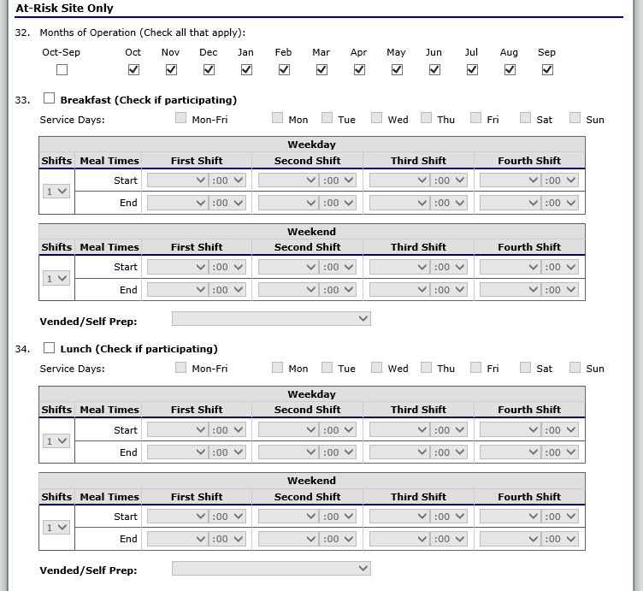
Application Packet – Site Application
Notes:
The At-Risk Site section does not begin until question 32. It is completed the exact same way as the child care meal/snack questions.

Slide 32
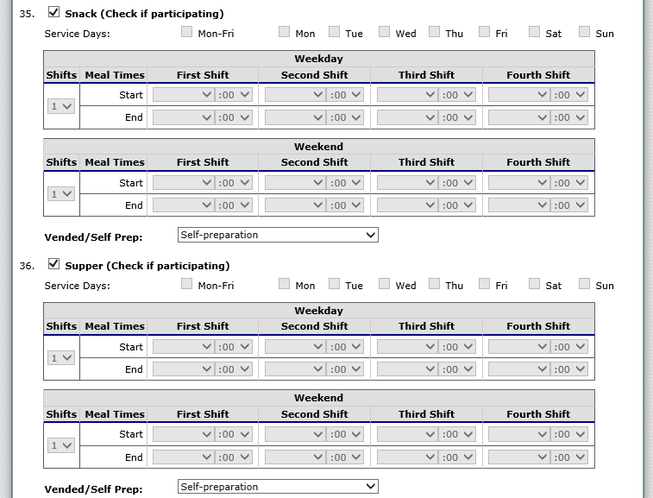
Application Packet – Site Application
Notes:
If you only participate in At-Risk snack or supper, please be aware that these questions do not begin until Question 35.

Slide 33
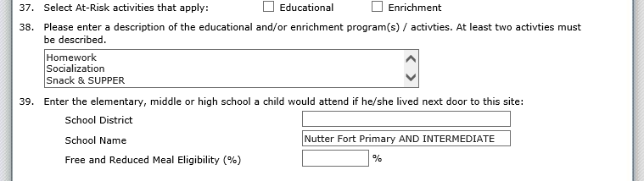
Application Packet – Site Application
Notes:
Next you will need to enter the information about the enrichment program activities provided by the At-Risk Program (Questions 37-38). When you change or renew your site application you will also need to enter in school data (school district, school name, and percent needy) for the area from which the site will draw its attendance.

Slide 34
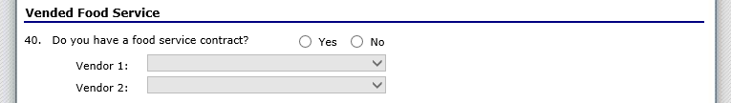
Application Packet – Site Application
Notes:
Indicate if meals are vended in Question 40. If meals are vended, use the dropdown box to select the vendor you entered into the Food Production Facility section of the Application Packet.

Slide 35
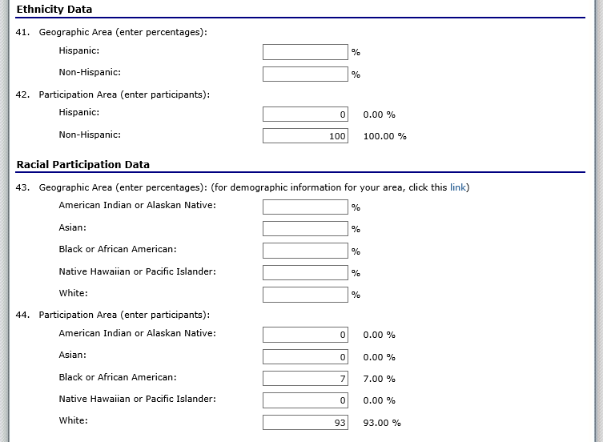
Application Packet – Site Application
Notes:
To the best of your ability, you will need to provide the Ethnicity and Racial Data.

Slide 36
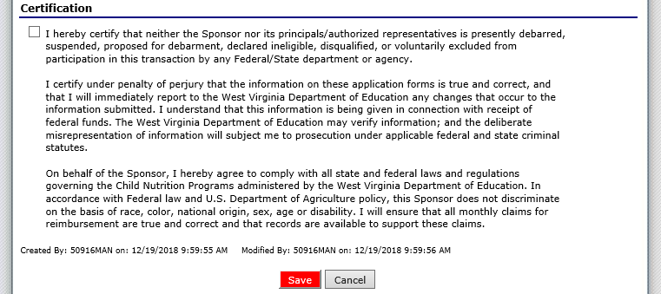
Application Packet – Site Application
Notes:
Finally, check the box under Certification and then click the red Save button. You will need to repeat this process for all of your sites.

Slide 37
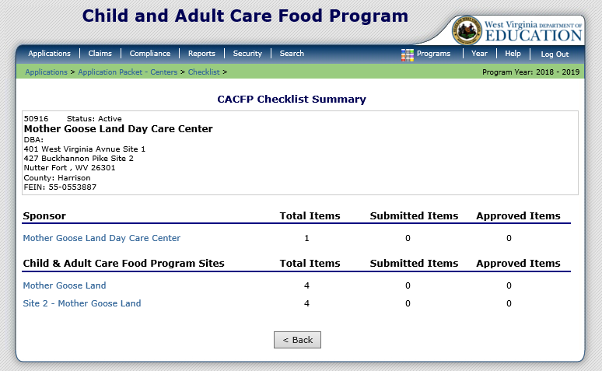
Application Packet – Checklist
Notes:
After the site applications are completed, you will need to complete the Checklist in the Application Packet. Please note that there is both a Sponsor section and a Site section. In this example, one Item needs completed for the sponsor and each site has four items that need completed. To begin, just click on the sponsor name in blue.

Slide 38
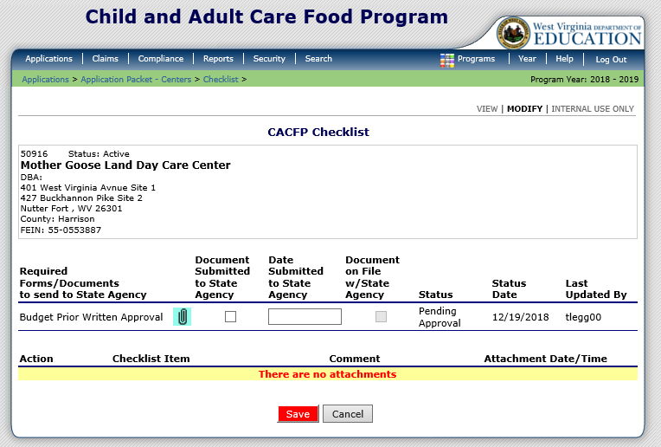
Application Packet – Checklist
Notes:
Each supporting document or checklist item will have a paperclip to attach a file. If you attach the file it will appear in the lower portion of this screen. You must check the checkbox beside the checklist item once it is uploaded or mailed/faxed to the state agency. Please remember to select the red Save button at the bottom of the screen.

Slide 39
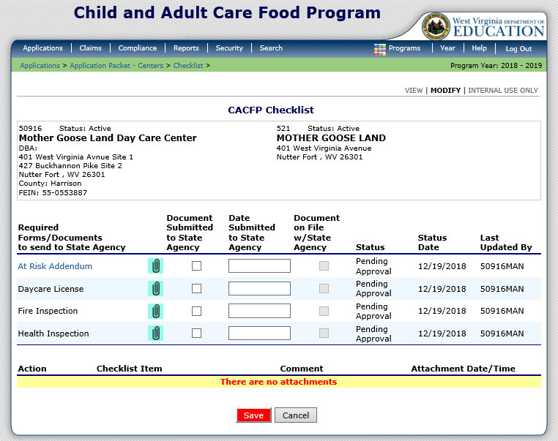
Application Packet – Checklist
Notes:
After the sponsor checklist items are completed, click on the blue site names and complete the same process. Please make sure that the boxes beside each checklist item are checked when the items are uploaded or mailed/faxed to the State Agency. Then click the red Save button.

Slide 40
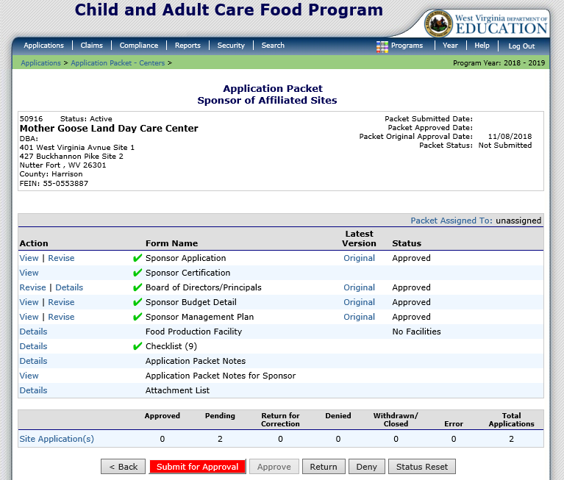
Application Packet – Submit for Approval
Notes:
Once all Action items are completed, click the red Submit for Approval button. WVDE cannot approve an application packet without this button being selected.

Slide 41
Claiming

Slide 42
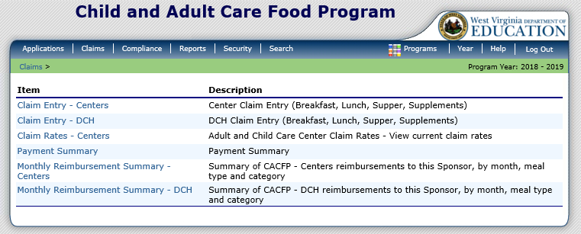
Claiming
Notes:
Once your sponsor Application is approved, you may begin submitting online reimbursement claim requests. To submit a claim, select Claims from the blue menu bar. Under Item, select the type of claim you would like to submit.
Claim Entry – Centers is for Centers
Claim Entry – DCH is only for Family Day Care Homes.

Slide 43
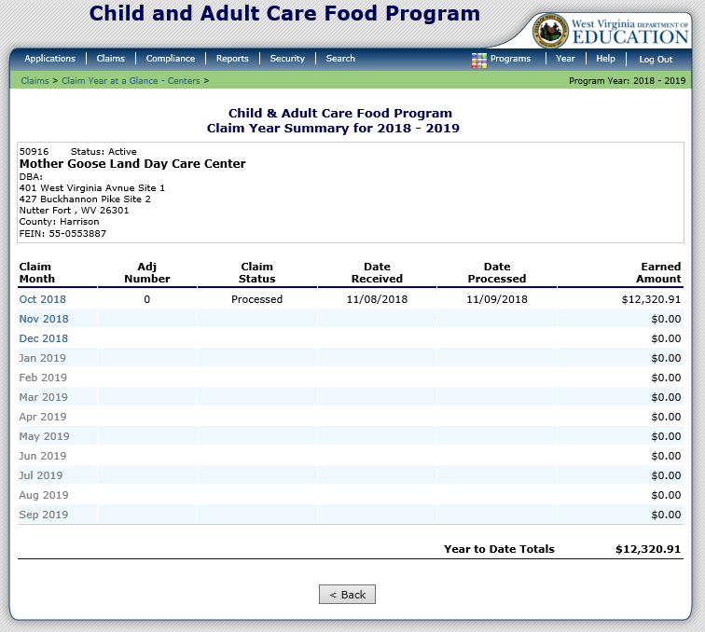
Claiming
Notes:
The Claim Year Summary screen summarizes information regarding the claim for each month in the designated year:
• Adj Number: identifies the number of revisions associated with the claim. Each revision must be re-processed by WVDE OCN.
• Claim Status: identifies the current status of the claim.
• Date Received: identifies the date the system initially received the claim submission.
• Date Processed: identifies the date the claim was included in the payment batch process.
• Earned Amount: identifies the current value of the claim.
To submit a claim, select the desired Claim Month.

Slide 44
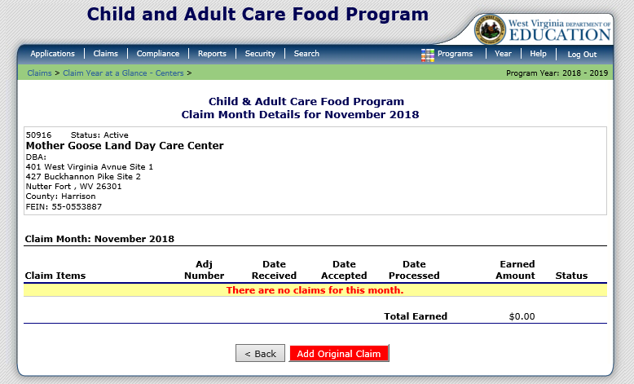
Claiming
Notes:
This screen will appear if this is the first time submitting a claim for the month selected. Select the red Add Original Claim button at the bottom of the screen to add a claim.

Slide 45
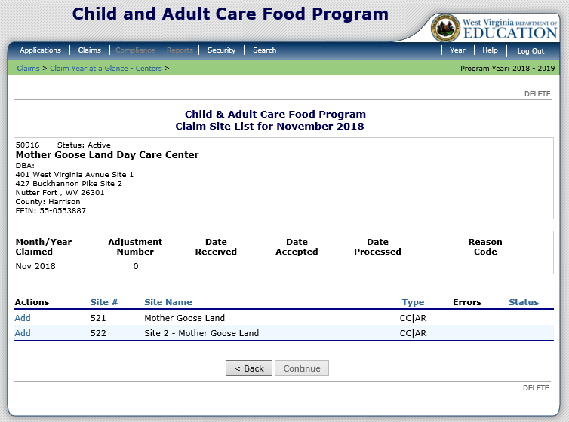
Claiming
Notes:
All sites should be listed on this screen. In the old version of ACES, you had to submit a claim for each site approved to operate in the month selected. The new ACES does not require you to add a claim for each site. If you only had meal counts for the first site then that is the only site you need to select. To submit a claim for a site select Add beside the site you wish to add a claim for.

Slide 46
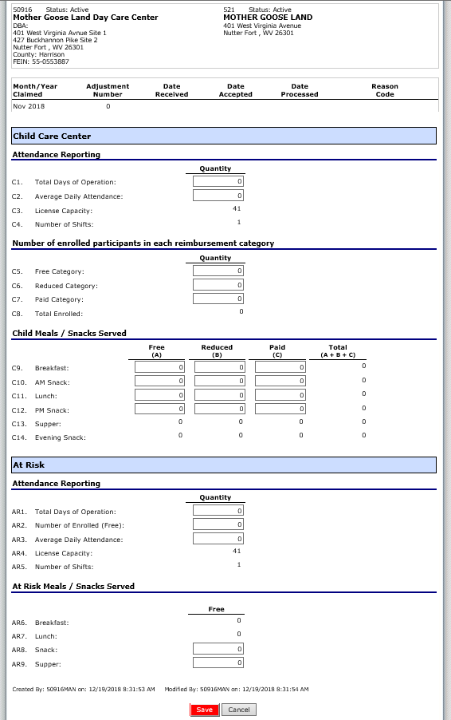
Claiming
Notes:
This screen shows the entire site claim form. It allows claiming for Centers and At Risk. The first section is the Child Care Center.

Slide 47
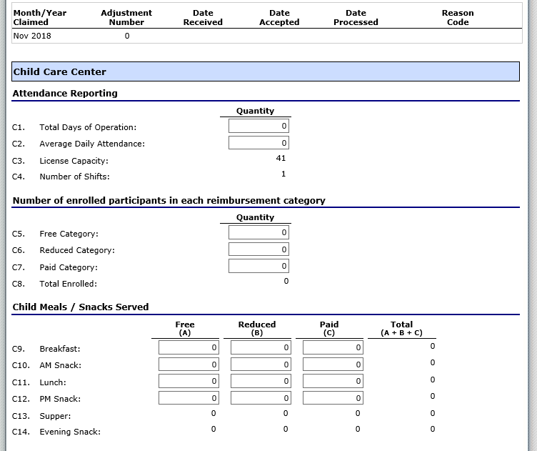
Claiming
Notes:
The section shown here is only the Child Care Claiming portion of the site claim form. This section does not include At Risk meals/snacks.
Boxes are only visible for the sections that you are approved to enter information. The good news is that you are no longer able to accidently enter meals in areas you are not approved for.
In this example, we must enter:
Total Days of Operation
Average Daily Attendance – Entered Last
Number of Free Children during the review month
Number of Reduced Children during the review month
Number of Paid Children during the review month
Breakfast Meals – Free, Reduced, and Paid
AM Snack Meals – Free, Reduced, and Paid
Lunch Meals – Free, Reduced, and Paid
PM Snack Meals – Free, Reduced, and Paid
Please note that the new version of ACES automatically generates the totals.

Slide 48
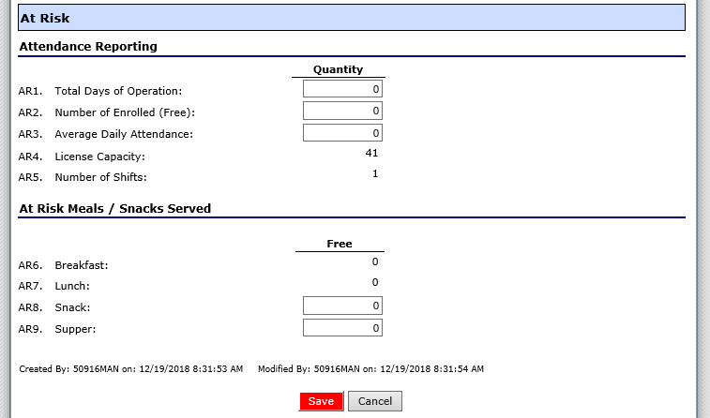
Claiming
Notes:
This section is only the At Risk claiming portion of the site claim form. There are only boxes around that sections that you are approved to enter information.
You must enter:
Total Days of Operation
Number of Enrolled (Free)
Average Daily Attendance – Entered Last
Total At-Risk Snack Meals
Total At-Risk Supper Meals
To calculate the Average Daily Attendance, select the biggest meal and then divide that by the number of operating days. If you served more At-Risk Snacks than At-Risk Suppers, you would use the total At-Risk Snack divided by the Number of Operating Days. Please remember to always round up. If the answer is 5.1, then the Average Daily Attendance entered should be 6.
Make sure to click the red Save button at the bottom of the screen when all the information for the site claim is entered.

Slide 49
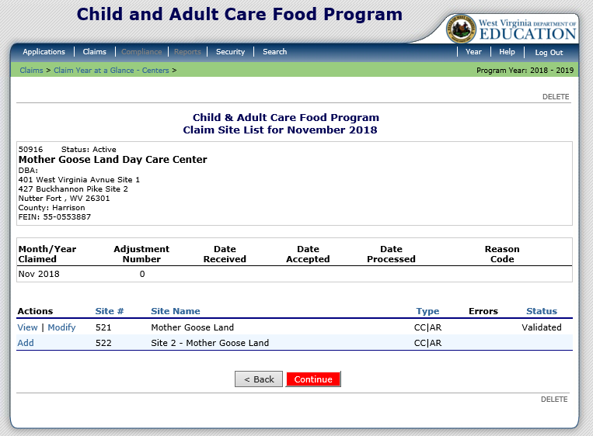
Claiming
Notes:
Once all meals are entered and the status is Validated for each site, select the red Continue button at the bottom of the screen.

Slide 50
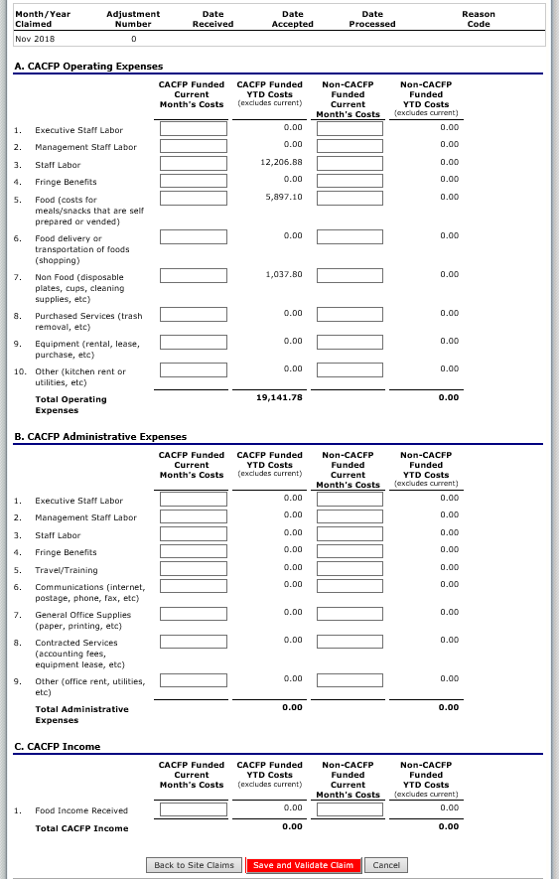
Claiming
Notes:
The old version of ACES required us to enter the financial information first. The new version of ACES requires the financial information to be entered after the meal counts are entered.
Once the financial expenses for the claim month are entered, select the Save and Validate Claim button at the bottom of the screen.

Slide 51
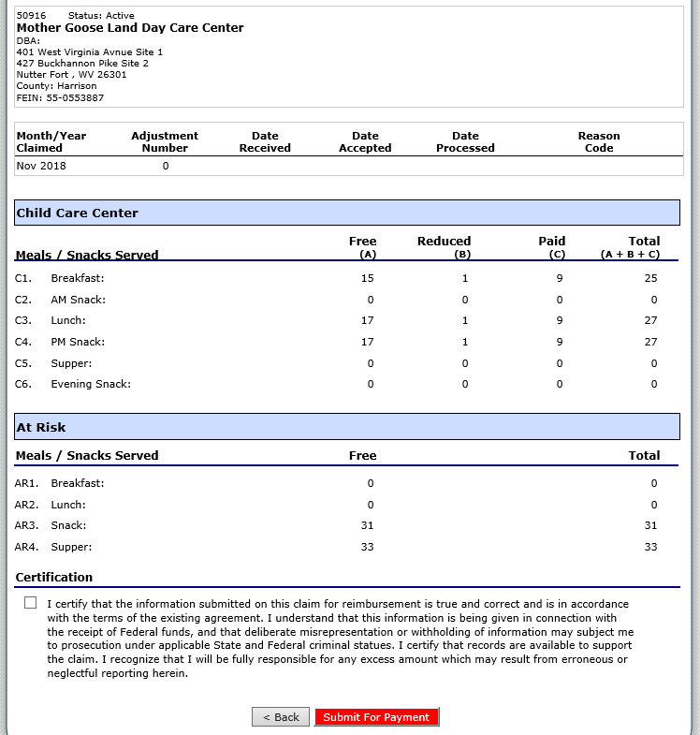
Claiming
Notes:
The next screen shows the meal counts for your entire claim. Once you have reviewed that the counts are accurate, check the box in the Certification section at the bottom of the screen. Select the red Submit for Payment button.

Slide 52
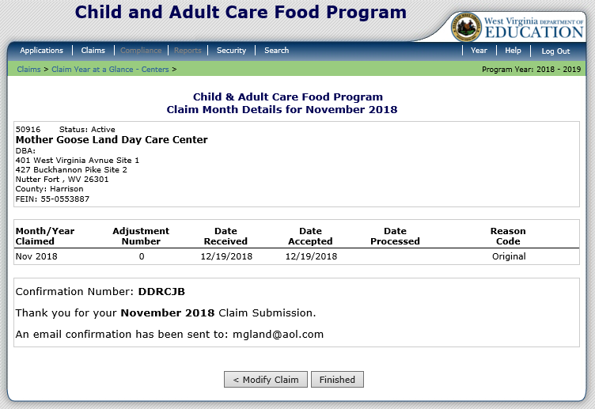
Claiming
Notes:
Once you successfully submit your claim, you will see this screen. It will display a confirmation number and generate an email letting you know that your claim was successfully submitted. Select the Finished button.

Slide 53
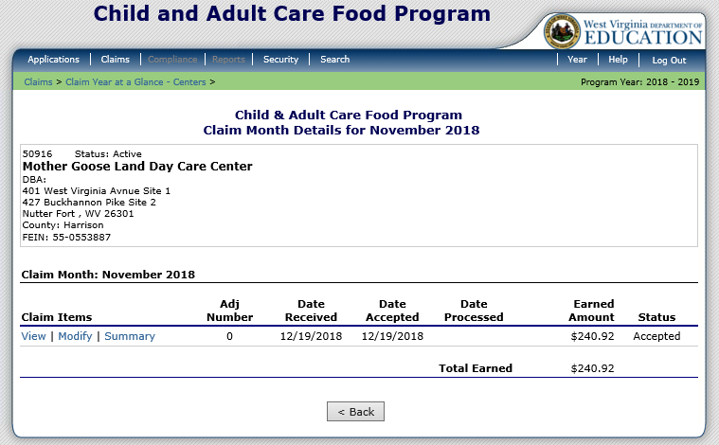
Claiming
Notes:
This is the next screen. It is just informational. In the old version of ACES, the only claim statuses were Not Processed and Processed. In the new ACES the statuses are Validated, Accepted, and Processed.
Validated is the status you receive before you submit your claim. This just means that you put in the data and there were no errors.
Accepted means that you have successfully submitted your claim and are waiting for WVDE OCN to process it.
Processed means that your claim has been batched and is in the hands of the State Auditors Office for payment.

Slide 54
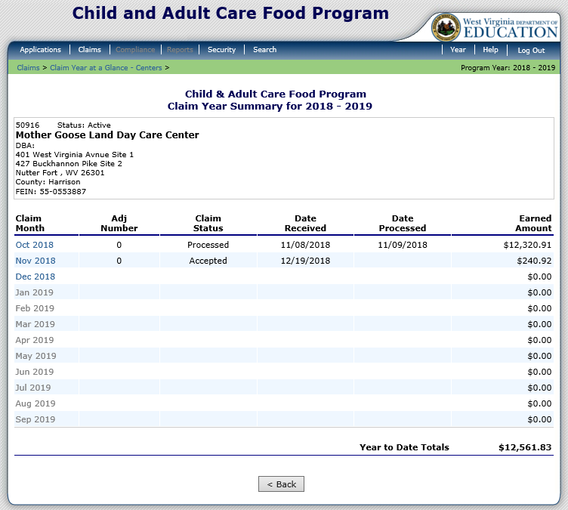
Claiming
Notes:
This screen shows the Processed and Accepted claim statuses.
In this example, the Nov 2018 claim was successfully submitted and accepted. The Oct 2018 claim has already been batched and paid so the claim status is Processed.

Slide 55

Claiming
Notes:
If you need to revise a claim that has already been Processed then select the claim month you need to revise. In this example, the October 2018 claim needs modified. To modify this claim, select the red Add Revision button at the bottom of the screen. Next repeat the steps conducted for entering a claim. Do not just enter the revision numbers. Enter the actual total amount of meals for each site and any financial changes that need to be entered for each site.

Slide 56

Claiming
Notes:
If you need to revise a claim that is has not been Processed and is listed as Accepted in the Status column then you click on the claim month and then click on Modify to make your edits. Simply follow the same procedures for completing a claim.
In this example, the claim is still in Accepted status, and has not been batched. This is the reason you can modify it instead of submitting a revision.

Slide 57
Questions

