Slide 1
UPDATED ACES
NSLP

Slide 2
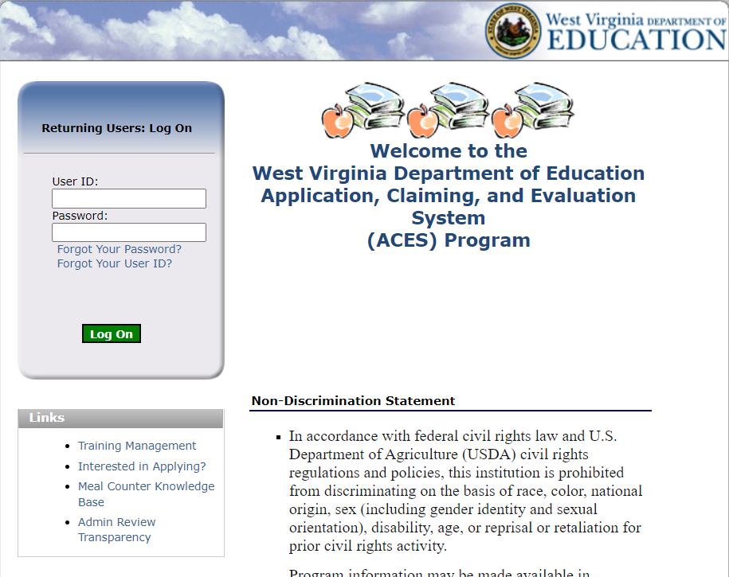
Login Screen for ACES
Notes:
The login screen always has the current nondiscrimination statement and you are able to reset your password by clicking Forgot Your Password.

Slide 3
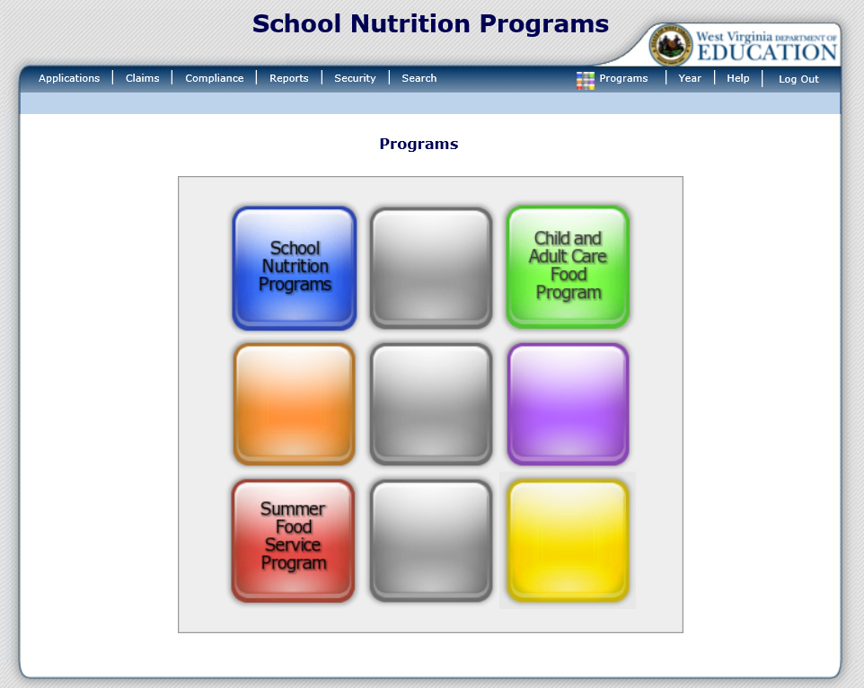
The Waffle
Notes:
Once you successfully log on, you will be directed to the Programs home page. The Programs home page provides access to all of the Child Nutrition Programs. Actual access to specific programs and modules depends on a user’s security rights. All Child Nutrition Programs you are approved for, will be listed here. In this example, the sponsor is approved to modify School Nutrition Programs (NSLP/SBP/SMP/ASSP/SSO), the Child and Adult Care Food Program (CACFP), and the Summer Food Service Program (SFSP). If you are not approved to modify one of these programs, it will simply show up as a blank square.

Slide 4
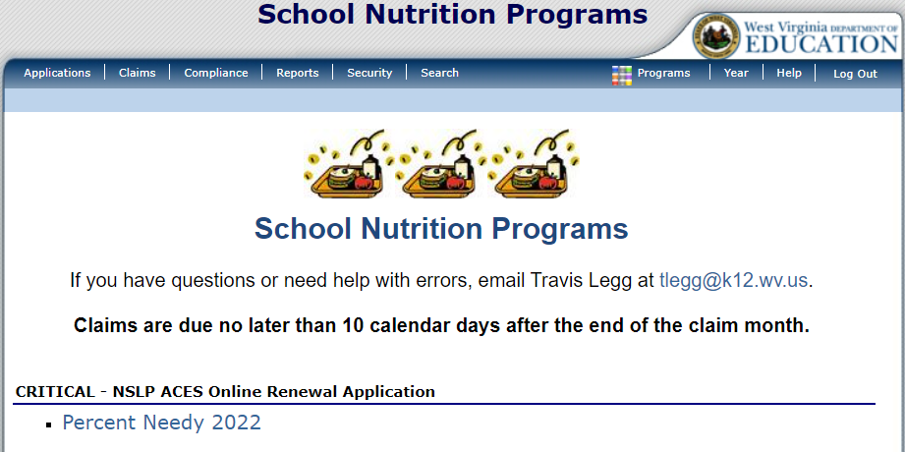
Navigation of ACES
Notes:
Once you select a program, you will see all of the navigation options for the program located at the top of the screen. In this example we selected School Nutrition Programs. If you need to go back to the Waffle, please click on Programs at the top right of the screen.

Slide 5
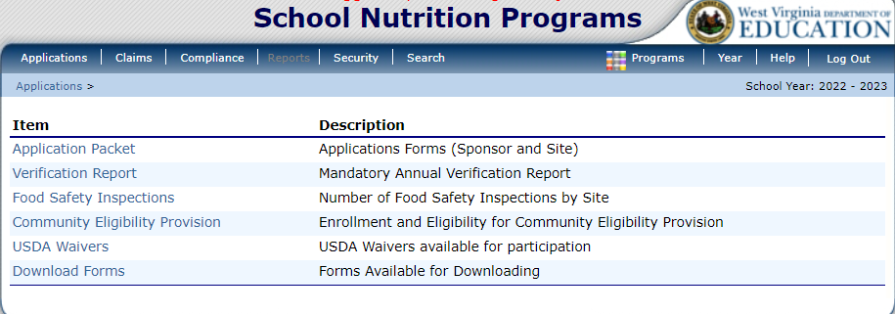
Applications
Notes:
Selecting Applications, on the left side of the dark blue menu bar, will bring you to this screen.
Application Packet is where you complete all of the information for you application renewal, including all site applications.
Verification Report is the location where you input all of your verification numbers. This is the location where you place all the information from the PrimeroEdge Collection Report.
Food Safety Inspections is the location where you report the number of food safety inspections conducted at each site.
Community Eligibility Provision is the location where CEP numbers are entered. WVDE OCN will enter these numbers for the entire state.
USDA Waivers is the location where you would apply for any USDA Waivers for a Program Year. These waivers are by site.
Download Forms is the area where WVDE OCN may put documents for you to download, but all forms needed are conveniently located on the home screen for the program selected of the Checklist Summary of the application packet.

Slide 6
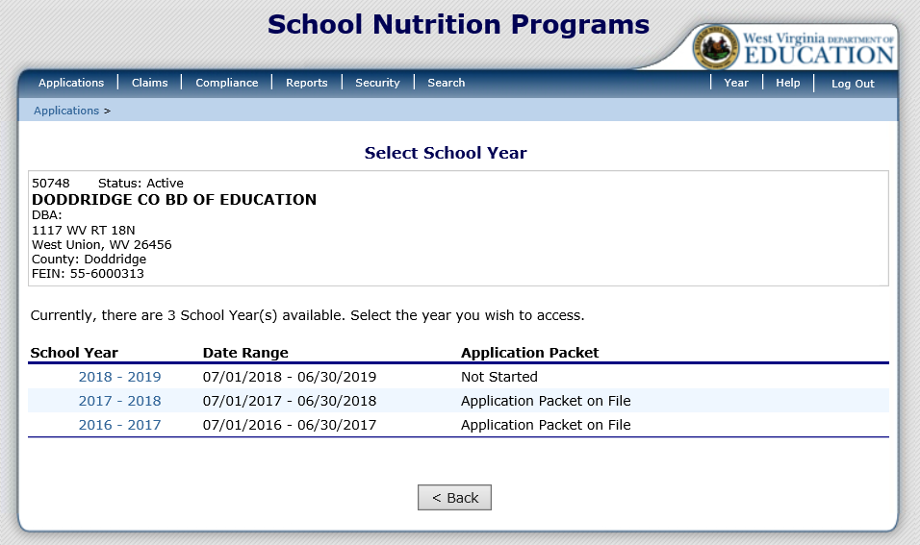
Application Packet
Notes:
Once you are on the Application Packet screen, select the school year you wish to access. The updated ACES shows both the school year and the actual school year date range. To begin the new application packet for the 2018 – 2019 School Year, simply click on “2018 – 2019”.

Slide 7
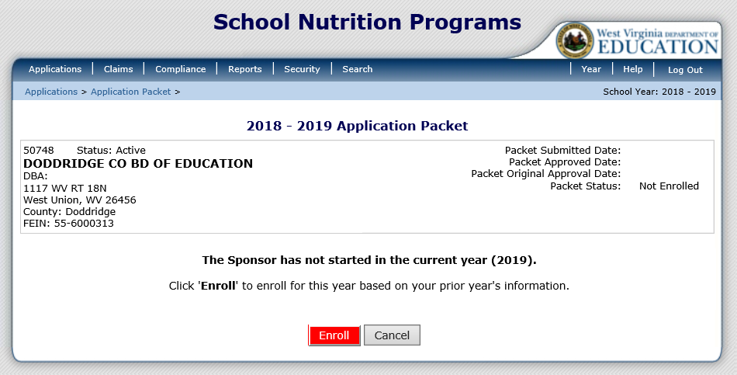
Application Packet
Notes:
If it is the first time working on the application, you must select the red Enroll button. Once selected, you will get a popup window asking you to confirm that you want to continue. Please click OK once this window appears.

Slide 8
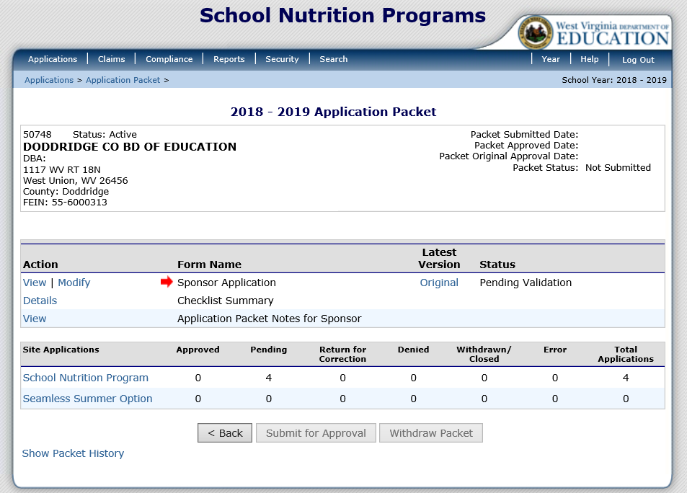
Application Packet
Notes:
The first section of the Application Packet is the “Sponsor Application”.
All of the site applications are completed at the bottom of the screen. If you participate in Seamless Summer, you must complete the Seamless Summer Option site application.

Slide 9
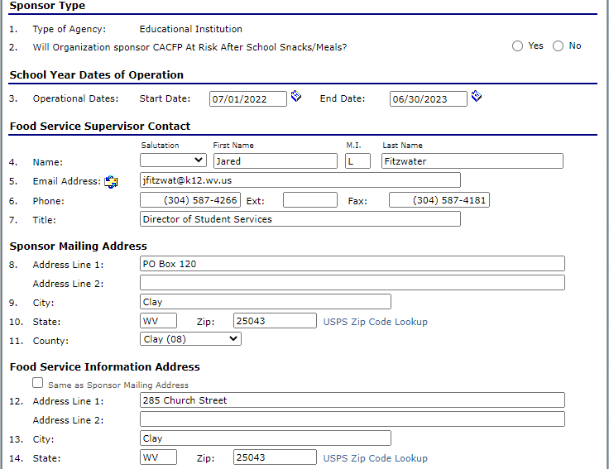
Application Packet – Sponsor Application
Notes:
Most of this information will transfer from the previous year's application packet. If you plan on participating in the CACFP At-Rick Program, please select yes on questions 2.

Slide 10
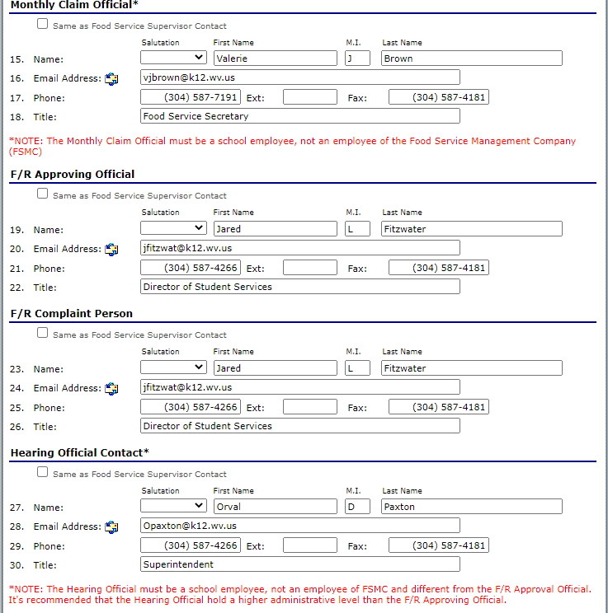
Application Packet – Sponsor Application
Notes:
All of the contact information will transfer from the old application packet. Please make sure that the information is correct.

Slide 11
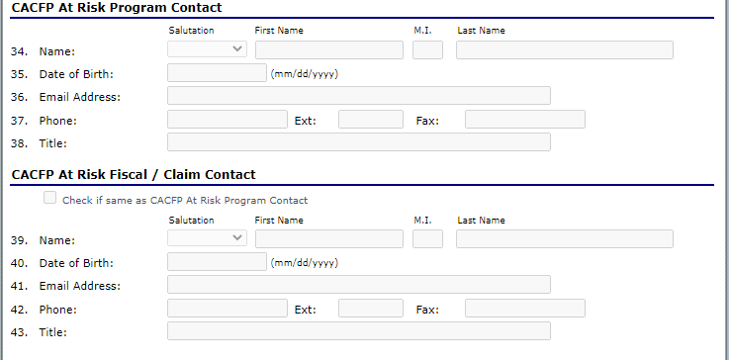
Application Packet – Sponsor Application
Notes:
If you selected yes on the CACFP At-Risk questions, you must complete these contact questions.

Slide 12
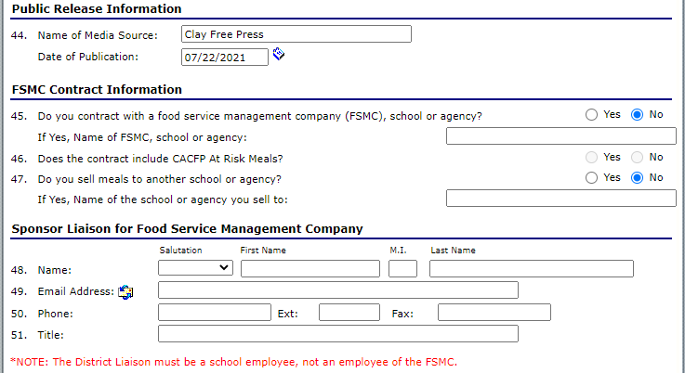
Application Packet – Sponsor Application
Notes:
You must update the Public Release information. Please remember to update the date. The old date rolls over from the previous year.
Answer FSMC Contract Information and the Sponsor Liaison if you use a Food Service Management Company (FSMC).

Slide 13
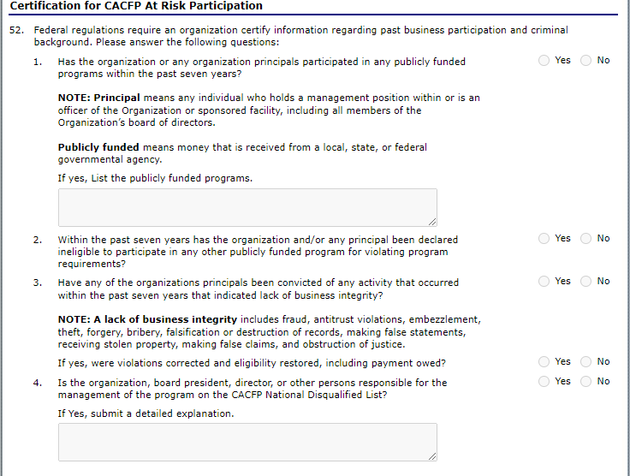
Application Packet – Sponsor Application
Notes:
These Certification questions only show up if you selected yes that you participate in the CACFP At-Rick Program.

Slide 14
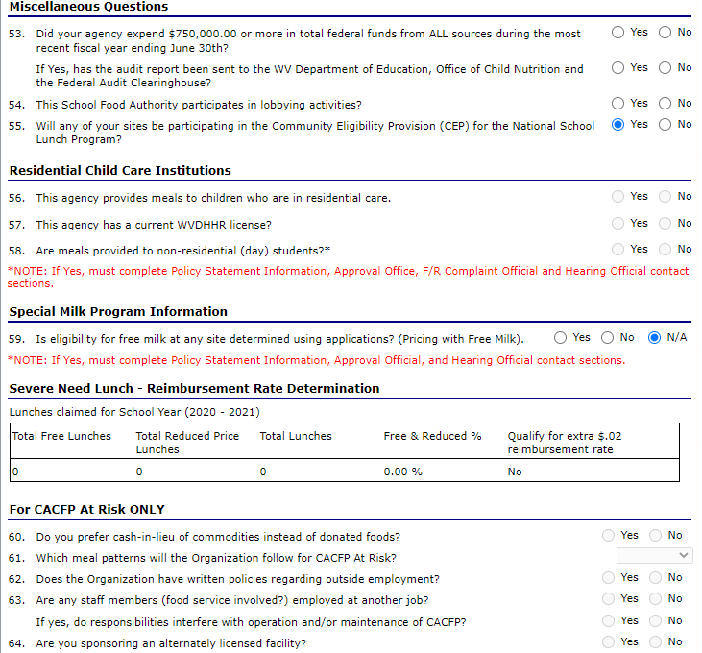
Application Packet – Sponsor Application
Notes:
Please answer the Miscellaneous Questions.
The Residential Child Chare Institutions are only answered if you are an RCCI.
You should only answer yes or no on the Special Milk Section if you participate in Special Milk, otherwise it should be N/A
Finally, answer the CACFP At Risk ONLY section if you selected that you participated in the CACFP At-Risk Program.
Make sure all Certification Checkboxes are checked and then click Save at the bottom.

Slide 15
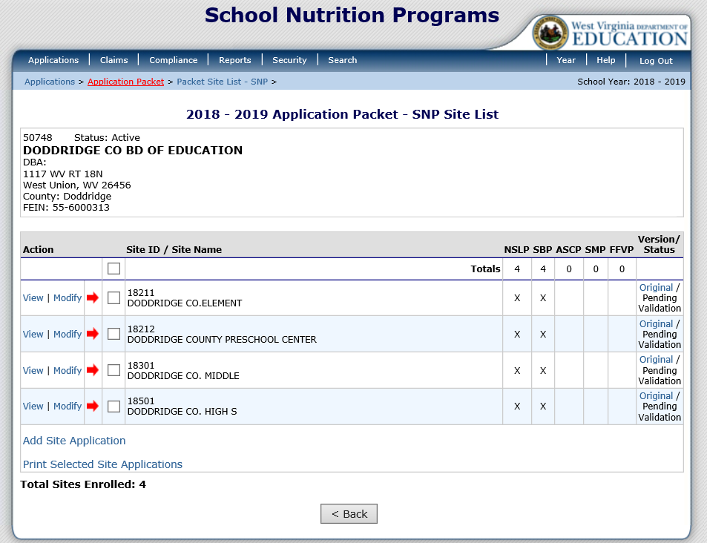
Application Packet - Site Application
Notes:
Once you select School Nutrition Program (SNP), under Site Applications, the screen will display all of your active sites. You do not have to select Add/Renew Site anymore. You can simply select “Modify” next to the site you are working on.

Slide 16
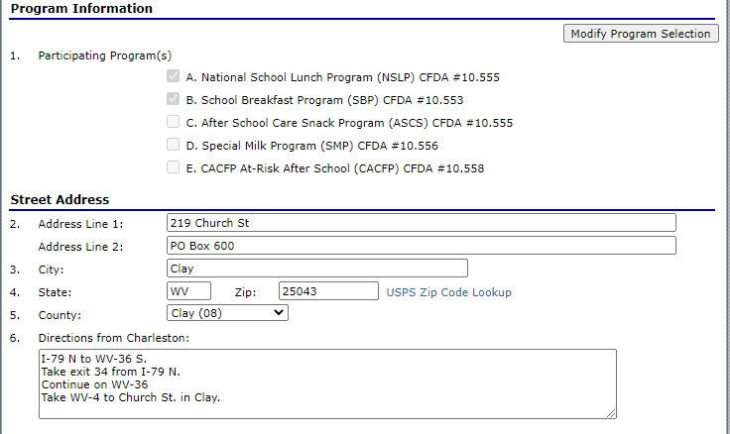
Application Packet - Site Application
Notes:
The site application begins with your program information. In this example, only the National School Lunch Program and School Breakfast Program are selected. The After School Care Snack Program, the Special Milk Program, and CACFP At-Risk After School are not selected. If you wish to participate in the NSLP After School Care Snack Program or CACFP At-Risk Program for this site, you must select “Modify Program Selection” in the upper right hand of the screen. Next, click on the box next to the After School Care Snack Program to place a checkmark inside of it. Make sure you click Save and Continue.

Slide 17
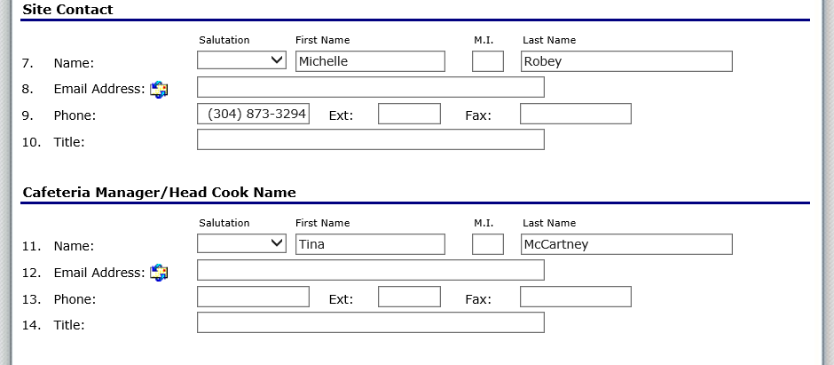
Application Packet - Site Application
Notes:
The next section of the Site Application is mandatory. Previously, only the names of the site contact/principal and the cafeteria manager/head cook were required. Now, in addition to the names, the system requires email, phone number and titles be listed. Please list the principal of the school as the site contact.

Slide 18
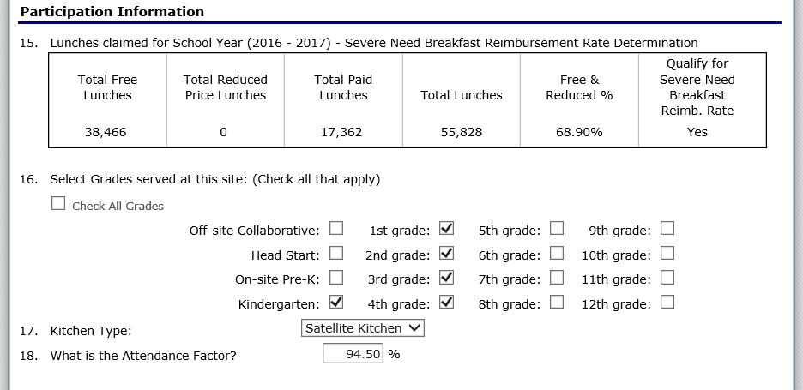
Application Packet - Site Application
Notes:
The information for question 15 is pulled from the previous year’s claims. Please do not put meal counts in question 15.
Questions 16 though 18 collect information unique to the site and includes the grades served, type of kitchen, and attendance factor.

Slide 19
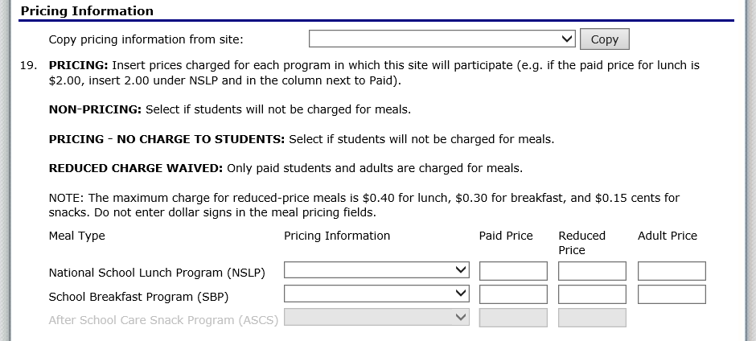
Application Packet - Site Application
Notes:
The pricing information for each site is now required. For example, when you select the dropdown next to the National School Lunch Program (NSLP), you must select one of the pricing information options and enter in the Paid Price, Reduced Price and Adult Price.
If you select the Non-Pricing – CEP option, then the Paid Price and Reduced Price boxes are grayed out. However, you will still need to enter the Adult Price.
Also, by selecting Non-Pricing – CEP, it adds the school in the Community Eligibility Section of the Application Packet for CEP Grouping.

Slide 20
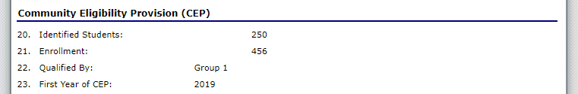
Application Packet - Site Application
Notes:
The Community Eligibility Provision (CEP) information on the Site Applications is entered by WVDE OCN. The grouping will be entered in a different section of the Application Packet.

Slide 21
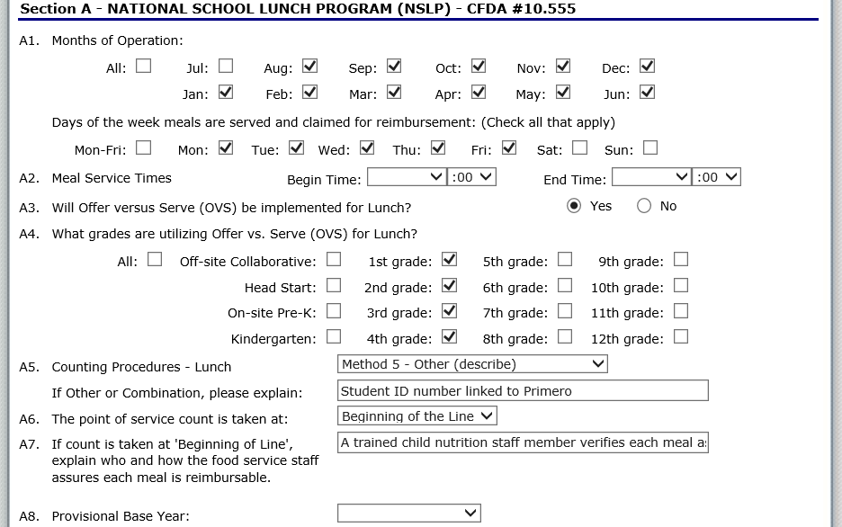
Application Packet - Site Application
Notes:
The next section is where you enter the meal information. It begins with Section A-National School Lunch Program. Sponsors should check all months, days of the week and times that meals will be served. There is a checkbox for Mon-Fri so that you don’t have to individually check each day of the week.
Next you must indicate whether offer vs. serve will be implemented and what grades, if any, will be participating in offer vs. serve.
Just like in the old version of ACES, you must enter the counting procedures. For most sites, this will be Method 3-Cards/Computer. This method means that you are using a computer to record POS. If you select Method 5-Other then you must give an explanation.
The location of the point of service (POS) is also mandatory information. If you select Beginning of the Line, you must give a explanation.
The question about Provisional Base Year should be left blank.

Slide 22
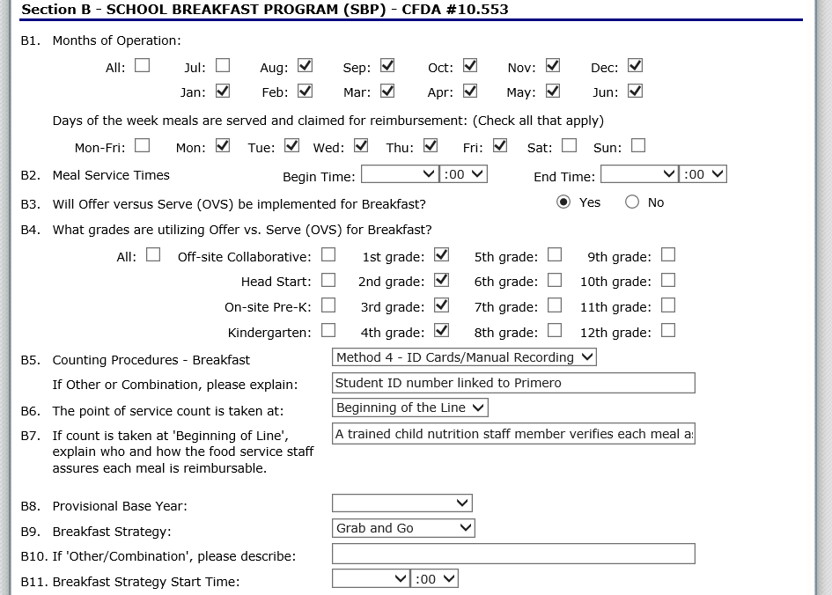
Application Packet - Site Application
Notes:
In Section B-School Breakfast Program you will enter information for the School Breakfast Program. This is completed the exact same way as Section A-National School Lunch Program with the exception of questions B9 – B11. These questions ask about the site’s breakfast strategy. If you select Other/Combination for the Breakfast Strategy in B9 then you will need to explain the strategy in B10. In B11 you will need to indicate the time the Breakfast Strategy begins.

Slide 23
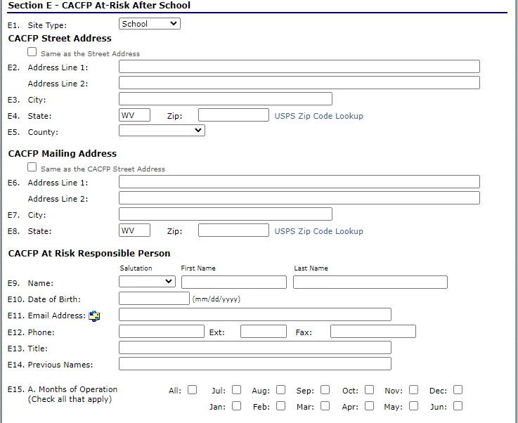
Application Packet - Site Application
Notes:
If you checked CACFP At-Risk After School at the top, you would need to complete the CACFP At-Risk After School Section. In question E15, please remember that you can only check months that school is in session. The month of July can never be checked unless you have a year-round school.

Slide 24
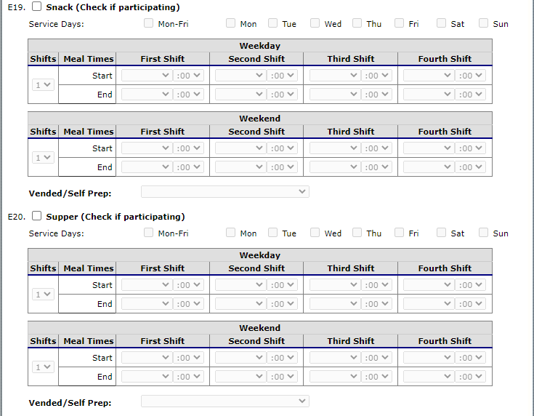
Application Packet - Site Application
Notes:
Put in your hours of operation of the CACFP At-Risk Program and then check the box beside the snack or meal being served. Make sure you select the days of the week this is being served and then put in the serving times. Just use first shift. Remember to select an option I the dropdown beside Vended/Self Prep before finishing.

Slide 25
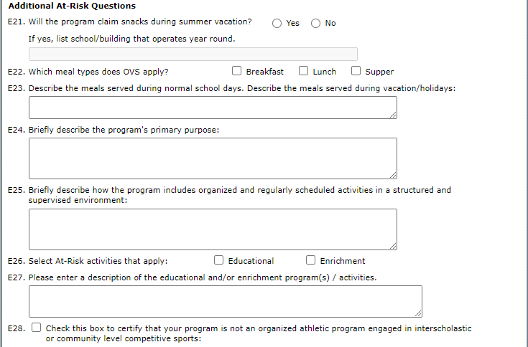
Application Packet - Site Application
Notes:
Finally, if you selected CACFP At-Risk After School, you must complete these additional questions. Once completed, please click Save at the bottom and then complete any remaining sites you may have.

Slide 26
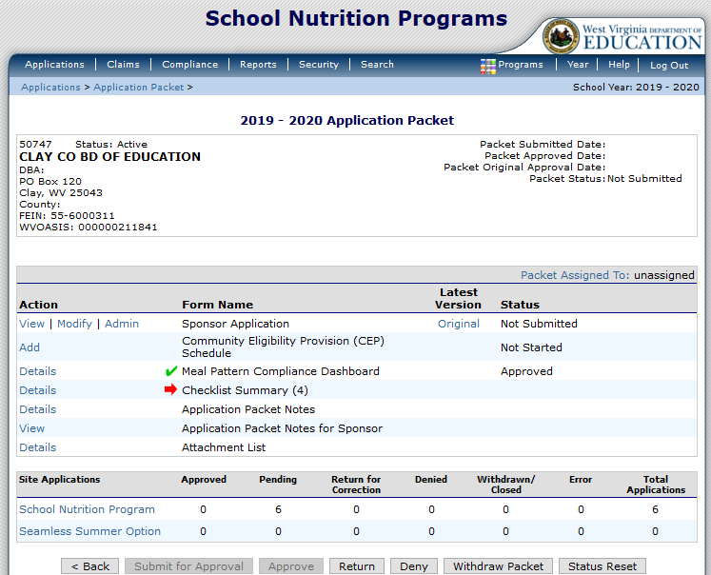
Application Packet – CEP Schedule
Notes:
If you plan to participate in CEP, click Add beside Community Eligibility Provision (CEP) Schedule

Slide 27
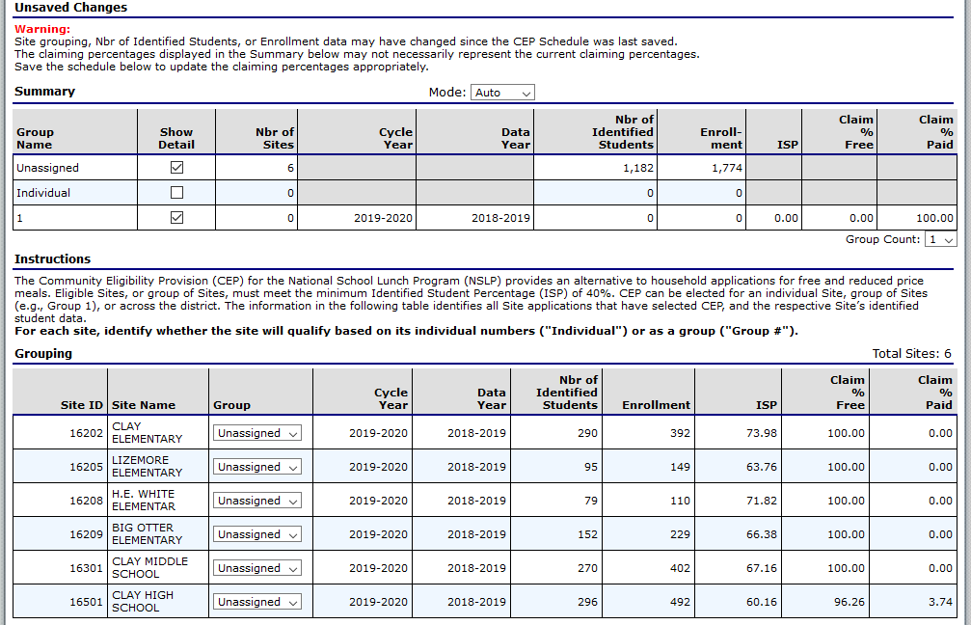
Application Packet – CEP Schedule
Notes:
If you plan to use the newest data for all of your schools, leave mode set to Auto.
If you want more than one Group, click the dropdown beside Group Count and select how many groups you wish.
Select the Dropdown beside each school and select what group that school would be in or if the school is using the individual percentage.
Each school participating in CEP should be assigned to a group or using individual.
Be sure to click Save at the Bottom of the screen.

Slide 28
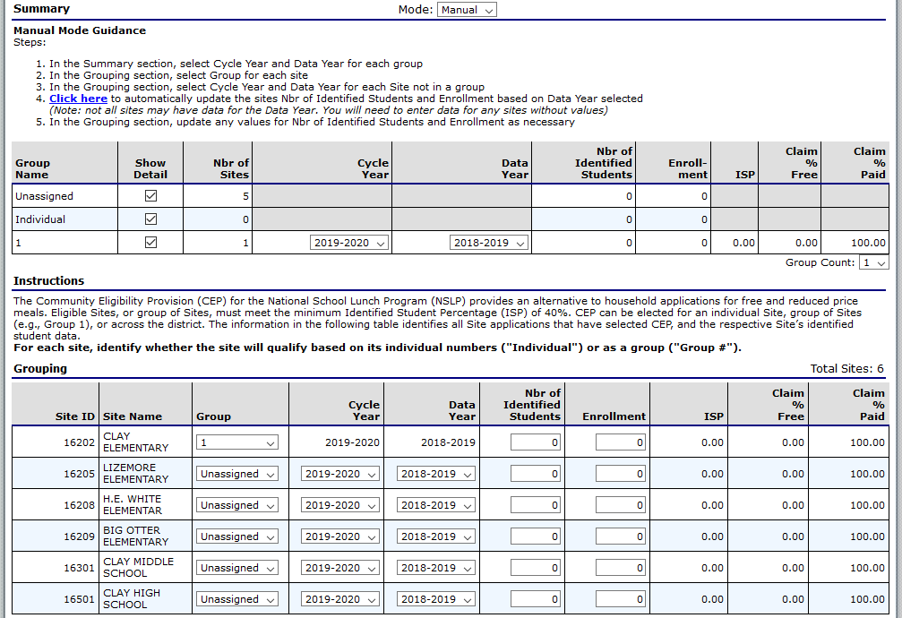
Application Packet – CEP Schedule
Notes:
If you plan to use some of a previous year’s CEP Data you must select manual mode.
If you want more than one Group, click the dropdown beside Group Count and select how many groups you wish.
Once the groups are created, you must select the Data Year Being used for that Group. If you change the Data Year, you must also change the cycle year.
Cycle Year is 4 years from the beginning year of the data being used.
If you are keeping the school as individual, make sure the dropdown beside the school in the Data Year Column selects the correct Data Year Being Used.
If you change the Data Year, you must also change the cycle year. Cycle Year is 4 years from the beginning year of the data being used.
Select the Dropdown beside each school and select what group that school would be in or if the school is using the individual percentage.
Each school participating in CEP should be assigned to a group or using individual.
Be sure to click Save at the Bottom of the Screen.

Slide 29
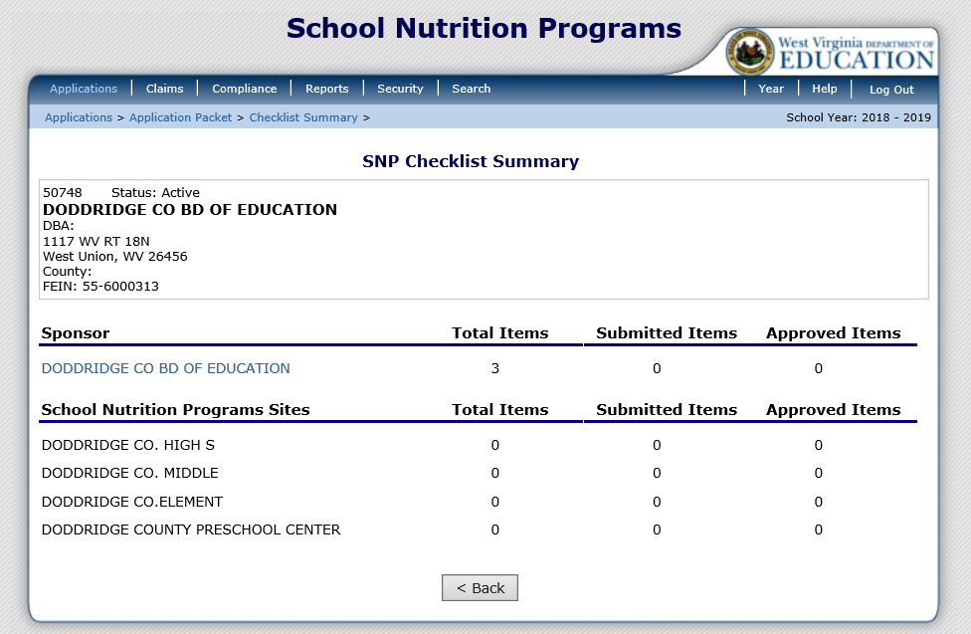
Application Packet – Checklist Summary
Notes:
The Checklist Summary was called Supporting Documents in the previous version of ACES. The top section shows the sponsor information, and the bottom section lists the individual program sites. As you can see in this example, three items are needed from the sponsor. However, 0 items have been submitted by the sponsor for the sites.
If you click on the sponsor name link, it will bring up the three supporting documents that are required.

Slide 30
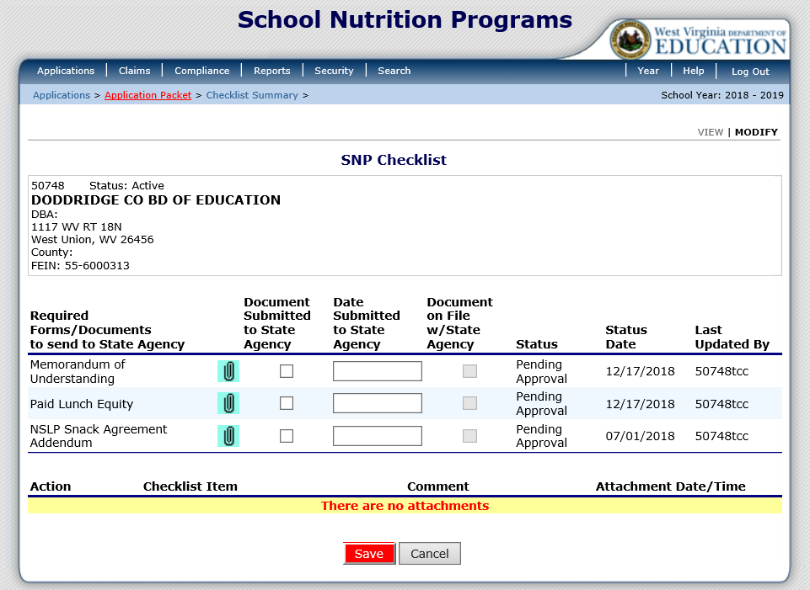
Application Packet – Checklist Summary
Notes:
Supporting documents can be attached using the blue paperclip. To upload a file, select the paper clip. Use the Browse button to select the file to upload. If desired, enter a brief comment (field is not required).
Once the file is attached it will appear in the lower portion of this screen. Select the red Save button at the bottom of the screen. Make sure you select Document Submitted to State Agency once the document is uploaded.

Slide 31
Claiming

Slide 32
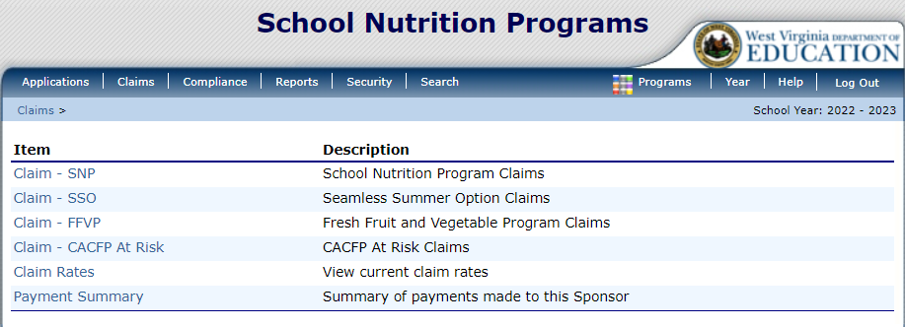
Claiming
Notes:
Once your sponsor Application is approved, you may begin submitting online reimbursement claim requests. To submit a claim, select Claims from the blue menu bar. Under Item, select the type of claim you would like to submit.

Slide 33
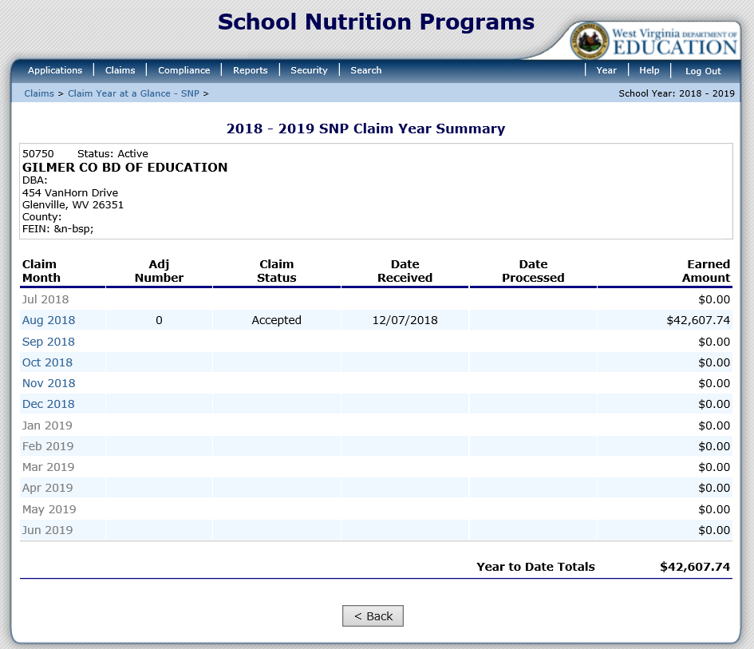
Claiming
Notes:
In this example Claim - SNP was selected.
The Claim Year Summary screen summarizes information regarding the claim for each month in the designated year:
• Adj Number: identifies the number of revisions associated with the claim. Each revision must be re-processed by WVDE OCN.
• Claim Status: identifies the current status of the claim.
• Date Received: identifies the date the system initially received the claim submission.
• Date Processed: identifies the date the claim was included in the payment batch process.
• Earned Amount: identifies the current value of the claim.
To submit a claim, select the desired Claim Month. You do not have to wait until the end of the month to claim. If you finish early in June, you can submit the June claim before July 1.

Slide 34
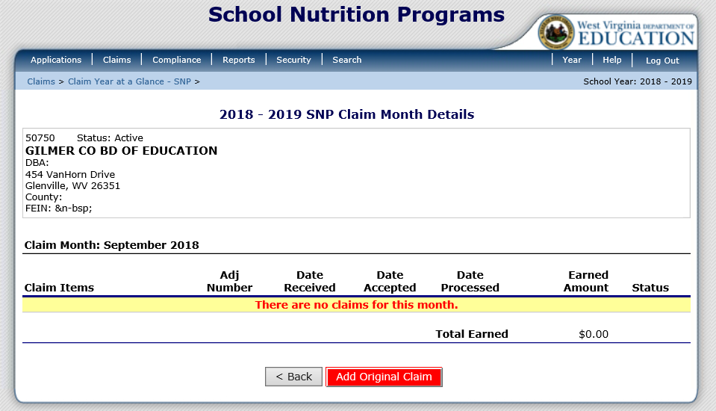
Claiming
Notes:
Once the month is selected the Claim Month Details screen displays. Select the red Add Original Claim button.

Slide 35
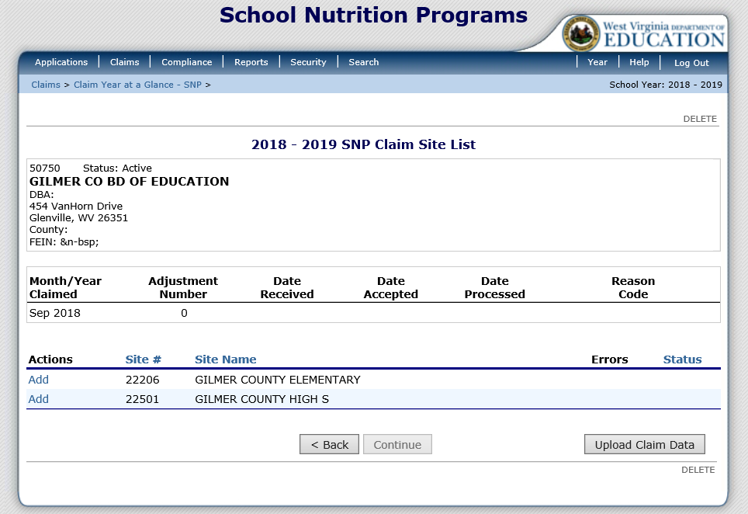
Claiming
Notes:
All sites should be listed on this screen. If you are uploading your claim from Primero then select the Upload Claim Data button at the bottom right-hand side of the screen. If you are not uploading your claim from Primero then click on Add beside the Site and enter the site level data.

Slide 36
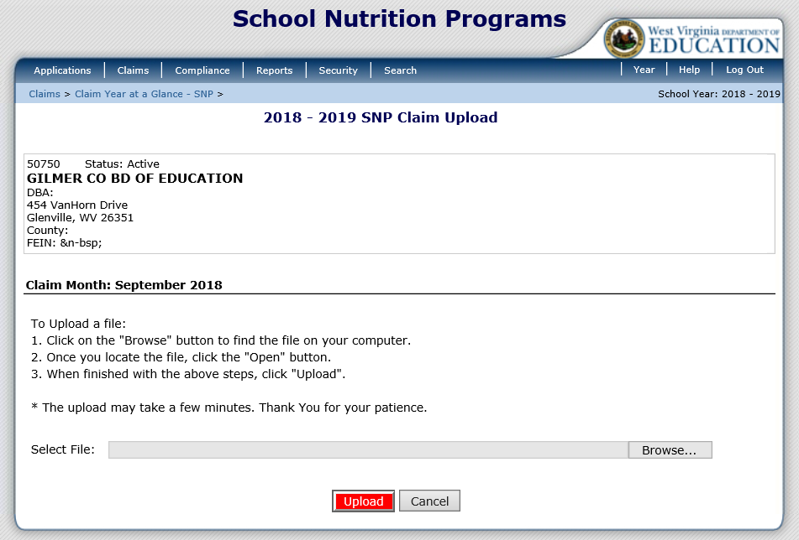
Claiming
Notes:
If you are uploading a file from Primero, click Browse. Select the file you wish to submit and then click the red Upload button. Once the claim is uploaded, you will be able to see if there are any claim errors without leaving the screen.

Slide 37
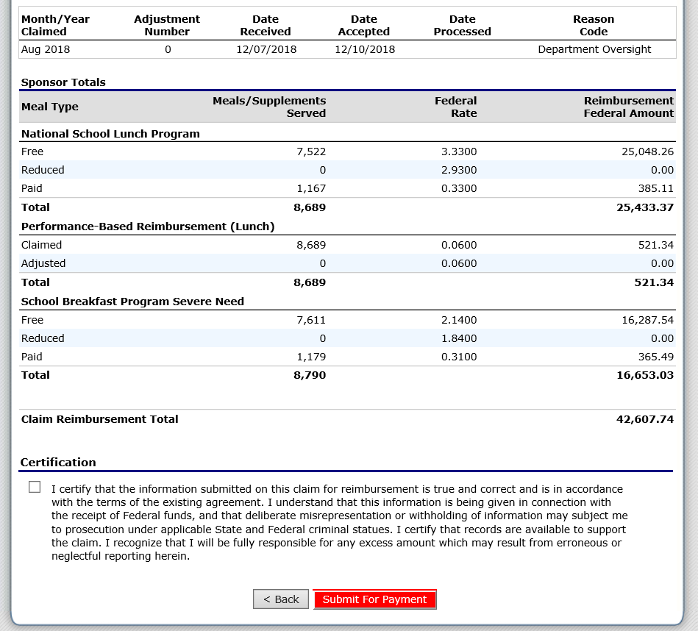
Claiming
Notes:
Once you have uploaded your claim, or manually put in your site claim information, click the red Continue button and it will bring you to this claim summary screen. You must check the checkbox in the Certification section and then click the red Submit for Payment button.

Slide 38
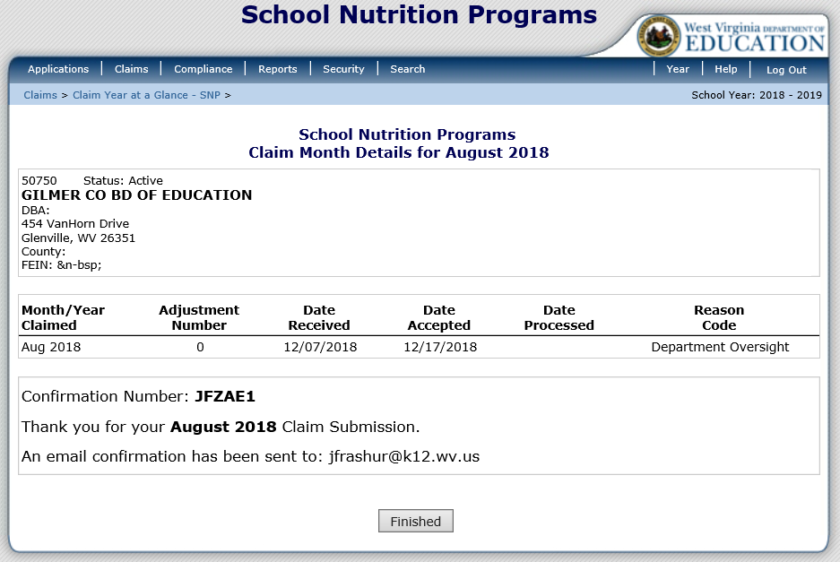
Claiming
Notes:
Once you successfully submit your claim, you will see this screen. It will display a Confirmation number and generate an email letting you know that your claim was successfully submitted. Select the Finished button.

Slide 39
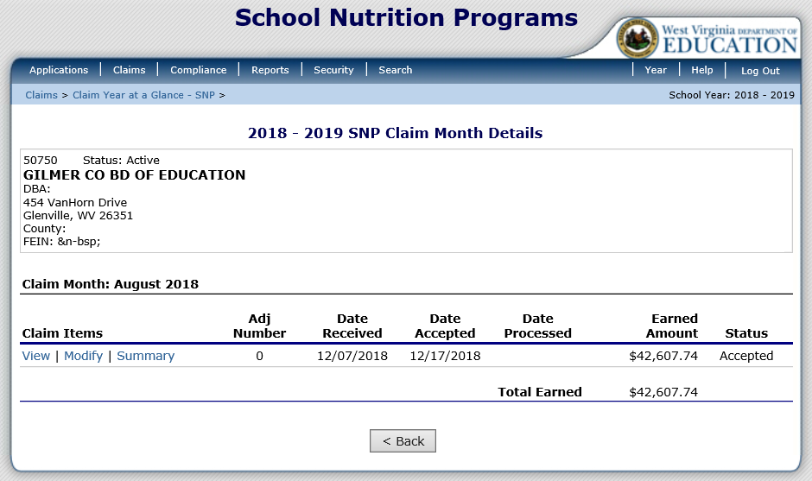
Claiming
Notes:
The next screen displays the Earned Amount and claim Status. Once the claim is batched by WVDE OCN it will show as processed. The Summary link will direct you to the claim summary so that it can be printed.

Slide 40
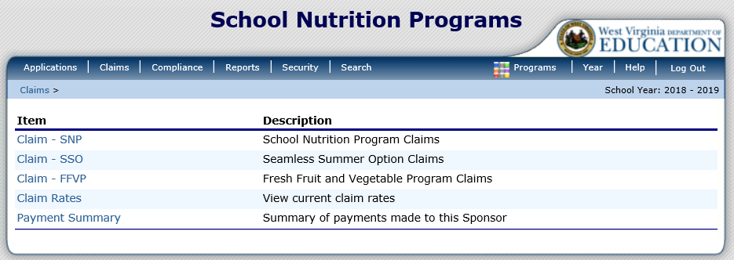
Claiming - SSO
Notes:
Claiming for Seamless Summer Option begins just like claiming for NSLP except you select Claim – SSO.

Slide 41
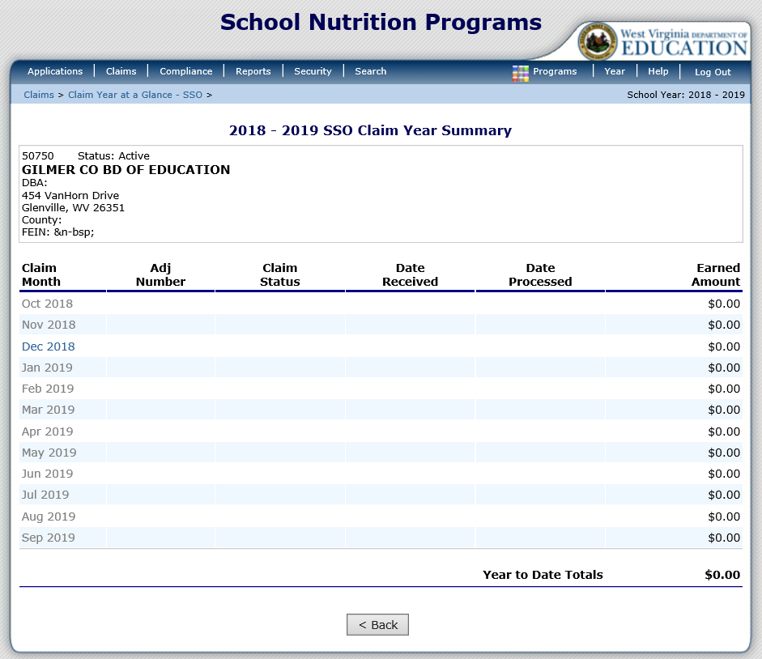
Claiming - SSO
Notes:
Select the operating month you wish to access.

Slide 42
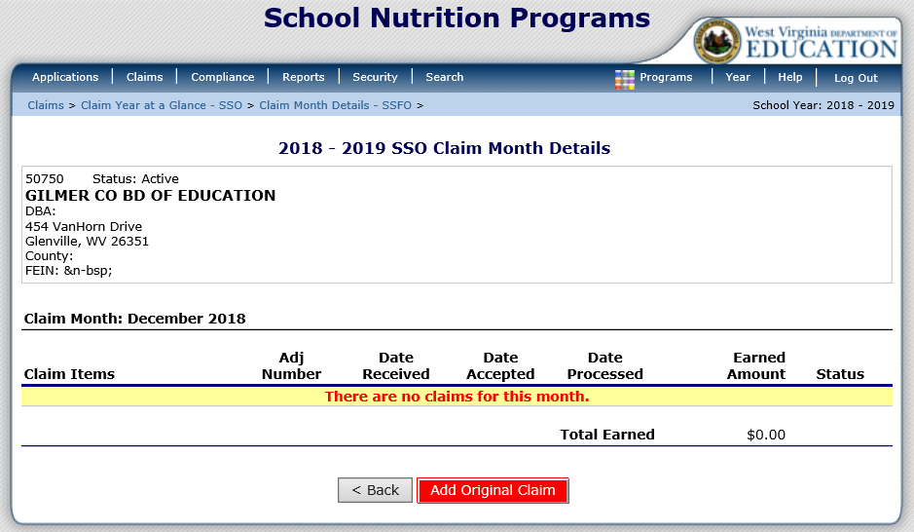
Claiming - SSO
Notes:
If this is the first SSO claim then click on the red Add Original Claim button.

Slide 43
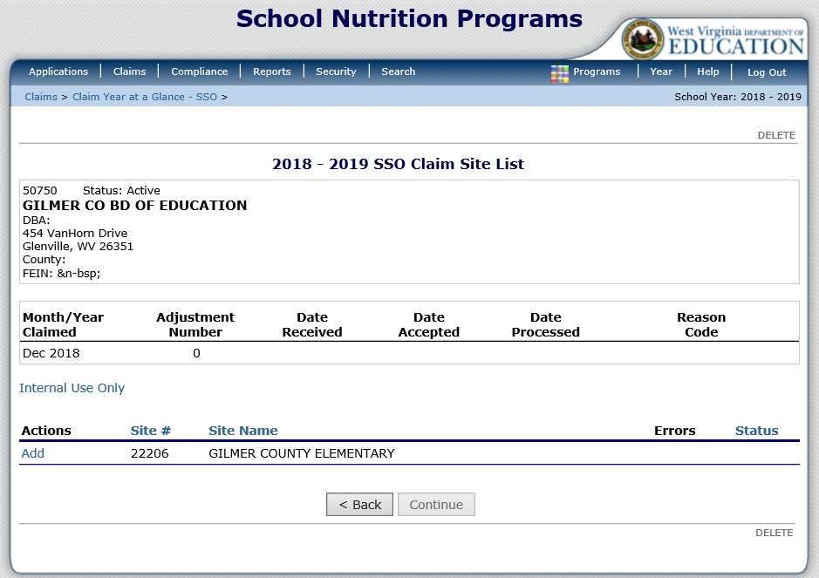
Claiming - SSO
Notes:
There is not an Upload Claim Data button for the Seamless Summer Option. Under Actions, select Add to the left of the Site you wish to add a claim.

Slide 44
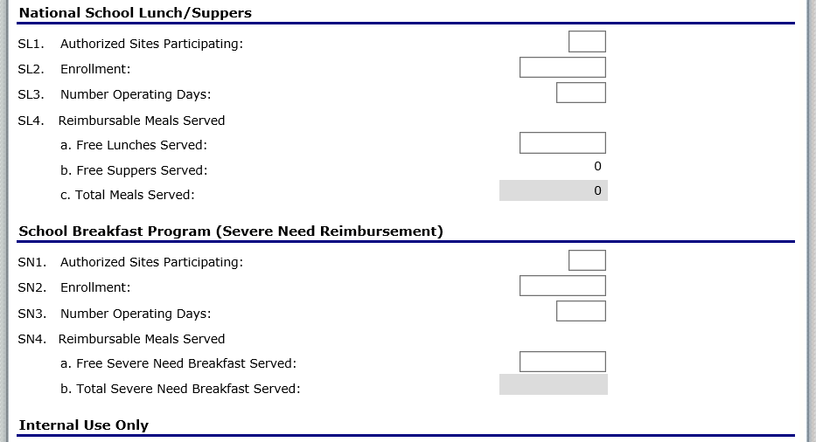
Claiming - SSO
Notes:
Input the information and select Save. Please notice in this example that there is not a box beside Free Suppers Served (SL4. b). In the SSO Application for this site, Supper was not selected. The Claim screen will only give you the option to type meal counts in for meals that were approved on the site application.

Slide 45
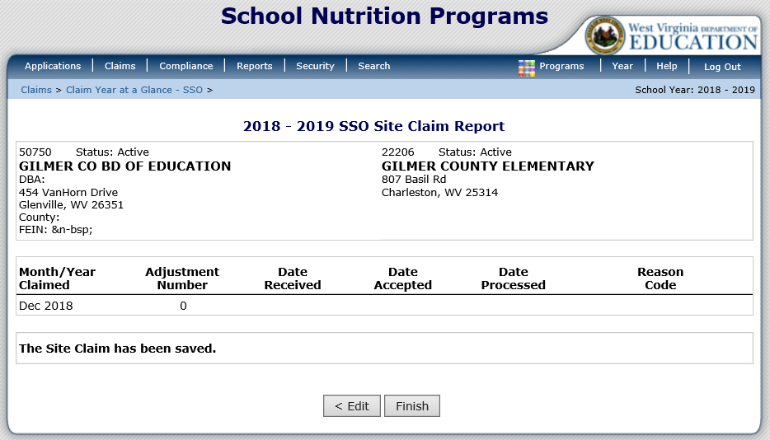
Claiming - SSO
Notes:
Then select Finish.

Slide 46
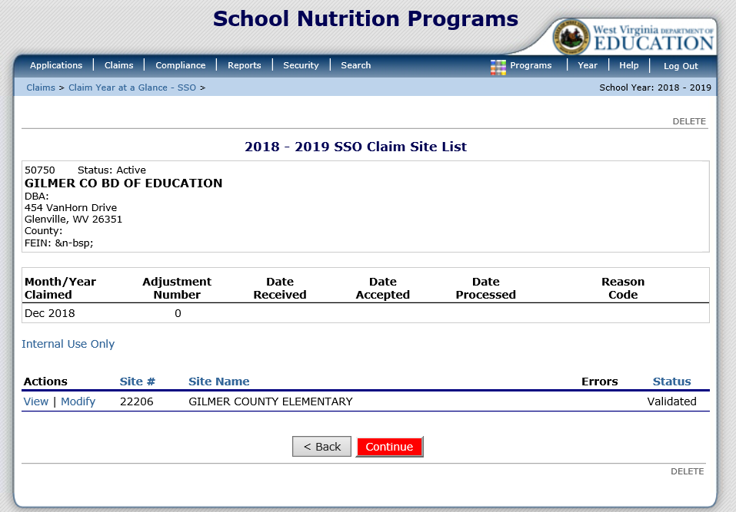
Claiming - SSO
Notes:
This will complete entering the SSO site claim information. Each site should have a Validated Status. Once each site is in a Validated Status, click the red Continue button.

Slide 47
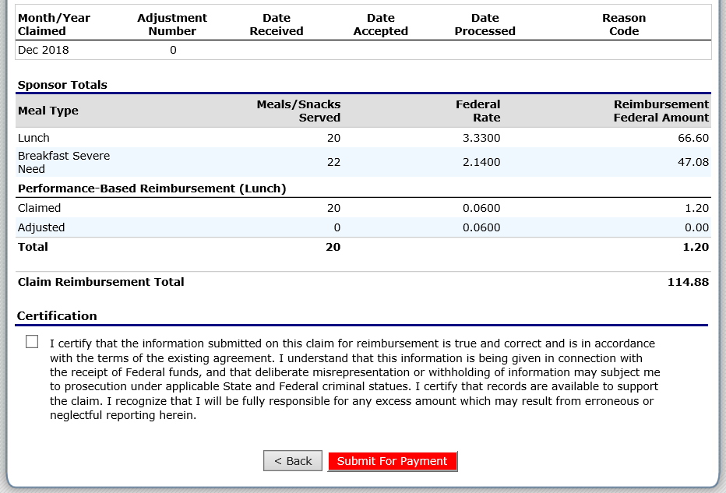
Claiming - SSO
Notes:
Next review the Meals/Snacks served for accuracy. If correct, check the checkbox in the Certification Section, and click the red Submit for Payment button.

Slide 48
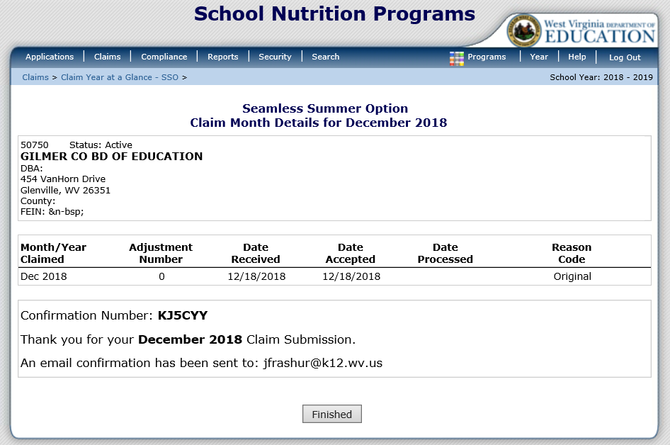
Claiming - SSO
Notes:
Once you successfully submit your claim, you will see this screen. It will display a confirmation number and generate an email letting you know that your claim was successfully submitted. Select the Finished button.

Slide 49
Claiming - FFVP
Notes:
Claiming for the Fresh Fruit and Vegetable Program begins just like claiming for SNP except you select Claim – FFVP.

Slide 50
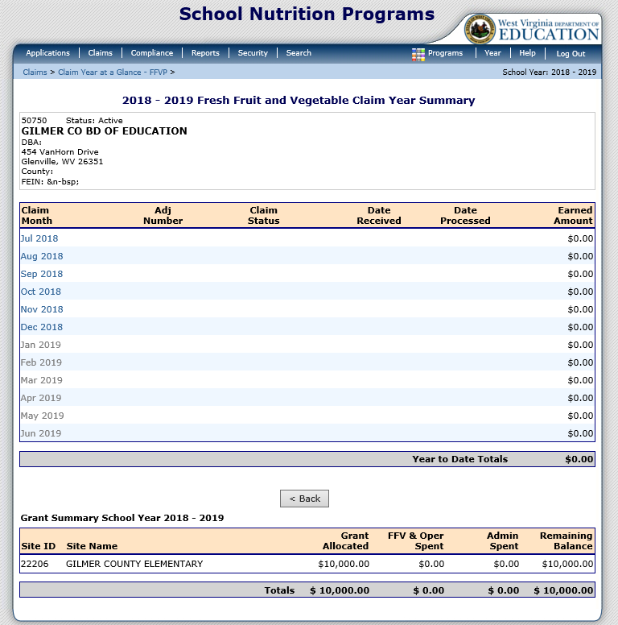
Claiming - FFVP
Notes:
Next select the month you wish to claim. This screen will also give you a running tally of the monies left in the grant.

Slide 51
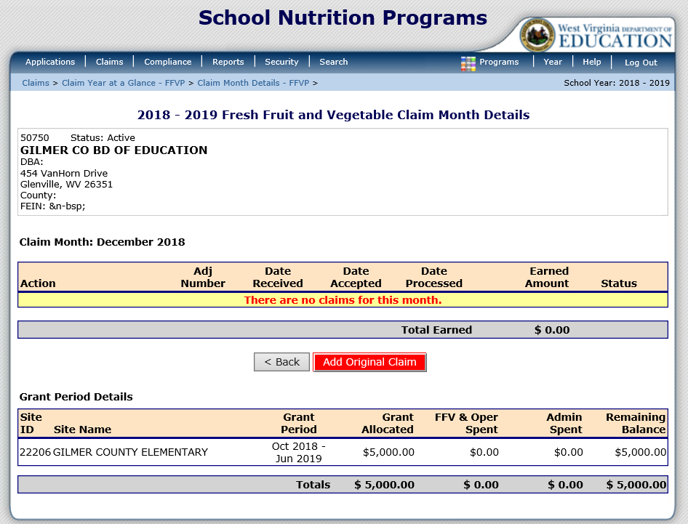
Claiming - FFVP
Notes:
Select the red Add Original Claim button.

Slide 52
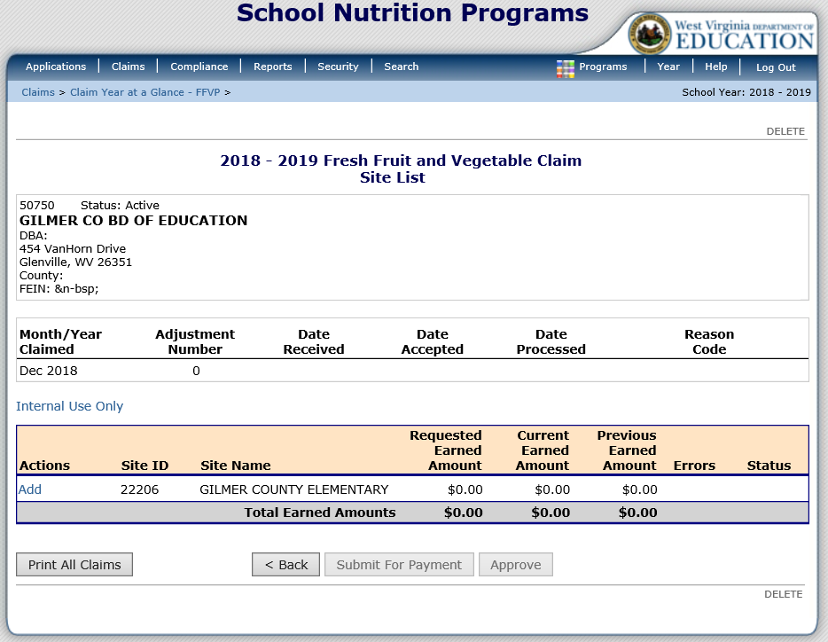
Claiming - FFVP
Notes:
Any site that is approved for FFVP will display on the screen and you must add each site’s claim individually.

Slide 53
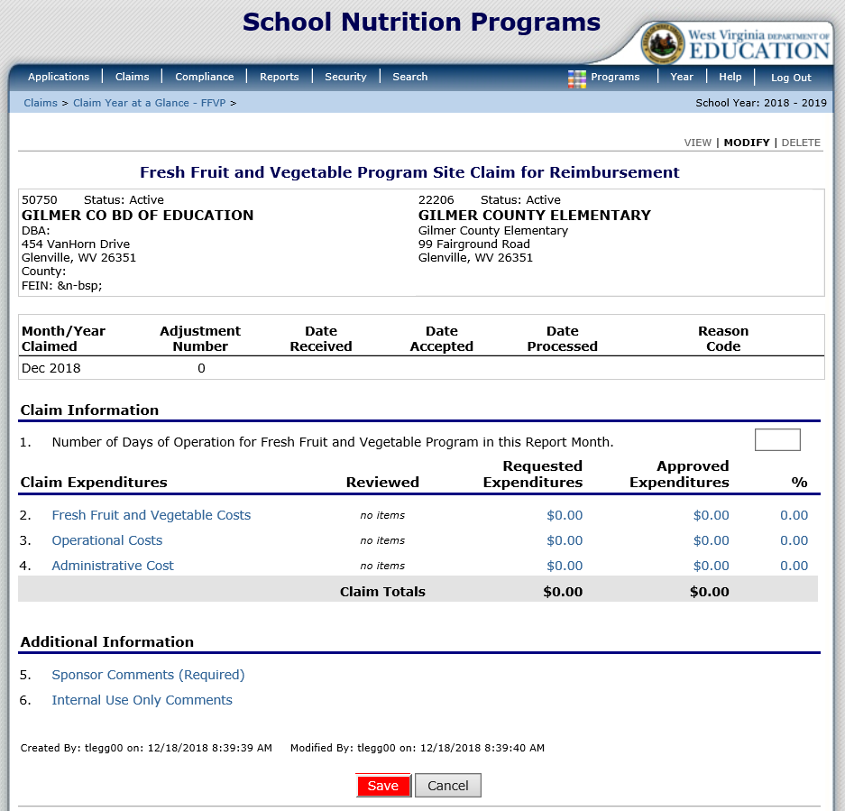
Claiming - FFVP
Notes:
Enter the number of operating days for the site in question 1. Then add each of the claim expenditures. To enter Fresh Fruit and Vegetable Costs, select the Fresh Fruit and Vegetable Costs link.

Slide 54

Claiming - FFVP
Notes:
The Fresh Fruit and Vegetable Costs link will take you to this screen. Enter the product description, size/weight/ of product, number of units, and cost per unit. The Total Unit Cost should automatically calculate.

Slide 55

Claiming - FFVP
Notes:
Once the Cost Information is entered, click the red Save button at the bottom of the screen.

Slide 56

Claiming - FFVP
Notes:
Then select Finish if you are done entering in Fresh Fruits and Vegetables costs.

Slide 57

Claiming - FFVP
Notes:
This completes entering the information for one site. If you have more sites that you need to add claims for then you would complete the same steps until each site is in a validated status. Once this is completed, select the red Submit for Payment button.

Slide 58

Claiming - FFVP
Notes:
The screen remains on the FFVP Screen after you click the Submit for Payment button, however, the status is now “Pending Approval.” There is nothing you need to do for this claim. It is waiting for WVDE OCN to review and approve it. To leave the screen select the Back button.

Slide 59
Questions

