Slide 1
Laying the Foundation for Communication Exchange:
Critical Points of Understanding
Presented for the National Center on Deaf-Blindness
February 28, 2018
Presented by: Susan M. Bashinski
Missouri Western State University

Slide 2
OBJECTIVES
Following this webinar, participants will be able to:
Explain at least one way in which 3 or 4 of the key “Communication Reminders” discussed in the webinar may be applied in their own daily lives / practice.
Contrast the basic differences between (a) nonsymbolic and symbolic and (b) non-intentional and intentional communication.
Describe the aspects of a routine, which can make a critical contribution to a learner’s feeling sufficiently safe and secure to reach out to those around her in a communicative manner.

Slide 3
ASSUMPTIONS
There is absolutely NO learner who does not communicate.
“Not having a voice to say I’d had enough food or the bath water was too hot or to tell someone I loved them was the thing that made me feel most inhuman. Words and speech...give us free will.... Without a voice, I couldn’t control even the simplest things.” (p. 79)
Pistorius, M. (2013). Ghost boy: The miraculous escape of a misdiagnosed boy trapped inside his own body. Nashville, TN: Nelson Books.

Slide 4
NOT BEING ABLE
TO SPEAK
IS NOT THE SAME
AS NOT HAVING
ANYTHING TO SAY

Slide 5
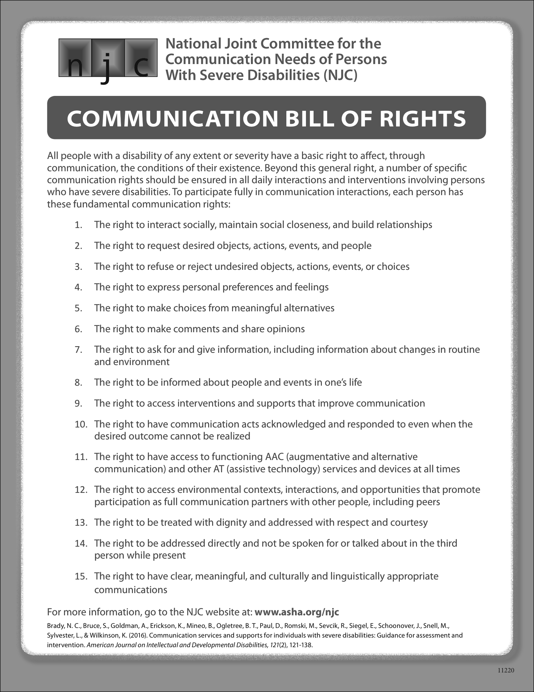
Communication Bill of Rights

Slide 6
NJC: Communication Bill of Rights
For more information, go to the NJC website at: www.asha.org/njc
Brady, N. C., Bruce, S., Goldman, A., Erickson, K., Mineo, B., Ogletree, B.,…Wilkinson, K. (2016). Communication services and supports for individuals with severe disabilities: Guidance for assessment and intervention. American Journal on Intellectual and Developmental Disabilities, 121(2), 121-138.

Slide 7
COMMUNICATION REMINDERS…
Notes:
14 total

Slide 8
Everyone communicates!
(Language is just one means.) Partners need to
EXPECT each learner to communicate.

Slide 9
Observe and focus!
Be “in the moment” and ATTUNED to the learner.

Slide 10
Behavior IS communication!
(Begin to ORGANIZE a way for a learner’s behaviors to become communicative.)

Slide 11
Communication is both a skill and a sensorimotor experience.

Slide 12
Early expression of “memories” will likely incorporate the movement and tactile aspects of the experience the learner is recalling.

Slide 13
Labels commonly used may be very confusing.

Slide 14
For a learner who experiences deaf-blindness, the way in which she receives info. might be different from the way she expresses info.

Slide 15
Proper positioning and supports are essential to communication facilitation.

Slide 16
Maximize the learner’s sensory access.

Slide 17
Teach multiple modes of communication!
(A GoTalk won’t “work” in the pool or bathtub, and batteries in AAC devices, hearing aids, and cochlear implants go “dead”)

Slide 18
“Do with, NOT for…”

Slide 19
WAIT!
(“Patience is a virtue.”)

Slide 20
Body language is a two-way street.

Slide 21
Model use of a learner’s communication modes.

Slide 22
Communication is the foundation for literacy skills.

Slide 23
Today affects tomorrow, but doesn’t predict it!

Slide 24
It’s NEVER too late to begin…

Slide 25
NOTHING IS FREE!

Slide 26
INTRODUCTION: BUILDING A FOUNDATION FOR COMMUNICATION EXCHANGE

Slide 27
NONSYMBOLIC COMMUNICATION DEVELOPMENT
Learners demonstrate skills at multiple points along the continuums used to describe communication development
Learners demonstrate different skills with familiar and unfamiliar partners
Learners demonstrate skills different skills in familiar and unfamiliar environments

Slide 28
SEQUENCE OF NONSYMBOLIC COMMUNICATION DEVELOPMENT
Levels of communication development are not differentiated by distinct boundaries
A shift from one level (i.e., stage) of communication does not occur overnight
Learners’ communication levels are generally labeled by the descriptor that corresponds with the majority of their communication skills

Slide 29
DEVELOPMENT OF SYMBOLIZATION ABILITY

Slide 30
SYMBOLIZATION
Definition of “SYMBOL”:
“one thing that stands for
(i.e., ‘represents’) another”
Referent (object / action to be represented)
Representation
  Symbolic communication - using ABSTRACT representations with DISTANCING

Slide 31
LEVELS OF SYMBOLIZATION DEVELOPMENT
Different authors / researchers identify varying numbers of “stages” of the development of symbolization ability.
We shall discuss these primary stages:
Nonsymbolic
Concrete symbolic (Transitional)
Abstract symbolic

Slide 32
SYMBOLIZATION: TYPES
Prelinguistic
Nonlinguistic
Presymbolic
Nonsymbolic*
(*preferred by Bashinski, because “pre-” indicates linguistic / symbolic development will definitely follow…)

Slide 33
LEVELS OF SYMBOLIZATION DEVELOPMENT:
NONSYMBOLIC
Idiosyncratic signals
Responsibility for successful communication rests with the partner
Context of interaction is critical
Examples of nonsymbolic forms:
Crying, body posturing, acting on people or objects, using unconventional gestures, vocalizing

Slide 34
COMMUNICATION BEGINS WITH NONSYMBOLIC BEHAVIOR
Observe a learner during unstructured time
Follow the learner’s lead
Embellish potential communicative signals
OFTEN…..
Nonsymbolic skills must be directly taught

Slide 35
LEVELS OF SYMBOLIZATION DEVELOPMENT:
TRANSITIONAL
Expressive signals become more conventional
Magnitude of partner’s role diminishes
Importance of context begins to diminish
Concrete symbolic communication
(e.g., 3-D objects, tangible symbols)
Examples of transitional forms:
gestures, use of object representations and
photographs

Slide 36
LEVELS OF SYMBOLIZATION DEVELOPMENT:
SYMBOLIC
Conventional expressions, consistent with learner’s culture and with consideration of primary language
Magnitude of partner’s role continues to diminish
Communication can occur free of context
Examples of symbolic forms:
speech, braille, print, manual sign language, written words

Slide 37
SYMBOLIZATION: COMPARISON
NONSYMBOLIC | TRANSITIONAL (Concrete Symbolic) | SYMBOLIC (Abstract Symbolic)
Birth – 8 / 9 mos. | 8 / 9 – 12 / 15 mos. | 12 / 15 mos.
Idiosyncratic gestures /vocalizations | Conventional gestures / vocalizations | Conventional verbalizations
Context is critical to derivation of meaning | Concretely-linked referents | Abstract referents
May demonstrate little overt behavior | 3-dimensional representations (i.e., objects) | 2-dimensional representations (i.e., traditional orthography)
Responsibility for communicative interaction rests with partner | Partner shares responsibility for communicative interaction | Learner is responsible for own communication

Slide 38
DEVELOPMENT OF INTENTIONALITY

Slide 39
INTENTIONALITY
Definition of “COMMUNICATIVE INTENTIONALITY”:
Deliberate pursuit of a goal, as well as the means to obtain the goal
Intentional behavior
vs.
Intentional communication (to have impact on another person, not just objects)

Slide 40
SEQUENCE OF COMMUNICATIVE INTENTIONALITY DEVELOPMENT
Though different authors / researchers identify varying numbers of “stages” of communication development, for our purposes today, we shall identify these primary stages:
Non-intentional
Transitional
  Behavior is intentional, but is NOT intentionally communicative
Intentional (behavior is BOTH intentional and intentionally communicative)
  Concrete symbolic / Transitional
  Abstract symbolic

Slide 41
INTENTIONALITY: TYPES
Preintentional
Nonintentional
(preferred by Bashinski, because “pre-” indicates intentional development will definitely follow…)

Slide 42
“STAGES” of INTENTIONALITY:
NONINTENTIONAL
In this stage, the learner is neither deliberately pursuing a goal nor aware of a means to obtain the goal.
A communication partner interprets the learner’s behaviors as if these were intentional.
Notes:
20 minutes TOTAL
MC #3

Slide 43
LEVELS OF INTENTIONALITY DEVELOPMENT:
NONINTENTIONAL
Expressive:
  Idiosyncratic; behavior state
  Context-driven
  Child learns the power of communication
  Partner must interpret behaviors
Receptive:
  Comprehends speaker’s tone of voice
  and physical contact / touch

Slide 44
“STAGES” of INTENTIONALITY:
TRANSITIONAL INTENTIONALITY
In this stage, the learner is deliberately engaging in behavior, but not with a “mental plan” for obtaining a desired goal.
A communication partner may use context to derive meaning of the learner’s behavior (some interpretation, of unconventional FORMS, might be required).
Notes:
20 minutes TOTAL
MC #3

Slide 45
LEVELS OF INTENTIONALITY DEVELOPMENT:
TRANSITIONAL INTENTIONALITY
Expressive:
  Dawning of intentionality
  Purposeful communication begins to emerge
  Context contributes to a minor degree
Receptive:
Comprehension of some words and
simple directives, in context

Slide 46
“STAGES” of INTENTIONALITY:
INTENTIONAL
In this stage, the learner is deliberately pursuing a goal and has a “mental plan” (i.e., a “means”) for obtaining the desired goal and / or is deliberately engaging in an exchange with another person for some intended purpose.
[NOTE: The form of the learner’s communication might still be unconventional.]
A learner uses his behaviors for the purpose of affecting another person.
Notes:
20 minutes TOTAL
MC #3

Slide 47
LEVELS OF INTENTIONALITY DEVELOPMENT
INTENTIONAL
Expressive:
  Beginning of true symbolic express.
  Use of first “true words”
  Communication becomes independent of context
Receptive:
Comprehension of words;
comprehension exceeds production

Slide 48
INTENTIONALITY: COMPARISON
NONINTENTIONAL | TRANSITIONAL | INTENTIONAL
Birth – 8 / 9 mos. | 8 / 9 – 12 / 15 mos. | 12 / 15 mos.
Reflexive behavior Random behavior Behavior state | Behavior is meaningful in context | Behavior is used to affect a partner
Behavior is NOT intentional | Behavior IS intentional | Behavior IS intentional
Behavior is NOT intentionally communicative | Behavior is NOT intentionally communicative | Behavior IS intentionally communicative
Partner must interpret behavior | Some degree of partner interpretation | No partner interpretation required
Perlocutionary | Illocutionary | Locutionary

Slide 49
ESSENTIAL TAKE-AWAYS
Meet each learner where she is; begin to build a communication system from that point.
Consistently respond to each learner’s behavior in a predictable way.
Plan programming to help the learner grow in the direction of conventional and intentional, symbolic communication.

Slide 50
THANK YOU!
Susan M. Bashinski
816.271.5629
sbashinski@missouriwestern.edu

