Slide 1
Nita M. Lowey
21st Century Community Learning Center
Bidders’ Conference
February 2026
Notes:
Welcome to the West Virginia 21st Century Community Learning Center Bidders’ Conference. I am Sherry Swint, the West Virginia Department of Education’s staff for the 21st Century program. Today I will provide an overview of this year’s grant application. If you have downloaded the current Request for Proposal from our web site, you may refer to it as we continue. https://wvde.us/21st-cclc/overview-and-application-information/
Please feel free to contact me if you have questions after attending the Bidders Conference.
This event is being recorded and will be available on the WVDE Application Resource webpage.

Slide 2

21st Century Nita M. Lowey Community Learning Center (21st CCLC)
Funded through Title IV, Part B of the federal Elementary and Secondary Education Act
Provides federal funding to establish high-quality afterschool programs in community learning centers
Targets students who are at risk of academic failure and their families
Notes:
You may know that the Nina M. Lowey 21st Century Community Learning Center Program, The Nita M. Lowey 21st Century Community Learning Centers (21st CCLC) program is authorized under Title IV, Part B of the Elementary and Secondary Education Act, as amended by the Every Student Succeeds Act (ESSA) of 2015.
Allocations are based on a formula that includes the state’s share of funds in the previous year under Part A of Title I, as well as census information.
The federal funding is to establish high quality afterschool programs in community learning center through a competitive grant process.

Slide 3

Grant Purposes
Provide academic enrichment and tutoring
Offer families active and meaningful engagement in their children’s education
Offer students a broad array of additional services, well-rounded educational programs, and activities
Notes:
Grant Purpose
The United States Department of Education has three broad goals for this grant program:
(1) The first goal is to provide opportunities for academic enrichment, including providing tutorial services to help students, particularly students who attend low-performing schools, to meet the challenging state academic standards;
(2) The second goal is to offer students’ families active and meaningful engagement in their children’s education, including opportunities for literacy and related educational development.
(3) The final goal is to offer students a broad array of additional enrichment services, well-rounded educational programs and activities.

Slide 4
Grant Awards
Duration
Amount:
  Grants are awarded for up to 5 years.
  Grantees must demonstrate sustained successes to receive 4th and 5th years of funding
  The minimum award is $50,000.
  The maximum grant award is $250,000
  Averaged Daily Attendance (ADA) amount, adjusted annually
    $3,050 for each student served daily, up to the maximum award amount.
  Transportation stipend of $10,000 if available.
Notes:
Approximately $7.3 million annually is provided to the West Virginia Department of Education (WVDE), and the estimated amount available for this grantee cohort is near $800,000.
Annual grant awards will range from a minimum of $50,000 to a maximum of $250,000 with an option for an additional $10,000 transportation award, if funding is available, for grantees providing regular transportation from the afterschool program to student residences or nearby bus stop at the end of the program day.
The WVDE reserves the right not to award all requested grant funds and/or to negotiate specific grant amounts. All awards are subject to the availability of federal funds, and grants are not final until the WVDE grant award is fully executed.
Grant Awards
Grants cannot exceed 5 years amount of funding will be adjusted based on ADA up to the maximum of $250,000 annually.
By federal statute, a 21st CCLC grant may not be less than $50,000 per year.
Applicants may request up to $3,050 per student according to the proposed ADA.
For example, an applicant with a proposed ADA of 20 students may request up to $61,000.
If an applicant provides transportation from the afterschool to the students’ residences, then an additional $10,000 may be received for transportation.
A funding is adjusted annually based on annual average daily attendance (ADA)

Slide 5
Authorized Activities
Academic enrichment programs
Mentoring programs
Well-rounded educational activities
Literacy education
STEM or STEAM education
Healthy and active lifestyle promotion
Cultural programs
Services for individuals with disabilities
Programming for students who are English language learners
Technology education program
Expanded library service hours
Assistance to students who have been truant, suspended, or expelled
Drug and violence prevention programs
Workforce and career development and readiness

Slide 6

Eligibility to Apply
Local education agencies
For profit organizations
Nonprofit organizations
Community- or faith-based organizations
Institutions of higher education
City and county governmental agencies
Notes:
RFP states:
Public and private organizations may apply for funding. Examples of public and private organizations include, but are not limited to: local education agencies, non-profit agencies, city and county government agencies, faith-based organizations, institutions of higher education and for-profit agencies.
That being said--collaboration between the applicant, the schools the participating students attend, and parents and community is vital to success with this grant.
Applications may have a partner agency and submit a joint application from a Local Education Agency (LEA) and at least one non- profit agency, city or county governmental agency, faith-based organization, higher education institution or for-profit corporation.
The lead agency may be the LEA, the community-based organization, the faith-based organization or other agency/institution, but the lead must always partner with at least one eligible school.
The applicant must provide evidence of planning with the partner agency during the creation of the application, such as meeting agendas, sign-in sheets, etc. The partner must also be described in the grant narrative as having significant, ongoing involvement in the program (as defined in the Competitive Priorities section of this application).

Slide 7
Federal Criteria of Eligibility
To be eligible to apply for this grant, an application must serve students who attend:
Schools eligible for schoolwide programs under Title 1, Section 114 ESSA, and the families of these students; or
Schools with at least 40 percent of their students from low social economic status families as designated by the federal government.
https://wvde.us/21st-cclc/application-resources/
Notes:
Eligibility
This grant requires that states fund applicants who plan to serve students in schools with high concentrations of low-income students and give priority to applicants serving students in high-priority schools (i.e Title 1, Comprehensive Support and Improvement). In West Virginia, applications must propose to ONLY serve schools with 40% or more of the students considered economically disadvantage.
This is not the free and reduced lunch percentages for each school but rather the percentage of students living in poverty and able to be directly eligible to receive federal assistance.
You can locate this direct certification information by accessing the Applicant Resources page on the WVDE 21st CCLC webpage. https://wvde.us/21st-cclc/application-resources/ Federally Direct Certification is labeled as low SES in the chart.

Slide 8

West Virginia Competitive Priorities
Joint submission of Local Educational Agency (LEA) and partner (2 points)
Serving only Comprehensive Support and Improvement (CSI) or Targeted Support Improvement (TSI) schools (2 points)
Geographic diversity (1 point)
Science, Technology, Engineering, and Mathematics (STEM) academic enrichment (1 point)
Offering only middle and/or high school program (1 point)
Notes:
Competitive Priorities-
West Virginia’s competitive priorities are listed on the screen. A proposal must score a minimum of 92 points (75%) that allows them to be considered for funding. Only after which, priority points will be added to the score.
Applications that are submitted jointly by a school districts receiving Title I funds and a community-based organization or other public or private organization will be awarded two priority points.
The following clarification comes from the USDOE Nonregulatory Guidance for 21st CCLC programs:
“In determining whether an application has been “submitted jointly,” States should look for evidence in the application that the LEA and at least one other organization collaborated in the planning and design of the program; each has substantial roles to play in the delivery of services, share grant resources to carry out those roles, and have significant ongoing involvement in the management and oversight of the program. Letters of endorsement are not by themselves sufficient evidence that organizations or school districts have substantially been involved in the design of a program. Applicants who submit jointly with LEAs, public, or private organizations will receive two priority points.
Applicants that propose to serve only schools identified as Comprehensive Support and Improvement schools designated as needing improvement under section 1116 of ESEA will receive two priority points. If you include a school not designated as a CSI school as a site, points will not be awarded.
To expand the geographic distribution of programs, two priority points will be awarded to applications that propose to serve schools in counties that have not had a 21st CCLC program in the last 5 years.
Programs that provide opportunities for participants in science, technology, engineering, arts, and mathematics (STEM) will be awarded one priority point.
Schools that provide afterschool services for only middle school and/or high school students will receive one priority point.

Slide 9
Timeline
Event | Date Due
Intent to Apply Form due | March 20, 2026
Virtual Technical Assistance Sessions are located on the Application Resources webpage | March 18, 2026, at 2 p.m. April 1, 2026, at 2 p.m. April 8, 2026, at 2 p.m. April 15, 2026, at 2 p.m.
Application Due Date | April 17, 2026
WVDE 21st CCLC Review | April through May 2026
Peer Review | May through June 2026
Award Decision Process | June and July 2026
Grant Award Announcements | July 2026
Program Begins | July 1, 2026, with sites operational on or before October 15, 2026

Slide 10
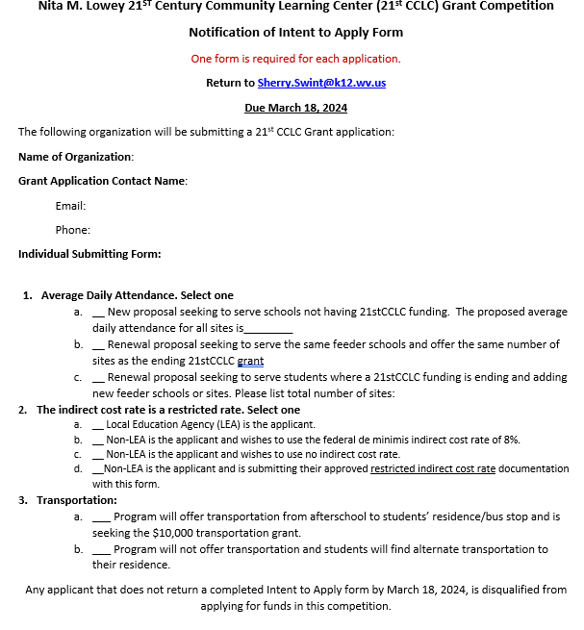
Submission Requirements
Intent to Apply form due Monday March 20, 2026
Applications due with all approvals in GPS Friday, April 17, 2026
https://wvdegps.k12.wv.us/
Notes:
Submission Requirements
The application package is available on the 21st CCLC website. It includes the Request for Proposal (RFP), an application template, and action plan worksheet. The application template and action plan worksheet are optional tools to help you gather information efficiently and write a successful proposal.
Once you have made the decision to apply, you must notify the West Virginia Department of Education’s 21st CCLC office by submitting a completed Intent to Apply form, located in the RFP (and in the application template) no later than March 20, 2026
You must also inform the community of your intent to submit an application, and it is required that you also make the application available to the public after submission. A form has been added in the RFP (and in the application template)—to verify that the requirement of ESEA legislation has been met.
All applications must be submitted entirely online through the Grants and Planning System, which is also referred to as GPS.
Completed applications must be submitted in GPS by Friday, April 17th. Applications submitted in any other format will not be considered. Also, applications that do not utilize the current RFP will not be scored.

Slide 11
Application Approval Process for GPS Submission
An application is fully submitted in GPS when it has been approved by the following assigned roles in the following order:
  (1.) LEA 21st CCLC Director,
  (2.) LEA Fiscal Representative, and
  (3.) LEA Superintendent.
The status of a fully submitted application is “LEA Superintendent Approved.”
Notes:
The application will be disqualified and not considered for funding if these agency-level approvals in GPS were not obtained by the deadline. Plan accordingly to allow for plenty of time for each agency representative to review and approve the application.
There is a recording on the Application Resources webpage that will lead you through how to set up and use GPS. You will not have access to GPS until after the Intent to Apply form has been received and information has been sent back to you via email. If you are not a school system or have never use GPS, an account will have to be set up for you and you will have to access the account before you are able to access GPS.

Slide 12
Review and Awarding Process
Each application will be reviewed by WV 21st CCLC Coordinators to ensure proposal meets requirements.
Applications meeting requirements will be scored by Peer Reviewers using a rubric.
If the base score is 75% or higher, then priority points will be added for a final score.
Funding is provided by the U.S. Department of Education.
Grant awards will be announced in July.
Notes:
Peer Review Process and Awarding
Each grant will be reviewed by WVDE 21st CCLC Coordinators to ensure that the proposal meets requirements. You can find in the RFP a list of requirements as well a list of items that will cause the application to be ineligible. A proposal not meeting requirements will not enter the peer review process.
An example of a disqualification would be not meeting and documenting with all private schools in the service area of your proposed application.
Each grant will be reviewed by several trained Peer Reviewers who have diverse experience in afterschool
Reviewers will, using a rubric, provide a combined score for each completed application. The rubric is available on the Application Resources page of the 21st CCLC website.
If an application has a base score of 75% or higher, then the grant proposal is considered for funding and priority points are added to the rubric score for a final score.
All funding is based on funds provided by the U.S. Department of Education Nina M. Lowey 21st Century Community Learning Center Program
Funding will be announced in July

Slide 13

Questions?

Slide 14
Requirements

Slide 15
Statutory Requirements
Program will take place in a safe and easily accessible facility.
The program is developed and carried out in active collaboration with schools where participating students attend.
The program is in alignment with the challenging State academic standards.
Program targets students who primarily attend schools eligible for the schoolwide program under section 1114 and the families of such students.
Grant funds will be used to increase the level of state, local and other non-Federal funds to be made available for programs and in no case supplant Federal, State, and non-Federal funds.
Program must operate in a manner that follows the Measures of Effectiveness.

Slide 16

Afterschool Design and Measures of Effectiveness
The programs developed for this proposal must:
  Be based on an assessment of objective data regarding the need
  Be based on established performance objectives
  Be based, if appropriate, on scientific research that provides evidence that the program or activity will help students meet the state academic achievement standards
  Ensure that measures of student success align with the regular academic program of the school and the needs of the students
  Collect the data necessary for the measures of student success
  What Works Clearinghouse https://ies.ed.gov/ncee/wwc/Docs/PracticeGuide/ost_pg_072109.pdf
Notes:
Powerpoint words pulled from federal Measures of Effectiveness.
Principles of Effectiveness
When writing the narrative, remember that 21st CCLC programs must meet the principles of effectiveness.
This means that proposed programs must be based on an assessment of data regarding the need for out-of-school time programs in the school and community; they must be based on established performance objectives aimed at ensuring high quality academic enrichment opportunities; and, where appropriate, be based on scientifically-based research that provides evidence that the program or activity will help students meet state academic standards.
The What Works Clearinghouse has a plethora of information on quality curricula, guides, and programs. We recommend you consider the information found in the clearinghouse when developing your proposed program.
For example, there is document entitled, “Structuring Out-of-School Time to Improve Academic Achievement” by the Institute of Education Sciences that provides practice guides to formulate specific and coherent evidence-based recommendations.

Slide 17
WVDE 21st CCLC Staffing Requirements
A minimum of 1 to 16 staff to student ratio
A staff and volunteer vetting process to ensure participant safety
Current CPR and First Aid certified staff at each site
Annual evaluation of staff
Annual staff professional development
Program director should allot a minimum of 10 hours per week to manage grant program
Notes:
and follow the WV Department of Human Services ratio guidance for more information

Slide 18

Professional Development Requirements
New Grant Cohort Training in August.
The program director attends the Multi-State Conference or its equivalent annually.
The program director and one program staff member to attend the WVDE-sponsored 21st CCLC conference annually.
Online trainings and meetings,

Slide 19
Evaluation Requirements
Local Evaluation
State Evaluation
Annual local evaluation report
Local evaluation report notification to community and stakeholders
Submit report to the WVDE 21st CCLC
If applicable, an external evaluator costs no greater than 5% of budget
  Data Collection App
  USDE 21 APR Report
  Annual Teacher Survey
  Annual Program Director Survey
  Program compliance monitoring
  Required trainings
Notes:
Collaboration with WVDE
Grantees must participate in state and federally mandated annual evaluations, as mentioned previously.
1. Collection of data through a WVDE data system
2. Completion of USDE 21 APR data collection system
3. Completion of the annual Teacher Survey by the regular K-5th grade classroom teacher of regular attendees of the program.
4. Submission of the annual Program Director Survey
5. Participation in program monitoring, conducted by WVDE 21st CCLC staff, requiring submission of required documentation and arrangement of focus group interviews with key stakeholders is assured.

Slide 20
WVDE 21st CCLC Site Operation Requirements
All Programs must be fully operational by October 15th.
App programs must operate a minimum of 10 hours a week for 25 weeks during the regular school year or its equivalent.
Programs must offer at least 3 meaningful family engagement experiences per site annually.
Grantees must adhere to the average daily attendance requirements:
  First year meet 85% ADA
  Second through fifth years meet 90% ADA.
Notes:
Do I add slides about calculating ADA? Here or after application narrative section?

Slide 21
Average Daily Attendance
Notes:
Loren

Slide 22
Calculating Average Daily Attendance (ADA)
Past grantees are required to use their ADA from the last three years of grant plus a 10% growth increase. For new sites, use your average ADA.
New applicants carefully consider using the ADA data chart provided in this presentation. It may be helpful to use parent and community surveys, school input, and past experiences to support your stated ADA.
Notes:
Loren
The WVDE will calculate the ADA for previously funded applicants using an average of the ADA form the last three years of the grant plus 10% growth.
New applicants should estimate their ADA using information form this presentation as well as from surveys, the school, and any experience.

Slide 23
Combined Site ADA Data from 2021-2024
 | Elementary Schools | K-8 Schools | Middle Schools | Middle and High Schools | High Schools
Average ADA | 25 | 32 | 15 | 13 | 16
Midpoint ADA | 21 | 28 | 13 | 11 | 14
Midrange ADA | 17 to 27 | 23 to 34 | 12 to 17 | 9 to 13 | 10 to 17
Notes:
Often, new applicants may not know how many students will attend daily, especially if they do not currently have an active afterschool program.
This chart comes from current 21st CCLC grantee site data. Long-time grantees most often have an average daily attendance near the top of the ranges seen here.
Your grant application may serve more than one site. If you plan to serve multiple sites, then you may consider that your average daily attendance would be approximately 17 to 22 students per site.
The Middle and High School Site category listed in the third row of the chart is reflective of a single afterschool program site that serves more than one school (often a middle school and a high school). This provides a larger pool of student from which to recruit and typically results in a higher ADA than a single site serving a single school.
For the minimum amount of funding, $50,000 one must serve at least 17 students every day. As you can see on the chart, it will likely be very challenging to serve high school and middle school students from one school.

Slide 24
Questions?

Slide 25
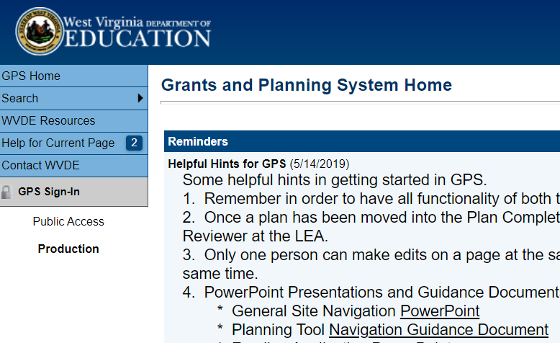
Application
https://wvdegps.k12.wv.us/
Cover Sheet
Assurances
Program Summary
Application Narrative
Budget and Budget Narrative
Appendices- Uploaded in "related documents" in the GPS section
Notes:
Application
As mentioned earlier, applications are to be completed entirely online through GPS.
All interested applicants will receive access to GPS only after they have completed and submitted all the requested information on the “Intent to Apply” prior to the deadline.
GPS will be open in March, and a training will be provided.

Slide 26
GPS Cover Sheet
Applicant contact information
Co-applicant information (if applicable)
Information about collaborating partners
Schools to be served
Number of afterschool sites
Amount of funds requested
Any matching or in-kind funds, including WVDE supplemental transportation grant
Notes:
Cover Sheet
In the Cover Sheet Section, contact information for the applicant and co-application partner (if applicable) is listed. Additionally, schools to be served and the number of sites to be funded are identified.
The applicants’ Unique Entity Identity (UEI) is also provided on the Cover Sheet. UEI numbers are available at SAM.gov
Finally, this section is where you would add any matching or in-kind funds. While these are not required, matching or in-kinds funds show the peer reviewers that community partners and applicants are prepared to invest and support a 21st CCLC program in the community.

Slide 27
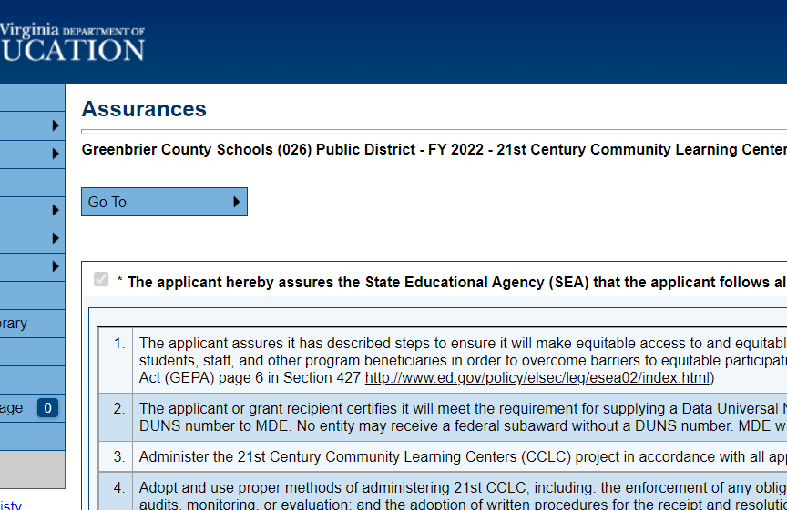
Assurances
Applicants agree to uphold regulations and listed assurances applicable for 21st CCLC.
Includes required federal and state program items such as evaluation, data collection, compliance monitoring, etc.​
Notes:
Assurance Section
There is an Assurance page, which outlines a list of regulations and obligations of a 21st CCLC program. In the GPS application you must agree to follow all regulations applicable to 21st CCLC, including the requirements listed in the assurance section, by clicking a box at the top of the list.
In the RFP you can read each assurance located in the appendices

Slide 28
Program Summary
Name and Site Location | Days and Times of Program Operation |  |  |  |  |  | Start Date | End Date | Estimated ADA | Fed Direct Cert. Students % | Estimated Families Served
 | Mon | Tue | Wed | Thu | Fri | Sat
ABC Center 21 Justice Ave, Justice WV 22000 | 2:30 – 5:30 pm | 2:30 – 5:30 pm | 2:30 – 5:30 pm | 2:30 – 5:30 pm | 2:30 – 5:30 pm |  | 9-1-2026 | 5-15-2027 | 30 | 76 | 25
​
Notes:
Program Summary
For the Program Summary Chart, list the name and location of each site you will operate, along with the days and times the program will operate at each location.
Include the number of students you anticipate serving daily during the school year, also known as the anticipated average daily attendance; the schools’ percentage of direct certified students eligible to receive federal assistance; and the anticipated number of adults and/or family members who will receive educational services.

Slide 29
Application Narrative
Statement of Need
Action Plan
Afterschool Program Implementation
Parent and Family Engagement
Facility Plan
Program Personnel
Collaboration
Sustainability
Organizational Capacity
Budget
Notes:
The narrative comprises of 9 sections plus budget section. For the next while, this workshop will review the expectation of what an applicant should describe and detail for each section of the proposal.
(123 points)

Slide 30
Statement of Need
Statement of Need
Establish a compelling need using multiple cited data sources
Describe how stakeholders contributed to the needs assessment process
Explain why the targeted community was selected
  Use the recent needs assessment to describe the community
  describe current afterschool services, gaps in afterschool services, and available resources
Notes:
Sherry
The Statement of Need is a critical component as it sets the application’s roadmap for the remaining sections. All sections are to link back to the needs described in this section.
Need for the Program
In this section, the applicant describes the needs of the populations to be served by the afterschool program, as demonstrated through a multitude of appropriately cited data sources as well as a community needs assessment conducted in the last three years.
The Applicant must show how the proposed program will meet these needs by providing services and opportunities not currently available.
The application should clearly show specific, identified needs that connect to the goals and measurable objectives of the application, the proposed activities and services, and the program evaluation.
Don’t forget to discuss how stakeholders and partners have been involved in this assessment process.
Needs data should be less than three years old and come from multiple sources, including a community needs assessment. Data should be properly cited, and a works cited page should be uploaded in the “Related Documents” section of GPS.

Slide 31
Action Plan Format
Goal 1: Increase Academic Achievement (Minimum 2 and Maximum 3 Objectives)
Objectives | Strategies | Outcomes | Progress Indicators | Evaluation Plan
Goal 2: Increase Family Engagement (Minimum 2 and Maximum 3 Objectives)
Objectives | Strategies | Outcomes | Progress Indicators | Evaluation Plan
Notes:
Sherry
The Action Plan in essence is a modified logic model. A well reasoned and well thought out action plan acts as the base for a successful application.
In the appendices is an example of an action plan.

Slide 32
Action Plan Objectives
Objectives: What is the growth or change that is measurable?
By the end of the school year, at least 75% of K-5 students who attend the 21st CCLC program for at least 60 hours, will meet their individual targets for expected growth from the i-Ready BOY (beginning-of- year) to the EOY (end-of-year) benchmark in English Language Arts
By the end of the school year, at least 75% 6-8 grade students who attend the 21st CCLC program for at least 60 hours, will maintain a C average or above in Language Arts during the school year
Detailed statements of intended results
Two SMART objectives are required for each goal (3 max.)
Specific, Measurable, Achievable, Relevant, and Timebound
Notes:
Sherry
Applicants are required to write a minimum of two (maximum of three) SMART objectives for each goal. For the goal, “Increase academic achievement,” one objective should focus on increasing achievement in mathematics, and another should focus on increasing achievement in English/Language Arts (ELA).
Objectives should be focused on growth and change per year that is measurable and realistic. Objectives should measure a change in knowledge, skills, or behaviors, as opposed to outputs, which are tangible or the direct result (i.e. attendance) of a process, task, or activity such as products, goods, or services
All objectives should be designed to meet the data-based needs of the students and families to be served by the 21st CCLC program as identified in the “Statement of Need” section of the application.
There should be a separate academic objective for English Language Arts and Math. Other academic objectives could focus on STEM, SEL, Workforce Development, entrepreneurship, etc.
Likewise for Family Engagement goal, applicants are to provide a minimum of 2 and a maximum of four objectives. Family engagement goals may focus on supporting a specific group of parents/guardians such as grandparents, or families with incarcerated parents. An objective could focus parenting skills obtainment or measuring grown in parents' advocacy of their student in the regular school day. Don’t forget that all objectives are to be derived from the statement of need that is presented in the application.

Slide 33
Action Plan Outcomes
Short-term, specific, measurable changes that will likely occur as a result of listed strategies, and that will be used to demonstrate progress toward annual objectives
Outcomes: What are the steps to complete to achieve the objective?
Students will master explicitly taught foundational reading and writing skills.
Students will demonstrate improved fluency with grade-level passages based on topics and texts under study.
Middle School students will have a homework completion rate of 90%.
Middle School students' 9-week grades will meet C average or better.
Notes:
Sherry
The Outcomes should be established as short-term “stepping stones” towards reaching the annual objectives.
It can be helpful to ask, “What is one short-term change that needs to happen periodically throughout the year in order to meet the targeted objective by the end of the year.
To meet the objective in the previous slide, an example outcome could be that, “Students will master explicitly taught foundational reading and writing skills.

Slide 34
Action Plan Strategies
Strategies: What actions will you take to make this short-term change happen?
Evidence-based tutoring and small group interventions to improve foundational skills listed in the WV College- and Career-Readiness Standards (WVCCRS) for ELA for all ages. Resources include staff, high interest text, computer software.
Small or whole group repeated readings (including read aloud and theater) and collaborative discussions to improve comprehension with high-interest, grade-level texts. Youth choice and WVCCRS for ELA, Social Studies, and Science will be used to guide text/topic selection and instruction. (K-8)
Homework will be completed daily by the middle school and staff will work with students to ensure homework is submitted. (6-8)
Actions needed to meet short-term outcomes and annual objectives
Notes:
Sherry
Strategies are actions needed to meet your short-term outcomes and annual objectives.
You also need to include who is responsible for completing the strategy, a timeline for the strategy, and resources needed.
For our example objective and outcome, a strategy could be, “evidence-based one-on one tutoring and small group interventions to improve foundational skills listed in the WV College- and Career-Readiness Standards for English Language Arts (ELA)
The instructor will use this strategy daily and they will need data to identify unmastered skills, targeted lesson plans, practice activities, materials, and the WV CCR Standards for ELA.
specific actions or interventions that the program will undertake to meet the objective. Strategies should include specific grade-level audiences and frequency of actions or interventions.

Slide 35
Action Plan Progress Indicators
Data sources and methods used to measure short-term outcomes such as students’ individual, small-group, or whole-group progress toward annual objectives
Process Indicator(s): What are the tools?
1. iReady progress monitoring assessments for foundational skills
2. Formative assessment documented by tutors with anecdotal notes, checklists, and rubrics while students practice ELA skills
Notes:
Sherry
Progress indicators are the tools you use to measure progress toward outcomes. You will have the opportunity annually to tweak or develop new objectives for the coming year.
Progress Indicators indicate how you are going to know if the program reached the outcomes or not. What data/tool are you using? How are you measuring?
For this example, the PALS (Phonological Awareness Literacy Screener), iReady, and formative assessments are being used to measure students’ progress on foundational skill mastery. The formative assessments are being documented with anecdotal notes, checklists, and rubrics while students practice phonics skills both in isolation and in connected text.

Slide 36
Action Plan Evaluation Plan
Evaluation Plan
i-Ready progress reports will be used by tutor and evaluator to document K-5 student growth and determine future for growth in ELA
For interventions only, all students will be grouped according to skills needed by tutor Ongoing formative assessment and anecdotal notes will be used by tutor to assess all individual skill progress
Monthly review of 6-8 grade students’ grades to identify achievement and areas needing improvement by individual students and tutor
Feedback discussions (every nine weeks) with students and site coordinator to determine various future ELA enrichment activities (K-8)
Process for collecting evidence of progress toward short-term outcomes and annual objectives, including how this information will be used to drive changes in program decision-making
Notes:
Sherry
The evaluation plan should describe the steps to be taken to collect evidence of completing program strategies, objectives, and outcomes, the process for reviewing this information, who will collect and evaluate the data, and how it will drive changes in program decision-making. The plan should also include a timeline that clearly aligns with the Action Plan.
You may use an external evaluator if you wish. If you do, be sure to identify that person (if known) in the Staff Section of the proposal. Be sure to provide the job description and the method of identifying a qualified evaluator.

Slide 37
What questions do you have about the Action Plan?
Notes:
Sherry

Slide 38

Afterschool Program Implementation
(API): Recruitment and Retention
Describe strategies for recruitment and retention of at-risk students
Describe plans for targeting students’ academic needs
Ensure equitable access for students, staff and family members
Plans for serving students with special needs
Notes:
Loren
Afterschool Program Implementation
In this section, discuss how the afterschool program will recruit and retain participants.
Also, include how you will ensure equitable access and participation for anyone with special needs.

Slide 39
API: Program Design
For each site or different student grades:
  Describe evidence-based practices and curriculum, and alignment to WV standards (ELA, Math, & enrichments)
  Link program activities and curriculum to school day learning (ELA, Math, & enrichments)
  Describe a continuous quality improvement process and
  Provide strategies for implementing optional summer programs, if applicable
Notes:
Loren
The afterschool program must be different than the regular school day. You do not want to offer two or three more hours of what they just had all day.
An effective afterschool program provides opportunities that are not only educational and cognitively challenging, but also interesting, exciting, and engaging.
Get students actively moving and doing, being creative, hands-on and giving them the opportunity to interact with the real world.
At the same time, a 21st CCLC program must employ strategies based on scientific research that provides evidence the that the program or activity will help students meet the state academic achievement standards-the third Measure of Effectiveness. Include any scientifically-based research that provides evidence that the programs or activities you are including will help students meet state and local academic achievement standards.
Applicants should plan for how 21st CCLC staff will collaborate with school day staff and administrators to identify areas for individualized student tutoring, and how to best meet the needs of participating students. Explain how afterschool staff will vary their approaches to help meet the needs of individual students and improve their achievement in core academic areas.

Slide 40

API: Program Operations
Include the following for each site:
  Weekly schedule, including activities
  Hours of operation and total number of hours
  Start by October 15
  Operate for 250 hours during the school year
  Provide summer program information, if applicable
Notes:
Loren
Afterschool Operations
21st CCLC programs must offer a minimum of 250 hours of programming during the school year and begin by October 15th.
Programs are to serve students immediately after the school day ends. Programs could also provide services before school hours, on weekends, or during the summer. However, most of the hours are to be offered after school.
The afterschool program must be different than the regular school day. You do not want to offer two or three more hours of what they just had all day.
An effective afterschool program provides opportunities that are not only educational and cognitively challenging, but also interesting, exciting, and engaging.
Get students actively moving and doing, being creative, hands-on and giving them the opportunity to interact with the real world.
At the same time, a 21st CCLC program must employ strategies based on scientific research that provides evidence the that the program or activity will help students meet the state academic achievement standards-the third Measure of Effectiveness. Include any scientifically-based research that provides evidence that the programs or activities you are including will help students meet state and local academic achievement standards.
Applicants should plan for how 21st CCLC staff will collaborate with school day staff and administrators to identify areas for individualized student tutoring, and how to best meet the needs of participating students. Explain how afterschool staff will vary their approaches to help meet the needs of individual students and improve their achievement in core academic areas.

Slide 41




API: Approved Activities May Include
Remedial Education | Expanded Library Hours
Drug and Violence Prevention Programs | Parent Involvement
Resilience Programs | Character Education
STEM Activities | Entrepreneurial Education
Arts and Music Activities | Financial Literacy Programs
Tutoring and Mentoring Programs | Nutrition and Health Programs
Recreational, Fitness, and Wellness Activities | Service Learning and Service Projects
Positive Youth Development Activities | Career and Technical Programs
Apprenticeships or Internships
Notes:
Loren
Approved Activities
On the screen is a list of activities approved by the USDE and WVDE for 21st CCLC programs. This does not mean that you need to include them all or that you are limited to only these.
Keep in mind the two broad goals of the grant: increase academic achievement and increase family engagement. Activities you select should be ones that will help meet the needs identified in the Statement of Need section and help achieve the goals and SMART objectives. Students, parents, families and communities vary; they will not all have the same needs, so, all 21st CCLC programs will not look exactly alike.

Slide 42
API: Supper and Snack
All grantees are required to provide a meal or snack during the afterschool program using the USDA Food and Nutrition Service.
21st CCLC funds may not be used to pay for snack or supper
Partner with county food service staff, who have resources, skills and experience.
Apply to become a sponsor by contacting WVDE Office of Child Nutrition: 304-558-2708 or https://wvde.us/child-nutrition/
Notes:
Loren
Supper and Snack
West Virginia 21st CCLC programs should offer supper, which may be done through the USDA Child and Adult Care Food Program. 21st CCLC funds may not be used to pay for snack or supper (FRAC and USDE).
Supper can be served at any point during the afterschool program. Even though it is called a supper, program staff can determine the best time to serve the meal. It can even be right when the children walk through the door.
Afterschool programs can purchase prepared meals or prepare their own meals through CACFP, depending on what works best for the program. Potential vendors include the school food service department, community kitchens, food banks, and private catering companies. Programs with limited refrigeration space can store meals in coolers.
The meals can be served hot, but do not have to be. In fact, many successful programs serve nutritious and appealing cold meals to children. The main entrée can be a sandwich, wrap, or pita pocket.
21st CCLC programs may also offer snack through Afterschool Snack, as part of the National School Lunch Program, or CACFP.
Both a meal and a snack can be served depending on the length of the program. The Office of Child Nutrition determines the length of time between meal services. Afterschool programs absolutely should consider serving both if the program operates for three or more hours.
For a site to participate in CACFP, the school district must run the CACFP, and the district or organization must sponsor or operate the afterschool program feeding site. For a site to participate in NSLP, the school district must run the NSLP and sponsor or operate the afterschool program feeding site.
Contact the WVDE Office of Child Nutrition with any questions.
Information about CACFP and Afterschool Snacks can be found on the WVDE website at https://wvde.us/child-nutrition/.

Slide 43
What questions do you have about the Afterschool Program Implementation Plan?
Notes:
We just went over a lot of information regarding the needs assessment, action plan, and program implementation sections. What questions do you have?

Slide 44

Parent and Family Engagement Plan:
Use evidence-based or best practice
Aimed at improving parents’/guardians’ involvement in their children’s learning
Support the connection between parent and their child’s learning needs
Involve parents and community in planning, implementation, evaluation, and decision-making
Ensure equitable access to all families, including members with special needs
Notes:
Sherry
Parent, Family and Community Involvement
In this section of the application be sure to describe activities that will target parents, families of students, and community members who will receive services from the program.
Parent involvement is important, but these activities-as was mentioned earlier-- must go beyond parent involvement types of activities and be aimed at improving the education and skill levels of adults or at supporting the connection between the parent and their child’s learning needs. They must also be more than one-time activities—they must be arranged as a practice. Consider a series of lessons, classes or opportunities that are evidence-based.
A minimum of 3 Engagement activities are required. These activities may be delivered at the home, at the center, or elsewhere.
Parents and community members must also be involved in planning, implementation, evaluation and decision making in the program and they must have representation on the Advisory Council.
Finally, describe the steps you will propose to ensure equitable access to, and participation by, family members and other program beneficiaries with special needs. Include money in your budget for parent, and family activities is required.
Be sure to include how you will disseminate information about the program to parents and community members in an understandable, accessible way.

Slide 45
Facility Plan
Describe each facility, including
  accessibility and safety
  specific areas or rooms available to be used
Address availability of transportation
Detail the emergency exit plan and emergency readiness plan and how the plans will be communicated and practiced
Notes:
Sherry
Facility Plan
In the facility section, you need to help the reviewer picture the facility by describing how the location and environment will be safe and welcoming. Include information that describes the interior and exterior environment of the site and the areas that will be used (library, playground, pool, etc.).
List the required agency inspections that are conducted at non-school based sites.
The facility must be at least as available and accessible to the participants as if the program were in an elementary or secondary school.
You must address transportation to and from the site and tell how the program will ensure that students will travel safely. The lack of ample, available transportation can be a limiting factor as to who can participate and how many can participate, so this factor has to be considered carefully. And be sure to include adequate funding for transportation needed in the budget.
Finally, conclude this section by briefly describe emergency readiness plan and how it will be communicated to staff, students and parents.

Slide 46

Program Personnel
Include a chart to show staff roles and responsibilities, including but not limited to:
  Program Director
  Collaborative Liaison between schools(s) and afterschool sites
  Evaluator
  Data Maintenance Staff
  Onsite Staff
Notes:
Sherry
RFP states:
Expenses may include payment of staff for time to plan and attend the training. Describe plans to ensure that at least one full-time staff member is certified in both CPR and first aid (within one month of employment).
Program Personnel
The applicant should explain personnel management through a chart format showing the roles and responsibilities of the proposed staff. You don’t need to name specific individuals, but you must include position descriptions for the personnel who will implement your program. An applicant should include the following roles: A Program Director for a minimum of 10 hours per week, a Collaborative Liaison between the school/s and afterschool sites, an Evaluator, family engagement staff and one staff member per site to be certified in both CPR and first aid.

Slide 47
Program Personnel
Explain the vetting process for staff hiring
Describe process to improve staff capabilities
  Include annual evaluations
  Outline professional development plans based on staff needs
Describe student safety
  Include staff to student ratios
Notes:
Applicant is to describe (1) a vetting and hiring process for staff and volunteers. (2) ensures that all staff and regular volunteers will have passed an approved state-level background check prior to working in the program. (3) The budget and budget narrative include funding for this expense. (4) and finally staffing levels and student to staff ratios are to assure participant safety as well as the highest quality of program delivery.
Suggested guidelines, such as those from West Virginia Department of Health and Human Resources, state:
9.2.b. For programs that operate with school age children, the program shall ensure that:
9.2.b.1. A 1:16 staff to child ratio is maintained;
9.2.c. During water activity such as swimming, canoeing, and fishing the staff: child ratio is maintained at 1:8 for groups of school age children
9.3. Groups of children must be distinct with staff persons knowing to which group they are assigned.
9.4. Staff: child ratio and group size are always maintained based on the age of the youngest child in the group.
Also in this section of the application,
Professional Development plans for ongoing local staff training for afterschool staff are to be provided. Expenses in your budget may include payment of staff for time to plan and attend the training. Training related to project-based learning, aligning with the school day, STEM or STEAM, strengthening partnerships and parent, family involvement practices may be some important training topics needed by most program staff members.
In addition to the local professional development; Program directors are required to attend A FALL and Spring Conference. Often, the fall conference is the Multi-state conference, held in collaboration with Indiana, Kentucky, Tennessee and WV. New awarded grantees will be required to attend up to New Director meetings throughout the year as well.

Slide 48
Collaboration
Complete the chart listing top three partner organizations and how the support ties to objectives
Detail afterschool and school collaboration, including data sharing process
Describe how private schools were consulted
Describe co-applicants, if submitted jointly, and how the proposal was a joint submission
MOU or letters from each partner and school principal are to be included in the related document section
Notes:
Sherry
Collaboration
Collaboration is vital to a successful afterschool program.
Collaboration should begin with the planning and design of the application and extend into the implementation and evaluation stages.
Applicants should describe other stakeholder partnerships and what contributions stakeholders bring to the program.
Use a chart to list the partners, the support they will provide, and how that supports a specific grant. Backup this chart with uploading Memorandums of Understanding from your largest partners.
When discussing school partnership include in your proposal data-sharing agreement. Describe how you will use student records, and individual and aggregate achievement data, in program planning, implementation and evaluation.
If a co-applicant has been identified, the proposal should describe the capacity of the co-applicant to be successful in their contribution to the partnership and how this will contribute to the academic achievement of the targeted students.
Any MOUs are to be uploaded in the Related Documents section of GPS. A signed letter from the principal of each participating school must be included.

Slide 49
Sustainability
Advisory Council
Sustainability Plan
Describe who will be a member,
Determine frequency of meetings,
Identify methods use to support sustainability
Describe other funding sources
Describe how the afterschool program will continue when 21st CCLC funding ends.
Notes:
Sherry
Sustainability
21st CCLC grant funding is intended to promote the long-range establishment of out-of-school-time programs. So, a good time to begin thinking about sustaining funding is in the initial grant planning stage. Work with your collaborators to create a reasonable strategic plan that will help sustain the program after funding ends.
Applicant's sustainability plan describes (1)what strategies will be used to maintain the program in years 4 and 5 when funding is reduced. (2) how partnerships will be utilized to continue the program beyond grant funding,
(3) how you will leverage other sources of funding and coordinate with other federal, state and local programs with compatible or complementary services, such as Title I or Adult Basic Education.
An Advisory Council is described by including (1) who will be a member, (2) frequency of meeting, (3) methods the council will used to implement the sustainability plan.

Slide 50
Organizational Capacity
New Applicants
Previously Funded Applicants
Capacity and experience to implement high-quality afterschool
Financial and administrative capacity.
Any audit findings over the last two fiscal years and measures performed to remedy finding(s).
How program improved students’ academic achievement & success
How program improved family engagement
Discuss program operation (hours, activities, etc.) during the last grant year and the ADA.
Explain how sustainability increased and how new grant will create greater impact
Any audit findings over the last two fiscal years and measures performed to remedy finding(s).
Notes:
Sherry
Organizational Capacity:
This section provides is your opportunity to persuade the reviewer of your ability to implement, administer, and evaluate a high quality, effective afterschool program.
A new applicant is defined as an entity that has never received 21stCCLC funding in the past. While the Re-applicants are those fiscal agents that have received 21stCCLC funding previously or currently.
Both are to explain their capability to administer a federal and other grants successfully. Specifically, new applicants should describe financial management processes and procedures to manage federal funds.
If an applicant had any audit findings over the last two fiscal years, they are to describe the findings and measures performed to remedy finding/s.
The applicant explains how this grant does not supplant afterschool programs operated by the applicant or by others within the community where the 21stCCLC is planned.
Re-applicants are to also include evidence of previous successful 21st CCLC afterschool programs, including successful completion of grant goals and objectives as well as lessons learned. This description should also include the number of students served and the percentage of those students meeting the 30 days or more attendance.
The re-applicant should identify how they have increased sustainability due to past 21stCCLC funding and how this new grant will impact their organization and the community.

Slide 51
Related Documents
Notes:
Sherry

Slide 52
GPS Related Documents
MOUs or letters of support
Private School Consultation Document
Accredited and Registered Non-Public Schools | West Virginia Department of Education
Community Notice Verification of Application
Administrative Cost Worksheet
Evidence of planning with partner, required of those submitting jointly
Summary of any evaluation studies, reports, or research of co-applicant partner or partners’ effective afterschool programs (optional)
Notes:
Sherry
Related Documents
Open the RFP and review each one to discuss…what it means to have private school meaningful consultation.
Many of the Forms for the Related Documents Section of GPS are located in the Appendices These forms and documents are to be uploaded to the related document sections in GPS as applicable.
MOUs or letters supplied by collaborating organizations and partners
Private School Consultation Document Accredited and Registered Non-Public Schools | West Virginia Department of Education This form is updated and requires the private school principal/director to sign off that a meeting occurred.
Community Notice Verification of sharing Intent/Application
Evidence of planning with partner, required of those submitting jointly
Summary of any evaluation studies, reports, or research that documents the effectiveness or success of the co-applicant partner (if applicable) and collaborating partners and of the activities and services proposed in the narrative section of the application (optional)

Slide 53
What questions do you have about the Application or Related Documents?
Notes:
We just went over a lot of information regarding the needs assessment, action plan, and program implementation sections. What questions do you have?

Slide 54
Budget
Notes:
Loren

Slide 55

Budget is required to be:
Reasonable,
Allowable,
Allocable, and
in accordance with Cost Principles 2 CFR 200 Subpart E and other federal and state requirements

Slide 56
Budget is to be based on:
the number of students and families to be served
the scope of services to be provided
the results to be expected
Notes:
Loren
Budget
The budget is to be reasonable in relation to the number of student and families to be served, the scope of services you will be providing, and the outcomes expected.
As a reminder, applicants may request up to $3,050 per student according to the proposed ADA.
For example, an applicant with a proposed ADA of 20 students may request up to $61,000.
Costs included in the budget must adhere to federal cost principles outlined in 2 CFR 200 Subpart E. As such, they must be allowable, reasonable, and allocable to the grant award. All expenditures must be documented.
Applicants must ensure that 21st CCLC funds will not be used to supplant, or take the place of, federal, state or local funds that exist. 21st CCLC funds must serve as a supplement. So, if a contract or a specific activity was paid for through other funding previously, you can’t change that funding source to 21st CCLC to save or redirect those other funds.

Slide 57




Budget Narrative
Provide a detailed narrative for year one, include a mathematical basis for costs
Name each staff position and the formula for rate of pay/duration of services; identify percentage of salary for salaried personnel
Do not use funding for purchasing food, facilities, and vehicles or construction
Notes:
Loren
Budget Narrative-
Although you are describing a multi-year program in the application, you only provide a formal budget narrative showing the mathematical basis of costs for the first year.
Each line item in the budget must utilize the budget function and object codes available in GPS, which are based on the WVDE LEA Chart of Accounts. These will be discussed later in the presentation. Each line item must also include a budget narrative that clearly aligns with the function and object codes used and relates to the program activities.
Include a separate line item for each type of staff position. An example would be a line item for tutoring staff that shows 4 tutors at $25/hour for 6 hours/week for 27 weeks a year with a final total of those costs provided.
The budget should also include separate line items for each specific type fringe benefit cost under each function code. For example, there should be a line item for Social Security Contributions for all staff costs included under in the K-12 Extended Day/Year function code.
Again, make sure costs are allowable, reasonable, and necessary. Link costs clearly to your program narrative.

Slide 58
Budget Requirements
Administrative costs, including indirect, limited to 30% of the grant budget
Use the restrictive indirect cost rate
Use the WVDE Chart of Accounts (function and object codes) to develop budget

Slide 59
Administrative Costs versus Program Costs
Program
Administrative
Program costs include staff who are regularly onsite at the afterschool program, directly working with or supervising students. Supply costs for student activities is another example of program costs.
Administrative costs may include the executive director, program director, program coordinator, finance staff, data entry staff, quality control staff, office rent, utilities, office supplies, restricted indirect costs, etc. In other words, administrative costs are expenses not going directly to the students or site.
Notes:
Loren
Administrative costs must be separated from programmatic costs in the budget.
Program cost would include program staff who are regularly onsite at the afterschool program, directly working with or supervising students. An example of a direct staff member is a site coordinator who is at the afterschool site daily supervising students and may implement activities.
An example of who is not a direct staff member is an administrative staff filling in for the day, providing the occasional activity, stopping by to complete a site visit, or dropping off supplies.
Supply costs for student activities and student transportation are additional examples of program costs.
Administrative cost include but are not limited to the executive director, program director, program coordinator, finance staff, data entry staff, quality control staff, office rent, utilities, office supplies, restricted indirect costs, etc. In other words, administrative costs are expenses not going directly to the students or site.

Slide 60
Administrative Costs: Direct and Indirect
Direct
Indirect
Direct Administrative Costs are defined as expenses directly related to the salaries and benefits of individuals responsible for the effective management and leadership of the 21st CCLC program; or clear costs that are readily identifiable.
Indirect Costs are defined as those costs of a general nature that are not readily identifiable with the activities of the grant. However, they are incurred for the joint benefit of those activities and other activities of the organization.
Notes:
Loren
Direct Administrative Costs are defined as expenses directly related to the salaries and benefits of those responsible for the effective management and leadership of the 21st CCLC program or other administrative costs that can be directly allocated to the 21st CCLC grant.
Indirect costs are defined as expenses of a general nature that are not readily identifiable with the activities of the grant. However, they are incurred for the joint benefit of those activities and other activities of the organization.
Indirect costs are only to be charged on actual direct expenditures less any dollars spent on equipment. Grantees must also use the restricted indirect cost rate since 21st CCLC funds are subject to supplement not supplant provisions.
Restricted Indirect Costs are not to exceed 8% unless the entity has a different restricted indirect cost rate.
LEAs are to use their rate that is established and approved by the State each fiscal year.
Multi-County Voc. Center are to use their respective fiscal county rate.
Other entities may submit their annual federally-negotiated indirect cost rate or take the de minims restricted indirect cost rate of 8%. Entities needing a federally –negotiated indirect cost rate must contact their federal cognizant agency to negotiate a rate.

Slide 61
Direct vs Indirect Administrative Cost Examples
Direct
Indirect
Program Director/Program Coordinator
Financial Officer or Bookkeeper
Computer purchase
Contracts for administrative services (e.g., payroll processing, background checks, staffing agency, etc.)
Janitorial services and supplies
Telephone, fax, software, and other communication services
Office rental
Utilities- light, heat, and power
Office Supplies
Communication Services or Contracts (e.g. Internet, Zoom)
Equipment rental such as copier, printer, etc.
Notes:
Loren
Here are examples of what would be considered direct administrative and indirect administrative costs. Please not that indirect administrative costs can not exceed the restricted indirect cost rate of 8%.

Slide 62

Budgeting for Indirect Costs
For those that are not using a restricted indirect cost rate, all indirect costs must be identified in the Administrative Cost Worksheet and limited to 8% of the total budget.
Notes:
Loren
For those grantees that will not use a federally-negotiated restricted indirect cost rate or the de minimis indirect cost rate, all indirect costs must be listed on the administrative cost worksheet and not exceed 8% of the total budget.

Slide 63
Budget Detail: Function and Object Codes
Budget items must have an assigned Function Code and Object Code.
When adding budget items, start with identifying the Function Code.
After identifying the Function Code, then identify the Object Code
Notes:
Loren
As mentioned previously, all line items within the budget must be assigned a budget function code and an object code.
It is recommended that when adding line items to the budget, you start with identifying the function of the cost and assign the appropriate function code.
Then you will assign an object code associated with the selected function code.

Slide 64
Available Function Codes
11119 Instruction – K-12 – Extended Day/Year
12134 Health-Nursing
12137 Health-Personal Care
12170 Parent/Family Involvement
12211 Supervision of Improvement of Instruction Services
12213 Staff Development
12317 Audit Services
12510 Fiscal Services-General
12544 Evaluation Services
12570 Personnel Services-General
12611 Operation of Buildings
12711 Vehicle Operations
12781 Contracted/Charter Buses
13121 Food Preparation/Dispensing
Notes:
Loren
On the screen is a list of the function codes available in the 21st CCLC GPS application.
Most programmatic costs, including direct service staff, will go under the Instruction – K-12-Extended Day/Year function code.
Parent engagement costs, including staff specifically hired for parent engagement, will go under the Parent/Family Involvement function code.
Student transportation costs will go under the Vehicle Operations or Contracted/ Charter Buses function codes.

Slide 65
GPS Budget Function Code Requirement
Administrative costs must be identified in the GPS Budget using the following function codes:
12211 Supervision of Improvement of Instruction Services
12317 Audit Services
12510 Fiscal Services-General
12570 Personnel Services-General
In addition, any administrative janitorial costs listed under Function Code “12611 Operation of Buildings” must be identified as an administrative cost in the budget narrative and be included in the Administrative Costs Worksheet on the Indirect Costs Worksheet Table.
Failure to properly identify administrative costs in the budget using these function codes will make the application ineligible for the peer review process.
Notes:
Loren
Administrative costs must be budgeted separately from Programmatic costs and be identified using the function codes listed on the screen.
Any administrative janitorial costs listed under Function Code “12611 Operation of Buildings” must be identified as an administrative cost in the budget narrative and be included in the Administrative Costs Worksheet on the Indirect Costs Worksheet Table.
Failure to properly identify administrative costs will make the application ineligible for the peer review process.

Slide 66
Budget Detail: Object Codes
Some Object Codes can be found under multiple Function Codes, so it is important that the correct Function Code is selected.
Ex.: Object Code “111 Professional Personnel – Regular” can be found under the following Function Codes:
    11119 Instruction – K-12 – Extended Day
    12134 Health-Nursing
    12170 Parent/Family Involvement
    12211 Supervision of Improvement of Instruction Services
    12510 Fiscal Services-General
    12544 Evaluation Services
    12570 Personnel Services-General
Notes:
Loren
Once the appropriate function code is identified for a line item, then an appropriate object code must be assigned as well.
Some object codes can be found under multiple function codes, such as the Professional Personnel – Regular object code, as seen here.
As such, it is important that the correct Function Code is selected.

Slide 67
New Object Codes
586 Travel—Student Travel
731 Property—Equipment—Machinery
734 Property– Equipment—Technology—Related Hardware
735 Property—Equipment—Technology—Related Software
Student travel is to be used for educational field trips.
Equipment with a unit cost of $10,000 requires prior written approval by the WVDE.
Notes:
You must add any field trip costs into this line item and describe how it is educational. WVDE can at anytime request additional information regarding the finical expenditure and learning objectives/lesson plans. No overnight stays. These are for daytrips.
Expenditures for equipment with a unit cost of $10,000 r more that required prior written approval by the WVDE

Slide 68
Non-LEA Example: Object Code 112 Usage
Function Code | Object Code | 21st CCLC Budget Item Application
11119 Instruction – K-12 – Extended Day | 111 Professional Personnel – Regular | 21st CCLC Site Coordinator, Site Staff
12134 Health-Nursing | 111 Professional Personnel – Regular | 21st CCLC Nurse
12170 Parent/Family Involvement | 111 Professional Personnel – Regular | 21st CCLC Parent/Family Engagement Coordinator
12211 Supervision of Improvement of Instruction Services | 111 Professional Personnel – Regular | 21st CCLC Program Director
12510 Fiscal Services-General | 111 Professional Personnel – Regular | Entity fiscal staff working on 21st CCLC
12544 Evaluation Services | 111 Professional Personnel – Regular | 21st CCLC Internal Local Evaluator
12570 Personnel Services-General | 111 Professional Personnel – Regular | Entity human resources staff working on 21st CCLC
Notes:
Loren
This chart shows how the Professional Personnel – Regular object code can be applied across multiple function codes for a non-LEA.

Slide 69
LEA Example: Object Code 112 Usage
Function Code | Object Code | 21st CCLC Budget Item Application
12211 Supervision of Improvement of Instruction Services | 111 Professional Personnel – Regular | 21st CCLC Program Director
12510 Fiscal Services-General | 111 Professional Personnel – Regular | Entity fiscal staff working on 21st CCLC
12544 Evaluation Services | 111 Professional Personnel – Regular | 21st CCLC Internal Local Evaluator
12570 Personnel Services-General | 111 Professional Personnel – Regular | Entity human resources staff working on 21st CCLC
Notes:
Loren
This chart is similar to the previous chart but reflect how the object code would most likely be applied in an LEA budget.

Slide 70
What are questions about budgeting?

Slide 71
Financial Management
Notes:
Sherry

Slide 72
FINANCIAL MANAGEMENT SYSTEMS
Section 200.302
A sub-grantee must expend and account for Federal awards in accordance with State laws and procedures for expending and accounting funds. The system must provide for the following:
  Identification of all Federal awards received and expended,
  Accurate, current, and complete disclosure of results
  Authorizations, Obligations, Unobligated balances, Expenditures, Assets,
  Effective control over all funds, property and other assets
  Comparison of expenditures with budgeted amounts, and
  Written procedures for determining the allow ability of costs.
Notes:
Sherry
Financial Management System
In accordance with federal regulations, grantees must adhere to certain financial management system requirements. This system must provide for the following:
Identification of all Federal awards received and expended
Accurate, current, and complete disclosure of results
Authorizations, Obligations, Unobligated Balances, Expenditures, Assets
Effective control over all funds, property and other assets
Comparison of expenditures with budgeted amounts
Written procedures for determining the allowability of costs
If you do not have these systems in place, do not apply for this funding.

Slide 73
Non-Allowable Expenses: Program Income & Subgrants
Subgrantees are not allowed to collect program income (2 CFR 200.80).
Program income generated without written prior approval from the US Department must be deducted from the funds awarded under the Federal grant (2 CFR 200.307 b).
Subgrantees may not provide subgrants to any organizations using 21st CCLC funding.
No WVDE employee may be paid by a 21st CCLC subgrantee as the West Virginia Department of Education is a recipient of 21st CCLC funds (2 CFR 200.459 Professional service costs).
Notes:
Sherry
Non-Allowable Expenses
There are a few non-allowable costs.
First Program income is not allowed. Program income generated without written prior approval from the US Department must be deducted from the funds awarded under the Federal grant (2 CFR 200.307 (b).
Program income is the gross income earned by the non-Federal entity that is directly generated by a supported activity or earned as a result of the Federal award during the period of performance (2 CFR 200.80).
Additionally, subgrants are not allowable to use the funds for food, capital expenses, vehicle purchases, construction, or facilities.
No WVDE employee may be paid by a 21st CCLC subgrantee as the West Virginia Department of Education is a recipient of 21st CCLC funds
§ 200.459 Professional service costs.
(a) Costs of professional and consultant services rendered by persons who are members of a particular profession or possess a special skill and who are not officers or employees of the recipient or subrecipient are allowable.

Slide 74
Equipment and Supplies
Tangible, nonexpendable property having a useful life of more than one year and an acquisition cost of $10,000 or more per unit. Grantee must have written approval from WVDE for the expenditure.
Management Requirements are in 2 CFR 200.313.
- Property Records
- Physical Inventory (includes
technology)
- Control System
- Maintenance Procedures
Notes:
Sherry
Equipment:
If grant funds are used to purchase equipment, certain records must be kept. Equipment is defined as tangible, nonexpendable, personal property having a useful life of more than one year and an acquisition cost of $10,000 of more per unit.
Equipment management requirements must be followed in accordance with 2 CFR200.313. These include requirements related to property records, physical inventory, control systems, and maintenance procedures.

Slide 75
Non-Allowable: SUPPLANTING
Funds MUST supplement, not supplant any federal, state, or local dollars available to support activities allowable under the 21st CCLC program.
Notes:
Sherry
Supplanting
21st CCLC funding must be used to supplement, not supplant any Federal, State or local dollars available to support activities allowable under the program.

Slide 76

Audit Requirements 2 CFR 200 Subpart F
All sub-recipients spending more than $1,000,000 or more in federal awards must have a single audit completed.
Unless the grantee received $1,000,000 or more in federal funds, cost of auditing may not be charged to the award. (Audit Costs 200.425)
Notes:
Audit Requirements
Grantees are subject to audit requirements contained in 2 CFR 200 Subpart F. In essence, all sub-recipients spending more than $1,000,000 or more in federal awards must have a single audit completed. The required audit must be completed and submitted within nine months of the end of the sub-recipient’s year end and a management decision on any audit findings must be issued within six months after receipt of the sub-recipient’s audit report. Unless the grantee received $1 million or more in federal funds, cost of auditing may not be charged to the award. (Audit Costs 200.425)
This year the federal awards have increased from $750,000 to 1 million in federal awards in order to have a proportional amount charged to the grant.

Slide 77
Subrecipient –AUDITS WV Code 12-4-14
State grants of $50,000 or more in the aggregate in a state’s fiscal year shall file a report of the disbursement.
Reports shall contain at least the following:
- Identifying state grants information
- Amount of award
- Receipts of funds
- Expenditure of funds
- Time period
Notes:
Sherry
WV Code 12-4-14 Audit Requirements:
Grantees must also comply with WV Code 12-4-14 which covers any entity receiving state grants of $50,000 or more in the aggregate in a state’s fiscal year.
If a report is required under 12-4-14 it must be filed within two years of the end of the fiscal year in which the disbursement was made.
Reports shall be filed within two years of the end of the fiscal year in which the disbursement was made.
Report - an agreed-upon procedures engagement or other attestation engagement performed and prepared by an independent CPA to test whether state grants were spent as intended. Does not mean a full-scope audit or review

Slide 78
Funds are Reimbursement Only
Federal funds are paid on a reimbursement basis, thus only funds spent can be claimed for reimbursement.
Requests for funding drawdowns may not include encumbrances
Notes:
Sherry
Drawdown Requests are reimbursement only
21st CCLC grant funds will be provided on a reimbursement basis. Requests for funding drawdowns cannot include encumbrances.

Slide 79
WV GRANT PERFORMANCE PERIODS
Obligation period
July 1, 2026 – September 30, 2027
Liquidation date
November 30, 2027
Notes:
Sherry
Grant Performance Periods
The 2026 grants will include the following performance periods: All funding must be obligated between July 1, 2026 and September 30, 2027 and liquidated by October 31, 2027. No extensions of funding will be made and any grant amounts not adhering to the above deadlines will be forfeited.

Slide 80
Helpful Links
2 CFR Part 200 | http://www.ecfr.gov/cgi-bin/text-idx?SID=6214841a79953f26c5c230d72d6b70a1&tpl=/ecfrbrowse/Title02/2cfr200_main_02.tpl
EDGAR | http://www2.ed.gov/policy/fund/reg/edgarReg/edgar.html
Uniform Guidance – Technical Assistance for Ed Grantees | http://www2.ed.gov/policy/fund/guid/uniform-guidance/index.html
Application Overview and RFP | https://wvde.us/21st-cclc/overview-and-application-information/
Application Resources | https://wvde.us/21st-cclc/application-resources/
WVDE Grants and Planning System (GPS) | https://wvdegps.k12.wv.us/
Notes:
Sherry
Helpful links for federal requirements and regulations have been listed in this slide. Additional information for applicants are listed in the WVDE 21stCCLC Website.

Slide 81

Questions about fiscal management?

Slide 82
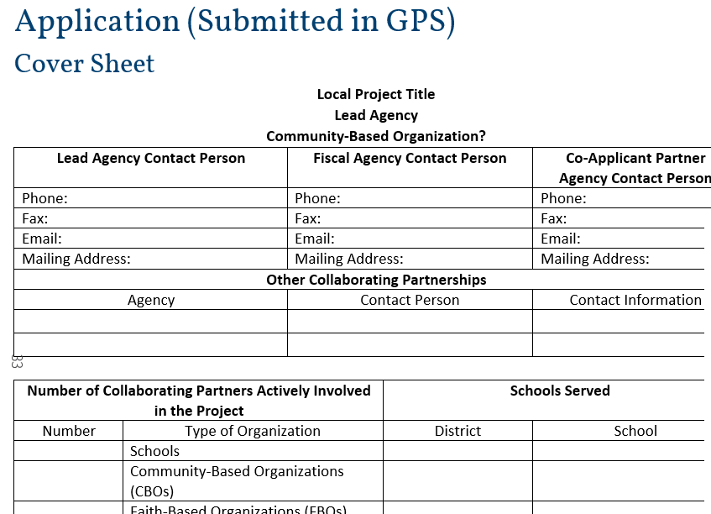

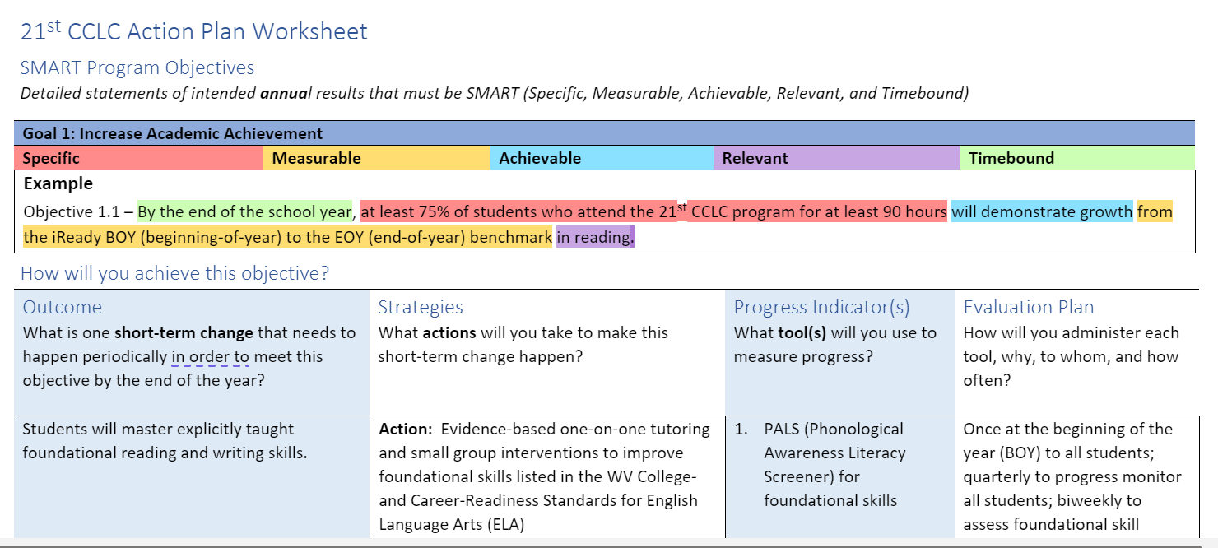
Application Tools
Visit WVDE 21stCCLC Webpage for application and resources:
https://wvde.us/21st-cclc/application-resources/
Notes:
Sherry
https://wvde.us/wp-content/uploads/2022/01/21st-CCLC-Application-Template.docx
On the WVDE Website there are several resources develop for applicants located under Application Resources.
This includes an application template, action plan worksheet, and school attribute tables. Additionally, there are the two top scoring grant proposals from last year for you to review if you wish.

Slide 83
Next Steps
Partnership Decision-making
Explore the Application Resource webpage
  Lists upcoming Technical Assistance calls
  Recordings of the conference and calls will be posted
  Application template and budget codes
  Data Sources
    School Attributes Table
    Average Daily Attendance Table
    List of accredited and registered nonpublic schools
    External Organization List
    Future Frequently Asked Questions Document
Complete the Intent to Apply form and return it by March 20, 2026

Slide 84

Contact Information
Carrie Reeves,
WVDE 21st CCLC Coordinator
cbreeves@k12.wv.us

