Slide 1


Slide 2
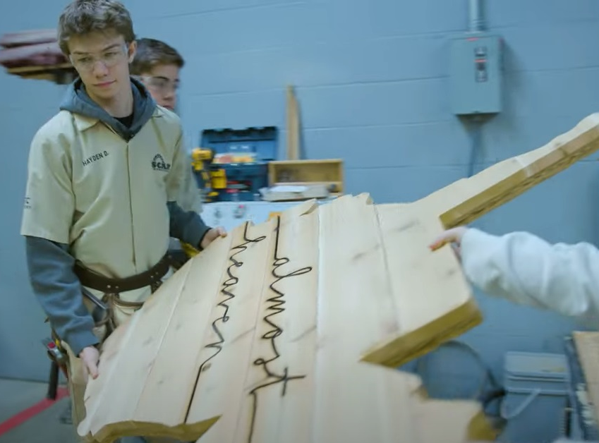
From
Participation to Impact
Building a Sustainable Workforce

Slide 3




2,000+
600+
350,000+
5,000,000+
Students
Partners
Hours
Dollars

Slide 4
Highlighted Industry Experiences
Agriculture
37 Schools
Construction
48 Schools
Healthcare
51 Schools
Manufacturing
35 Schools

Slide 5
Expanding Opportunities
Utilities & Energy
Aviation
Entrepreneurship

Slide 6
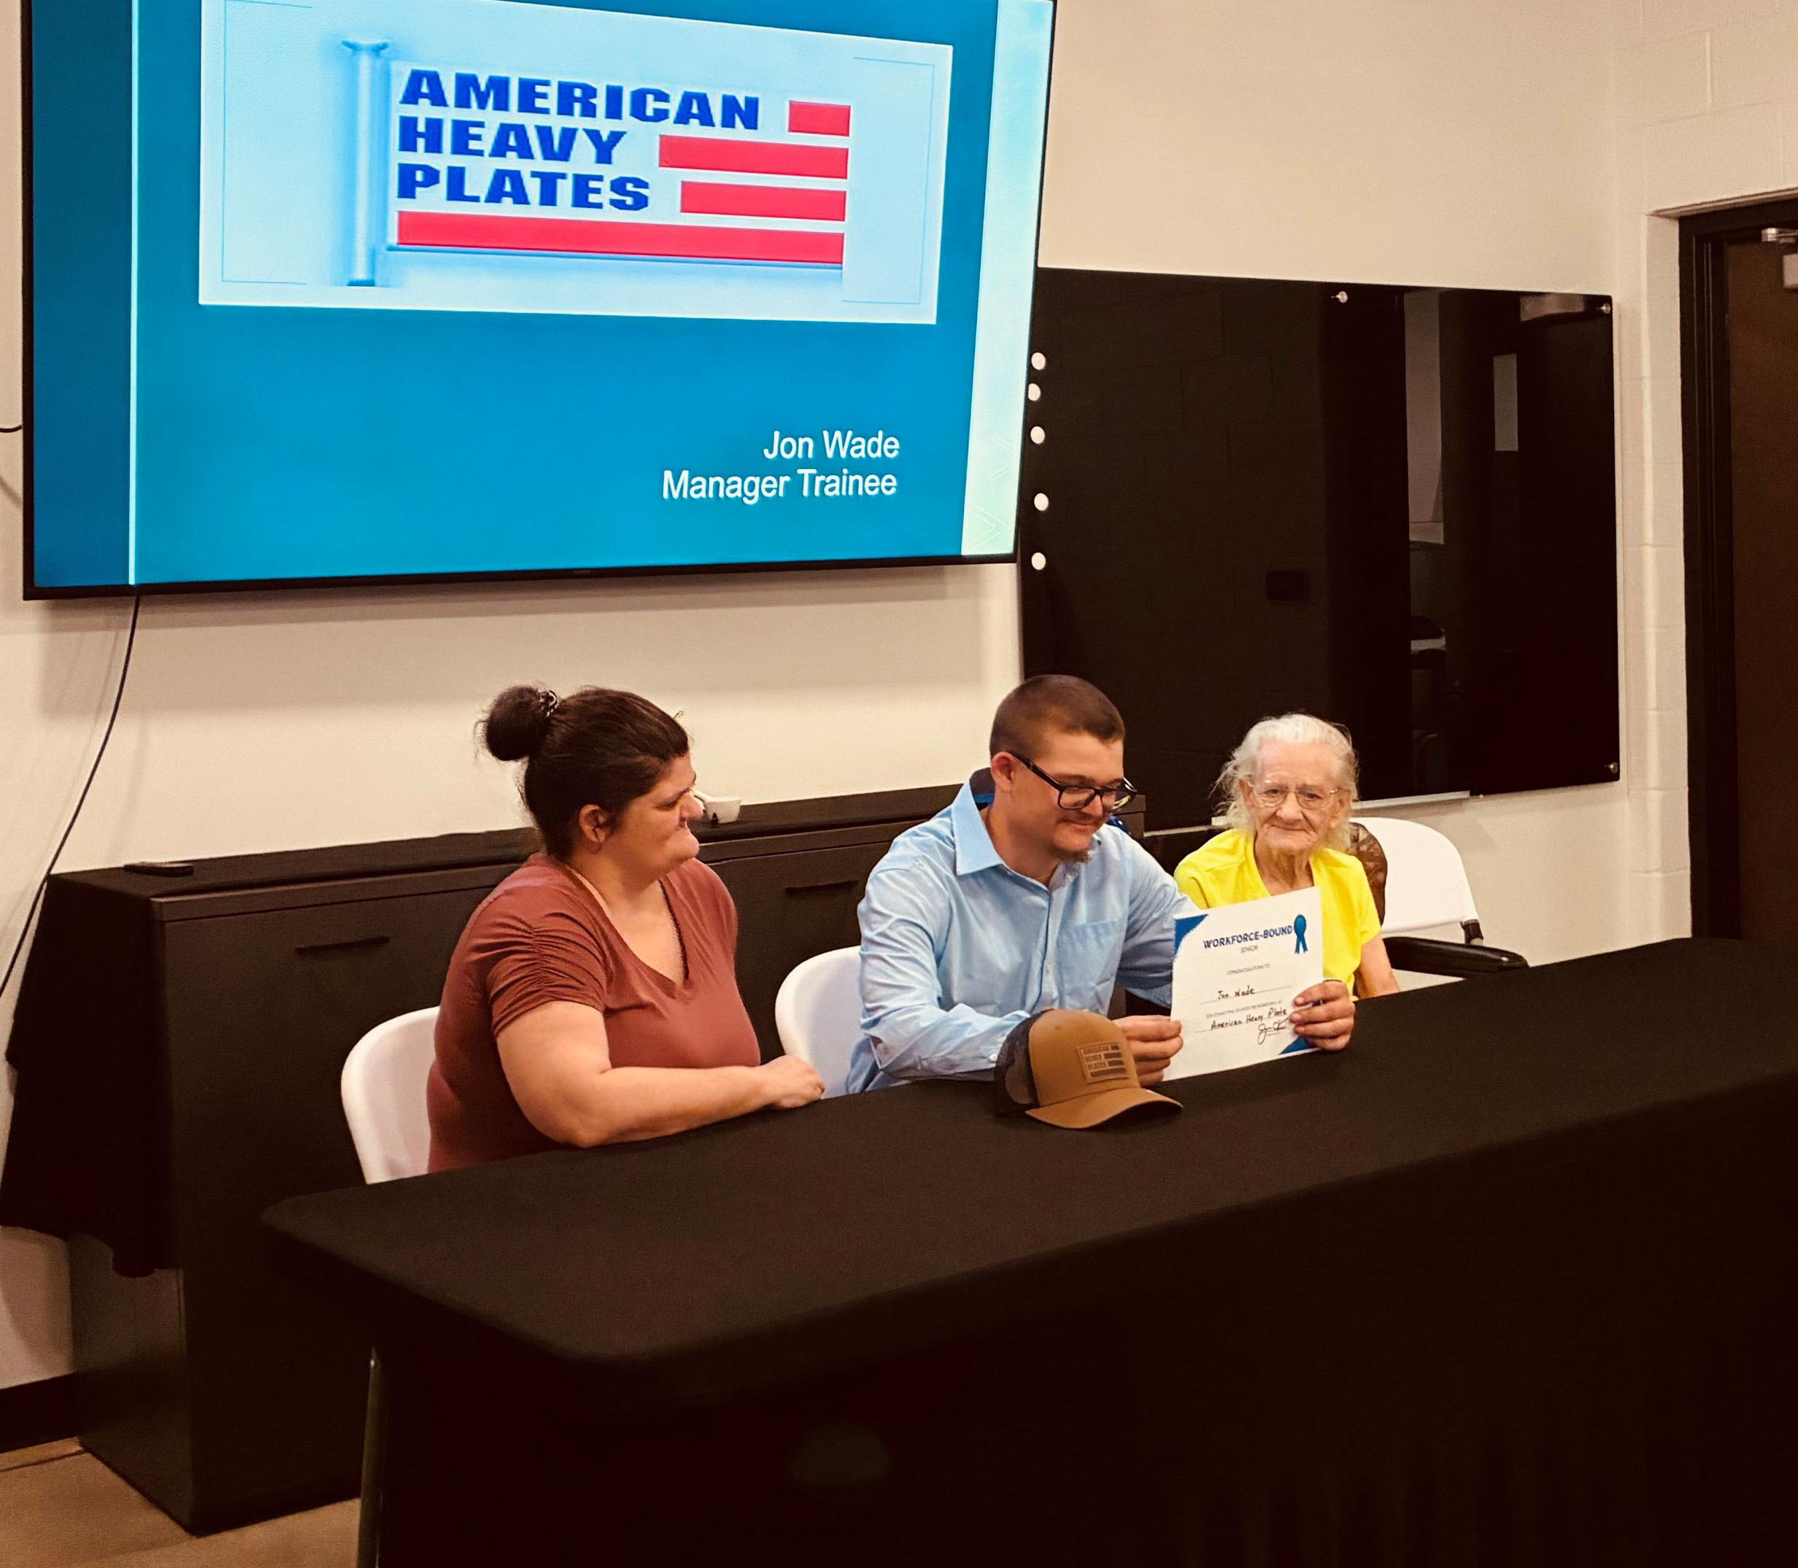
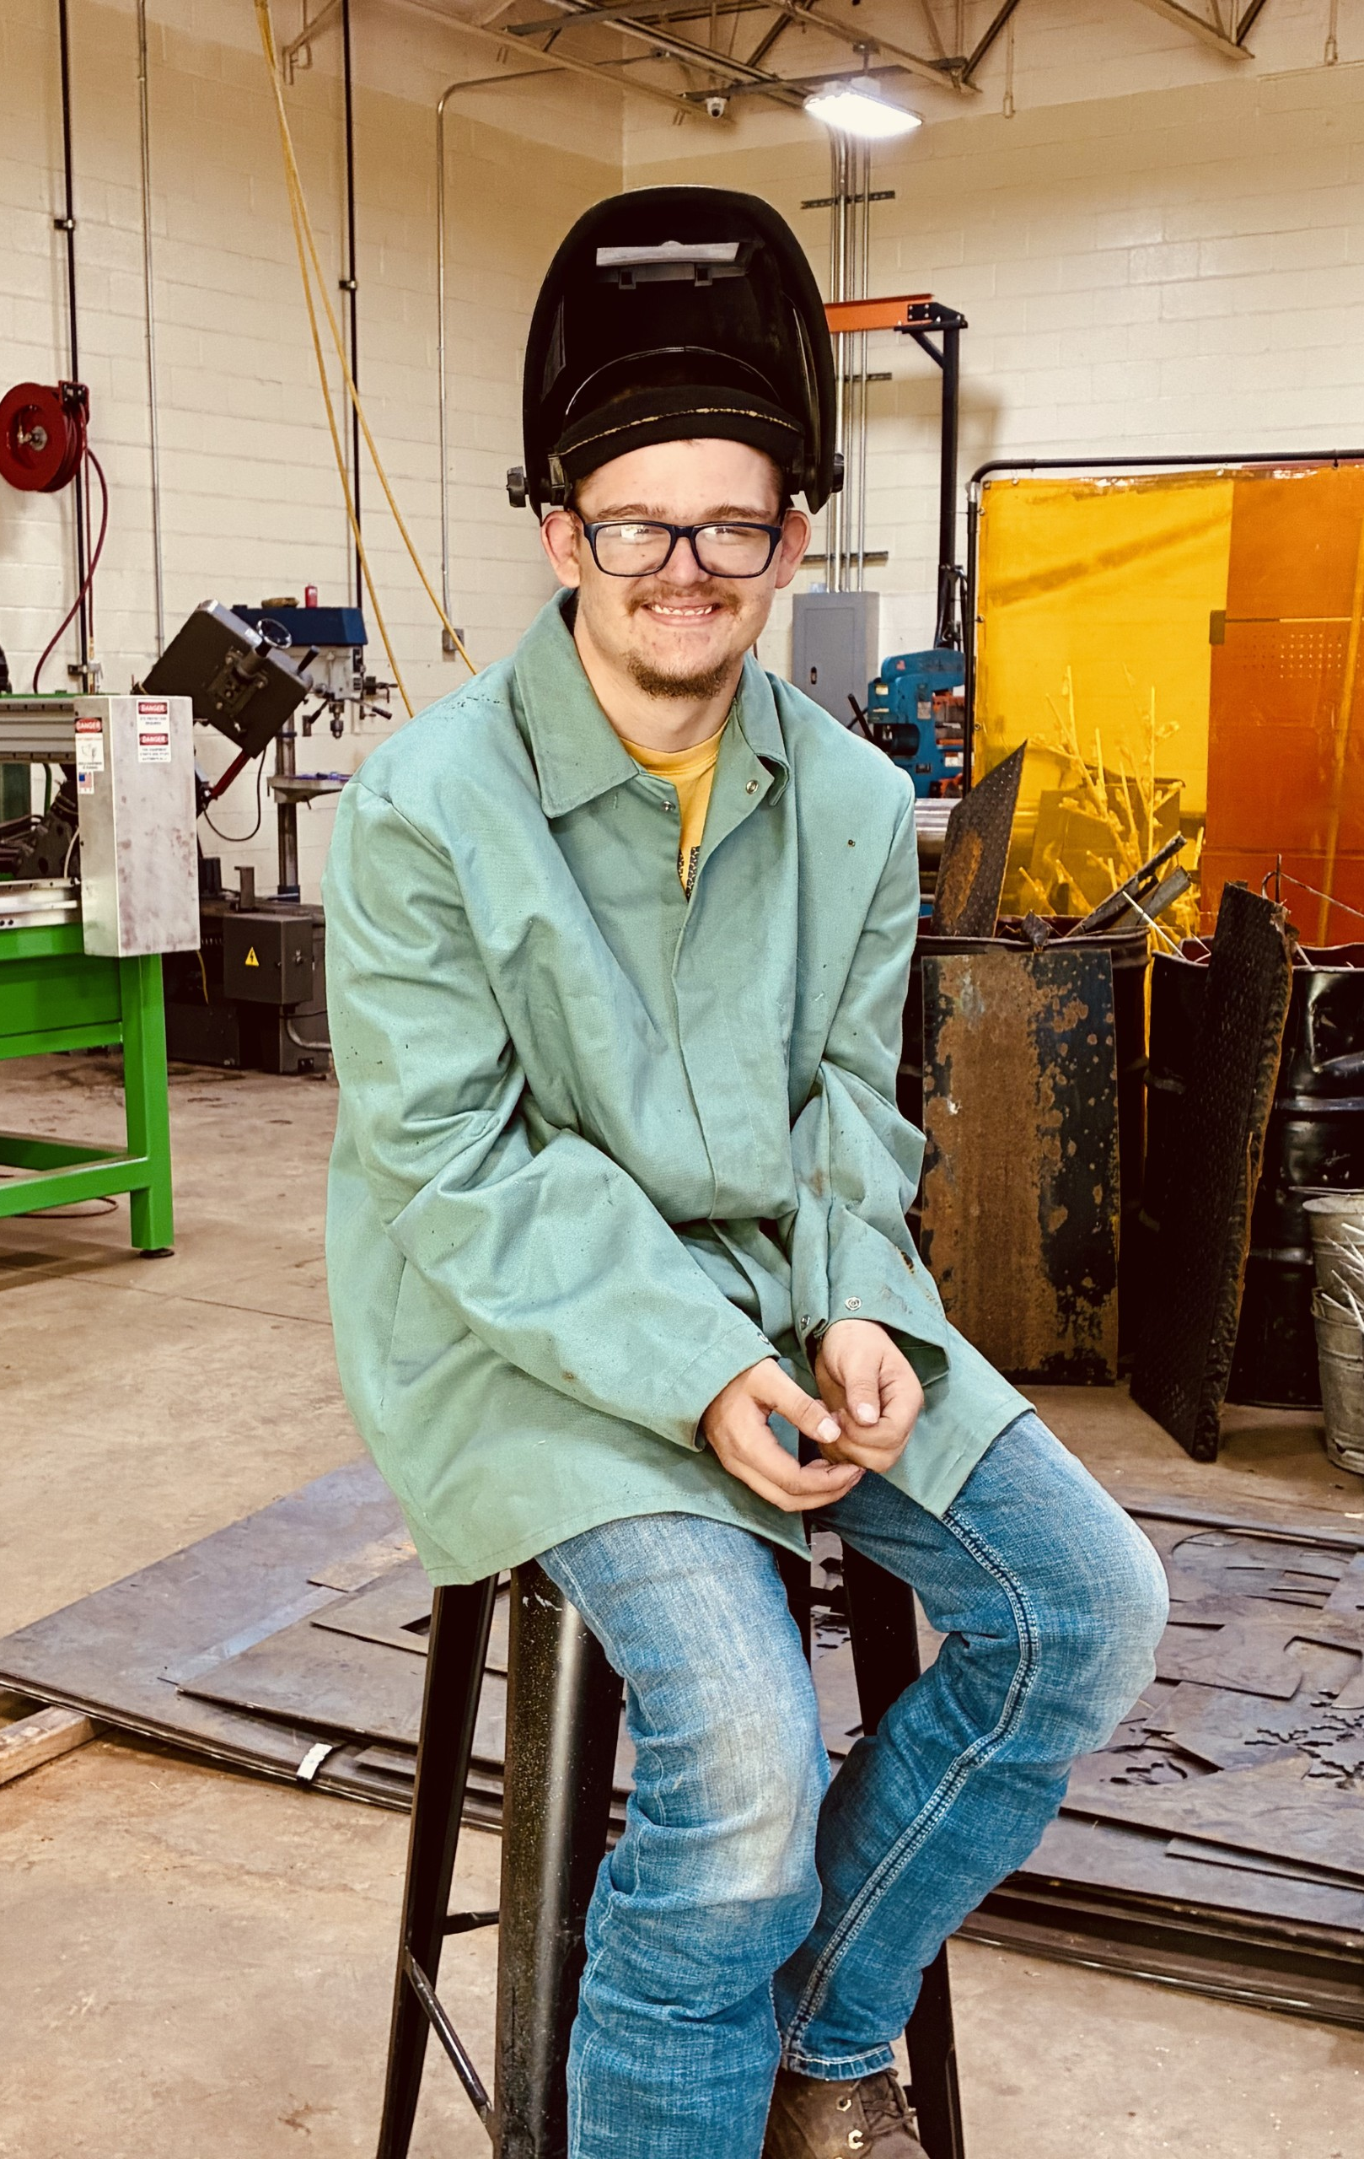
Jon Wade
Wetzel County Technical Education Center

