Slide 1
Office of Professional Preparation
Certification Training
Webinar II
Thursday, June 27, 2013

Slide 2
West Virginia Policy 5202
Minimum requirements for license of educational personnel are established within WV Educational Policy 5202.
Board of Education Legislative Rule Title 126, Series 136

Slide 3
New Protocols
Faxes are no longer accepted in lieu of required original documents
Certificates available online (PDF)
All Form 26 submissions require the processing fee ($$)
Fees are no longer able to be transferred (very few exceptions)

Slide 4
Fingerprints/Background
All first-time applicants must complete
Out of state clearance not acceptable
Options:
Schedule a LiveScan appointment through Morpho Trust (L1) https://wv.l1enrollment.com/OpenNetworkPortal/spring/customer?execution=e1s1 or by calling 855-766-7746
Request fingerprint cards from our office http://wvde.state.wv.us/certification/forms/fingerprint.html
and
submit with application to our office; or
send to Morpho Trust by completing and sending the WV Card Scan Form http://wvde.state.wv.us/certification/forms/WV_Card_Scan_Form_2012.pdf

Slide 5
Finding the Most Current Forms
Be sure to retrieve forms from our website each time you need a form.
Follow this procedure:
From the WVDE home page
Select Educators
Then select Certification
From the Certification page, select Downloadable Forms
Do not use the search feature on website
Notes:
Please do not make copies and keep in a drawer; don’t use the Search feature on the website to locate a form

Slide 6

Notes:
This is what it looks like

Slide 7
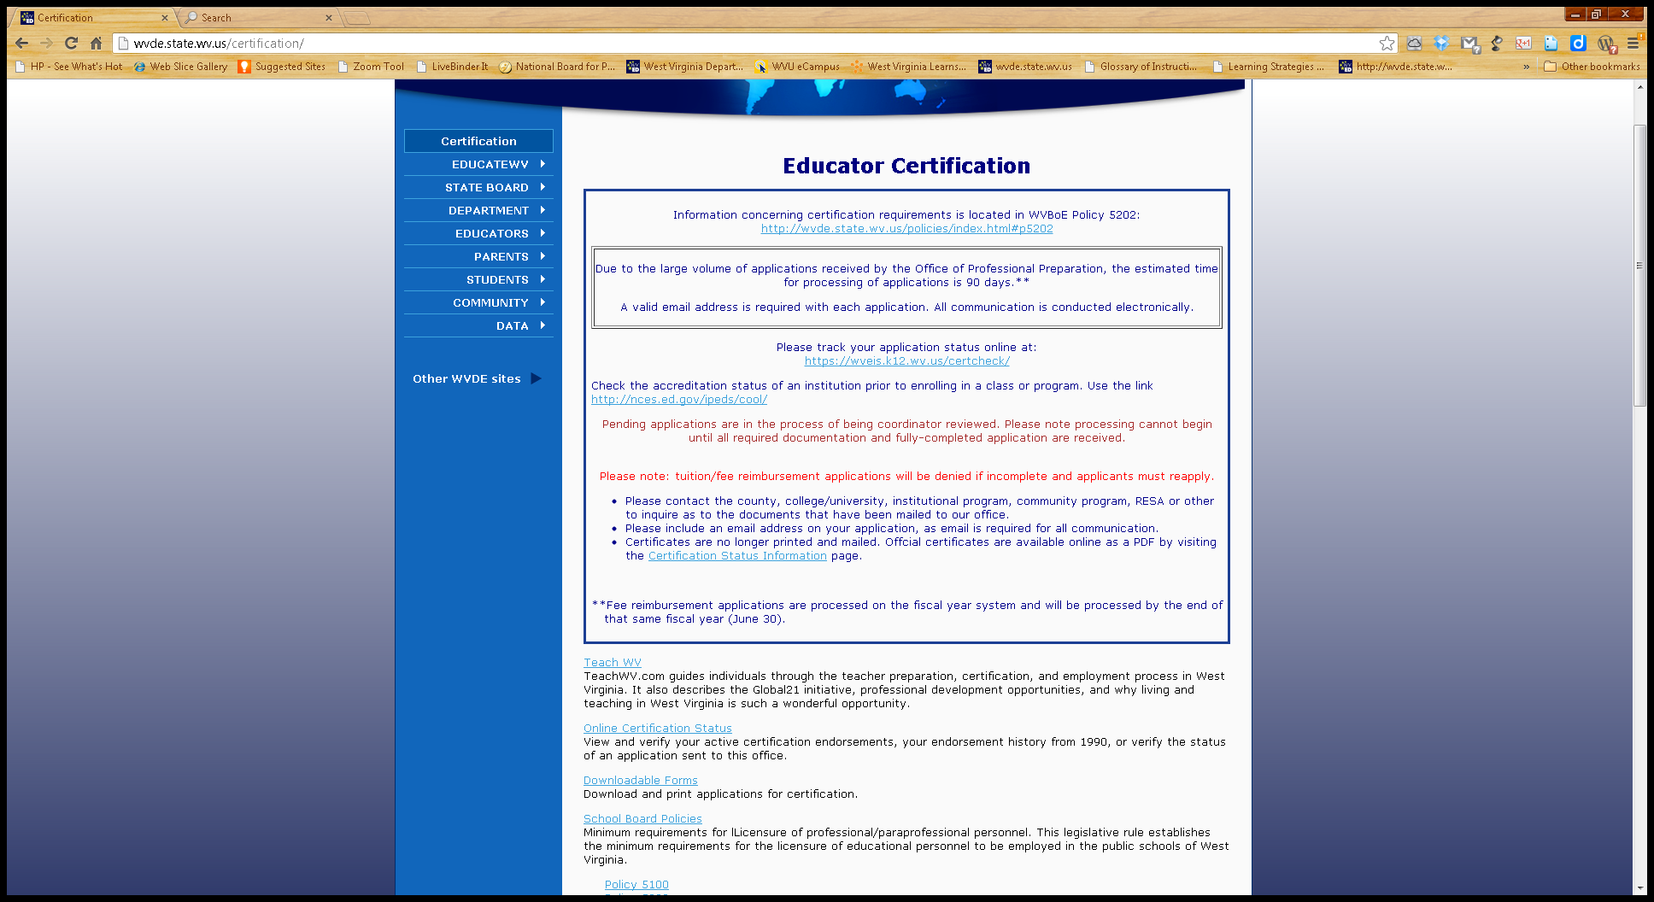
Next, select Downloadable Forms
Notes:
All certification forms used in the Office of Professional Preparation can be found here.

Slide 8
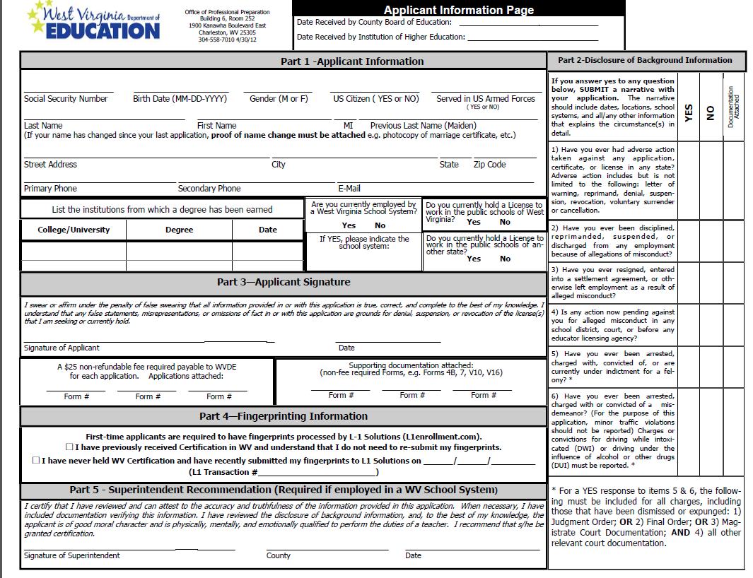
Applicant Information Form
Notes:
The applicant information pages have changed. Different applicant information pages go with varying applications. For example this applicant information page can be used with most applications that are not tied to employment.

Slide 9
Applicant Information Form
Please complete all sections of the applicant form.
Essential information
Part 1 –SSN, US Citizen, Email, County School System.
*If there’s no county listed, remember to complete a Form 4B
*If there was a name change, please provide a copy of your marriage certificate, etc.
Part 2 – Please answer all questions openly and honestly. If the applicant answers “yes” to any question, they must also include a detailed narrative of any/all incidents, any court and/or personnel documents, and documentation of completion of required programs or paid fines/fees.
Part 3 -- Original Applicant Signature and Date
Part 4 --Original Superintendent Signature and Date
Notes:
An applicant must disclose each and every time they submit an application. If previously disclosed, the applicant can indicate this by writing “On file at WVDE” by the disclosed section.

Slide 10
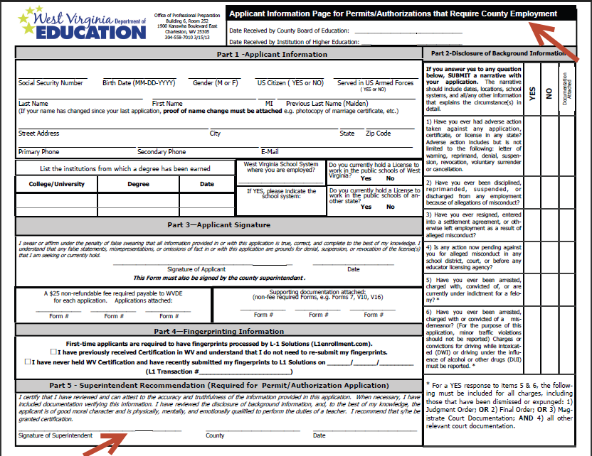
Applicant Information page tied to employment
Notes:
This applicant information page is tied to employment and is used for permits and authorizations. Notice the different title/heading it has at the top; in Part 5, the county superintendent must sign the form prior to its being submitted to our office for processing.

Slide 11
Form 7
All first-time applicants must complete

Slide 12
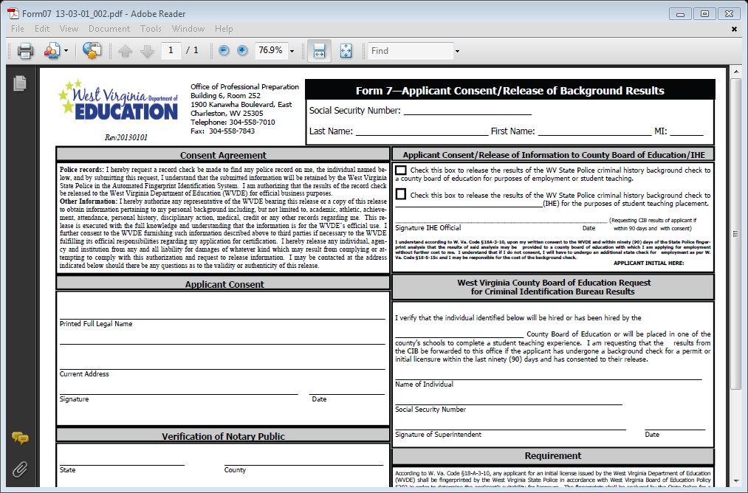
Form 7
Notes:
This form is the applicant’s consent to have their background and fingerprint results shared with their employing county. It must not only be signed by a notary public, but must also bear the seal of the notary public. If either is missing, the application will be placed on hold, and applicant will be notified that the application is in jeopardy of being denied.

Slide 13
Advanced Credentials Forms 30 & 35
Documentation for each Advanced Credential is listed on the Form and is very specific to each credential

Slide 14
Form 30
Technology Integration Specialist (TIS)/Renewal
Mentor Teacher
Master Mentor Teacher/Renewal
Advanced Placement Teacher/Renewal
Notes:
All applications and renewals for TIS are approved by the assistant director of the Office of Instructional Technology. Applications and renewal for Mentor Teacher must be accompanied by a certificate of completion for the appropriate number of days training -- Mentor Teacher 2 days; Initial Master Mentor 4 days (includes the first two days for mentor training); Master Mentor Renewal – total of 6 days training (2 days per training period/certificate).

Slide 15
Form 30
Advanced Credential
Documentation
Technology Integration Specialist (TIS) /Renewal
Mentor Teacher
Master Mentor
Renewal Master Mentor
URL Link to Online portfolio
320/40 clock hours PD
Approval of WVDE Director of Instructional Technology
CPD training 2 Days (Certificate)
CPD Days 3 & 4 (Certificate)
Additional 2 days (total 6)
Form 30
Notes:
All documentation for the TIS credential is sent to the Office of Instructional Technology for approval. The TIS credential must be renewed every year.
Documentation for mentor teacher and master mentor is the certificate of completion from the WV CPD. For the mentor teacher, a two-day training certificate is required plus three years of teaching experience; master mentor requires an additional two days of training– documentation is training for days 3 &4 of WV CPD training (if days one and two were already submitted) –documentation for all four days if taken all at once. The Renewal of Master Mentor requires yet another 2 days of training for a total of 6 days. Each mentor certificate is good for a period of 3 years.

Slide 16
Advanced Placement Teacher
Complete College Board AP Course Audit AND
Attend 30-clock hour Summer AP Institute OR
Serve as exam reader for at least one College Board AP Exam Reading OR
Deliver at least one course-specific workshop through College Board OR
Successfully mentor a new AP teacher OR
Complete 3 semester hours of coursework related to AP course for which licensure is sought
Form 30
Notes:
Documentation must be submitted for – AP Course Audit and certificate of completion of 30 clock hours summer institute OR documentation for serving as exam reader, workshop presentation, mentoring new AP teacher, or transcript of 3 semester hours of coursework.

Slide 17
RENEWAL Advanced Placement Teacher
Complete the Course Audit AND
Serve as exam reader for at least one College Board AP Exam reading OR
Deliver at least one course specific workshop through the College Board OR
Successfully mentor to a new AP teacher OR
Complete 3 semester hours of coursework related to the AP course for which licensure is sought (must submit an official seal-bearing transcript)
Form 30
Notes:
Documentation as noted on slide – course audit and one other as listed

Slide 18
Form 35 Advanced Credential
Educator 21
Personal Finance Specialist
Teacher Leadership for Building School and Community Culture
Teacher Leadership for Professional Learning
Teacher Leadership for Student Learning
Business Education Specialist
Marketing Education Specialist
Coordinator of Career and Work Skills Training
Notes:
Each of these credentials requires specific documentation as noted in policy. I will be going over only the new credentials and what they require.

Slide 19
Form 35
***NEW***
Coordinator of Career and Work Skills Training
Hold a Career and Technical Education Certificate or a Professional Teaching Certificate endorsed for a specialization in engineering technical, human services, agriculture, food and natural resources, health science education or business education; AND
Wage-Earning Experience. – Complete a minimum of one year (2,000 clock hours) of related wage earning experience in a non-teaching position; AND
Professional Development. – Successfully complete professional development and/or coursework related to the Coordinator of Career and Work Skills training programs in Career and Technical Education as specified/approved by WVDE
Form 35

Slide 20
Personal Finance Specialist
Successfully complete professional development on personal finance approved by WVDE AND
Successfully document the integration of personal finance education into the core curriculum utilizing the Teach 21 framework and approved by WVDE
Form 35
Notes:
This credential requires the approval from the Office of Instruction. Personnel in OI will review the written instructional plan applicant’s must develop in coordination with the summer training.

Slide 21
Personal Finance Specialist Permanent Credential
A permanent Advanced Credential for Personal Finance Specialist may be obtained after receiving the initial credential and one renewal of the credential at the appropriate renewal period and successfully completing the following:
Completion of an additional 5 days professional development related to personal finance education knowledge, skills, and pedagogy and offered/approved by the WVDE; AND
Successfully complete at least three semester hours of coursework from a regionally accredited institution of higher education or its equivalent from West Virginia eLearning, and directly related to the field of Personal Finance Education.
Form 35
Notes:
Each renewal of the Personal Finance Specialist requires attending the summer workshop and creating and implementing a new instructional plan that must be approved by the Office of Instruction. To be eligible for the Permanent certificate, one must have held a valid certificate for personal finance specialist and have successfully renewed that certificate at least once at the appropriate renewal time. Then one must again attend the workshop for personal finance specialist and document add to their instructional plan, AND successfully complete 3 semester hours of coursework directly related to personal finance education as documented on an official transcript.

Slide 22
Form 40
Paraprofessional Certificate

Slide 23
**Note** This is not the same as the Early Childhood Paraprofessional Certificate that goes into effect July 1, 2014 For more information on the Early Childhood Paraprofessional, please contact Teresa Epperley @ tepperle@access.k12.wv.us
Form 40

Slide 24
Required Documentation
High school diploma/GED
Official transcripts
Passing score on state competency test for classroom aides
Praxis I scores (reading, writing, math), if using
Certificates of completion for all PD
County verification of work experience (classroom management)
County verification of work experience (SPED) + 10 hours PD
Form 40

Slide 25
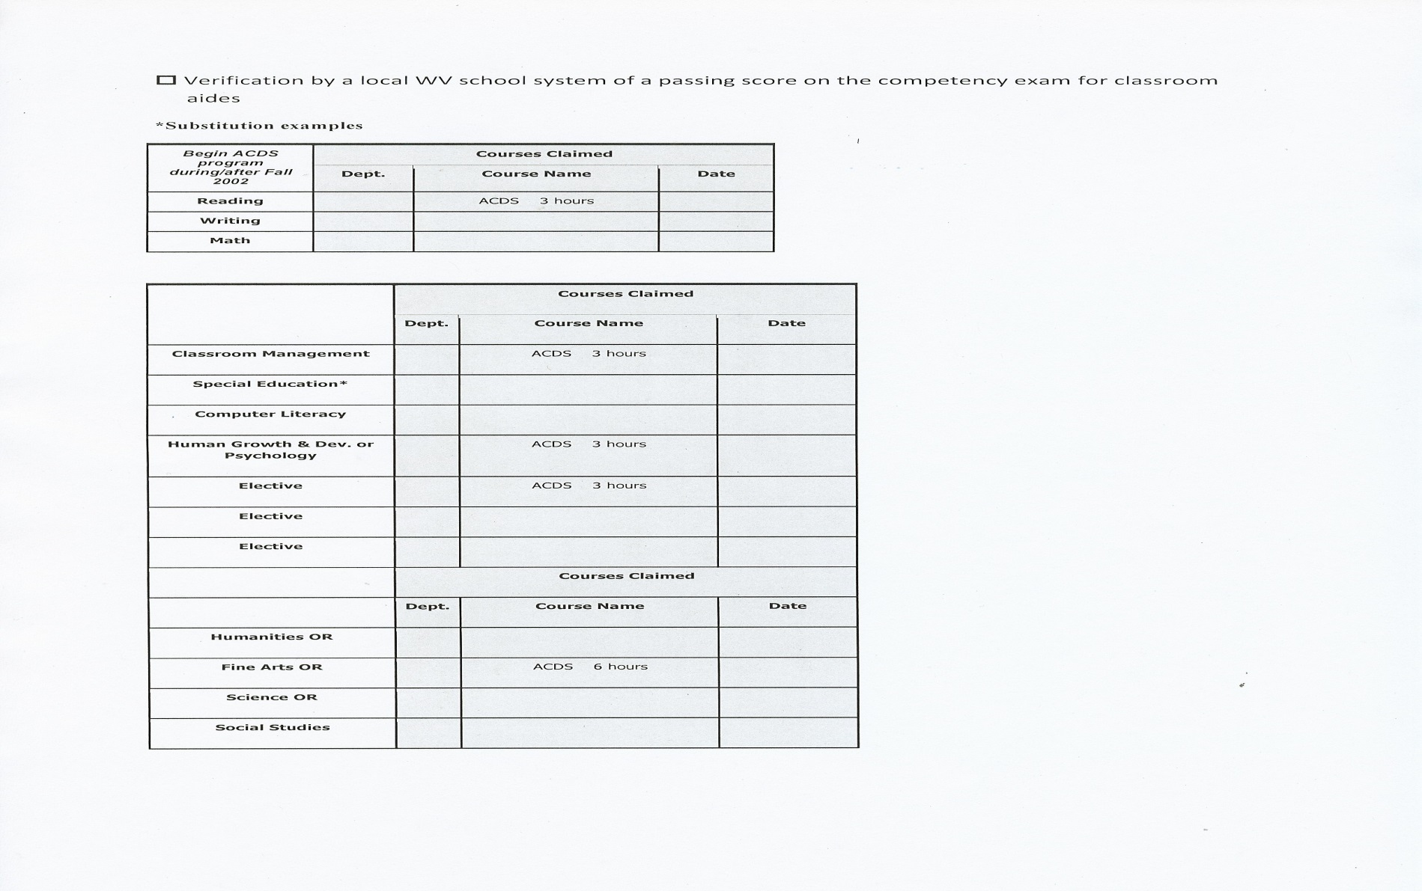
Required Courses and Equivalent Training
Reading, Writing, Math
can use Praxis I
ACDS will count for Classroom Management, Psychology, an Elective, and 6 hours of either Humanities, Fine Arts, Science, or Social Studies
3 credit hours each
Form 40
Notes:
A passing score on Praxis I may be used in lieu of the basic skills classes reading, writing, and math. If the applicant has a certificate from the ACDS and the accompanying certificate from the U.S. Department of Labor, the ACDS certification may be used in lieu of the 3 credit hours required for Reading, Classroom Management, Psychology, an elective, and for 6 hours of Humanities, Fine Arts, Science, or Social Studies. Applicants should also know that 15 clock hours = 1 credit hour; 45 clock hours = 3 credit hours.

Slide 26
Form 60
Paraprofessional Educational Interpreter

Slide 27
Permanent Certificate –All requirements met Initial Certificate --All requirements not met; may be renewed two times Renewal Certificate – Initial Certificate and 15 clock hours
Form 60

Slide 28
Required Documentation
Copy of passing EIPA Score
HS diploma/GED
Passing score on state competency exam for classroom aides
Official Transcript, if applicable
Score Reports – Praxis I, if applicable
Certificates of completion for any/all PD
Verification of work experience for classroom management and special ed + 10 hours PD for SPED
Form 60
Notes:
If using classroom experience + 10 hours PD for special education, the same may be used for classroom management. However, work experience for classroom management may not be used in lieu of special education.

Slide 29
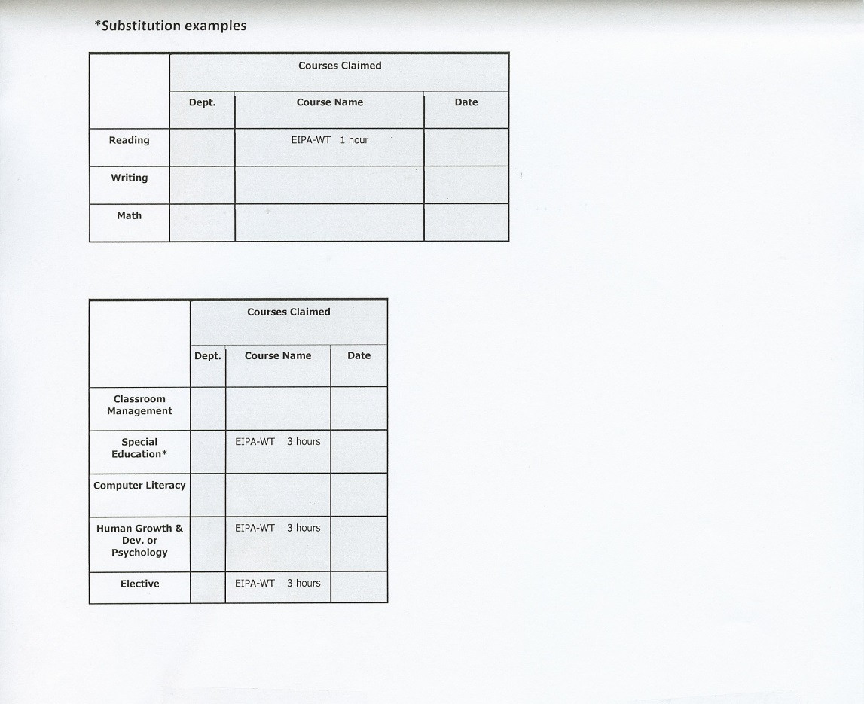
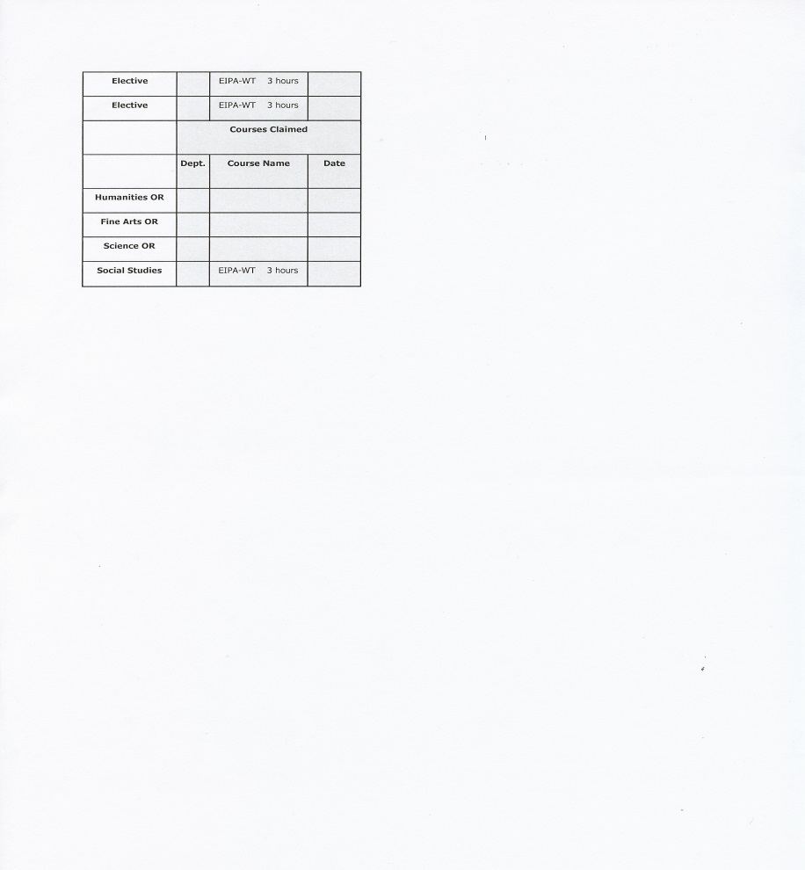
Required Courses and Equivalent Training
EIPA – WT 1 hour
EIPA - WT 3 hr
EIPA - WT 3 hr
Form 60
Notes:
Passing scores on the written test for EIPA may be used for 1 credit hour for Reading, 3 credit hours each for Special Education, Psychology, an elective, and social studies. Hours are credited as follows: 15 clock hours = 1 credit hour; 45 clock hours = 3 credit hours.

Slide 30
Salary Supplement and Fee Reimbursement for Teachers (NBCTs)
Salary supplement and fee reimbursement are available for teachers with recognized National Certification from the National Board for Professional Teaching Standards (NBPTS).
The annual state salary supplement for NBCTs is currently $3,500.00. The county may provide an additional supplement, if desired. §126-136-23.3.

Slide 31
Salary Supplement and Fee Reimbursement for Teachers (NBCTs)
Salary Supplement: Form 12
Salary Supplement Renewal: Form 12
Fee Reimbursement: Form 37
http://wvde.state.wv.us/certification/forms/

Slide 32
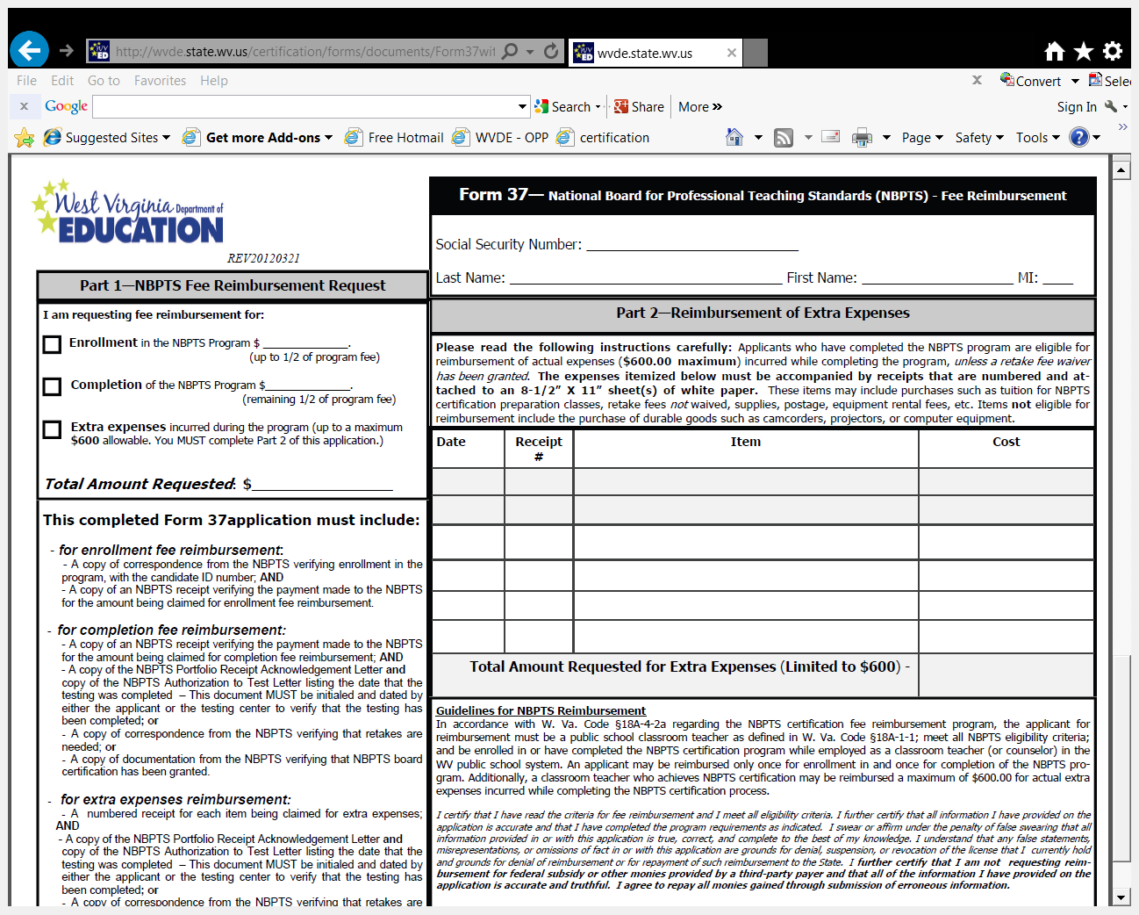
Form 37

Slide 33
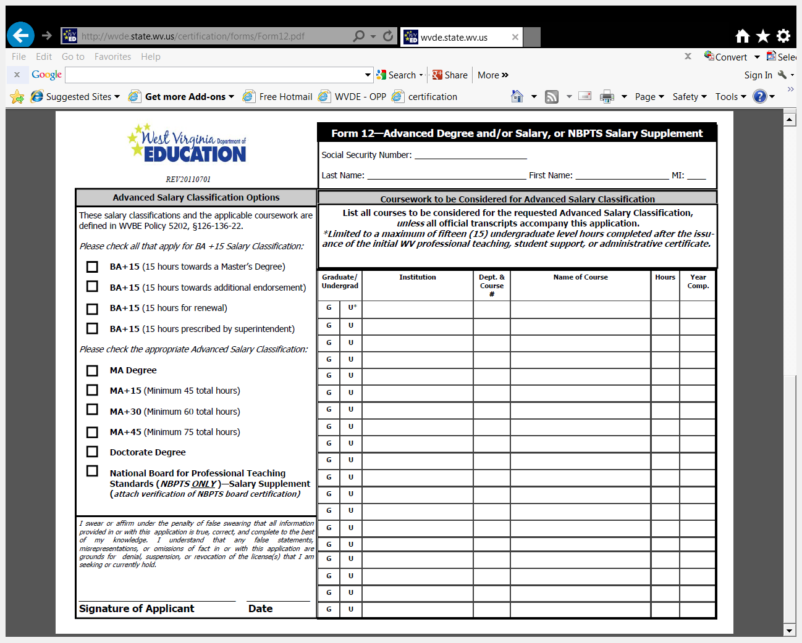
Form 12

Slide 34
Salary Supplement and Fee Reimbursement for Student Support Professionals
Salary supplement & fee reimbursement are available for certain student support professionals with recognized National Certification in Speech-Language Pathology, Audiology, Counseling, School Psychology, and School Nursing.

Slide 35
Salary Supplement and Fee Reimbursement for Student Support Professionals
Applications are accepted from January 1 through September 15 each year for processing once per year
115 total personnel are identified once each year to receive the fee reimbursement and/or the salary supplement

Slide 36
Salary Supplement and Fee Reimbursement for Student Support Professionals
The annual state salary supplement for student support professionals identified to receive it is $2,500.00.
The county may provide an additional supplement, if desired. §126-136-23.4.

Slide 37
Salary Supplement and Fee Reimbursement for Student Support Professionals
Salary Supplement: Form 43
Salary Supplement Renewal: Form 44
Fee Reimbursement: Form 33
http://wvde.state.wv.us/certification/forms/

Slide 38
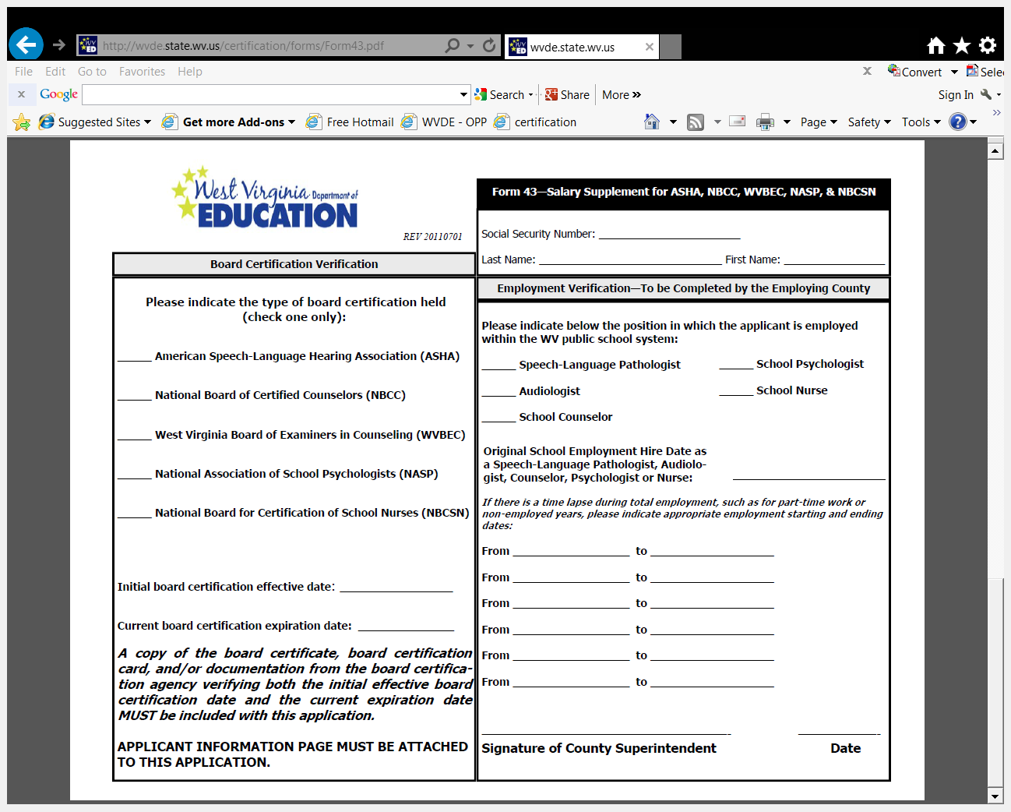
Form 43

Slide 39
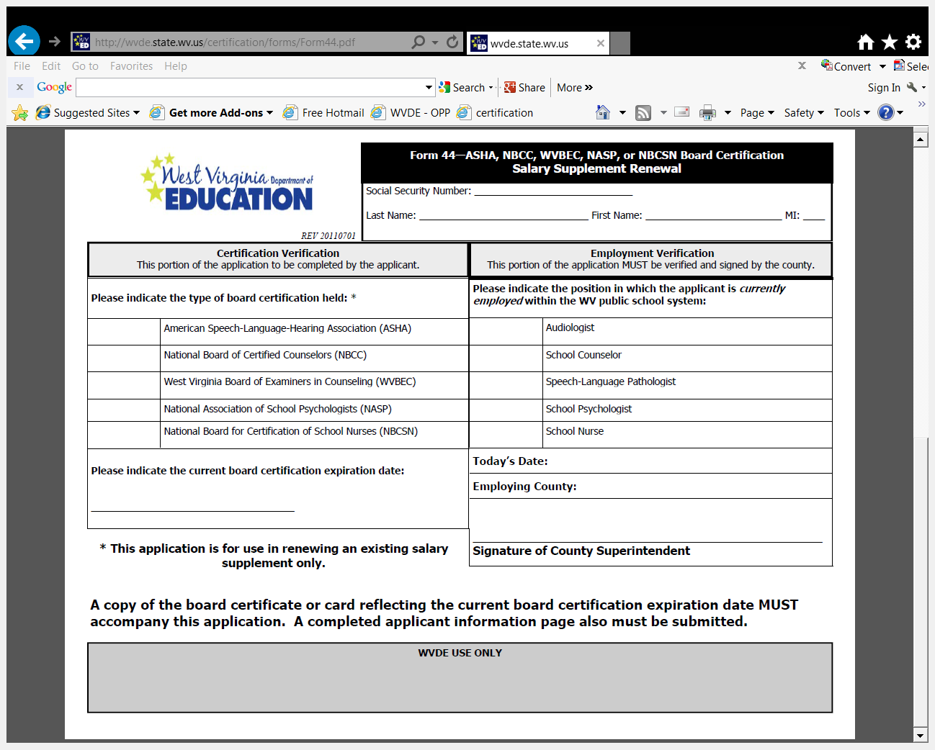
Form 44

Slide 40
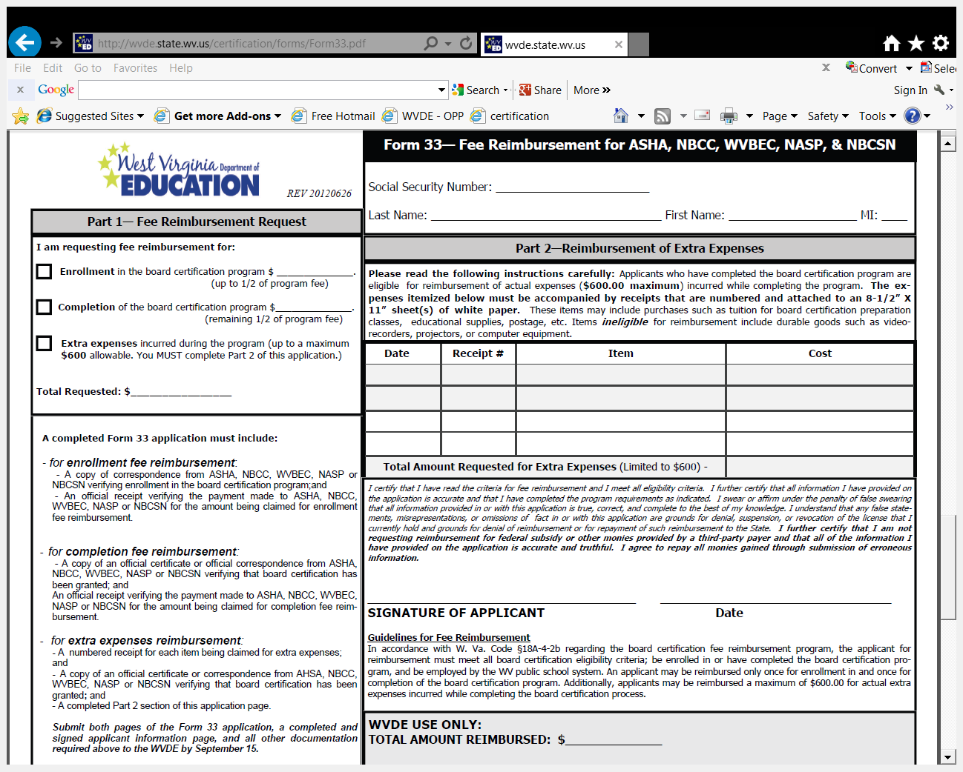
Form 33

Slide 41
Moving Expenses Fee Reimbursement
This reimbursement is available only when an educator has been RIFed in one WV county and hired in another WV county in a verified shortage area; §126-136-23.2.
Fee Reimbursement: Form 32
http://wvde.state.wv.us/certification/forms/

Slide 42
Tuition Reimbursement
Applications for state tuition reimbursement are accepted from July 1 through June 15, or until the Out of Funds status occurs, each fiscal year.
Coursework must be completed during the same fiscal year in which the Form 36 application is received by the OPP.

Slide 43
Tuition Reimbursement
Fifteen (15) maximum lifetime shortage area hours currently are allowable for reimbursement.
A GPA of 3.0 is required for the coursework.
Shortage area coursework is currently legislatively prioritized over renewal area coursework.
§126-136-23.1.
Tuition Reimbursement: Form 36
http://wvde.state.wv.us/certification/forms/

Slide 44
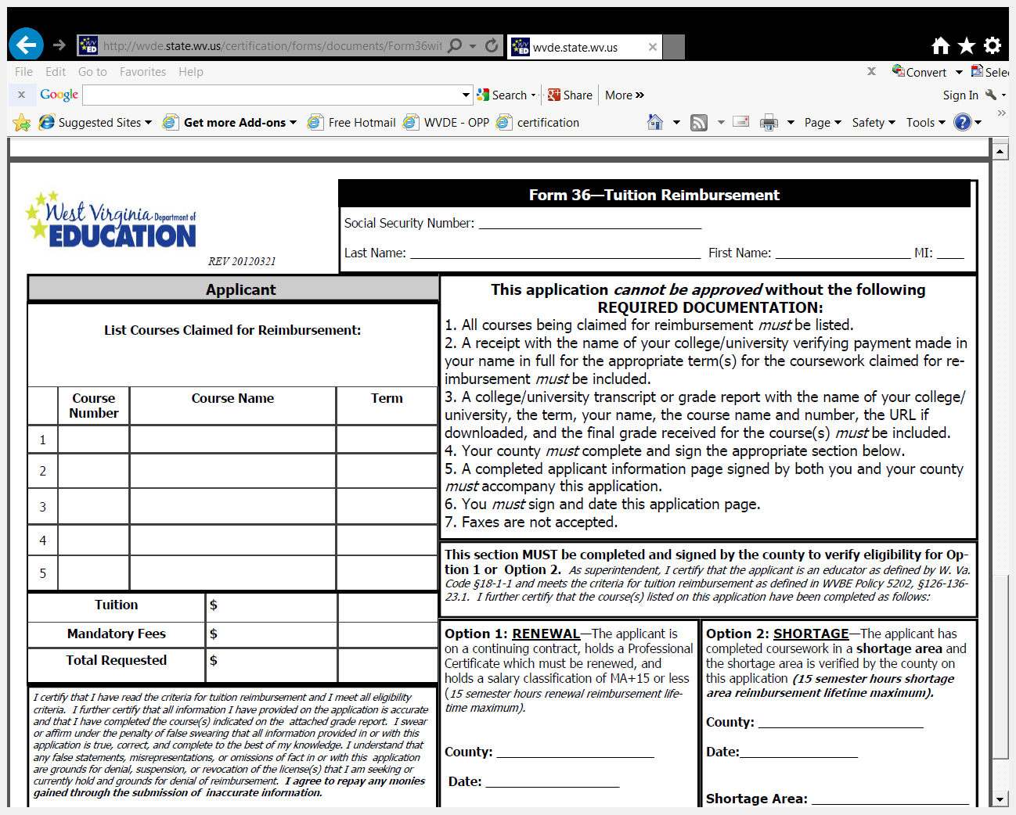
Form 36

Slide 45
Fee Reimbursements
Information is available online only for the Form 32, 33, 36, and 37 fee reimbursement applications, through the educator’s certcheck site, or the county’s WVEIS WOW OPP Reimbursements screen, through the “Reimbursements - View Results” link .

Slide 46
Permanent Authorization
For the modification/extension of grade levels for specified endorsement areas, as listed in §126-136-11.9.3.K.
Permanent Authorization: Form 42
http://wvde.state.wv.us/certification/forms/

Slide 47
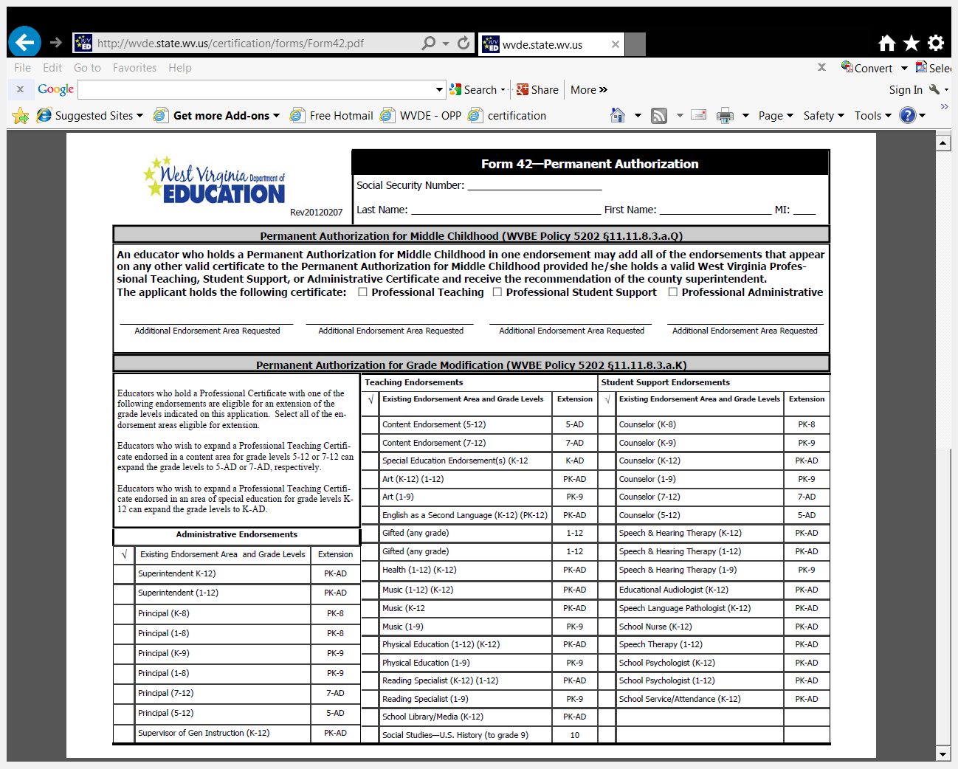
Form 42

Slide 48
Community Programs Authorization
Initial Community Programs Authorization
Requirements beginning August 1, 2013:
(a) Degree. – The minimum of a bachelor’s degree in child development, early childhood, or occupational development with an emphasis in child development/early childhood; AND
(b) Experience. – Verification of at least one year of early education teaching experience; AND

Slide 49
Community Programs Authorization
Initial Community Programs Authorization
c) Commitment – Submission of commitment verifying the applicant’s agreement to complete coursework and/or professional development in the areas specified by the WVDE Office of Early Learning; AND
(d) Recommendation of the county superintendent OR the community program’s director

Slide 50
Community Programs Authorization
Community Programs Authorization Renewal
Six (6) semester hours of WVDE-approved coursework or equivalent professional development are required for each renewal, as defined and approved by the WVDE Office of Early Learning, until all requirements have been met for a permanent authorization.

Slide 51
Community Programs Authorization
Permanent Community Programs Authorization
Completion of all requirements as stated in §126-136-19.3.FF
Community Programs Authorization: Form 50
http://wvde.state.wv.us/certification/forms/

Slide 52
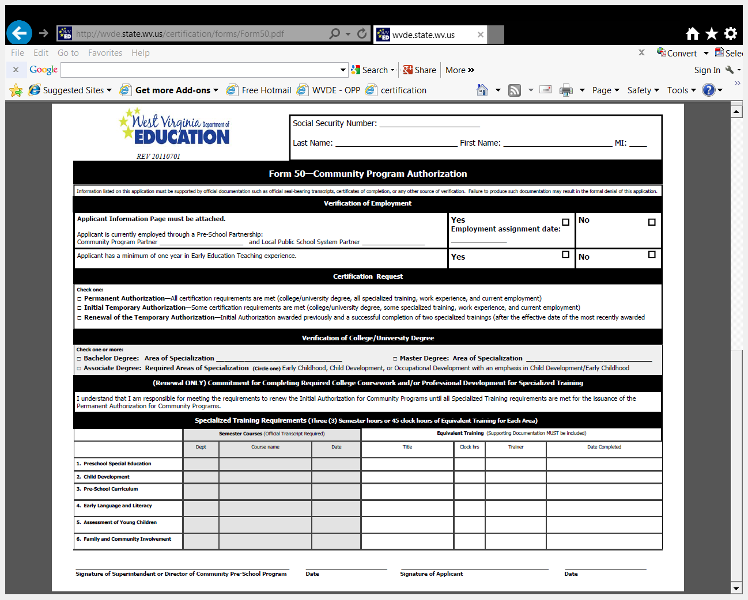
Form 50

Slide 53
Temporary Authorizations
Available for certain authorizations listed in §126-136-19.1: Authorizations Issued to Educators. Requirements are determined by the appropriate WVDE Office for each authorization type.
Temporary Authorization: Form 38
http://wvde.state.wv.us/certification/forms/

Slide 54
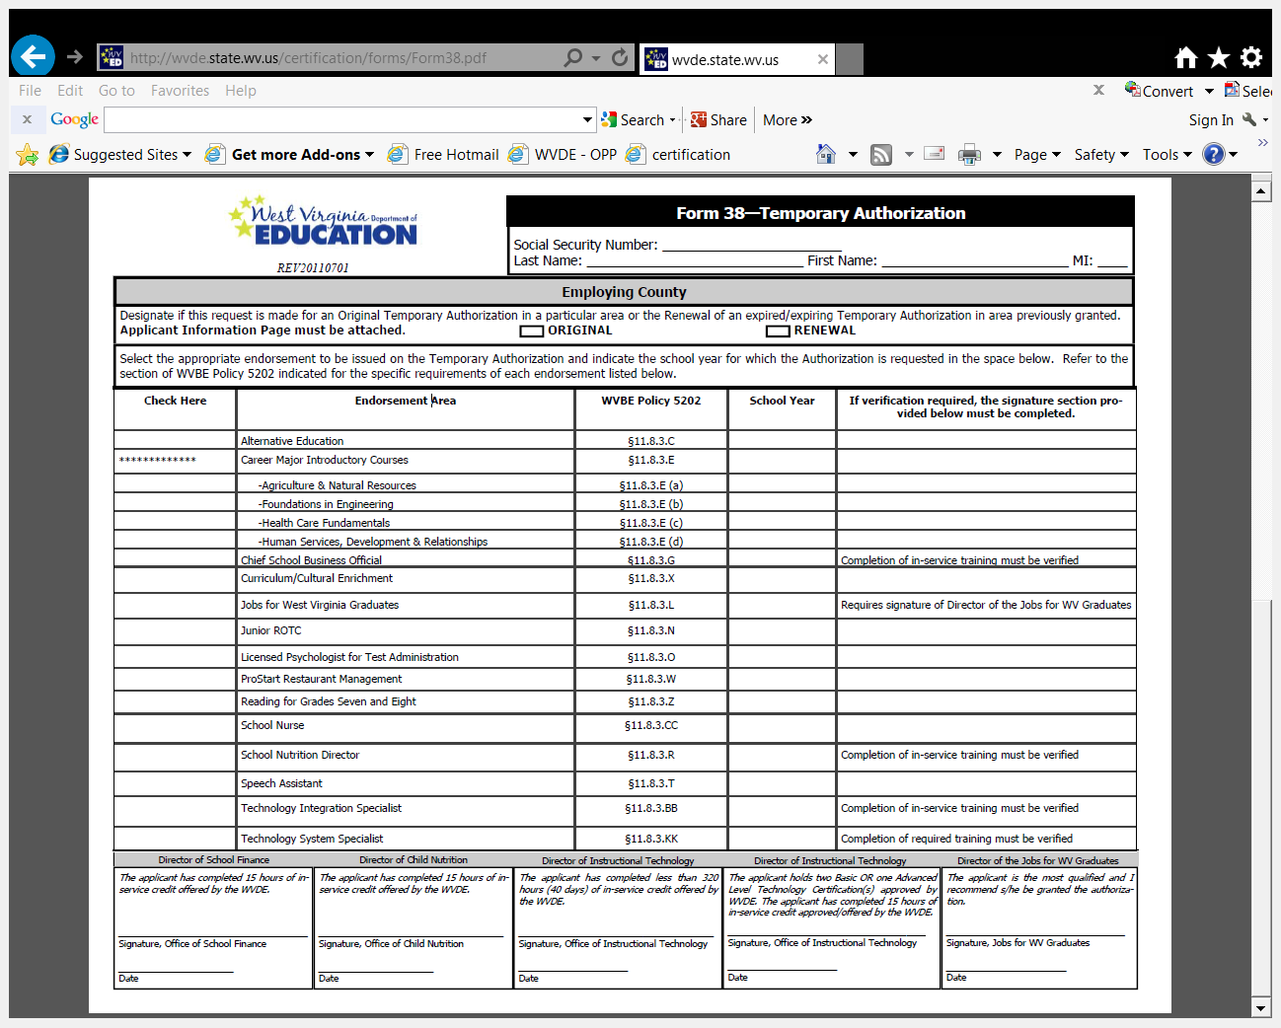
Form 38

Slide 55
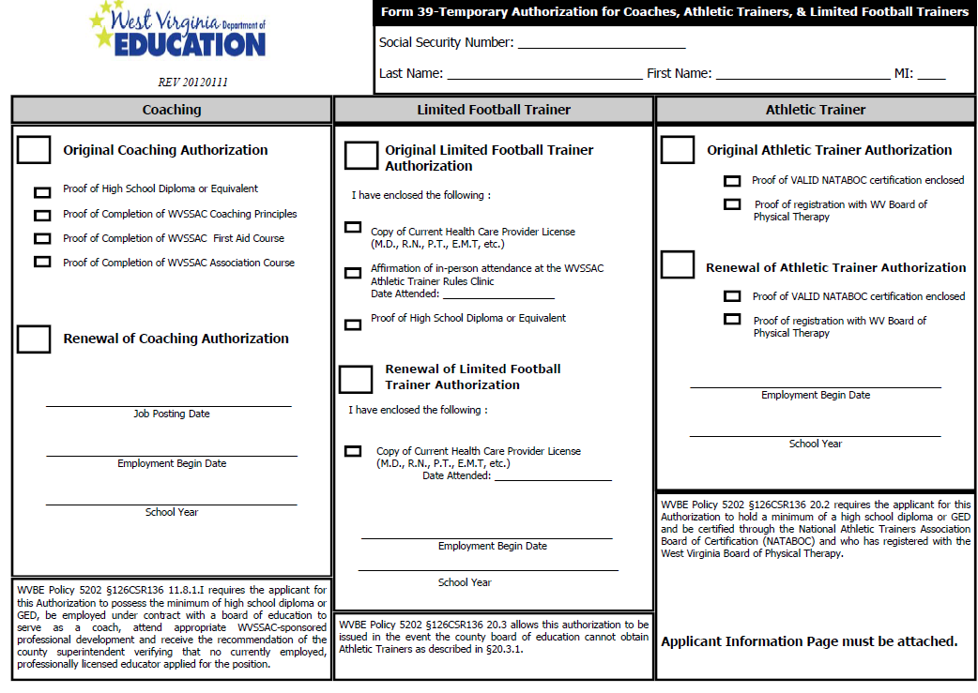
Form 39 Temporary Authorization for Coaches, Athletic Trainers, & Limited Football Trainers

Slide 56
Form 39 Temporary Authorization for Coaches, Athletic Trainers, & Limited Football Trainers
If you are applying for a coach, athletic trainer, or limited football trainer complete the appropriate section on Form 39 and provide the required listed documentation.
Only Professional Personnel are given
a 90-day grace period.
Notes:
Coaches must have Coaching Principles; Sport First Aid; WV Secondary School Activities Commission; High School Diploma/Equivalent
They must have a WV Public School System County listed on their applicant form in order to be processed.

Slide 57
Form 39 Temporary Authorization for Coaches, Athletic Trainers, & Limited Football Trainers
Coaches Exception
If an applicant has taken the WVSSAC training before 2004 and has held a coaching authorization certificate, the only requirement was to have Coaching and First Aid. All they have to do is renew.
All new applicants after January 2004 are required to have Coaching, First Aid, and the Association Course
Notes:
Applicant’s submitting Form 39 are not eligible for the 90-day grace period.

Slide 58
Career and Technical Education Certification
Notes:
[LISA / ROBERT]
Thank you for joining us for the second in a series of webinars as we move forward toward full statewide implementation of the new educator evaluation system. We have a very large group that registered, and we are very excited that you have joined us. Please note that the webinar is being recorded and will be uploaded to the WV Department of Education website. The PPT will also be uploaded. Additionally, there will be a time provided for questions at the end of the webinar. In order reduce background noise during the webinar, we ask that you mute your phones unless you are directing a question to a webinar presenter or contributing directly to the webinar discussion.
Introductions of all in the room.
Next slide
So, without

Slide 59
V7 – Career Technical Certification
Applicable Uses
Initial
Renewal
Permanent
Additional Endorsement(s)

Slide 60
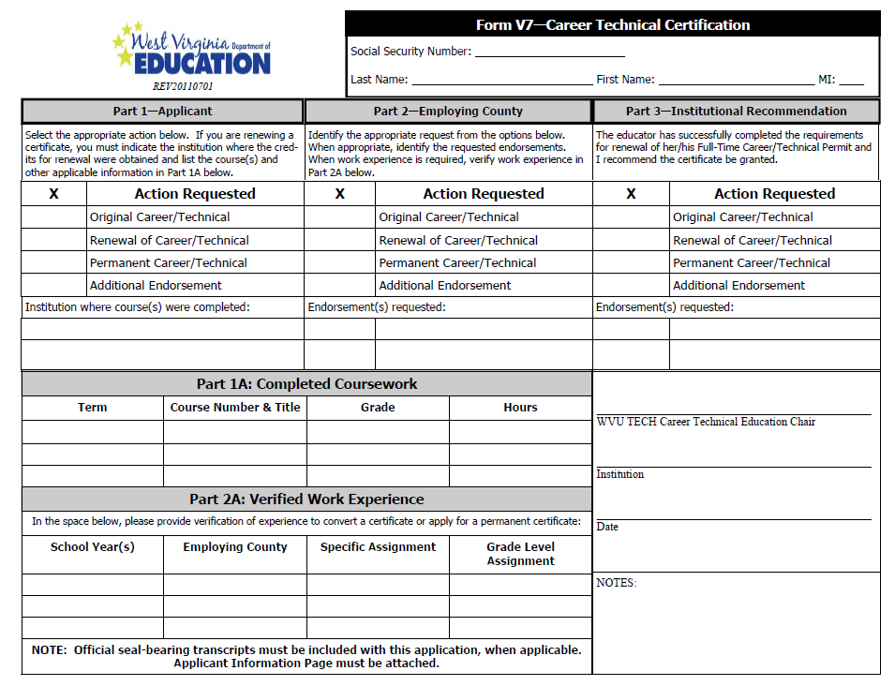

Slide 61
Initial Career Technical Certification
Part 1 Applicant – place an “X” next to the top row “Original Career/Technical”
Part 2 Employing County – place an “X” next to the top row “Original Career/Technical”
the endorsement/s being requested MUST be listed
Part 3 Institutional Recommendation – college signature MUST be acquired for initial certification
College must select “Original” AND list the endorsement/s being requested
Part 1A - must be completed by one of the stakeholders (applicant, county, college)
Part 2A – county MUST complete to acknowledge the required work experience
Additional items required for processing:
Official Transcripts
Copy of valid industry credential (if applicable – Appendix C)
Passing Basic Skills Test Scores
Passing NOCTI Scores (written and performance)
Copy of birth certificate (when using age for renewal)

Slide 62
Renewal of Career Technical Certificate
Part 1 Applicant – place an “X” next to the top row “Renewal of Career/Technical”
Part 2 Employing County – place an “X” next to the top row “Renewal of Career/Technical”
the endorsement/s being requested MUST be listed
Part 3 Institutional Recommendation – NA
Part 1A - must be completed by applicant OR county
Part 2A – county MUST complete to acknowledge the required work experience
Additional items required for processing:
Official Transcripts
OR
Copy of birth certificate showing age sixty+

Slide 63
Permanent Career Technical Certification
Part 1 Applicant – place an “X” next to the top row “Permanent Career/Technical”
Part 2 Employing County – place an “X” next to the top row “Permanent Career/Technical”
the endorsement/s being requested MUST be listed
Part 3 Institutional Recommendation – NA
Part 1A - NA
Part 2A – county MUST sign to acknowledge the required 5 years work experience
Additional items required for processing:
Official Transcripts OR Copy of birth certificate
Option #1 |  | Option #2
Hold/Eligible for Certificate AND |  | Hold/Eligible for Certificate AND
Hold Earned Master’s Degree AND |  | 2 certificate renewals
5 years educational experience |  | 6 semesters hours Initial #1 Renew #2 Permanent #3

Slide 64
V9 – First-Class/Full Time CTE or Substitute Permit
Applicable uses:
Original First-Class/Full Time Permit
Renewal of First-Class/Full Time Permit
Original Substitute CTE Permit
Renewal of Substitute Permit

Slide 65
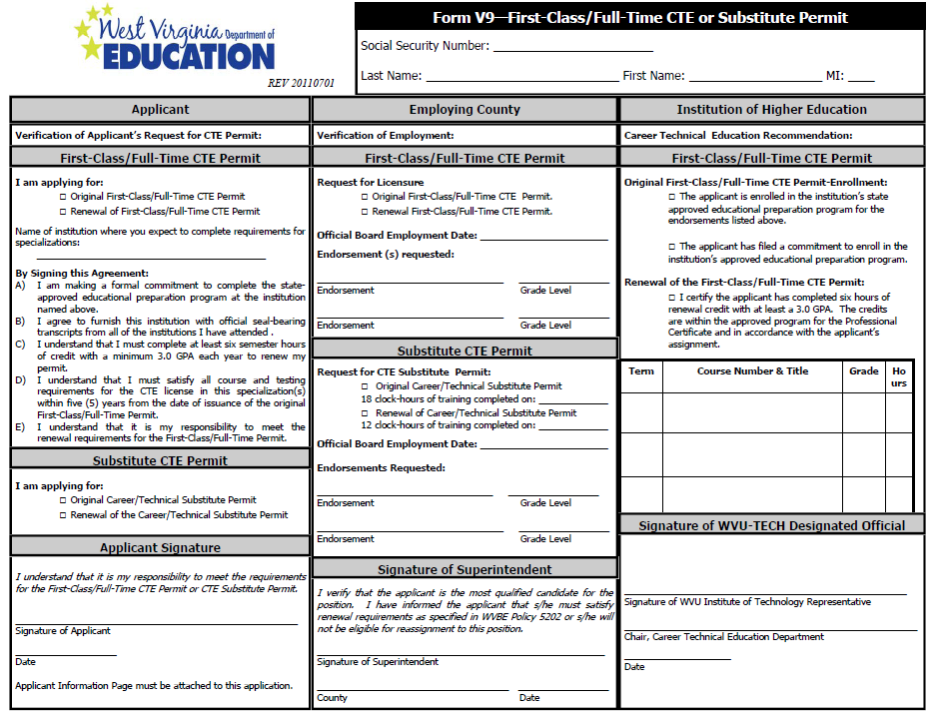

Slide 66
Original First-Class/Full-time CTE Permit
Column 1 Applicant – place an “X” next to “Original First-Class/Full-Time CTE Permit”
Column 2 Employing County – place an “X” next to “Original First-Class/Full-Time CTE Permit”
Official employment date MUST BE completed
the endorsement/s being requested MUST be listed
Column 3 Institutional Recommendation – college signature MUST be acquired for initial certification
College must select “Original”
Additional items required for processing:
Official Transcripts or High School Diploma/GED
V10 – verification of work experience
Copy of valid industry credential (if applicable – Appendix C)
Passing Basic Skills Test Scores

Slide 67
Renewal of First-Class/Full-time CTE Permit
Column 1 Applicant – place an “X” next to “Renewal of First-Class/Full-Time CTE Permit”
Column 2 Employing County – place an “X” next to “Renewal of First-Class/Full-Time CTE Permit”
Official employment date MUST BE completed
the endorsement/s being requested MUST be listed
Column 3 Institutional Recommendation – college signature MUST be acquired for renewal of certification
College must select “Renewal” AND list the courses completed
Additional items required for processing:
Official Transcripts
Passing NOCTI Scores (written and performance)

Slide 68
Original Substitute CTE Permit
Column 1 Applicant – place an “X” next to the top row “Original Career/Technical Substitute Permit”
Column 2 Employing County – place an “X” next to the top row “Original Career/Technical Substitute Permit”
List date of completion for 18 hours training
List official board employment date
The endorsement/s being requested MUST be listed
Additional items required for processing:
Official Transcripts or High School Diploma/GED
V10 – verification of work experience
Valid RN license (if applicable)

Slide 69
Renewal of Substitute CTE Permit
Column 1 Applicant – place an “X” next to the top row “Renewal of Career/Technical Substitute Permit”
Column 2 Employing County – place an “X” next to the top row “Renewal of Career/Technical Career/Technical Substitute Permit”
List date of completion for 12 hours training
List official board employment date
The endorsement/s being requested MUST be listed

Slide 70
V9 Checklist
Applicant column – signature required
Select original or renewal of First-Class Permit
OR
Select original of renewal of Substitute Permit
Employing County column – signature required
Select original or renewal of First-Class Permit
Employment date
Endorsement (per current Policy 5202)
OR
Select original of renewal of Substitute Permit
List completion date of required training
Employment date
Endorsement (per current Policy 5202)
IHE column – signature required
Original Permit (college must select appropriate box)
Renewal (college must select if renewing)
Courses completed must be listed

Slide 71
V9 continued
Additional items needed for processing:
Form 7
Background Report ( State and Federal)
Completed Form V10 (include additional V10’s as needed)
High School Diploma/GED
Official Transcripts (if applicable)
Copy of valid industry credential (Appendix C Policy 5202)
Only required for Initial Permit
Passing Basic Skills Test Scores
Passing NOCTI Scores (written and performance)
Only required for Renewals

Slide 72
V14 – Advanced Salary Classification For Career Technical Certificate
Applicable uses:
Advanced salary

Slide 73
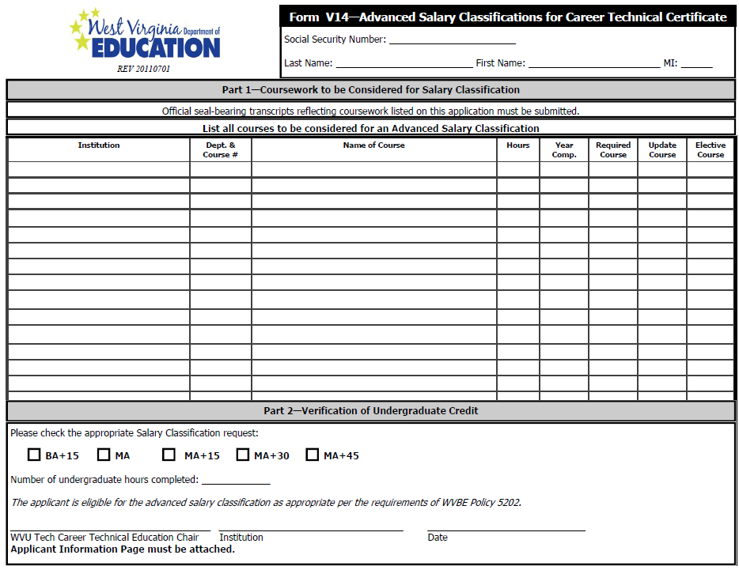
V14 – Advanced Salary for Career and Technical Certificate

Slide 74
V14 Checklist
Part 1 – All classes to be considered for advanced salary must be listed
Part 2 – completed by WVU Tech Career and Technical Education Chair (signature IS required)
Official Transcripts required for processing

Slide 75
V15 – Adult License for Adult Basic Education
Applicable uses:
Original Adult License for Adult Basic Education
Renewal of Adult License for Adult Basic Education

Slide 76
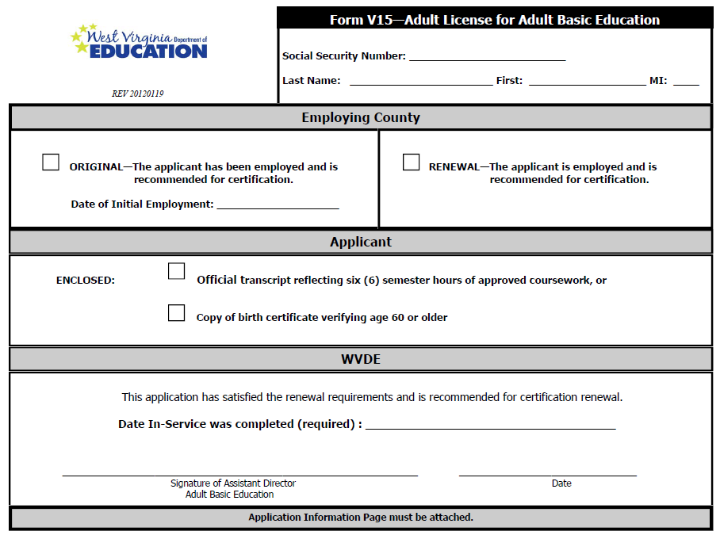

Slide 77
V15 Checklist
Part 1 –Employing County – select original OR Renewal
List initial employment date if original
Official Transcripts required for processing
Part 2 – Applicant
renewal only
Official Transcripts required for processing
Copy of birth certificate verifying age if applicable

Slide 78
V17 – Adult Permit for Special Interest and Occupational Areas
Applicable uses:
Original Adult Permit for Adult Special Interest
Original Adult Permit for Occupational Area

Slide 79
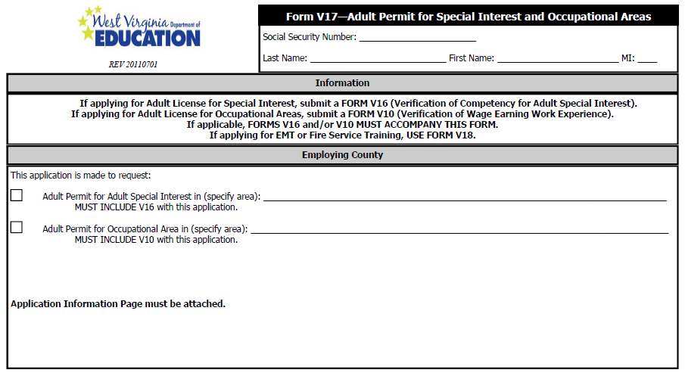

Slide 80
V17 Checklist
Copy of HSD/GED or official transcripts reflecting degree award date
Special Interest – submit a V16
Occupational Area – submit a v10

Slide 81
V18 Adult Permit for EMT and Fire Service Training
Initial EMT Certification
Renewal of EMT
Initial Fire Service Certification
Renewal of Fire Service

Slide 82
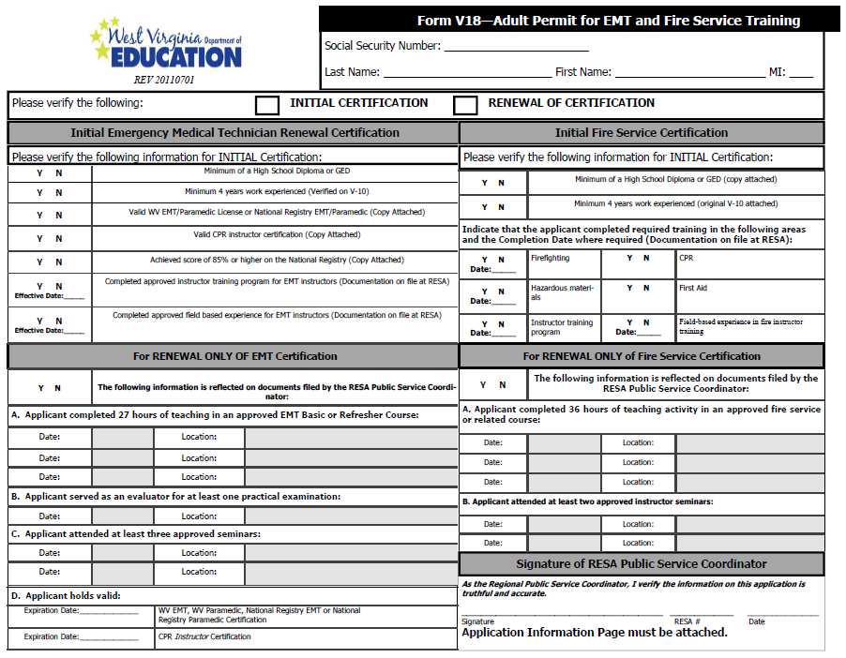

Slide 83
V18 Checklist - EMT
Valid EMT/Paramedic License
V-10 documenting minimum 4 years
Valid CPR card
National Registry Test Scores
Instructor Training
Field Based Experience
EMT/Paramedic and CPR cards must be submitted for both initial and renewal
RESA Signature
Notes:
Current/valid copies are required for renewal

Slide 84
V18 Checklist – Fire Service
Valid EMT/Paramedic License
V-10 documenting minimum 4 years
Valid CPR card
Instructor Training
Hazardous Materials Training
Firefighting Training
Field Based Experience
First Aid and CPR cards must be submitted for both initial and renewal
RESA signature
Notes:
Current/valid copies are required for renewal

Slide 85
Contact
Forms 20-T, 20A, 20S, 23, 24, and Educator Evaluation
Trent Danowski tdanowski@access.k12.wv.us
Forms 4, 8,19,26, and 39; OEPA & Title I Reports; HQ Reports; Legal Files
Lori Buchanan llbuchan@access.k12.wv.us
Forms 1/1A, 12, 32, 33, 36, 37, 38, 42, 43, 44, and 50
Scottie Ford smford@access.k12.wv.us
Forms 2, 30, 35, 40, and 60 and for National Board Process
Teresa Epperley tepperle@access.k12.wv.us
Forms 4, 25, 25T, All V Forms
Doug Cipoletti dccipole@access.k12.wv.us

Slide 86
Thank you!
800-982-2378
http://wvde.state.wv.us/certification/

