Slide 1
Office of Educator Effectiveness and Licensure
July 30, 2015
Bridgeport Conference Center

Slide 2
Robert Hagerman
Assistant Director
Office of Educator Effectiveness and Licensure

Slide 3
Information
We are experiencing a large amount of applications being submitted that are incomplete, including but not limited to:
  Missing Transcripts
  Missing Signatures from the applicant and County Superintendent
  Missing pages from an application that is more than one page
  Please make sure all applications are complete and all required documentation is submitted

Slide 4
Online Submission of Applications
You may submit original scanned (PDF) applications and required documents via WVEIS WOW portal
You may only submit scanned copies of verified original documents and signatures
Upload complete application packet as one PDF for each applicant
Applicant must make payment online
You will need to request your WVEIS County contact to provide you access to this new menu option

Slide 5
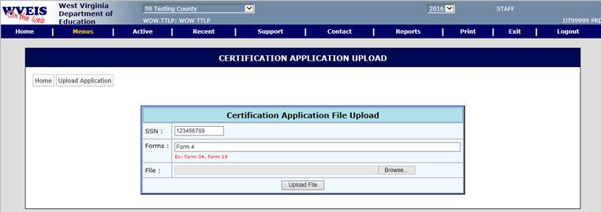
Online Submission of Applications

Slide 6
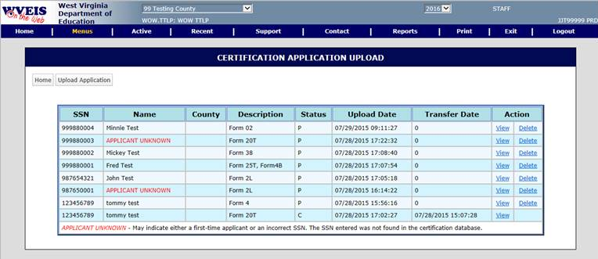
Online Submission of Applications

Slide 7
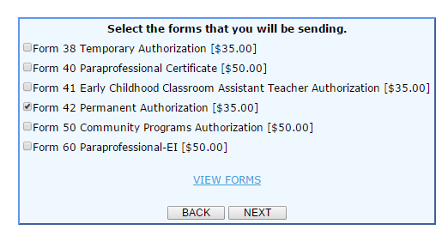
Online Payment
Be certain to use the FORM #, not the FORM name when you pay online.
Notes:
Be sure to verify that the applicant has correctly paid.

Slide 8
NBPTS Mentors
NBPTS Mentor at a Persistently Low-Performing School
Report all classroom teachers who (1) hold a valid certificate issued by the NBPTS (2) are employed to teach at a school designated as a persistently low performing school by the West Virginia Department of Education and (3) are assigned as part of their regular employment to serve in a mentoring capacity for other teachers at the school using code 7 from above. According to WVC §18A-4-2c, these personnel are entitled to an additional $2,000 per year. Once a national board certified teacher becomes eligible for the additional payment under WVC §18A-4-2c, the teacher remains eligible for five consecutive years of employment at the same school in the same assignment regardless of a subsequent change in the designation of the school as a persistently low performing school. The teacher may become eligible again at the same school if it continues to be persistently low performing or at a different persistently low performing school, but not sooner than five years from the beginning of a previous eligibility. If the teacher’s NPBTS certificate is no longer valid, they would no longer be entitled to the additional $2,000 annual supplement.

Slide 9
NBPTS Mentors
To verify mentoring status, WVDE will be confirming through the edit process that individuals identified as NBPTS mentors hold a certificate code of 30 with an endorsement code of either 0060 (Mentor Teacher) or 0061 (Master Mentor Teacher). Pending applications for the mentoring endorsements will be acceptable as of October 1st. Please note that in order to qualify for the endorsement codes, the individual must have completed a mentor training course through the West Virginia Center for Professional Development. If finding a training course timeslot that meets the needs of the county is problematic, please contact the Office of Educator Effectiveness and Licensure.
Please note that the certified list can only accommodate one code for national certifications. Therefore, the individuals assigned a code of 7 will be assumed to be receiving $5,500 in total annual salary supplements ($3,500 for holding the NBPTS certification and an additional $2,000 for being a mentor at the persistently low performing school) for state aid funding calculation purposes. Be sure to appropriately classify the limited group of teachers who will qualify for this additional annual supplement so that state aid funding is calculated appropriately.

Slide 10
Waiver Process
As a result of new accountability measures and ensure educator quality, the waiver request guidelines will be strictly enforced
Waiver form and letter required
Waiver request form must be submitted by County Superintendent/equivalent or Community Program Director and must include the correct licensure application and processing fee(s)
Waiver must meet at minimum one of the eligible criteria
Waivers (if approved) will result in the issuance of the certificate requested and will expire on June 30 of the academic year for which the waiver was requested
Only one waiver may be submitted for the life of the certificate
Notes:
Mr. Robert Hagerman and others as directed

Slide 11
Waiver Process
Only the following certificates are eligible for a waiver request:
  Professional Certificates or Equivalent
  First-Class, Full-Time Permit
  Out of Field Authorization
  Community Program Authorization
  Substitute Permit
  Alternative Teaching Certificate
  Career and Technical Certificates
Notes:
Mr. Robert Hagerman and others as directed

Slide 12
Extenuating Circumstances Required for Waiver Request | Unacceptable Criteria for Waiver
Illness/Death | X Unable to meet required GPA as defined in WVBE Policy 5202
Hardship | X Not having passing scores on Praxis exams or inability to take exams
Unavailability of Coursework Inability to register/enroll in coursework/program as a result of time of year, semester already in progress, or other qualifying circumstance must be documented and verified by IHE | X Lack of understanding of renewal requirements (i.e. number of hours needed, dates for eligible coursework)
Notes:
Mr. Robert Hagerman and others as directed

Slide 13
TSS Certification
Effective school year 2015-2016, all individuals holding a temporary authorization for TSS must hold a minimum of an Associates Degree, per WVBE Policy 5202.
No waivers will be granted for applicants who do not hold the required degree.
Notes:
No waivers will be allowable for 2015-2016 for TSS for the required AA degree level.

Slide 14
Policy 5202, 5100, 5901, 5310
30-Day Public Comment Period ending August 10, 2015.
  http://wvde.state.wv.us/policies/

Slide 15
Form Updates

Slide 16
Form 4
An applicant who currently holds an initial certificate (code 21) must first fulfill the requirements for conversion to the five-year certificate (code 22), as listed in Options 1-6 on the Form 4, in order to be eligible for a permanent certificate (code 22-4)
These requirements are in addition to the requirements for a permanent certificate.

Slide 17
First-Class, Full-Time Permit
Five Year Limit. –The position held is not subject to posting, provided the educator meets the annual renewal requirements and completes the state-approved certification program within five years.
The State Superintendent may extend the five-year limit if appropriate extenuating circumstances warrant the extension.

Slide 18
First-Class, Full-Time Permit
Initial First Class Permit: The college/university teacher certification specialist must verify on the Form 1/1A application that 25% of the state-approved program for the endorsement area has been completed.

Slide 19
First-Class, Full-Time Permit
Renewal:
Complete six (6) appropriate semester hours annually
Coursework must be verified by the college/university
Requires 3.0 GPA (Grade of B or higher)
An official transcript is required for each Form 1/1A application
Each Form 1/1A requires both the college/university and the district completion and signature

Slide 20
Teacher-in Residence
Bluefield State College -- McDowell County
Concord University -- Fayette County, McDowell County, Mercer County, Raleigh County, Summers County, Wyoming County
Fairmont State University -- Berkeley County
WV State University -- Boone County, Clay County, Kanawha County, Mingo County, Putnam County, Roane County

Slide 21
Clinical Experience Permits
Form 23 and 24 and 24A
Required for various types of clinical experiences (teachers, administrative, student support, etc.)
School districts are required to have agreements with out-of-state IHEs for student teachers using a Form 23 (no fee)
Form 24 A used to make changes to already issued Clinical Exp. Permits or to add an experience in a new County

Slide 22
Clinical Experience Permits
Form 24
Form 24 is not required if the individual currently holds a valid First-Class, Full-Time Permit
If a student will be placed in a clinical experience in more than one school district, each county must approve a Form 24.
Please attach a Form 24-A and a Form 7 for each additional district - no additional fee will be required for the Form 24-A or Form 7

Slide 23
Career and Technical Education
Forms V7 and V9
Pay close attention to the type of licensure requested on form V9
Requested endorsement code from WVBE Policy should be included on the form
Requested endorsement should match course codes being taught
Signature from WVUIT is required when verifying approved coursework, professional commitment or program completion

Slide 24
Adult Basic Education
Form V15
Only Part 1 is required to be completed by the employing county
The applicant must select an option for Part 2 when applying for renewal
Part 3 should be left blank – as the WVDE will complete this information

Slide 25
Permanent Adult Part-Time Permit
Form V17
V10 is required for work experience
Industry recognized credentials are required, if applicable
Ensure that education level documentation is included with the application

Slide 26
EMT/Fire Service Adult Permit
Forms V18
V18 – Requires two signatures:
  Superintendent or RESA Director must sign the Applicant Information Page and
  Regional Public Service Coordinator signs the Form V18
Achieved score of 85% on WVDE-approved examination may be verified by letter on official letterhead, if kept on file at RESA
Please pay close attention to what must be attached to the application and to what is kept on file at RESA

Slide 27
Verifying Work Experience
Form V10
If the applicant is claiming work experience based on self-employment – tax records are required.
Tax records should include:
  the business name
  applicant’s signature
  indicate full-time work at this business.

Slide 28
Verifying Work Experience
Form V10
It is best for the name of the company verifying employment in Part 1 (applicant) to match the name of the company/agency in Part 2 (verification of employment by the employer)
The Form V10 must be signed by a public notary with an official seal included

Slide 29
Alternative Certification for 2015-2016
WVBE Policy 5901 will establish the approval process and required criteria
Currently on public comment until Aug. 10, 2015

Slide 30
Paraprofessionals and Paraprofessional Educational Interpreters
Applicants for Paraprofessional must:
Have completed all requirements prior to submitting the Form 40 appliation
Be employed by a district
Have the superintendent verify employment by signing the Applicant Information Sheet attached to the Form 40 application

Slide 31
§18-5-18. Kindergarten programs.
Beginning July 1, 2014, any person previously employed as an aide in a kindergarten program and who is employed in the same capacity on and after that date and any new person employed in that capacity in a kindergarten program on and after that date shall hold the position of aide and either Early Childhood Classroom Assistant Teacher I, Early Childhood Classroom Assistant Teacher II or Early Childhood Classroom Assistant Teacher III. Any person employed as an aide in a kindergarten program that is eligible for full retirement benefits before July 1, 2020, may remain employed as an aide in that position and shall be granted an Early Childhood Classroom Assistant Teacher permanent authorization by the state superintendent pursuant to section two-a, article three, chapter eighteen-a of this code.

Slide 32
Eligible for Full Retirement Benefits
(Effective March 9, 2015)
Any person employed as an aide in a Pre-K classroom that is eligible for full retirement benefits before July 1, 2020,must apply for permanent authorization unless the WV Universal Pre-K classroom is in collaboration with Head Start.
All coursework is required for Head Start Assistant Teachers WVBE Policy 2525

Slide 33
Eligible for Full Retirement Benefits
(Effective March 9, 2015)
Before July 1, 2020
Applicants must apply with the following:
  Applicant Information Page
  Revised Form 41

Slide 36
Eligible for Full Retirement Benefits
Before July 1, 2020
Applicants must apply with the following:
  Applicant Information Page
  Revised Form 41
  Form 7 (Background Check) **
  Proof of passing score of the State Competency Exam**
  Proof of a high school diploma or equivalency**
  Pay the $35 fee online
  **Exempt for Paraprofessionals

Slide 37
ECCAT Initial
Apply upon Placement in a Pre-K or Kindergarten
Applicants must apply with the following:
  Applicant Information Page
  Revised Form 41
  Form 7 (Background Check) **
  Proof of passing score of the State Competency Exam**
  Proof of a high school diploma or equivalency**
  Pay the $35 fee online
  NO COURSEWORK REQUIRED FOR INITIAL APPLICAITON
  **Exempt for Paraprofessionals

Slide 38
ECCAT Renewals
Applicants must apply with the following:
  Applicant Information Page
  Revised Form 41
  Proof of successful completion of coursework or semester hours.
    Seal-bearing transcript OR
    E-Learning completion certificate OR
    ACDS seal-bearing certificate OR
    CDA advisor signature
  Pay the $35 fee online

Slide 39
Coursework must be listed for processing.

Slide 40
Permanent ECCAT
Applicants must apply with the following:
  Applicant Information Page
  Revised Form 41
  Proof of successful completion of coursework or semester hours.
    Seal-bearing transcript OR
    E-Learning completion certificates for all three (3) courses
    ACDS ~ A copy of the official certificate from the United States Department of Labor OR
    CDA ~A copy of the official seal-bearing certificate from the National Credentialing Agency OR
  Pay the $35 fee online

Slide 41
Advanced Salary
All graduate level hours in public education or in an endorsement area held on the certification may be used for advanced salary on a professional certificate after the appropriate master’s degree has been awarded (Form 12 advanced salary application required).

Slide 42
Advanced Salary
Up to 15 undergraduate level or post-baccalaureate level hours in public education or in an endorsement area held on the certification may be used for advanced salary if completed after the WV professional certification effective date.

Slide 43
Advanced Salary
Only highest degree level can be recognized on a permit or authorization unless: First Class Permit for an endorsement requiring a master’s degree (BA15 allowable); or the professional equivalent certificates as defined in WVBE Policy 5202, section 126-136-4.57.

Slide 44
Salary Supplements
NBPTS Teachers:
Salary Supplement: Form 12
Salary Supplement Renewal: Form 12
Fee Reimbursement: Form 37
http://wvde.state.wv.us/certification/forms/

Slide 45
Salary Supplements
A separate salary supplement & fee reimbursement are available for certain student support professionals with recognized National Certification in Speech-Language Pathology, Audiology, Counseling, School Psychology, and School Nursing.

Slide 46
Salary Supplements
The annual state salary supplement for student support professionals identified to receive it is $2,500.00.
The county may provide an additional supplement, if desired. §126-136-23.4

Slide 47
Salary Supplements
Student Support Professionals:
Initial Salary Supplement: Form 43
Salary Supplement Renewal: Form 44
Fee Reimbursement: Form 33
http://wvde.state.wv.us/certification/forms/

Slide 48
Tuition Reimbursement
Applications for state tuition reimbursement are accepted from July 1 through June 30, and are processed for funding until the Out of Funds status occurs each fiscal year.
Coursework must be completed during the same fiscal year in which the Form 36 application is received by the OPP.

Slide 49
Tuition Reimbursement
Fifteen (15) maximum lifetime shortage area hours currently are allowable.
A GPA of 3.0 is required for the coursework. §126-136-23.1.
Tuition Reimbursement: Form 36
http://wvde.state.wv.us/certification/forms/

Slide 50
Certification Application
All requirements for renewal must be completed before a Form 38 application is submitted to the WVDE Office of Professional Preparation. This includes:
Chief School Business Official
Professional Accountant
Child Nutrition Director
TIS and TSS
Notes:
Applications submitted before renewal requirements have been completed will be denied. Some applications are being submitted weeks or months before renewal requirements are being completed.

Slide 51
Highly Qualified Teachers
Elementary Education = Multi Subjects
Multi Subjects K – 8 only allows someone to teach courses K – 6. They must hold the appropriate content area endorsement or permanent authorization for teaching 7th or 8th grade classes. Refer to Policy 5202 18.6.

Slide 52
HQT Requirements for Title I Reading Teachers
8.2.b.2. Title I Reading Teacher. – According to the NCLB guidelines, a Title I reading teacher is considered HQ if the individual holds state certification in one of the following: (revision of policy effective 11/2014)
Master’s degree in reading specialist
Completion of a graduate level reading specialist program
Completion of a reading education endorsement program.

Slide 53
Form 8C
Go to: http://wvde.state.wv.us/certification/forms
At the top portion of the site you will see:
  Additional Endorsement Based on Content Proficiency
  (Guidance Document)
Link to guidance document is:
  http://wvde.state.wv.us/certification/forms/documents/WebsiteGuideEndorsemebtbyPraxis.pdf

Slide 54
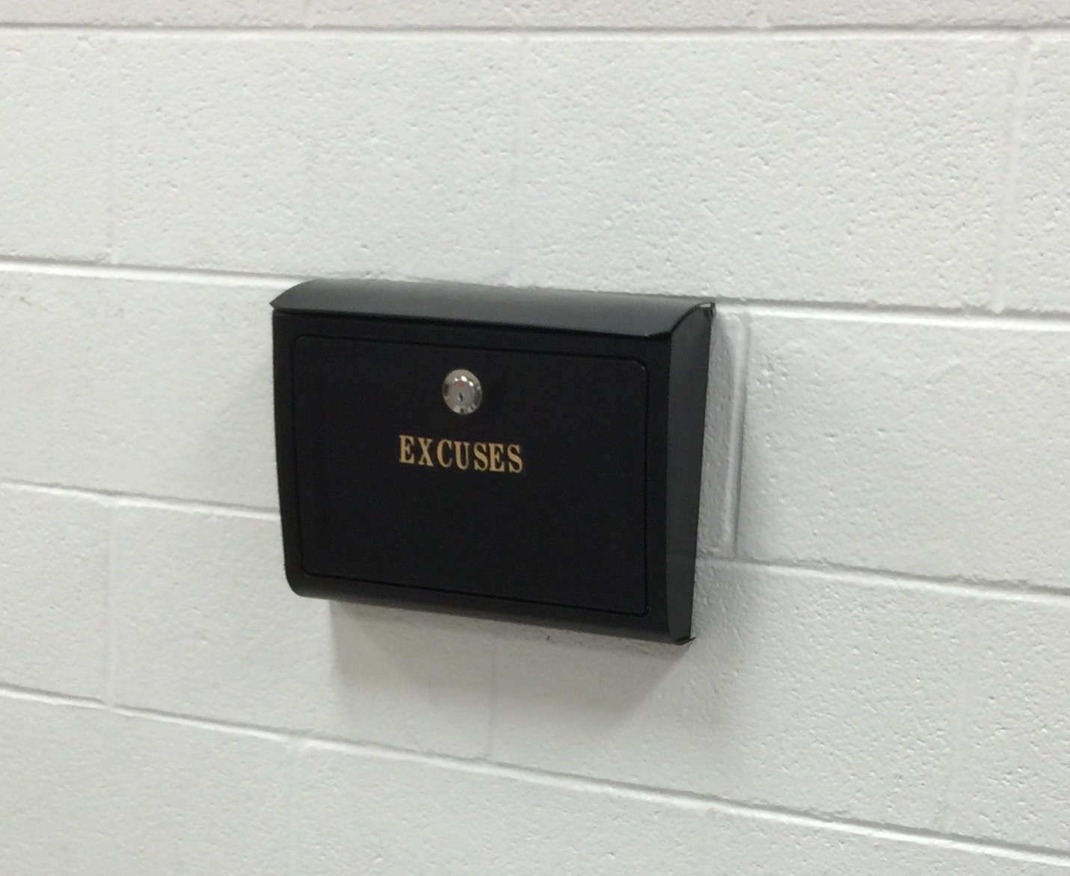
Questions?

