Slide 1
Alternative Certification Office of Educator Effectiveness & Licensure
March 16, 2017
Informational Webinar

Slide 2
WVDE Liaisons for Alternative Certification--
Welcome & Introductions
Linda Bragg, AC Program Review
Robert Mellace, AC Implementation
Kelly Mordecki, AC Applications

Slide 3
Today’s Agenda
Alternative Certification (AC) Updates
Current Status of Program Approval and Implementation
Policy 5901
How to Make Changes to Existing AC Programs (Addendum, Amendment or Revision)
Providing Special Education Content Preparation-- Topics Specific to each Special Education Endorsement
Upcoming AC Processes for Enrolled Candidates
Comprehensive Evaluation Report
Recommendation for Licensure
Renewal

Slide 4
AC Program Approval Status
Current Totals:
52 General Education programs in 51 School Districts
49 Special Education programs
**We have received several letters of intention to submit alternative certification proposals for the Summer Session of the Alternative Certification Educator Preparation Program Review Board (ACEPPRB)

Slide 5
Alternative Certificates Issued
Currently, 34 Teachers hold Alternative Certificates--
25 Special Education Certificates
4 multi-categorical with autism
1 severe disability with autism
20 multi-categorical
9 General Education Certificates
2 math 5-AD
1 math 5-9 with English 5-AD
3 English 5-AD
1 art PK-AD
1 Biology 9-AD
1 Marketing/Business 5-AD

Slide 6
Policy 5901 Update
Essential Topics for Autism, Deaf and Hard of Hearing, and Visual Impairment
5.2.d
5.2.e
5.2.f

Slide 7
Policy 5901 Update
REMINDER—NO LONGER REQUIRED:
Core content (math, English, science, social studies, etc.) for candidates completing special education endorsements is no longer required (result of ESSA).
Special education candidates are no longer required to hold, qualify for or simultaneously complete a core content/subject area along with their preparation for a special education endorsement

Slide 8
Policy 5901 Update-- Reduction in Force Guidance
An alternative program teacher certificate is the same as a professional teaching certificate for the purpose of issuing a continuing contract.
3.1.e.5. …in the event that the alternative program teacher certificate needs to be renewed and the individual has been released from the qualifying vacancy due to a reduction in force, the alternative teaching certificate may be renewed only if the individual is employed in an area of critical need and shortage that is for the same endorsement and programmatic levels received on the initial alternative teaching certificate in order to continue the program.

Slide 9
Clarifying, Adding To or Making Changes to Existing AC Programs
Addendum = Clarifying
Amendment = Adding to (usually a general education endorsement).
Revision = Making Changes--when changes occur in multiple places in the existing, approved program (usually adding a special education endorsement or changing/adding a partner)

Slide 10
Addendum -- Clarifying an Existing AC Program
Providing descriptions that clarify broad statements already in the approved program
No partner signatures required because the program is not changing
The addendum is completed and submitted on a template, sent from the Office of Educator Effectiveness and Licensure (OEEL) upon notification of intent to submit an addendum
Example: Clarifying how and by whom the specific content preparation for each special education endorsement will be delivered.

Slide 11
Amendment -- Adding an Endorsement to an Approved General Education AC Program
Requires submission of a one-page, completed template to WVEIS (Template will be provided when our office receives the letter of intent to amend an already approved AC program).
Requires partner signatures
Requires simple, review by the Alternative Certification Educator Preparation Program Review Board (ACEPPRB)
ACEPPRB recommendation to the WVBE

Slide 12
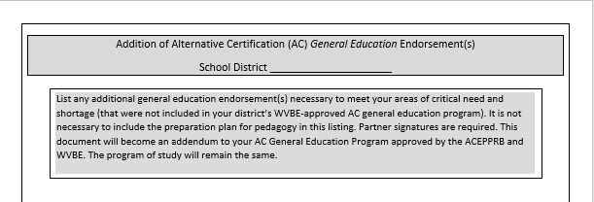
Amendment Template: Currently Used for Adding AC General Education Endorsement(s)

Slide 13
Revision – Making Substantial Changes to an Existing AC Program
Making changes to an existing, approved program of study and/or partnership agreement (often used for adding a special education endorsement or a new partner).
Highlight and/or underline and strike-through so that the changes are clear to the Alternative Certification Educator Preparation Program Review Board (ACEPPRB)
Include a cover sheet that is a summary of revisions. The WVDE will send the template upon the district’s notification of intent to submit a revision.
Upload entire revised proposal to WVEIS system
Signatures of all partners required

Slide 14
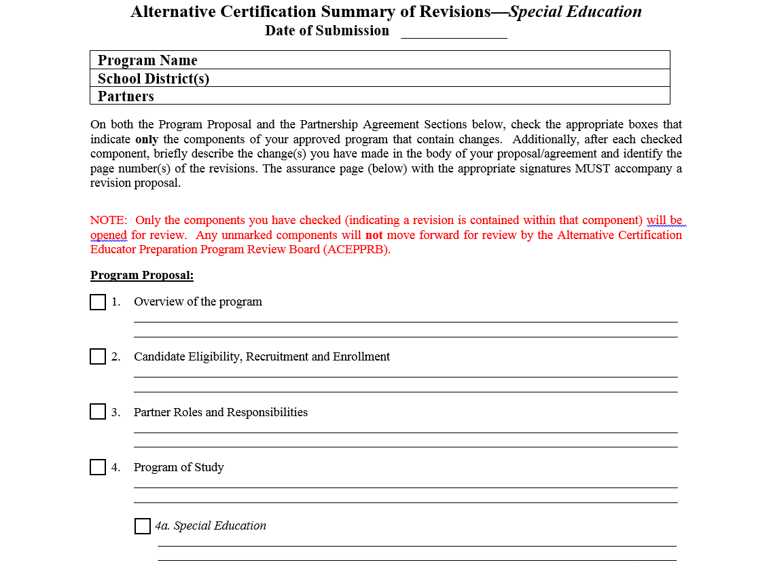

Slide 15
Addressing AC Special Education Content Preparation for each Endorsement Approved on District’s AC Program
Assurance statement needed for each approved special education program. (The partnering RESA may submit on behalf of their partnering districts)--
Provides how the coursework or PD for each approved special education endorsement is provided and who delivers it (Coursework/PD will include the study of the specific content for each respective endorsement)
For this assurance, the Office of Educator Effectiveness and Licensure has developed a simple template (and sent to each RESA a template for districts and/or AC partner to complete. (See next slide)

Slide 16
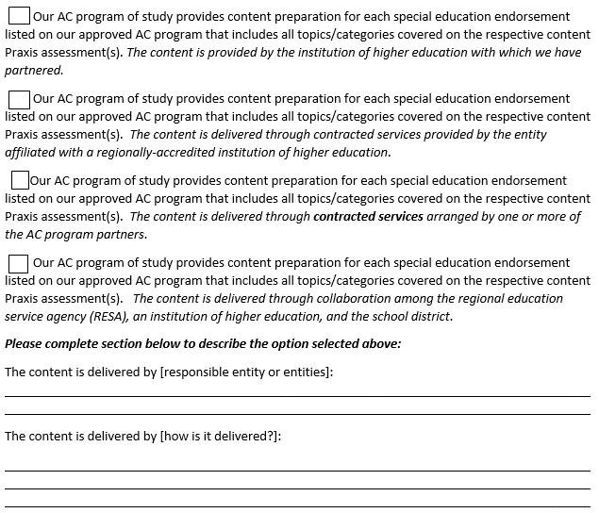

Slide 17
End of the Year AC Considerations
Comprehensive Evaluation Report
Renewal(s)
Initial Professional Teaching Certificate

Slide 18
Comprehensive Evaluation Report
Three Ratings: Approved, Insufficient, or Disapproved
Two Possible Outcomes:
Approved – the comprehensive evaluation report is submitted with the application for conversion to a professional teaching certificate, OR
Not Approved - if an applicant leaves the alternative certification program for any reason during a valid certification period, the county must notify the Office of Educator Effectiveness and Licensure so that the certification may be terminated.

Slide 19
Policy 5901—Renewal of the alternative program teacher’s certificate is subject to the following:
3.1.e.1. the teacher to whom it is issued shows satisfactory progress in the alternative program for the education of teachers; AND
3.1.e.2. the teacher to whom it is issued remains enrolled in and actively participates in a WVBE-approved alternative program for the education of teachers; AND
3.1.e.3. the teacher to whom it is issued remains employed in the critical need and shortage position for which he/she was hired in a school that is part of a partnership of a WVBE-approved alternative program for the education of teachers.
3.1.e.4. the teacher to whom it is issued receives satisfactory evaluations pursuant to W. Va. Code §18A-2-12 and has the recommendation of the county superintendent.
(3.1.e.5. – See reduction in force language)

Slide 20
Conversion to a Professional Teaching Certificate
Applicants must have
successfully completed a WVBE approved program for alternative certification, including all components identified in WV Code, as applicable, AND
met proficiency scores on the WVBE-required exam(s) as listed in the current WV Licensure Testing Directory, AND
have received satisfactory teacher evaluations, AND
have a minimum overall GPA of 2.5 (requires transcript and/or certificate), AND
have the recommendation of the county superintendent, AND
have a recommendation of “APPROVED” on the required comprehensive evaluation report.

Slide 21


Slide 22
Contact Information for Alternative Certification
Office of Educator Effectiveness & Licensure 1.800.982.2378
Linda Bragg lnbragg@k12.wv.us
Robert Mellace rmellace@k12.wv.us
Kelly Mordecki kmordecki@k12.wv.us

