Slide 1
Office of Certification and Professional Preparation
Certification Update Webinar

Slide 2
Office of Certification and Professional Preparation Staff Robert Hagerman, Executive Director Lori Wilson, Assistant Director
Emily Curry
Teacher Quality Coordinator
Scottie Ford
Certification Coordinator
Brad Fittro
Teacher Quality Coordinator
Christina Haymaker
Credentialing Technician
Robert Mellace
Teacher Quality Coordinator
Kelly Mordecki
Teacher Quality Coordinator
Jodi Oliveto
Teacher Quality Coordinator
Sherri Hudnall
Program Analyst
Cheryl Nichols
Program Assistant
Mona Bowe
Associate
Madison Haymaker
Intern

Slide 3
Today’s Agenda
Policy Updates
Online Applications
Form updates and reminders
Many forms were updated 12/11/18
The newest form must always be used.
Salary and tuition reimbursements
Resources
OneNote Notebook
Department of Education website
Recently updated

Slide 4
Policy 5202
WVBE Policy 5202 revision became effective on December 11, 2017.
A Guidance Document highlighting the revisions was sent via e-mail on December 11, 2017 and a follow-up e-mail was sent on January 11, 2018.

Slide 5
On-Line Certification Portal
Current electronic applications:
Coach Renewal
Initial Teaching
Teacher and Student Support Renewals
Administrative Renewals
Initial Coaching
https://wveis.k12.wv.us/certportal/index.cfm
Please advise your applicants to open up the User Guides and follow the instructions as many questions can be answered by using the User Guides.
Notes:
Upcoming electronic applications to be implemented:
Initial Student Support
Initial Administrative
Additional Endorsements
As the Office of Certification and Professional Preparation continues to implement the electronic application process, an additional certification form will be available in the coming weeks.
Currently the renewal of coaches Form 39 and the initial licensure Form 20T have been implemented and are fully functional. Your county should now be receiving notification of approval for your applicants for both of those forms.
Full implementation of new forms began January 23rd.

Slide 6
Renewal On-Line Applications
Please make sure the application that you have been asked to approve is actually for an employee in your county and not just a resident of your county. If they are not employed, please reject/deny the application. Do not do a SEND BACK.
When an application arrives for your approval, please look in the top left of the Coordinator Dashboard for the option of the certificate type (Renewal, Conversion, or Permanent) is correct. During your review, If the incorrect request is made, please REJECT/DENY the application so the applicant can make a new application. Please do not use the SEND BACK option.
Please review the files for transcripts and if they are required and you have them, please upload them during the approval process. Otherwise, they need to be uploaded in the WVEIS WOW System.

Slide 7
Renewal On-Line Applications
The WVDE is not allowed to accept transcripts that applicants have tried to upload, nor are counties allowed to accept transcripts that have been printed from a PDF that was issued to the applicant.
Transcripts must be issued to the county or to our office at the WVDE. If an applicant brings a transcript in an official sealed envelope from the college/university, you may open it and initial that you verify that it was indeed an official seal-bearing transcript and then you may upload it through the WVEIS WOW system.
Please make sure that for Conversion to a Five-Year Certificate or Permanent that the Work Experience section is completed and the Beginning Educator Internship is listed (if applicable).

Slide 8
Form 1/1A: First-Class/Full-Time Permits
Individuals who have completed their program, but who are waiting to pass a PRAXIS Exam are not eligible to hold a First-Class/Full-Time Permit.
Individuals who are waiting on successful completion of a PRAXIS Exam are not eligible for a waiver, neither are individuals who have not maintained or achieved the minimum GPA of 2.5.
There has recently been an increase in applicants discovering that the program in which they were enrolled is not leading to licensure. Please encourage individuals seeking the First-Class/Full-Time Permit to get in writing from the college/university that the program does lead to licensure to work in the public schools.

Slide 9
Form 8
There are three professional certificates: Teaching, Administrative, Student Support.
An educator who holds one of the three professional certificates and seeks to obtain a different type of professional certificate (mentioned above) CANNOT use a Form 8.
Additional endorsements in Driver’s Education must include the college signature, a copy of the driving record from the DMV, and a copy of the front and back of the valid Driver’s License.

Slide 10
Form 8
An additional endorsement for Autism from any institution of higher education who are just completing six hours does not require a signature of the college/university official.
If the individual has completed an approved full Autism program leading to licensure, such as Marshall or Bethany, the certification officer must sign the Form 8.
Certification for Middle School Wellness
Beginning August 1, 2018, all educators newly assigned to teach a Wellness course in grades 7-8 must hold a Wellness (2250) endorsement. There are three currently approved educator preparation programs leading to licensure in Wellness. Also, licensed educators will have the ability beginning March 2018 to add the Wellness endorsement by successfully taking the Health and Physical Education: Content Knowledge (Wellness) Praxis 5857.

Slide 11
Form 8C
Reading Specialist and Autism cannot be added by taking a PRAXIS Exam.
Student Support and Administrative endorsements are not eligible to be added by taking a PRAXIS Exam.
For the most up-to-date list of eligible exams, please use the following link:
http://wvde.state.wv.us/certification/forms/documents/AdditionalEndorsementViaPRAXISExameffectiveJanuary11_2017.pdf
Please try to submit a PRAXIS Score Report with the Form 8C. The WVDE does not receive score results until 4-6 weeks after the applicant receives their results.
Beginning March 2018, applicants may add the Wellness endorsement by successfully taking the Health and Physical Education: Content Knowledge (Wellness) Praxis 5857.

Slide 12
Initial Out-Of-State Teacher On-Line Application
For your employees, please ensure they are using the proper option when applying. If they have requested licensure based upon completion of a program in another state and it is discovered they have an out-of-state certificate, please REJECT/DENY the application and have them reapply and select the option “certificate issued in another state (Reciprocity)”.
If an applicant has provided you with transcripts when they make application for the Initial Teaching Certificate, please upload them prior to approval or through the WVEIS WOW system after approval.

Slide 13
On-Line Coaching Applications
The School Year 2018-2019 has been added to the list of School Years. Please make sure if you are still submitting applications for the 2017-2018 School Year, that you choose the proper school year on the drop-down list.
Please ensure that the individual making application has selected the correct option. If the individual needs to renew the authorization available on a Form 39 (Coach, Limited Football Trainer, or Athletic Trainer Certificate), please look at the top left corner of the application and see that the correct option has been selected.
If they are wanting to renew and you notice in the top left corner that it is an Initial Temporary Authorization, you must REJECT/DENY the application. Applicant must go back into the system and select RENEW beside the credential.

Slide 14
On-Line Coaching Applications
A reminder that prior to allowing a coach, who is not a Professional Educator, to begin working in such capacity, he/she must hold a Coaching Authorization. An individual who is not a certified professional educator employed by the county must be issued an athletic coach authorization prior to beginning any coaching activity under West Virginia Code 18A-3-2a(e)(3) and WVBE Policy 5202 in order to work or volunteer as a coach of a school's athletic team. In order to be issued a coaching authorization, the applicant must be employed under a coaching contract with a county board of education, hold a minimum of a high school diploma or an equivalency diploma and complete training from the West Virginia Secondary School Activities Commission (WVSSAC) or approved local board of education training if the sport is not within the WVSSAC's jurisdiction.

Slide 15
Coaching Authorizations
Some counties are permitting coaching applicants to work during the season their particular sport is being played even though their applications have not yet been approved. Sometimes, in fact, the Office of Certification and Professional Preparation has denied an application based upon evidence of misconduct by the applicant only to find that the applicant has already coached the entire season. Counties may have mistakenly relied upon the WV Code section 18A-3-2 that provides for the employment of a professional educator for up to three school months if a teacher is employed in good faith on the anticipation that he/she is eligible for a certificate. This statutory section applies specifically to professional educators only defined in West Virginia Code 18A-1-1, not athletic coaches working under an authorization.

Slide 16
Certification OneNote Notebook
Certification OneNote Notebook
Frequently requested information at your fingertips
Most current
Version of Policy 5202
Applications
Instructions for submitting an application

Slide 17
Form 38 Temporary Authorization
Be sure to apply for renewals AFTER January 1 of the year the certificate expires. Applying early will lead to denial
Be sure to indicate the correct school year for the authorization
Option Pathway has been removed from Authorizations and is now an Advanced Credential (Form 30)

Slide 18
Permanent Authorization for Wellness
Any educator who has been assigned to teach a Health or Physical Education course in grades 6 through 8 during the 2017-18 school year will be granted the Wellness (2250) endorsement due to the changes in WVBE Policy 2510.
Submit a Form 38 at NO CHARGE for the authorization.
Beginning August 1, 2018, all educators newly assigned to teach a Wellness course in grades 7-8 must hold a Wellness (2250) endorsement.

Slide 19
Advanced Credentials
Option Pathway is now an Advanced Credential
Applicants will apply on a Form 30
All applicants will request “Initial Option Pathway” for this year, even if they have held an Option Pathway Authorization in the past.
Option Pathway Advanced Credential validity period will mirror the applicant’s professional teaching certificate not to exceed five years if an applicant is permanent.

Slide 20
Form 4 Administration Renewal/Permanent
In order for an individual to request a Permanent WV Professional Administrative Certificate they must have the following:
Six semester hours related to the endorsement, OR MA + 30, OR age 60.
Five (5) years of educational experience, one of which must be in WV
Two (2) years of administrative experience that must be in the endorsement area on the administrative certificate
If an applicant does not hold the endorsement that matches the work experience (i.e. Principal/Supervisor of Instruction/ Superintendent, then they MUST have evidence that the WV Professional Administrative Certificate was required for employment

Slide 21
Early Childhood Classroom Assistant Teacher Updates
The Form 41 application was updated on January 10, 2017
Please make sure that you are using the newest form and filling it out in its entirety because we require all information for processing.

Slide 22
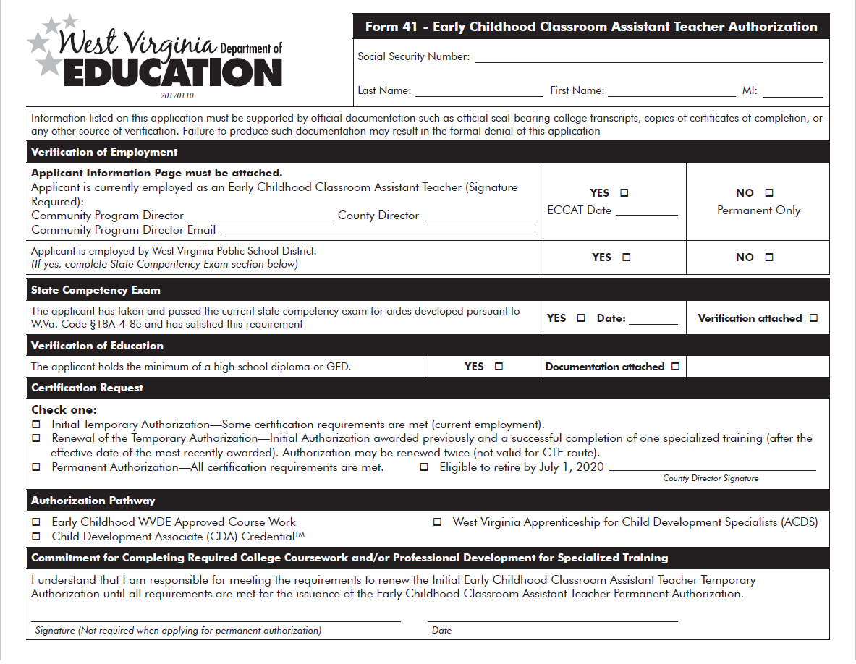

Slide 23
Notes:
We must have the signature and email address of the community program director so that we can direct any questions regarding the application to the proper people.

Slide 24
Notes:
We always need the ECCAT placement date. This is when the applicant was placed in the classroom. This is what triggers the effective date on the authorizations so it is imperative that this is filled out for all new applicants.

Slide 25
Notes:
If an applicant has passed the state competency exam and has all three courses required for authorization, they may choose “permanent only” for their authorization. The application will be approved effective the date that the application is received. This is not for applicants working as full time ECCATs. This is only for those who wish to be ECCAT certified but are not currently employed in an ECCAT position.

Slide 26
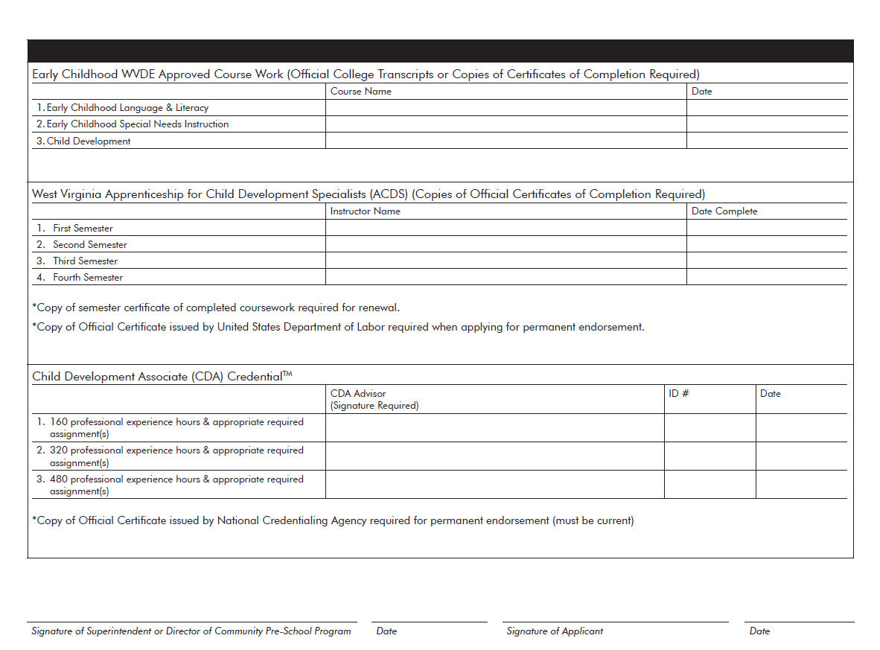
Notes:
Signatures are required on this page regardless of whether the applicant has taken any courses or not.

Slide 27
Notes:
The signature of the Superintendent or Director of Community Pre-School Program is required here. It must match the signature reflected on pages 1 and 2 of the application.

Slide 28
Notes:
The applicant must sign this page each time they apply. This assures us that they purport this information to be true and accurate.

Slide 29
Waivers
Examples of criteria that can not be waived
GPA
Previous waivers on that application
Praxis
Other important points to remember
Waiver letter must include the specific criteria being waived
Waivers have an extended processing time.
Approval of a waiver is not approval of the application.
Unavailability of coursework requires documentation.
Waiver request letter, waiver request form and application must all be submitted

Slide 30
Alternative Certification (AC)
AC applications (Forms 25, 25R, 25C, 20P, etc.) require a date of 12/11/2017 or later.
Application form 25 for the Alternative Teaching Certificate requires documentation of the job posting.
Eligibility Updates: Policy 5202, Section 10.1.b.3.F.
New test scores used for exemptions of the basic skills exams
New degree based exemptions for content exams
Notes:
ACT - Attained, from a single administration, a composite score of 25 on the American College Test (ACT), 26 on the ACT enhanced (effective November 1989)
SAT – Attained, from a single administration, 1035 on the Scholastic Achievement Test (SAT), 1125 on the re-centered SAT (effective April 1995), or 1170 on the revised SAT using the combined Critical Reading and Math score (effective March 2005). Attained 1240 on the New SAT using the combined Evidence-Based Reading and Writing + Math (effective May 2016)
GRE - Attained from a single administration a score of combined score of 800 verbal and quantitative (tested prior to November, 2011) or at least a 286 (November, 2011 or after)
An individual who holds a doctorate in the content area for which West Virginia licensure is available and requested
An individual who holds a master’s degree in the content area for which West Virginia licensure is available and requested AND five years of directly related work experience in the area
Note: The new exemptions apply to both traditional and alternatively licensed applicants.

Slide 31
Alternative Certification
Provisional Certification:
Now AC program completers apply for a provisional license, rather than an Initial Professional Teaching Certificate
Renewal of the Provisional Teaching Certificate Requires:
Applicant is employed in a WV school district
Receives satisfactory evaluations
Recommendation of the employing Superintendent

Slide 32
Alternative Certification
Conversion from the Provisional to an Initial Professional Teaching Certificate Requires:
Successful completion of a Beginning Educator Internship/Induction
Six semester hours of appropriate college/university coursework reflecting a 3.0 GPA and related to the public school program
Two years of full-time teaching experience under the Provisional Professional Certificate and in the area(s) of endorsement
Successful evaluations for each year taught under the Provisional Professional Certificate within the West Virginia Educator Evaluation System, and with an earned performance rating of emerging or above
Recommendation of the employing Superintendent

Slide 33
Title II AC Reporting
14 AC Program Providers (school districts) reported data to ETS for 2016-2017.
Title II data for 2016-2017 must also be reported at https://title2.ed.gov/. School District AC Program Contacts will receive their account information and instructions in February of 2018. The data reporting deadline is April 30, 2018.
Westat will provide dates of upcoming technical assistance webinars for Title II. School District AC Program Contact attendance is strongly encouraged.
Luis Romero is WV’s new state support representative at the Title II Support Center. You may reach him at Title2@westat.com or LuisRomero@westat.com.
Kelly Mordecki provides Title II reporting support for AC programs at the WVDE.

Slide 34
Long and Short-Term Substitute Permits
New forms are available at (Form MUST be completed by county)
https://wvde.state.wv.us/certification/forms/
You do NOT need to submit proof of training (i.e. certificates), you only need to confirm the date on the form by indicating when the last date of final training occurred.
Please include employment date for new applicants
Substitute permits are considered non-professional permits; therefore, advanced degrees/salaries can no longer be recognized for new applicants. Certificates for individuals that have already been granted an advanced degree/salary will NOT be changed.

Slide 35
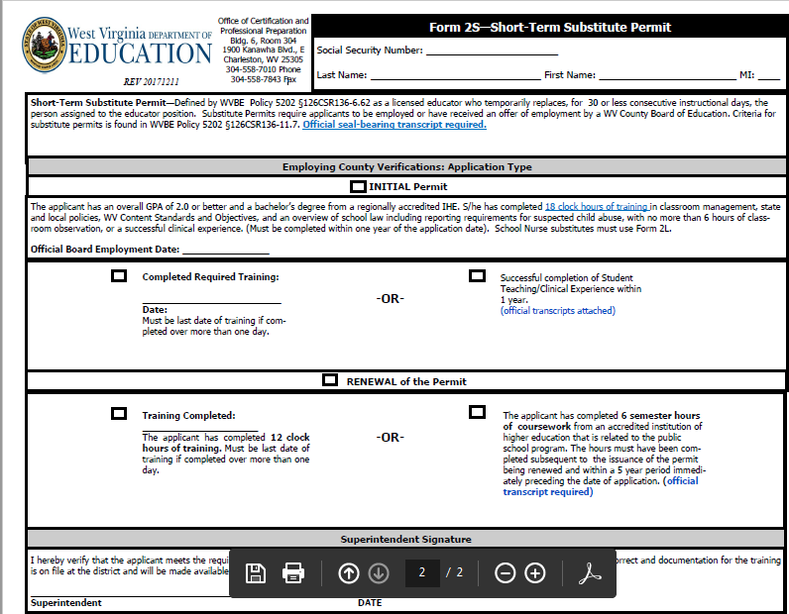
2S Short-Term Permit Application

Slide 36
2L Long-Term Permits
There are new requirements for substitute training for those seeking endorsements in Elementary Education and Nursing which can be found at: http://wvde.state.wv.us/policies/index.html#p5202
11.7.c.3.A.1. Exceptions. -- Those applying for School Nurse Substitute permits must hold a valid registered nurse licensure issued by the West Virginia Board of Examiners and have completed 12 hours of training related to school nursing and 6 hours of clinical time with a certified school nurse who is an RN; AND
WVDE is now offering the substitute teacher training through e-Learning.
Contact Donna Landin for further information. dlandin@k12.wv.us.

Slide 37
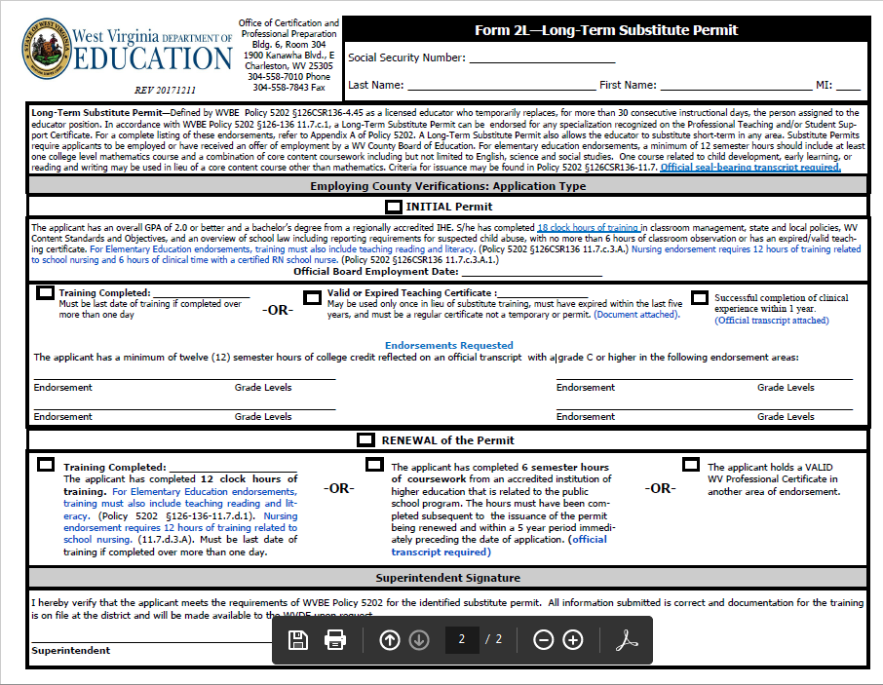
2L Long-Term Permits

Slide 38
Clinical Permits (Forms 24, 24A, 24B, and Form 23)
Beginning this Summer and for the Fall 2018 semester, applicants must now have PASSED all content exams (as well as basic skills or have a qualifying exemption) BEFORE they apply for their clinical placement permit.
All forms have been updated and can be found at https://wvde.state.wv.us/certification/forms/
Form 23 is for applicants seeking an observation placement who are attending an out-of-state IHE or for applicants seeking a clinical placement who are attending an out-of-state IHE (they must also submit a Form 24 for a clinical placement).
It is the county’s responsibility to ensure that a student teacher holds a valid clinical experience permit prior to placement except for those meeting the exemption in Policy 5202 §126-136-4.20.

Slide 39
Clinical Permits (Forms 24, 24A, 24B, and Form 23)
Form 24 is for first time applicants seeking a clinical placement in a county-district from an in-state IHE.
Form 24A should only be submitted if the applicant had a previously approved Form 24 and they are wishing to extent their clinical experience, or change their placement county/district.
Form 24B is only for applicants attending an in-state IHE applying for a clinical experience out-of-state; therefore, you should not receive any applications form 24Bs

Slide 40
Form 3 - Teacher-in-Residence
The Form 3 has not changed but has been updated with the new WVDE logo and should be used for new applications.
There must be a WVBE approved TIR program/agreement with the county and IHE. https://wvde.us/wp-content/uploads/2018/01/ApprovedTIRprograms20171114.pdf
The applicant must have a minimum GPA of 3.0 to apply.
The applicant must also submit his/her transcripts to date so that the GPA can be verified.
The applicant must have passed all required exams, including basic skills and all content exams prior to application.
The job must be posted twice and documentation of the posting must be submitted with the application.

Slide 41
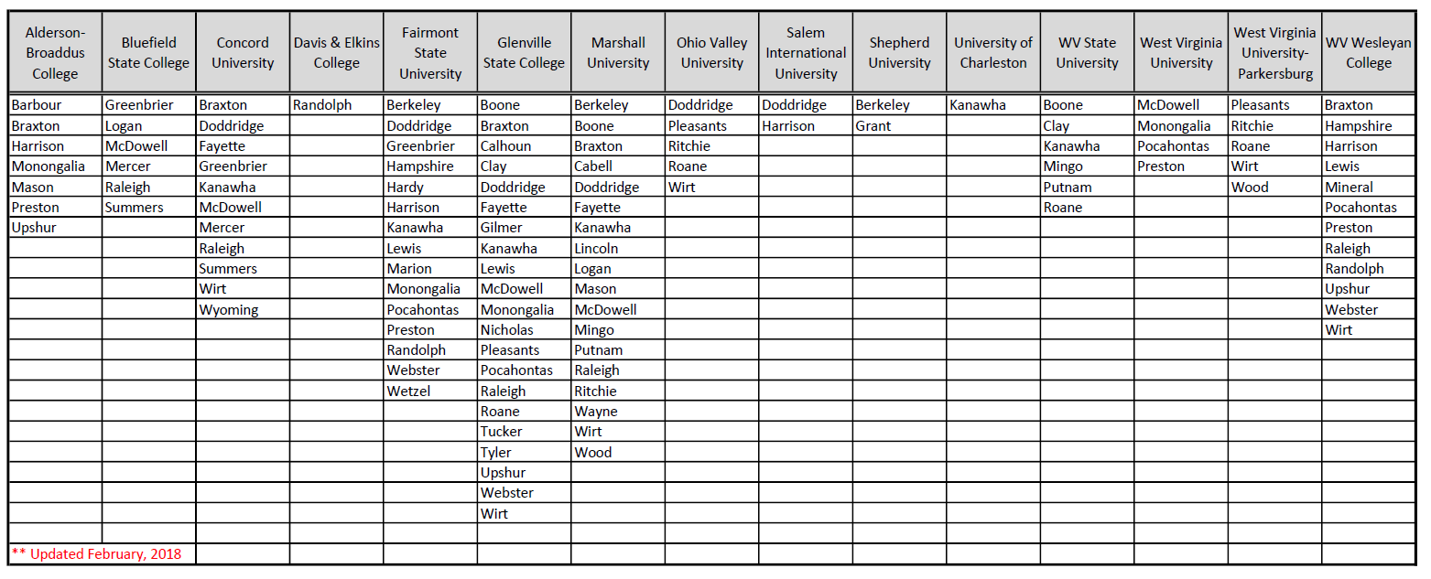
WVBE Approved TIR Programs List

Slide 42
Legal Disclosures
Online Applications
Applicants are required to add a disclosure for each incident or action on the first Online Application submitted.
*For disclosures that have been previously reviewed, note ‘previously reported’ in the narrative
Once a disclosure is made online, it remains in the application and applicants do NOT need to add it again.
Items that should accompany a disclosure:
Date (Month/Year)
Title (name of the charge/action)
Narrative (description/summary of the events that led to the disclosed incident/action)
Personnel and/or Court Documents and/or Police Report

Slide 43
Legal Disclosure Information
Paper Applications
*Check ‘yes’ to appropriate question(s)
*Provide a Narrative (description/summary of the events that led to the disclosed incident/action)
*Provide Personnel and/or Court Documentation
*When disclosing a previously reviewed incident, check ‘yes’ to the appropriate box or boxes and note ‘previously disclosed’

Slide 44
FBI Reporting
The FBI now requires that we verify ID prior to sharing information or requesting information regarding reports found on the FBI background.
The WVDE can no longer send a request letter for information regarding incidents found only on the FBI report.
Applicants are required to appear in person at the WVDE or conference by Skype with picture ID to obtain a copy of his or her FBI background report and disclosure requirements.

Slide 45
Tuition Reimbursement
Tuition Reimbursement: WV Code section 18A-3-3a provides for tuition reimbursement for educators holding a valid WV professional or provisional professional teaching, service, or administrative certificate.

Slide 46
Tuition Reimbursement
Tuition reimbursement for educators holding a first class permit is allowable only for those seeking an additional endorsement in a shortage area. No allowance for state tuition reimbursement is made for those on a first class permit seeking an initial professional certificate.

Slide 47
Tuition Reimbursement
Courses completed prior to the July 1 start of a fiscal year are ineligible for state tuition reimbursement. Form 36 tuition reimbursement applications must be complete when received by the WVDE. All incomplete applications are denied.

Slide 48
Advanced Salary
Advanced salary levels and advanced degree level recognition are allowable on valid WV professional and provisional professional teaching, service, and administrative certificates.

Slide 49
Advanced Salary
For a master's degree (MA level), 80% of the coursework (24 of the 30 minimum graduate degree hours) must be “related to the public school program” as defined in Code and Policy. No more than 6 graduate hours in an area that is unrelated either to the public school program or to an endorsement area held on the professional certification may be used for the MA level.

Slide 50
Advanced Salary
Advanced salary / advanced degree level recognition is not allowable on most permits or authorizations under WV Code §18A-4-1. Only the degree level required for issuance of the permit or authorization is allowable.

Slide 51
National Board Extra Expenses Reimbursement
Additional fee reimbursement of up to $600.00 is available for extra expenses incurred during the National Board process after board certification has been achieved.

Slide 52
Transcripts
The WVDE Office of Certification & Professional Preparation has a new email address specifically created for county central office contacts, institutions of higher education contacts, and individuals to utilize when transcripts are sent directly to our office via Escripts or other electronic delivery from the institution. Please use this email: cert.transcripts.wvde@k12.wv.us

Slide 53
Career and Technical Education (CTE)
Application forms V7, V9, V14, V17 and V35:
Initial, Renewal and Advanced Salary applications are initially reviewed by the Office of CTE by Assistant Director, Mr. Richard Gillman, before being reviewed by CAPP.
Application form V14 signature authority:
Authority has been changed from WVUIT to the WVDE. Mr. Richard Gillman is the Designated Official. The Office of CTE also reviews and approves occupational updates prior to being transcripted for use with the application.

Slide 54
CTE Application Renewals
New Requirement:
Applicants must submit a copy of their valid industry credentials, if one is required for their endorsement.
If the industry credential expires, it must be renewed and valid at the time of application.
If the industry credential is a one-time training or permanent, the previously submitted credential will be reviewed and verified by the Office of CTE.

Slide 55
Questions or comments?
Thank you so much for attending!

