Slide 1
Office of Certification and Professional Preparation

Slide 2
Welcome from Executive Director Dr. Robert Hagerman

Slide 3
CAPP Staff Introduction
Robert Hagerman, Executive Director
Lori Wilson, Assistant Director
Coordinators
Emily Curry
Brad Fittro
Scottie Ford
Christina Haymaker
Robert Mellace
Julie Morris
Kelly Mordecki
Jodi Oliveto
Support/Program Staff
Mona Bowe
Sherri Hudnall
Cheryl Nichols

Slide 4
Today’s Agenda
West Virginia Board of Education (WVBE) Policy Updates
Application Form Updates
TeachWV Update

Slide 5
Robert Hagerman

Slide 6
CertCheck
All county office personnel dealing with processing of certification or needing access to individual’s certification need to have access to CertCheck.
Many reports available
If you do not have access, you need to complete the Certification Status Lookup Log-On Request by clicking on the following link:
https://wveis.k12.wv.us/certcheck/login.cfm

Slide 7
Fingerprint/Background

Slide 8
WVBE Policy 5202 Brad Fittro

Slide 9
Policy 5202 Updates Effective April 15, 2019
§126-136-10. Licenses for Professional Educators.
Language is included to clarify that one year of experience must be obtained in a West Virginia school system in order to convert a professional teaching certification and student support certificate to a five year or permanent certificate.
Exemptions of the PLT Praxis were clarified that allows colleges/universities to also use an approved teacher performance assessment instead of the PLT.
A Professional Business Official Certificate was added for School Business Officials and Professional Accountants.
Allow e-LEARNING Certificates of Completion for the areas of CTE just like the Professional Teaching Certificates in relation to flexibility in cost savings, rather than pay to have the applicant pay for the credit hours at an institution of higher education when the WVDE is offering the coursework.

Slide 10
Policy 5202 Updates (Continued)
§126-136-11. Permits Issued to Professional Educators
Changed the requirements for a TSS to receive a Permanent TSS Authorization once all requirements have been met and the individual may not have to wait for three years. However, individual must be employed.
§126-136-12. Early Childhood Classroom Assistant Teacher Authorization and Paraprofessional Certification
An applicant who holds a valid Child Development Associate Certificate (CDA), will now meet nine of the thirty-six hour required for a Permanent Paraprofessional Certificate.

Slide 11
Policy 5202 Updates (Continued)
§126-136-16. Out-of-State Applicants
Removed the error in policy that allowed out-of-state applicants graduating from an out-of-state institution the ability to obtain a Temporary Teaching Certificate while they are waiting to complete/pass the PRAXIS Exams.
§126-136-18. Appropriate Assignments According to License
Clarified language that coaches cannot be hired on good faith on the anticipation that he/she is eligible for a certificate.
§126-136-21. Additional Endorsement(s) for Existing License
Clarified language that an individual on a Provisional Certificate cannot add endorsements based on taking a PRAXIS Exam.

Slide 12
Policy 5202 Updates (Continued)
An authorization was added for the Computer Science.
An endorsement option was added for Chinese after completion of an eligible program.
§126-136-22. Salary Classifications for Educators
Language was amended to ensure that the WVDE is the approval authority for all coursework related to vocational salary classifications, rather than the CTE preparation program provider.
§126-136-24. Advanced Credentials
Removed Advanced Credentials that are no longer offered by the WVDE.

Slide 13
Application Form Updates

Slide 14
Form 4 Renewal On-Line Application
Please review the applications and ensure that the correct option for the type of licensure the applicant selected is correct.
If you discover the applicant is eligible for a Conversion to a Five-Year or a Permanent Certificate, please REJECT/DENY the application so the applicant can make a new one selecting the correct option.
If the applicant is submitting an initial Five-Year Conversion or for a Permanent Certificate, please make sure the experience is listed and verified for all educational experience your county is giving the applicant credit.
Please review the application and make sure the most current transcript with the coursework for this application is on file at our office and upload the transcript as you are approving the application.

Slide 15
Form 4 On-Line Application (Continued)
Those who hold a Professional Certificate (a Certification 21 or 22) must complete the on-line Form 4.
The Provisional Teaching Certificate is issued to individuals that are currently working in the Alternative Certification Program or through the certificate of eligibility option.
Please advise the applicants they cannot pay for the application until after you have approved the application. They cannot go through the certpayment system and make a payment before your approval.

Slide 16
WVBE Policy 5901 Robert Mellace

Slide 17
WVBE Policy 5901 Updates Effective December 17, 2018
Clarifies that the county board of education must certify that the academic major or occupational qualifications of a candidate are, “the same as or similar to” the subject matter.
A requirement that all AC programs must, “provide evidence of the candidate’s successful completion of a valid and reliable performance assessment instrument that demonstrates and measures the proficiencies in the professional roles and in the programmatic levels for which candidates are preparing and be consistent with relevant national and West Virginia content and professional standards” for candidates enrolled after July 1, 2019.

Slide 18
WVBE Policy 5901 Reminders
Employment must only be offered in a shortage area after the vacancy has been posted twice for a period of a total of at least 10 days with no certified applicants.
Only request endorsements listed within the state approved AC program’s, “program overview”.
Before submitting an application for enrollment, the school district must be certain that the applicant holds a valid Alternative Teaching Certificate.
When individuals enrolled in the approved AC program leave or complete the program, form 25C must be submitted to CAPP.

Slide 19
Jodi Oliveto

Slide 20
Certification Notebook (OneNote)
The Certification OneNote Notebook has been recently updated to include new policy sections and revised Form Names so that you know exactly the type of application to advise an applicant to make.
The Notebook is updated periodically as changes are made.
If you do not have access to the OneNote, please notify Jodi Oliveto at joliveto@k12.wv.us and request access.

Slide 21
Administrative Certificates
Professional Provisional Administrative Licensure
This certificate is a professional certificate:
Valid for five (5) years and can be renewed
Can be used for reciprocity
Can be used for employment and should be viewed as such
Upon employment as an administrator, candidates may complete observations on professional faculty and staff but may not complete end of the year evaluations until they have completed the in-person ELI and applied for and obtained the Initial Administrative Certificate
Applicants who have completed an educational leadership program that leads to licensure with the following requirements:
Praxis 5412
Transcripts that reflect a completed program
Online Evaluation Leadership Institute (ELI)
Recommendation from the college/university for licensure

Slide 22
Professional Initial Administrative Certificate
Professional Initial Administrative Licensure
This certificate is a professional certificate:
Valid for five (5) years and can be renewed
Can be used for reciprocity
Within ninety (90) days of employment as an administrator candidates MUST complete the In-Person ELI and apply for the Initial Administrative Certificate. Once they hold the Initial Administrative Certificate, end of the year evaluations may be completed
Applicants who have completed an educational leadership program that leads to licensure with the following requirements:
Employed as an administrator
Holds a valid Professional Provisional Administrative Certificate OR
Praxis 5412
Transcripts that reflect a completed program
In-Person Evaluation Leadership Institute (ELI)
Recommendation from the college/university for licensure

Slide 23
Administrative Certificate: Spring Graduates
Had to apply with the paper Form 19 AND pay prior to 11:59pm April 14, 2019 to be accepted under the ‘old’ Policy 5202
Applicants took paper applications to their institutions for upload
All requirements must be submitted to the Office of Certification and Professional Preparation by June 30, 2019 to be issued an Initial Administrative Certificate
Once all requirements have been submitted, the paper Form 19 will be sent to the counties for superintendent signature and upload for processing.
These graduates will be the last ones that will issued an Initial Administrative Certificate without being hired as an administrator.

Slide 24
Teacher in Residency (TIR)
Continue to utilize this option for shortage areas when possible.

Slide 25
Scottie Ford

Slide 26
Tuition Reimbursement
Reminder
WV Code section 18A-3-3a provides for tuition reimbursement only for educators holding a valid WV professional or provisional professional teaching, service, or administrative certificate, or equivalent.

Slide 27
Tuition Reimbursement
Tuition reimbursement is available for educators holding a first class permit only if seeking an additional endorsement in a shortage area. No allowance for reimbursement is made for those on a first class permit seeking an initial professional certificate.

Slide 28
Advanced Salary
For a master's degree (M.A. advanced salary level), 80% of the coursework (24 of the 30 minimum graduate degree hours) must be related to the public school program as defined in Policy 5202. No more than 6 graduate hours in an area that is unrelated either to the public school program or to an endorsement area available for a professional certificate are allowable for the M.A. advanced salary level.

Slide 29
Christina Haymaker

Slide 30
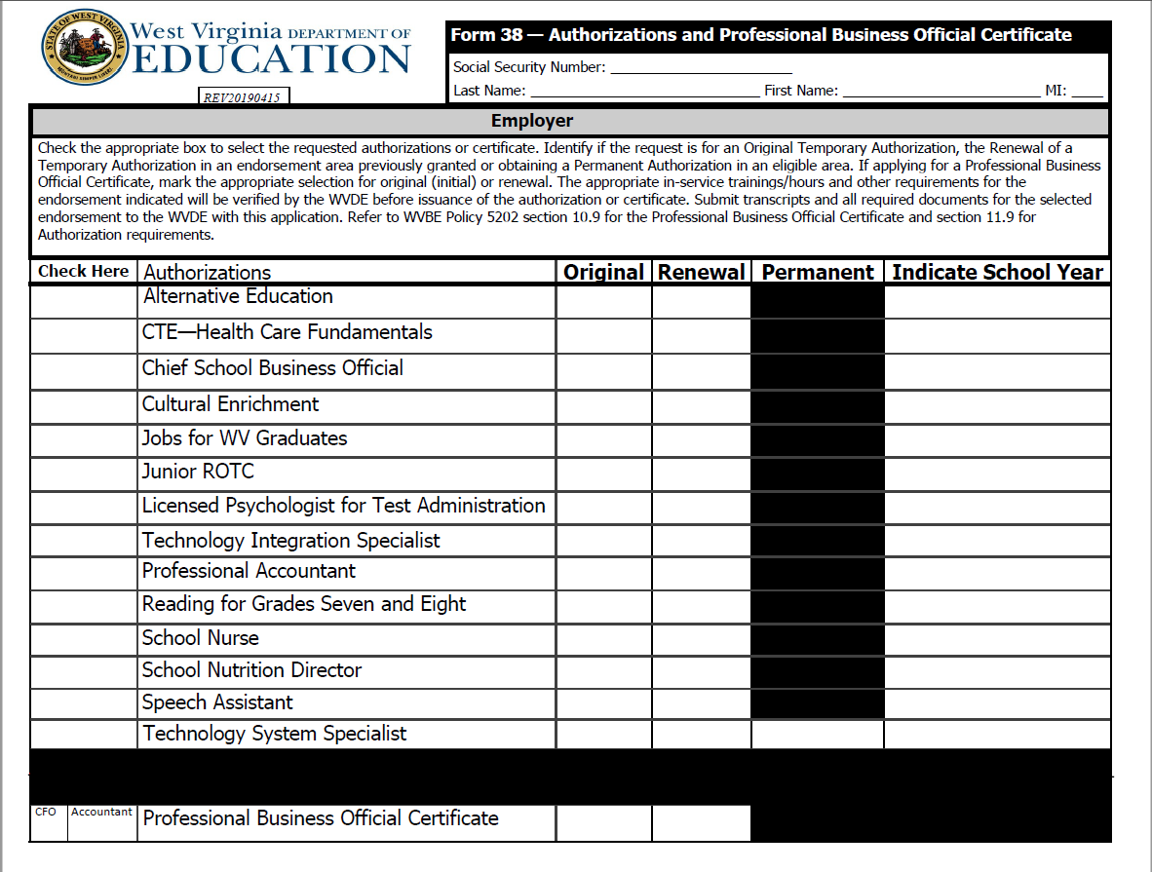
Authorizations Form 38
Applicants must hold a valid professional teaching certificate for the following authorizations:
Alternative Education
Option Pathways
Cultural Enrichment
Reading for Grades Seven and Eight
Technology Integration Specialist
Please be sure to indicate the requested school year.

Slide 31
Additional Questions/Concerns
Form 41
Form 38
Form 30
Waivers

Slide 32
Julie Morris

Slide 33
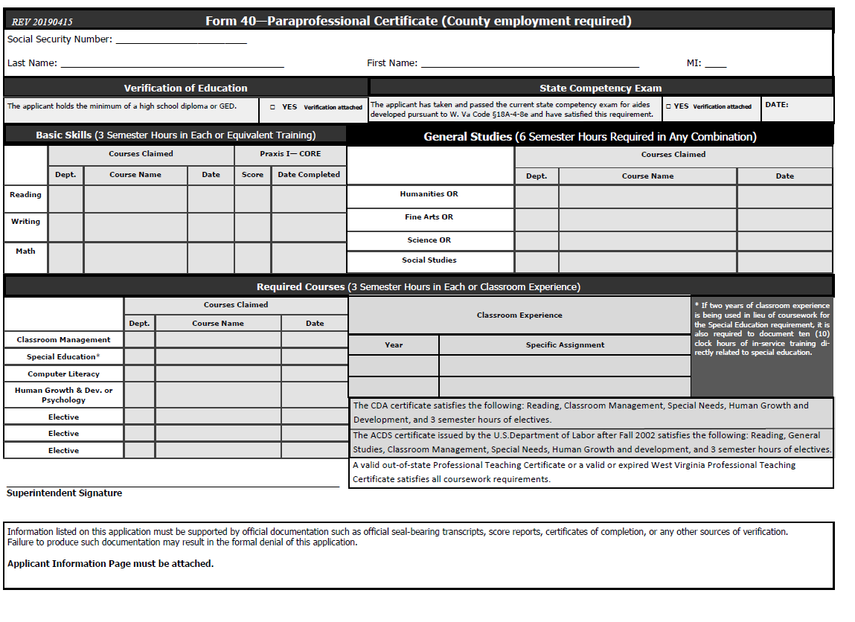
Form 40- Paraprofessional Application
New information has been added to clarify the requirements met by the ACDS and CDA certificates.

Slide 34
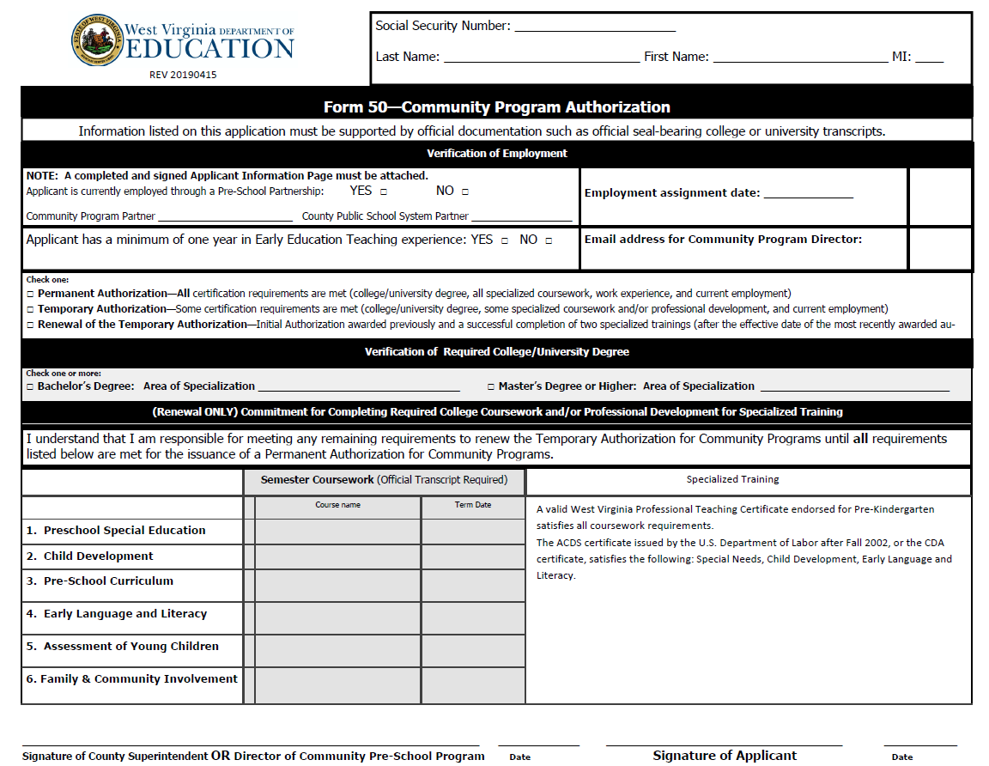
Form 50- Community Programs
New information has been added for clarification of requirements met by the ACDS and CDA certificates.

Slide 35
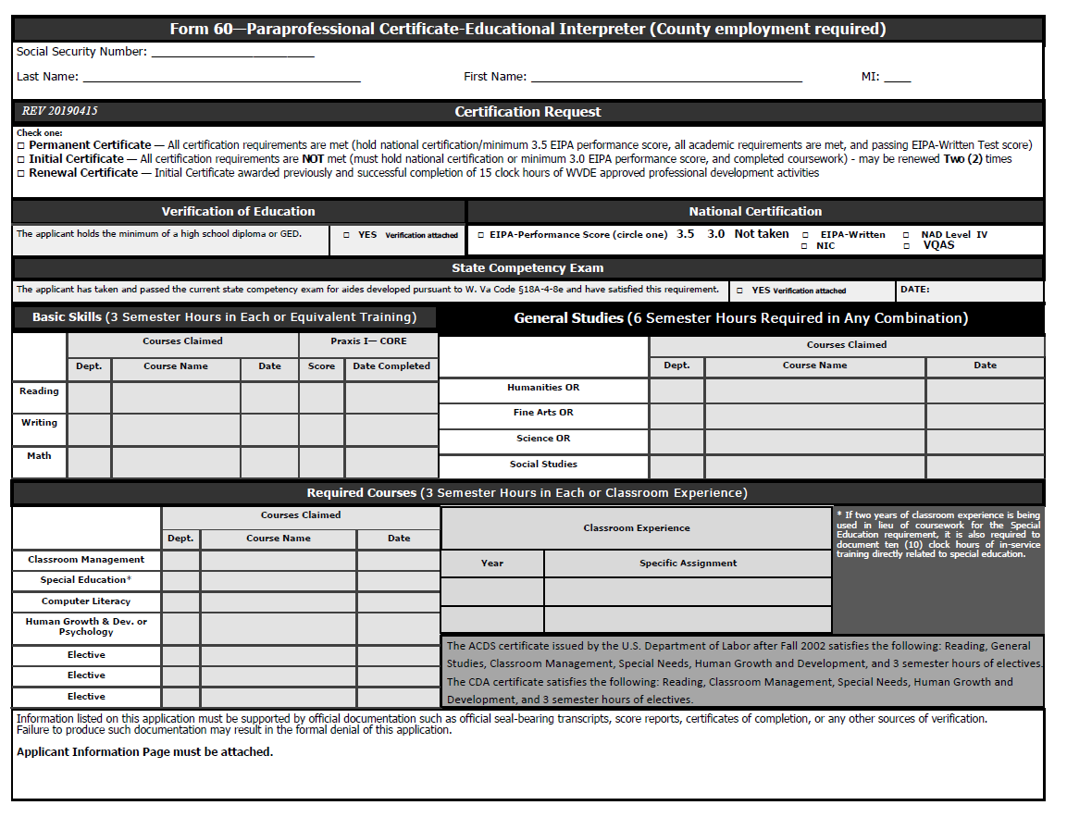
Form 60- Paraprofessional Interpreter
New information has been added for clarification of requirements met by the ACDS or CDA certificates.
Reminder- When using 2 years of classroom experience in lieu of the classroom management course, a letter with dates of employment must be signed and submitted. When using the 2 years of experience for special education course requirements, at least 10 clock hours in special education training must be verified.

Slide 36
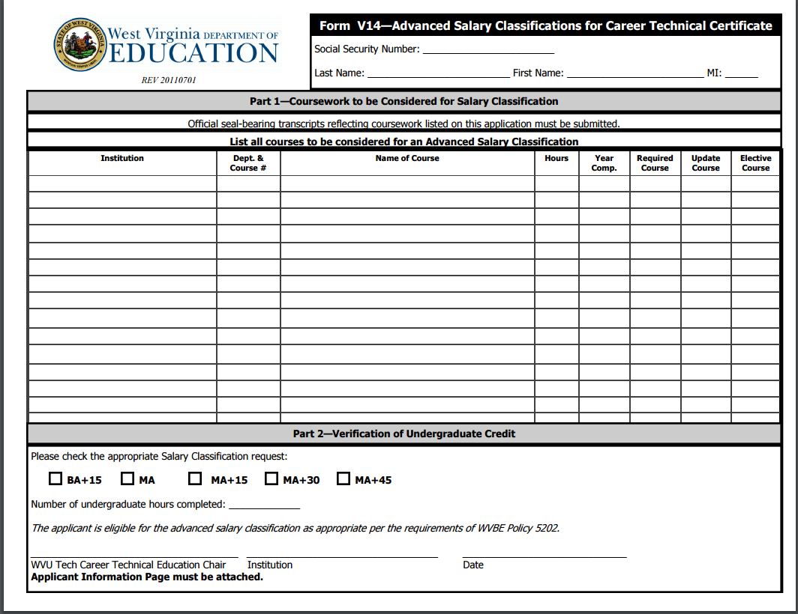
Form V14- CTE Salary Classification
Reminders:
The required 18 credits to finish the CTE program do not count toward salary increases.
CTE salary increases do not necessarily coincide with the awarding of a degree.
In order to receive credit for all coursework, please have the applicant fill out all courses to be reviewed. (More than one form may be sent.)

Slide 37
Online Application Update
Form 39
Please ensure that the individual making application has selected the correct option. If the individual needs to renew the authorization available on a Form 39 (Coach, Limited Football Trainer, or Athletic Trainer Certificate), please look at the top left corner of the application and see that the correct option has been selected.
If they are wanting to renew and you notice in the top left corner that it is an Initial Temporary Authorization, you must REJECT/DENY the application and they need to go back into the system and select RENEW beside the credential.
The online form requires a yearly date- “Employment Begin Date.” This does not need to be the date of first hire.

Slide 38
Kelly Mordecki

Slide 39
SUBSTITUTE PERMITS
For initial substitute teacher applications, be sure to list the date the substitute teacher training was completed on the form 2S or 2L, and include transcripts.
For initial 2Ls, be sure to indicate which endorsements you are requesting. A list of current endorsements can be found in Appendix A of Policy 5202
For substitute renewals, applicants must complete either (a) 12 hours of your own county level training which covers areas listed in Policy 5202, or (b) complete the eLearning Substitute teacher RENEWAL course (this is the ONLY eLearning course they may use for renewal), or (c) have a valid teaching certificate.
Nursing substitutes must complete “nursing” substitute training; they cannot use the eLearning regular teacher training. If getting both a nursing substitute permit and a regular substitute permit, they must complete both trainings.

Slide 40
Alternative Certification Program Reporting for Federal Title II - 2017-2018
All counties who use the Alternative Certification route to licensure for teachers must complete the yearly Federal Title II reporting.
District certification for the 2017-2018 school year must be completed by April 30, 2019. Failure to report and certify district AC data could result in a substantial monetary penalty assessed to the district by the Federal Title II Office.
At this time, each participating county must sign on at https://title2.ed.gov/Public/Home.aspx and review and certify your 2017-2018 AC data. Each applicable county has a USER account for both ETS and WESTAT.
In January, applicable counties verified their pass-rate data through ETS (via their ETS USER account).
ETS then transferred the verified county pass-rate data to WESTAT in mid-April, 2019
Currently applicable counties are now signing into their WESTAT account (via WESTAT USER account) to certify all AC data.

Slide 41
Alternative Certification Process
Steps to initial certification for AC via Form 25:
Job must be posted twice and/or for 10 days FIRST. If no qualified applicant applies, the district may consider other individuals who ALREADY meet the AC program requirements.
Before submitting Form 25 for consideration, FIRST, please verify that the candidate currently meets all AC criteria (i.e. passed all Praxis exams, GPA, degree in or related (GenEd), previous postings, etc.) Then, submit Form 25 with FUTURE date of employment and FUTURE enrollment in the Program. Note: The candidate may NOT be placed in the classroom or enrolled in the AC Program until they are first approved for an AC Certificate.
Be sure to submit transcripts (2.5 or above), basic skills (and content scores if GenEd), job postings with endorsement matching requested endorsement on Form 25. Form V10 must be submitted (for GenEd) if degree is not in or related to the endorsement. If the applicant qualifies for the basic skills exemption, please submit documentation of which exemption applies (i.e. ACT, SAT, etc.).
Prior to placement in the classroom, the candidate must complete an initial teacher training which may be provided by the school district.

Slide 42
Alternative Certification Process - continued
Provisional Licensure and Provisional Renewals
After the AC Candidate completes the AC Program, the candidate will submit a Form 20P and Form 25C, for a Provisional Certificate (along with supporting documentation including passing exam results and coursework transcripts/certificates). Policy 5202, Section 15.1 to 15.6.
Provisional Certificates (Non-transferable) must be renewed yearly and expire June 30 of each year. Form 20PR is the renewal form. They may be renewed twice. Policy 5202, Section 15.7.
Conversion to an Initial Teaching Certificate
Candidates MUST successfully complete a full two years of teaching with a Provisional Certificate BEFORE applying for an Initial Teaching Certificate (Form 20C), and complete the additional coursework. Policy 5202 Section 15.9.
For questions or assistance, please contact Kelly Mordecki or Robert Mellace.

Slide 43
Robert Mellace

Slide 44
Forms V7 and V7R – Career and Technical Education Certificate
Criteria for an Initial Career and Technical Education Certificate remains the same.
Application for renewal or a permanent Career and Technical Education Certificate has been removed from the form V7 and placed on form V7R.
E-Learning courses are now acceptable for the purpose of renewal, but not vocational salary classification advancement
The application fee for each form is $35

Slide 45
Form V18 - Adult Permit for EMS and Fire Service Training
Revised to require written verification of passing scores (85% or higher) on required exams on the application:
Initial Emergency Medical Services Certification
EMS Test Score _____%
Initial Fire Service Certification
Firefighter 1 Score _____%
Firefighter II Score _____%
HazMat Operations Score ____%

Slide 46

New logo, palm cards and handout
Sections:
Homepage
Educator Preparation (Information about pathways leading to licensure, financial aid, Troops to Teachers and program approval)
Job Opportunities
Professional Growth (Information about state tuition reimbursement, professional teaching standards, E-Learning and NBCT)
Commission for Professional Teaching Standards

Slide 47
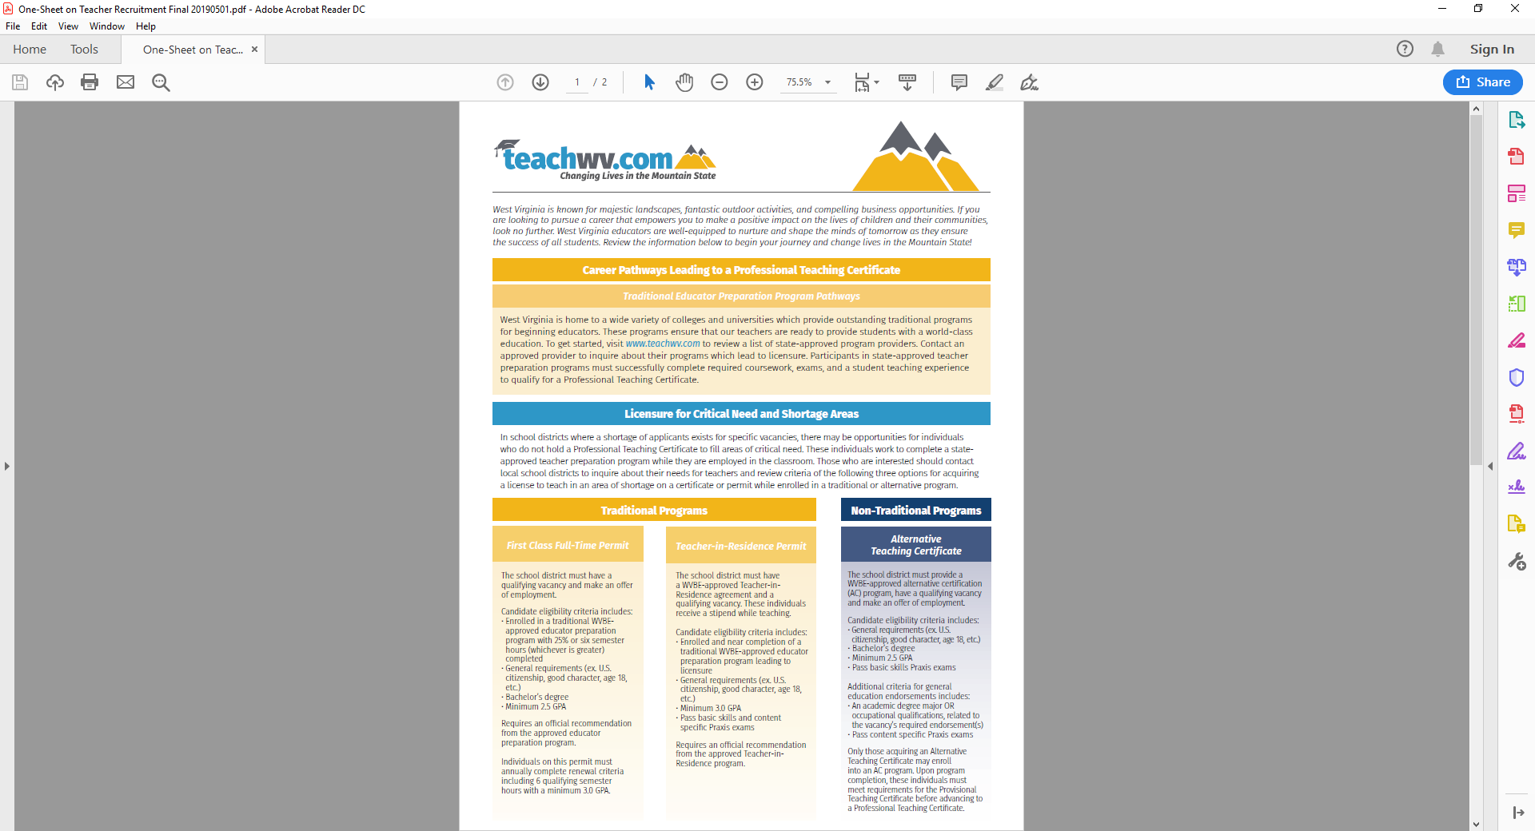
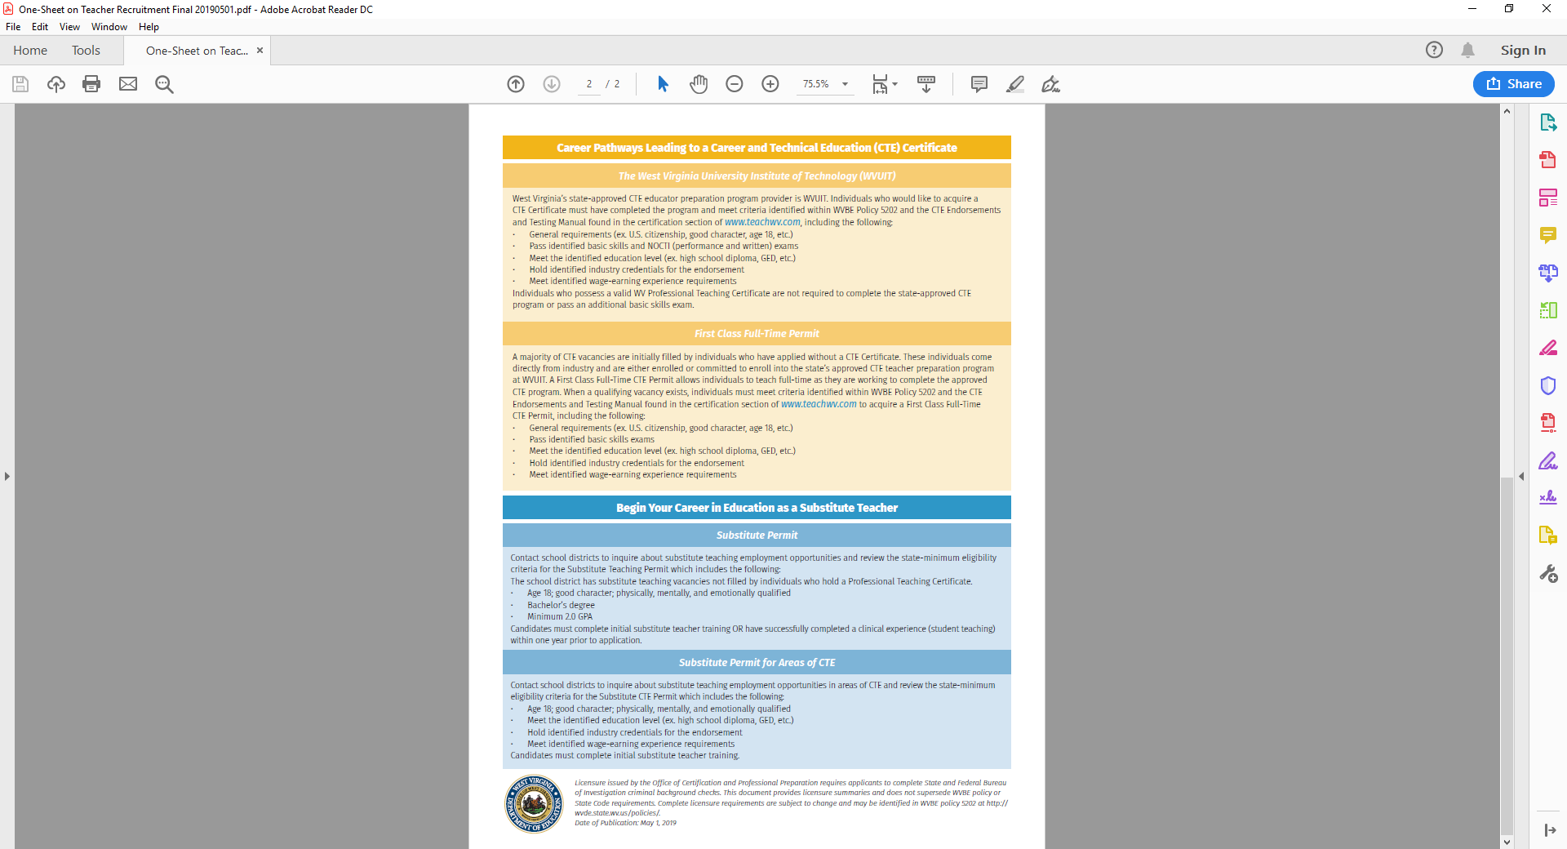

Slide 48



Slide 49

Common Ground Partnership https://wvde.us/commonground/
Focused on increasing the capacity of schools to ensure the success of all students.
Provides schools and school districts with the ability to request guest speaker visits from military service organizations online.
Topics include:
Promoting literacy,
Substance abuse prevention,
Anti-bullying,
Drop-out prevention and career exploration
Provides resources for schools in support of military families
Partners include the Governor’s Office; WVBE; WVDE; Active, Reserve and National Guard based military organizations; the West Virginia Veterans Council; West Virginia Civil Air Patrol; West Virginia Congress of Parents and Teachers, Inc. (WVPTA); and Prevent Suicide WV.

Slide 50
Q & A
This presentation will be posted in the resources section of our website at http://wvde.state.wv.us/certification/.
West Virginia Department of Education
Office of Certification and Professional Preparation
(CAPP)

