Slide 1
Civil Rights Training Child Nutrition Programs

Slide 2
Purpose of Civil Rights Policy
The purpose of civil rights policy as it pertains to the United States Department of Agriculture (USDA) Food and Nutrition Service (FNS) programs is to ensure compliance with and enforcement of the prohibition against discrimination in ALL federally funded Child Nutrition Programs (CNP) and to protect the recipients and customers of said programs.
Notes:
Programs and activities receiving federal financial assistance must abide by Civil Rights requirements

Slide 3
Civil Rights Concepts
Stereotyping
Preconceived beliefs or over-simplified generalizations about a particular group
Prejudice
A set of rigid and unfavorable attitudes toward a particular group that is formed without considering facts
Discrimination
The practice of treating people differently because of how we have grouped them in our minds according to our prejudices

Slide 4
What is discrimination in CNP?
Different treatment which makes a distinction of one person or a group of persons from others, either intentionally, by neglect, or by the actions or lack of actions based on a protected class
Protected classes for CNP
Race
Color
National origin
Age
Sex
Disability

Slide 5
Areas of Compliance
Assurances
Public notification
Complaints of discrimination
Civil Rights training
Racial and ethnic data collection
Limited English Proficiency (LEP)
Disability compliance
Compliance reviews and resolution of noncompliance

Slide 6
Assurances
To qualify for Federal financial assistance, an application must be accompanied by a written assurance that the entity to receive financial assistance will be operated in compliance with all nondiscrimination laws, regulations, instructions, policies, and guidelines.
Example: Sponsoring Organization’s Permanent Agreement with WVDE

Slide 7
Assurances
Subrecipient agreements must also include a Civil Rights assurance of nondiscrimination.
Example: Many SFAs contract with Food Service Management Companies (FSMC) to provide food service to students. SFAs are be responsible for ensuring that their FSMCs are in compliance with CR requirements.
These assurances are binding on the program applicant and its successors, transferees, and assignees, as long as they receive assistance or retain possession of any assistance from USDA.

Slide 8
Public Notification
All FNS assistance programs (i.e. CNP) must include a public notification system.
Elements of public notification
Program availability
Complaint information
Nondiscrimination statement

Slide 9
Elements of Public Notification
Program Availability
Inform applicants, participants, and potentially eligible persons of their program rights and responsibilities and the steps necessary for participation
Complaint Information
Must advise applicants and participants at the service delivery point of their right to file a complaint, how to file a complaint, and the complaint procedures
Nondiscrimination Statement
All information materials and sources, including websites, must contain a nondiscrimination statement. (The statement is not required to be included on every page of the program Web site. At a minimum the nondiscrimination statement or a link to it must be included on the home page of the program information.)

Slide 10
Methods of Public Notification
CNP Sponsoring Organizations must:
Must prominently display the “And Justice for All” poster at service delivery points
Inform applicants or participants of programs or changes in programs
Provide information in alternative formats and languages as necessary
Convey message of equal opportunity in all photographic or pictorial program information

Slide 11
Nondiscrimination Statement
In accordance with federal civil rights law and U.S. Department of Agriculture (USDA) civil rights regulations and policies, this institution is prohibited from discriminating on the basis of race, color, national origin, sex (including gender identity and sexual orientation), disability, age, or reprisal or retaliation for prior civil rights activity.
Program information may be made available in languages other than English. Persons with disabilities who require alternative means of communication to obtain program information (e.g., Braille, large print, audiotape, American Sign Language), should contact the responsible state or local agency that administers the program or USDA’s TARGET Center at (202) 720-2600 (voice and TTY) or contact USDA through the Federal Relay Service at (800) 877-8339.
To file a program discrimination complaint, a Complainant should complete a Form AD-3027, USDA Program Discrimination Complaint Form which can be obtained online at: https://www.usda.gov/sites/default/files/documents/USDA-OASCR%20P-Complaint-Form-0508- 0002-508-11-28-17Fax2Mail.pdf, from any USDA office, by calling (866) 632-9992, or by writing a letter addressed to USDA. The letter must contain the complainant’s name, address, telephone number, and a written description of the alleged discriminatory action in sufficient detail to inform the Assistant Secretary for Civil Rights (ASCR) about the nature and date of an alleged civil rights violation. The completed AD-3027 form or letter must be submitted to USDA by:
mail:
U.S. Department of Agriculture
Office of the Assistant Secretary for Civil Rights
1400 Independence Avenue, SW
Washington, D.C. 20250-9410; or
fax:
(833) 256-1665 or (202) 690-7442; or
email:
program.intake@usda.gov
This institution is an equal opportunity provider.

Slide 12
Nondiscrimination Statement (Spanish)
De acuerdo con la ley federal de derechos civiles y las normas y políticas de derechos civiles del Departamento de Agricultura de EE. UU. (USDA), esta institución tiene prohibido discriminar por motivos de raza, color, origen nacional, sexo (incluida la identidad de género y la orientación sexual), discapacidad, edad, o represalia o represalia por actividad anterior de derechos civiles.
La información del programa puede estar disponible en otros idiomas además del inglés. Las personas con discapacidades que requieran medios alternativos de comunicación para obtener información del programa (p. ej., Braille, letra grande, cinta de audio, lenguaje de señas estadounidense), deben comunicarse con la agencia estatal o local responsable que administra el programa o el Centro TARGET del USDA al (202) 720- 2600 (voz y TTY) o comuníquese con USDA a través del Servicio Federal de Retransmisión al (800) 877-8339.
Para presentar una queja por discriminación en el programa, el Demandante debe completar el Formulario AD-3027, Formulario de queja por discriminación en el programa del USDA, que se puede obtener en línea en: https://www.usda.gov/sites/default/files/documents/USDA-OASCR %20P-Complaint-Form-0508-0002-508-11-28-17Fax2Mail.pdf, desde cualquier oficina del USDA, llamando al (866) 632-9992, o escribiendo una carta dirigida al USDA. La carta debe contener el nombre, la dirección, el número de teléfono y una descripción escrita de la supuesta acción discriminatoria del denunciante con suficiente detalle para informar al Subsecretario de Derechos Civiles (ASCR) sobre la naturaleza y la fecha de la supuesta violación de los derechos civiles. El formulario o carta AD-3027 completo debe enviarse al USDA antes de:
correo:
Departamento de Agricultura de EE. UU.
Oficina del Subsecretario de Derechos Civiles
1400 Avenida Independencia, SW
Washington, DC 20250-9410; o
fax:
(833) 256-1665 o (202) 690-7442; o
correo electrónico:
program.intake@usda.gov
Esta institución es un proveedor que ofrece igualdad de oportunidades.

Slide 13
Nondiscrimination Statement
USDA Nondiscrimination Statement (NDS)
Short versions
“This institution is an equal opportunity provider.”
“Esta institución es un proveedor que ofrece igualdad de oportunidades.” (Spanish)
**Can be used in special circumstances only and only with WVDE OCN approval**
Translations
Other languages are available here: Nondiscrimination Statement | USDA-FNS

Slide 14
Nondiscrimination Statement
At a minimum, the Nondiscrimination Statement must be on
Application Form(s)
Notification of Eligibility or Ineligibility
Notice of Adverse Action Form
Program (Home) Web Page
Public Information, including program literature

Slide 15
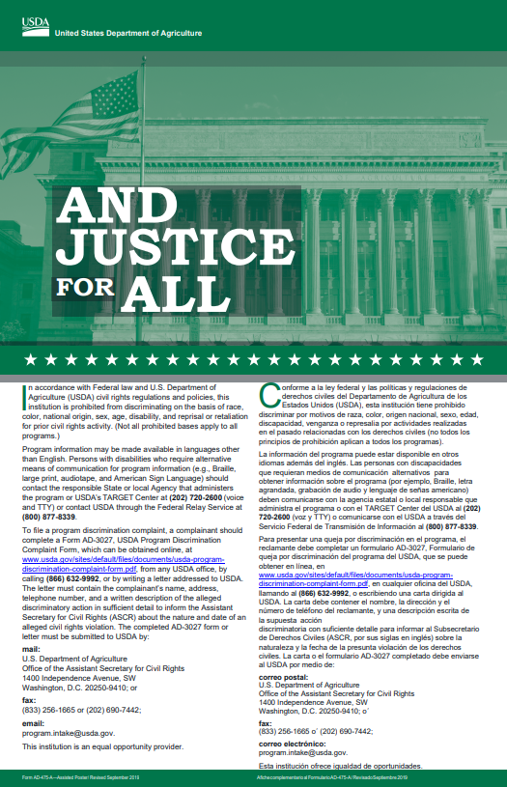
“And Justice For All” Poster
All sites must display posters
in a prominent location for all
to view
Poster reflects current
Nondiscrimination Statement
and new graphic

Slide 16
Complaints of Discrimination
Applicants or participants allege different treatment based on protected class(es)
Race
Color
National origin
Age
Sex (gender identity and sexual orientation)
Disability
Notes:
Discrimination based on gender identity and sexual orientation now falls under the protected class of sex.

Slide 17
Complaints of Discrimination
Applicants and participants must file within 180 days of the alleged action
Confidentiality extremely important
All complaints must be documented by the Sponsoring Organization on the Civil Rights Complaint Log
Or, a participant may file their complaint directly with USDA using the following forms:
Filing a Program Discrimination Complaint as a USDA Customer | USDA

Slide 18
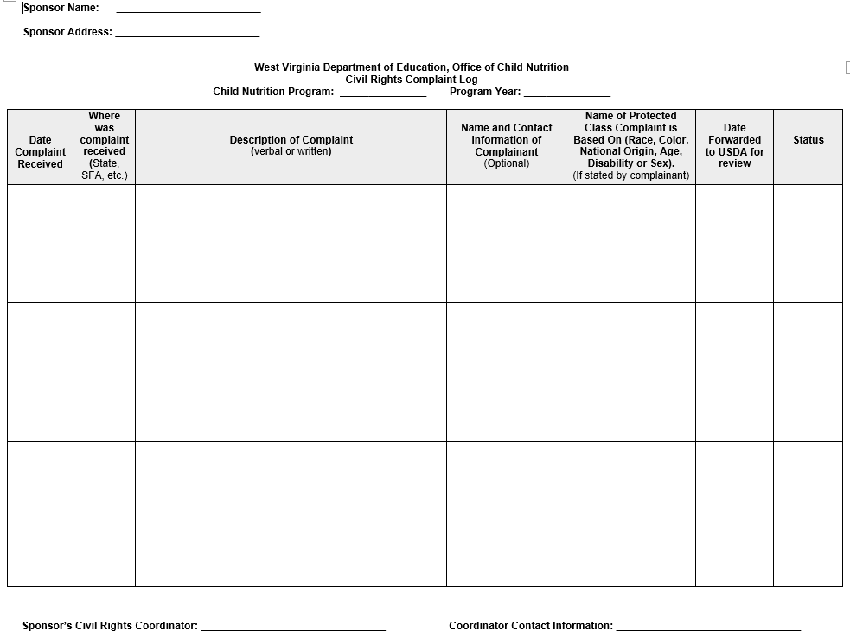
Civil Rights Complaint Log

Slide 19
Complaints of Discrimination
Once a complaint is received by the Sponsoring Organization, the complaint must be documented on the Civil Rights Complaint Log then the WVDE OCN must be notified immediately.
The WVDE OCN will then forward all complaints to USDA within five days of receipt of complaint.

Slide 20
Civil Rights Training
Training is required so that individuals involved in all levels of administration of programs that receive Federal financial assistance understand Federal laws, regulations, instructions, policies and other guidance.

Slide 21
Civil Rights Training
State agencies are responsible for training local agencies/subrecipients.
Local agencies are responsible for training their staff and subrecipients on an annual basis.
Includes “frontline staff” and those who supervise frontline staff
New employees must receive Civil Rights training before participating in Program activities.
Volunteers (if any) must also receive training appropriate for their roles and responsibilities.

Slide 22
Civil Rights Training
All staff should receive training on all aspects of Civil Rights compliance, including:
Assurances
Public notification
Complaints of discrimination
Civil Rights training
Racial and ethnic data collection
Limited English Proficiency (LEP)
Disability compliance
Compliance reviews and resolution of noncompliance
Conflict Resolution
Customer Service

Slide 23
Customer Service
Service is
Effectively communicating with customers,
Responding to their needs,
Valuing their worth, and
Instilling excellence through
Courtesy, confidence, and
Enthusiasm.

Slide 24
Conflict Resolution
IDENTIFY THE PROBLEM. Identify the problem based on the information the customer gives you.
DETERMINE A SOLUTION. Depending on the specifics of the conversation and your knowledge of your organization, the solution may involve calling the customer again.
GAIN APPROVAL FROM THE CUSTOMER. If the customer does not agree to the proposed solution, it will resolve nothing!
MAKE AN AGREEMENT. You and the customer should determine what is to be done, when it is to be done, and by whom. If it is not possible, suggest an alternative.
FOLLOW UP. Personally make sure that the customer has been satisfied; and provide feedback.

Slide 25
Racial and Ethnic Data Collection and Reporting
Data collection is mandatory
Recipients of federal financial assistance must maintain a system to collect racial and ethnic data in accordance with FNS policy
Data must be maintained for 3 years
Must be submitted to FNS as requested

Slide 26
Racial and Ethnic Data Collection and Reporting
Data must be collected using a two-part question
1. Ethnicity
Hispanic or Latino
Not Hispanic or Latino
2. Race (may select more than one)
American Indian or Alaskan Native
Asian
Black or African American
Native Hawaiian or Other Pacific Islander
White

Slide 27
Racial and Ethnic Data Collection and Reporting
If disparities or incidents of underrepresentation exist, it will be necessary to investigate the causes.
If necessary, take action to ensure equal opportunity to participate in the program(s).

Slide 28
Limited English Proficiency (LEP) and Program Access
Who are persons with LEP?
Individuals who do not speak English as their primary language and who have a limited ability to read, speak, write, or understand English because of their national origin
Recipients of Federal financial assistance have a responsibility to take reasonable steps to ensure meaningful access to their programs and activities by persons with LEP.
Failure to provide “meaningful” access to persons with LEP could be discrimination on the basis of national origin.

Slide 29
Limited English Proficiency (LEP) and Program Access
Factors included in assuring “meaningful” access include:
The number or proportion of LEP people eligible to be served or likely to be encountered by the program
The frequency with which LEP individuals come in contact with the program
The nature and importance of the program, activity, or service provided by the program to people’s lives
The resources available to the recipient and costs

Slide 30
Limited English Proficiency (LEP) and Program Access
Translation of vital documents is required.
Oral translations and interpretation services are also required if such a request arises.
Staff training regarding how to provide LEP populations with meaningful access is paramount (frontline staff).

Slide 31
Limited English Proficiency (LEP) and Program Access
Language services
Applicants and participants cannot be asked to bring their own interpreters
Children should not be used as interpreters
Examples of language services
Bilingual staff
Telephone interpreter lines
Oral interpretation services
Written language services
Community organizations and volunteers

Slide 32
Limited English Proficiency (LEP) and Program Access
Population data sources:
US Census Data
http://www.census.gov/2010census/data/
American Community Survey
http://www.census.gov/acs/
Migration Policy Institute’s National Center on Immigrant Integration Policy
http://www.migrationpolicy.org/

Slide 33
Disability Discrimination
What is the definition of disability?
A person who has a physical or mental impairment which substantially limits one or more major life activities, has a record of such an impairment, or is regarded as having such an impairment.
Major life activity means functions such as caring for one’s self, performing manual tasks, walking, seeing, hearing, speaking, breathing, learning and working.
functions of the immune system, normal cell growth, digestive, bowel, bladder, neurological, brain, respiratory, circulatory, cardiovascular, endocrine, and reproductive functions. (ADA Amendments Act of 2008)

Slide 34
Disability Discrimination
State and local offices must provide reasonable accommodations in policies and practices to applicants and participants with disabilities when necessary.
Reasonable accommodations
Must be funded through State/local offices, not by applicants and participants
Require good communication between all parties involved
Provide the same level of service to applicants and participants in an alternative way

Slide 35
Disability Discrimination
Accessibility of State and local agency websites, and online application systems to persons with visual impairments and other disabilities.
Physical Program access to persons in wheelchairs and with mobility disabilities.
Accessibility through Braille, large print and audio tape and other alternative formats.
Accessibility to American Sign Language (ASL) and interpreters.

Slide 36
Compliance Reviews
Examine the activities of State agencies, local agencies, and subrecipients to determine Civil Rights compliance
FNS Civil Rights and Program staff review State agencies.
FNS staff and State agencies review local agencies and subrecipients.
Significant findings must be provided in writing to the reviewed entity.

Slide 37
Compliance Reviews
There are three types of compliance reviews
Pre-award compliance reviews
Routine (post-award) compliance reviews
Special compliance reviews

Slide 38
Pre-Award Compliance Reviews
Potential CNP Sponsoring Organizations must be in compliance with Civil Rights requirements prior to approval for Federal financial assistance.
Reviews conducted during pre-approval review.
Reports must be maintained in appropriate program files.

Slide 39
Routine/Post-Award Compliance Reviews
State agencies must conduct routine compliance reviews as identified by FNS Instruction 113-1 and program-specific regulations and policies
Assess all of the Civil Rights compliance areas
Sample post-award review questions
Do printed materials contain the nondiscrimination statement?
Is the “And Justice For All” poster displayed appropriately?
Are program informational materials available to all?
Is data on race and ethnicity collected appropriately?
How are applicants and participants advised of their right to file a Civil Rights complaint of discrimination?
Are reasonable accommodations appropriately made for people with disabilities?
Are appropriate language services provided?

Slide 40
Special Compliance Reviews
Conducted by USDA’s Office of the Assistant Secretary for Civil Rights independently or in conjunction with FNS program or Civil Rights staff
May be scheduled or unscheduled
To follow-up on previous findings of noncompliance
To investigate reports of noncompliance by other agencies, media, or grassroots organizations
May be specific to an incident or policy
History of statistical underrepresentation of particular group(s)
Pattern of complaints of discrimination

Slide 41
Resolution of Noncompliance
A factual finding that any Civil Rights requirement, as provided by law, regulation, policy, instruction, or guidelines, is not being adhered to by a State agency, local agency or subrecipient agency
Steps must be taken immediately to obtain voluntary compliance
A finding’s effective date is the date of notice to the reviewed entity

Slide 42
Contact Information
West Virginia Department of Education
Office of Child Nutrition
Building 6, Room 750
1900 Kanawha Blvd, East
Charleston, WV 25305
Telephone: (304) 558-3396

