Slide 1
UPDATED ACES SFSP

Slide 2
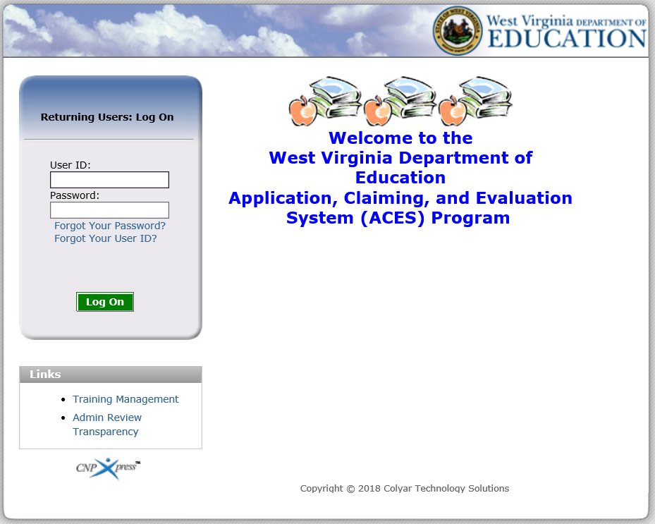
Has a Similar Feel
Notes:
The login screen for the updated ACES has a new look but a similar feel.

Slide 3
Has a Similar Feel
Notes:
Some good news is that the links for Forgot Your Password and Forgot Your User ID work. To reset your password, select the Forgot Your Password link and enter the User ID and email address associated with the account. To reset your User ID, select the Forgot Your User ID link, and enter the email address associated with the account.

Slide 4
Has a Similar Feel
Notes:
The login screen still provides a Training Management link which allows users to register for WVDE OCN trainings. Each time a new training is offered, WVDE OCN will email detailed instructions and screenshots on how to register for the training.

Slide 5
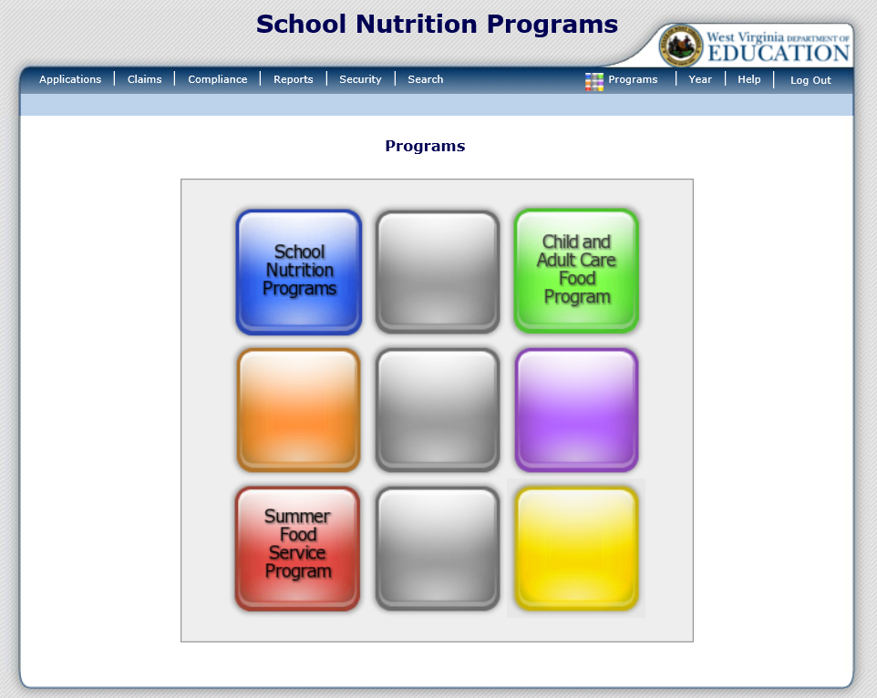
Introducing the Waffle
Notes:
Once you successfully log on, you will be directed to the Programs home page. The Programs home page provides access to all of the Child Nutrition Programs. The screen now displays a waffle instead of a pie. Actual access to specific programs and modules depends on a user’s security rights. All Child Nutrition Programs you are approved for, will be listed here. In this example, the sponsor is approved to modify School Nutrition Programs (NSLP/SBP/SMP/ASSP/SSO), the Child and Adult Care Food Program (CACFP), and the Summer Food Service Program (SFSP). If you are not approved to modify one of these programs, it will simply show up as a blank square.
If you only participate in the SFSP Program, you will log straight into it.

Slide 6
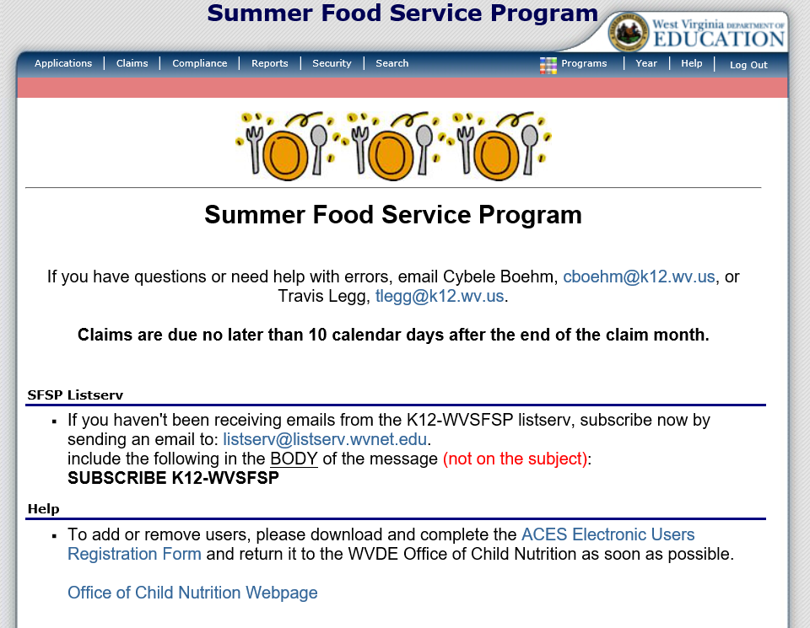
Navigation of ACES
Notes:
Once you select a program, you will see all of the navigation options for the program located at the top of the screen. In this example we selected Summer Food Service Program.

Slide 7
Applications
Notes:
Selecting Applications, on the left side of the dark blue menu bar, will bring you to this screen.
Application Packet is where you complete all of the information for you application renewal, including all of your site applications for SFSP.
Advance Request is only for Family Day Care Homes and not Child Care Centers.
Download Forms is the area where WVDE OCN may put documents for you to download.

Slide 8
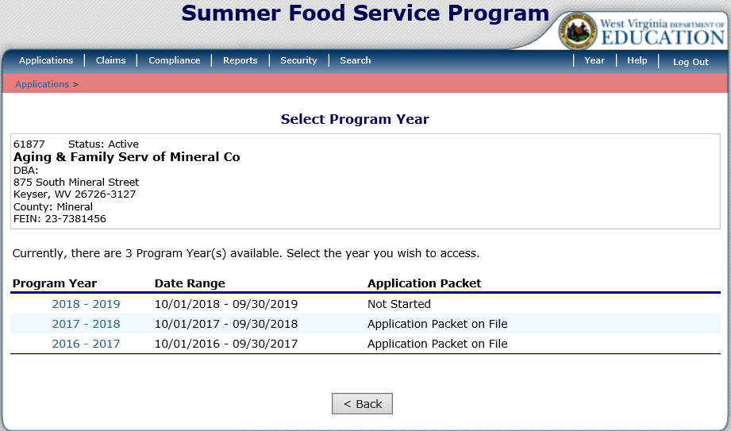
Application Packet
Notes:
Once you are on the Application screen, select the Program Year you wish to access. The updated ACES shows both the program year and the actual date range. To begin the new application packet for the 2018 – 2019 Program Year, simply click on “2018 – 2019”.

Slide 9
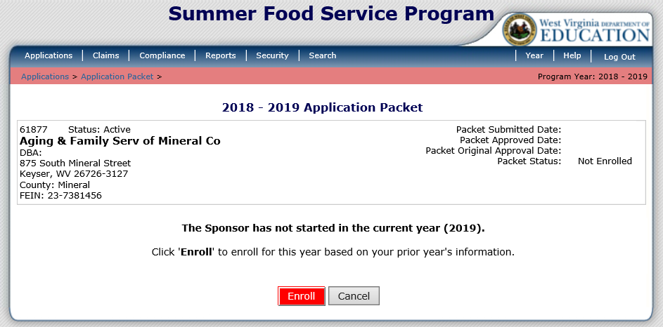
Application Packet
Notes:
If it is the first time working on the application, you must select the red Enroll button. Once selected, you will get a popup window asking you to confirm that you want to continue. Please click OK once this window appears.

Slide 10
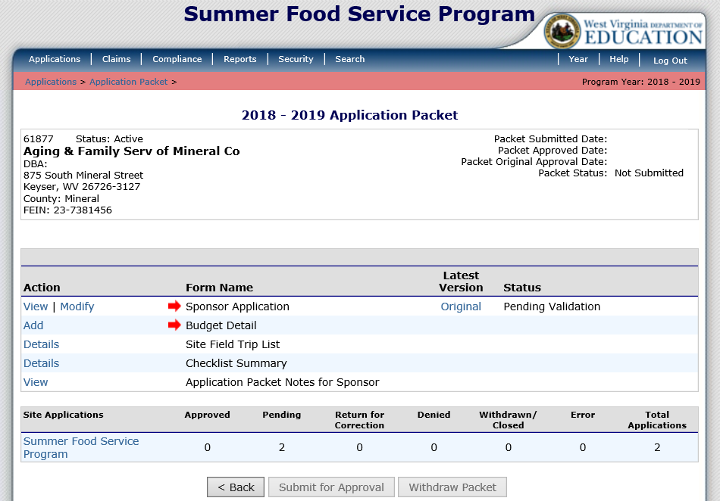
Application Packet
Notes:
The terminology on the Application Packet screen is exactly the same as it was in the old version of ACES. The first section of the Application Packet is the “Sponsor Application”.
Budget Detail is your budget for the program year. You must complete you site application before you complete the Budget Detail.
Site Field Trip List must be completed after the site applications are completed. This is to be filled out if you plan to feed anywhere else except the address listed on the site application.
Checklist Summary is the Supporting Documents. This must be completed after all of the site applications are entered.
At the bottom of the screen is where you complete your site applications.

Slide 11
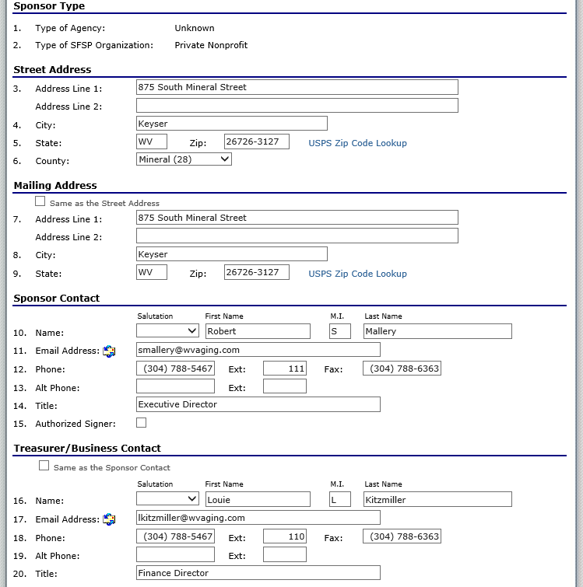
Application Packet – Sponsor Application
Notes:
In the Application Packet, click on modify by Sponsor Application. It begins with the street address and contact information for the sponsor.

Slide 12
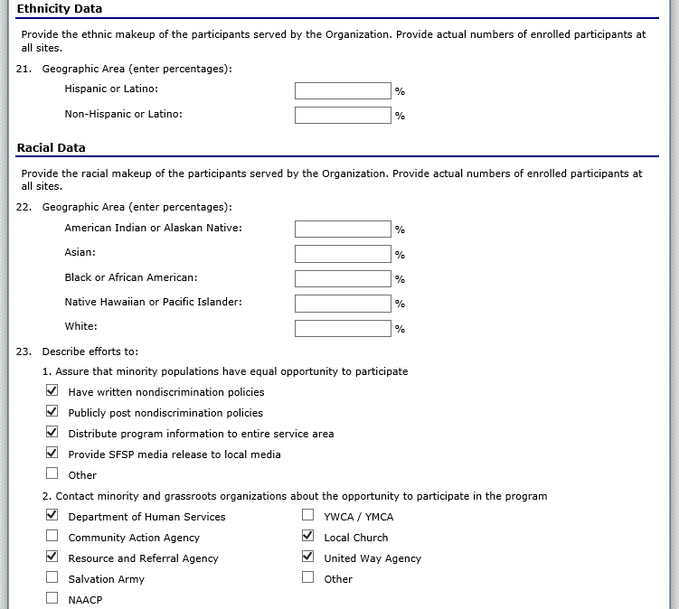
Application Packet – Sponsor Application
Notes:
Next, provide the Ethnic and Racial Data for the Sponsor.

Slide 13
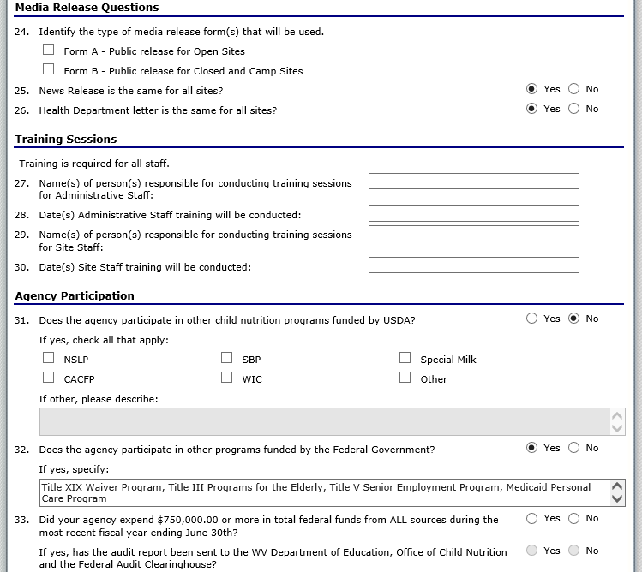
Application Packet – Sponsor Application
Notes:
The Media Release Question, Training Sessions, and Agency Participation Questions are almost exactly the same as the old ACES. Some of this information will be there from the old ACES, but anything not filled out must be completed.

Slide 14
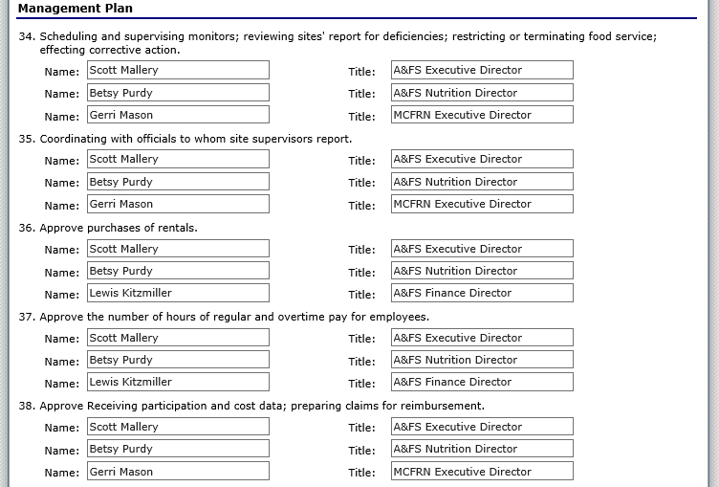
Application Packet – Sponsor Application
Notes:
This should be transferred from the old ACES, but you must ensure that all the data is still correct.

Slide 15
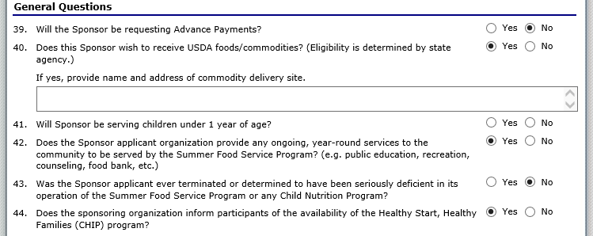
Application Packet – Sponsor Application
Notes:
Most of the General Questions will be converted from the old ACES, but please be sure to answer every question.

Slide 16
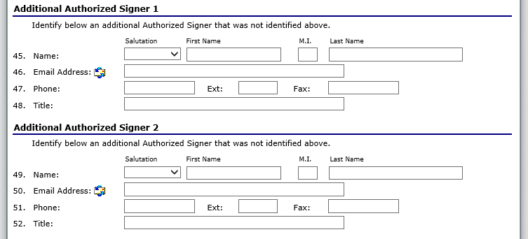
Application Packet – Sponsor Application
Notes:
An Authorized Signer will be the personnel allowed to make changes to the application or submit a claim.

Slide 17
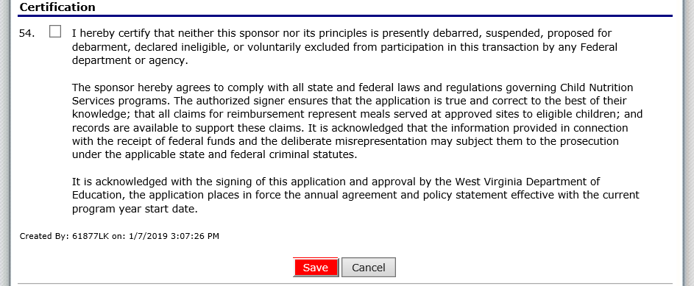
Application Packet – Sponsor Application
Notes:
Finally, click the checkbox in the Certification Section and click Save.

Slide 18
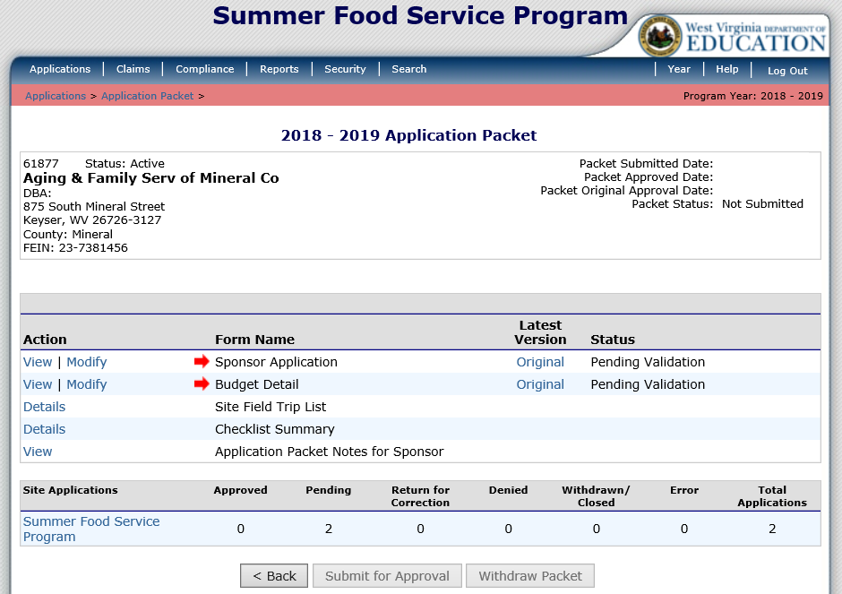
Application Packet – Site Application
Notes:
You must complete the site Applications before Budget Detail, Site Field Trip List, and Checklist Summary. Please click Summer Food Service Program at the bottom of the screen to add the Site Applications.

Slide 19
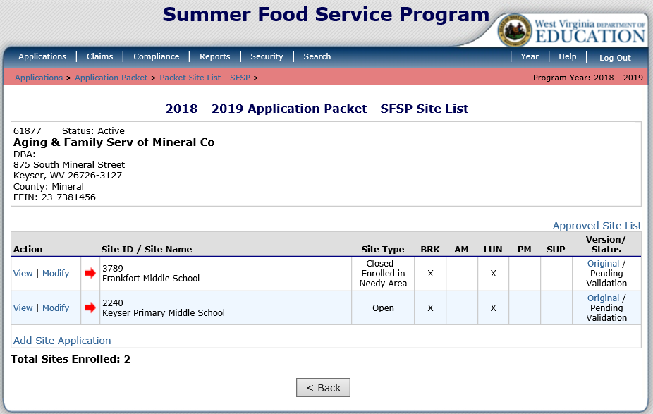
Application Packet – Site Application
Notes:
Once you select Site Applications on the Application Packet screen, it will display all of your active sites. You no longer need to select Add/Renew Site. You can just select Modify beside the site you are working on (or select Revise if the site has already been approved).

Slide 20
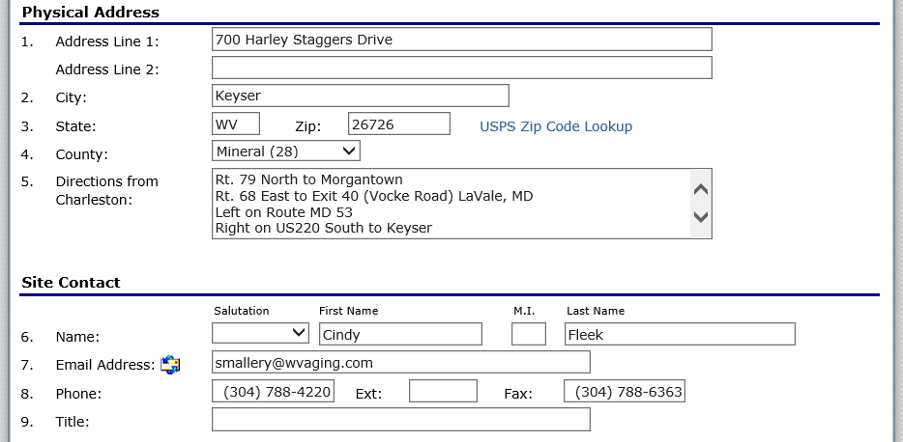
Application Packet – Site Application
Notes:
The site application begins by entering the site’s address and contact information. Some of this information will roll over from the old version of ACES; however, the new site application requests additional information.

Slide 21
Application Packet – Site Application
Notes:
The General Site Information must include the Operation Dates, the number of days in each of the operating months, type of meals being served, and what meal pattern is being followed.
Question 10: Click on Calendar in Blue.

Slide 22
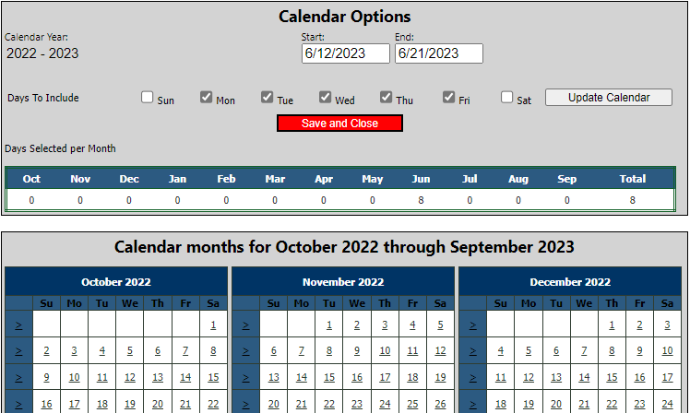
Application Packet – Site Application
Notes:
Type your Start Date and End Dates into the Calendar Options. Next, make sure to select the days of the week that you will be operating this site. Once this is completed, please click on Update Calendar. It may take a minute to update. You may confirm your dates in the calendar below. You days will display in Green. Once finished, please remember to click on the red Save and Close Button.

Slide 23
Application Packet – Site Application
Notes:
After you selected your dates, please click Refresh From Calendar in Blue. This will add the correct days of the week in the appropriate month.

Slide 24
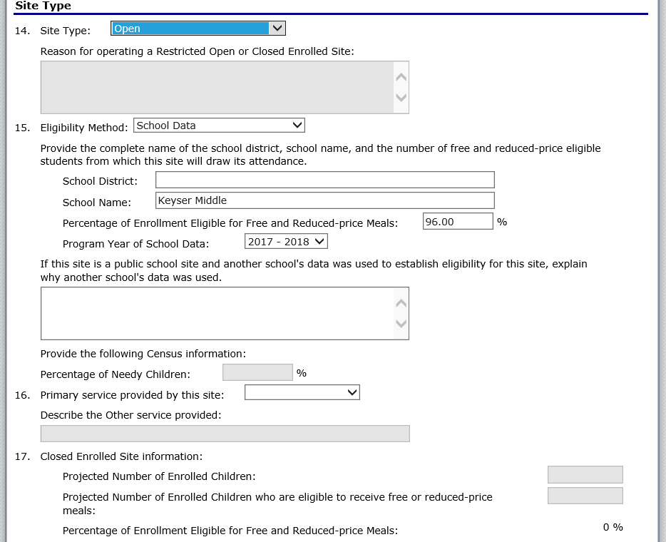
Application Packet – Site Application
Notes:
Site Type must be selected. In this example, Open site is selected and ACES grays out the questions that do not apply.

Slide 25
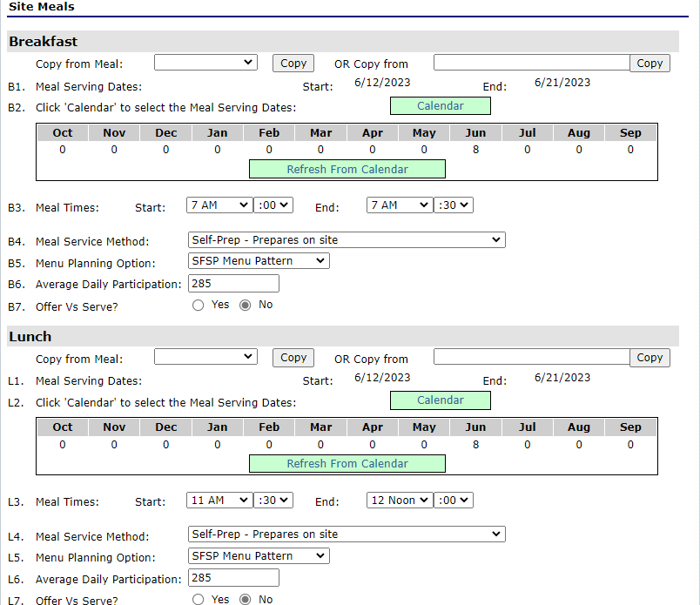
Application Packet – Site Application
Notes:
Site Meals Includes the serving dates, days in the operating months, days served, meals times, service method, meal pattern, and average daily participation.
Under Breakfast it says Copy from Meal and there is a dropdown. If you select Site Operations in the dropdown and click on Copy, it will transfer the dates and days you selected from questions 10 of the Site Application. This way you don’t have to put in the date's multiple times. This procedure will also put the number of days in the month to match what you entered on questions 10 as well.
The same steps above should be used under Lunch as well.

Slide 26
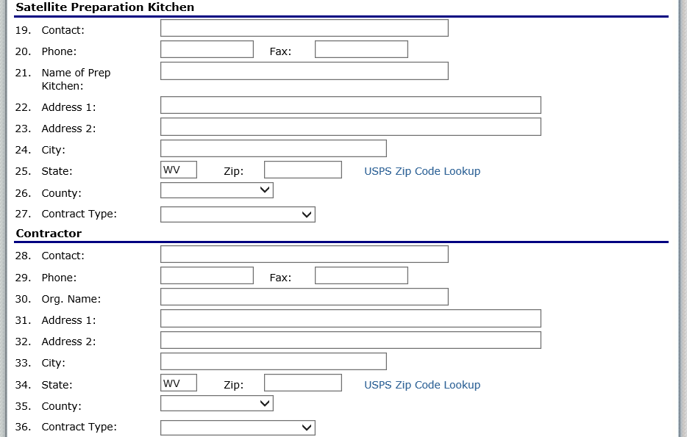
Application Packet – Site Application
Notes:
If meals are not prepared on-site, then the Satellite Preparation Kitchen section must be completed. If you are purchasing the meals from a vendor, then the Contractor section must be completed.

Slide 27
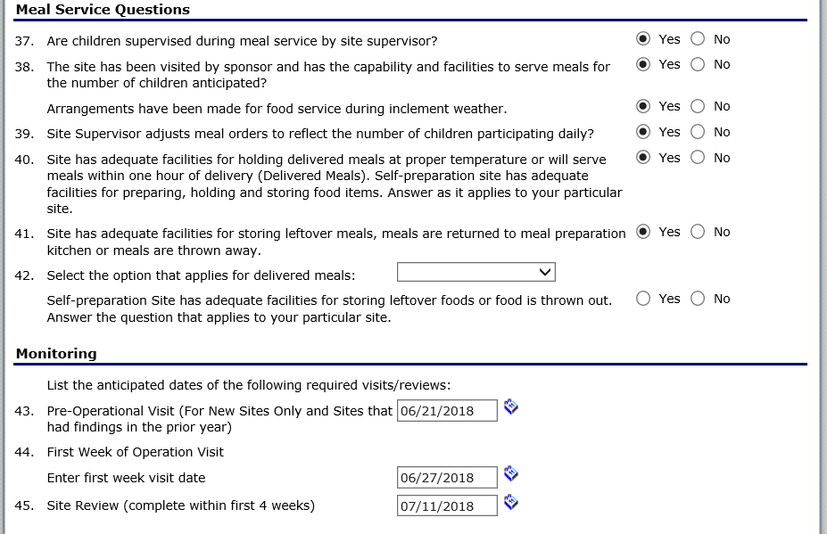
Application Packet – Site Application
Notes:
Meal Service Questions and monitoring questions come next. Monitoring questions require the dates of the planned monitoring. If you select the calendar icon, you may select the dates from a calendar.

Slide 28
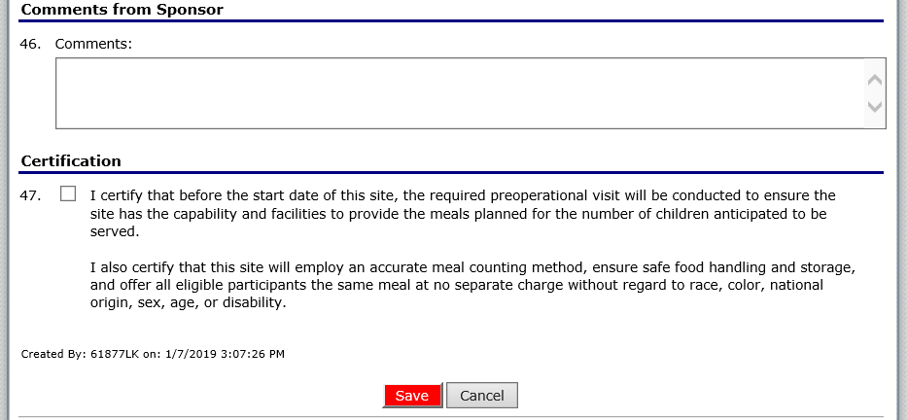
Application Packet – Site Application
Notes:
Finally, there is a comment section from the sponsor to the Office of Child Nutrition. To complete the site application, check the checkbox and click save. Repeat these steps for any additional sites.

Slide 29
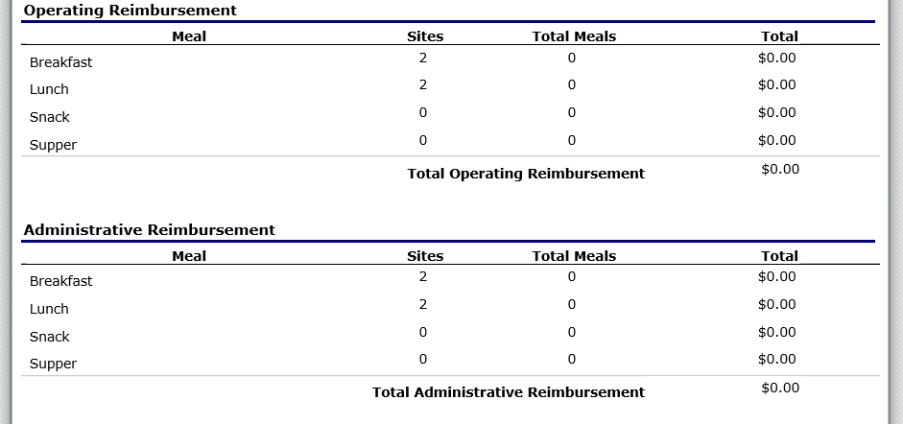
Application Packet – Budget Detail
Notes:
The Budget Detail screen in the new ACES is similar to the screen in the old version of ACES, with just a slightly different look.
The Operating Reimbursement and Administrative Reimbursement is calculated based on the information you placed in the site applications.

Slide 30
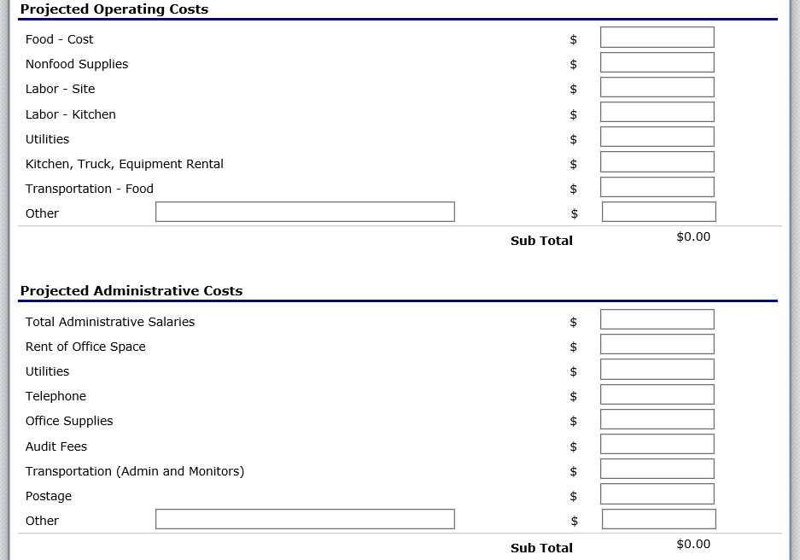
Application Packet – Budget Detail
Notes:
The next section is exactly like the old version of ACES. This will allow you to put in what your are budgeting for.

Slide 31
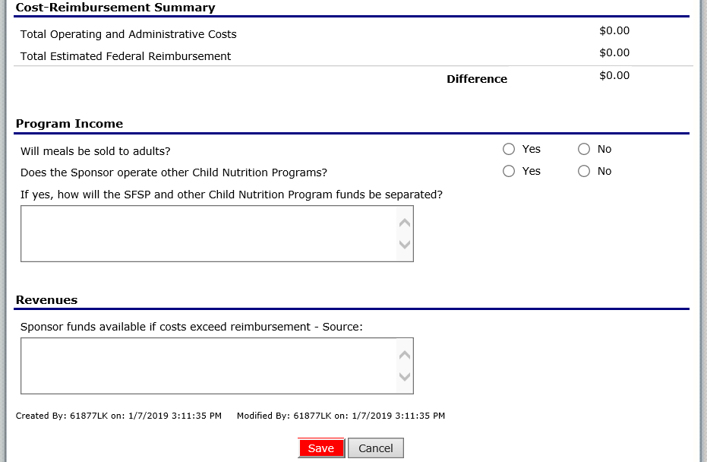
Application Packet – Budget Detail
Notes:
The next section is exactly like the old version of ACES. It will compare you reimbursement to your expenses, and then you must answer Program Income and Revenue questions. Once Completed, please click Save.

Slide 32
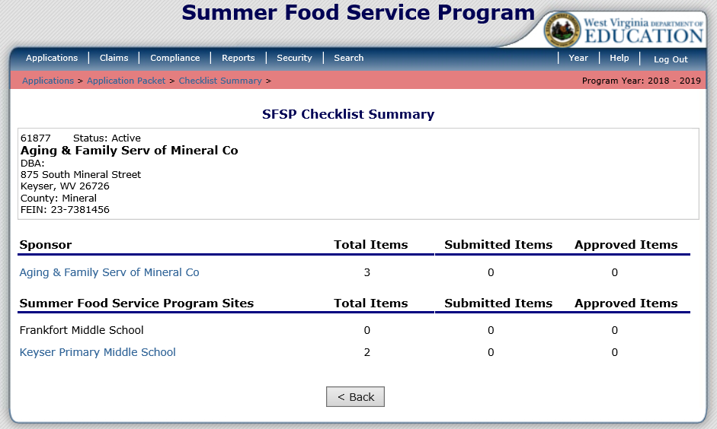
Application Packet – Checklist Summary
Notes:
After the site applications are completed, you will need to complete the Checklist Summary in the Application Packet. Please note that there is both a Sponsor section and a Site section. In this example, three Items need to be completed for the sponsor and one site has two items that need completed. To begin, just click on the sponsor name in blue.

Slide 33
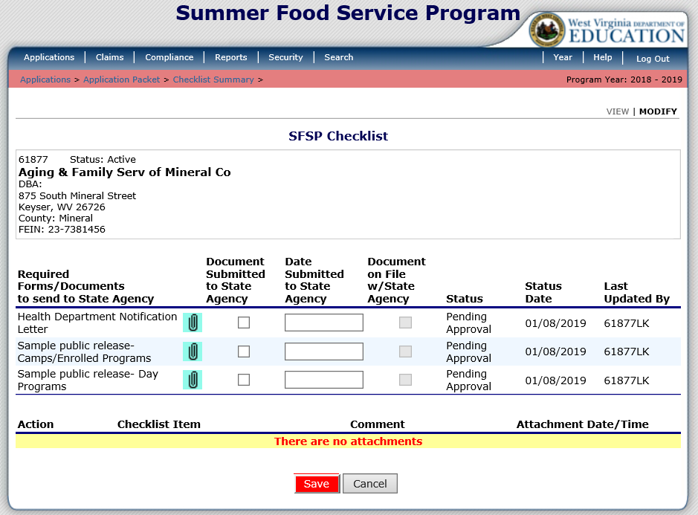
Application Packet – Checklist Summary
Notes:
Each supporting document or checklist item will have a paperclip to attach a file. If you attach the file it will appear in the lower portion of this screen. You must check the checkbox beside the checklist item once it is uploaded or mailed/faxed to the state agency. Please remember to select the red Save button at the bottom of the screen.

Slide 34
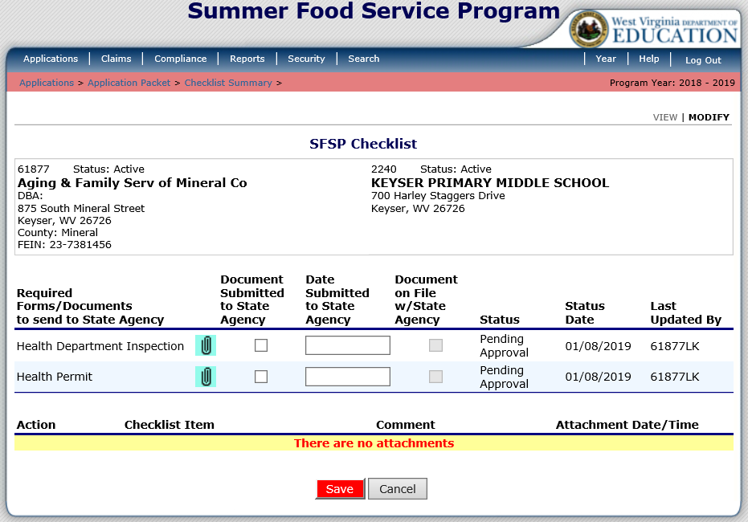
Application Packet – Checklist Summary
Notes:
After the sponsor checklist items are completed, click on the blue site names and complete the same process. Please make sure that the boxes beside each checklist item are checked when the items are uploaded or mailed/faxed to the State Agency. Then click the red Save button.

Slide 35
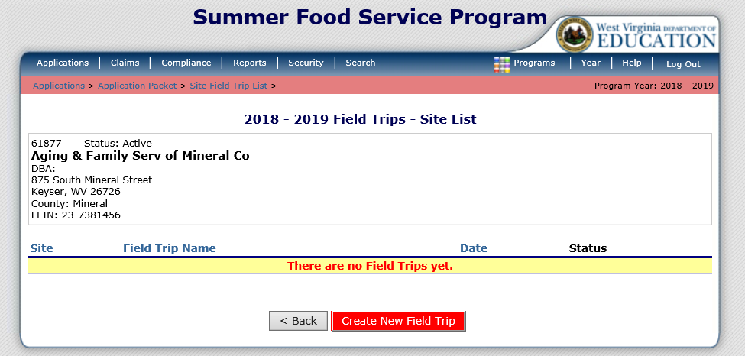
Application Packet – Site Field Trip List
Notes:
If you have field trips planned, please select Details beside the Site Field Trip List in the Application Packet. To add the planned Field Trip, click Create New Field Trip at the bottom of the screen.

Slide 36
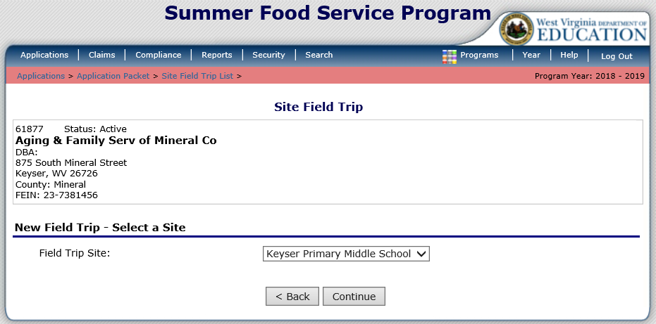
Application Packet – Site Field Trip List
Notes:
The dropdown list contains your sites. You must select the site that will be going on the field trip and click Continue.

Slide 37
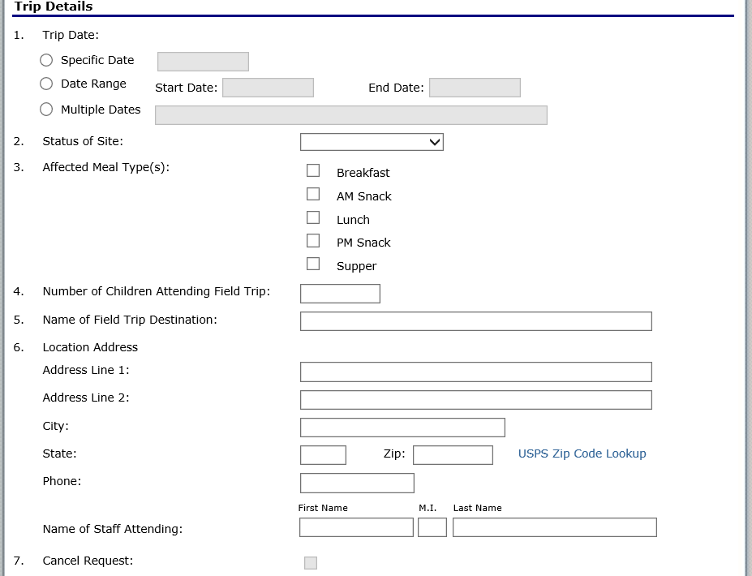
Application Packet – Site Field Trip List
Notes:
To submit the Field Trip Request, complete the information and then click Save at the bottom of the screen. You may create Field Trip Requests even if your Application Packet is Approved and it will not change the Approval Status of the Application Packet.

Slide 38
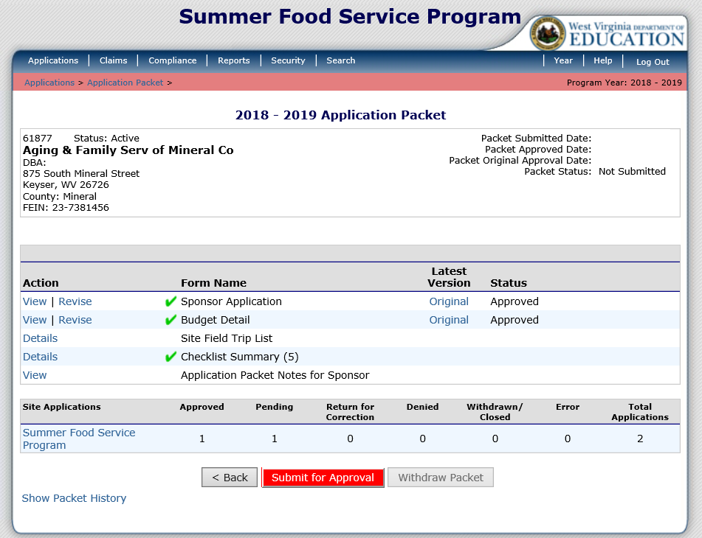
Application Packet – Submit for Approval
Notes:
Once all Action items are completed, click the red Submit for Approval button. WVDE cannot approve an application packet without this button being selected.

Slide 39
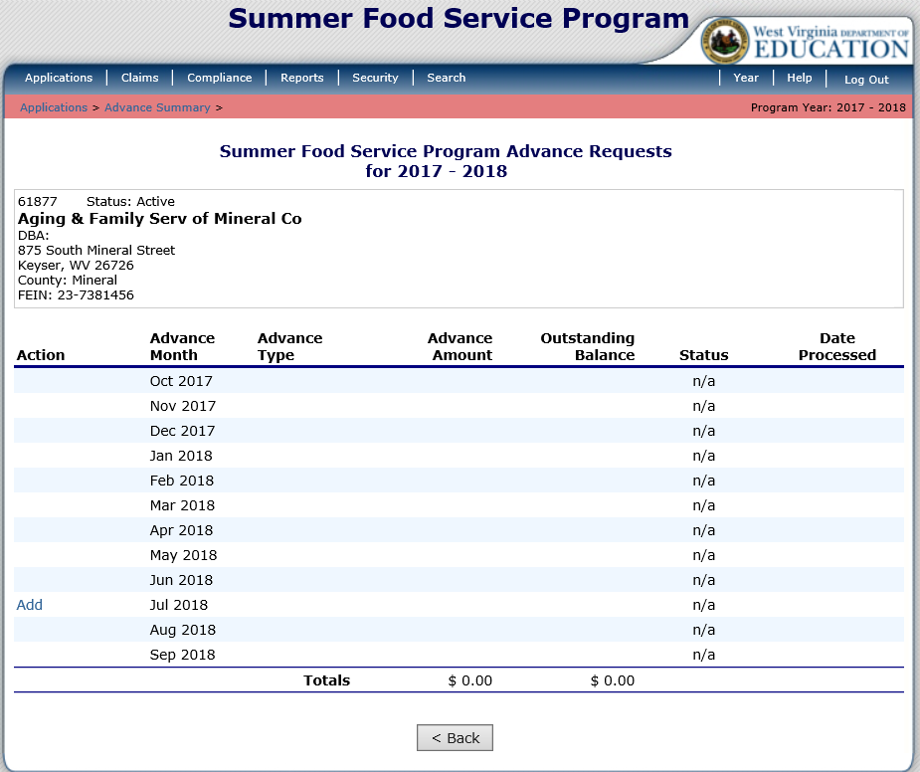
Applications – Advance Requests
Notes:
After selecting Applications from the Menu Bar, you may select Advance Requests if you wish to receive an advance.
Click Add beside to month you wish to receive an advance.

Slide 40
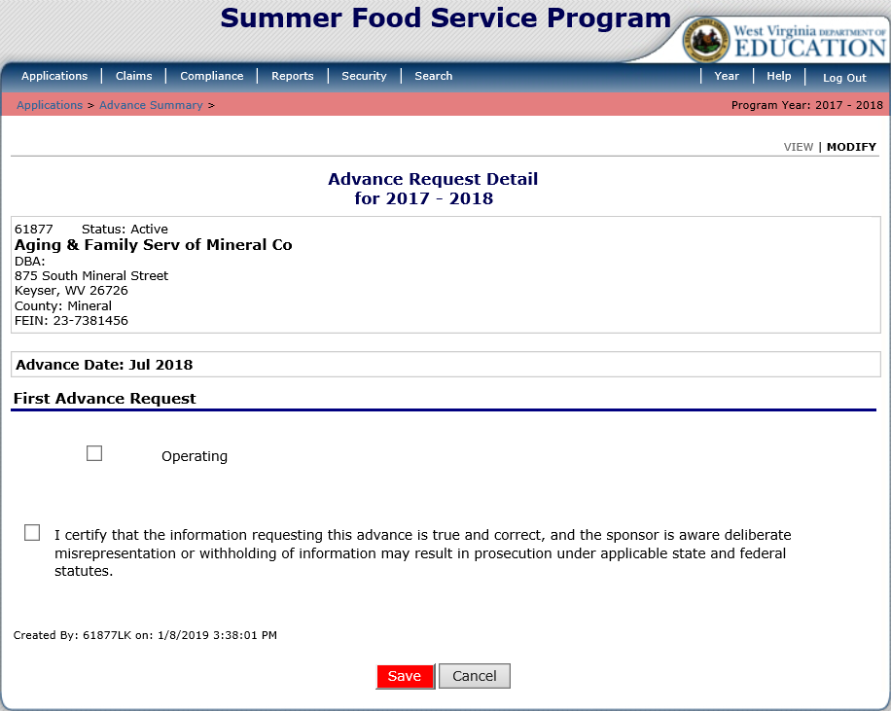
Applications – Advance Requests
Notes:
Check the checkbox beside Operating and the checkbox that certifies the information. Please remember to click Save.

Slide 41
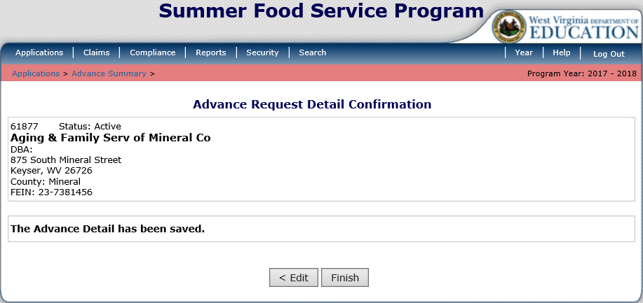
Applications – Advance Requests
Notes:
You will receive a confirmation screen that the information was saved. Please click Finish.

Slide 42
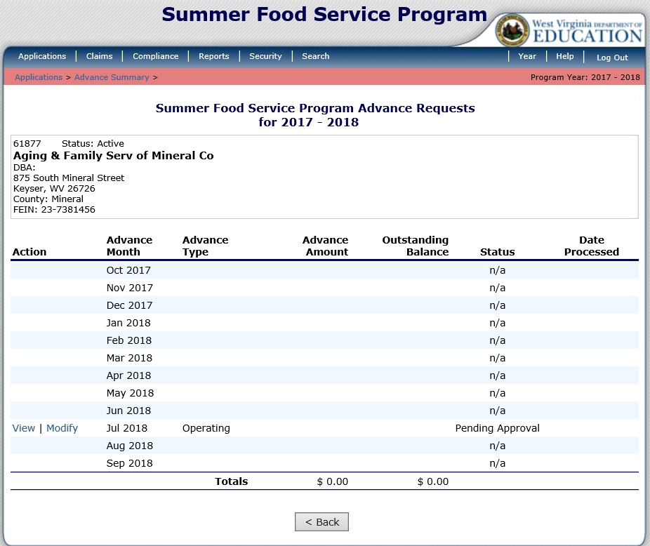
Applications – Advance Requests
Notes:
You will be able to see that the Advance Request is Pending Approval for the month you selected.

Slide 43
Claiming

Slide 44
Claiming
Notes:
Once your sponsor Application is approved, you may begin submitting online reimbursement claim requests. To submit a claim, select Claims from the blue menu bar. Under Item, select the type of claim you would like to submit.
Click Claim - SFSP

Slide 45
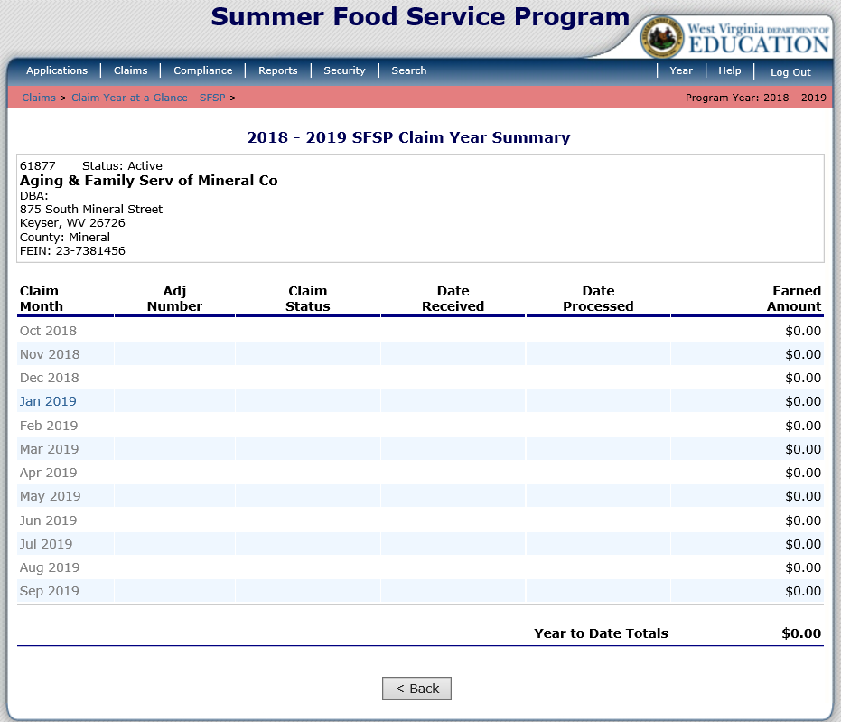
Claiming
Notes:
The Claim Year Summary screen summarizes information regarding the claim for each month in the designated year:
• Adj Number: identifies the number of revisions associated with the claim. Each revision must be re-processed by WVDE OCN.
• Claim Status: identifies the current status of the claim.
• Date Received: identifies the date the system initially received the claim submission.
• Date Processed: identifies the date the claim was included in the payment batch process.
• Earned Amount: identifies the current value of the claim.
To submit a claim, select the desired Claim Month.

Slide 46
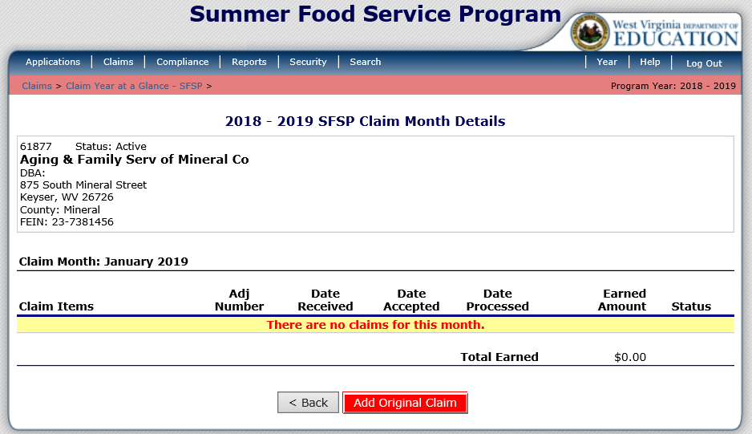
Claiming
Notes:
This screen will appear if this is the first time submitting a claim for the month selected. Select the red Add Original Claim button at the bottom of the screen to add a claim.

Slide 47
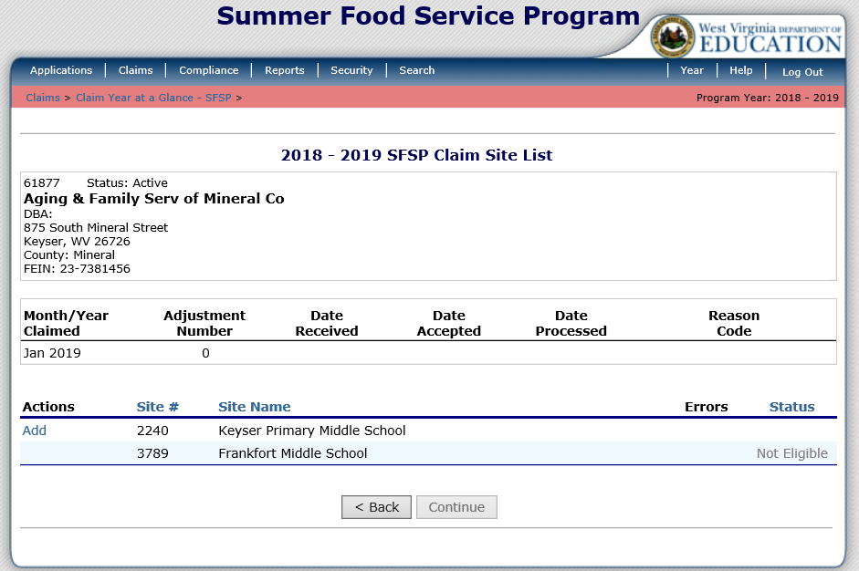
Claiming
Notes:
All sites should be listed on this screen. In the old version of ACES, you had to submit a claim for each site approved to operate in the month selected. The new ACES does not require you to add a claim for each site. If you only had meal counts for the first site then that is the only site you need to select. To submit a claim for a site select Add beside the site you wish to add a claim for.

Slide 48
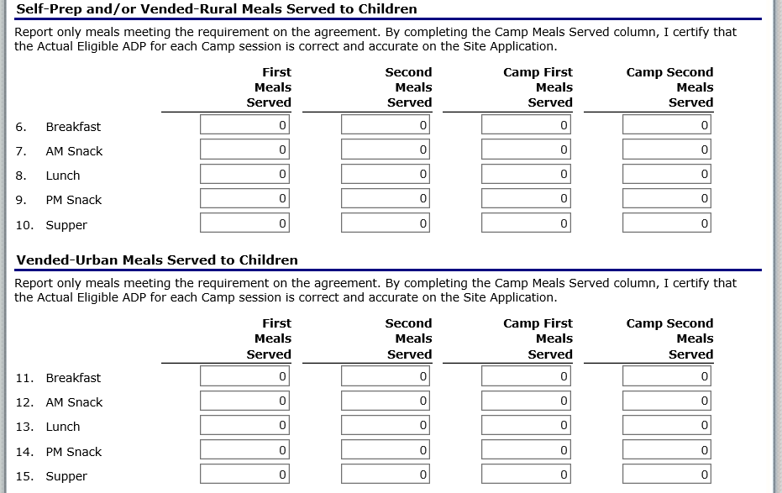
Claiming
Notes:
The may be a little confusing.
Self-Prep and/or Vended-Rural Meals Served to Children – For meal reporting for Rural Sites
Vended-Urban Meals Served to Children – For meal reporting for Urban Sites
In each of these sections,
First Meals Served and Second Meals Served are for all forms of Open Sites
Camp First Meals Served and Camp Second Meals Served are for all forms of Camps
Please be sure that you record the meals in the correct section and column.

Slide 49
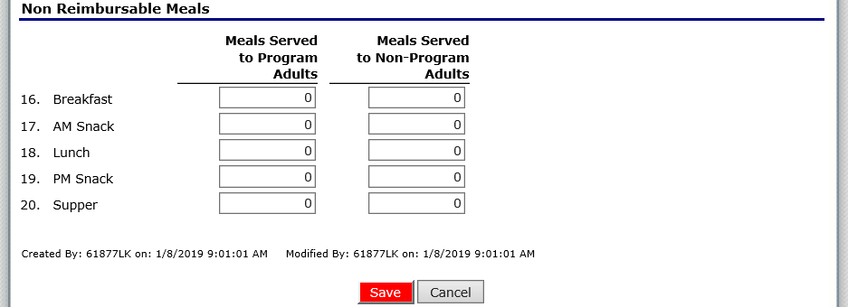
Claiming
Notes:
Finally, type in the number of Non Reimbursable meals and click Save.

Slide 50
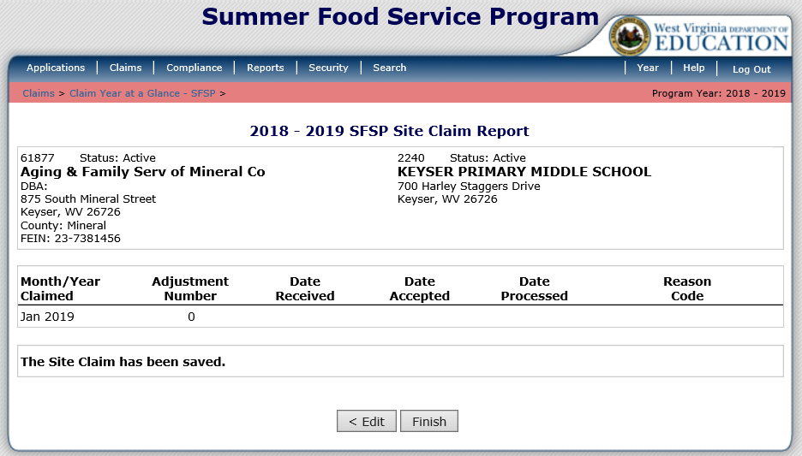
Claiming
Notes:
After saving your claim information, you must click Finish at the bottom of the screen and then continue this process for any other site you are claiming for.

Slide 51
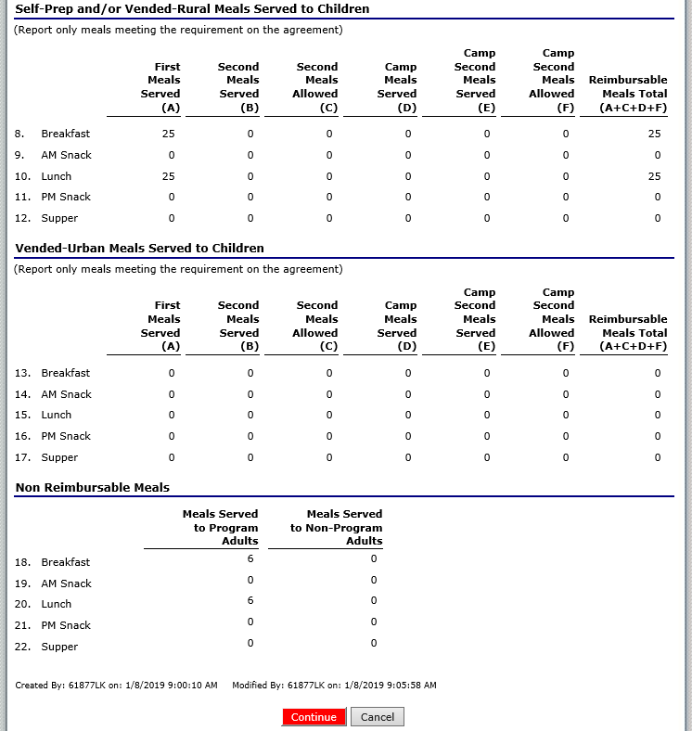
Claiming
Notes:
Next you will receive meal count totals for all of the sites you claimed. If everything appears to be correct, click Continue at the bottom of the screen.

Slide 52
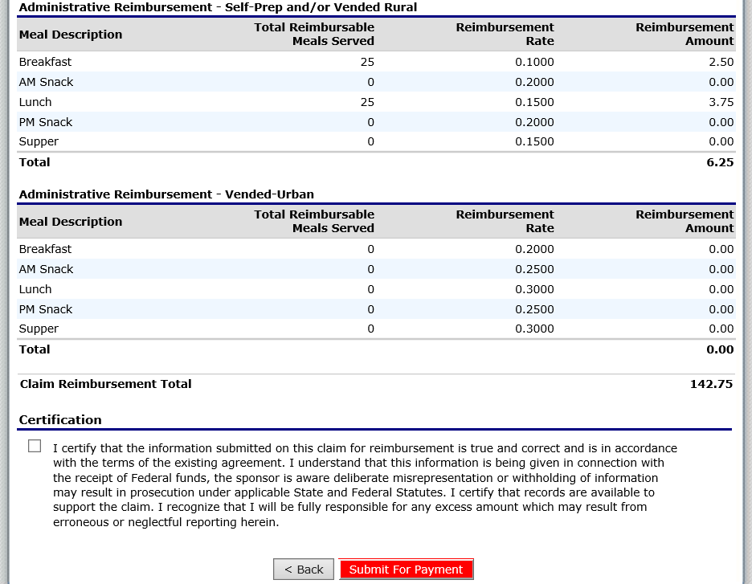
Claiming
Notes:
The next screen will have the meal counts and the Reimbursement Amount for the entire claim. To complete the claim submission, check the checkbox in the Certification Section and click Submit For Payment.

Slide 53
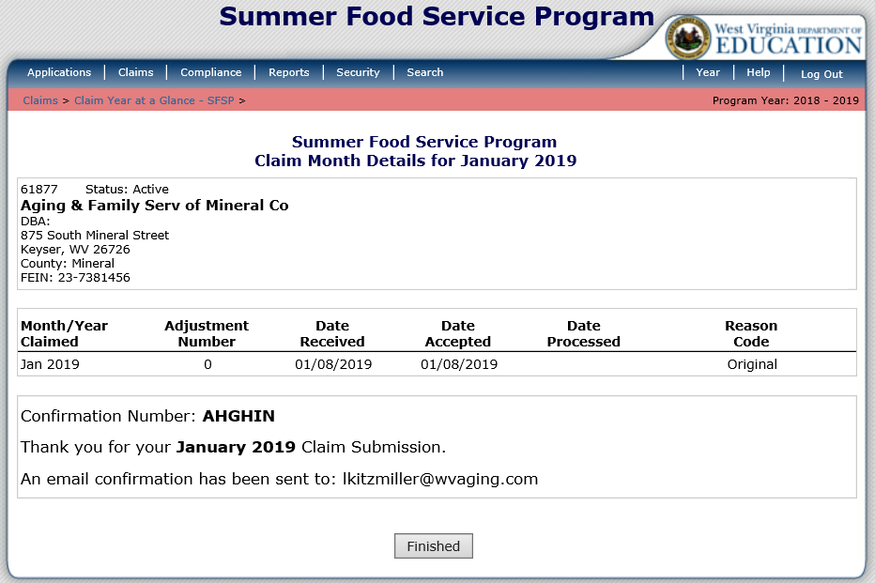
Claiming
Notes:
Once you successfully submit your claim, you will see this screen. It will display a confirmation number and generate an email letting you know that your claim was successfully submitted. Select the Finished button.

Slide 54
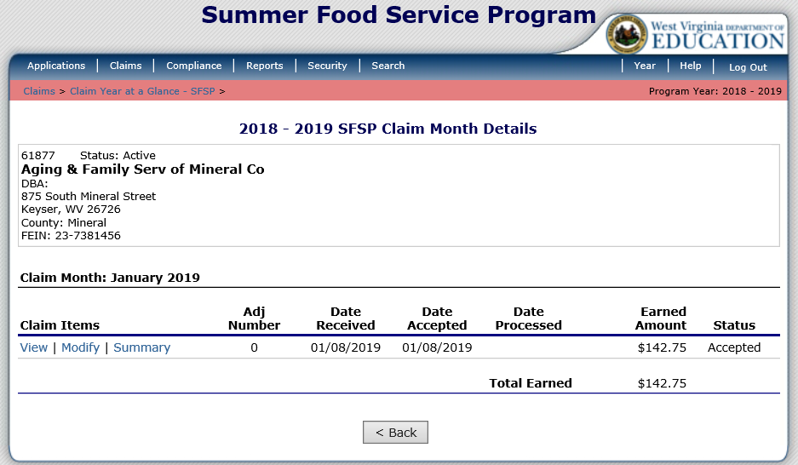
Claiming
Notes:
This is the next screen. It is just informational. In the old version of ACES, the only claim statuses were Not Processed and Processed. In the new ACES the statuses are Validated, Accepted, and Processed.
Validated is the status you receive before you submit your claim. This just means that you put in the data and there were no errors.
Accepted means that you have successfully submitted your claim and are waiting for WVDE OCN to process it.
Processed means that your claim has been batched and is in the hands of the State Auditors Office for payment.

Slide 55
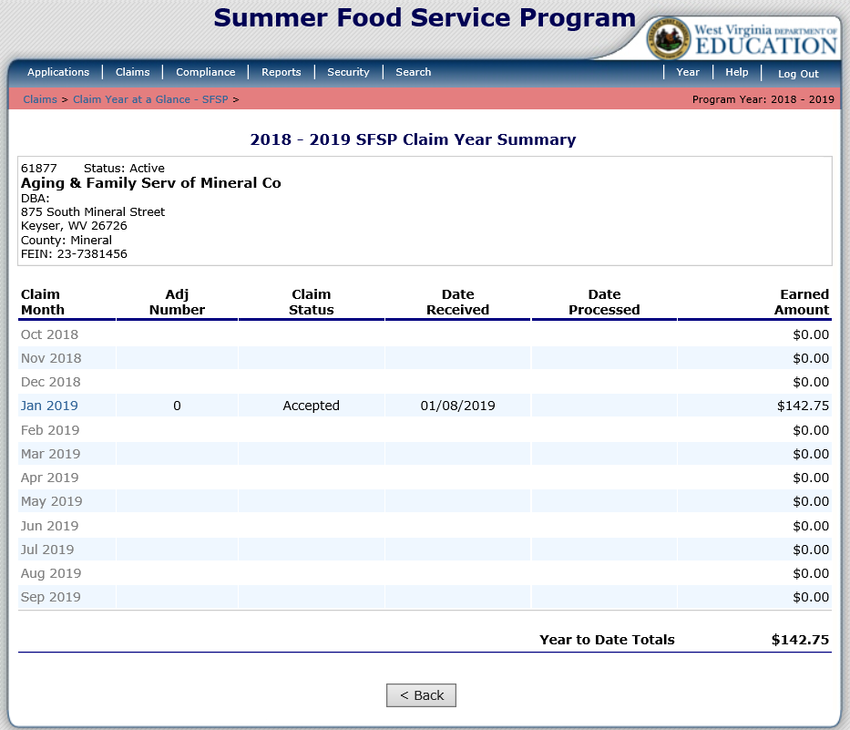
Claiming
Notes:
This screen shows the Processed and Accepted claim statuses.
In this example, the Jan 2019 claim was successfully submitted and accepted.

Slide 56
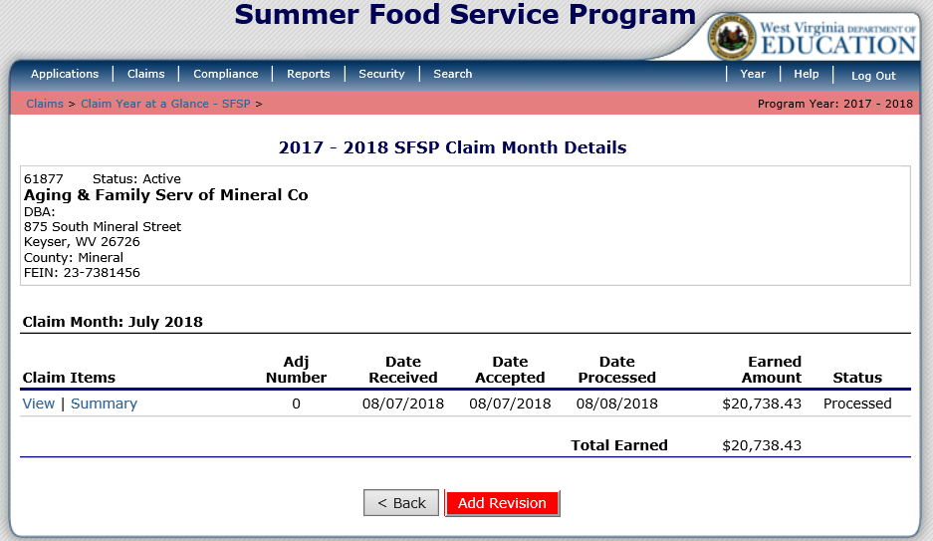
Claiming
Notes:
If you need to revise a claim that has already been Processed then select the claim month you need to revise. In this example, the July 2018 claim needs modified. To modify this claim, select the red Add Revision button at the bottom of the screen. Next repeat the steps conducted for entering a claim. Do not just enter the revision numbers. Enter the actual total amount of meals for each site and any financial changes that need to be entered for each site.

Slide 57
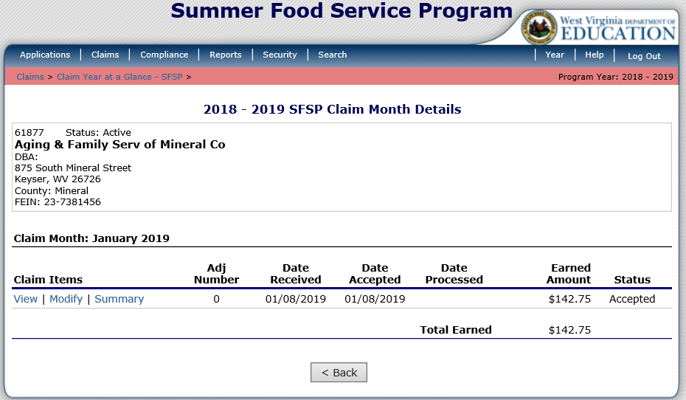
Claiming
Notes:
If you need to revise a claim that is has not been Processed and is listed as Accepted in the Status column then you click on the claim month and then click on Modify to make your edits. Simply follow the same procedures for completing a claim.
In this example, the claim is still in Accepted status, and has not been batched. This is the reason you can modify it instead of submitting a revision.

Slide 58
Questions

