Slide 1
Office of Professional Preparation
Association of School Business Officials
May 13, 2015 Embassy Suites, Charleston

Slide 2
Welcome
Dr. Monica Beane, NBCT
Executive Director
Office of Professional Preparation

Slide 3
Meeting Agenda
Introductions
WVBE Policy Revisions
(5202, 5100, 5310, 5901)
OPP Application Process, Forms and Procedural Updates
Q&A Session

Slide 4
Robert Hagerman
Assistant Director
Office of Professional Preparation

Slide 5
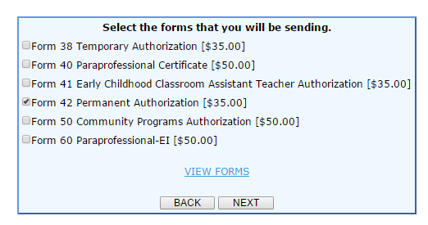
Online Payment
Be certain to use the FORM #, not the FORM name when you pay online.
Notes:
Be sure to verify that the applicant has correctly paid.

Slide 6
Waiver Process
As a result of new accountability measures and ensure educator quality, the waiver request guidelines will be strictly enforced
Waiver form and letter required
Waiver request form must be submitted by County Superintendent/equivalent or Community Program Director and must include the correct licensure application and processing fee(s)
Waiver must meet at minimum one of the eligible criteria
Waivers (if approved) will result in the issuance of the certificate requested and will expire on June 30 of the academic year for which the waiver was requested
Only one waiver may be submitted for the life of the certificate
Notes:
Mr. Robert Hagerman and others as directed

Slide 7
Waiver Process
Only the following certificates are eligible for a waiver request:
Professional Certificates or Equivalent
First-Class, Full-Time Permit
Out of Field Authorization
Community Program Authorization
Substitute Permit
Alternative Teaching Certificate
Career and Technical Certificates
Notes:
Mr. Robert Hagerman and others as directed

Slide 8
Extenuating Circumstances Required for Waiver Request | Unacceptable Criteria for Waiver
Illness/Death | X Unable to meet required GPA as defined in WVBE Policy 5202
Hardship | X Not having passing scores on Praxis exams or inability to take exams
Unavailability of Coursework Inability to register/enroll in coursework/program as a result of time of year, semester already in progress, or other qualifying circumstance must be documented and verified by IHE | X Lack of understanding of renewal requirements (i.e. number of hours needed, dates for eligible coursework)
Notes:
Mr. Robert Hagerman and others as directed

Slide 9
TSS Certification
Effective school year 2015-2016, all individuals holding a temporary authorization for TSS must hold a minimum of an Associates Degree, per WVBE Policy 5202.
No waivers will be granted for applicants who do not hold the required degree.
Notes:
No waivers will be allowable for 2015-2016 for TSS for the required AA degree level.

Slide 10
Embassy of Spain
Visiting Teacher Program
Notes:
Mr. Robert Hagerman

Slide 11
Brad Fittro
Teacher Quality Coordinator
Office of Professional Preparation

Slide 12
Policy 5202
Proposed revisions to WVBE in July 2015
30-Day Public Comment Period
http://wvde.state.wv.us/policies/

Slide 13
Form Updates

Slide 14
Form 4
An applicant who currently holds an initial certificate (code 21) must first fulfill the requirements for conversion to the five-year certificate (code 22), as listed in Options 1-6 on the Form 4, in order to be eligible for a permanent certificate (code 22-4)
These requirements are in addition to the requirements for a permanent certificate.

Slide 15
First Class Permit
A First-Class, Full-Time Permit (FCP) or Out-of-Field Authorization (OOF) may be issued to an educator who is not certified for a specific employment position, but meets criteria established in Policy 5202
Only permissible when no fully-certified educator has applied for the position

Slide 16
First-Class, Full-Time Permit
Five Year Limit. –The position held is not subject to posting, provided the educator meets the annual renewal requirements and completes the state-approved certification program within five years.
The State Superintendent may extend the five-year limit if appropriate extenuating circumstances warrant the extension.

Slide 17
First-Class, Full-Time Permit
Initial First Class Permit: The college/university teacher certification specialist must verify on the Form 1/1A application that 25% of the state-approved program for the endorsement area has been completed.

Slide 18
First-Class, Full-Time Permit
Educators who currently hold an appropriate Professional Certificate may be eligible for an Out-of-Field Authorization if the 25% program completion requirement has not yet been met
Employment may continue until the 25% program completion requirement is met.

Slide 19
First-Class, Full-Time Permit
Renewal:
Complete six (6) appropriate semester hours annually
Coursework must be verified by the college/university
Requires 3.0 GPA (Grade of B or higher)
An official transcript is required for each Form 1/1A application
Each Form 1/1A requires both the college/university and the district completion and signature

Slide 20
Linda Bragg
Teacher Quality Coordinator Office of Professional Preparation

Slide 21
Clinical Partnerships Teacher-in Residence

Slide 22
Robert Mellace
Teacher Quality Coordinator Office of Professional Preparation

Slide 23
Clinical Experience Permits Form 23 and 24
Required for various types of clinical experiences (teachers, administrative, student support, etc.)
School districts are required to have agreements with out-of-state IHEs for student teachers using a Form 23
Applicants are encouraged to submit a Form 24 application within 90 days of the clinical experience (in order to be in compliance for fingerprinting)
Always indicate the experience placement dates, content specializations and grade levels
The name of the public school is not required if it is unknown at the time of application

Slide 24
Clinical Experience Permits Form 24
FBI and State background check is required for the clinical experience permit if an applicant has not previously held a West Virginia:
professional teaching certificate
administrative certificate
student support certificate
FBI and State background check will be required again upon applying for initial licensure (per W.Va. Code)

Slide 25
Clinical Experience Permits Form 24
Form 24 is not required if the individual currently holds a valid First-Class, Full-Time Permit
If a student will be placed in a clinical experience in more than one school district, each county must approve a Form 24.
Please attach a Form 24-A and a Form 7 for each additional district - no additional fee will be required for the Form 24-A or Form 7

Slide 26
Career and Technical Education Forms V7 and V9
Pay close attention to the type of licensure requested on form V9
Requested endorsement code from WVBE Policy should be included on the form
Requested endorsement should match course codes being taught
Signature from WVUIT is required when verifying approved coursework, professional commitment or program completion

Slide 27
Adult Basic Education Form V15
Only Part 1 is required to be completed by the employing county
The applicant must select an option for Part 2 when applying for renewal
Part 3 should be left blank – as the WVDE will complete this information

Slide 28
Permanent Adult Part-Time Permit Form V17
V10 is required for work experience
Industry recognized credentials are required, if applicable
Ensure that education level documentation is included with the application

Slide 29
EMT/Fire Service Adult Permit Forms V18
V18 – Requires two signatures:
Superintendent or RESA Director must sign the Applicant Information Page and
Regional Public Service Coordinator signs the Form V18
Achieved score of 85% on WVDE-approved examination may be verified by letter on official letterhead, if kept on file at RESA
Please pay close attention to what must be attached to the application and to what is kept on file at RESA

Slide 30
Verifying Work Experience Form V10
If the applicant is claiming work experience based on self-employment – tax records are required.
Tax records should include:
the business name
applicant’s signature
indicate full-time work at this business.

Slide 31
Verifying Work Experience Form V10
It is best for the name of the company verifying employment in Part 1 (applicant) to match the name of the company/agency in Part 2 (verification of employment by the employer)
The Form V10 must be signed by a public notary with an official seal included

Slide 32
Troops to Teachers
Provides the following benefits to qualifying military service members:
Career Counseling
Job Placement Assistance
Financial Assistance
Contact:
North Atlantic Regional Director
Vanessa Barron
1.855.241.2173
vbarron@troopstoteachers.net

Slide 33
Teresa Epperley, NBCT
Teacher Quality Coordinator Office of Professional Preparation

Slide 34
Alternative Certification for 2015-2016
Requires an approved partnership between a school or school district, an IHE, an entity associated with an IHE, the WVDE or a RESA. Any combination of these will form a partnership.
WVBE Policy 5901 will establish the approval process and required criteria

Slide 35
Requirements
Hold a minimum of a bachelor’s degree from an accredited institution of higher education (IHE) in an area other than education
Be a US Citizen
Prior to being hired, candidates for general education content area positions and candidates for special education positions must submit passing scores on the Praxis I CORE (#5751) (or qualify for an exemption) https://wvde.state.wv.us/transitiontoteaching/eligibility.php
Prior to being hired, general education teacher candidates must submit passing scores on the Praxis II for content knowledge

Slide 36
Paraprofessionals and Paraprofessional Educational Interpreters
Applicants for Paraprofessional must:
Have completed all requirements prior to submitting the Form 40 appliation
Be employed by a district
Have the superintendent verify employment by signing the Applicant Information Sheet attached to the Form 40 application

Slide 37
Jodi Oliveto-Moore
Teacher Quality Coordinator
Office of Professional Preparation

Slide 38
§18-5-18. Kindergarten programs.
Beginning July 1, 2014, any person previously employed as an aide in a kindergarten program and who is employed in the same capacity on and after that date and any new person employed in that capacity in a kindergarten program on and after that date shall hold the position of aide and either Early Childhood Classroom Assistant Teacher I, Early Childhood Classroom Assistant Teacher II or Early Childhood Classroom Assistant Teacher III. Any person employed as an aide in a kindergarten program that is eligible for full retirement benefits before July 1, 2020, may remain employed as an aide in that position and shall be granted an Early Childhood Classroom Assistant Teacher permanent authorization by the state superintendent pursuant to section two-a, article three, chapter eighteen-a of this code.

Slide 39
Eligible for Full Retirement Benefits (Effective March 9, 2015)
Any person employed as an aide in a Pre-K classroom that is eligible for full retirement benefits before July 1, 2020,must apply for permanent authorization unless the WV Universal Pre-K classroom is in collaboration with Head Start.
All coursework is required for Head Start Assistant Teachers WVBE Policy 2525

Slide 40
Eligible for Full Retirement Benefits (Effective March 9, 2015)
Before July 1, 2020
Applicants must apply with the following:
Applicant Information Page
Revised Form 41

Slide 43
Eligible for Full Retirement Benefits
Before July 1, 2020
Applicants must apply with the following:
Applicant Information Page
Revised Form 41
Form 7 (Background Check) **
Proof of passing score of the State Competency Exam**
Proof of a high school diploma or equivalency**
Pay the $35 fee online
**Exempt for Paraprofessionals

Slide 44
ECCAT Initial Apply upon Placement in a Pre-K or Kindergarten
Applicants must apply with the following:
Applicant Information Page
Revised Form 41
Form 7 (Background Check) **
Proof of passing score of the State Competency Exam**
Proof of a high school diploma or equivalency**
Pay the $35 fee online
NO COURSEWORK REQUIRED FOR INITIAL APPLICAITON
**Exempt for Paraprofessionals

Slide 45
ECCAT Renewals
Applicants must apply with the following:
Applicant Information Page
Revised Form 41
Proof of successful completion of coursework or semester hours.
Seal-bearing transcript OR
E-Learning completion certificate OR
ACDS seal-bearing certificate OR
CDA advisor signature
Pay the $35 fee online

Slide 46
Coursework must be listed for processing.

Slide 47
Permanent ECCAT
Applicants must apply with the following:
Applicant Information Page
Revised Form 41
Proof of successful completion of coursework or semester hours.
Seal-bearing transcript OR
E-Learning completion certificates for all three (3) courses
ACDS ~ A copy of the official certificate from the United States Department of Labor OR
CDA ~A copy of the official seal-bearing certificate from the National Credentialing Agency OR
Pay the $35 fee online

Slide 48
Scottie Ford
Certification Coordinator
Office of Professional Preparation

Slide 49
Advanced Salary
All graduate level hours in public education or in an endorsement area held on the certification may be used for advanced salary on a professional certificate after the appropriate master’s degree has been awarded (Form 12 advanced salary application required).

Slide 50
Advanced Salary
Up to 15 undergraduate level or post-baccalaureate level hours in public education or in an endorsement area held on the certification may be used for advanced salary if completed after the WV professional certification effective date.

Slide 51
Advanced Salary
Only highest degree level can be recognized on a permit or authorization unless: First Class Permit for an endorsement requiring a master’s degree (BA15 allowable); or the professional equivalent certificates as defined in WVBE Policy 5202, section 126-136-4.57.

Slide 52
Salary Supplements
A salary supplement and fee reimbursement are available for teachers with recognized National Certification from the National Board for Professional Teaching Standards (NBPTS).
The annual state salary supplement for NBCTs is currently $3,500.00. The county may provide an additional supplement, if desired. §126-136-23.3.

Slide 53
Salary Supplements
NBPTS Teachers:
Salary Supplement: Form 12
Salary Supplement Renewal: Form 12
Fee Reimbursement: Form 37
http://wvde.state.wv.us/certification/forms/

Slide 54
Salary Supplements
A separate salary supplement & fee reimbursement are available for certain student support professionals with recognized National Certification in Speech-Language Pathology, Audiology, Counseling, School Psychology, and School Nursing.

Slide 55
Salary Supplements
The annual state salary supplement for student support professionals identified to receive it is $2,500.00.
The county may provide an additional supplement, if desired. §126-136-23.4

Slide 56
Salary Supplements
Student Support Professionals:
Initial Salary Supplement: Form 43
Salary Supplement Renewal: Form 44
Fee Reimbursement: Form 33
http://wvde.state.wv.us/certification/forms/

Slide 57
Tuition Reimbursement
Applications for state tuition reimbursement are accepted from July 1 through June 30, and are processed for funding until the Out of Funds status occurs each fiscal year.
Coursework must be completed during the same fiscal year in which the Form 36 application is received by the OPP.

Slide 58
Tuition Reimbursement
Fifteen (15) maximum lifetime shortage area hours currently are allowable.
A GPA of 3.0 is required for the coursework. §126-136-23.1.
Tuition Reimbursement: Form 36
http://wvde.state.wv.us/certification/forms/

Slide 59
Certification Application
All requirements for renewal must be completed before a Form 38 application is submitted to the WVDE Office of Professional Preparation. This includes:
Chief School Business Official
Professional Accountant
Child Nutrition Director
TIS and TSS
Notes:
Applications submitted before renewal requirements have been completed will be denied. Some applications are being submitted weeks or months before renewal requirements are being completed.

Slide 60
Lori Buchanan
Teacher Quality Coordinator
Office of Professional Preparation

Slide 61
Highly Qualified Teachers
Elementary Education = Multi Subjects
Multi Subjects K – 8 only allows someone to teach courses K – 6. They must hold the appropriate content area endorsement or permanent authorization for teaching 7th or 8th grade classes. Refer to Policy 5202 18.6.

Slide 62
HQT Requirements for Title I Reading Teachers
8.2.b.2. Title I Reading Teacher. – According to the NCLB guidelines, a Title I reading teacher is considered HQ if the individual holds state certification in one of the following: (revision of policy effective 11/2014)
Master’s degree in reading specialist
Completion of a graduate level reading specialist program
Completion of a reading education endorsement program.

Slide 63
HQT Requirements for Title I Reading Teachers
The Reading Crosswalk Memorandum from 2011 is no longer a valid document due to this latest revision of policy regarding the HQT requirements for Title I Reading teachers.

Slide 64
Form 8C
Go to: http://wvde.state.wv.us/certification/forms
At the top portion of the site you will see:
Additional Endorsement Based on Content Proficiency
(Guidance Document)
Link to guidance document is:
http://wvde.state.wv.us/certification/forms/documents/WebsiteGuideEndorsemebtbyPraxis.pdf

Slide 65
Trent Danowski
Teacher Quality Coordinator
Office of Professional Preparation

Slide 66
Policy 5310 & Educator Evaluation
The policy is scheduled to go before the WVBOE in June.
Recommendation will be for Policy to go out on comment for 30 days.
The following sections of policy have received revisions and will be open for public comment in June:
§126-142-4. Definitions.
§126-142-9. Educator Evaluation.
§126-142-13. Evaluation Process for Teachers.
§126-142-22. Professional Support Personnel Responsibilities.

Slide 67
Roster Verification System
Why Roster Verification in West Virginia Now?
In order to guarantee equitable professional evaluations which incorporate student growth data from state testing, classroom educators are offered an opportunity to review and correct student roster information.
The first year of full implementation for Roster Verification across the state of West Virginia is scheduled to conclude later this month.
School and educator participation in the roster verification process has been excellent! http://wvde.state.wv.us/evalwv/trainings.html

Slide 68
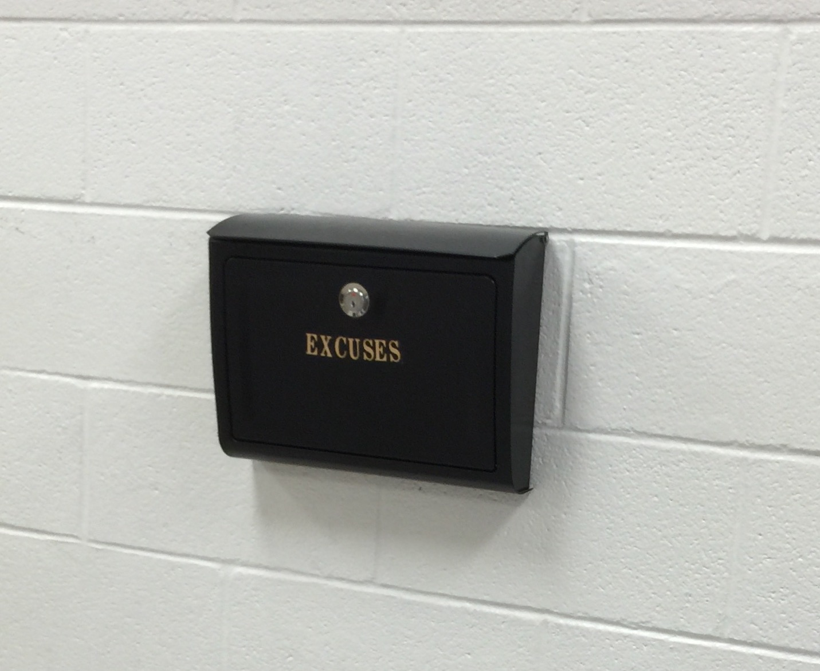
Questions?

