Slide 1
Office of Professional Preparation
WV School Personnel Association Conference
May 14, 2014
Embassy Suites, Charleston
Notes:
Dr. Monica Beane

Slide 2
Welcome
Dr. Monica Beane
Executive Director
Office of Professional Preparation
Notes:
Dr. Monica Beane

Slide 3
MEETING AGENDA
WVBE Policy 5202
WVBE Policy 5310
OPP Application, Form and Procedural Updates
Transition to Teaching
Embassy of Spain
Additional Topics
Questions and Answers Session
Meeting Conclusion
Notes:
Dr. Monica Beane

Slide 4
WVBE Policy 5202
Robert Hagerman
Assistant Director
Office of Professional Preparation
Notes:
Mr. Robert Hagerman

Slide 5
Policy 5202
The policy was out on comment for a period of 30 days
The following are changes that will be in place when the policy becomes effective next month
Notes:
Mr. Robert Hagerman and others as directed

Slide 6
Policy 5202
§126-136-4. Definitions. The following definitions were added: Early Childhood Classroom Assistant Teacher Temporary Authorization, Early Childhood Classroom Assistant Teacher Permanent Authorization, Early Childhood Classroom Assistant Teacher Paraprofessional Certificate, The Student Teaching Permit was changed to Clinical Experience Permit to encompass teacher, administrator or student support candidates placed in clinical experiences in public schools settings.
§126-136.5. Categories of Licenses. Language was added to clarify that the Temporary Certificate is valid for a period of one year and may not be renewed.
Notes:
Mr. Robert Hagerman and others as directed

Slide 7
Policy 5202
§126-136-6. Legal Basis for Licensure. Clarifying language was inserted to reflect that a county may employ an applicant for a professional educator’s certificate in good faith on the anticipation that he or she is eligible for a certificate. Additionally, language was added to clarify the reinstatement procedure following the suspension and/or revocation of licenses. Language was added to clearly state that a certificate that was designated as permanently revoked shall not be eligible to apply for reinstatement. Language was also added to clarify the Hearing and Appeals section as it pertains to the West Virginia Commission for Professional Teaching Standards (WVCPTS).
Notes:
Mr. Robert Hagerman and others as directed

Slide 8
Policy 5202
§126-136-7. Responsibilities for Licensure. Language was added to clarify that the waiver granted by the State Superintendent shall only be for a period of one year. During this one-year period, the applicant must complete all requirements that were waived. Prior to the conclusion of the one year waiver period, the applicant must apply for licensure and will be required to meet all requirements for the licensure to be issued for the remaining period of the license.
§126-136-10. Licenses for Professional Educators. Language was clarified to reflect the renewal option for a permanent certificate based on renewing the professional certificate valid for five years once; not two times, as previously stated.
Notes:
Mr. Robert Hagerman and others as directed

Slide 9
Policy 5202
§126-136-11. Permits Issued to Professional Educators. References to permits for student teachers were updated to reflect permits for clinical experiences for teachers, administrators, and student support candidates. Language was revised to reflect the requirements for the Initial Fire Service Training Adult part-Time Permit. An Authorization for Professional Accountant was added. Additionally, updated numbering was required to reflect the most recent revision to Policy 5202. Previous references are no longer valid due to renumbering the section.
Notes:
Mr. Robert Hagerman and others as directed

Slide 10
Policy 5202
§126-136-12. Early Childhood Classroom Assistant Teacher Authorization and Paraprofessional Certification. This section was revised from Paraprofessional to include Early Childhood Classroom Assistant Teacher Authorization and Paraprofessional Certification. Due to Legislative action, specifically W. Va. Code §18-5-44(m), the Early Childhood Classroom Assistant Teacher Authorization was added. Additionally, revisions were necessary for the requirements of the Permanent Paraprofessional Certificate and the Educational Sign Language Interpreter I and II.
Notes:
Mr. Robert Hagerman and others as directed

Slide 11
Policy 5202
§126-136-15. Alternative Routes to Certification. Language was added to clarify the issuance of an Alternative Teaching Certificate endorsed for elementary education, per special permission of the WVBE.
§126-136-16. Out-of-State Applicants. Language was added to clarify that a temporary, one-year certificate issued to an out-of-state applicant who did not meet requirements for an initial three year certificate, is non-renewable.
Notes:
Mr. Robert Hagerman and others as directed

Slide 12
Policy 5202
§126-136-17. Non-United States Citizen. Language was added to include a Permit for Exchange/Visiting Teachers – Non-United States Citizen. This permit would allow exchange/visiting teachers participating in a program or exchange recognized and/or approved by the WVDE/WVBE to receive a non-renewable Permit for Exchange/Visiting Teachers based upon verification from the partnering organization that the applicant has completed the equivalent of an approved educational personnel preparation program.
Notes:
Mr. Robert Hagerman and others as directed

Slide 13
Policy 5202
§126-136-21. Additional Endorsement(s) for Existing License. Language was added to allow a teacher or administrator with a valid West Virginia Professional certificate to be awarded certification to teach in an additional area of certification upon submission of a passing score on the appropriate content area test required of other teachers or administrators for certification in that area regardless of whether additional course work was taken in that area. Additionally, language was added to require an applicant to provide additional documentation when applying for an endorsement for driver education.
Notes:
Mr. Robert Hagerman and Lori Buchanan others as directed

Slide 14
Policy 5202
§126-136-23. Fee Reimbursements and Salary Supplements. The word ‘waivers’ was removed from this section of policy. It was erroneously added as a typographical edit during the previous policy revision.
§126-136-24. Advanced Credentials. A Permanent Advanced Credential for Technology Integration Specialist was created. This addition required the renumbering of this section of policy.
Notes:
Mr. Robert Hagerman and others as directed

Slide 15
Policy 5202
APPENDIX A – Programmatic Levels and Specializations Recognized on the Professional License. A grade level option for Classroom Assistant Teacher, PKK was added.
APPENDIX B – Approved Standards For Program Development and Required Tests for Completion of WV Approved Programs Leading to WV Licensure. Revisions include updating the PRAXIS exam numbers for the following Endorsement areas: Agriculture, Early Childhood Education, General Science, Safety Education, School Psychologist, and Speech Pathologist. Additionally, references to PPST were removed and additional requirements were added for the Driver Education endorsement.
Notes:
Mr. Robert Hagerman and others as directed

Slide 16
WVBE Policy 5310
Educator Evaluation and
Roster Verification
Trent Danowski
Teacher Quality Coordinator
Office of Professional Preparation
Notes:
Mr. Trent Danowski

Slide 17
Policy 5310 & Educator Evaluation
The policy is now out on comment for a period of 30 days
The following sections of policy have been revised and are open for public comment:
  §126-142-4. Definitions.
  §126-142-9. Educator Evaluation.
  §126-142-10. Plans to Support Continuous Improvement.
  §126-142-11. Evaluation Process for School Leaders.
  §126-142-13. Evaluation Process for Teachers.
  §126-142-15. Evaluation Process for Counselors
  §126-142-18. Improvement Plan for Professional Support Personnel and Central Office Personnel.
Notes:
Mr. Trent Danowski

Slide 18
Roster Verification System
The WV Department of Education has partnered with the Battelle for Kids organization to provide an online Roster Verification System to schools and educators in West Virginia.
WVDE is piloting the new system with approximately 15 schools during May and June (2014).
The new Roster Verification System will be employed by schools state-wide beginning with the 2014-2015 school year.
Notes:
Mr. Trent Danowski

Slide 19
Educator Evaluation Trainings
WVDE and WVCPD will continue to support the educators of the state this summer by providing continued training opportunities and materials:
WVDE will continue to conduct educator evaluation / roster verification seminars within the context of various conferences this summer.
  Summer Data Conference (June 17th – 19th)
  RESA Training Sessions (Dates TBD)
WVCPD and WVDE are organizing evaluation training sessions for principals.
More information on all trainings will be posted as it becomes available at the following link:
http://wvde.state.wv.us/evalwv/trainings.html
Notes:
Mr. Trent Danowski

Slide 20
OPP Application, Form and Procedural Updates
OPP Staff Members
Notes:
Mr. Robert Hagerman and others as directed

Slide 21
OPP Form Updates
Forms:
  Several forms have been updated or newly created (4, 12, 19, V17, V35, 38, 42, 50)
  Form 12 now requires that courses claimed are listed. Transcripts submitted prior to 2003 must be resubmitted
  Substitute permits (Form 2S and Form 2L), a copy of the substitute training certificate of completion must be attached to these applications
Notes:
Mr. Robert Hagerman and others as directed

Slide 22
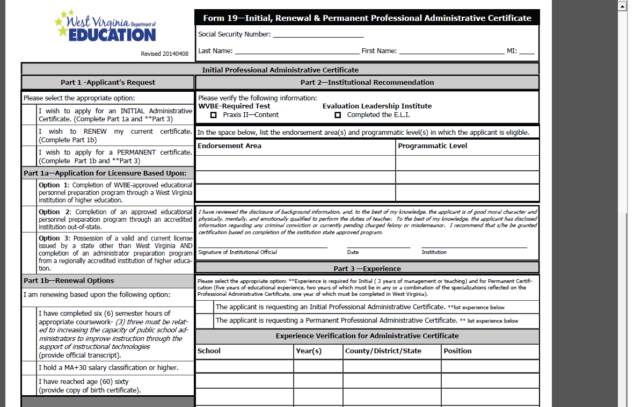
Form 19 Revisions
Notes:
Mrs. Lori Buchanan
Part 1 now specifies what other section(s) must be completed. Reminder that renewals and/or permanent request must hold a MA+30, be age 60 or older, or submit an official transcript with 6 hours of appropriate college credit. Three hours must be in administrative technology. Refer to Policy 5202 Section 10.2.c.1.B

Slide 23
Legal Procedures
All applicants who disclose or for whom results indicate arrests or offenses need to submit a narrative in their own words in addition to any personnel, court, or any other available documentation
Notes:
Mrs. Lori Buchanan

Slide 24
Fingerprints/Background
Only background checks done for done for individuals with a pending application for certification may be shared with the county
Applicants other than those indicated above do not qualify to have a federal background check through L1/MorphoTrust
As per State Police and federal regulations, backgrounds received by OPP where the applicant is not applying for initial licensure/permit/authorization, may not be released from our office to anyone
If background is conducted for county purposes or for service personnel, when registering applicants must indicate the county as the recipient and only pay $28.85
Background checks conducted erroneously may require an additional check and may require additional payment
No service personnel (excluding bus drivers) background checks can be shared with counties
Notes:
Mrs. Lori Buchanan

Slide 25
OPP Application Fees
Beginning July 1, 2014, the processing fees will be $35 for in-state applicants and $100 for out-of-state applicants. In addition, those applications requiring detailed document analysis, a considerable higher processing time commitment, and staff involvement to process will carry a $15 document analysis fee.
For the purpose of application, an in-state applicant is considered to be an individual who completes an educator preparation program at one of the twenty (20) educator preparation programs in WV, or one who is applying for a permit or certificate requiring employment in a WV County public school regardless of residency An out-of-state applicant is considered to be an individual who is completing a preparation program at an institution outside of WV who is applying for an initial license in our state regardless of residency.
Notes:
Mr. Robert Hagerman

Slide 26
New Mentor Reimbursement
Procedure
  Teachers:
  Reimbursement based on number of new teachers hired by the county as reported on certified list and number of employed educators with 1 to 3 years of experience
  Awards generated beginning April 1 of the fiscal year
  Principals:
  Reimbursement based on number of administrators in the county
Notes:
Mr. Robert Hagerman

Slide 27
Early Childhood Classroom Assistant Teacher
Policy 5202: §126-136-12. Early Childhood Classroom Assistant Teacher Authorization and Paraprofessional Certification.
Notes:
Ms. Scottie Ford

Slide 28
Initial Early Childhood Classroom Assistant Teacher – Temporary Authorization
General Requirements
  minimum high school diploma or equivalent
  hired in a kindergarten or pre-k classroom
    Applicants hired by a county board of education must pass the State Competency Exam
  commit to complete required coursework
Notes:
Ms. Scottie Ford

Slide 29
Renewal of Initial Early Childhood Classroom Assistant Teacher – Temporary Authorization
Complete a minimum of 3 semester hours (or equivalent) approved by WVDE in the areas of preschool special education, child development, and early childhood language and literacy
Notes:
Ms. Scottie Ford

Slide 30
Early Childhood Classroom Assistant Teacher – Permanent Authorization
General Requirements
  minimum high school diploma or equivalent
  hired in a kindergarten or pre-k classroom
    Applicants hired by a county board of education must have passed the State Competency Exam
  Completed required coursework
Notes:
Ms. Scottie Ford

Slide 31
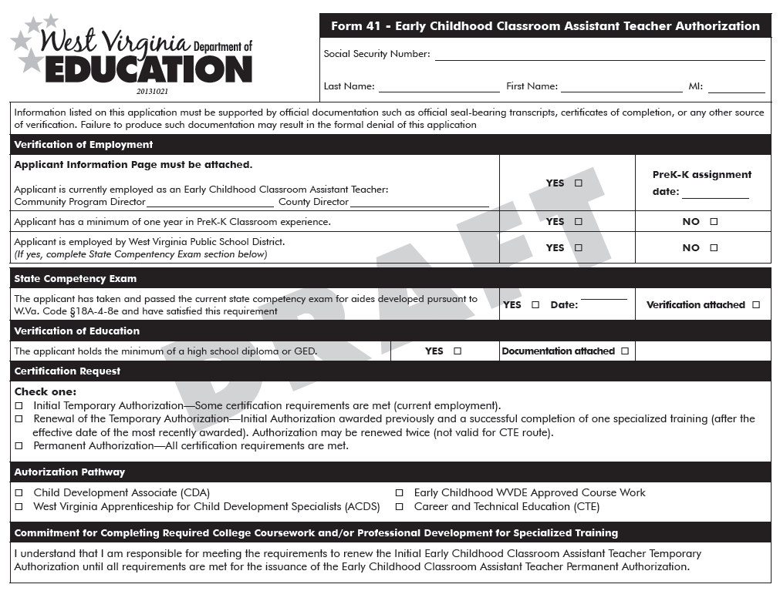
Form 41
Notes:
Ms. Scottie Ford

Slide 32
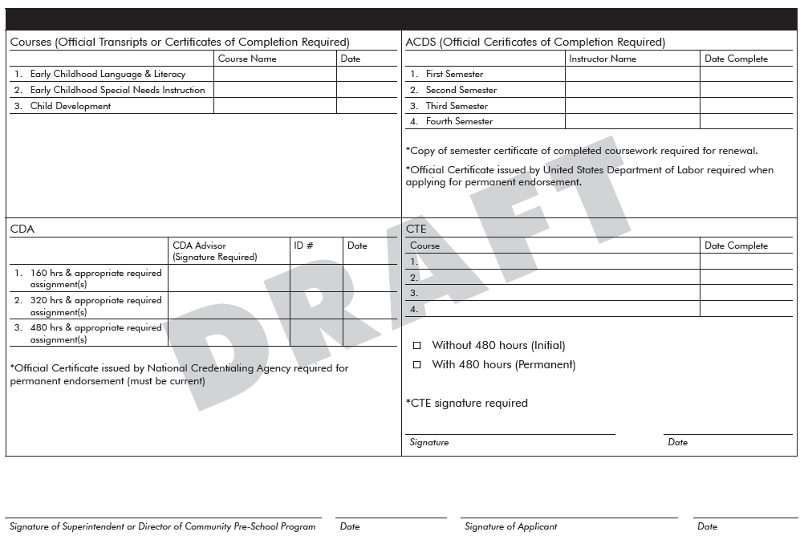
Form 41
Notes:
Ms. Scottie Ford

Slide 33
Sample Documentation
ACDS Sample Certificate
CDA Sample Certificate
ELearning Certificates of Completion
  Early Childhood Special Needs
  Early Childhood Language and Literacy
  Early Childhood Child Development Birth-age 8
Notes:
Ms. Scottie Ford
E-learning cert of completion will be uploaded to the final course dropbox should anyone need to go back and print
Log back in and download

Slide 34
State Tuition Reimbursement
  State tuition reimbursement funds for FY2014 have been expended. All remaining Form 36 applications for tuition reimbursement received through June 30, 2014, are being denied due to the Out-of-Funds status.
  Beginning July 1, 2014, Form 36 applications for coursework completed during FY2015 will be accepted through the end of FY2015, or until funds are expended.
Notes:
Ms. Scottie Ford

Slide 35
OPP Online System
OPP is moving towards an automated online system. The system will be implemented in phases and each phase will go through a pilot process.
  Phase I is currently in place and allows for electronic payments for certification applications
Notes:
Mr. Robert Hagerman

Slide 36
Waiver Process
As a result of new accountability measures and ensure educator quality, the waiver request guidelines will be strictly enforced
Waiver request form must be submitted by County Superintendent/equivalent or Community Program Director and must include the correct licensure application and processing fee(s)
Waiver must meet at minimum one of the eligible criteria
Waivers (if approved) will result in the issuance of the certificate requested and will expire on June 30 of the academic year for which the waiver was requested
Only one waiver may be submitted for the life of the certificate
Notes:
Mr. Robert Hagerman and others as directed

Slide 37
Waiver Process
Only the following certificates are eligible for a waiver request:
Professional Certificates or equivalent, First Class Full Time Permit, Out of Field Authorization, Community Program Authorization, Substitute Permit, Alternative Teaching Certificate, and Career and Technical Certificates
Only for the following extenuating circumstances:
Unavailability of Coursework (currently listed in WVBE Policy 5202)
Illness/Death (currently listed in WVBE Policy 5202)
Hardship (currently listed in WVBE Policy 5202)
Documented, and verified by IHE, inability to register/enroll in coursework/program as a result of time of year, semester already in progress, or other qualifying circumstance
Notes:
Mr. Robert Hagerman and others as directed

Slide 38
Waiver Process
Unacceptable Criteria for Waiver Requests:
Unable to meet required GPA as defined in WVBE Policy 5202
Not having passing scores on Praxis exams or inability to take exams
Lack of understanding of renewal requirements (i.e. number of hours needed, dates for eligible coursework, technology requirement)
Notes:
Mr. Robert Hagerman and others as directed

Slide 39
Clinical Experience Permit
Pending the approval of WVBE policy 5202:
This permit will replace the student teaching permit
All individuals completing a clinical experience (teaching, administrator, student support) who do not already hold a license must apply for the permit
Fingerprints used to obtain this permit may not be used for any future licensure application
Upon successful completion of the experience able to short-term substitute teach until June 30 of the academic year. Candidates able to substitute teach even though they may not have graduated yet without any additional application/form required by the WVDE. IHE officials must submit to the county a Successful Completion of Student Teaching (Clinical Experience) form. The completion form does not need to be submitted to the WVDE.
Notes:
Mr. Robert Mellace

Slide 40
Exceptions for Veterans and Spouses
The following proposed plan of action is pending legal review:
Proposed Eligibility
Must be on active duty or within 6 months after active duty
Must submit a completed application w/ background check
Must submit active duty orders (DD 214 or NGB 22)
If a spouse, must also submit a marriage certificate
If criteria met
Must be processed within 30 days of receiving all documents
OPP application fees are waived, except for background check fee
Expiration of authorization, permit or license delayed 1 year beyond 6 months after active duty orders end, on June 30th
Renewal requirements also excepted for 1 year beyond 6 months after active duty orders end, on June 30th
Notes:
Mr. Robert Mellace

Slide 41
Transition to Teaching
Robert Mellace and Teresa Epperley
Teacher Quality Coordinators
Office of Professional Preparation
Notes:
Mr. Robert Mellace

Slide 42

2014-2015 Program Update:
Transition to Teaching is now available to all counties in West Virginia.
It is designed to assist school districts by recruiting individuals with a bachelor’s degree or higher to become highly qualified teachers in subject areas of critical need.
The total cost to a county for one TtT participant will be $5,000 per teacher, per year for a two-year induction period – a total of $10,000 per teacher.
Notes:
Mr. Robert Mellace

Slide 43
Successes:
Between 2008 and 2013:
84,000 Unique visitors on Teachwv.com
26,500 Unique visitors on TtT homepage
Over 1,500 eligible applicants
144 Employed TtT program members
82% Retention rate (118 of 144)
2014-2015 School Year
Database of more than 200 candidates
Notes:
Mr. Robert Mellace

Slide 44
Transition to Teaching Online Portal for Candidates: http://wvde.state.wv.us/forms/transition-to-teaching/
Personnel Directors: http://wvde.state.wv.us/forms/transition-to-teaching/admin
Access to the TtT candidate database requires a WebTop account.
If you do not already have access, provide your WebTop user name to a Transition to Teaching coordinator.
Notes:
Mr. Robert Mellace

Slide 45
Transition to Teaching Members are Highly Qualified
WV State Code 18A-3-1(c) 2
“The alternative program teacher certificate is equivalent to a professional teaching certificate for the purpose of issuing a continuing contract.”
Notes:
Mr. Robert Mellace

Slide 46

Partnering Responsibilities
County/LEA
Cohorts
IHE
WVDE
Notes:
Mr. Robert Mellace

Slide 47
counties will include
TtT in their WV SIPP plan:
WV SIPP
Plan Component | Action Steps: | Person(s) responsible | Funding Sources | Evidence of Impact
Teachers: 0 to 2 years experience | Partnership with Transition to Teaching | Professional support team to include: | State mentoring funds, federal funds, etc.
Notes:
Mr. Robert Mellace
TtT coordinator will work with county (at county request) to make recommendations for support

Slide 48
For more information, please contact:
Robert Mellace rmellace@access.k12.wv.us or
Teresa Epperley tepperle@access.k12.wv.us
Notes:
Mr. Robert Mellace

Slide 49
Embassy of Spain
Visiting Teacher Program
Robert Hagerman
Assistant Director
Office of Professional Preparation
Notes:
Mr. Robert Hagerman

Slide 50

Embassy of Spain
5 teachers currently serving in WV
Certified teachers in Spain with a minimum of three years experience
Three year program
Certification
Candidates
Contact Robert Crawford rcrawford@access.k12.wv.us for more information
Notes:
Mr. Robert Hagerman
Program second year to WV has been in operation in other states including: Utah, Kentucky, Ohio, Indiana, North Carolina, Delaware. Benefits of the program it provides students access to a native speaker of the language who also has intimate knowledge of the target culture. Nuances of the products, practices and perspectives of culture promote in world languages. In our state used to fulfill critical teacher shortage. Teachers currently working in Berkeley, Gilmer, Grant, Greenbrier and Nicholas counties.
Teachers have a Minimum of Three years of experience of teaching (passed national exams, B.A. equivalency, related teacher training programs).
Legal authority to work up to a maximum of three years in the assignment. This is conditional upon mutual consent. In other words, after the initial year, both the district and the teacher have the opportunity examine the suitability of the placement and make a determination regarding renewal.
All candidates are screened by the Embassy of Spain to comply with state requirements.
Candidate Profiles in the program vary: range from young single individuals, married teachers with families, even cases of married couples who are both teachers wanting to participate in the program. As previously mentioned, all have taught a minimum of three years.

Slide 51
Additional Topics
Robert Hagerman
Assistant Director
Office of Professional Preparation
Notes:
Mr. Robert Hagerman

Slide 52
Additional Topics
Electronic transcripts
Original signatures on applications
Faxed documents
Retirement of two associate staff members within the Office of Professional Preparation
Current forms
Complete forms in their entirety
Importance of signatures
Form 12 – Documents submitted prior to 2003
Office of Professional Preparation PowerPoints may be accessed at http://wvde.state.wv.us/certification/resources.html
Notes:
Mr. Robert Hagerman and others as directed

Slide 53
Questions and Answers Session
West Virginia Department of Education
Office of Professional Preparation
Notes:
Mr. Robert Hagerman and others as directed

Slide 54
Conclusion of Meeting
Dr. Monica Beane
Executive Director
Office of Professional Preparation
Notes:
Dr. Monica Beane

