Slide 1
Course Code Manual
Notes:
[LISA / ROBERT]
Thank you for joining us for the second in a series of webinars as we move forward toward full statewide implementation of the new educator evaluation system. We have a very large group that registered, and we are very excited that you have joined us. Please note that the webinar is being recorded and will be uploaded to the WV Department of Education website. The PPT will also be uploaded. Additionally, there will be a time provided for questions at the end of the webinar. In order reduce background noise during the webinar, we ask that you mute your phones unless you are directing a question to a webinar presenter or contributing directly to the webinar discussion.
Introductions of all in the room.
Next slide
So, without

Slide 2
http://wveis.k12.wv.us
Click on the SUPPORT tab
and then look on the right side toward the middle of the page
Click on
2014-2015 Course Code Manual
(or the most current manual update for your school year)

Slide 3

Open the
Course Code Manual

Slide 4

Course Code
Title Page

Slide 5
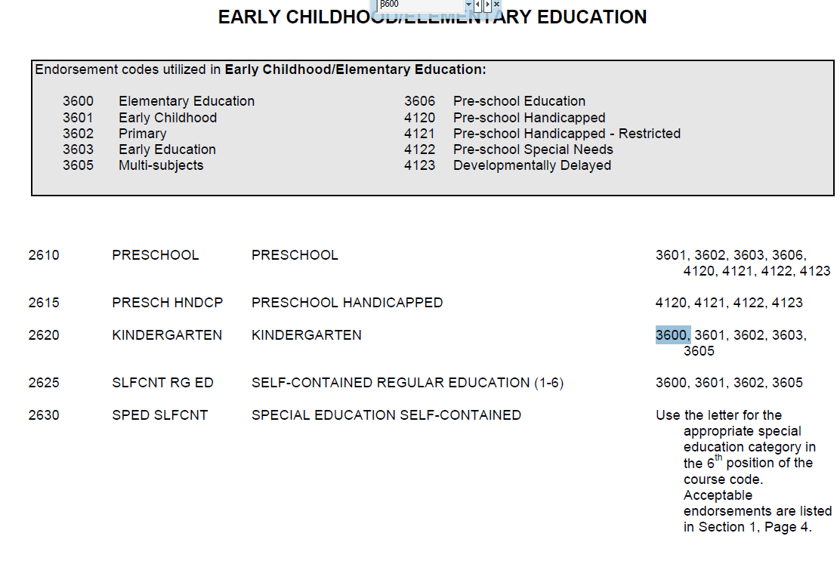
How to Read the
Course Code Manual
Lists the teacher endorsement names
Course Codes
Teacher Endorsement Codes

Slide 6
Navigating the
Course Code Manual
  Right click on this document. If you have an Adobe reader, you will see a drop down with “FIND” or “SEARCH”. Click on FIND or SEARCH. A small window will appear.
You can enter a course code, endorsement code, letters, words, etc. and you can move with the arrows forward or backward through the document and it will highlight that item all through the manual so you can check course codes, endorsement codes, etc. Course codes are on the left and the required Endorsement codes are on the right.

Slide 7
Quiz: Navigating the Course Code Manual
List any course code and/or endorsement codes for each.
Search code 3600.
Search code 7602. What is special about this code?
Search code 4000.
Search code 3423.
Search code 1905.

Slide 8
Quiz: Navigating the Course Code Manual
Answers:
3600 is an endorsement code for Elementary Education. 3600 is also a course code for General Music Kindergarten.
7602 is a course code for Academic Enrichment. You must hold a 4500 endorsement code for gifted.
4000 is a course code for English Language Arts Kindergarten AND 4000 is also an endorsement code for School/Social Work and Attendance.
3423 is in a range of course codes used for Dance –Independent Study.
1905 is a endorsement code for Math through Algebra I. (Look at what classes this code allows someone to teach) and 1905 is also a course code for Machine Tool Technology-Fundamentals of Machine Process

Slide 9
Course Code Manual
The sixth position of the six-character course code number is listed in
Section 1, Page 10
(refer to your handout)
QUIZ:
What is the course and exceptionality?
-- 4000 U
-- 7007 R
-- 3012 T
-- 6021 M

Slide 10
Course Code Manual
QUIZ:
What is the course and exceptionality?
4000 U | English K Autism
7007 R | Social studies 7 Specific Learning Disabilities
3012 T | Math I-9 Multi Categorical (LD, BD, and MI)
6021 M | Biology Other Health Impaired

Slide 11
Suggested
Pages to Print
Numbering System: The first four digits of the course code number are assigned only by the West Virginia Department of Education and must be requested through the appropriate curriculum area.
Fifth (5th) Digit Codes
D DIBELS courses
E Classes taught by EDGE teachers
L Locally-approved credit recovery course
V Virtual School courses
W West Virginia Department of Education Virtual Courses offered for Credit Recovery

Slide 12
Suggested
Pages to Print
Sixth (6th) Digit Codes for Special Education
Code Special Education Category
U Autistic
B Behavior Disorders
C Blind/Partially Sighted
D Communications Disorders
E Deaf and Blind
F Deaf/Hard of Hearing
G Gifted (1-8)
Q Exceptionally Gifted (9-12)

Slide 13
Suggested
Pages to Print
Sixth (6th) Digit Codes
Code Special Education Category
I Mildly Mentally Impaired
J Moderately Mentally Impaired
K Severely Mentally Impaired
L Profoundly Mentally Impaired
T Multi-categorical Class
M Other Health Impaired
N Handicapped/Orthopedically Impaired
P Preschool Handicapped
R Specific Learning Disabilities
W Traumatic Brain Injury

Slide 14
Suggested
Pages to Print
Other Sixth (6th) Digit Codes
H Higher Level (formerly called Honors)
X Dual Credit courses are approved for substitution of required courses, i.e. English 2, only if a waiver has been granted by the West Virginia Board of Education. College Course- Dual credit courses must list the appropriate 4 digit course code of the course for which high school credit is being given. College courses without an equivalent (according to accepted Content Standards and Objectives for the course) should use the courses code 7676 through 7690 as assigned in the manual.
V Non-Vocational Course Taught at CTE
S Satellite Course/Advanced
Y Satellite Course
Z Teacher of Alternative Education –
4140 endorsement required

Slide 15
Questions?
Lori Buchanan
Federal Programs & Monitoring
Certification Coordinator
Office of Professional Preparation
1-304-558-7010
llbuchan@k12.wv.us

