Slide 1
Principals’ Training
Spring 2015

Slide 2
Pre -Test
1. What is the WVEIS Course Code Manual and when do I need it?
2. What makes someone credentialed?
3. What makes someone highly qualified?
4. What information is on the Compliance Tool and do I need to use it?
5. Why is it important to review and update the Master Schedule?
6. How can I prepare for an audit?

Slide 3
It All Starts with the
Master Schedule
Information is generated from
the Master Schedule to:
1-Determine if a teacher is appropriately credentialed and/or Highly Qualified
2-Complete OEPA Reports
3-Complete Title I Reports
4-Complete Educator Evaluations
5-Complete Roster Verification
6-Complete the HQ Data/Class Count Report

Slide 4
Master Schedule
Things to Remember:
As you finalize your Master Schedule, double check everyone’s SSN and Employee ID.
Make sure that you reference the current WVEIS Course Code Manual for accuracy.
-Course Codes align with Endorsement Codes
-Listing special education codes; AP/Virtual codes; etc. in the correct position
Notes:
If the SSN and ID aren’t correct or don’t match, it will show as a SSN Error and the person’s name and credentials will not appear.

Slide 5
Master Schedule
Things to Remember:
Make certain that all of your Alternate Education Teachers hold a valid 4140 Alternate Education endorsement (Form 38) which must be renewed every year.
To view/download forms:
http://wvde.state.wv.us/certification/forms

Slide 6
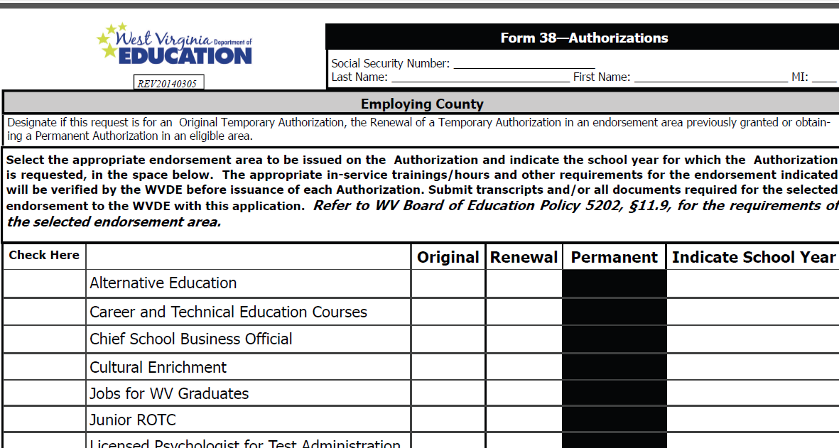
Form 38
Notes:
Check “Alternative Education” at the top of the list. Refer to handouts for Form 38 and Form 42

Slide 7
Master Schedule
& HQ Status
Remember, a teacher may be HQ, but if they are not scheduled properly, they may be reported as not HQ due to your scheduling error.

Slide 8
Credentials
How do you determine if your staff is
properly credentialed?
Toolbox:
WVEIS Course Code Manual
Compliance Preparation Tool

Slide 9
Example of
Incorrect Scheduling
4012-ENG LA 12 1 Grades: 11 12
4012-ENG LA 12 2 Grades: 11 12
7821-PLANNING 1 Grades:
7829-TEACHER DUTY 1 Grades:
21 Professional Teaching Certificate 4115 -Multi-Categorical (LD, BD, MI) Grds: 05-AD Exp: 06/30/2014
78 Content for Special Education 1000 -English Grds: 05-AD Exp: Permanent

Slide 10
Credentials
Not credentialed!
QUIZ
Teacher 1:
Classes/ Schedule | Certification
2620-KINDERGARTEN 0 Grades: 0K | 22 Professional Teaching Certificate 3600 -Elementary Education Grds: 01-06 Exp: Permanent
Notes:
Look at grade levels.

Slide 11
Credentials
Not Credentialed for 7602!
Teacher 2:
Classes/Schedule: | Certification:
6008-SCIENCE 8 2 Grades: 08 7602-ACAD ENRICH 8 Grades: 08 7602-ACAD ENRICH 8 Grades: 08 7633-DVLP GUID 8 Grades: 08 | 22 Professional Teaching Certificate 2900 -General Science Grds: 05-09 Exp: 06/30/2017 22 Professional Teaching Certificate 3605 -Multi-Subjects Grds: 0K-08 Exp: 06/30/2017
Notes:
Is the teacher credentialed for the entire schedule? What would you need to do?

Slide 12
Credentials
Credentialed!
Teacher 3:
Classes/Schedule | Certification
6021-BIOLOGY 3 Grades: 09 10 11 12 6103-ADV HMN ANAT E Grades: 10 11 12 7821-PLANNING 3 Grades: 7829-TEACHER DUTY 3 Grades: | 22 Professional Teaching Certificate 2600 -Biological Sciences Grds: 07-12 Exp: Permanent 22 Professional Teaching Certificate 2900 -General Science Grds: 07-12 Exp: Permanent

Slide 13
Credentials
Credentialed!
Classes/Schedule | Credentials
3012-MATH I - 9 2 T-MULTI-CATEGORICAL Grades: 09 10 11 3013-MATH I-9 LAB 1 T-MULTI-CATEGORICAL Grades: 09 11 3045-GEOMETRY 3 T-MULTI-CATEGORICAL Grades: 10 7821-PLANNING 3 Grades: 7829-TEACHER DUTY 3 Grades: SE ROSTER/CASELOAD: LD BD MI | 78 Content for Special Education 1000 -English Grds: 05-AD Exp: 06/30/2015 78 Content for Special Education 1900 -Mathematics Grds: 05-AD Exp: 06/30/2015 78 Content for Special Education 2900 -General Science Grds: 05-AD Exp: 06/30/2015 78 Content for Special Education 3000 -Social Studies Grds: 05-AD Exp: 06/30/2015 22 Professional Teaching Certificate 0600 -Business Education Grds: 05-AD Exp: 06/30/2018 22 Professional Teaching Certificate 4115 -Multi-Categorical (LD, BD, MI) Grds: 05-AD Exp: 06/30/2018 22 Professional Teaching Certificate 4116 -Autism Grds: 05-AD Exp: 06/30/2018 78 Content for Special Education 1900 -Mathematics Grds: 05-AD Exp: Permanent
Notes:
Check the special education credentials first. If credentialed for special education, then look for content (78-; HOUSSE; content praxis)

Slide 14
Any Questions?
Specific instructions are provided on individual topics/reports on our WVDE website under “Resources” at http://wvde.state.wv.us/certification
County trainings are available upon request.

Slide 15
Contact Information
Lori Buchanan
Federal Program & Monitoring
Certification Coordinator
WVDE
Office of Professional Preparation
Building 6, Room 722
1900 Kanawha Blvd. E.
Charleston, WV
304-558-7010
llbuchan@k12.wv.us

