Slide 1
Results-Driven Priorities Application Training

Slide 2
Objectives
How to complete the application on the Grants & Planning System (GPS)
Frequently Asked Questions (FAQ)
Next steps
Notes:
We’re going to go through step-by-step instructions on how to log in and complete your application in GPS.
As we go through the application, we’ll also be addressing some frequently asked questions that we’ve received since the announcement of RDP. The FAQ will be compiled and sent out via email after the webinar.
Last, we’ll address what our next steps are as we move forward with the application process.

Slide 3
FAQ #1
Q: How do I receive Results-Driven Priorities (RDP) funds?
A: In order to receive RDP funds, you must complete an application through the online GPS system. There is no other avenue to make application.
https://wvdegps.k12.wv.us

Slide 4
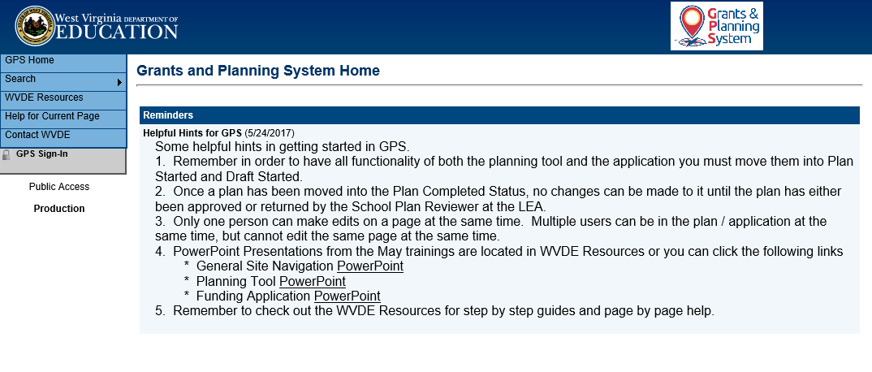
GPS Website
Notes:
The front page of the GPS system will show

Slide 5
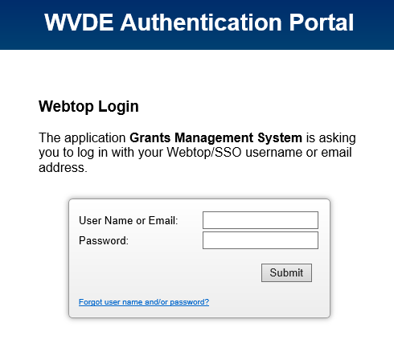
GPS Login
Notes:
Enter your webtop credentials

Slide 6
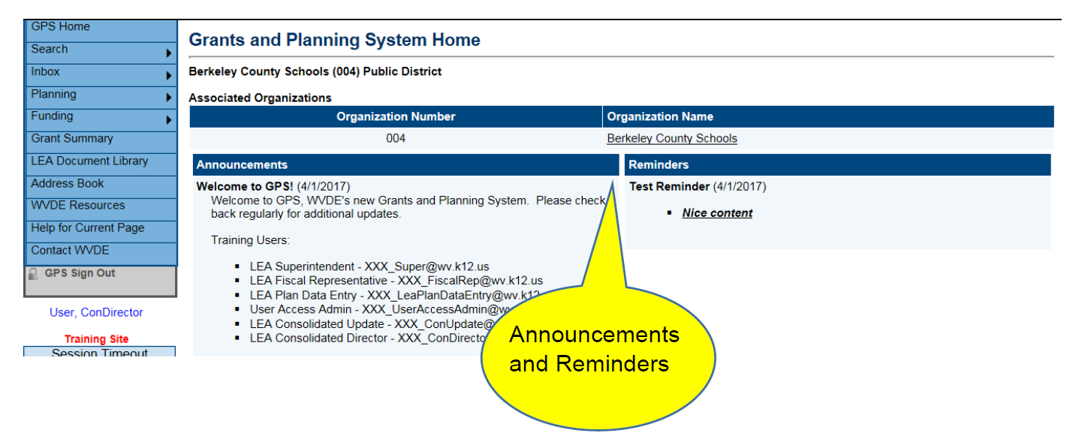
Announcements & Reminders
Notes:
Please review announcements and reminders each time you access the system for any new information.

Slide 7
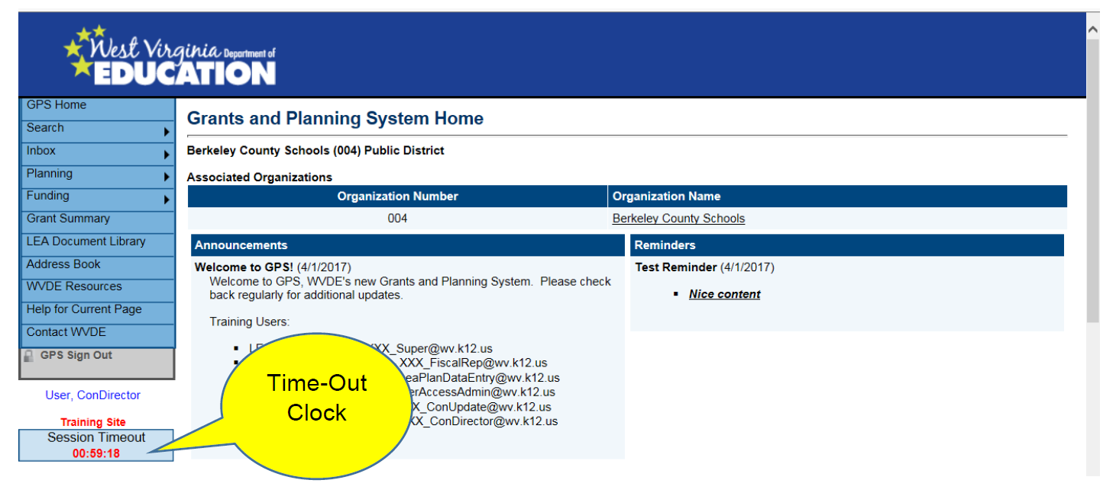
Session Time-Out
Notes:
GPS has a 60-minute time-out. The timeout clock is beneath the main left-hand navigation menu. The clock will reset every time you move to a new page or if you perform a save on the page with “Go To: Current Page”.

Slide 8
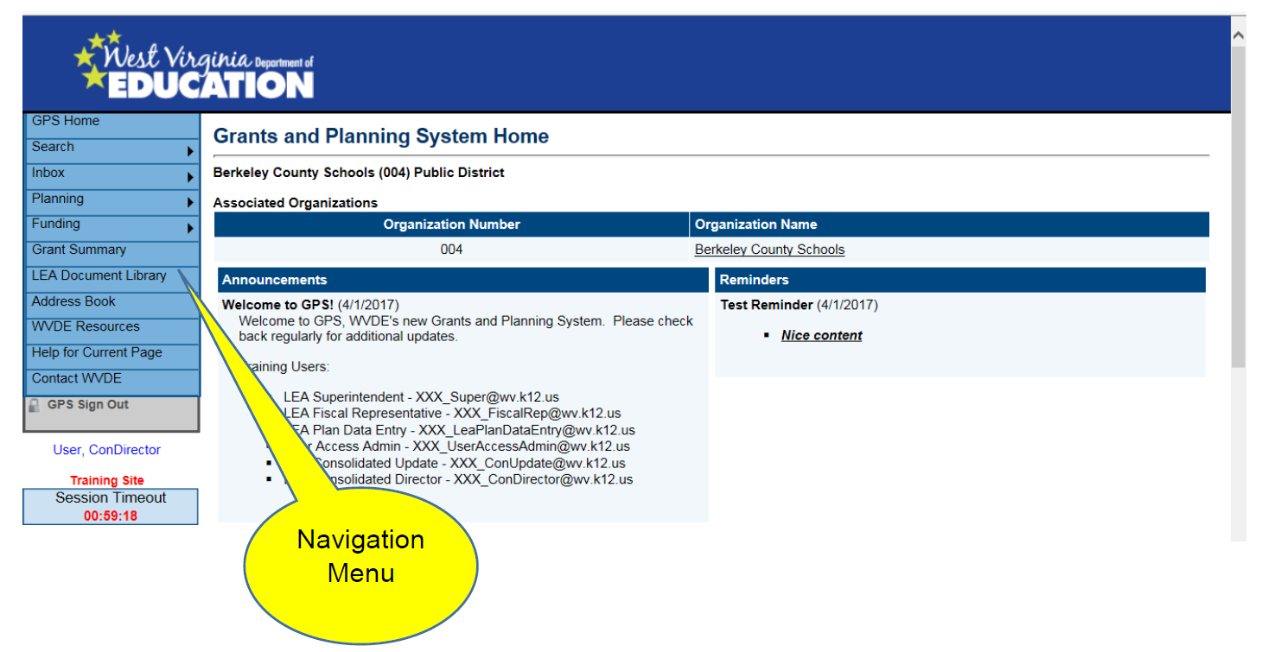
GPS Navigation Menu

Slide 9
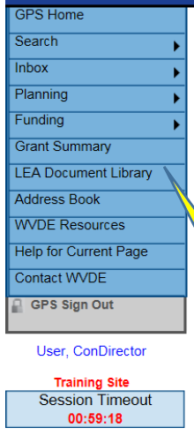
GPS Navigation Menu
Search – Allows a search of Organizations and Grants
Inbox – Email message archive
Planning – Strategic Planning Section
Funding – RDP Application
Grant Summary – Allows viewing of previous and current year applications
LEA Document Library – Area to upload requested documentation
Address Book – Listing of funding application and planning tool contacts
WVDE Resources – Guidance and reference documents
Help for Current Page – Helpful hints and instructions for the specific page selected

Slide 10
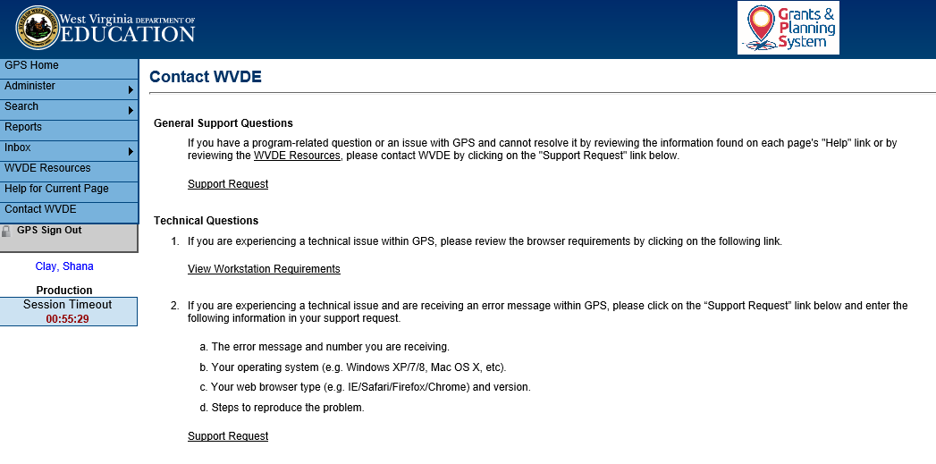
WVDE Contact Page
Notes:
Area to submit requests for technical assistance on specific sections of the application. This section contains a form to complete that will allow you to specify your area of concern. It will also help WVDE track and respond to any isues system wide. Please use this option as your primary communication for WVDE GPS technical assistance.
Click “Support Request” to pull up the WVDE GPS Technical assistance form.

Slide 11
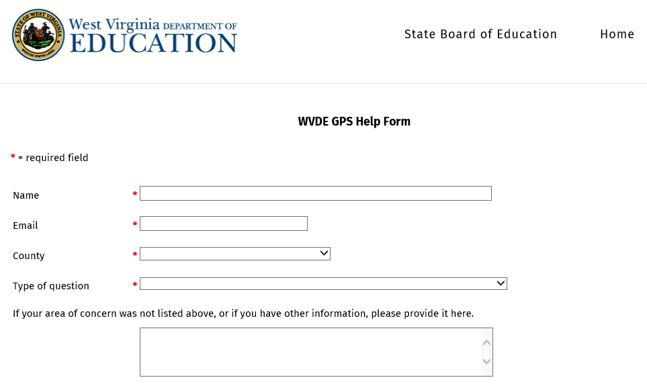
GPS Help Form
Notes:
RDP topics will be added as soon as possible to the “Type of Question” section.

Slide 12
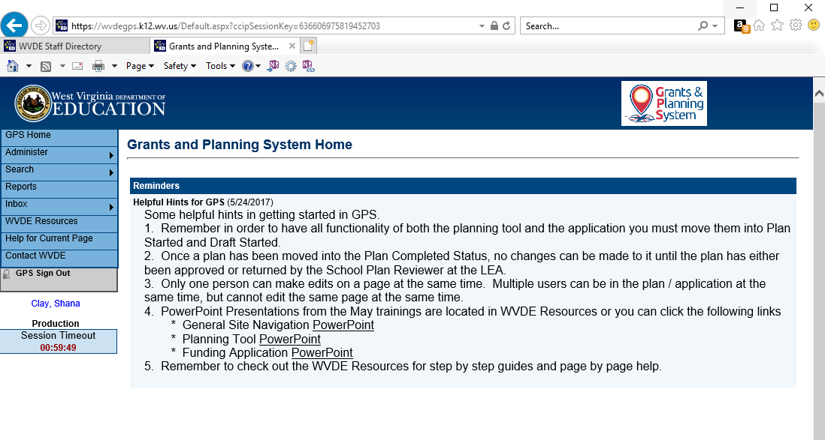
GPS Navigation
Notes:
Do NOT use the internet browser’s forward and back buttons as it will create an error message. GPS must be navigated from within the program. To navigate, make a selection from the “Go To” menu or the Main Navigation Menu.

Slide 13
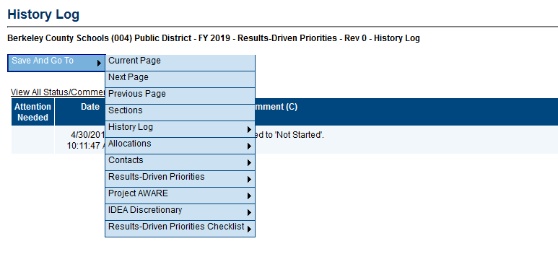
GPS – Save and “Go To”
Notes:
To access another page or section in the application and to save the progress you have made on your current page, select the “Save and Go To” button at the top or bottom of every page.
Go over options.

Slide 14
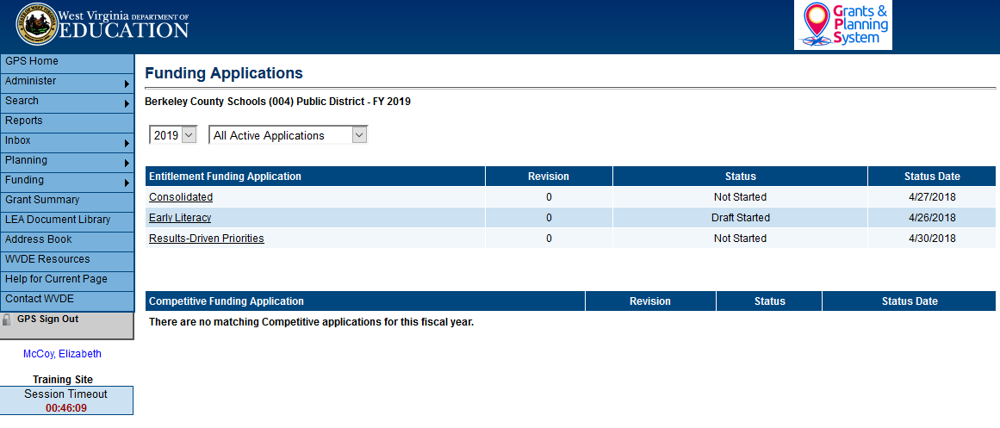
Funding Application
Notes:
Select Funding from the Navigation Options then select Funding Applications. This page is where you will select the year and the application you want to access.
Click on the application name under the Entitlement Funding Application heading.

Slide 15
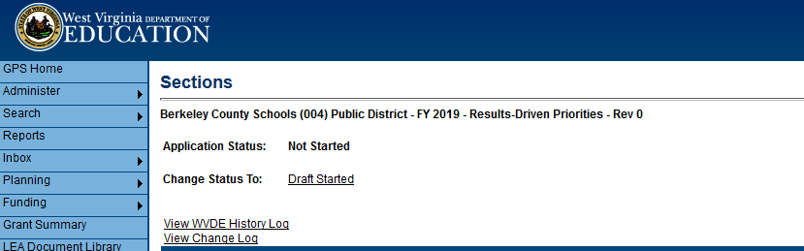
Sections Page
The application status must be changed to “Draft Started” in order to be able to access all functionality of the application.
The “View Change Log” allows the user to view all changes that have occurred within the application.
Notes:
The top of this page displays the county name and number along with the current application status and the next step in the application process.

Slide 16
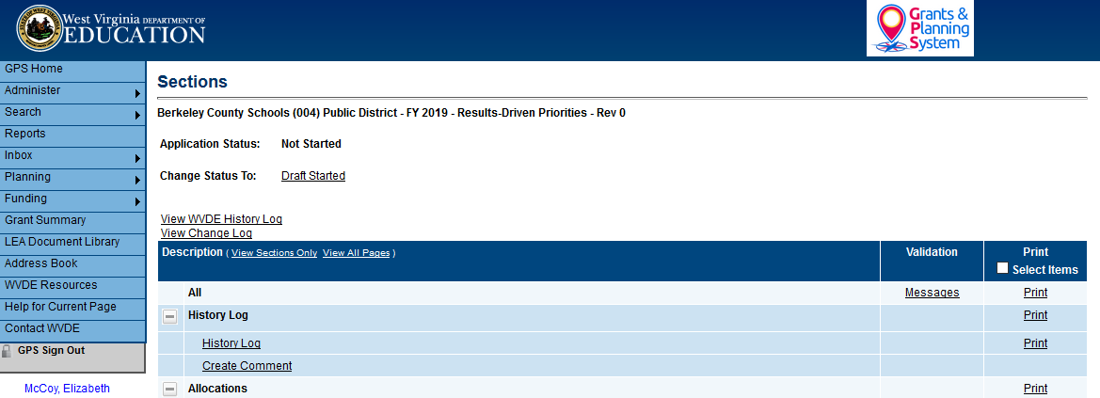
Sections Page
In the Description Header, you may choose to either display the section titles only, or all pages.

Slide 17
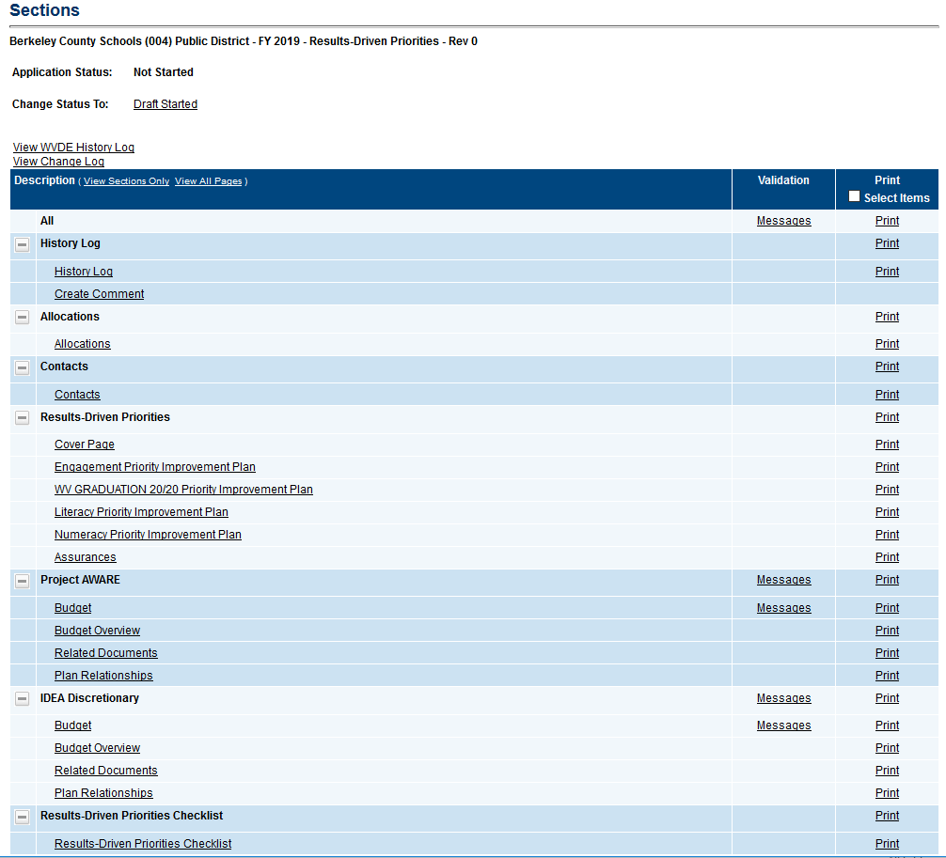
Sections Page
Notes:
Sections include:
History Log – displays the history of comments and status changes within GPS. Also contains the ability to post comments and send emails within GPS.
Allocations – Displays an overview of the allocations for each RDP grant.
Contacts – A listing of LEA contacts for each RDP grant.
Results-Driven Priorities – RDP grant application pages.
Project AWARE – project aware funding grant budget pages.
IDEA Discretionary – IDEA Disc funding grant budget pages.
Results-Driven Priorities Checklist – Sectional review of each grant.

Slide 18
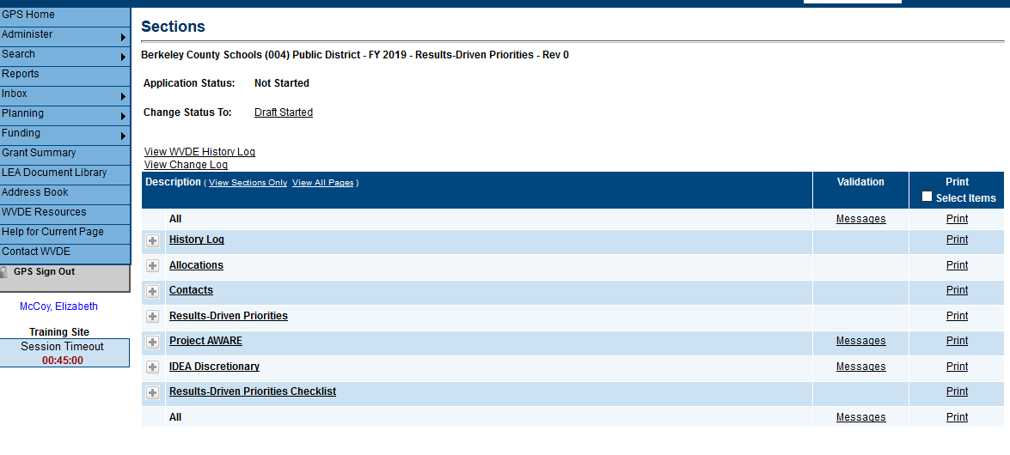
Validations
The validations column provides messages related to each section and page.
  Note: Messages display errors and warnings that must be addressed in order to successfully submit the application.
Notes:
Section messages will display errors and warnings for the selected section or page.
“All messages” will display errors and warnings for all sections of the application.

Slide 19
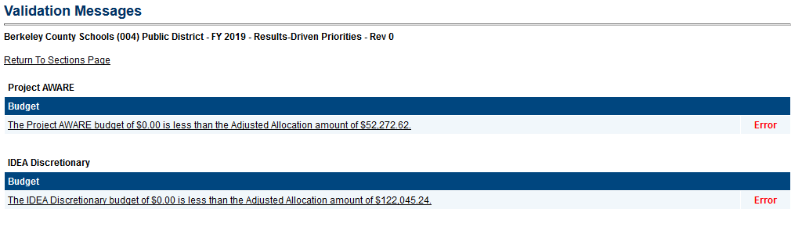
Validations

Slide 20
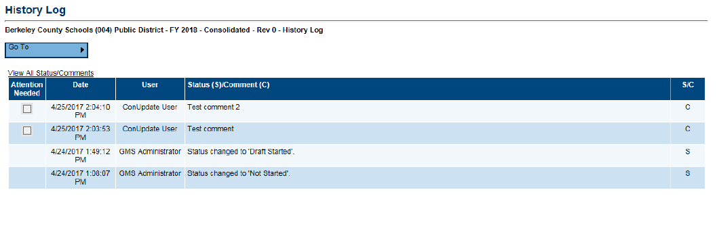
History Log
Displays the history of comments and status changes within GPS.
Checked “Attention Needed” checkboxes indicate areas within the application that need to be addressed. These will show up at the top of the history log no matter the date they were entered.
S/C – Status changes are represented with an “S” and comments are represented with a “C”.
Date – Displays the date the status change or comment was entered.
User – Displays the user who made the status change or created the comment.

Slide 21
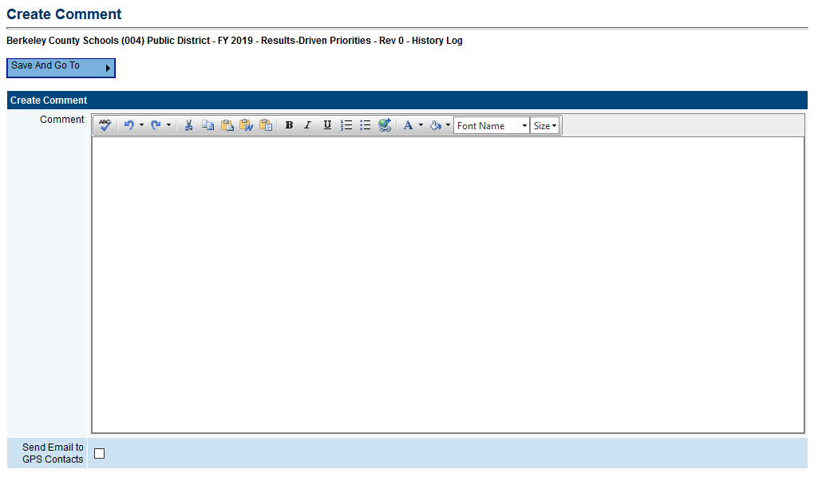
Creating a Comment
Enter comments directly into the text box or copy and paste from a Word document.

Slide 22
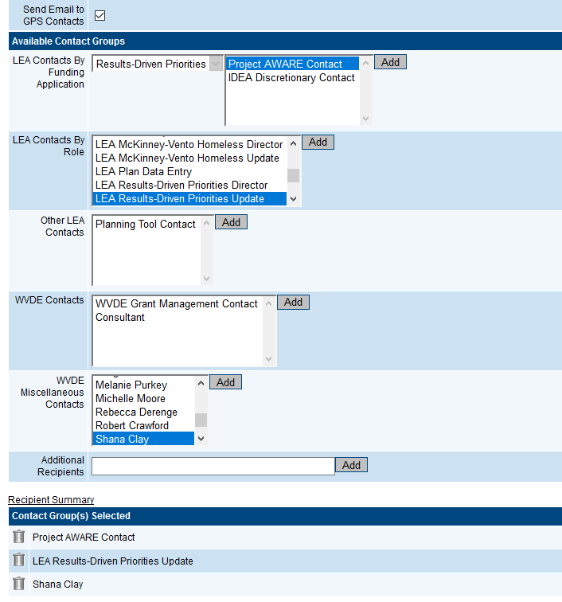
Creating a Comment
Checking the “Send Email to GPS Contacts” checkbox opens the available contact group area.
  The user is able to select and add contacts from multiple contact fields.
  Click the “Add” button after selecting the appropriate contacts.
  The recipient summary shows all contacts added.
  Contacts can be removed by clicking the trash can.

Slide 23
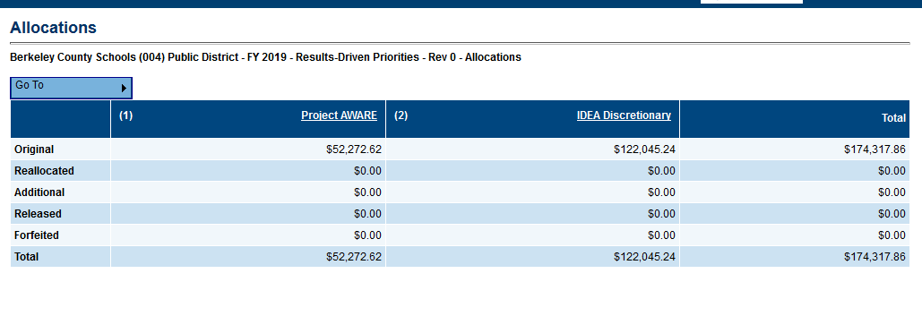
Allocations
Notes:
This is mostly a read-only page that shows the county’s total allocations under each grant award included in RDP.

Slide 24
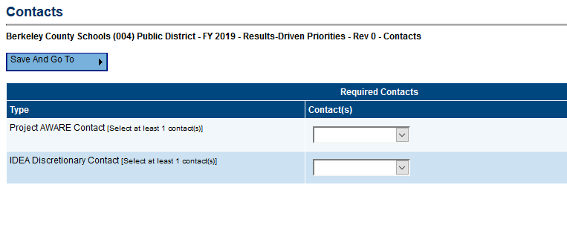
Contacts
This page contains a listing of LEA contacts for each RDP grant. A contact is required to be selected for each of the listed grants. The drop down will display the available users for your county.
  Note: If a contact is not showing up, please contact WVDE utilizing the Contact WVDE page.

Slide 25
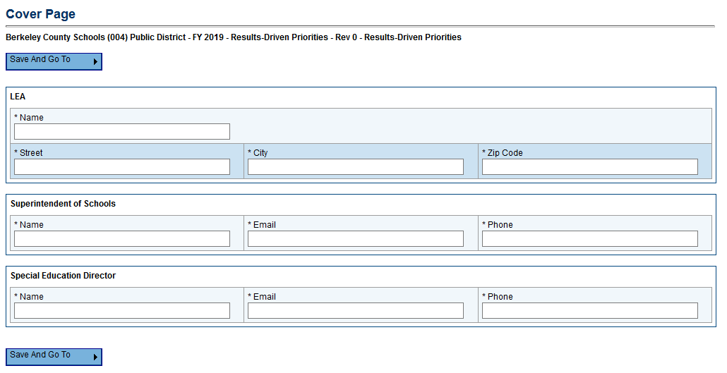
RDP – Cover Page
Please complete all sections of the cover page.

Slide 26
Improvement Plans
There are 4 Priority Improvement Plans to complete:
  Engagement
  WV GRADUATION 20/20
  Literacy
  Numeracy
A selection MUST be made on each improvement plan relating to whether or not your county will be selecting the area as a priority.
Notes:
Go to each page and show them.

Slide 27
FAQ #2
Q: Are Project AWARE funds only to be used on special education students?
A: No. Project AWARE funds can be used on all students as they are not regulated under IDEA.
The IDEA discretionary funds need to be used with a primary focus on students with disabilities, however all students may incidentally benefit from the activities the funds pay for.

Slide 28
FAQ #3
Q: If my county is receiving money for GRADUATION 20/20, do we have to use all of it for GRADUATION 20/20?
A: Not necessarily. Of the funds that were allocated to each county for GRADUATION 20/20, $2,500 per participating school is REQUIRED to be used for the program.
Each participating school should have a plan for how to spend their $2,500 and provide the budget to their County Contact for GRADUATION 20/20.

Slide 29
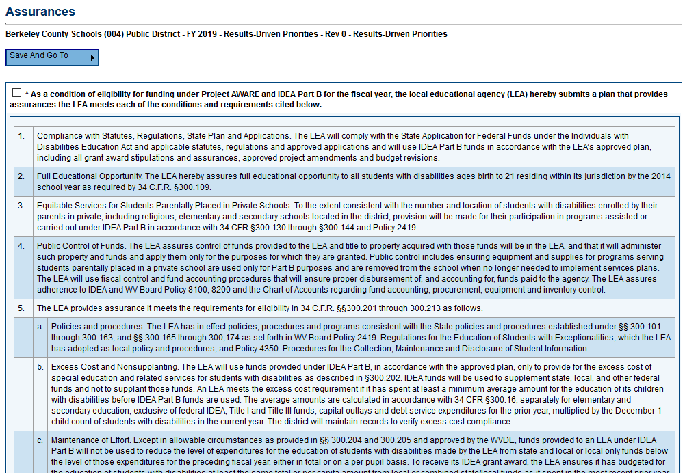
Assurances
Notes:
Box must be checked.

Slide 30
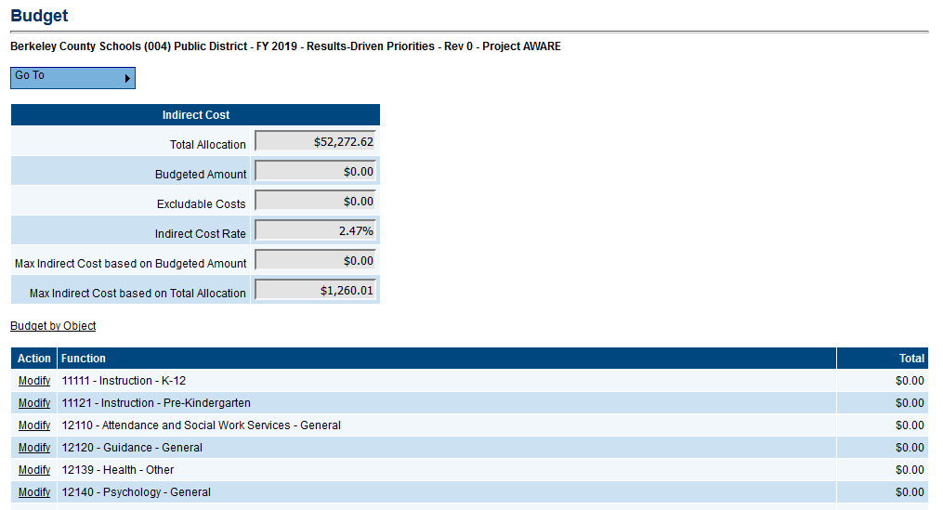
Budget
Indirect Cost Guide
Notes:
Go over indirect cost guide

Slide 31
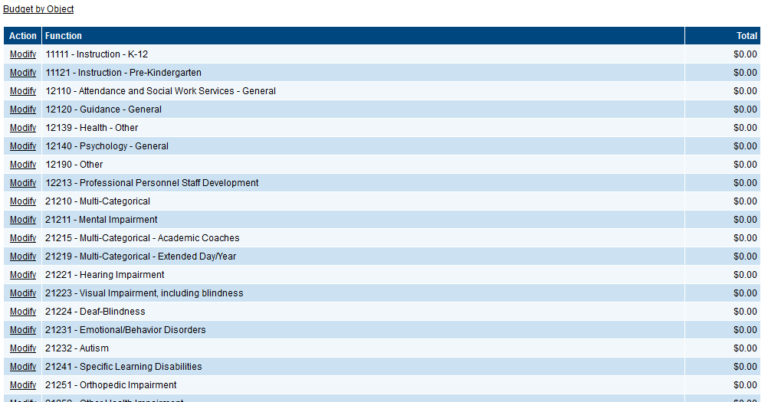
Budget
Budget sheet can be viewed in two different formats – by Function or by Object.
Notes:
Show example on actual website. And go on to show IDEA is the same.
Then, go on to show Budget Overview.

Slide 32
Next Steps
The application is now live and can be submitted at any time.
Applications will be reviewed as soon as possible following submission.
Final deadline – June 1st.
Send questions through WVDE Contact site or email/call Shana Clay at OSE.

