Slide 1
Special Education Child Count
October Child Count
Notes:
October Child Count

Slide 2
Special Education Child Count Timeline
New Timeline
October 1-8 Review, correction, and submission window (district-level Special Education Directors; state staff may provide assistance)
October 8-19 Final district review and correction/adjustment window
October 19 Final Superintendent certification deadline (no later than 11:59 p.m.)
Notes:
October 2018 marks the implementation of new review, submission, and certification dates.
This change allows the Office of Special Education to review the data prior to federal reporting to ensure data quality:
In the event that an error is discovered after the superintendent certifies the data, the OSE will work with districts to ensure additional corrections are made

Slide 3
Special Education Child Count
The Special Education Child Count reflects:
The unduplicated number of students with disabilities:
Who are receiving special education services as of October 1 of the current academic year.
The federal count includes number of students ages 3-21 by:
disability
age
gender
limited English proficiency (LEP) status
race/ethnicity and
least restrictive environment (LRE)
Prior to submission, verify student exceptionality codes, birth dates, race/ethnicity codes, LEP designation and LRE codes are accurate in WVEIS records.

Slide 4
Instructions for Special Education
Part 1: Green Screen Instructions
Run the WVA.200-SER.OST (Special Education Teacher Roster) on the WVEIS Child Count Reporting Menu and provide rosters to principals and/or special education teachers to verify as correct.
Confirm that any students who have exited special education are appropriately exited through the service records
Similarly, validate any students who:
have been newly identified
Reevaluated
transferred in or have had their IEPs updated
have been enrolled at the school
entered in the WVEIS special education record and
have an unduplicated, unexited service record.
Notes:
If using Green Screen to review and verify child count data is correct, you can access and edit information via the Special Education Teacher Roster on the WVEIS Child Count Reporting Menu.
This is where you will make sure that all the bulleted items are reviewed and corrected if needed.

Slide 5
Instructions for Special Education
Part 1: Green Screen Instructions Cont.
Ensure the students who are to be counted meet the following criteria:
All students have current IEP or Service Plan (reviewed within the last year);
All services documented on the students’ IEPs or Service Plans are being provided;
Students are receiving instruction from a special educator;
All students have a current evaluation and eligibility determination (within the last three years);
All eligible students have been included in the unduplicated count and have been counted only one time; and
All students are identified as eligible students with disabilities.
Notes:
Additional items to check to ensure that students who are to be counted in the Oct 1 Child Count meet the bulleted criteria.

Slide 6
Instructions for Special Education
Part 2: WOW Instructions
Log into WVEIS on the Web (WOW).
Select Menus.
Find WVR West Virginia State Reporting.
Find WVR100 State Reporting
Find and select OCT.SECC – October 1 Special Education Child Count.
Notes:
The next slides will walk you through the process using WVEIS on the Web (WOW) via WV State Reporting and October Special Education Child Count (OCT.SECC) where the Special Education Child Count data are located.

Slide 7
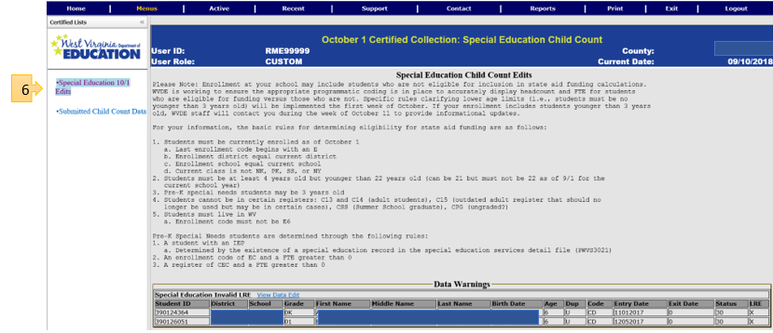
Instructions for Special Education
Part 2: WOW Instructions cont.
Then, select Special Education 10/1 Edits.
New: Edits Instructions
New: Data Warnings/Errors
Data Warnings: This section will have an Orange or Red outline. The color of the outline indicates whether the edits are a warning or an error.
* If red, the “SUBMIT” button will remain inactive until the data are corrected.
Notes:
Once you select the Special Education 10/1 Edits;
Notice the new instructions for data edits as well as a section following that will show specific Data Warnings and/or Data Errors
The data warnings section will be outlined in orange or red, indicating if the edits are:
warnings (where you need to review the data and confirm they are correct) or
errors (where there is definitely an error which needs corrected).

Slide 8
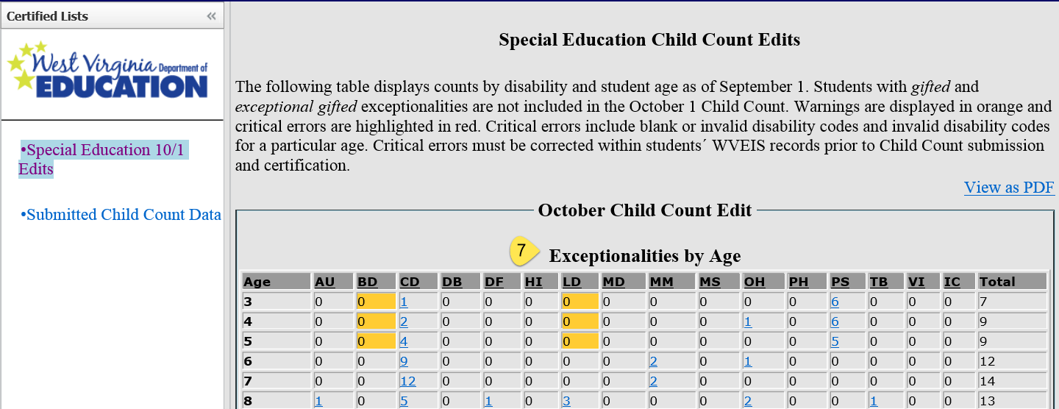
Instructions for Special Education
Review the Exceptionalities by Age table. Note the warnings in yellow/orange and the critical errors in red.
* If red, the “SUBMIT” button will remain inactive until the data are corrected.
Notes:
Once you select the Special Education 10/1 Edits, a display will show district data in the appropriate categories, including Exceptionalities by Age.
Notice the warnings in yellow/orange and critical errors in red.
* If red, the “SUBMIT” button will remain inactive until the data are corrected.

Slide 9
Instructions for Special Education
Part 2: WOW Instructions cont.
Scroll down to the LRE by Age table. Critical errors are shown in red. Critical errors include:
blank LRE codes or
invalid LRE codes for a particular age.
* Critical errors will remain red and the “SUBMIT” button will be inactive until the data are corrected.
Notes:
LRE by age table
Critical errors which will show in red are typically a blank LRE code or an invalid LRE code for a particular age.
Remember ages 3-5 should have alpha codes while ages 6-21 should have numerical codes

Slide 10
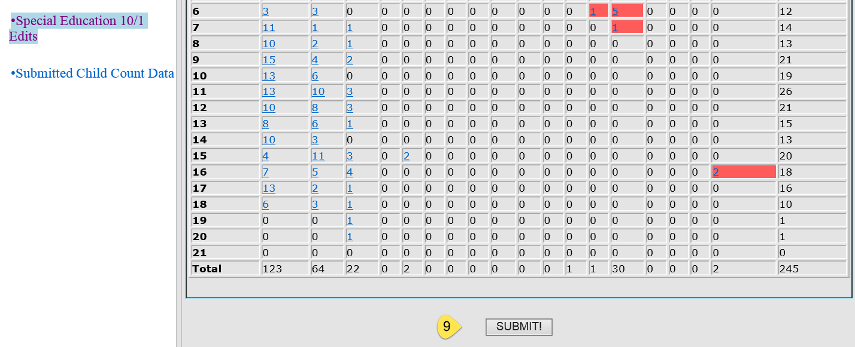
Instructions for Special Education
Part 2: WOW Instructions cont.
Once the information in both tables are correct and critical errors have been resolved, click on the submit button. Note the warnings in yellow/orange and the critical errors in red*.
* If red, the “SUBMIT” button will remain inactive until the data are corrected.
Notes:
After addressing any corrections needed within the data, especially those generating a critical error, you are ready to click on the submit button!
Again, the submit button will not be available until all critical errors are resolved.

Slide 11
Special Education Child Count – R-District
The “R-District” in each county is a special location in which information is stored about students who receive special services through the public school district but whose primary education is conducted through a private or parochial school.
Typically, R-district students are students with disabilities, although some may also be English language learners. Both the Special Education Director and the Title II Director for a district should have reviewed the enrollments to ensure that all R-district students are appropriately counted in the enrollment totals.
Special Education Directors are responsible for submitting the R-district enrollment counts for the Superintendent to review and certify.
Please Note: You will need to certify R-district enrollment data even if the R-district enrollment is 0 (zero). Doing so confirms to WVDE that there are no private/parochial school students receiving special services through your district as of October 1 of the current year.
Notes:
There are specific instructions concerning R-District Child Count.
R-District includes students who receive special services through the public school district whose primary education is provided via private or parochial school.
It is a good idea to consult with the Title II Director regarding the review of enrollment totals for these students
Child counts for the R-District must be certified, even if the number is zero

Slide 12
R-District
The R-District Enrollment Verification can be accessed via OCT.ENRL in WOW:
This application requires review and submission of the R District enrollment by the Special Education by the established date on the WVEIS Calendar to enable the Superintendent to certify by the established date on the WVEIS Calendar:
The principal has the responsibility to review the data displayed in the R District Enrollment component of OCT.ENRL, which displays the live data from STU.301 in WOW.
If the Special Education Director sees inaccuracies, he/she should go to the source data, make the changes, and the updates will be reflected in OCT.ENRL.
Once the Special Education Director determines that the R District Enrollment component is correct, he/she should press the “Submit” button. This will lock the data in place for the Superintendent to review.
Notes:
The application used for verifying R-District enrollment can be accessed via October Enrollment (OCT.ENRL) in WOW
Responsibilities begin with the principal, then the SE director reviews and submits and finally the superintendent reviews and certifies.

Slide 13
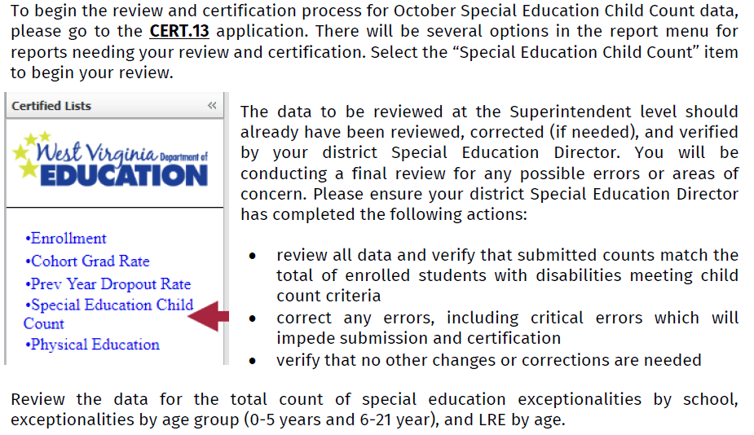
Reviewing the Data
Notes:
Start the review of your Child Count data by going to the CERT.13 application, then click on the “Special Education Child Count” link
Review data to make sure the total counts in each category match:
Exceptionality
Age
LRE

Slide 14
Reviewing the Data
Please Note: LRE designations are valid for specific age levels:
LREs designated with a letter (M, N, P, R, S, W, X, Y Z) are valid for students 5 years of age or younger.
Those designated with a number (0-9) are valid for students 6 years of age or older.
* Please discuss LRE coding with your Special Education Director for more details.
Notes:
Remember students under age 5 should have a letter and students 6 and older will have numerical codes

Slide 15
Correcting Errors – Special Ed. Director
The Special Education Director is responsible for making any corrections of data errors prior to submitting for the superintendents certification.
If resubmission is needed, the Superintendent will need to unlock the submission to allow the director to change source data and resubmit the corrected information. Unlocking the submission must occur in the OCT.SECC (October 1 Special Education Child Count) application.
Notes:
Correcting errors and submitting and certifying that the data is correct is the responsibility of the special education director and superintendent:
When late errors are found after the special education director submits
The superintendent must unlock the submission to allow the director to make changes to the source data and then resubmit
NOTE: unlocking and resubmission must occur within the OCT.SECC application

Slide 16
Correcting Errors - Superintendent
Notes:
Superintendents can navigate the OCT.SECC application within the WVR/WVR100 state reporting menu in WOW:
Click on “submitted child count data” link
Click on “unlock special education child count data link
Then the special education director can make corrections to data and resubmit

Slide 17
Certifying Special Education Child Count Data
When all reviews have been conducted and you are satisfied that the data are complete and accurate, you will need to certify the Special Education Child Count data through CERT.13.
The certification statement and submission button will be available near the bottom of the “Special Education Child Count” review screen in CERT.13, following all data review tables. Clicking the certification button will lock and certify the October Child Count data for the current school year.
Notes:
After addressing any corrections needed within the data, especially those generating a critical error, you are ready to click on the submit button via CERT.13!
Again, the submit button will not be available until all critical errors are resolved.
Once the superintendent certifies the child count data, the collection will lock for the current school year

Slide 18
Notes:
This presentation and webinar will be available for downloading from the Office Of Special Education website for your training and reviewing purposes.
Thank you so much for you attention
We are now open for questions

Slide 19
The Office of Special Education
304-558-2696
Renee Ecckles-Hardy, Part B Data Manager Coordinator
renee.ecckleshardy@k12.wv.us
Aaron Riley, WVEIS IDEA Data Coordinator
ariley@k12.wv.us

