Slide 1
Universal Design for Learning
UDL

Slide 2
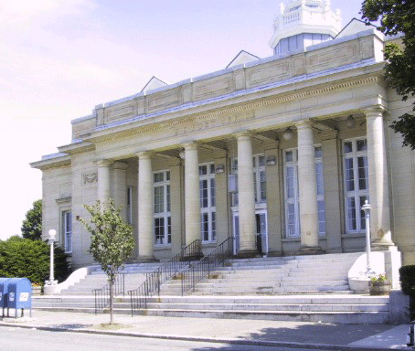

What is Universal Design?
Notes:
Take a moment and study this picture.
While looking at the picture, identify entry points, and the number of ways that a person may have access to this building.
Now think about the accessibility barriers that are present.
If these stairs were the only way to enter this building, might they be a barrier for some people trying to access the building?
Think about people in wheelchairs, on roller blades, pushing a stroller, using rolling laptop cases, and those with breathing problems or paraplegics.
Would they have difficulty gaining access to this building because of the structure (lack of accessibility features)?
Equitable access originated in architecture and is termed Universal Design in everyday life.

Slide 3
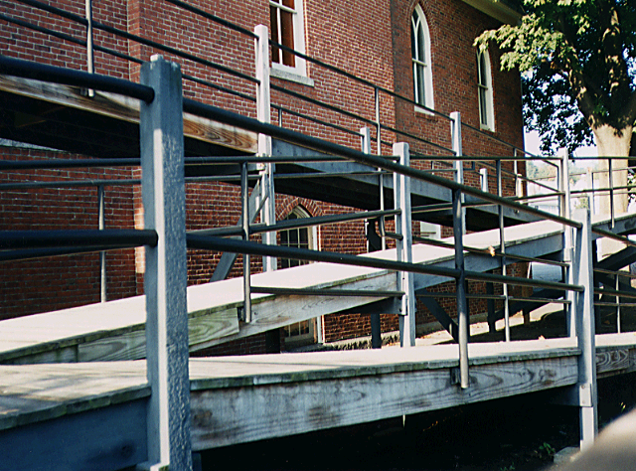
Universal Design
What are some of the drawbacks of retrofitting?
  Each retrofit solves only one problem, which you may have to do over and over.
  Retrofitting can be costly
  Many retrofits are UGLY!
Notes:
Before the Universal Design movement, architects rarely addressed the mobility and/or communication needs of people with disabilities.
The results were buildings that were inaccessible to many. Legislation mandating access led to extensive retrofitting with ramps, elevators, talking signs, and other access devices.
But retrofitting is expensive, often aesthetically disastrous, and inadequate from a practical standpoint.
Universal Design of buildings with built-in accessibility for everyone was an approach superior to retrofitting buildings to accommodate diverse individual needs.

Slide 4
Universal Design Defined…
  “Consider the needs of the broadest possible range of users from the beginning”
Architect, Ron Mace
Notes:
Universal Design was originated by Ron Mace at North Carolina State University to create physical structures that are designed from the beginning to accommodate the widest range of users, including those with disabilities.

Slide 5
What is Universal Design for Learning?
UDL is not one size fits all – but is alternatives for everyone.
UDL is not added on later – but IS designed from the beginning.
UDL is not access for some – but IS access for everyone.
Notes:
This slide mentions some high points of what UDL IS AND IS NOT.

Slide 6
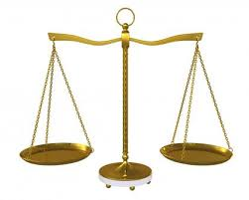
Universal Design for Learning (UDL) is a set of principles for curriculum development that gives all individuals equal opportunity to learn (National Center on Universal Design for Learning, 2014)
Notes:
Just as these scales reflect equality or inequality, UDL principles provide a framework for educators to develop curriculum and instruction that reduce barriers and give access to all students.

Slide 7
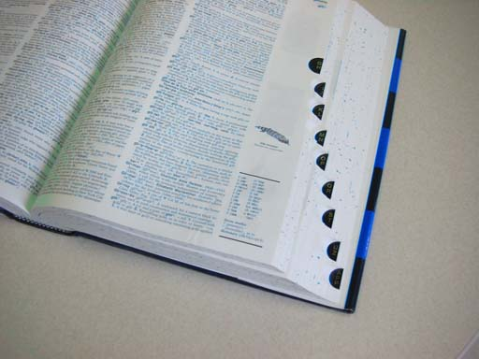
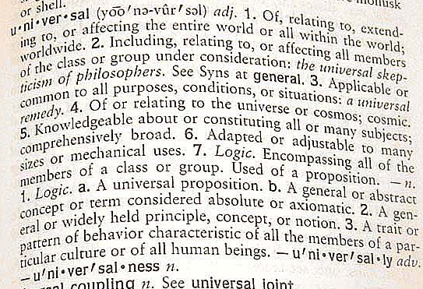
What is Universal Design for Learning (UDL) ?
UD in buildings is about access to the environment. In learning, UD addresses all areas of instruction.
UNIVERSAL DESIGN FOR LEARNING is an educational approach to teaching, learning, and assessment.
Notes:
UDL is an educational approach to teaching, learning and assessment…..

Slide 8
What does research say about Universal Design for Learning (UDL) ?
UDL is… "scientifically valid framework for guiding educational practice,"
UDL facilitates the design and implementation of a flexible, responsive curriculum, UDL offers options for how information is presented, how students respond or demonstrate their knowledge and skills, and how students are engaged in learning.
UDL implementation provides the opportunity for all students to access, participate in, and progress in the education curriculum by reducing barriers to instruction.
Notes:
The Higher Education Opportunity Act of 2008 marks the beginning of the application of Universal Design concepts in architecture to Universal Design for Learning.
As you see in the bullets on this slide, the essence of UDL is flexibility and the inclusion of alternatives to adapt to the variations in learner needs, styles, and preferences.
UDL principles draw on brain and media research to help educators reach and teach all students.
With UDL, each student is addressed as an individual with unique needs, interests, and abilities.

Slide 9
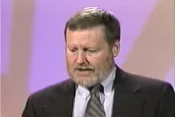
CAST believes that “barriers to learning are not, in fact, inherent in the capacities of learners, but instead arise in learners' interactions with inflexible educational goals, materials, methods, and assessments.”
Teaching Every Student in the Digital Age, p. vi
Dr. David Rose
Notes:
David Rose at CAST drives home that the challenge is not to “fix” the child who is struggling, but to “fix” the curriculum so that it will meet diverse learner needs.
Background: Founded in 1984, CAST (Center for Applied Special Technology) is a not-for-profit, educational research and development organization whose mission is to expand learning opportunities for all individuals, especially those with disabilities and at-risk learners, through innovative uses of technology and UDL.

Slide 10
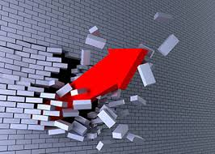
Notes:
Take just a moment and think of some of the barriers that exist for students in your classroom or school.
Think of both physical barriers AND curricular barriers.

Slide 11
Barriers?
A building barrier might be stairs; a change made to the building might be _______________.
A learning barrier might be a textbook; a change made for learning might be_______________.
A learning barrier might be ___________; a change made for learning might be ______________.
Notes:
Let’s use these analogy stems to move our thoughts from universal design of buildings to universal design for learning.

Slide 12
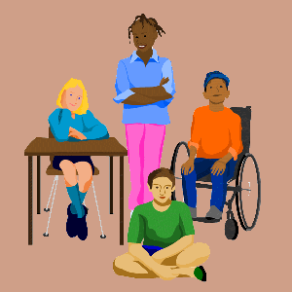
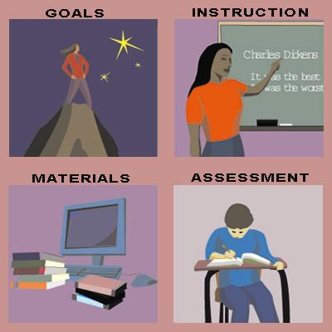
So what do we change?
Notes:
Think back to what David Rose said about UDL and what is to be changed or fixed.
We need to change aspects of the curriculum (to include goals, instruction, materials, and assessment) in order to increase learning for students.
UDL is one of the ways we do that.

Slide 13
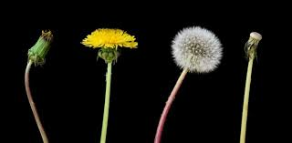
When does UDL play out?
Before Instruction
During Instruction
After Instruction
Notes:
UDL is provided at all points during instruction.
Teachers should take the time before instruction to plan and prepare for all students to be active learners.
Teachers should provide opportunities during instruction for all learners to be rigorously engaged in the curriculum.
Teachers should employ ongoing or alternate assessments after instruction to determine progress, needs, and future direction of class.

Slide 14
BEFORE instruction
Get to know your students’ abilities, special needs, and learning styles
After reviewing standards, determine learning needs
Devise instructional approaches to reach greatest number of students
Recognize individual needs of students
Set curricular goals
Determine learning supports
Adapt methods and materials to individual student needs
Select appropriate UDL strategies, tools, and features to adapt instruction.
Notes:
This slide gives a variety of examples of what teachers can and should do as they prepare lessons/before instruction.
Take a moment to read over the list and identify examples that you currently practice, as well as those you need to adopt.

Slide 15
DURING instruction
Use equitable, flexible, accessible methods to fit instruction to student needs
Special educator and general educator collaborate to resolve residual problems
Use UDL features to determine student progress for feedback and to adjust instruction
Differentiate instruction to reach students on their own levels
Special educator and general educator consult with one another
Use other methods and ongoing feedback to adjust instruction
Notes:
This slide also gives examples of ways to provide UDL during instruction.
Again, take some time to look over the list and identify ways that you currently provide support in your classroom.

Slide 16
AFTER instruction
Employ ongoing or alternate assessments to determine progress, needs, and future direction of class
Repeat planning cycle
Make sure assessments reflect UDL characteristics
Assess continuously through variety of formats to track student progress
Adapt delivery of instruction as needed
Notes:
This slide emphasizes the importance of assessment in the process of UDL.
Each item is critical in the process to track student progress and repeat the planning cycle if necessary.

Slide 17
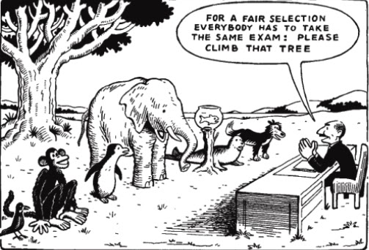
What is wrong with this picture?
“Everybody is a genius. But if you judge a fish by its ability to climb a tree, it will live its whole life believing that it is stupid.”
-Albert Einstein
Notes:
This is probably a familiar slide, but one that adequately represents our often one-size-fits-all approach to education.

Slide 18
Where do you stand …with UDL?
Do you meet the needs of the widest range of students by reducing the number of barriers to learning?
Do you provide challenging, salient, and age-appropriate materials to students with a range of abilities?
Do you allow students to learn in accordance with their dominant learning preferences?
Do you create alternative ways for students to both receive and deliver information?
Notes:
So…..
Where do you stand with UDL?
Take a moment to reflect on the information from this webinar.
Read each item and identify your level of UDL implementation.

Slide 19

Dawn Embrey-King
dembreyking@k12.wv.us
304-558-2696

