Slide 1
Special Education Surveys
Exit Survey and One-Year Follow-up Survey

Slide 2
Objectives
Provide an overview of two Special Education Surveys
Exit Survey
One-Year Follow-up Survey
Review the process for inputting and monitoring survey responses
Share state level reports and discuss how to use these data to improve services and outcomes for our students

Slide 3
Special Education Surveys Location
From wvde.us → Teaching & Learning → Special Education → Surveys
https://wvde.us/special-education/surveys/

Slide 4
Exit Survey
Provide survey to any student with an active IEP who exits school for the following reasons:
Graduated with standard or modified diploma
Drops out of school
Reaches age of 21
The survey is most often done at the time of the exit interview
Students or parents/guardians may complete the survey on paper, online, or over the phone
Districts are responsible for entering the data into the web based platform

Slide 5
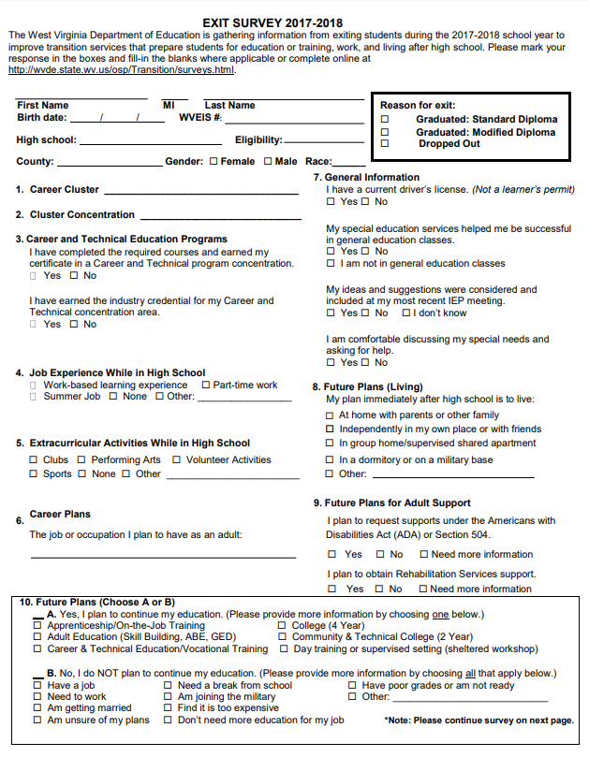
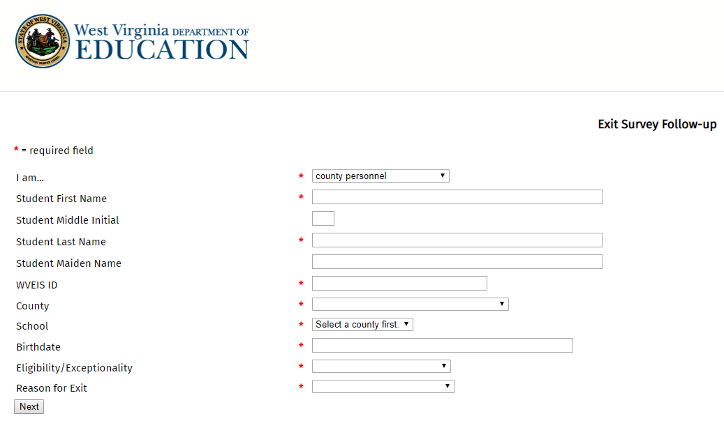
Paper version
Online data entry

Slide 6
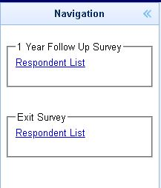
Exit Survey Data Entry and Response Monitoring
All surveys must be entered into the online system at:
http://wvde.state.wv.us/forms/exit-survey/
Responses may be monitored at the county level:
Log onto WOW
Navigate to: SPE → SPE200→ SRVY.RESP →

Slide 7
WV Exit Survey Report 2016-2017
You should have received your district level report this week
School level reports are coming

Slide 8
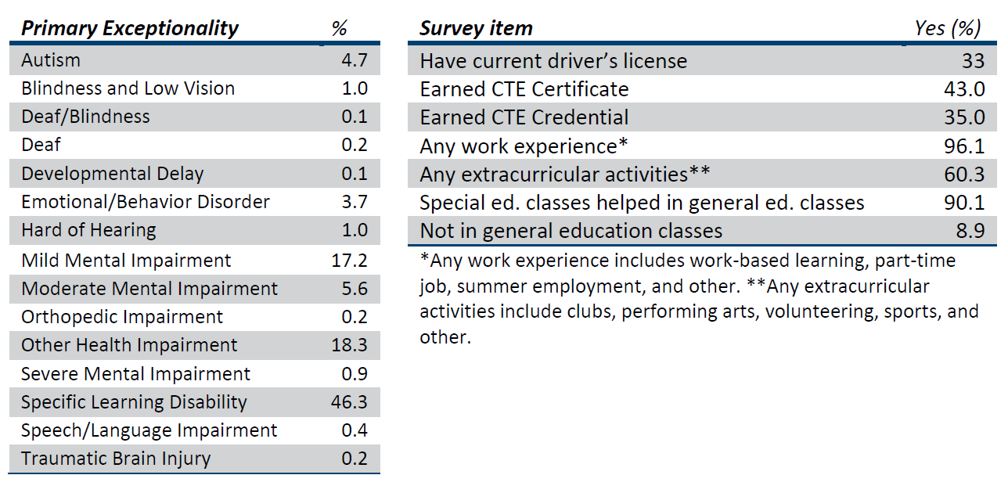

Slide 9
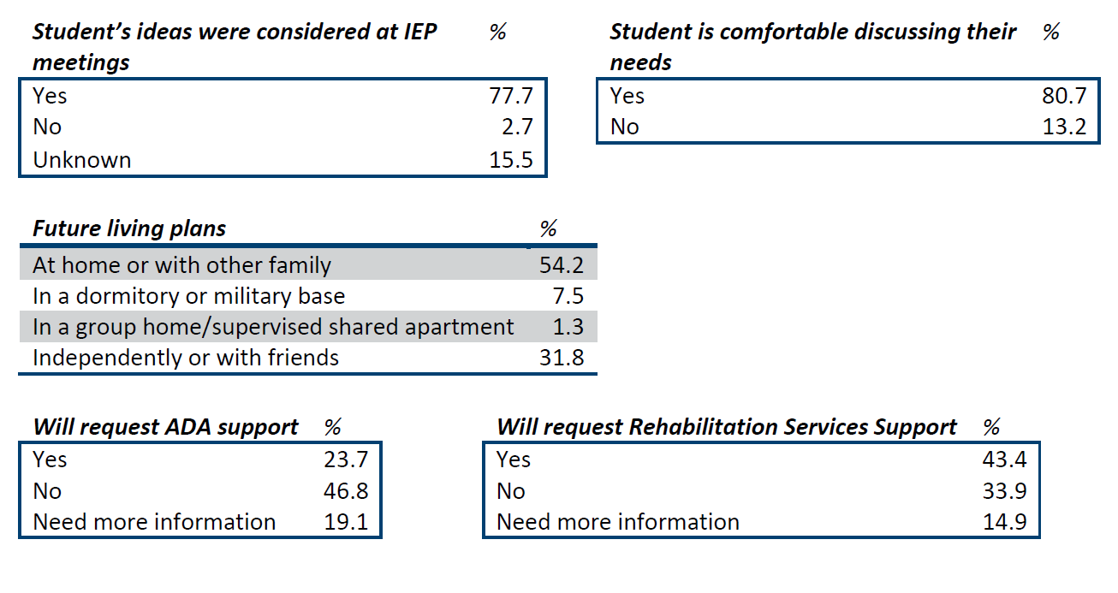

Slide 10
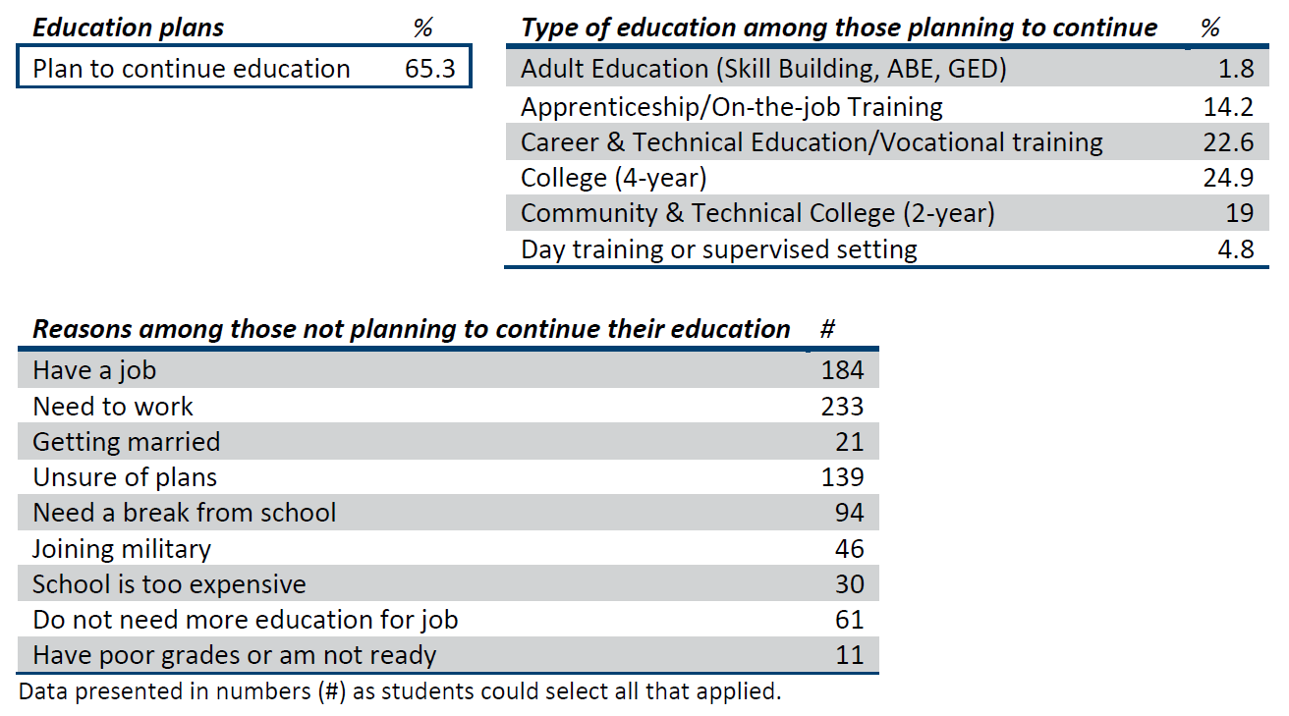

Slide 12
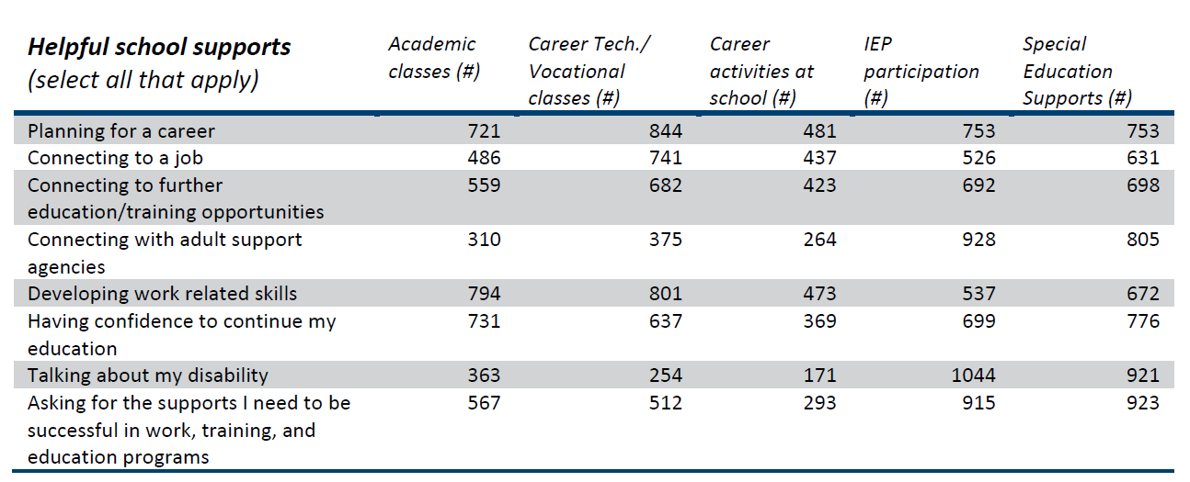

Slide 13
One-Year Follow-up Survey
Provide survey to any student with an active IEP who exits school for the following reasons:
Graduated with standard or modified diploma
Drops out of school
Reaches age of 21
Districts are responsible for entering the data into the web based platform
WVDE sends each district labels with student name and last known address
Mail paper survey, or survey via telephone
Student, parent/guardian, school staff, or county staff enter survey data into WVDE web platform
Surveys conducted no sooner than 12 months after student exit date

Slide 14
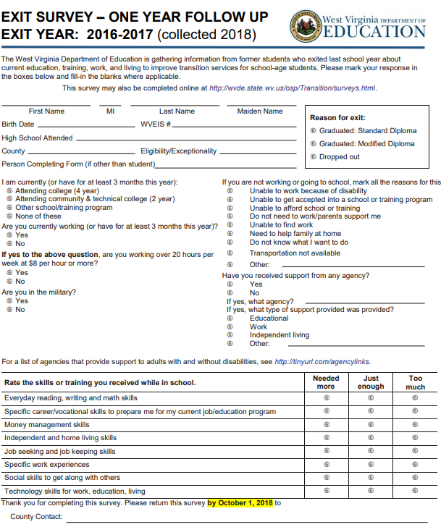
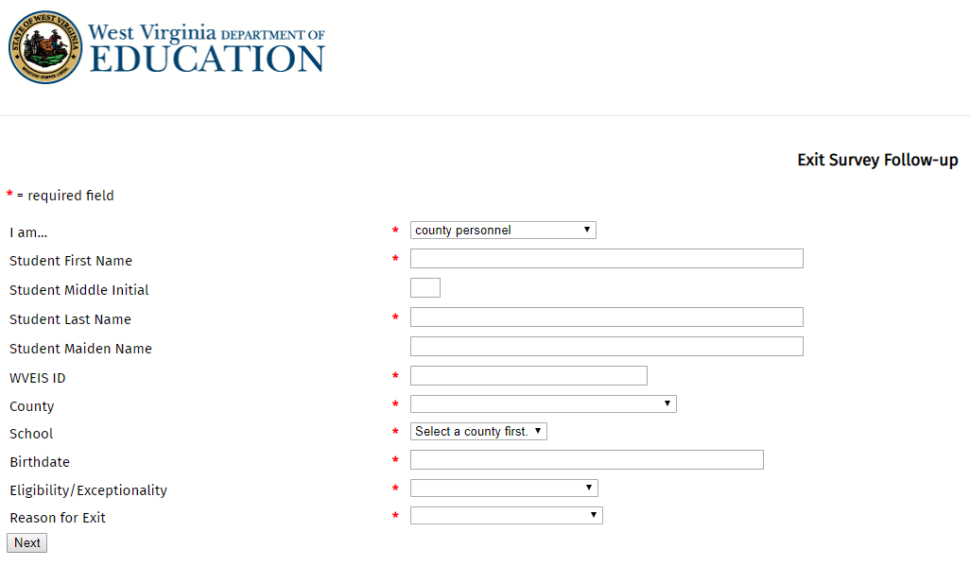
Paper version
Online data entry

Slide 15
One-Year Follow-up Survey Data Entry and Response Monitoring
All surveys must be entered into the online system at:
http://wvde.state.wv.us/forms/exit-survey-follow-up/
Responses may be monitored at the county level:
Log onto WOW
Navigate to: SPE → SPE200→ SRVY.RESP →

Slide 16
Why is the One-Year Follow-up Survey Important?
Data from this survey are used in Indicator 14 (Post School Outcomes)
Collects information to determine if students are:
Engaged in higher education
Competitively employed
Enrolled in some other postsecondary education/training or some other type of employment
Unengaged

Slide 17
Definitions
Higher Education
Enrolled full or part time
Community College (2-year program)
College/University (4-year+ program)
1 complete term
Competitive Employment
Work for pay at or above minimum wage
In a setting with others who are nondisabled
At least 20 hours a week
90 days any time in the year since leaving high school
Includes military employment
Other Postsecondary Education or Training
Enrolled full or part-time
Education or training program that is less than a 2-year program
1 complete term
Other Employment
Worked for pay or self-employed
90 days at any time since leaving high school
Includes working in a family business

Slide 18
Indicator 14 targets (WV targets for FFY 2017)
WV targets for FFY 2017 (reported in 2019)
Participation = 60%
Higher Education = 19%
Higher Education + Competitive Employment = 53%
Higher Education + Competitive Employment + Other Education + Other Employment (all engagement) = 68%

Slide 19
WV One-Year Follow-up Survey Report 2016-2017
District and school level reports are in the works

Slide 20
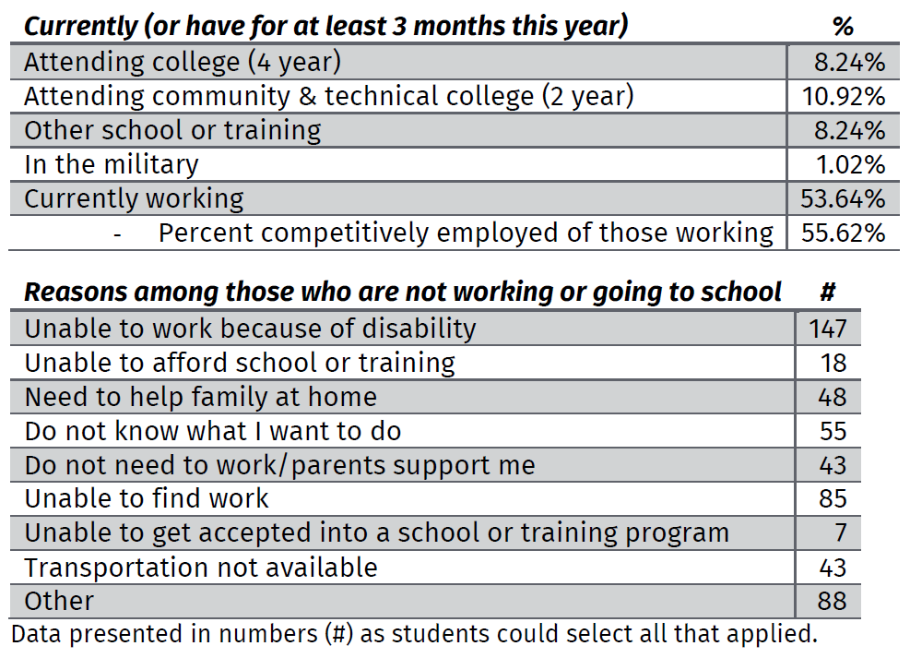

Slide 21
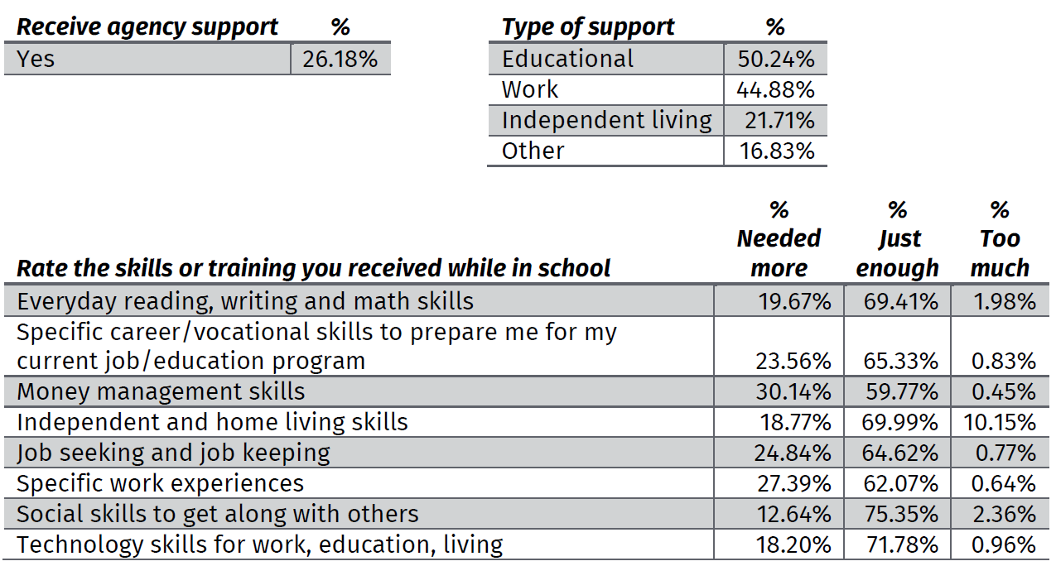

Slide 22
Amber Stohr
WVDE
Office of Special Education
astohr@k12.wv.us
304.558.2696

