Slide 1
Special Education Child Count
December 1

Slide 2
Dec 1 Special Education Child Count Objectives
Session Objectives:
Learners will learn federal requirements for Dec 1 SE Child Count
Learners will learn important timeline dates for submitting and certifying Dec 1 SE Child Count
Learners will become familiar with the WVEIS/WOW applications used during the Dec 1 collection process
Learners will explore who is responsible for editing, submitting and certifying the Dec 1 SE Child Count
Learners will obtain knowledge of tools available for assisting with reviewing Dec 1 SE Child Count data
Notes:
Today will go over:
Federal requirements for Dec 1 SE Child Count
Certifying dates
The WVEIS application used during the collection process
Roles and responsibilities
Available tools

Slide 3
Special Education Child Count Timeline
November 20-30 Initial review and update/correction window (district-level Special Education Directors; state staff may provide assistance, if needed)
December 1-2 Data snapshot and submission window
December 3-10 Final Superintendent review and certification window
December 10 Final Superintendent certification deadline (no later than 11:59 p.m.)
Notes:
The December Child Count timeframe begins in mid-November and concludes in early December. Data regarding student enrollment, exceptionalities, and other characteristics will be captured on the school day closest to December 1 each year. District staff (specifically, Special Education Directors) are responsible for reviewing, verifying, and submitting information. The Superintendent is responsible for final certification and may certify the data at any point after submission and prior to the final certification deadline. The timeline outline in indicated on this slide.
Please Note: These dates are provided as a general rule for most years. If a submission due date (Dec. 1) falls on a weekend, the deadline will be the business day prior to Dec. 1. WVDE staff may provide adjusted dates in years when collection or due dates fall on weekends or holidays. District staff should make note of any announcements provided through official channels (e.g., Superintendent’s Updates, WVEIS Collection Calendar, email or other notices sent to WVEIS County Contacts) that may list specific date changes.

Slide 4
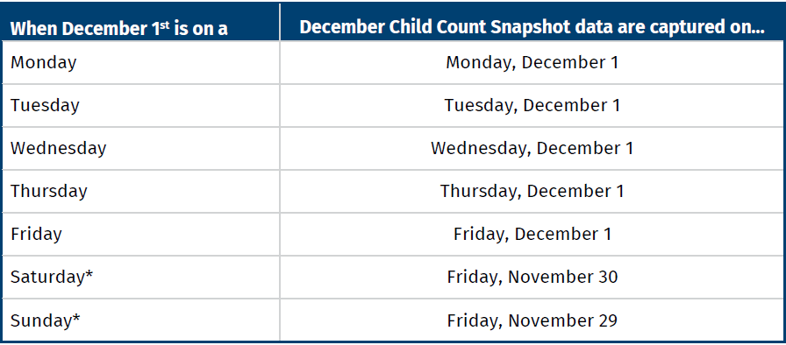
Special Education Child Count Timeline
A Note about “December 1”
Notes:
The December Child Count is a snapshot of data taken on or before December 1 of each school year. In some years, December 1st falls on a weekend, which necessitates some adjustments to the snapshot date in order to account for the weekend days on which students and staff are not in school. Child Count data are captured on December 1st or the last school day prior. The table presents the data capture dates.

Slide 5
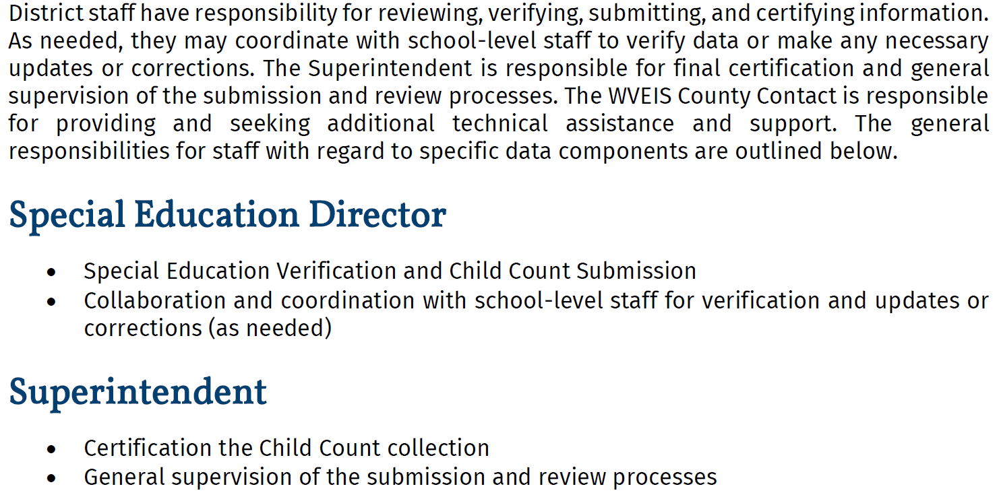
Responsibilities and Roles
Notes:
During the Child Count process, SE Directors are responsible for…and Superintendents are responsible for

Slide 6
Special Education Child Count
The Special Education December Child Count reflects:
The unduplicated number of students who are receiving special education services as of December 1 of the current academic year.
This submission captures all students of the appropriate age enrolled as of December 1 with an unduplicated, unexited service record.
District Special Education Directors should review these data, with any errors being corrected before submission for the Superintendent’s review.
Corrections to student records may be made through various tabs in STU.301. Submission and review will occur through CERT.DCC. Teacher rosters, which can be used to involve teachers or principals in review, can be generated through SER.OST.

Slide 7
Finding the Applications
The applications that school staff should use to review, verify, and submit December Child Count data in WVEIS on Web (WOW) or the Portal can be found in several different WOW menus:
Student Information: STU.301
(SMS Student Management System/SMS100 Student Management Maintenance) Including basic student information, enrollment, registration, and special education tabs, among others as needed.
Special Education Child Count: CERT.DCC
(WVR West Virginia State Reporting/WVR100 State Reporting)
Special Education Teacher Roster: SER.OST
(SPE Special Education System/SPE200 Special Education Reports)

Slide 8
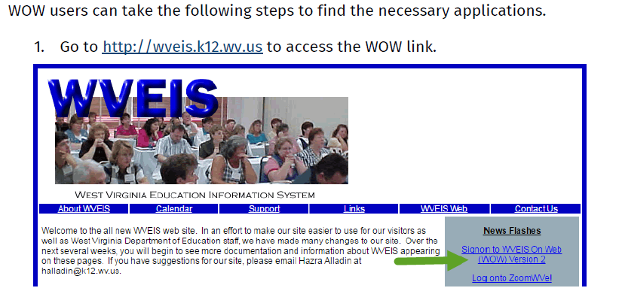
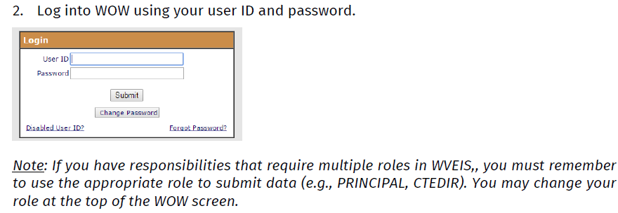

Slide 9
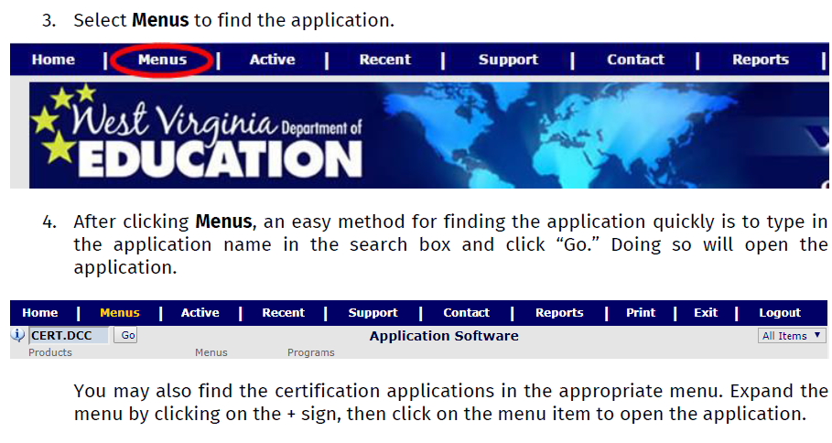

Slide 10
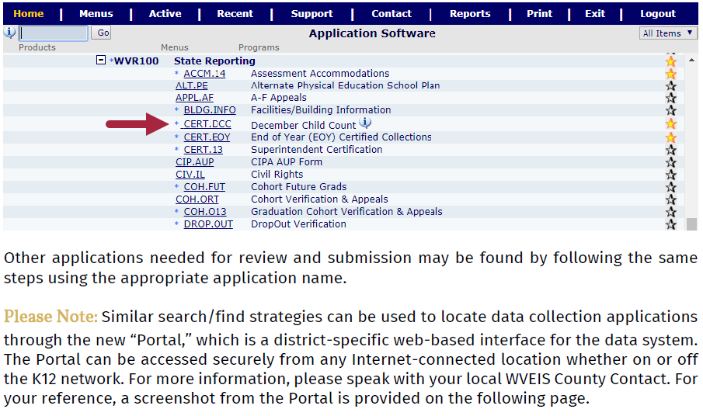

Slide 11
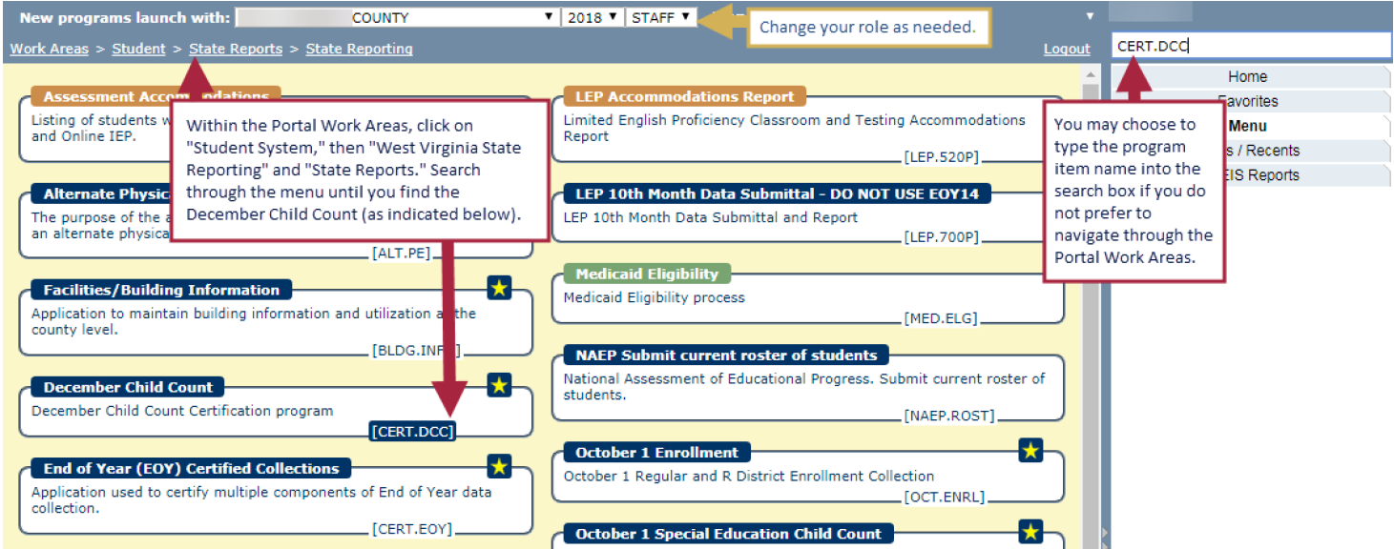

Slide 12
District Special Education Director
The Special Education December Child Count is found in the application CERT.DCC within the WVR/WVR 100 State Reporting Requirements menu.
This collection requires submission by the Special Education Director, followed by superintendent certification. The Special Education Director may wish to collaborate with the school principal or other staff to ensure that all information about special education students is current and correct.

Slide 13
Instructions for Special Education Directors
The special education child count includes (Ages 3-21):
The number of students by exceptionality and age
The number of students by least restrictive environment (LRE) and age
Special Education Directors must verify:
exceptionality codes,
birth dates,
race/ethnicity codes,
LEP designations, and
LRE codes in students’ WVEIS records.

Slide 14
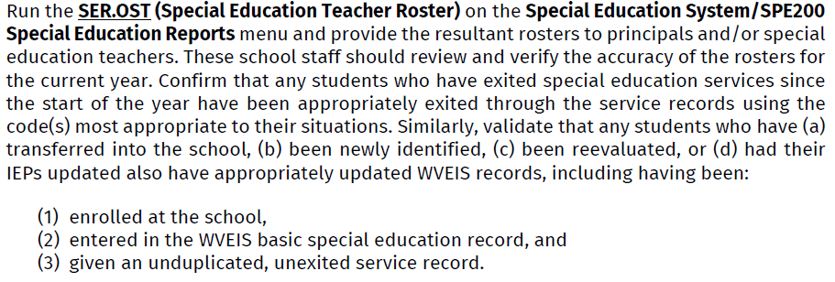
Part 1 - Preparing for Submission
Notes:
The SE directors can run the teacher roster in SER.OST on the SPE200 SE Reports menu in order to provide principals and/or special education teachers rosters to review and verify for accuracy for the current school year.
Confirm…

Slide 15
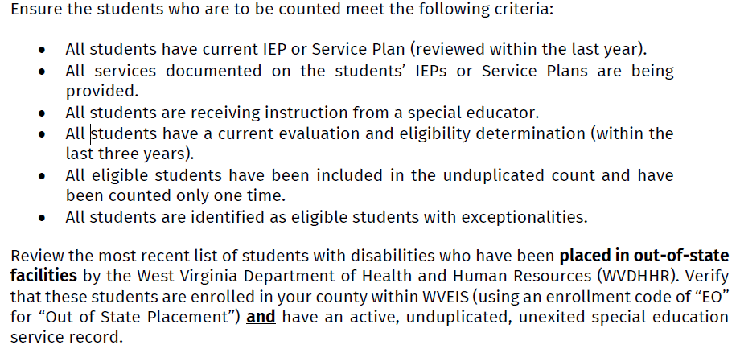
Part 1 - Preparing for Submission

Slide 16
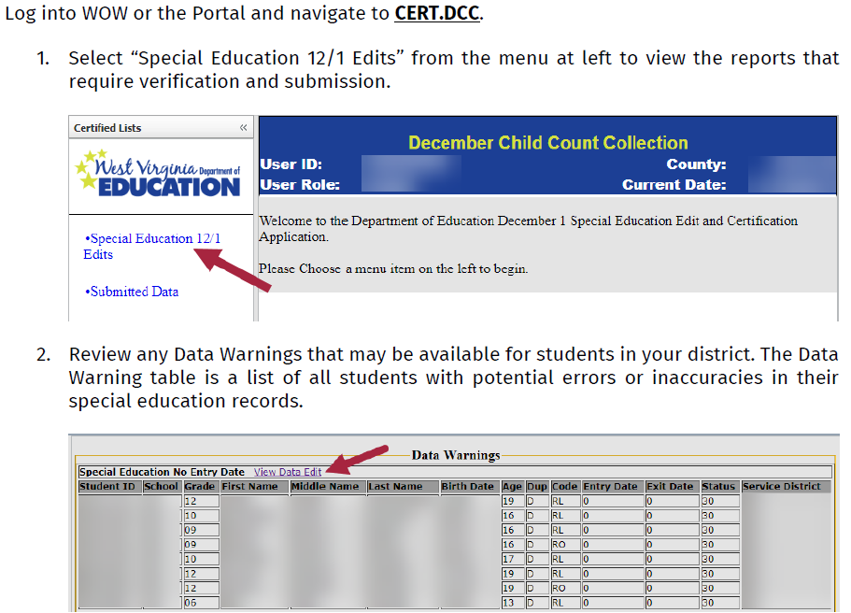
Part 2 - Reviewing and Submitting

Slide 17
Part 2 - Reviewing and Submitting
Please Note: Clicking on the “View Data Edit” link will activate a new pop-up window or tab with similar information about the students appearing on the list.
Please work to resolve any data warnings first prior to further review of the data. The data warnings displayed at the top of the “Special Education 12/1 Edits” screen may affect the counts displayed in the tables presented for additional review. You may need to make corrections in students’ service records, which can be accessed through the STU.301 application. Please coordinate any necessary corrections or updates with other district or school staff who may need to be involved.

Slide 18
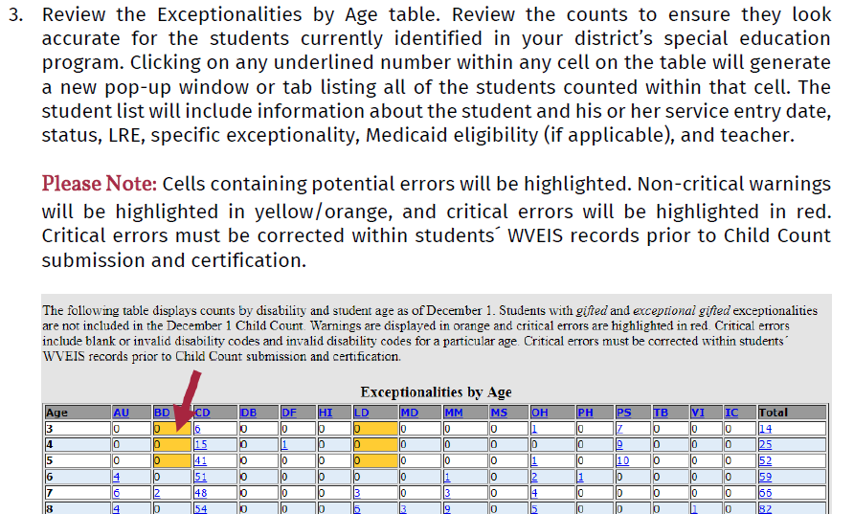
Part 2 - Reviewing and Submitting
Note: Non-critical warnings will be highlighted in yellow/orange indicating a need to review for accuracy.

Slide 19
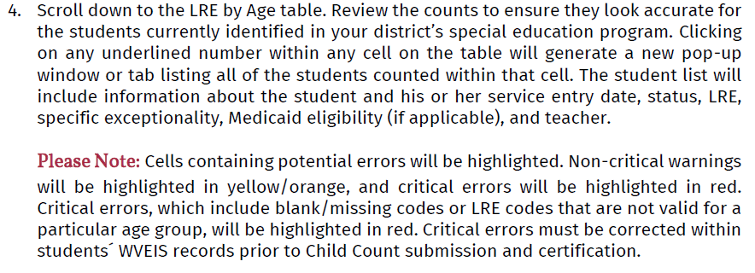
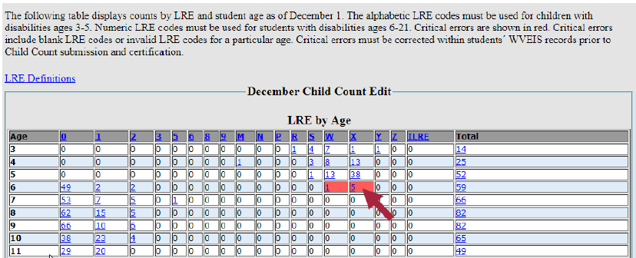
Part 2 - Reviewing and Submitting
* If red, the “SUBMIT” button will remain inactive until the data are corrected.
Notes:
LRE by age table
Critical errors which will show in red are typically a blank LRE code or an invalid LRE code for a particular age.
Remember ages 3-5 should have alpha codes while ages 6-21 should have numerical codes

Slide 20
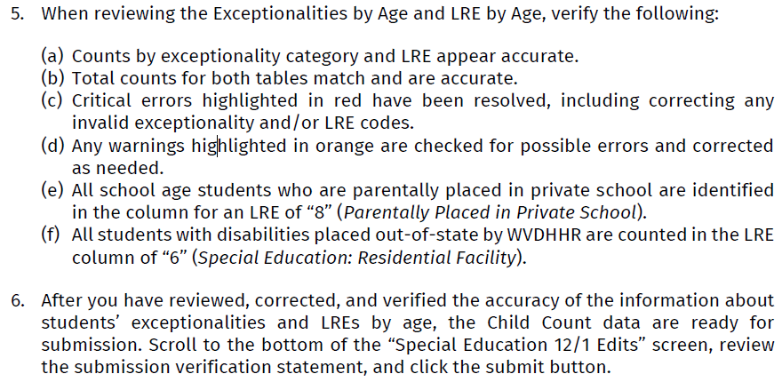
Part 2 - Reviewing and Submitting
* If red, the “SUBMIT” button will remain inactive until the data are corrected.
Notes:
After addressing any corrections needed within the data, especially those generating a critical error, you are ready to click on the submit button!
Again, the submit button will not be available until all critical errors are resolved.

Slide 21
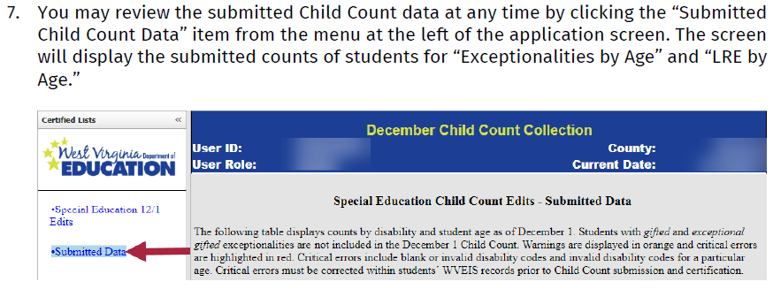
Part 2 - Reviewing and Submitting
* If red, the “SUBMIT” button will remain inactive until the data are corrected.

Slide 22
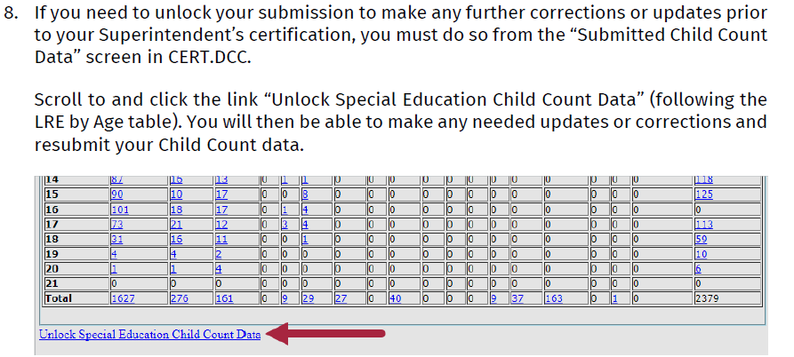
Part 2 - Reviewing and Submitting

Slide 23
Superintendent – Correcting Errors & Submitting

Slide 24
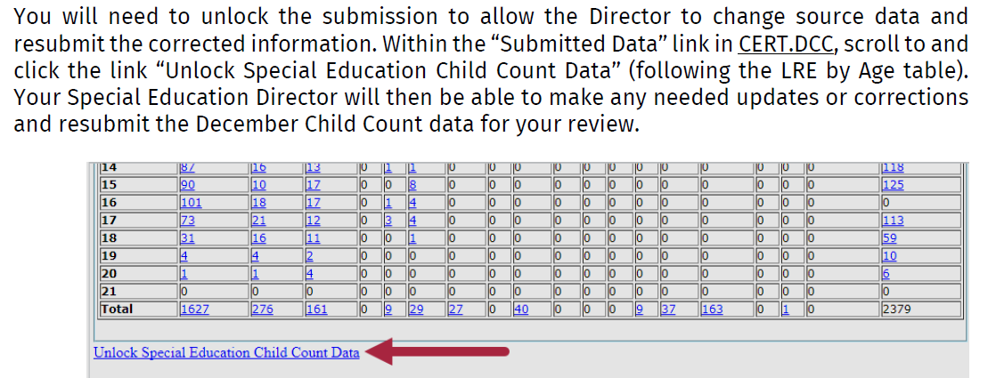
Superintendent – Correcting Errors & Submitting

Slide 25
Superintendent – Correcting Errors & Submitting

Slide 26
Deafblind Exceptionality
Since 1988, WVDE has housed the state’s Deafblind grant, WV SenseAbilities. All 50 states and territories receive trainings and technical assistance from deafblind projects (although most grantees are IHEs or CEDs).
Like the December 1 Child Count, WV SenseAbilities is required to submit the National Deaf-Blind Child Count.
There is significant discrepancies between the December 1 Child Count and the National Deaf-Blind Child Count. This is a national issue not only a WV issue.
 | 2013 | 2014 | 2015 | 2016 | 2017
Dec 1 Child Count Students with Deafblindness | 12 | 13 | 17 | 20 | 21
Deaf-Blind Census data | 104 | 86 | 102 | 93 | 99
Notes:
I will now turn the presentation over to Annette Carey with important information about the Deafblind Exceptionality and Dec 1 Child Count.

Slide 27
Deafblind Exceptionality
Policy 2419
C. Deafblindness
Definition: Deafblindness means concomitant hearing and visual impairments, the combination of which causes such severe communication and other developmental and educational needs that they cannot be accommodated in special education programs designed solely for students with deafness or blindness or students who are hard of hearing or partially sighted.
Eligibility Criteria for Deafblindness
An eligibility committee will determine that a student is eligible for special education services as a student with deafblindness when all of the following criteria are met:
The student exhibits characteristics consistent with the definition.
The student is diagnosed by an optometrist or ophthalmologist for vision loss and by an otologist, otolaryngologist, or audiologist for hearing loss.
The student’s condition adversely affects educational performance.
The student needs special education.
Deafblindness should be the primary eligibility for a student who meets the above criteria. In addition, a student meeting the above criteria and who also has additional impairments contributing to the student’s severe educational needs may be determined eligible for deafblindness.
Notes:
Red highlights the new addition. Reason for this addition:
This clarification is found in IDEA under multiple disabilities. However as WV does not recognize that exceptionality, the clarification was not included in Policy 2419,

Slide 28
Deafblind Exceptionality
WV does not recognize teacher certification in deafblindness.
90% of the children identified as deafblind have additional disabilities.
Appropriate caseload is determined by impact during EC and may be teacher of the visually impaired, deaf/hard of hearing or intellectual disability.
IEP should reflect services from both the TVI and TDHH.
The range of sensory loss could be mild to severe or progressive in both vision and hearing.
The child’s needs do not equate to hearing loss plus vision loss but rather the impact is multiplicative. The educational impact of a child with a mild loss in one of his senses vs a child with a mild loss in both is significant.
An intervener is a specially trained person who works consistently one-to-one with a student who is deafblind. The intervener facilitates access to the environmental information that is usually gained through vision and hearing but which is incomplete to the child who is deafblind. The intervener helps the student gather information, learn concepts and skills, and develop communication and language. (Policy 2419)

Slide 29
Data Quality Tools
WVDE provides various tools to assist local staff with reviewing data for accuracy and completion.
Coding Standards and Manuals
WVDE has prepared several coding standards and manuals to provide guidance and rules for how data should be entered and maintained in WVEIS. These documents are available to users through the WVEIS support webpage, available at wveis.k12.wv.us/wveis2004/support.htm.
Student Data Edits
Within WOW, WVDE staff have developed a program (STU.EDT Student Data Edits) providing detailed information about potential discrepancies or irregularities within local data. The potential errors and irregularities included are based on system business rules and coding standards. The edits are categorizes into three levels: (1) errors, which will prevent submission and certification of data; (2) warnings, which indicate discrepancies that may be in need of review and correction but will not stop submissions; and (3) informational items, which are intended to bring information to local staff members’ attention and do not necessarily indicate errors.
Notes:
There are a number of data quality tools in place in order to assist districts:
1.

Slide 30
Data Quality Tools
Data Edit Emails
WVDE staff have adapted the STU.EDT program into an automated notification. Regularly throughout the year, emails are generated within WVEIS and sent to district staff detailing potential discrepancies or irregularities within local data. The potential errors and irregularities included in the messages are based on system business rules and coding standards. Following the title and description of the specific error or edit, a record count indicates how many student records in the county fall into that category. The email allows local staff to click on the record count and view the list of students whose records may be in question (logging on with WebTop credentials is required for security reasons). Local staff may then log into WVEIS to review the student record and make any adjustments that may be needed.
Because the data edit emails are sent throughout the year, local staff may use the information on an ongoing basis to facilitate quicker EOY reviews and more accurate submissions.

Slide 31
Data Quality Tools
ZoomWV-e Data Quality Dashboard
Within ZoomWV for Educators (ZoomWV-e), a “Data Quality” dashboard lists counts of certain types of data errors or irregularities. Counts are presented by error type as well as totals by school. Clicking on any item will render additional information, including the ID of students with discrepant or non-standard data and other details about the discrepancy. Local staff may then log into WVEIS to review the student record and make any adjustments that may be needed.
Please note: Because the ZoomWV-e system updates information nightly, changes made in a student record prior to 6:00 PM will be reflected in the ZoomWV-e dashboard on the following school day.

Slide 32
Data Quality Tools
Certification Status Emails
WVDE staff also use WVEIS to generate automatic messages outlining completion status for certifications. These messages list each required collection and indicate whether data have been submitted and certified for the district. Local staff may use these messages to monitor certification and ensure that deadlines are met.

Slide 33
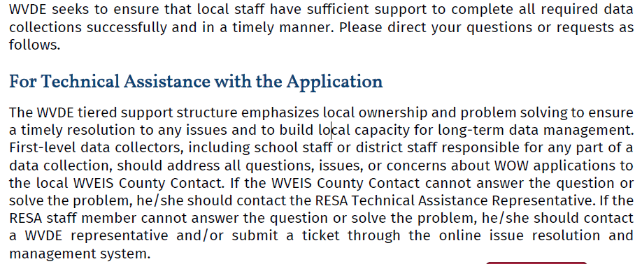
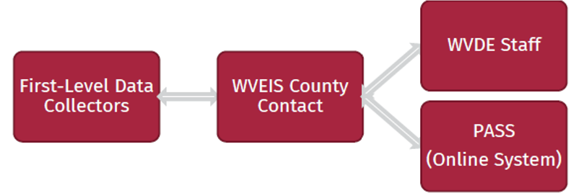
Technical Assistance Hierarchy

Slide 34
Notes:
This presentation and webinar will be available for downloading from the Office Of Special Education website for your training and reviewing purposes.
Thank you so much for you attention
We are now open for questions

Slide 35
The Office of Special Education
304-558-2696
Renee Ecckles-Hardy, Part B Data Manager Coordinator
renee.ecckleshardy@k12.wv.us
Aaron Riley, WVEIS IDEA Data Coordinator
ariley@k12.wv.us
Annette Carey, OSE (Deafblind LRE Assistance)
acarey@k12.wv.us

