Slide 1
IDEA Part B Annual Personnel Data Reporting
Personnel Employed to Provide Special Education and Related Services
West Virginia’s Reporting Requirements for 2018-2019 School Year
Renee Ecckles-Hardy

Slide 2
Special Education Personnel Data Objectives
2018-2019 Reporting Requirements
Collecting High Quality Data – Why it is Important
Instructions for WVEIS Special Data Collections Website
Overview of who is reported
Overview of how Full Time Equivalency (FTE) is reported
Notes:
This webinar will review the 2018-2019 personnel and related services data collection, which is required by the federal Office of Special Education Programs.
It will include who is reported, who is not reported, and how to calculate Full-time Equivalency (FTE)

Slide 3
High Quality Data
Timely, Accurate, Complete
Informative and Relevant; Can Be Used for Decision Making
Slides 3-6, IDC in collaboration with CIFR, CIID & NTACT
Notes:
Timely data are: current per a specific period of time, submitted by the due date, collected and analyzed in a period where the data are useful for intended purposes
Accurate data are reliable – that is – consistent across time, methods and locations;
Complete – data represent the entire population defined. We’ll get into what timely, accurate and complete mean for IDEA Personnel Data.
High quality data are informative and relevant and can be used for decision-making.
Valid – that is – represent what they intended to measure.

Slide 4
The Importance of High Quality Data
Shift from monitoring solely for compliance to Results-Driven Accountability
WVDE focus on improving data quality
Increasing data use – tell the story!
Use data to improve special education programs, address achievement gaps
Useful for applying for grants, requesting funding from legislature
Notes:
In line with the shift that the federal government has made toward Results Driven Accountability and Data Quality, WV’s OSE is working closely with the Office of Special Education Programs funded centers. WV is receiving ongoing technical assistance to promote high quality data from the IDEA Data Center (IDC), Center for the Integration of IDEA Data (CIID) and the Center for IDEA Fiscal Reporting (CIFR)

Slide 5
The Importance of High Quality Data
Poor data quality will:
Breed organizational mistrust
Block improvement efforts
Inhibit good data-driven decision making
Increase potential for financial loss

Slide 6
Collect and Report High Quality Data
Systematic documented processes
Data system(s) • Cross-department data sharing and matching
• Cross-agency data sharing and matching
Validating and editing
Clear, dedicated staff responsibilities and accountability for data entry and quality
Training
Technical assistance or support
Notes:
At the state level, the OSE is implementing systematic documented processes with the assistance of the IDC;
New Data Systems for federal reporting with CIID, coupled with a data validation/editing system;
Staff roles have been defined in order to promote clear responsibilities and data entry and quality accountability.
Training, technical assistance and support for your local data quality is provided via webinars, on-site visits, and conferences

Slide 7
Special Education Personnel Data Objectives
The Annual Data Report of Personnel Employed to Provide Special Education and Related Services
Submitted to the West Virginia Department of Education (WVDE), Office of Special Education (OSE), through WVEISweb
No later than January 15th.

Slide 8
Special Education Personnel Data Objectives
Required by IDEA
Special Education Director is responsible
Includes FTEs of special education teachers, paraprofessional and related service providers
Serving students with disabilities, ages 3-21
As of Dec 1
Notes:
This report, required under Part B of the Individuals with Disabilities Education Act (IDEA 2004), is entered online by the local director of special education or designee. It lists the full-time equivalency (FTE) of the assignment of special education teachers, related service providers and paraprofessionals employed on or about December 1st to provide special education and related services for students with disabilities ages 3-21.

Slide 9
SPECIAL EDUCATION PERSONNEL:
Which personnel should be reported?
The FTE of all special education teachers, paraprofessionals, and related service providers:
employed or contracted to provide special education and related services to children with disabilities
(IDEA) ages 3 through 21 regardless of funding source (i.e., Part B IDEA, State, or local), including personnel employed by private agencies.
This includes preschool teachers, itinerant/consulting teachers, and home/hospital teachers.
Teachers of children with disabilities (IDEA) in separate schools and facilities.

Slide 10
SPECIAL EDUCATION PERSONNEL:
Which personnel should not be reported?
Staff employed for infants and toddlers.
Notes:
Exclude the FTE of special education personnel who provide special education services exclusively to children with disabilities (IDEA) from birth through age 2.

Slide 11
SPECIAL EDUCATION TEACHERS:
How are data reported by FTE?
Percentage of time
Rounded to the hundredth decimal
Notes:
This is not a “count” or “number” of personnel…

Slide 12
Examples of Calculating FTE
How are data reported by FTE?
A special education personnel who works specifically with children with disabilities for 3 hours per day of a 6-hour school day is counted as 0.50 FTE
3/6=0.50
A special education personnel who works 4 hours per day of a 6-hour school day is counted as 0.67 FTE.
4/6=0.67
Also, if an LEA has two special education personnel who each work with children with disabilities for 4 hours per day of a 6-hour school day, the LEA would report 1.33 FTE (rounding 1.334 to the nearest hundredth decimal place).
8/6=1.33
Notes:
FTE is calculated the same for all categories: teachers, paraprofessionals and related services professionals

Slide 13
SPECIAL EDUCATION TEACHERS:
How are personnel FTE reported by Qualification Status?
FTE for Teachers and Related Service providers are reported as either:
Fully certified or
Not fully certified
FTE for Paraprofessionals are reported as either:
Fully Qualified
Not Fully Qualified
Notes:
Personnel contracted or employed to work with children who are receiving special education or related services according to whether or not they are identified to be fully certified/qualified for the capacity in which they serve.

Slide 14
SPECIAL EDUCATION TEACHERS:
How are personnel FTE reported by Qualification Status?
Personnel reported as fully certified/qualified must:
Meet the standard based on the definition of fully certified/qualified in WVBE Policy 5202:
Minimum Requirements for the Licensure of Professional/Paraprofessional Personnel and Advanced Salary Classifications.
Notes:
WVBE Policy 5202 further explains all licensure/certification requirements that apply to FTE

Slide 15
SPECIAL EDUCATION TEACHERS:
What if personnel serve both children with disabilities (IDEA) and students without disabilities under IDEA?
Report only the proportion of their FTE working:
specifically with children with disabilities (IDEA)
receiving special education and
related services.
Notes:
If personnel work part of their time with children with disabilities (IDEA) and part of their time with children without disabilities

Slide 16
RELATED SERVICES PERSONNEL:
FTEs for:
Psychologists
Social Workers
Occupational Therapists
Audiologists
Physical Education Teachers and Recreation and Therapeutic Recreation Specialists
Physical Therapists
Speech-Language Pathologists
Interpreters
Counselors and Rehabilitation Counselors
Orientation and Mobility Specialists
Medical/Nursing Service Staff
Notes:
Provide the number of FTE for all related service personnel categories that are employed or contracted to provide related services to children with disabilities (IDEA), ages 3 through 21, in your district: (These categories only)

Slide 17
SPECIAL EDUCATION PARAPROFESSIONALS:
Who are Special Education paraprofessionals?
Paraprofessionals are employees who provide instructional support, including those who:
provide one-on-one tutoring if such tutoring is scheduled at a time when a student would not otherwise receive instruction from a teacher
assist with classroom management, such as organizing instructional and other materials
provide instructional assistance in a computer laboratory
conduct parental involvement activities
provide support in a library or media center
act as a translator
provide instructional support services under the direct supervision of a teacher.
Notes:
Paraprofessionals have specific instructional support including those listed here

Slide 18
WVEIS Special Data Collections Website Instructions

Slide 19
WVEIS Special Data Collections Website Instructions

Slide 20
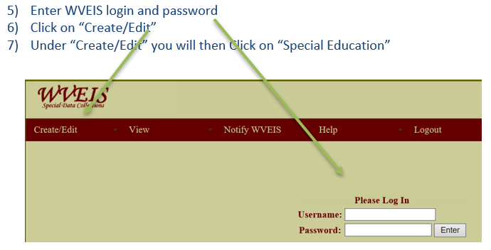
WVEIS Special Data Collections Website Instructions

Slide 21
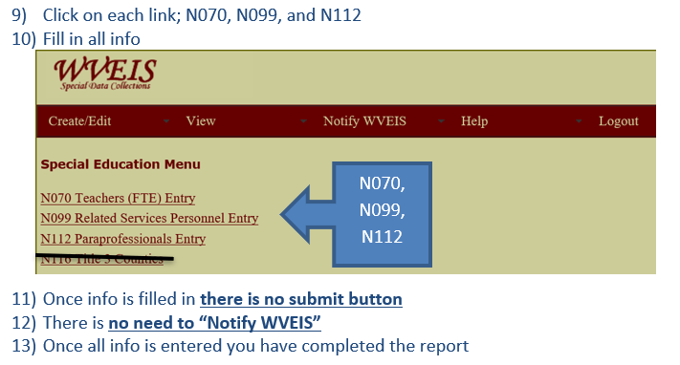
WVEIS Special Data Collections Website Instructions

Slide 23
Renee Ecckles-Hardy
Data Manager Coordinator
Office of Special Education
renee.ecckleshardy@k12.wv.us
304.558.2696

