Slide 1
Adding Context to Content Instruction Using Digital Mapping Tools
Erika Klose, eklose@k12.wv.us

Slide 2
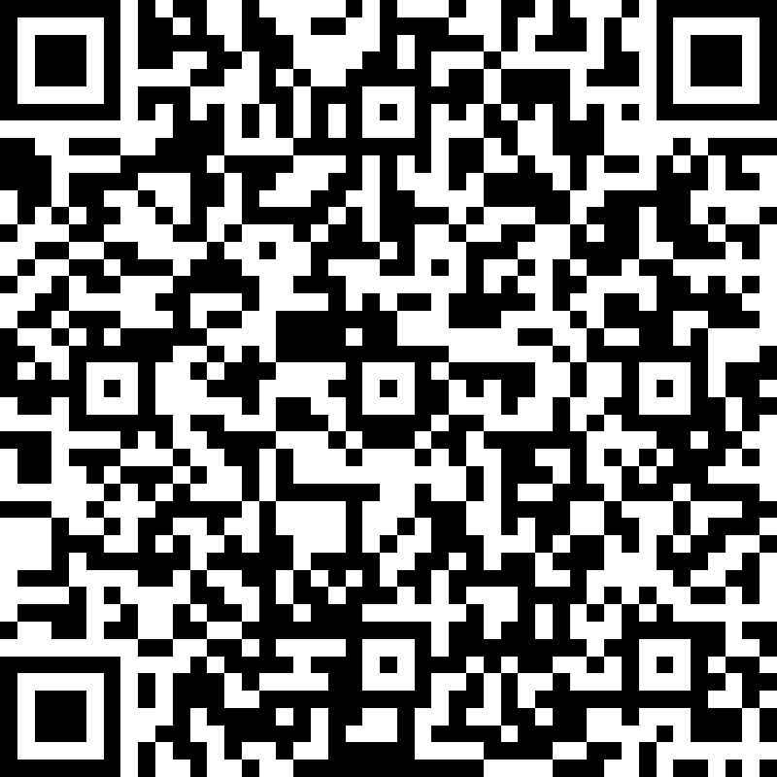
Welcome!
Introduction - Please use this QR code and a smart phone to answer two questions about yourself. I will paste the link to the same survey form in the chat.
View Results
Hopes, Fears, and Expectations
Notes:
Introductions.
Of possible, please have your phone or another device available. We’ll be using some other tools to answer questions. I’ll put links in the chat, but it may be easier to use the camera on your phone to scan the QR code.
Please note that the chat is always available and I will do my best to answer questions.

Slide 3
Why Geotechnology is important
More of the Geospatial Revolution can be found at http://www.geospatialrevolution.psu.edu/

Slide 4
Why Geotechnology is important
Let’s watch and discuss
Discussion with MentiMeter https://www.menti.com/5bj161w8k9
More of the Geospatial Revolution can be found at http://www.geospatialrevolution.psu.edu/

Slide 6
Why GIS? Why now?
Head to this page: http://www.esri.com/industries
Review the list of industries and choose one to read about further.
In the Teams chat, please answer this question – Which industry surprised you?

Slide 7
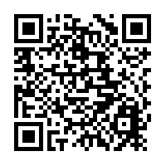
Who is ESRI?
Why do they give all this away for free?
https://www.esri.com/en-us/industries/education/schools/our-story

Slide 8
Introduction to GeoInquiries

Slide 9
Introduction to GeoInquiries
Cracked Plates Demonstration
Lesson:
https://www.esri.com/content/dam/esrisites/en-us/media/pdf/geoinquiries/earth-science/6-plateboundaries-earthscience-geoinquiry.pdf
Map:
http://esriurl.com/earthgeoinquiry6
All Geoinquiries
http://esri.com/geoinquiries
WV Standards Alignment - https://wvde.us/middle-secondary-learning/gis/

Slide 10
Anatomy of a GeoInquiry
Video: https://www.youtube.com/watch?v=qJlG9voKdK4
All Geoinquiries
http://esri.com/geoinquiries
Discussion:
Inquiry vs. Enquiry?
https://sjtylr.net/2018/01/30/inquiry-vs-enquiry/
Two Models:
Geographic Inquiry Model
5E Instructional Model

Slide 12
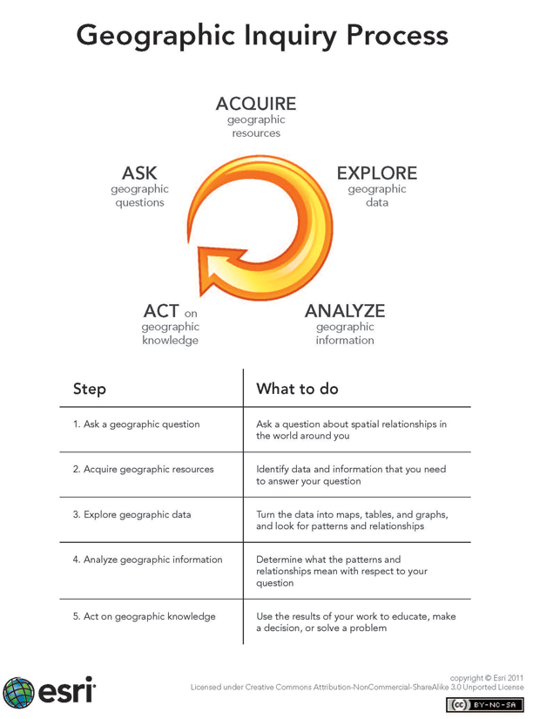

Slide 13
ENGAGE: The purpose for the ENGAGE stage is to pique student interest and get them personally involved in the lesson, while pre-assessing prior understanding.
EXPLORE: The purpose for the EXPLORE stage is to get students involved in the topic; providing them with a chance to build their own understanding.
EXPLAIN: The purpose for the EXPLAIN stage is to provide students with an opportunity to communicate what they have learned so far and figure out what it means.
EXTEND: The purpose for the EXTEND stage is to allow students to use their new knowledge and continue to explore its implications.
EVALUATE: The purpose for the EVALUATION stage is for both students and teachers to determine how much learning and understanding has taken place.
Descriptions from: https://nasaeclips.arc.nasa.gov/teachertoolbox/the5e

Slide 14
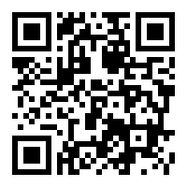
Choose a GeoInquiry!
Choose one of the GeoInquiries from http://esri.com/geoinquiries
Choose one that you could use in class.
Share the name of your choice by using the QR code, or a web browser to access https://b.socrative.com/login/student/
Enter KLOSE for the room.
Answer the question.
Presentation Links - https://linktr.ee/eklose

Slide 15
Resources - Adding Context to Content Instruction Using Digital Mapping Tools
WVDE GIS website: https://wvde.us/middle-secondary-learning/gis/
Get your own ESRI account – using WV’s own mapping site. https://wvstudentmaps.maps.arcgis.com/
Mapping Hour – ESRI’s new educator video series https://mappinghour-k12.hub.arcgis.com/pages/welcome
Story Map – The United States of Apathy http://bit.ly/apathyUS
http://storymaps.arcgis.com Storymaps. Click resources. Explore Stories.
Course for students: http://bit.ly/2xbwj61 Putting Your GIS Skills to Work
ArcGIS 5x5. Five 5-minute activities. https://community.esri.com/docs/DOC-12394-arcgis-online-five-by-fivepdf
Getting Started with GIS for Educators. https://community.esri.com/docs/DOC-9864-getting-started-with-gis-for-educatorspdf
Story maps blog: https://blogs.esri.com/esri/arcgis/category/story-maps/
Education Blog: https://geonet.esri.com/community/education/blog
Q&A and links to selected resources: http://bit.ly/2N4iFMR
Sign up for Story Maps newsletter: http://go.esri.com/planet-story-maps
Web Course: http://bit.ly/2RsGnRz Telling Your Story with Esri Story Maps
Erika Klose, eklose@k12.wv.us, @eklose
Presentation Links - https://linktr.ee/eklose

Slide 16
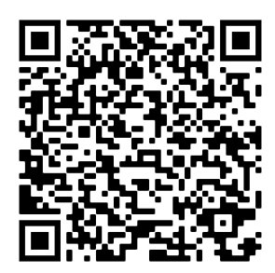
Survey link:
Instructional Support Professional Learning Forum Session Survey/Evaluation
https://bit.ly/survPL83720
IMPORTANT:
You must complete the survey and hit “submit” to be counted as present for this session.
Presentation Links - https://linktr.ee/eklose

