Slide 1
Integrating Science and Social Studies Standards
Pre-K –Grade 5

Slide 2
Learning Targets
Participants will examine standards-based instruction to develop problem-solving, critical thinking, and inquiry, as well a progressions within grade-level standards.
Participants will explore integration of science and social studies with ELA and math standards.

Slide 3
Key elements of high-quality instruction
standards
teacher
formative assessment
environments
Notes:
The Teacher is the center of the triangle. The teacher organizes and plans instruction through data collected from formative assessment.

Slide 4
Policy 2510: Assuring Quality of Education: Regulations for Education Programs
Best practices for a comprehensive approach to early learning instruction indicate appropriate and sufficient emphases in all content areas are provided.
Developmentally appropriate integration of literacy, numeracy, and other content is utilized to provide rigor based on students’ prior experiences, knowledge, and developmental levels.
Early Learning Programs provide responsive environments that include time, space, and developmentally appropriate materials necessary to create print- and language-rich environments conducive for learning and integration of standards.
Classrooms are designed and equipped in a manner that supports discovery, small group and individual learning, exploration, and problem solving.
Early Learning Readiness, Primary, and Intermediate classrooms have sufficient quantity and variety of appropriate materials and resources to support student-centered learning.

Slide 5
Benefits of Integration of Standards
Addressing different standards through one study or project.
Projects or studies are based on children’s interests, increasing active engagement.
An integrated approach increases children’s understanding of concepts and ability to assimilate information and skills to other areas.
Increased ability to relate knowledge to other areas of life.
Integration requires various modes of learning, which provides more opportunities for hands-on, experiential learning.

Slide 6
Shadows: Why do they change throughout the day?
ELA
Math
Science
Social Studies

Slide 7
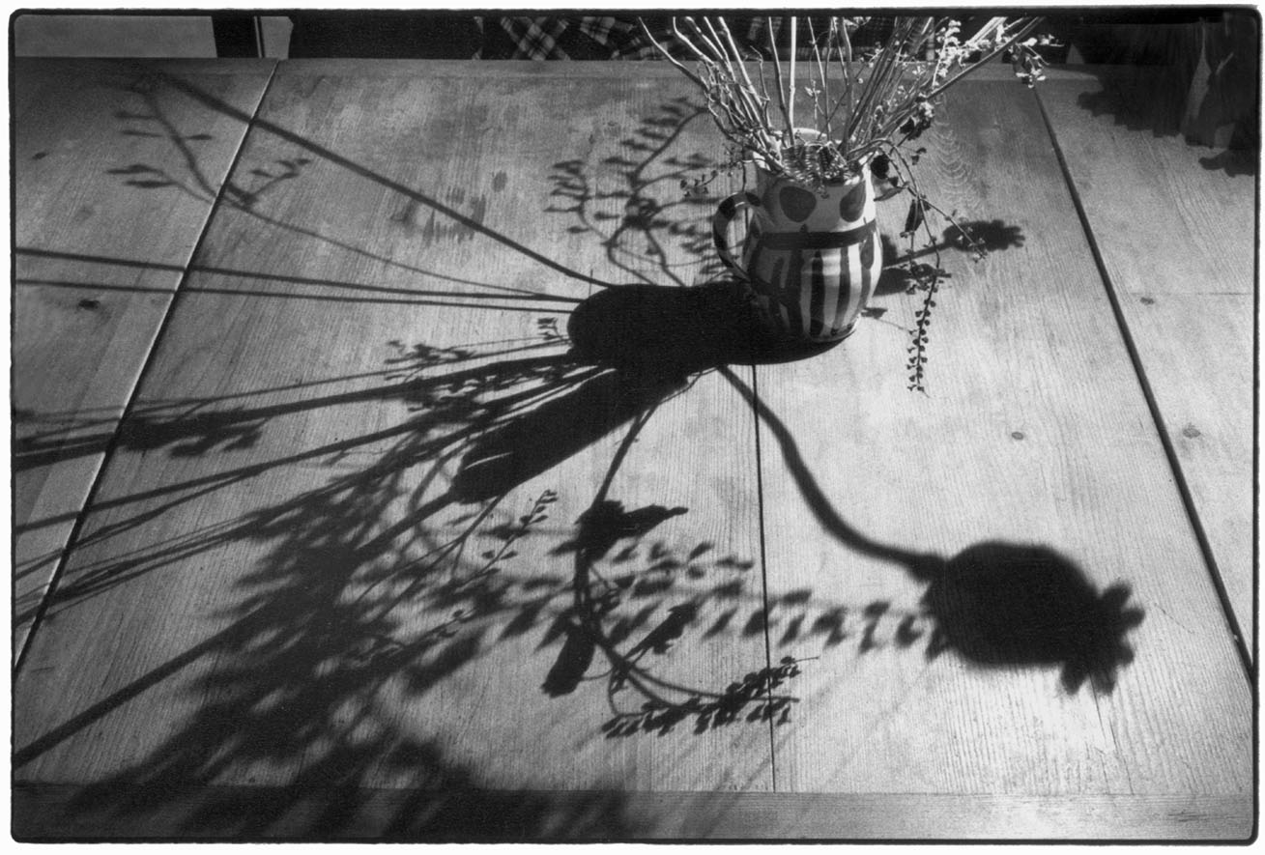
Shadows: Why do they change throughout the day?
Science Standards:
S.1.GS.3. plan and conduct an investigation to determine the effect of placing objects made with different materials in the path of a beam of light.
Math Standards:
M.1.18: Organize, represent, interpret data with up to three categories; ask and answer questions about the total number of data points, how many in each category and how many more or less are in one category than in another.

Slide 8

Shadows: Why do they change throughout the day?
ELA Standards:
ELA.1.11: Know and use various text features to locate key facts or information in an informational text.
ELA.1.26: Participate in shared research and writing.
Social Studies Standards:
SS.1.11: Describe how climate and location affect the way people live, work and play.

Slide 9
Integration of Literacy in Social Studies
Social Studies Standards note that:
“Literacy strategies and skills are applied as students acquire information and communicate their learning and understanding of social studies. Integration of literacy in social studies is critical for student success. It is essential that literacy strategy and skill instruction be purposefully and appropriately planned and embedded within social studies instruction.”

Slide 10
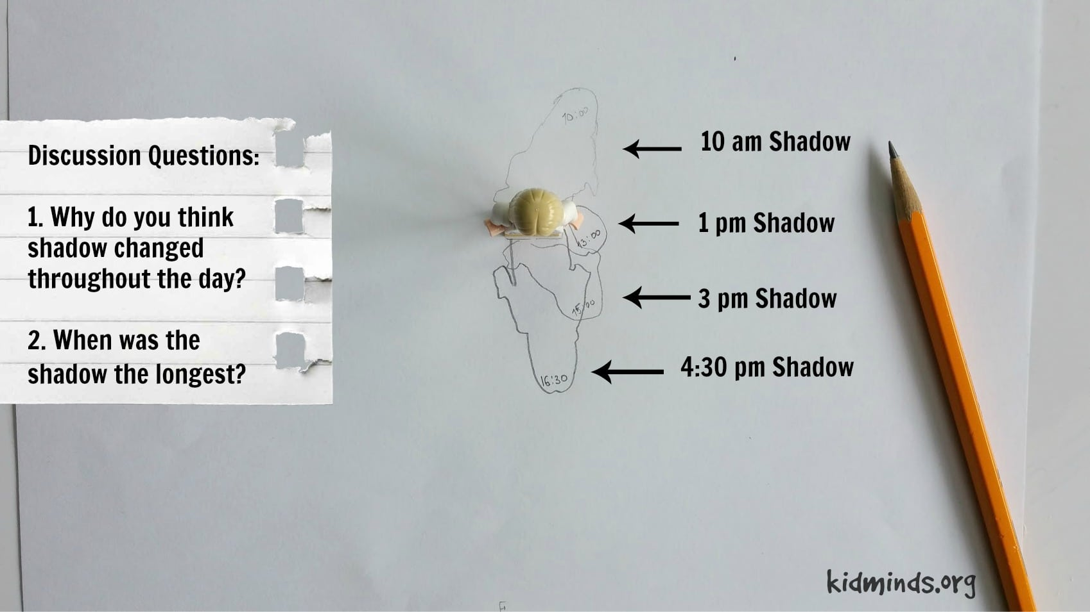
Shadows: Why do they change throughout the day?
ELA
Math
Science
Social Studies

Slide 11
Key elements of high-quality instruction
standards
teacher
formative assessment
environments
Notes:
The Teacher is the center of the triangle. The teacher organizes and plans instruction through data collected from formative assessment.

Slide 12
The Learning Environment
Schedules must allow for active exploration of the project with teacher supports.
Materials must be open-ended to support exploration.
Materials must be accessible to children.
Materials assist in the formative assessment process.

Slide 13
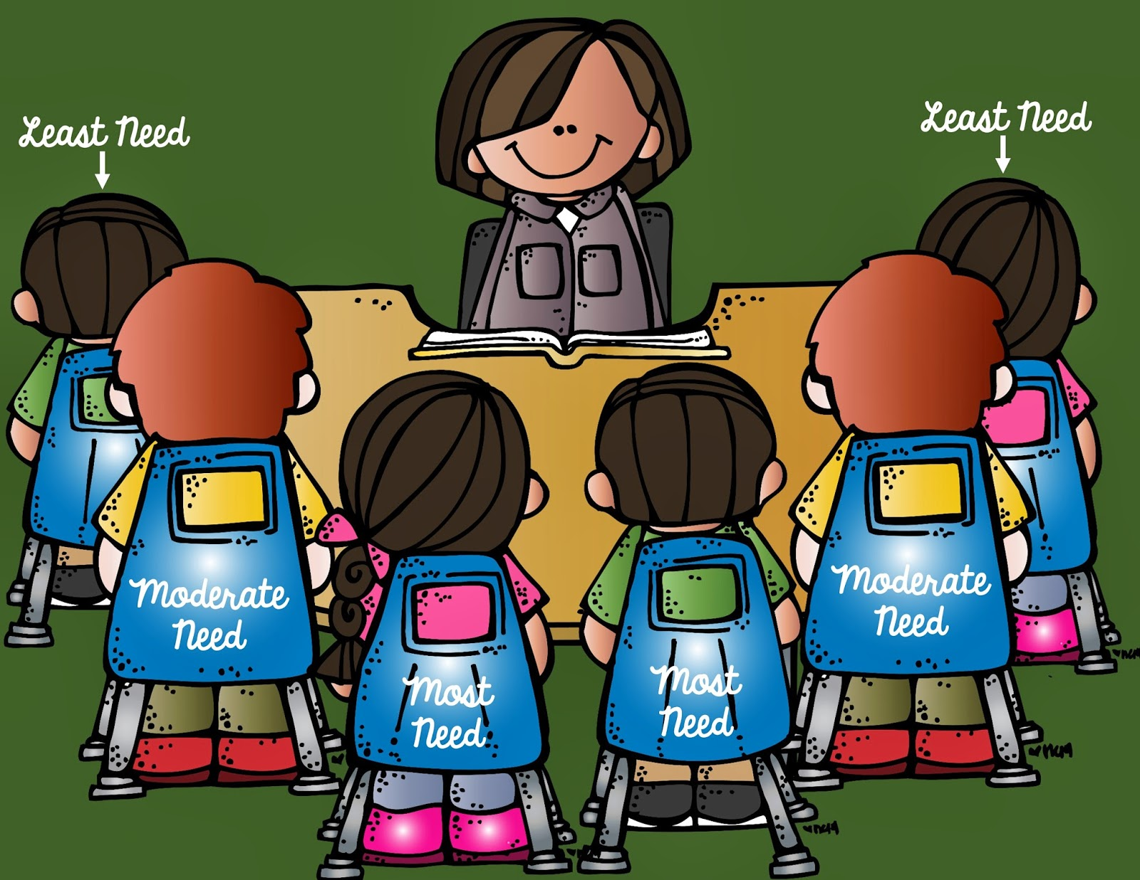
Why Small Groups?
Notes:
Small groups, by definition, allow teachers to create flexible groups based on children's needs and similar skill levels.
This intentional grouping of children limits the diversity of need so that the teacher can focus her teaching to discrete, specific skills.
Whole group instruction doesn't meet the need of every child and also makes it difficult for a teacher to truly assess what a child really knows.

Slide 14
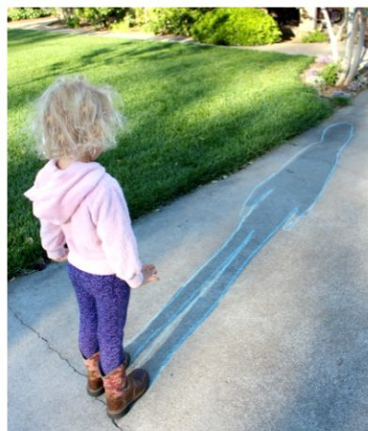
Materials
Overhead Projectors
Dark area of room
Flashlights
Paper
Pencils, chalk, other writing materials
Various sized materials
Camera
Weather reports

Slide 15
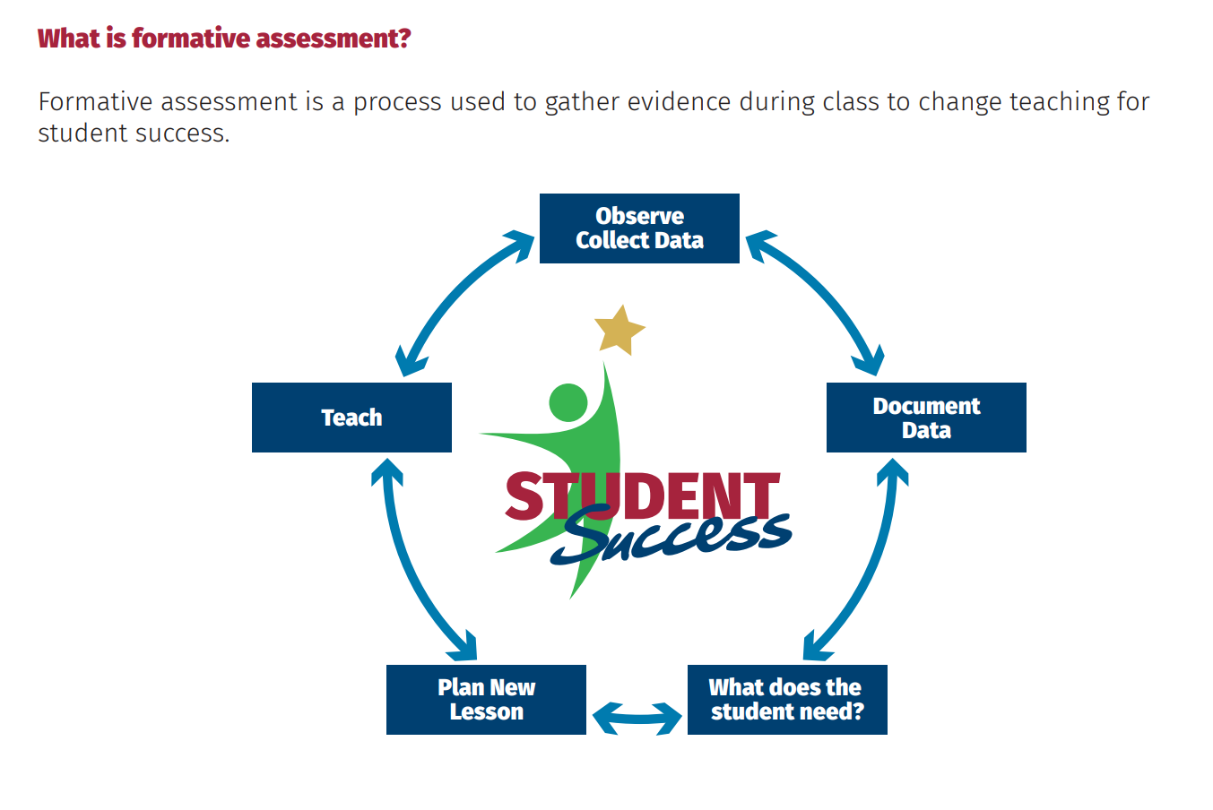
Formative Assessment
Notes:
Children’s behavior is a good indication of how well the physical environment of your classroom is arranged.

Slide 16
How do we support learning remotely through integration at home?
Explore, discover, and solve problems through simple, everyday elements.
Activity/Standard | Skills/Behaviors Parent comments
Make a snack or meal for the family. | Have your child: Count food for each person. Read a recipe. Measuring ingredients. Talk about sharing and equal amounts. Set a place at the table for each family member. Discuss food groups. Discuss changes in food while cooking.
Parent Observations:
Pre-K-2
Mathematics
English Language Arts
Science
Technology & Computer Science
Wellness Education & Physical Health and Development
The Arts
Social Studies & Social and Emotional Development
Dispositions and Standards for Student Success

Slide 17
Resources:
WVBE Policy 2510 Guidance: https://wvde.us/early-and-elementary-learning/wvbe-policy-2510-guidance/
WVBE State Board Policies (including Content Standards): http://wvde.state.wv.us/policies/
Rhythms of Play. Picture obtained on July 29, 2020 from https://rhythmsofplay.com/educational-shadow-activities-for-kids/
Nelson, D. (January 18, 2017). What’s in a Shadow? NAEYC Blog. Accessed on July 28, 2020 from https://www.naeyc.org/resources/blog/whats-shadow
Kid Minds. (May 23, 2016) The Science of Shadows (Unit Study) picture obtained on July 29, 2020 from https://kidminds.org/science-of-shadows-unit-study/.

Slide 18
Thank you for participating!
Contact Information:
Janet Bock-Hager, Coordinator, WVDE Office of Early & Elementary Learning
E-mail address: jbockhager@k12.wv.us

Slide 19
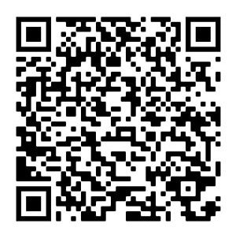
Session Evaluation
Participants only get credit for attending through completion of the session evaluations. Pease complete the evaluation by the end of the day.
Instructional Support Professional Learning Forum Session Survey/Evaluation

